Slide 1


Climate change and Environmental Justice in Mexico
Robert H. Manson
JPAC Public Forum: Climate Change and Environmental Justice “Leaving no one behind: working together for more equitable solutions to climate change impacts”
September 9, 2021

Slide 2
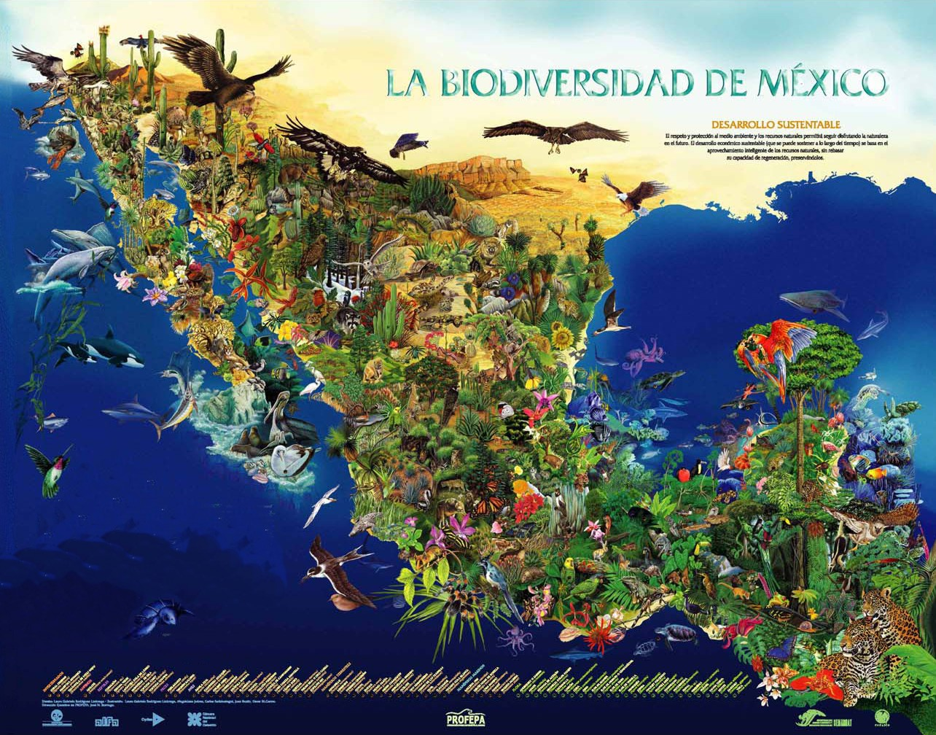
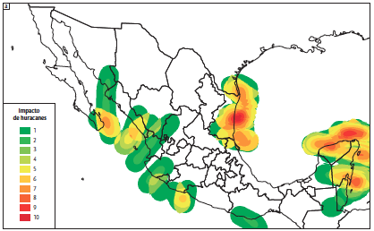
Climate Change Impacts
  Temperature increase of 1.5 ℃ with increased severity of droughts
  Increasing frequency and intensity of storms
  Extensive transformation and fragmentation of natural ecosystems
  Environmental degradation resulting in losses of 2-3% of GDP
  68% of the population and 71% of GDP at risk
Manson y Jardel (2008)

Slide 3
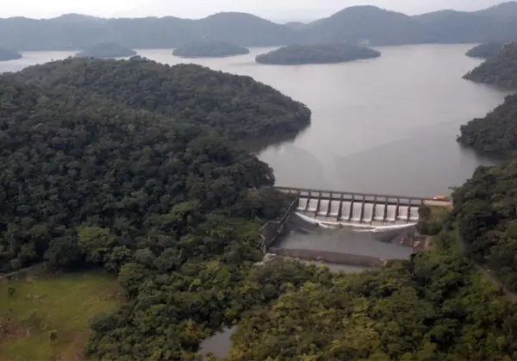
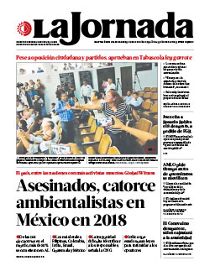
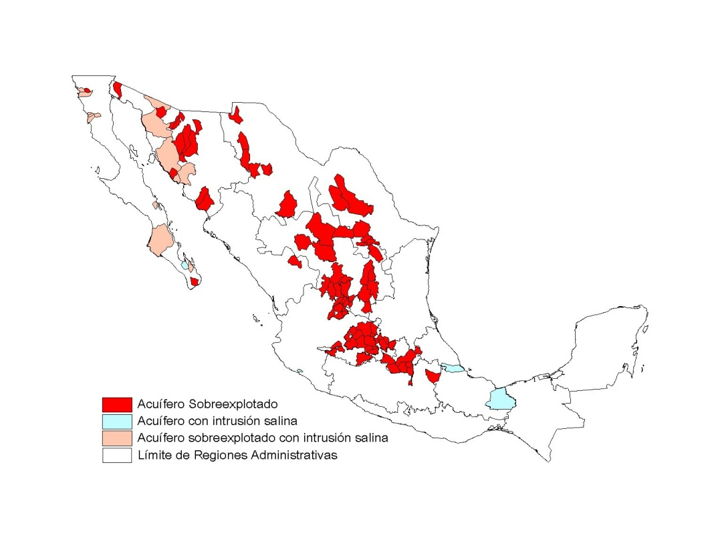
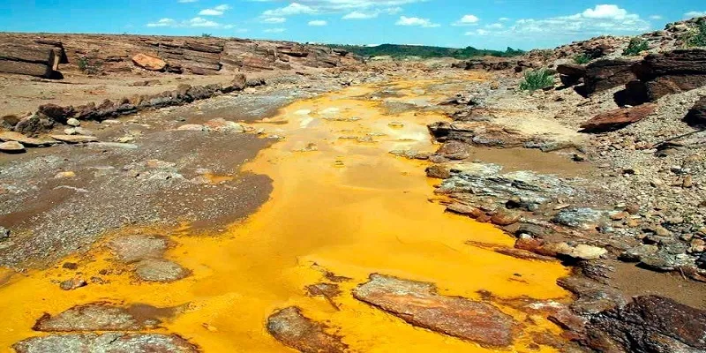
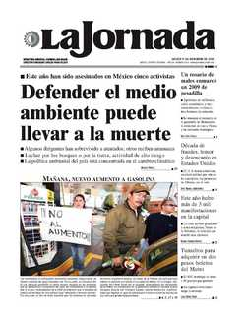
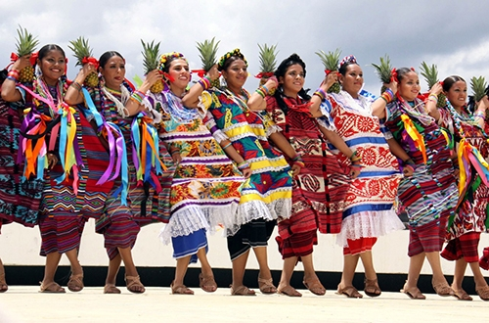
Development and Environmental Justice
Extensive impacts from mining
Flooding and displacement from hydroelectric dams
Overexploitation of aquifers for irrigation and factories
Threats to environmentalists
http://tuxtepecturismo.com
Sonora River (2015): https://www.ocmal.org/
CONAGUA (2007)
http://www.mundohistoriamexico.com

Slide 4
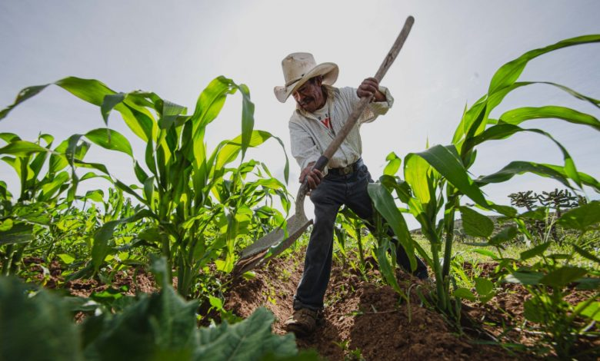
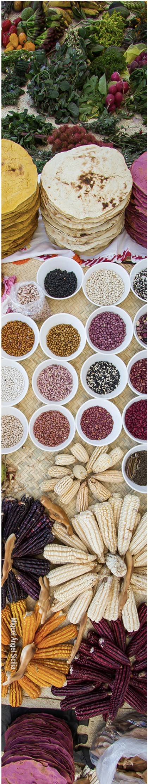
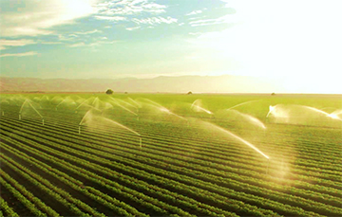
Risks for Agriculture
Center of origin of 94 cultivars comprising 15% of the world population diet
10% of GDP with 5.5 million on-farm workers in farms
40-70% loss of land possible by 2030
High poverty (55.3%) and migration to cities, the US and Canada
SADER (2021
SIAP (2018)

Slide 5
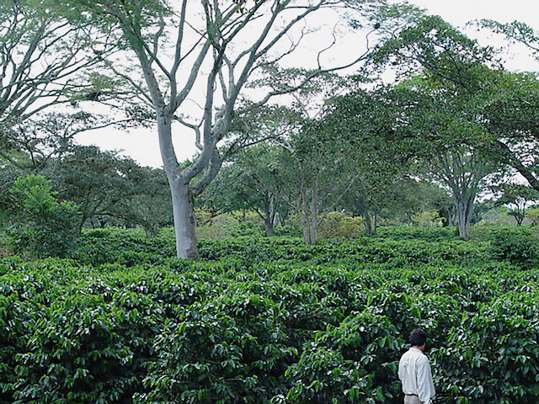
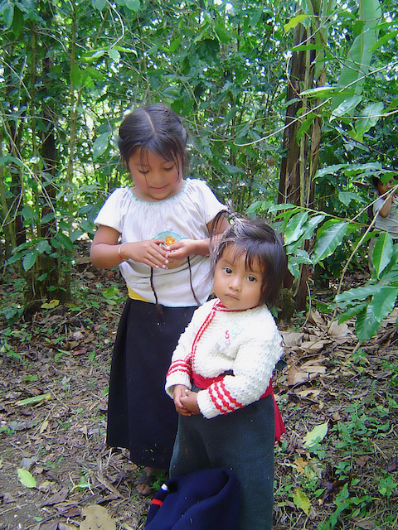
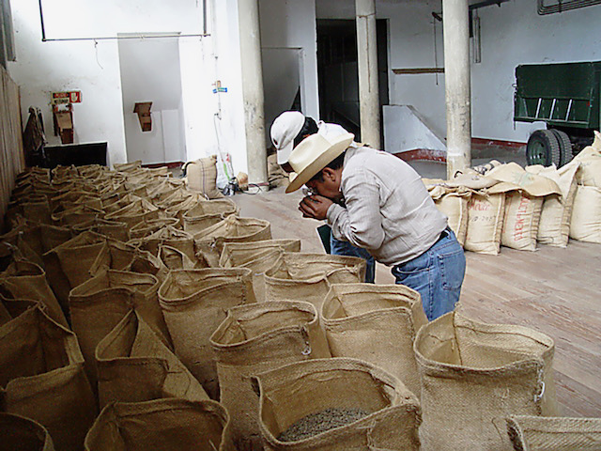
Socioeconomic and Cultural Importance of Coffee
527,000 farmers in 15 states covering 620,000 ha
92% are small farms with less than 1.5 ha
$897 million dollars in exports + domestic consumption
60% of municipalities are dominated by indigenous groups from 30 ethnic groups

Slide 6
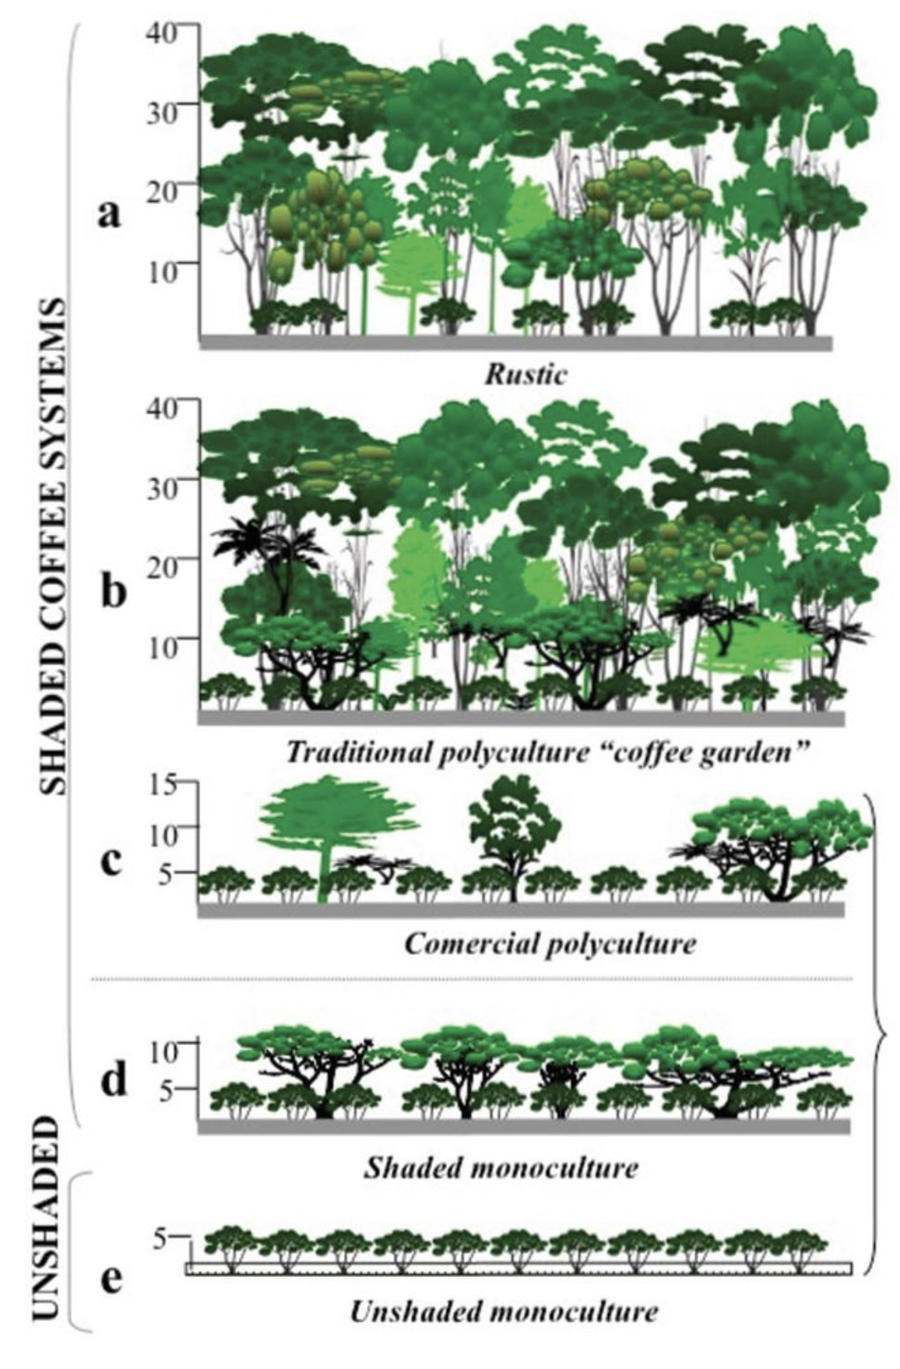
Environmental Importance
> 90% of farms a structurally similar to forest
Important for native and migratory biodiversity, especial in areas of cloud forest
Location in watershed makes these farms important for water regulation and carbon sequestration
Toledo y Moguel (2012)

Slide 7
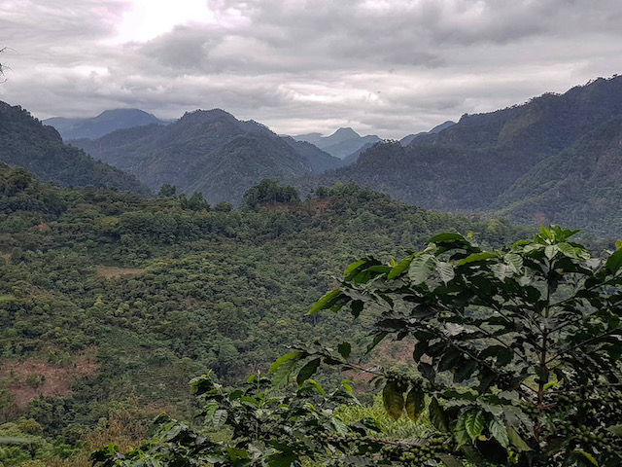
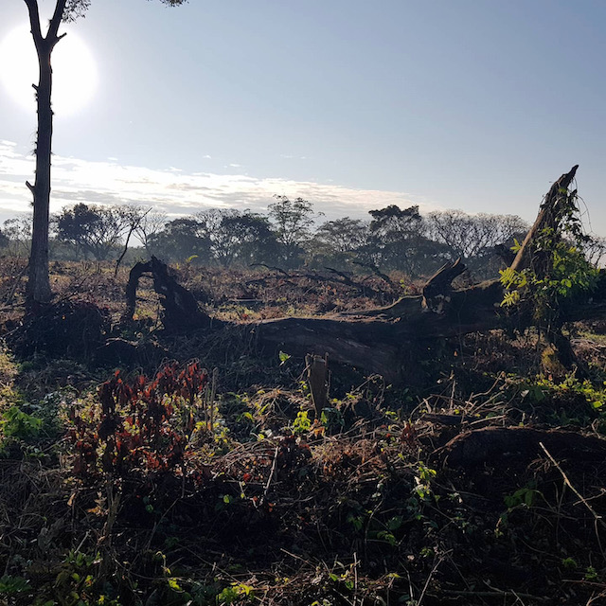
A Sector in Crisis
Elimination of INMECAFE and international accords
Cycles of overproduction and falling prices
Small growers with limited capital and aggregated value, and high poverty
Low yields
Increased abandonment or transformation and migration to cities

Slide 8
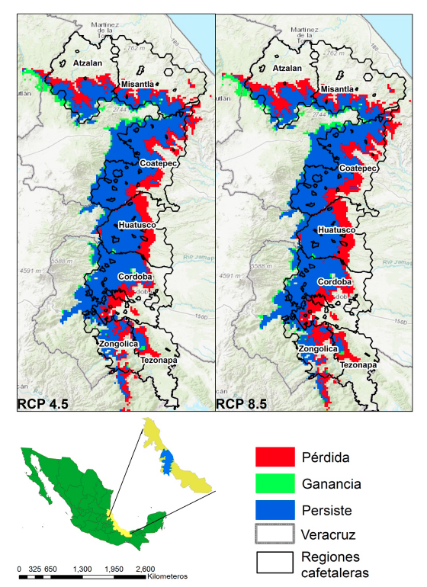
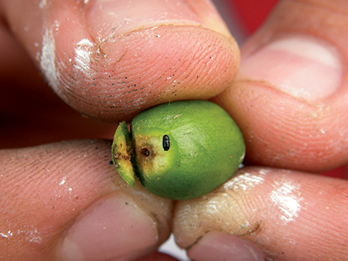
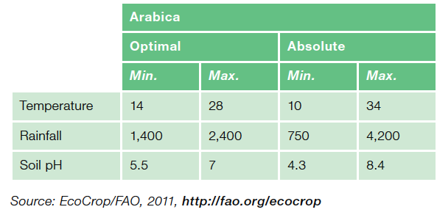
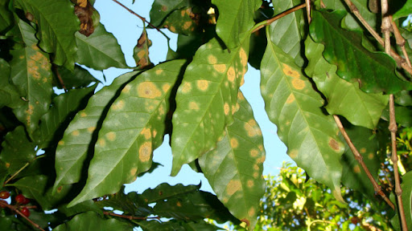
Climate Change: The last straw?
Narrow range of suitability for growth and fruit production
27-97% loss in optimum areas of production
Differential impacts for a perennial crop requires long-term planning
Expansion of pests (Broca) and diseases (Rust fungus) causing 10-55% losses in production
Fuente: Cabrera García (2019)

Slide 9
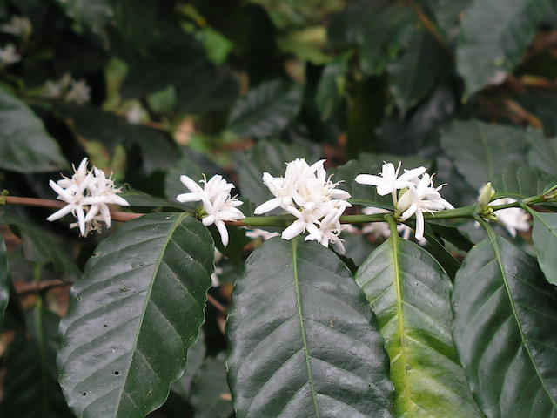
Future Production Paths
Intensification:
Replanting with high-yield resistant varieties
More agrochemicals, less shade
Lower quality and price
Greater vulnerability to climate change and market volatility
Differentiation:
Lower yields but higher aggregated value (certification or specialty coffee)
Greater coordination
Higher quality, prices, and less market variability
Increased crop diversification and food security

Slide 10
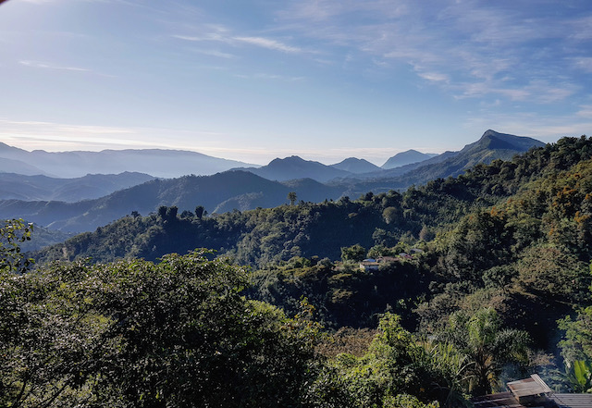
Recommendations
Better management of hydrological resources is key to long-term sustainability and environmental justice in Mexico
Increase local governance by strengthening communities and indigenous groups and improved monitoring of activists
More emphasis needed on sustainable agriculture, particularly agroforestry systems such as coffee
Important role for the CEC in the promotion platforms, databases and exchanges on mitigation and adaptation strategies
Helping to harness and channel market forces is important as well

