Slide 1
Climate change, climate action and justice in North America
Leticia Merino
Universidad Nacional Autónoma de México

Slide 2
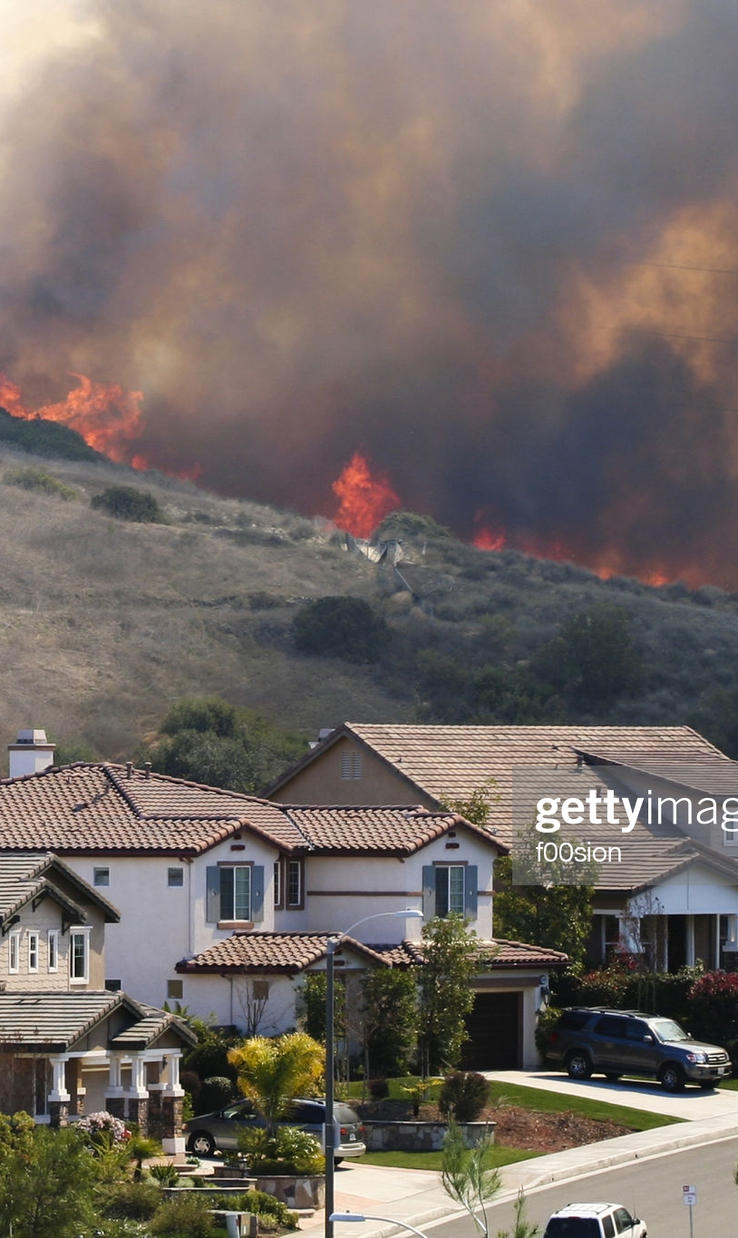
North America, leaving the safe space of the Holocene
NA is already extremely vulnerable to CCH. many of those already vulnerable are the more affected,
Wilde fires in Canada´s central provinces, the West of the United States and Alaska,
Drought affecting the West of the US and Northern Mexico,
Water scarcity in central and northern Mx and the US West.
Flooding affecting Southern and Central Mx and the SW of the US.
Expansion of agricultural and forest pests in the whole region,
Hurricanes affecting the Gulf of Mexico in Mx and the US.

Slide 3
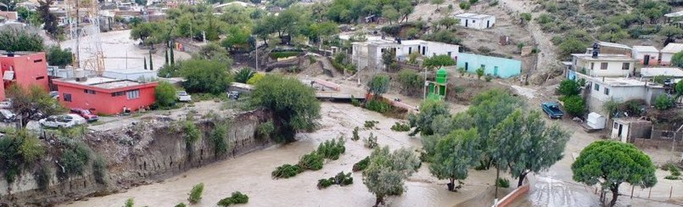
Increased climatic vulnerability in North America
Rise of the sea level in the costal areas, increase of ocean acidity and hypoxia,
Rapid deterioration of artic environments and glaciers,
Diverse impacts on public health,
Many impacts are stronger in megalopolies with urban heat islands, flooding, water scarcity,
These alarming events are part of a large, pervasive, systemic transformation that threatens life as we know it, and demands the involvement of all members of society: governments, communities, indigenous people, citizens, religious leaders, business. D. Kaimowitz

Slide 4
How to build safe environments for the people in North America?
Climate Change, near tipping points leading to an unsafe future.
Need of new governance systems for the Anthropocene.
- Risk of authoritarian solutions responding to the
perception of crisis.
- Risk of political and economic and political elite capture at
the expense of the poor and future generations.
The poor depend more on natural resources and are more affected by environmental degradation.
“Safe environmental targets are not necessary just. Tipping points should consider potential harm to people” J. Gupta.
” Need to incorporate the justice perspective in the definition of climate/environmental targets and climate governance schemes.

Slide 5
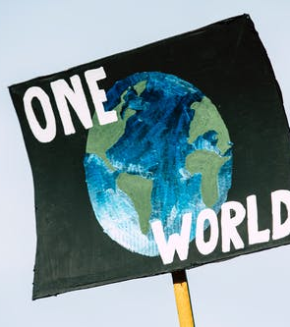
Climate change, challenges of global commons
CCH is a “public bad” none can scape from it, but:
Profound injustice in in the distribution of responsibilities of the GHE and and of the harm of climate change, including future generations. Free riding tends to be the status quo.
The impacts of many mitigation actions do not directly benefit those who implement them, nor they are evident in a short time frame,
Profound mistrust among different actors, associated with colonialism, economic and political inequality and inequality of their environmental foot-print.
No commons without communities, need to create pro-communities in North America able to address climate crisis: empowering citizens, cities, academics, business, to be stewards of the regional and global commons (Joyeeta Gupta).

Slide 6

Just targets for North America in the Anthropocene
Need of transformative justice approach: no significant harm, access ensured, procedural justice and substantive justice.
Based on universal rights, and open to diverse and local approaches.
Procedural justice: access to recognition, information and participation in decision making.
Sustantive Justice, corrective, distributive: access to needed resources for everybody,
Targets: respect to acquired rights, access to minimum rights, not to harm people.
Living within safe spaces demands transformative policies
Need to achieve justice within safe climate limits and the planetary borders, e.g. energy, wáter, food.
Justice approach in the SDGs, leaving none behind, pushing none behind

Slide 7
Mitigation and adaptation policies
Changes in energy production should be respectful of rights. They should prioritize the reversion of energetic poverty and democratization of energy governance and production.
Emissions from forest loss and bad agricultural practices represent some 25 percent of the emissions. Managing those resources better could provide more than 30% of the solution. Forest protection could prevent around 300 billion metric tons of carbon from being released into the atmosphere, Ford Foundaton
To keep temperatures from rising more than two degrees, carbon out of the atmosphere should be actively pulled.
When governed fairly, the natural resource sector can contribute to reducing inequality. Likewise, where indigenous and local communities have secured and recognized land rights, their livelihoods are protected, rates of deforestation are lower and there is less conflict, Ford Foundation, IPBES.
Mitigation policies should be based on diagnostic of the structural causes of emissions: regressive subsidies to fossil fuels, land use changes for avocado production in Central Mx to respond to NAmerican demand, deforestation of mangroves due to the expansion of tourism in Yucatan, illegal expansion of urban areas at the expense of peri-urban forests.
For adaptation, there is an urgent need to investment in public goods, severely neglected in poor regions of n NA, particularly in Mx since the implementation of NAFTA.

Slide 8
Questions and issues driven from the Paris Agreement:
Which are the roles of the Estates, communities, civil society, given the power of corporations responsible of most of the emissions?
How to prioritizing the solution of energetic poverty, human right to water and food security, while reducing emissions and promoting resilience?
How to enhance cooperation in North America for the understanding and action on issues such as:
- Early warning systems and Emergency preparedness,
- Impacts of trade and financial investment on ecological and social vulnerability,
- Understanding of slow onset events and Awareness of events that may involve
irreversible and permanent loss and damage, including noneconomic loses,
- Resilience of communities, livelihoods and ecosystems.

Slide 9
Preliminary Conclusions
Structural inequalities, endangered dignity, leading to inequal dignities are incompatible with the collective action required for an effective response to climate change.
The response of Climate Change requires social mobilization in demand of better laws, regulation, policies, and procurement of justices. The action of progressive state.
Key importance of environmental citizenship and public – community partnerships.

Slide 10
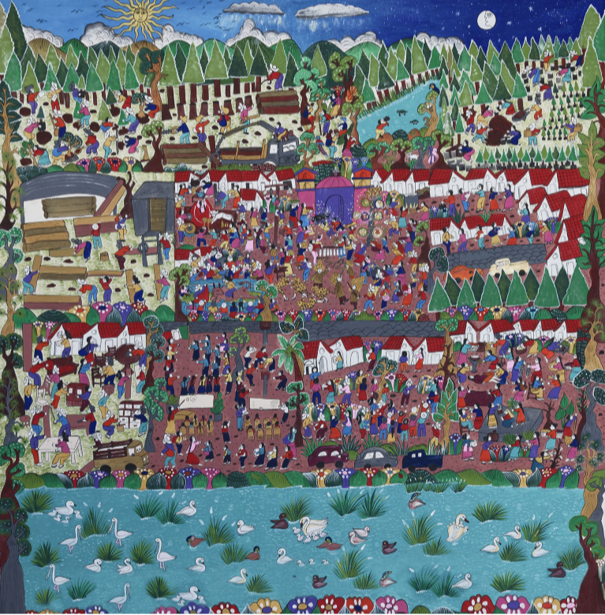
“Defender las montañas”
The defense of the land is a key climate strategy

