Slide 1
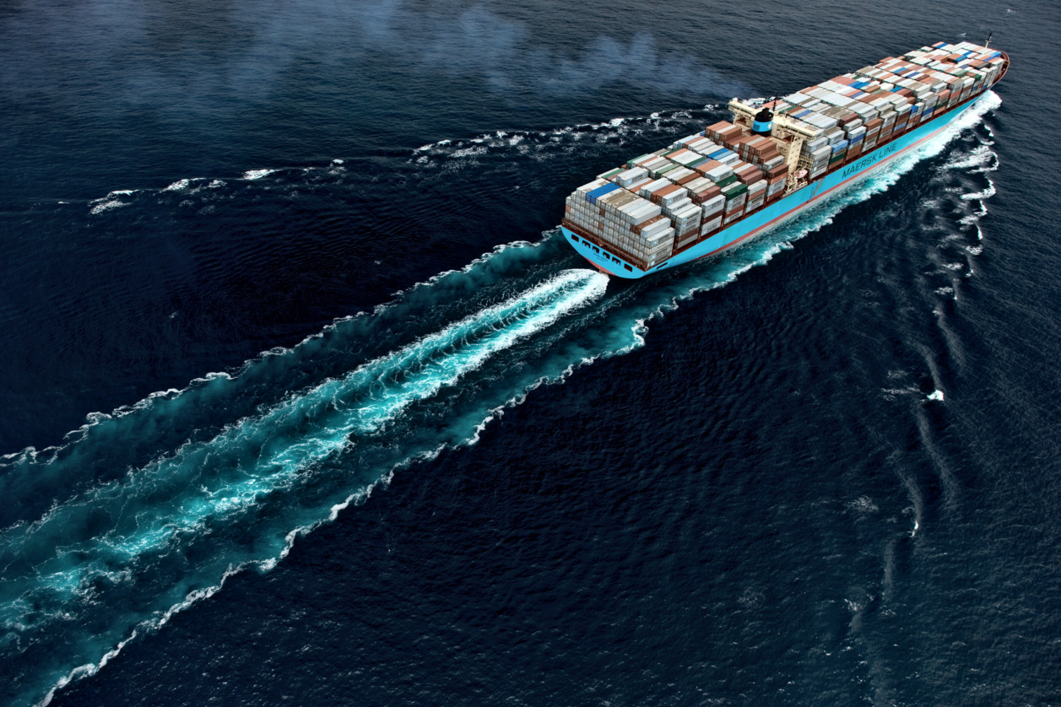
Moving the needle toward industry decarbonization
Nov 2022 | Dr Lee Kindberg – Head of Environment and Decarbonization, Maersk NAM
Notes:
Accelerating Progress Toward Zero Carbon Shipping
This is the decade of action to decarbonize shipping and supply chains, and the rate of change continues to accelerate. Major cargo owners are setting zero carbon goals and demanding that their supply chain transportation providers make faster progress toward zero carbon shipping. Strategies include new fuels and energy sources, Green Corridor projects and additional operational efficiencies. Vessel owners and operators are investing in new vessels and engine types, dual fuel approaches and innovative technologies. In ports, shore power and electrification are major investments, and alternative fuels and electrified vehicles are essential to full decarbonization. Metrics are being adapted to enable analysis of full lifecycle impacts of these developing strategies. These changes will have profound impacts across supply chain operations, transforming port, inland and ocean operations, fuel supply infrastructures, shipping routes and potentially even sourcing and manufacturing decisions. There is no single ideal strategy for success, and collaboration across the industry will be important on the road to success.

Slide 2
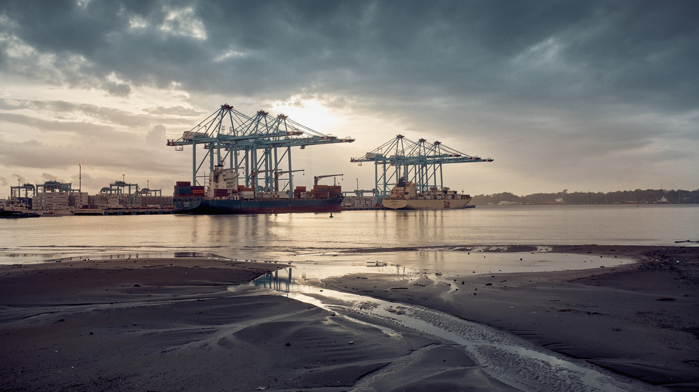

The climate challenge in shipping is huge
While it is the most energy efficient way to move goods, shipping emits 3% of global CO2 emissions. (Around 3.5 Gigatons (Gt) of CO2 emissions yearly)
Maersk’s 700+ container ships emit 0.1% of Total global CO2 emissions.
One very large container ship consumes 7,000 ton of fuel oil on a trip from Europe to Asia and back.

Slide 3

In 2018, we committed to Net Zero Carbon shipping by 2050
This year we accelerated that by 10 years, to 2040
42.6%
reduction Vs 2008 per container transported
0
Net
ZERO
2008
2030
2040
2021
3

Slide 4



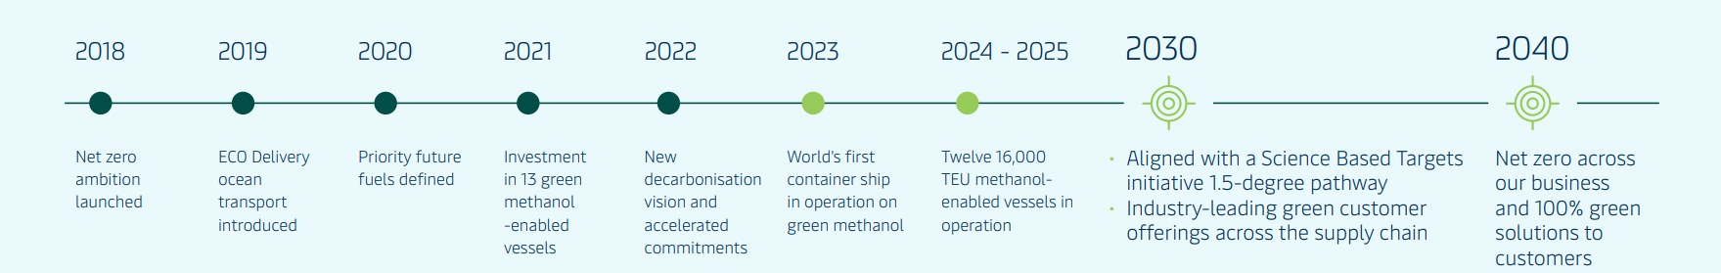

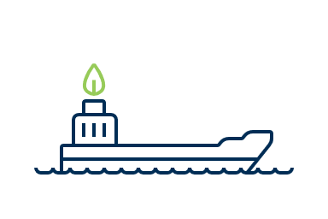
*’
Roadmap to deliver net zero by 2040
New 2040 Decarb Vision and ESG as part of Global Business strategy
OUR DECARBONISATION COMMITMENTS
2030: Industry-leading
green customer offerings
Ocean: 25% of cargo transported with green fuels
Air: min. 30% of cargo transported with green fuels
Contract logistics and cold chain: MIn. 90% green operations (scope 1 and 2)
Inland transportation: Industry leading green offering (targets to be set in 2022)
2030: 50% reduction of
absolute direct climate impact*
Ocean ~50% reduction in emissions intensity
Terminals ~70% absolute reduction (scope 1 & 2)
Aligned with Science Based Target net zero criteria
Natural Climate Solutions above and beyond the SBTi
*2020 Baseline
2040: Net zero
across our business
100% Green solutions to our customers
Net Zero greenhouse gas emission across the whole business/all scopes
Aligned with Science Based Target net zero criteria

Slide 5

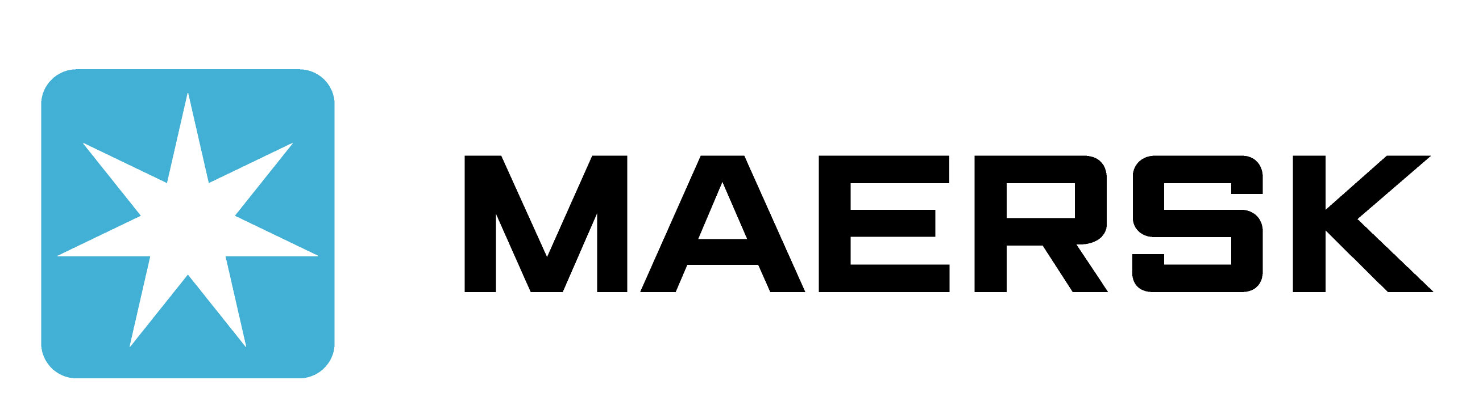
International Maritime Organization (IMO) sets shipping’s global rules
Shipping is the only industry with global decarbonization goals and metrics
IMO vision and context
Maersk decarbonization targets
Vision:
IMO remains committed to reducing GHG emissions from international shipping and, as a matter of urgency, aims to phase them out as soon as possible in this century.
Vision:
As a global provider of end-to-end logistics services across all transport modes, it is a strategic imperative for Maersk to extend our net zero ambition to the total footprint of the business. These very ambitious targets mark our commitment to society and to the many customers who call for net zero supply chains.
2018: IMO initial strategy on GHG reduction
The strategy aims to reduce CO₂ emissions per transport work, as an average across international shipping…
  …by 40% by 2030 (compared to 2008)
  …by 70% by 2050 (compared to 2008)
Total emissions to be reduced by 50% by 2050
The strategy includes a specific reference to “a pathway of CO2 emissions reduction consistent with the Paris Agreement temperature goals.”
The strategy introduces the EEXI and CII as the key measures to deliver on its short-term objectives
Maersk decarbonization commitments
Ambitious targets set for the Maersk business to achieve net zero greenhouse gas emissions in 2040 – one decade ahead of the initial 2050 ambition.
50% reduction in emissions per transported container in the Maersk Ocean fleet by 2030
70% reduction in absolute emissions from fully controlled terminals by 2030
By 2030 Industry leading green customer offerings across the supply chain:
  Ocean: 25% of all cargo transported using green fuels
  Air: Minimum 30% of cargo transported using Sustainable Aviation Fuels
  Contract Logistics: Minimum 90% green operations (scope 1 & 2) across warehouses, depots and cold chain

Slide 6
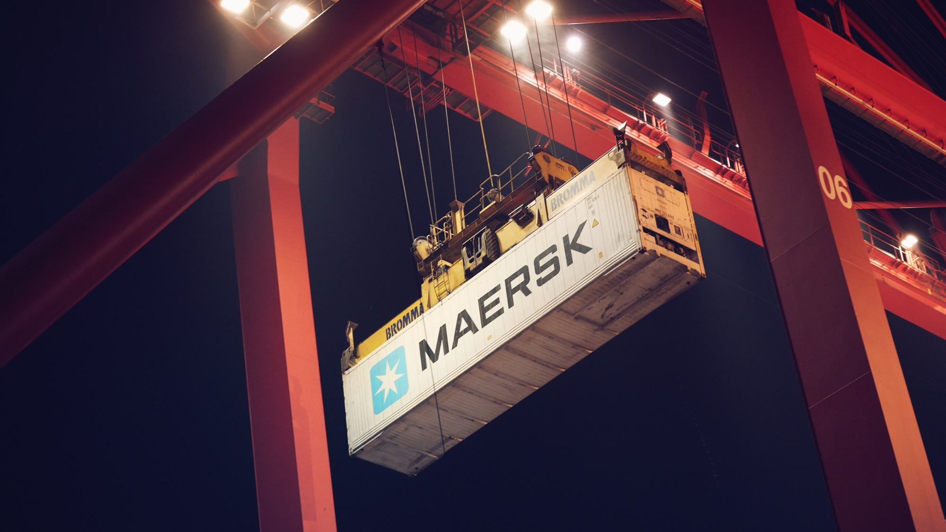
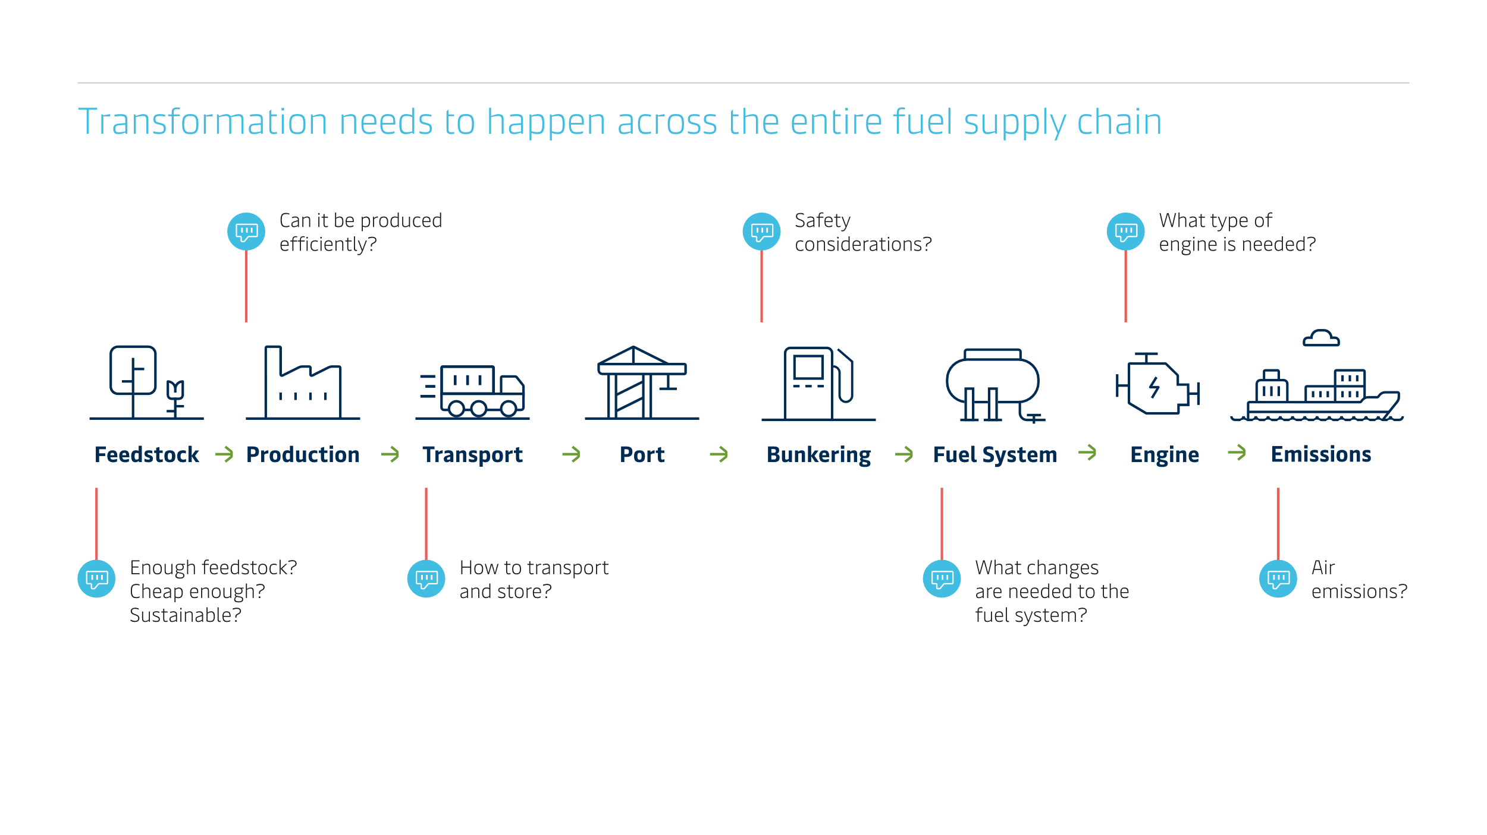
New fuels are not enough
- we need to build a new ecosystem
1. Price
2. Scalability
3. Sustainability
4. Tech. viability

Slide 7
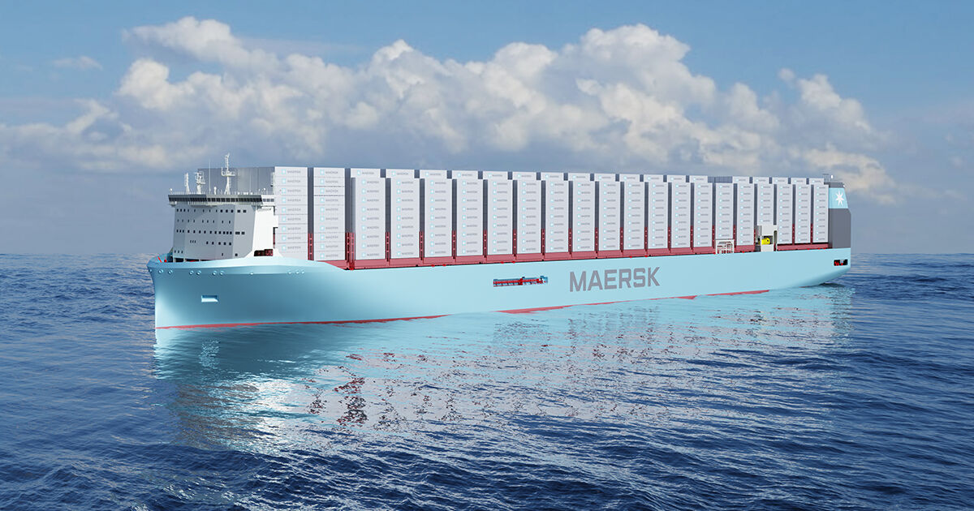
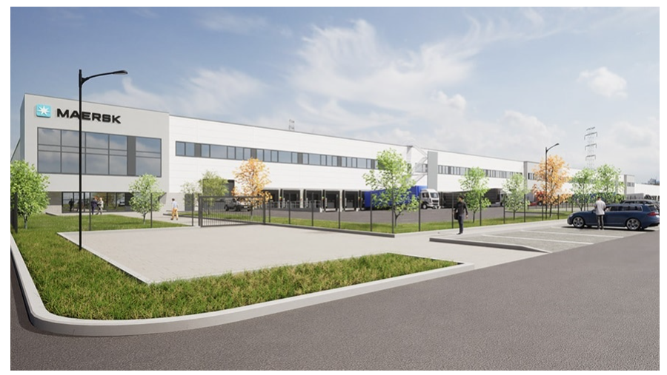
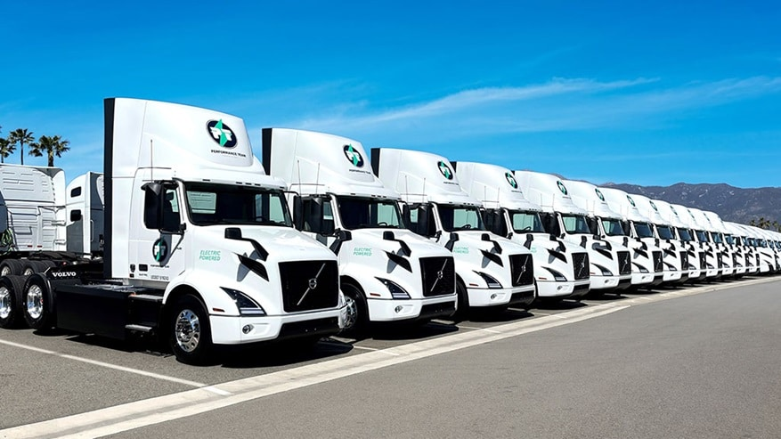
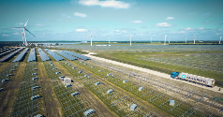
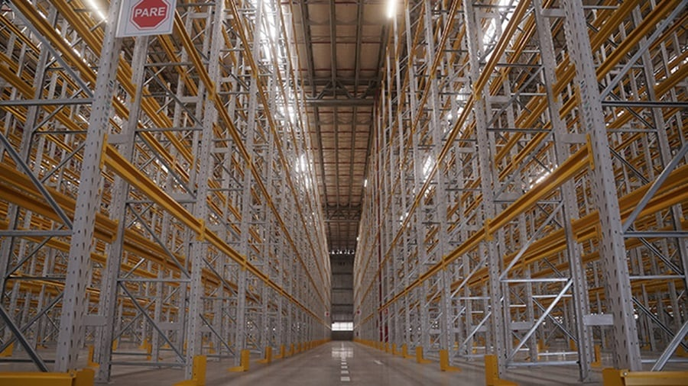
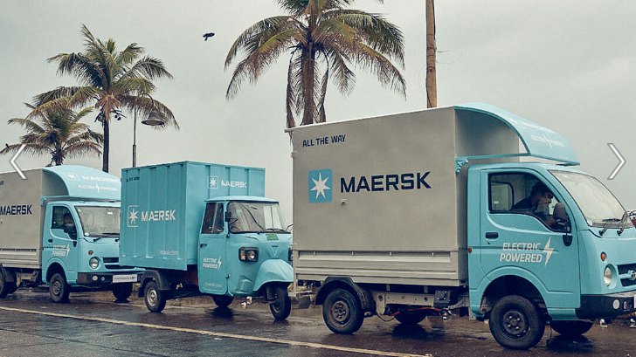
Maersk´s latest investments to accelerate decarbonization
Ocean
Warehousing
Inland solutions
Designing the future of our customers’ supply chains with carbon-neutral methanol vessels
Construction of 43,000 sqm Green Maersk Warehouse to begin in Duisburg – BREEAM Excellent sustainability rating
Performance Team – A Maersk Company orders 126 Volvo and 300 Enride Class 8 Electric Trucks
Maersk engages in strategic partnerships across the globe to scale green methanol production by 2025
Maersk expands footprint in Latin America with new Green warehouse in Brazil
Maersk founding member of EV100+ to tackle world’s most polluting road vehicles | Climate Group (theclimategroup.org)
And EV’s for middle mile in India

Slide 8
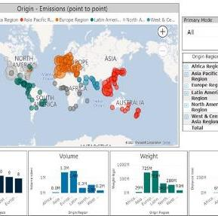


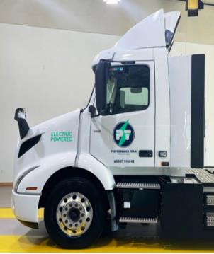
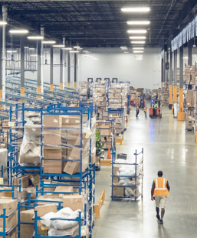

Opportunities to Collaborate on our journey to Net Zero 2040
|8
Emissions Visibility and reporting
Maersk ECO Delivery - Ocean
Decarbonized Airfreight
Decarbonized Trucking
Decarbonized Contract Logistics and Warehousing
Decarbonization Partnership
Notes:
We can’t do this alone

Slide 9
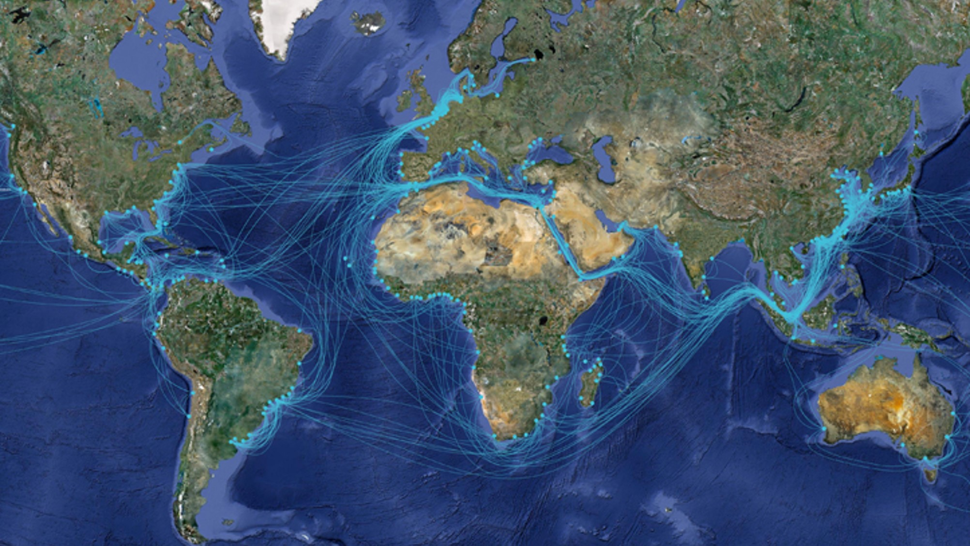
Thank you
Lee Kindberg
Environment & Sustainability North America
lee.kindberg@maersk.com

