Slide 1



OFFSET RESET—
KAI CHAN
2024.12.5
JPAC CEC
Let’s Raise the Bar for Ecosystem-Based Offsets & Credits
Notes:
Commission for Environmental Cooperation (CEC) of North America, Session 24-02 of the Joint Public Advisory Committee 4–5 Dec 2024

Slide 2
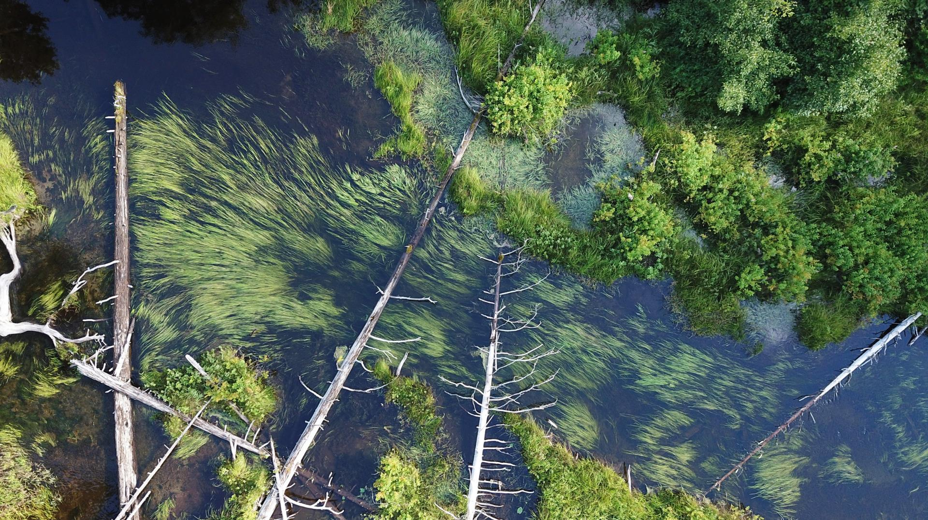



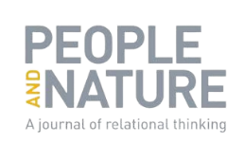

KAI CHAN
PROFESSOR &
CANADA RESEARCH CHAIR
© Kai Chan @KaiChanUBC

Slide 3
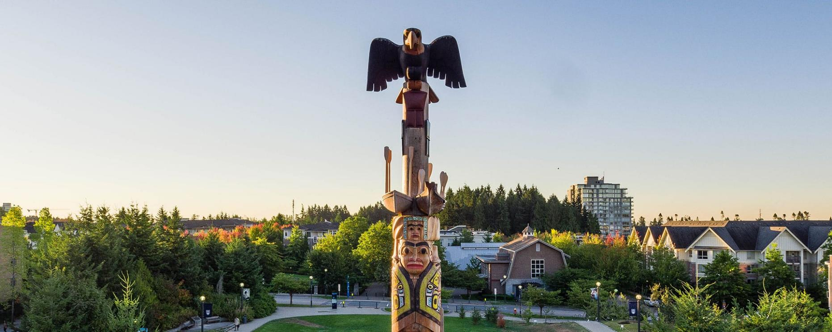
  LAND ACKNOWLEDGEMENT
I LIVE AND PLAY ON THE UNCEDED TRADITIONAL TERRITORIES OF THE XʷMƏΘKʷƏY̓ƏM (MUSQUEAM), SḴWX̱WÚ7MESH (SQUAMISH), AND SƏLILWƏTAꞭ (TSLEIL-WAUTUTH) NATIONS

Slide 4
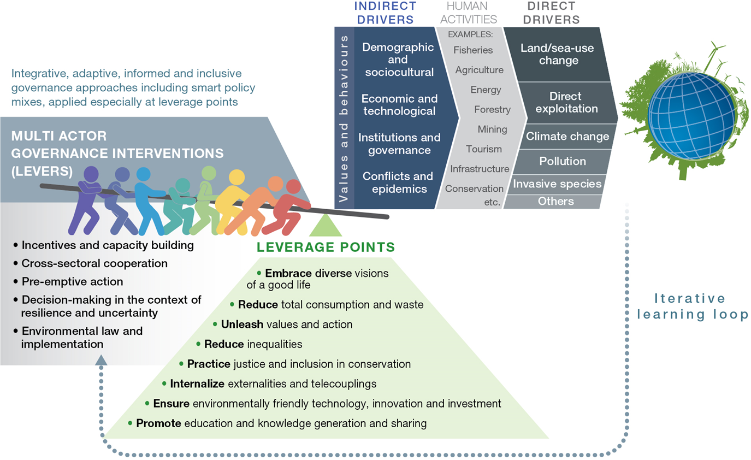

IPBES 2019,
Chan et al. 2020
Notes:
Looking broadly at the problem, we found that genuine solutions—ones that addressed all six of those nature-related foci—had some common elements. 5 kinds of governance interventions (‘levers’) at 8 points of leverage, all affecting a variety of human systems that drive the ecological and climate crisis.
Chan, K.M.A., D.R. Boyd, R.K. Gould, et al. (2020). "Levers and leverage points for pathways to sustainability." People and Nature 2(3): 693-717. https://doi.org/10.1002/pan3.10124
IPBES (2019). Global assessment report of the Intergovernmental Science-Policy Platform on Biodiversity and Ecosystem Services. Bonn, Germany, IPBES Secretariat. http://doi.org/10.5281/zenodo.3831673

Slide 5
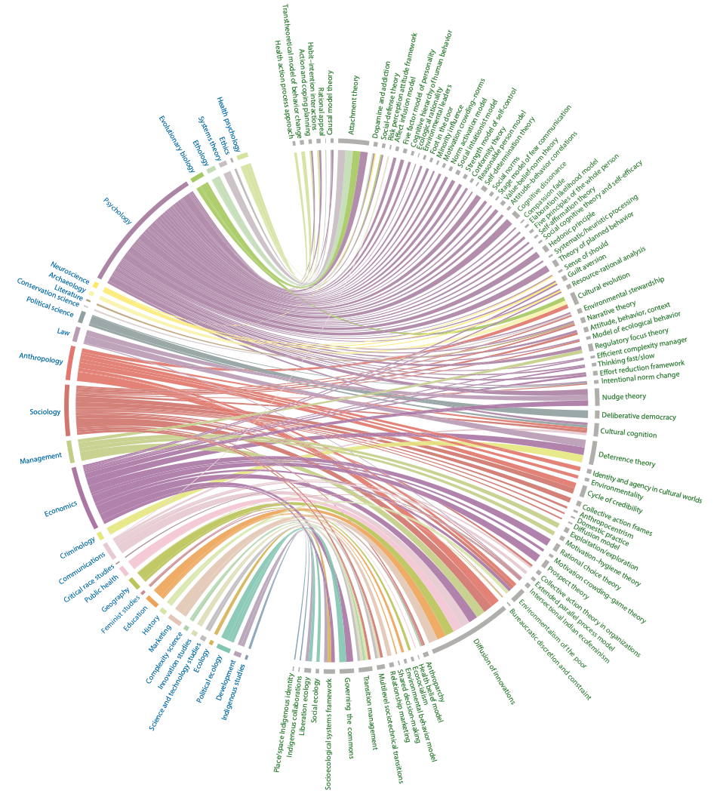
THEORIES OF HUMAN ACTION
We know what enables action (?)
Eyster, Satterfield & Chan 2022 ARER, “Why people do what they do”
Notes:
We have a tremendous diversity of research characterizing what makes people act/behave. We found 86 theories of human action spread across the social sciences.
Eyster, H.N., T. Satterfield and K.M.A. Chan (2022). "Why people do what they do: An interdisciplinary synthesis of human action theories." Annual Review of Environment and Resources 47(1): 725–751. https://doi.org/10.1146/annurev-environ-020422-125351

Slide 6
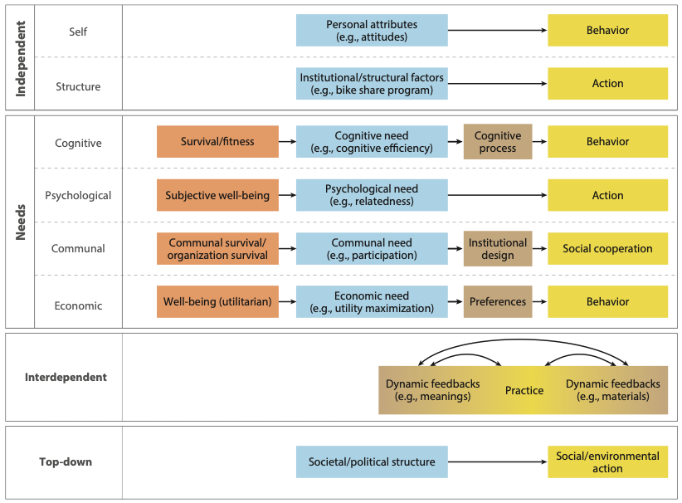
8 META-
THEORIES OF HUMAN ACTION
Eyster, Satterfield & Chan 2022 ARER
Notes:
Most ecologists practice science engagement with a very small set of theories in mind about what yields changes in human action, relying almost entirely at the individual scale on the “Economic Needs” metatheory, and at coarser scales on “Independent Structure”.
Moreover, most of these theories (and meta-theories) are very linear (one thing causes another thing, which changes a person’s behaviour). This linearity means that they cannot be very useful for predicting the deep social change that appears needed to achieve sustainable pathways (where what some people do changes the environment/institutions/infrastructure to change what other people do, dynamically).
Eyster, H.N., T. Satterfield and K.M.A. Chan (2022). "Why people do what they do: An interdisciplinary synthesis of human action theories." Annual Review of Environment and Resources 47(1): 725–751. https://doi.org/10.1146/annurev-environ-020422-125351

Slide 7
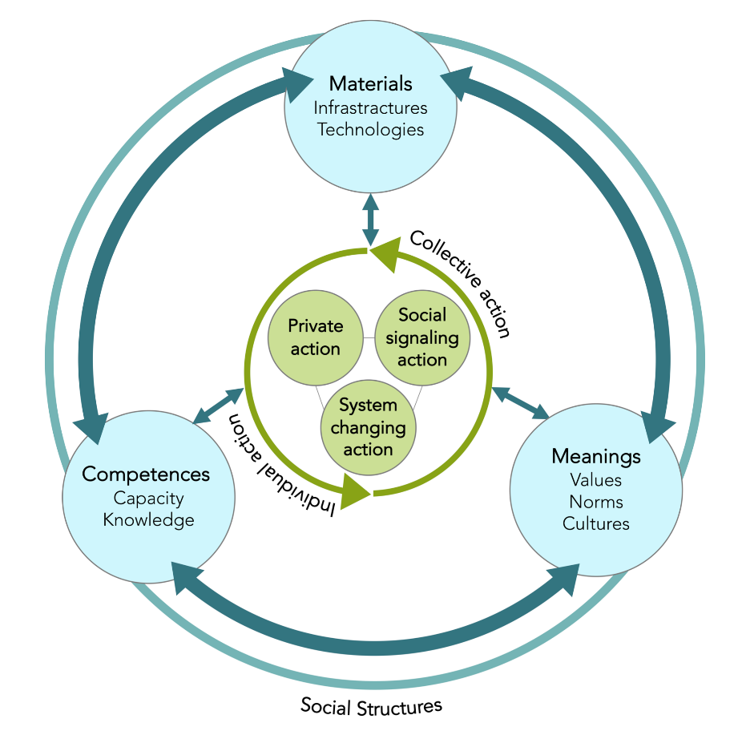
INTEGRATING THEORIES—FOR TRANSFORMATION
Private
Social-signaling
System-changing
Naito, Zhao & Chan 2022 Sust Sci
Notes:
Putting together some of those disciplinary theories, we proposed an integrative theory for individual contributions to social transformation.
The emerging science of transformative change establishes that individuals can play crucial roles toward system change, but that we have mostly been engaged in ways that are only marginally helpful.
In particular, the literature (and advocacy) have largely focused on private actions, like recycling, composting, and buying organic—all of which have only a small role in system change, unless accompanied by more.
The real power in individuals comes from:
Social-signalling actions: actions that involve publicly sharing and signaling pro-environmental values, attitudes, identities, and opinions.
System-changing actions: behaviors that people collectively engage in with the intent of changing laws, policies, corporate actions, institutions, and infrastructure.
We know very little about what enables these. When widespread individual actions are in line with social-signaling and system-changing actions—and when there’s a critical mass for a common goal—large scale structural change can occur and shift our trajectories towards a sustainable future.
Naito, R., J. Zhao and K.M.A. Chan (2022). "An integrative framework for transformative social change: a case in global wildlife trade." Sustainability Science. https://doi.org/10.1007/s11625-021-01081-z Shareable link for the pdf: https://rdcu.be/cFkw1

Slide 8

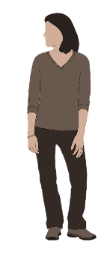
VALUES: THE INSTRUMENTAL/INTRINSIC VIEW
HELD VALUES
Abstract guiding principles, e.g., honesty, fidelity
INTRINSIC VALUE
Nature has value, independent of people
INSTRUMENTAL VALUE
Being in/seeing nature brings people pleasure or satisfaction
Chan et al. 2016 PNAS
Notes:
Up until 2015, people in the environmental movement were talking about value in a very limited set of ways. In relation to nature, it was instrumental or intrinsic.
[In Barbara Muraca’s quoting of the MA referring to Emmanuel Kant, nature has either a price or a dignity.]
There’s also held values, from psychology, sociology, etc.
Chan, K.M.A., P. Balvanera, K. Benessaiah, et al. (2016). "Why protect nature? Rethinking values and the environment." PNAS 113(6): 1462–1465. http://www.pnas.org/content/113/6/1462.full

Slide 9
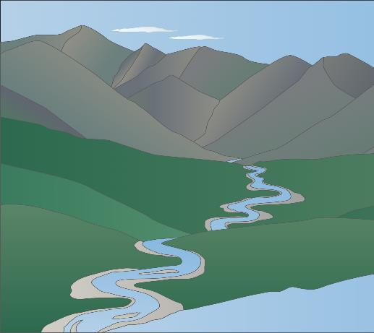


THE RELATIONAL VIEW
RELATIONAL VALUES (involving the human collective)
Place is important to my people, to who we are as a people (Cultural identity)
Being in nature provides a vehicle for me to connect with people (Social cohesion)
Caring for ecosystems is crucial to caring for my fellow humans, present and future (Social responsibility)
Caring for all lifeforms and physical forms is a moral necessity (Moral responsibility to non-humans)
RELATIONAL VALUES (primarily individual)
This place is important to me, to who I am as a person (Individual identity)
My care for this land fulfills me, helps me lead a good life (Stewardship eudaimonic)
Keeping the land healthy is the right thing to do (Stewardship principle/virtue)
Chan et al. 2016 PNAS
Notes:
With help from Unai Pascual, Berta Martín-López, and then Sandra Díaz we managed to get this notion of RVs inserted as central in the IPBES CF, even though no one had ever fleshed out the conceptualization as laid out here. That’s when I realized it was necessary to flesh it out, as we did in the PNAS article of 2016.
Chan, K.M.A., P. Balvanera, K. Benessaiah, et al. (2016). "Why protect nature? Rethinking values and the environment." PNAS 113(6): 1462–1465. http://www.pnas.org/content/113/6/1462.full

Slide 10
RELATIONAL THINKING, E.G.
Haidt’s “moral foundations” are arguably deeply relational
Haidt & Graham 2007, Eyster et al. 2023
Notes:
Haidt, J. and J. Graham (2007). "When morality opposes justice: Conservatives have moral intuitions that liberals may not recognize." Social Justice Research 20(1): 98-116. http://dx.doi.org/10.1007/s11211-007-0034-z
Eyster, H.N., T. Satterfield and K.M.A. Chan (2023). "Empirical examples demonstrate how relational thinking might enrich science and practice." People and Nature 5(2): 455-469. https://doi.org/10.1002/pan3.10453

Slide 11
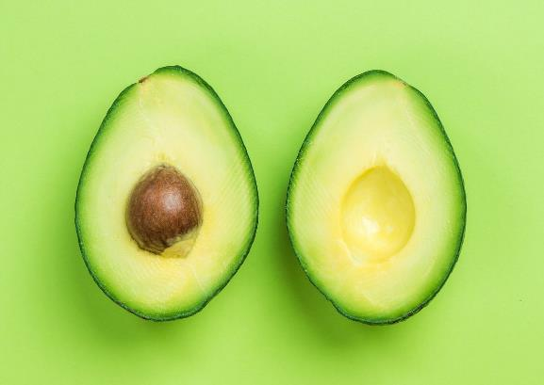
RELATIONAL THINKING, E.G.
The mystery of “ghosts of evolution” are resolved with relational thinking
Janzen & Martin 1982, Eyster et al. 2023
Notes:
Why do we have cashews, avocados, honey locust, and so many other big fruits, many of which we love? (DISCUSS in groups?) Why would a plant produce a big fruit, with big seeds that can easily be spit out? For a plant, this is a massive waste of energy and resources. These trees only would have evolved over millions of years alongside megavertebrates, including elephantids like gomphotheres but also giant ground sloths (roughly the same size). Those big animals (mostly herbivores) would have consumed these fruit in large quantities, mashing the fruit a bit but avoiding chewing the bitter seeds, swallowing the lot. They would have then deposited the seeds in a steaming pile of fertilizer (manure), often kilometres away (as the tree ‘intended’). Many seeds actually require scarification, which mimics the abrasion and stomach acid that they would have been exposed to in the guts of these animals.
Today these trees are either cultivated and spread by people, or they are on a slow march to extinction. Many big-fruit, big-seeded trees are now found only in flood plains. This is because there is a tremendous penalty to seedlings growing up under the parent tree (seed and seedling predators find them easily), and flood waters have become the only real seed dispersal. But there’s only one direction to that dispersal: towards the sea.
Janzen, D.H. and P.S. Martin (1982). "Neotropical anachronisms: the fruits the gomphotheres ate." Science 215(4528): 19-27. http://www.jstor.org/stable/1688516
Eyster, H.N., T. Satterfield and K.M.A. Chan (2023). "Empirical examples demonstrate how relational thinking might enrich science and practice." People and Nature 5(2): 455-469. https://doi.org/10.1002/pan3.10453

Slide 12
THE PROBLEM
01
Offsets—tained but not worthless
THE SOLUTION
02
5 tenets to raise the bar
TABLE OF CONTENTS
OUR ROLE
03
#Offsetreset strategy & involvement
COSPHERE
04
To enable you!

Slide 13
01
TAINTED, BUT NOT WORTHLESS

Slide 14
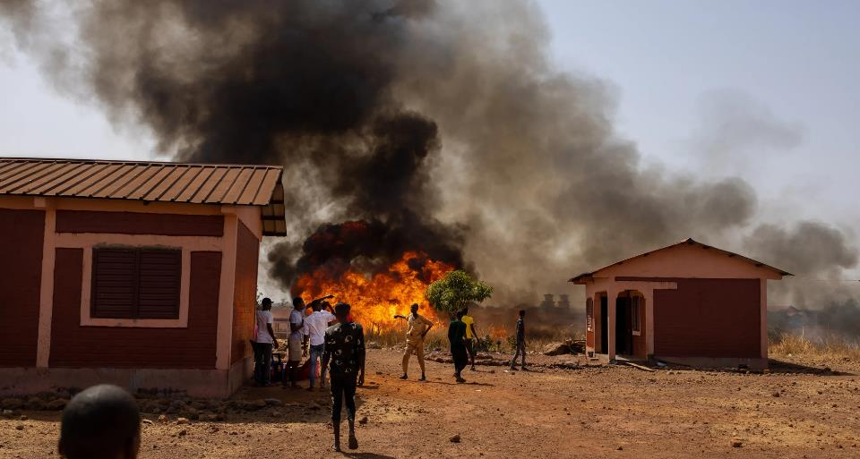
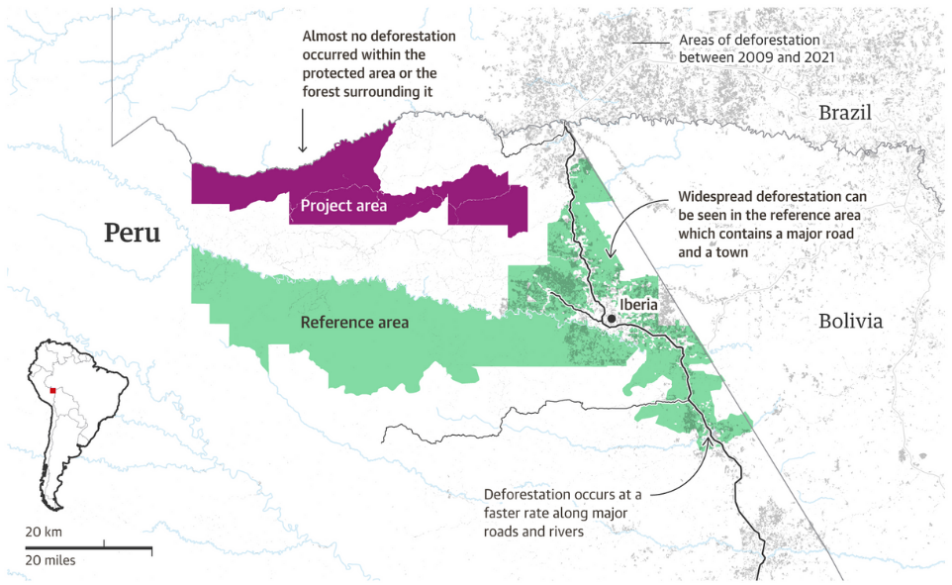
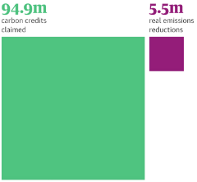
LANDGRABBING & GREENWASHING
A VILLAGE WAS RELOCATED FROM A SHADED GROVE TO A SCORCHING, BARREN HILLTOP, WITH RESIDENTS SAYING THEY HAD LITTLE CHOICE.
VERRA PROJECT EXAMPLE AND ITS REFERENCE AREA FOR PROJECTING DEFORESTATION RATES
Notes:
(Note that these are C offsets)

Slide 15


CURRENT GUIDELINES (BIODIVERSITY)
Notes:
Current guidelines for biodiversity offsetting reflect some important learning based on problems with carbon offsets, but they don’t go far enough to address some fundamental critiques.

Slide 16
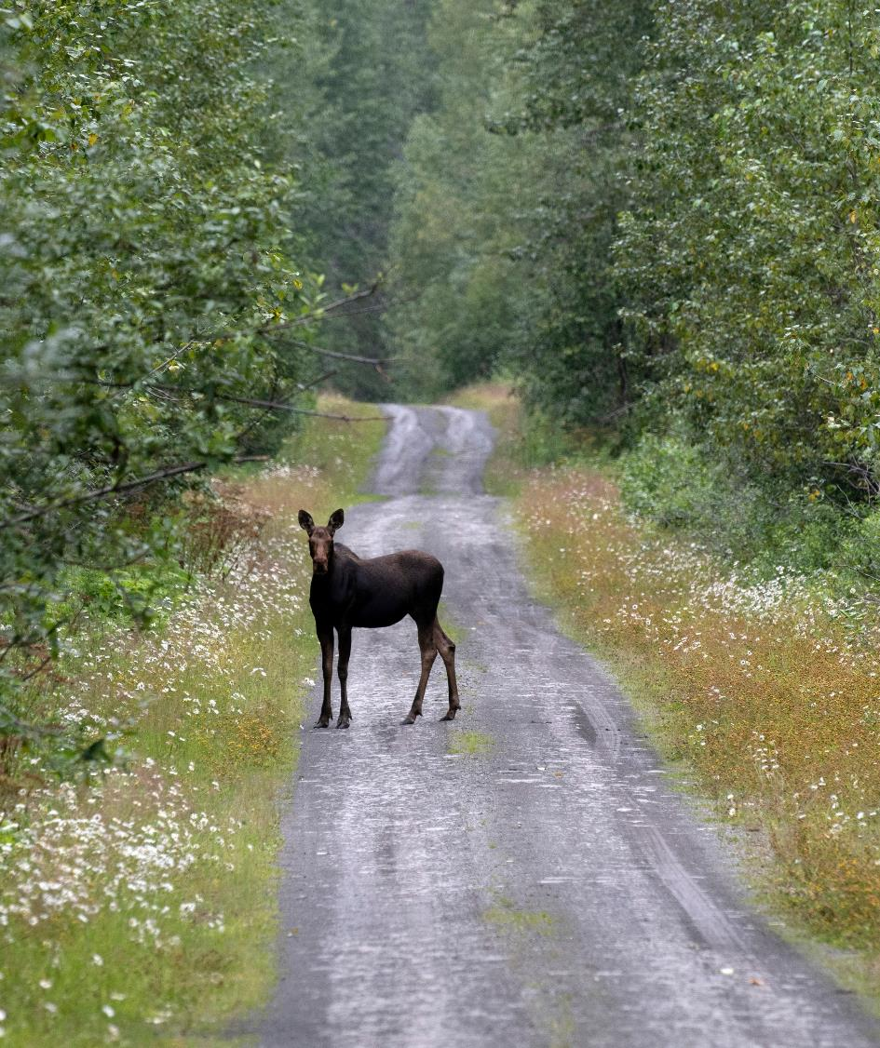
#OFFSETRESET
CARBON OFFSETS
HAVE ENABLED GREENWASHING AND LAND-GRABBING.
BIODIVERSITY OFFSETS
ARE COMING SOON.
PREEMPTIVELY & TOGETHER
WE ARE GOING TO RAISE THE BAR, FOR BOTH.

Slide 17
02
RAISING
THE BAR
How might carbon and biodiversity credits and offsets restore people–nature relationships?

Slide 18



OFFSET
NON-OFFSET
CREDIT-BASED OFFSET
CREDIT
(NON-OFFSET)
  offset generates credit
  credit for ecological conservation
  not tied to ecosystem repair
CREDIT
OFFSETS & CREDITS
TRADABLE
CREDIT
REPARATION OF ECOSYSTEM
TRADABLE
CREDIT
(rare)
OFFSET
(NON-CREDIT)
  offset does not generate a credit
  voluntary offset
INACTION OR UNCREDITED ACTION
NON CREDIT
REPARATION OF ECOSYSTEM
Notes:
This is a complex landscape. Not only do we have credits/offsets for C, Biodiversity, and both; we also have different kinds of offsets and credits.

Slide 19
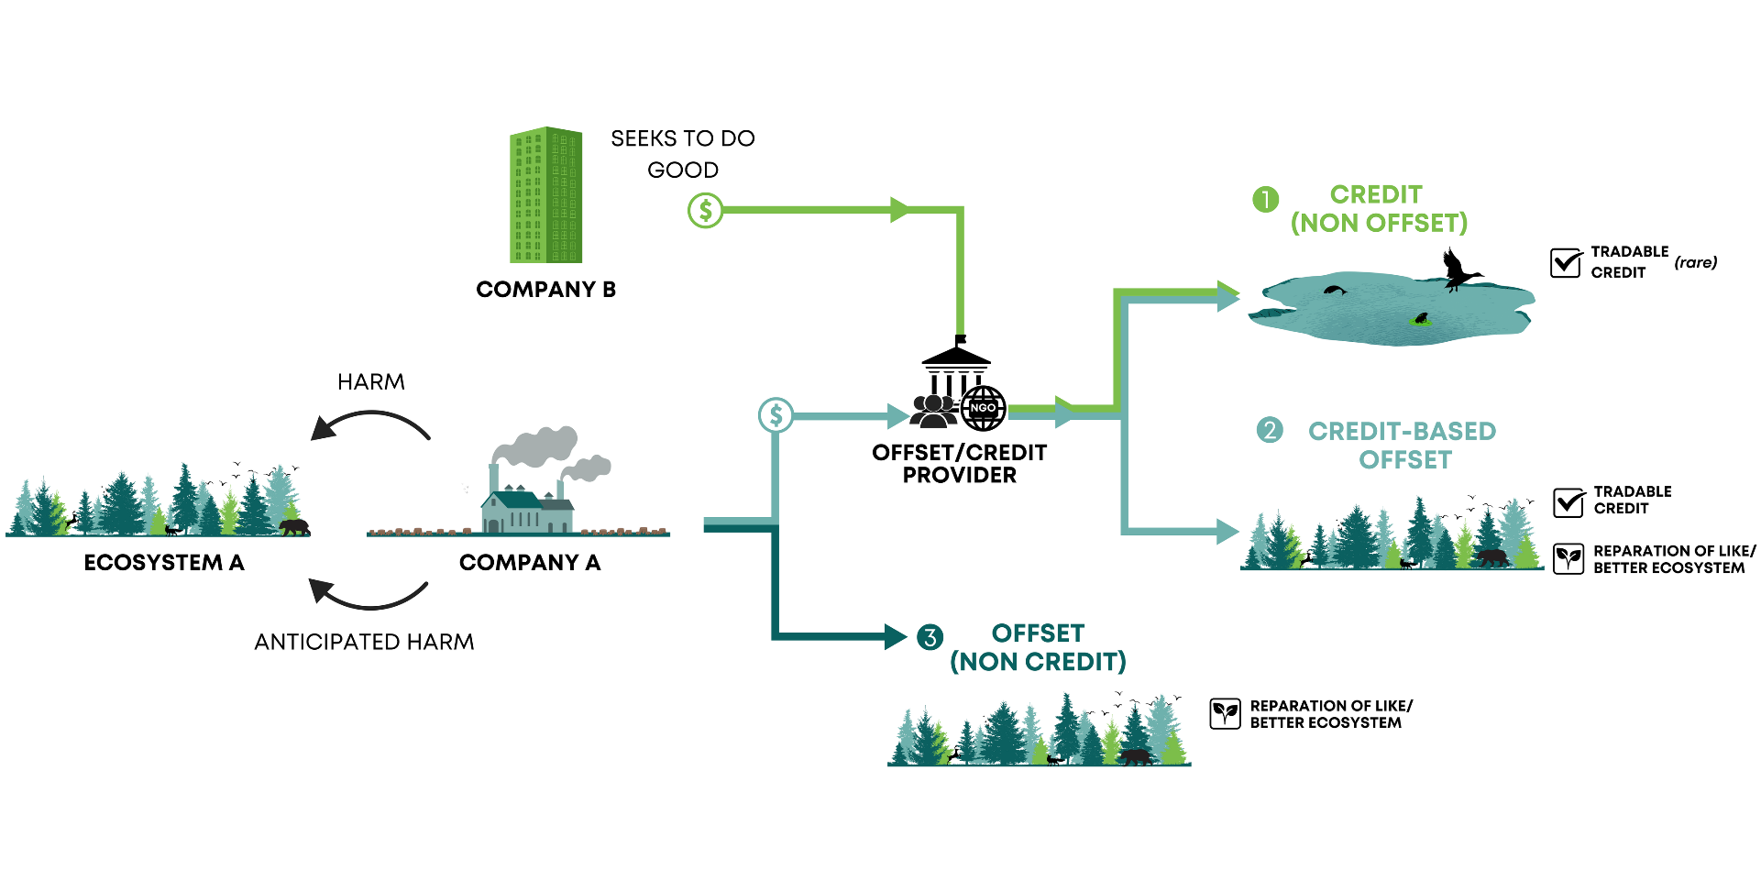
Notes:
Different kinds of entities enter at different points, in different ways: companies incurring some kind of place-based harm, and those seeking to do good; also governments, companies, or third-party non-profit or community-based organization organizations, which might do the conservation and/or restoration themselves or commission another entity to do it (we’ve lumped together those commissioning possibilities under “Offset/Credit Provider”).
Graphic from Hanaa Punja.

Slide 20
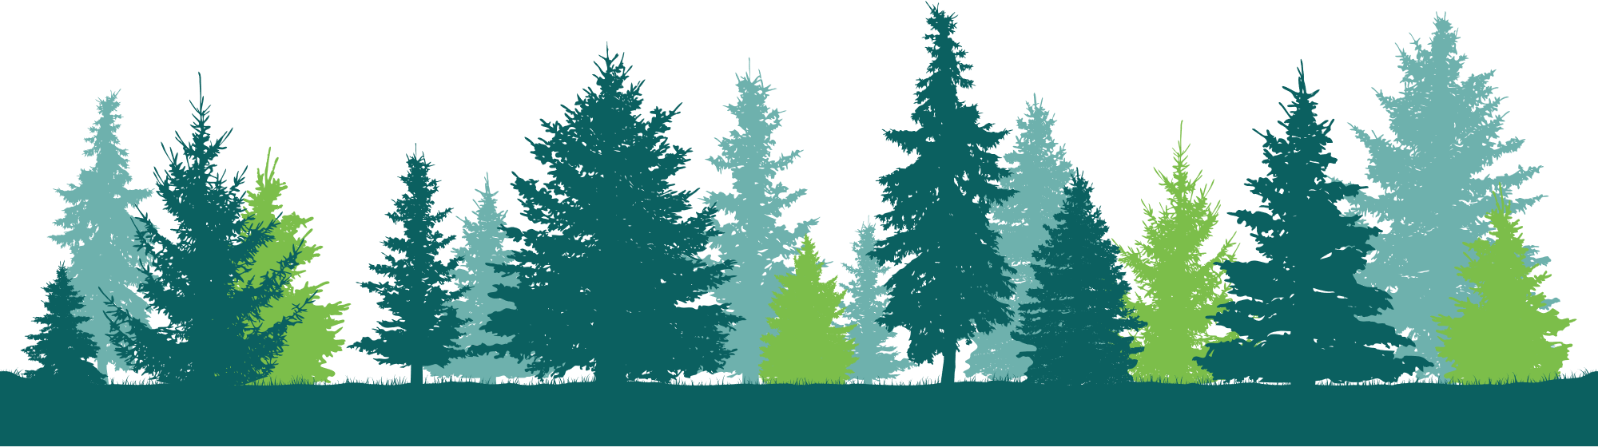




Consider Connections:
ALWAYS ADDRESS BIODIVERSITY
TENET 01
Any carbon credit with a footprint on land or water has implications for biodiversity and ecosystem services and must have net positive consequences.
Notes:
Despite the benefits of simplifying assumptions about the separation of things, the inherent connectivity between things means we cannot optimize for one thing without undermining others.

Slide 21



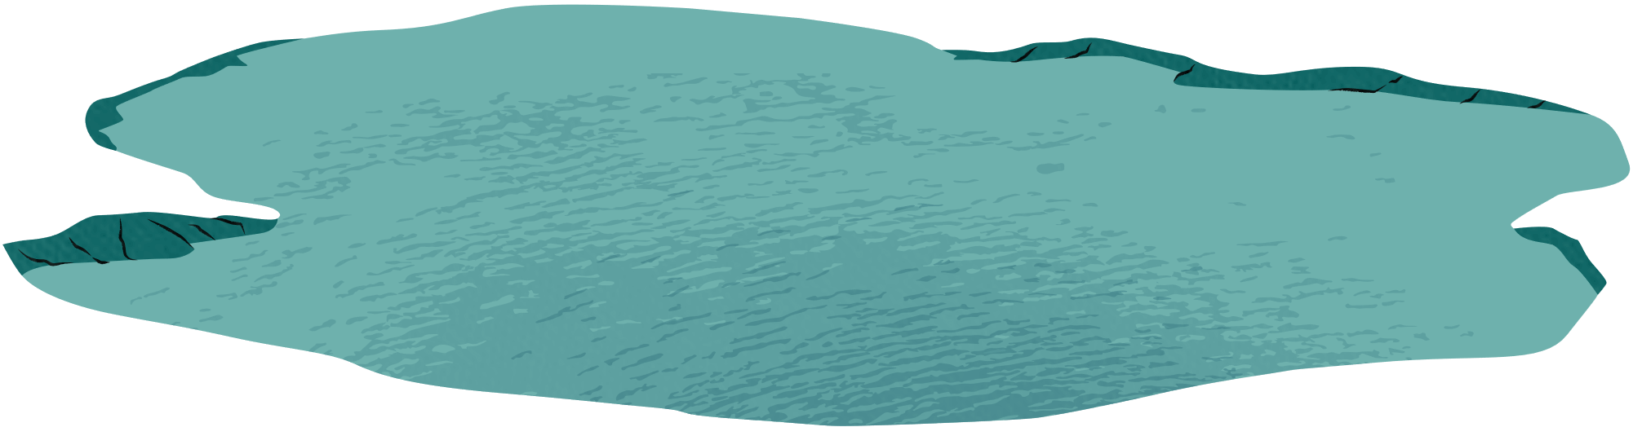



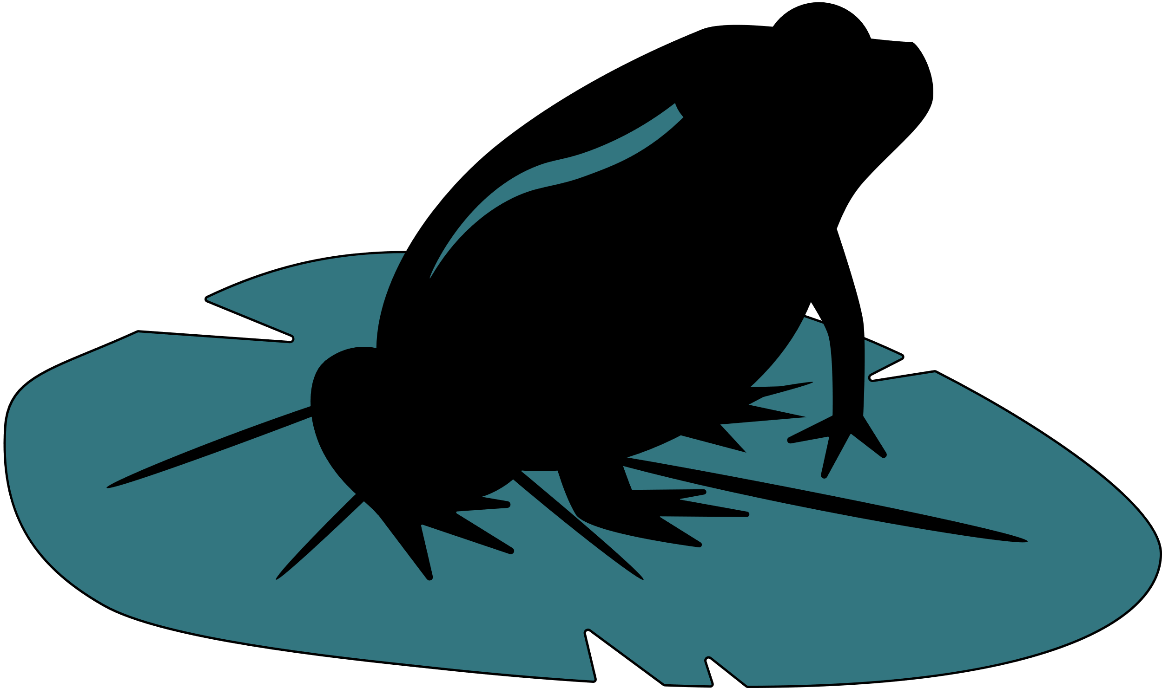
People Are Part of Nature:
RESTORE NATURE & ITS CONTRIBUTIONS
TENET 02
Offsets must cover a comprehensive set of species, habitats, and ecosystems, as well as ecosystem services (or nature’s contributions to people, including cultural dimensions).
Notes:
Biodiversity change necessarily impacts innumerable human values associated with that nature.

Slide 22


Timing and Continuity Are Key:
RESTORE BEFORE GIVING CREDIT
TENET 03
Restoration must have already occured before credits are assigned to offset damage.
Notes:
A relationship is distinguished from a set of interactions in part by the timing or sequencing of those interactions. Goodwill and gifts do not connote friendship if the giver is not there for the recipient when needed.

Slide 23




Perspective and Involvement Matter
CO-GOVERN
TENET 04
Offset developers must enable Indigenous Peoples and local communities to participate safely and accessibly in governance of programs. This co-governance should include both the identification and accounting of impacts to ecosystems (and associated services), and the prioritization of programs to address those impacts (the solutions).
Notes:
One person’s rubbish is another’s treasure, and a decision may not advance your agency or interests if someone else made it for you without your involvement.

Slide 24

Treat Others as Ends, Not Means
PREVENT PROFITEERING
TENET 05
Individuals and firms can profit from restoration activities, but there should be no profiteering, where financers speculate on offsets in order to profit from market fluctuations.
Notes:
This primary ethical rule, most famously expressed by Immanuel Kant, explains why many of us immediately categorize relationships as ones of friendship, transaction, or a (difficult) combination of the two.

Slide 25
03
#OFFSETRESET
Notes:
If this were normal, in addition to the usual best-practices, then Offsets would cost enough to serve as a vehicle to trigger real changes in production and consumption to minimize impacts on nature, and the offsets themselves would have considerable positive consequences. That ideal world is not immediately at hand, but we can move towards it, together.

Slide 26

TIMELINE
DRAFT A SCIENTISTS’ DECLARATION
OUTREACH, COLLATE FEEDBACK, & STRATEGIZE
REFINE DECLARATION
WRITE, PUBLISH, & PUBLICIZE ACCOMPANYING ARTICLE
DISSEMINATE & PUBLICIZE DECLARATION
CIVIC CAMPAIGN TO PRESSURE COMPANIES & GOVERNMENTS

Slide 27


GET INVOLVED
CONTRIBUTE!
SCAN HERE
COAUTHOR
1
  HELP WRITE THE PAPER AND DECLARATION
CAMPAIGNER
2
  LEAD SIGNATORY OF DECLARATION
  HELP TARGET CAMPAIGN
  DISSEMINATE DECLARATION AND CAMPAIGN TO SPECIFIC GROUPS/ORGS & BROAD LISTS
3
COLLABORATOR
  SIGN AND SHARE DECLARATION AND CAMPAIGN

Slide 28
04
COSPHERE

Slide 29

INTEGRATING
COSPHERE
Community of Small-Planet Heroes
Systems science with real-world solutions.
EQUIPPING
People with knowledge and tools to orient their actions toward transformative change for sustainability.
BUILDING
A platform and community to enable action.
WWW.COSPHERE.NET

Slide 30
OUR PLEDGE
“I AM PLEDGING TO FOSTER DEEP SYSTEM CHANGE TOWARDS A SUSTAINABLE FUTURE”
132 nations agreed that deep-reaching ‘transformative’ change is needed to address our global social and ecological crises—but their actions are still insufficient. Enough is enough!
This challenge is bigger than any of us. We need to unite in a coalition for a better world for us and future generations.

Slide 31

















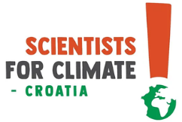

OUR MEMBERS

Slide 32
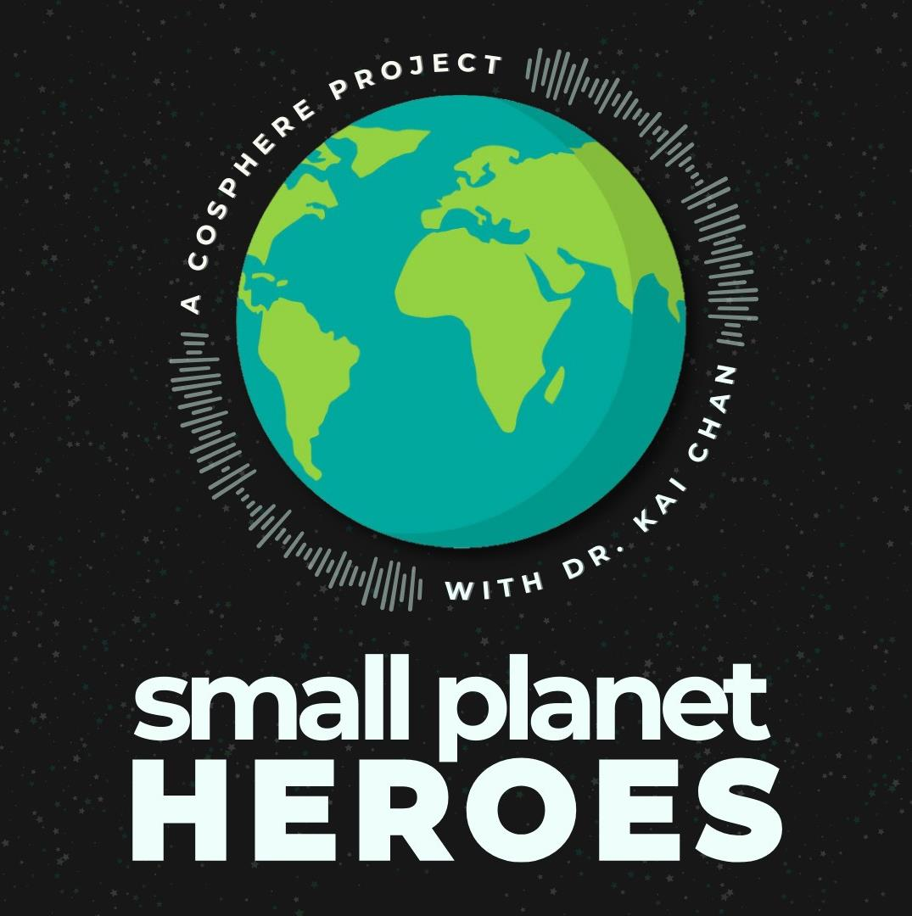
OUR PODCAST
SMALL PLANET HEROES

Slide 33
LEARNING
INSPIRING
CONVENING
BEYOND COMMUNICATION
RAISING THE BAR
UNLEASHING VALUES
BUILDING COMMUNITIES

Slide 34
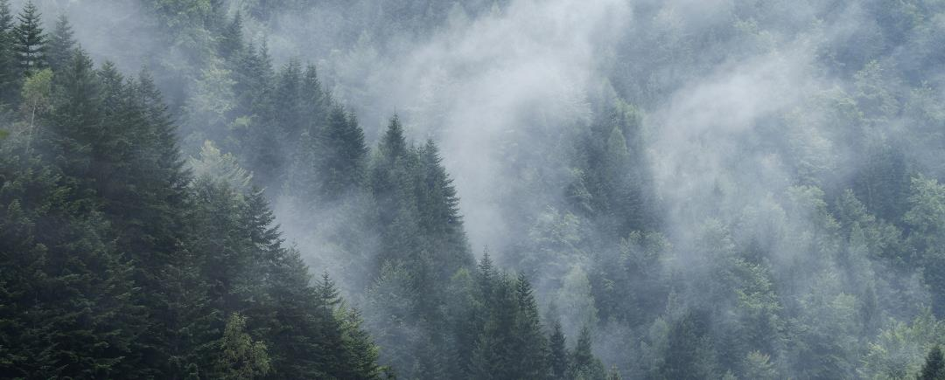
FORWARD
JOIN
ENGAGE
SUPPORT
INVITE OTHERS
THE COSPHERE COALITION!
WITH OUR INITIATIVES #UnleashValues
#OffsetReset
#SmallPlanetHeroes (podcast)
#LetDeathBegetLife
THROUGH DONATIONS- ANYTHING HELPS!
TO DO THE SAME!

Slide 35





COSPHERE.NET
  CREATE AN ACCOUNT AT
WWW.COSPHERE.NET
CONNECT WITH US @COSPHEREPROJECT
CONTACT US
CONTACT@COSPHERE.NET
CONTACT@COSPHERE.NET

Slide 36





SUMMARY
BEYOND ENERGY
AGENTS OF CHANGE
COSPHERE
COMMUNITY
TRANSITIONS ARE NOT ENOUGH—DEEP CHANGE IS NEEDED
IT’S UP TO US TO EFFECT TRANSFORMATIVE CHANGE
JOIN OUR COMMUNITY OF SMALL-PLANET HEROES!
HELP US CREATE COMMUNITIES TO CHANGE SYSTEMS

Slide 37
ACKNOWLEDGEMENTS
CHANS Lab
CoSphere team
HANAA PUNJA, BROOKE SUTHERLAND, CLAIRE ARMSTRONG, LAUREN MOODY, CLARE PRICE, MAIA O’DONNELL, DAN FORREST, VYSHU MANOHARA, KATIE KATHIRESAN, JOSH DYER, ANAHITA SERAJI, NANCY KANG, ERIC LEE, MARÍA LUNA SANTACRUZ, FELIX LANDRY YUAN, WILLOW VOLKERT & MORE

Slide 38
REFERENCES
Chan, K. M. A., P. Balvanera, K. Benessaiah, et al. (2016). "Why protect nature? Rethinking values and the environment." PNAS 113(6): 1462–1465. http://www.pnas.org/content/113/6/1462.full
Chan, K.M.A., J. Agard, J. Liu, A.P.D.d. Aguiar, et al. (2019). Pathways towards a sustainable future. Global assessment report of the Intergovernmental Science-Policy Platform on Biodiversity and Ecosystem Services. E.S. Brondízio, J. Settele, S. Díaz and H. Ngo. Bonn, Germany, IPBES. https://doi.org/10.5281/zenodo.3832100
Chan, K.M.A., D.R. Boyd, R.K. Gould, et al. (2020). “Levers and leverage points for pathways to sustainability.” People and Nature 2(3): 693-717. https://doi.org/10.1002/pan3.10124
Eyster, H.N., T. Satterfield and K.M.A. Chan (2022). "Why people do what they do: An interdisciplinary synthesis of human action theories." Annual Review of Environment and Resources 47(1): 725–751. https://doi.org/10.1146/annurev-environ-020422-125351
Eyster, H. N., P. Olmsted, R. Naidoo and K. M. A. Chan (2022). "Motivating conservation even for widespread species using genetic uniqueness and relational values." Biological Conservation 266: 109438. https://doi.org/10.1016/j.biocon.2021.109438
Eyster, H.N., T. Satterfield and K.M.A. Chan (2023). "Empirical examples demonstrate how relational thinking might enrich science and practice." People and Nature 5(2): 455-469. https://doi.org/10.1002/pan3.10453
IPBES (2019). Summary for policymakers of the global assessment report on biodiversity and ecosystem services of the Intergovernmental Science-Policy Platform on Biodiversity and Ecosystem Services. S. Díaz, J. Settele, E. Brondízio et al. Bonn, Germany, IPBES Secretariat. https://doi.org/10.5281/zenodo.3553579
Klain, S. C., P. Olmsted, K. M. A. Chan and T. Satterfield (2017). "Relational values resonate broadly and differently than intrinsic or instrumental values, or the New Ecological Paradigm." PLOS ONE 12(8): e0183962. https://doi.org/10.1371/journal.pone.0183962
Naito, R., J. Zhao and K.M.A. Chan (2022). "An integrative framework for transformative social change: a case in global wildlife trade." Sustainability Science 17: 171–189. https://doi.org/10.1007/s11625-021-01081-z

