Slide 1
Unlocking Private Sector Innovation and Finance for Nature-based Solutions
Dr. Gregg Brill
Associate Director, Accounting for Nature
Pacific Institute
JPAC Public Forum Building Sustainable Economies: Circular Models and Nature-based Solutions for a Resilient North America | July 2025

Slide 2
Context
Watersheds globally are in peril
Nature-based solutions (NBS) protect, manage, and restore watersheds providing multiple benefits
NBS also support climate mitigation and adaptation efforts and reduce the impacts of extreme events – multiple co-benefits
NBS can also be a driver for social change

Slide 3
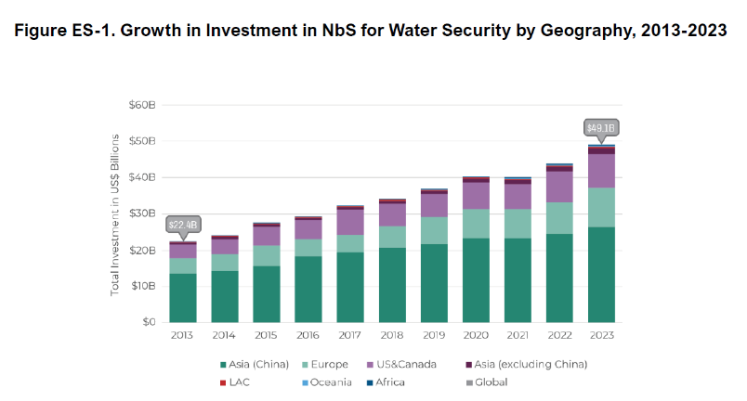
Context
Current NbS investment: <0.1% of global climate finance flows
Private sector is underutilized but increasingly critical in scaling investment and innovation.
Source: Doubling Down on Nature: State of Investment in Nature-based Solutions for Water Security.(2025). Forest Trends and The Nature Conservancy
Notes:
Total investment doubled over the past decade, reaching USD 49 billion in 2023 across more than 880 initiatives.
China, the U.S., and the EU dominate the landscape, accounting for 94% of total investment. China alone contributed USD 26.4B (54%). Outside the “Big Three,” investment is growing even faster, especially in Africa and Oceania. Every geographic region experienced investment growth, ranging from growth rates of 2x to 5x.
The most commonly supported ecosystems include forests and riparian zones, while grasslands, shrublands, and wetlands are region-specific.

Slide 4
Role and Potential of the Private Sector
CURRENT ROLE
Growing demand from ESG, SBTi, TNFD, CSRD frameworks Companies engaging through value chain resilience, water stewardship, and carbon markets
POTENTIAL
Catalytic capital to de-risk public or blended finance Technology and data to improve NbS monitoring and outcomes Supply chain integration - investing in regenerative agriculture, sustainable forestry, etc.

Slide 5
Private Sector Challenges
Technical
Lack of expertise in designing and implementing NBS
Uncertainty regarding intended outcomes of NBS
Difficulty in assigning economic values
Lack of a standardized approach to identify and account for NBS benefits
Financial
Inadequate financial resources and under-investment
Bankability and replicability of NBS projects or activities
Governance
Inappropriate/inadequate policy and governance frameworks
Path dependency
Institutional fragmentation or conflicting mandates
Limited land and time availability
Notes:
The Accounting for Nature Program emerged as the private sector has increasingly sought to incorporate NBS into operations and their portfolio of investments to address their immediate operational risks and in part to help support social and environmental challenges in the basins where they operate or have critical supply-chain elements.
As the program has grown, additional stakeholders from other sectors investing in or developing NBS have been incorporated into the scope.
2. Interviews with individuals from the public and private sectors, NGOs, civil society groups, academic institutions, and development banks between 2020 and mid-2024 point to ten limitations to NBS scaling and mainstreaming. These challenges and barriers span three broad areas: technical, financial, and governance.
Previous stages of work under this impact area have explored these limitations and opportunities in mainstreaming and upscaling NBS. To date, the Pacific Institute has supported organizations in building the business case for NBS, focusing primarily on the challenge of a lack of a standardized approach to identify and account for the benefits accrued from investments in NBS (technical challenge 4). Initial assessments, methodology development, and guidance have started to meet the needs of the key audiences by developing a standardized benefit accounting framework that supports investors and practitioners in identifying, accounting for, and valuing the benefits accrued from NBS projects. These outputs, developed by multiple partners over several stages of work, have been adopted by multiple companies and other partners, and have been used in various stages of their NBS journey.

Slide 6





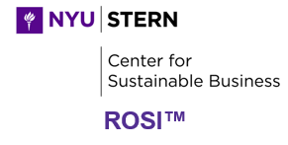




Valuation Tools for Stacked Benefits
Tools quantify multiple benefits: carbon sequestration, water regulation, biodiversity gains, livelihoods
Build the business case by converting intangibles into monetized value or risk mitigation.

Slide 7
Effective Finance Models and Partnerships
Blended finance: Public and private capital (e.g., Green Climate Fund co-financing NbS)
Pay-for-performance models (e.g., water funds, carbon credits)
Collective action platforms: CEO Water Mandate, 1000 Landscapes, WBCSD NbS Incubator
Notes:
Key: De-risk early-stage investment and align incentives across stakeholders.

Slide 8
Call to Action
Mobilize private capital through:
  Clear valuation of benefits
  Scalable finance models
  Transparent outcome reporting
Promote multi-stakeholder partnerships to build trust and scale
Notes:
Key: De-risk early-stage investment and align incentives across stakeholders.

Slide 9
Thank you!
Dr. Gregg Brill | Associate Director, Accounting for Nature
GBrill@pacinst.org
www.pacinst.org
www.NBSBenefitsExplorer.net

