Slide 1
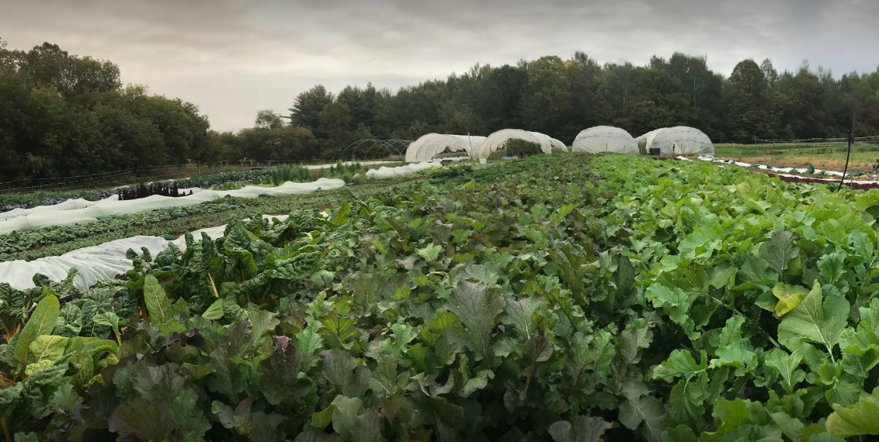


SPARK SOURCE CONSULTING
Reg
energy
Renewable Energy for Sustainable Agriculture

Slide 2

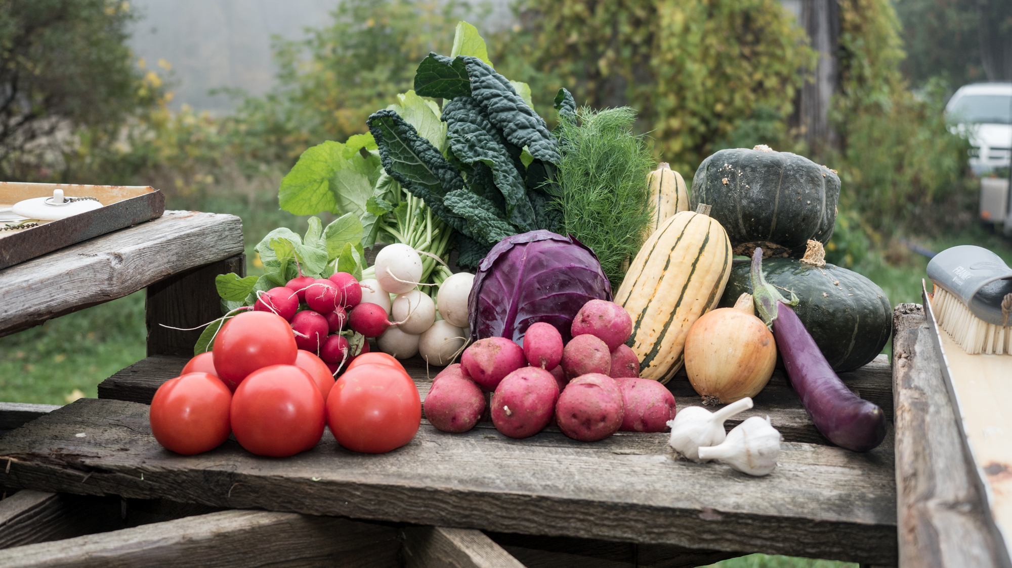
SPARK SOURCE CONSULTING
About Us

Slide 3
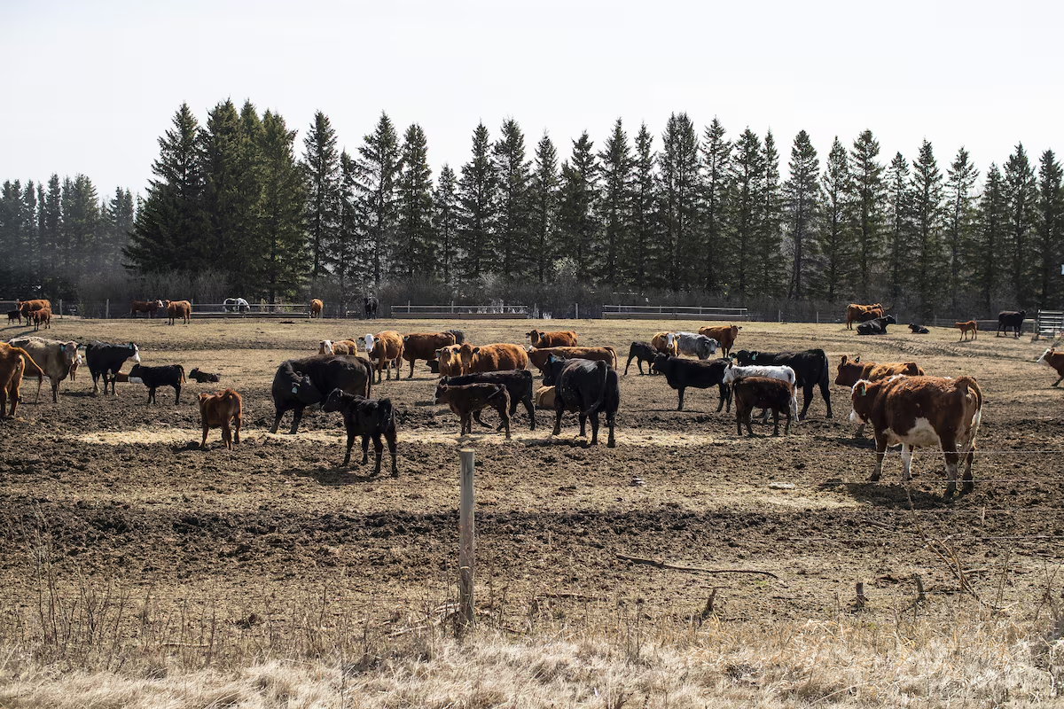
SPARK SOURCE CONSULTING
Farmers are struggling
26% DROP
IN REALIZED NET INCOME FOR FARMS IN 2024
350%
INCREASE IN ANNUAL FEDERAL GOVERNMENT SPENDING ON CROP INSURANCE SINCE 2020
1 IN 2
FARMERS RELY ON OFF-FARM WORK TO SUPPORT THEMSELVES
66%
OF CANADIAN FARMLAND EXPERIENCING DROUGHT CONDITIONS
Notes:
Realized net income fell in every province in 2024, excluding Prince Edward Island and Nova Scotia. Saskatchewan posted the largest decline (-$1.3 billion), mainly due to lower crop revenues.
62% of Canada is currently classified as either “Abnormally Dry” or facing Moderate to Extreme Drought.
This spans 66% of all agricultural land, indicating a significant impact on farming regions .

Slide 4
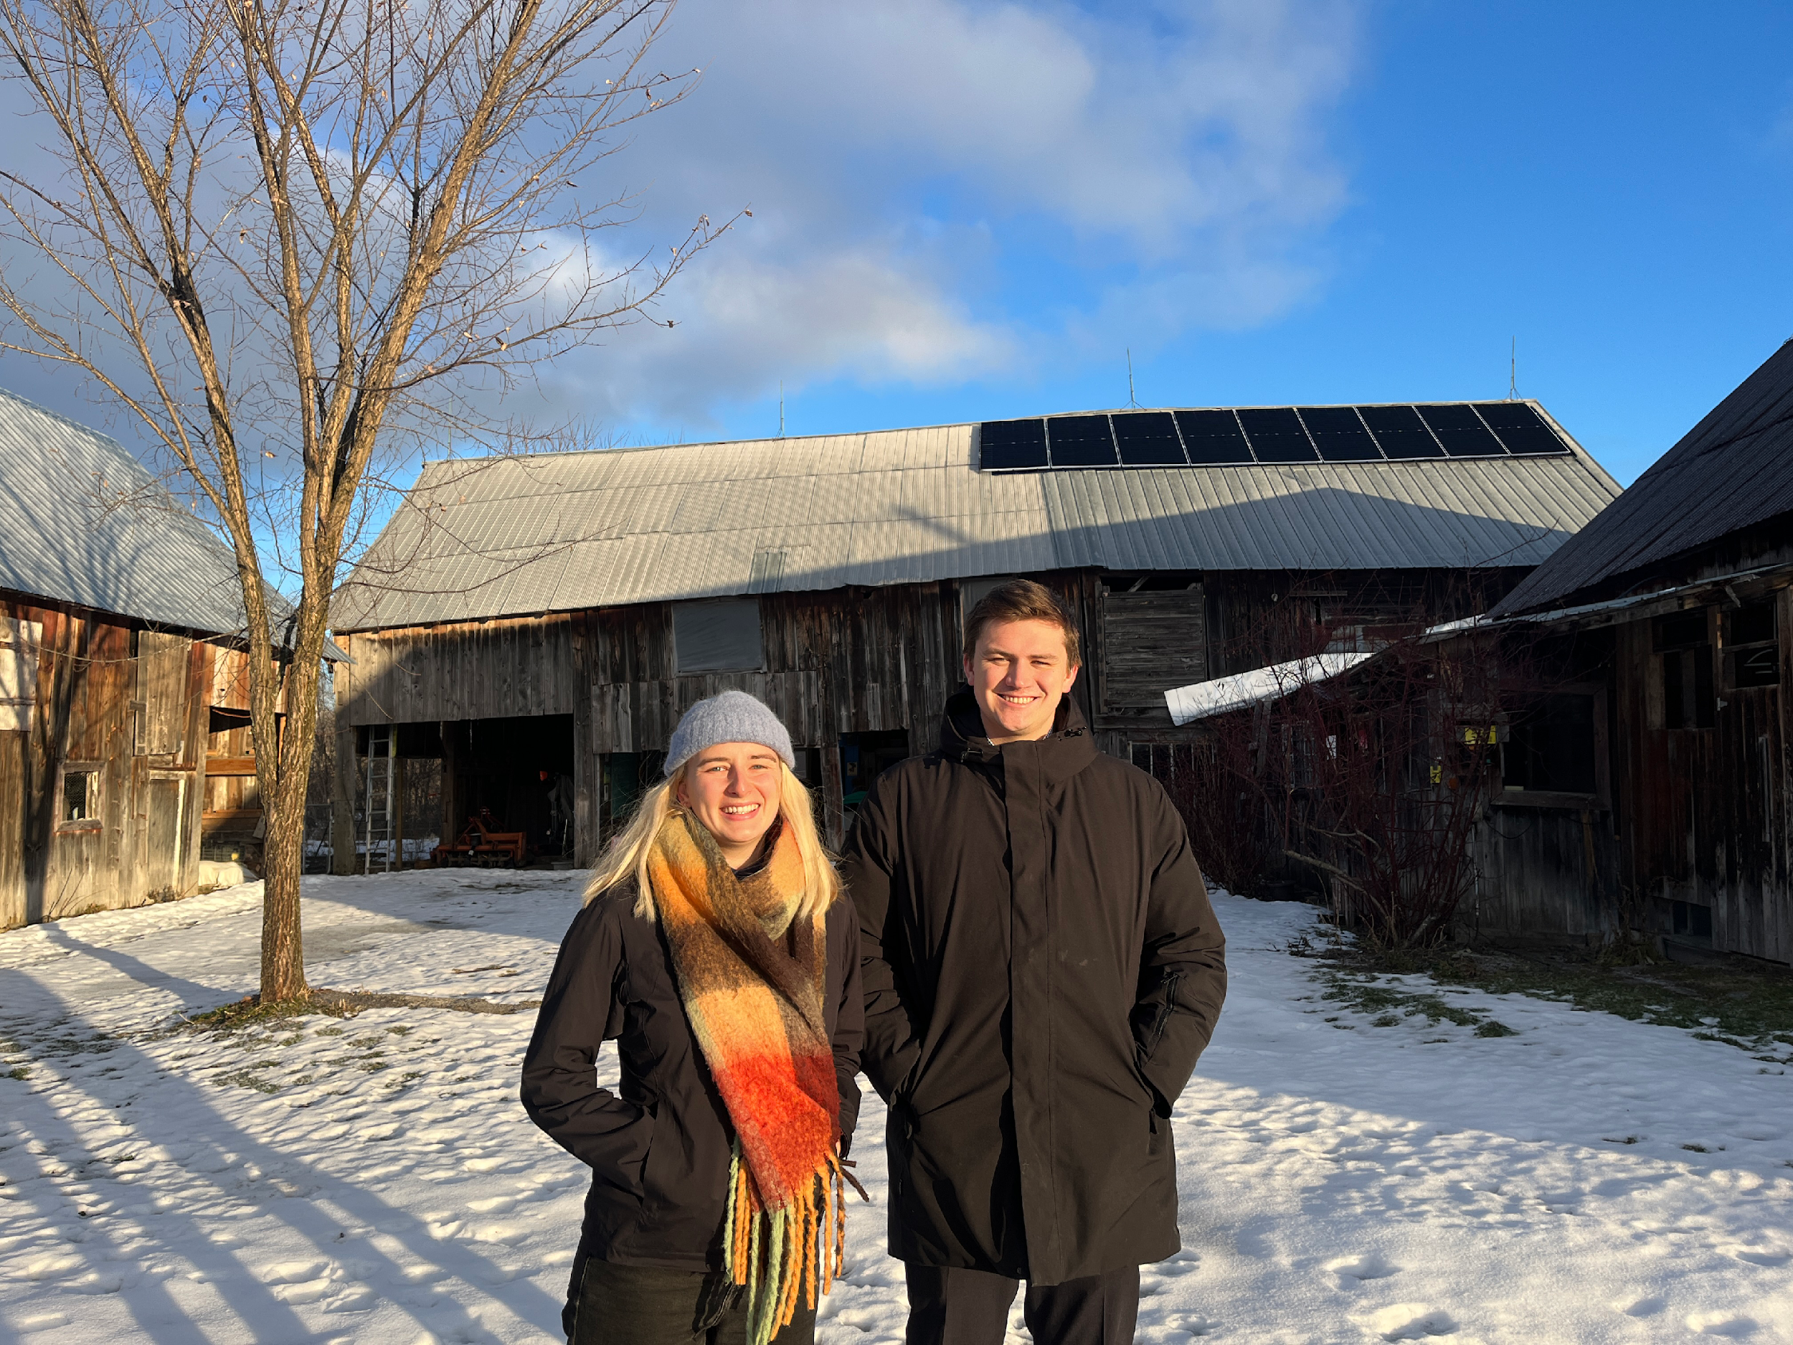
SPARK SOURCE CONSULTING
For every $1 invested in solar on this farm, they received $1.18 back
Solar energy reduces
farming costs and CO² emissions
Notes:
Over its 25-year life, a 5 kW system in Ontario would be carbon-negative, offsetting its own embedded emissions in 5–10 years, then delivering ~2–4 tonnes CO₂e net reduction over the remaining decades.

Slide 5
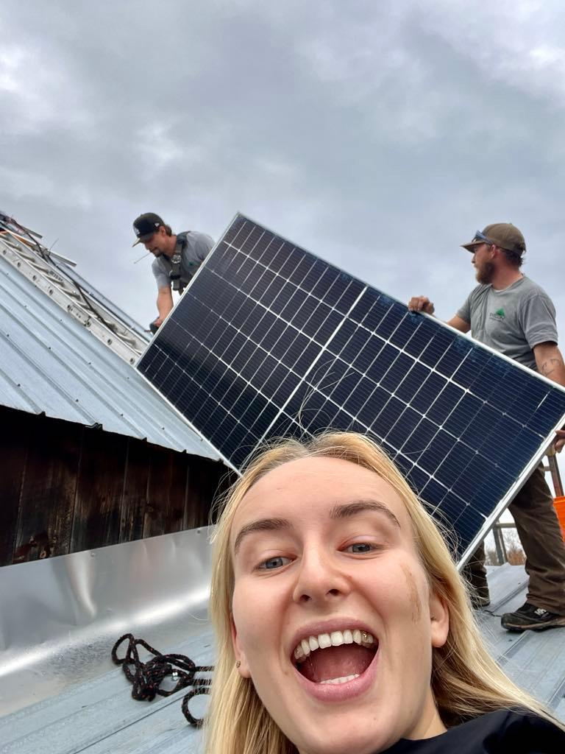
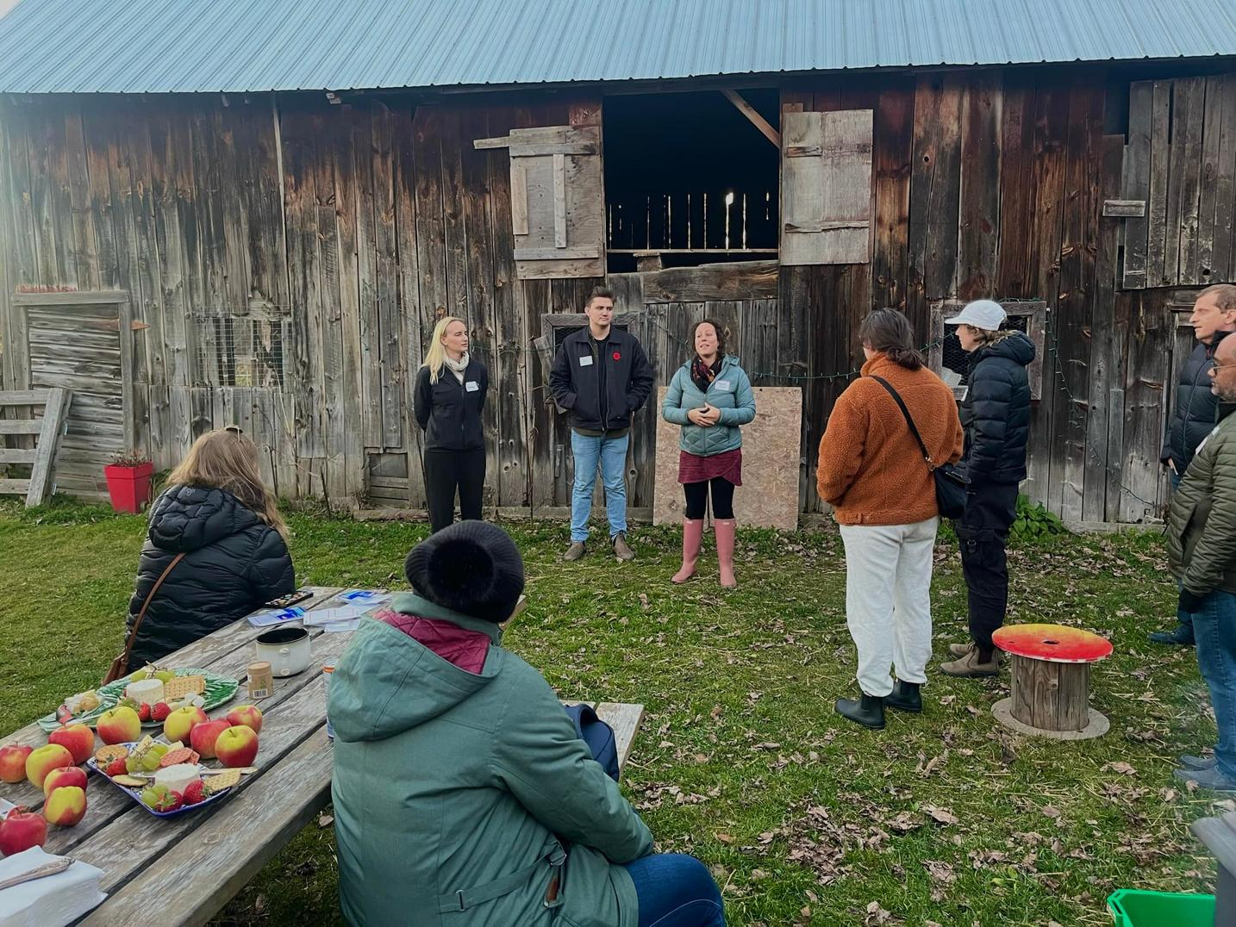
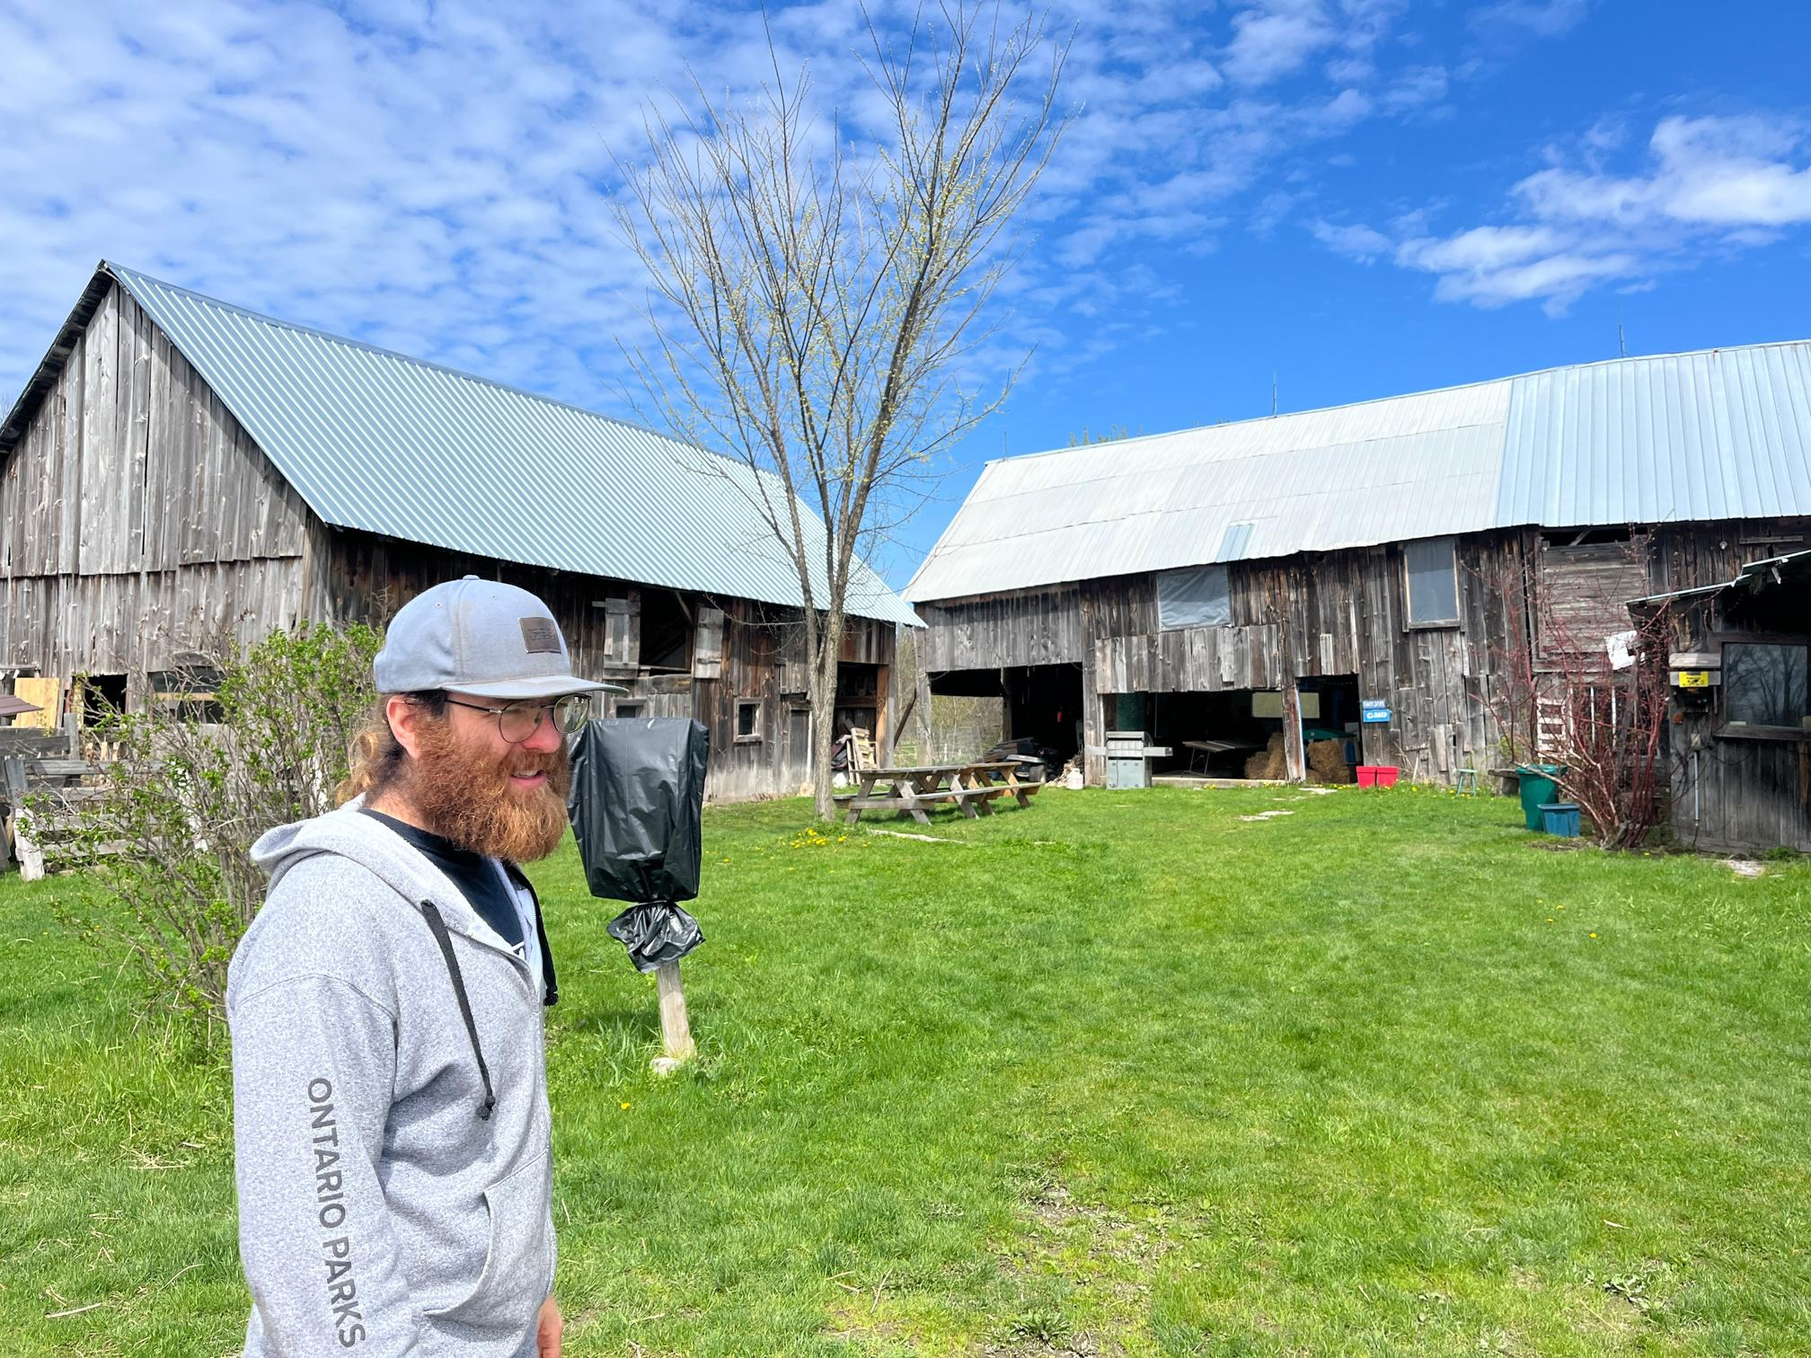
SPARK SOURCE CONSULTING
Our Solution
  Farmers are already feeling climate change, they deserve tools to adapt.
  We fight climate change and support the little guy at the same time.
  We provide educational resources and toolkits to assist in solar adoption.
Notes:
Power Regenerative Farms: Deliver solar energy solutions to local regenerative farms, lowering energy costs and GHG emissions.
Empower Farmers: Engage directly with farmers to showcase the value and practicality of solar—making clean energy accessible and actionable.
Educate & Equip: Create and share practical, farmer-friendly educational resources that simplify solar adoption.
Foster Peer Learning: Support farmer-to-farmer knowledge sharing to accelerate the shift to solar-powered agriculture.

Slide 6

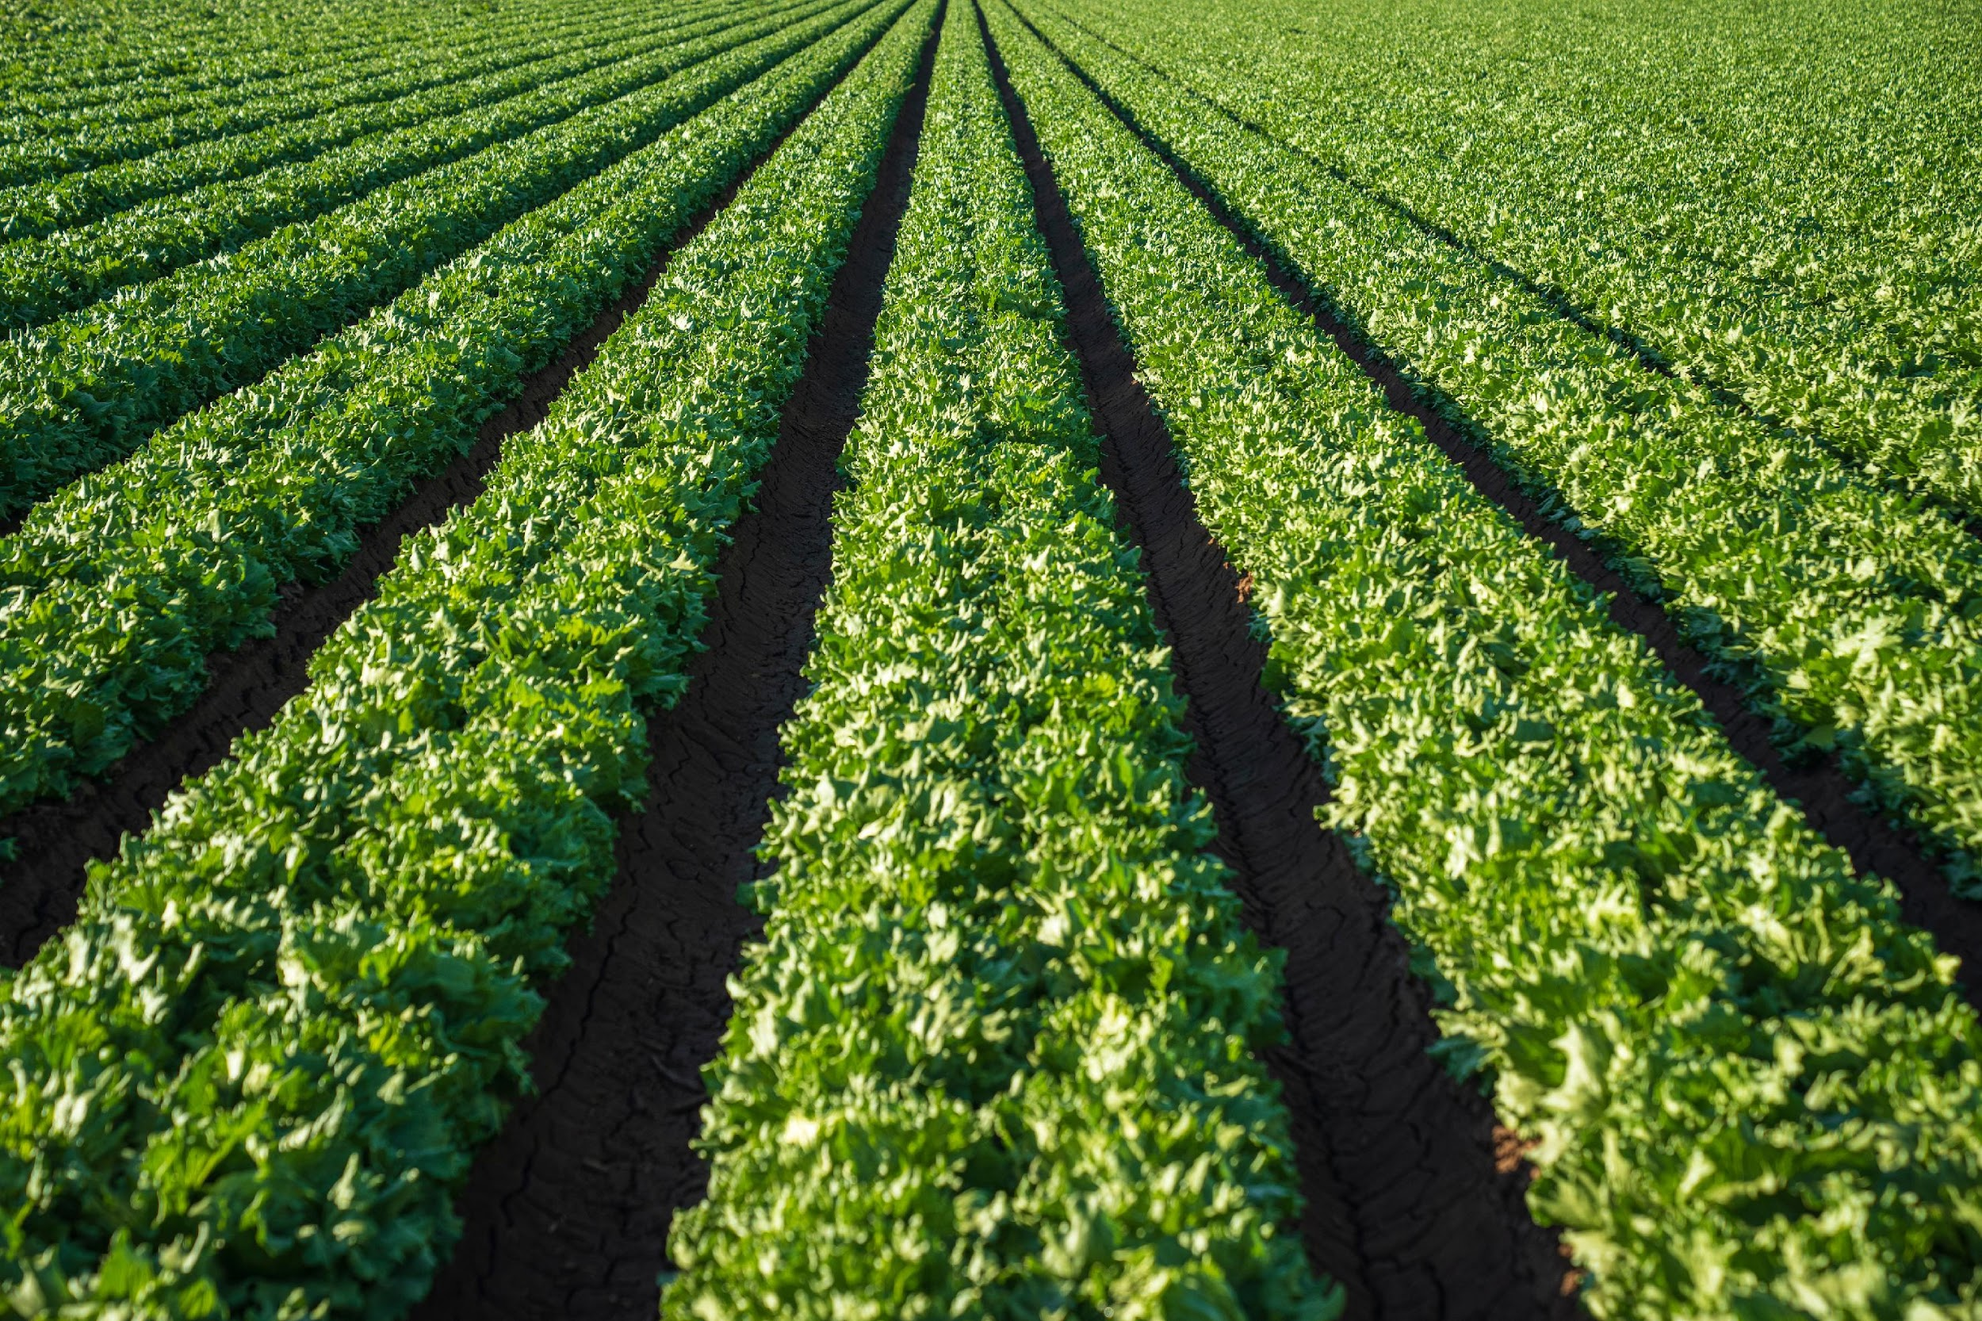
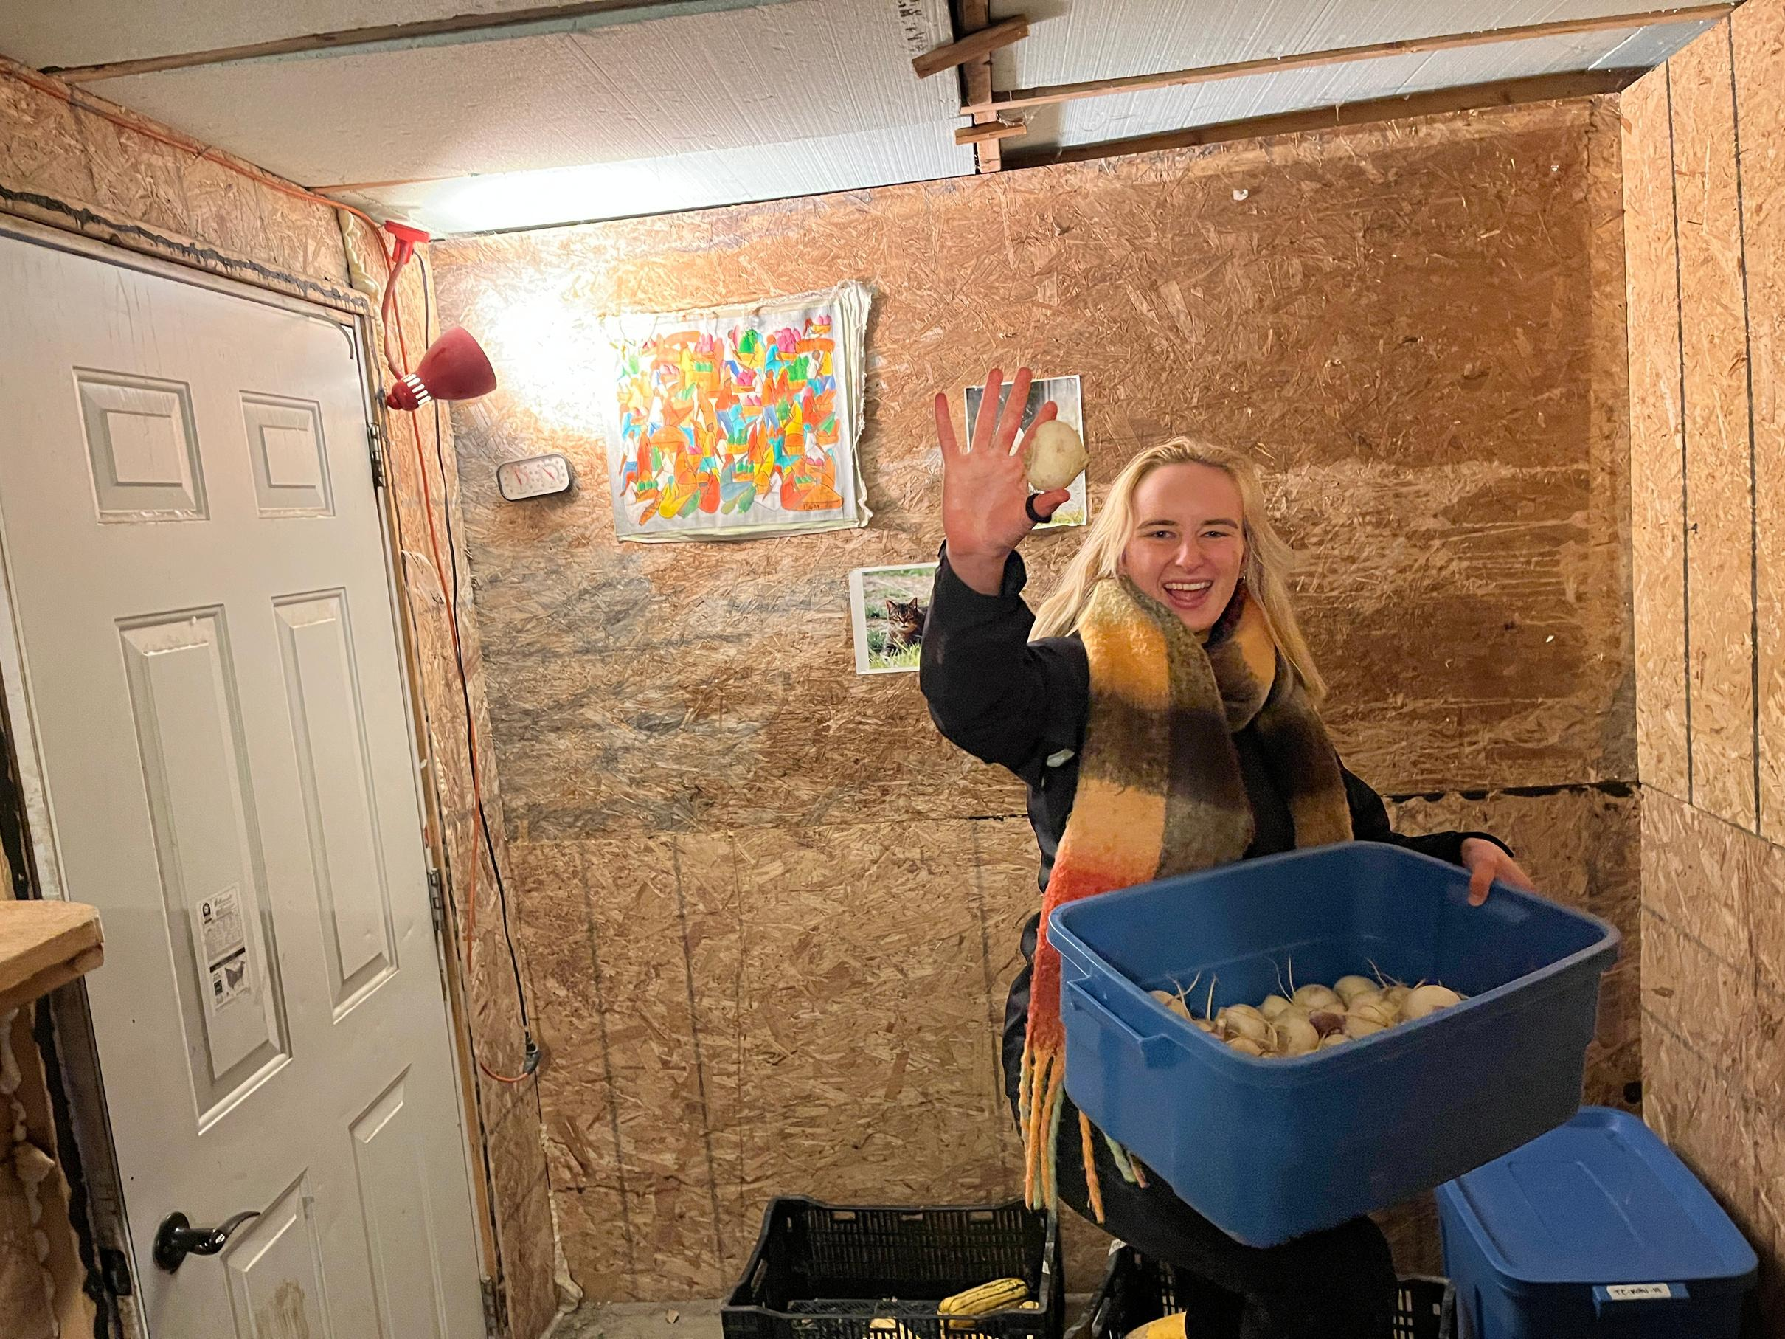
SPARK SOURCE CONSULTING
Thank
You
Join us in powering the people who grow our food.
BENEATHTHEBERG.CA
VINOGRADOVA.SONIA@GMAIL.COM

