Slide 1
^{SEM Process}
^{under CUSMA/USMCA}

Slide 2


A renewed trilateral commitment under the CUSMA and ECA
1994: Established under the North American Agreement on Environmental Cooperation (NAAEC)
2020: Renewed commitment under the Agreement on Environmental Cooperation and CUSMA/USMCA

Slide 3

Mission
Facilitate cooperation and community participation for the conservation, protection and enhancement of the North American environment
Support sustainable development in benefit of present and future generations

Slide 4
Environment Committee CUSMA/USMCA Chapter 24
The CEC

Slide 5

NAFTA and NAAEC
ECA and CUSMA/USMCA Chapter 24
NAFTA was silent on environmental issues
NAAEC made a commitment to effectively enforce environmental laws
NAAEC creates the Commission for Environmental Cooperation
CEC implements the SEM Process
ECA negotiated in parallel with CUSMA
Both agreements entered into force simultaneously
ECA replaces the NAAEC
Continuity of the CEC as originally established in NAAEC
The SEM process integrated into CUSMA Chapter 24

Slide 6

CUSMA Chapter 24
Creates the Environment Committee
CEC operational provisions are now in the ECA
All SEM-related provisions are now in CUSMA Chapter 24
Active submissions at the time
of the entry into force of CUSMA are being processed according
to NAAEC
www.cec.org/atlas

Slide 7

Submissions on Enforcement Matters process
Article 24.27(1) Any person of a Party may file a submission asserting that a Party is failing to effectively enforce its environmental laws.
Note: “environmental law” is defined in Article 24.1 and there are specific definitions for each country
Articles 24.27(2) and (3) contain requirements for submissions and criteria for the Secretariat’s review process
Article 24.27(4) describes the government response
Notes:
Article 24.27(2)
The CEC Secretariat may consider a submission under this Article if it finds that the submission:
is in writing in English, French, or Spanish;
clearly identifies the person making the submission;
provides sufficient information to allow for the review of the submission including any documentary evidence on which the submission may be based and identification of the environmental law of which the failure to enforce is asserted;
appears to be aimed at promoting enforcement rather than at harassing industry; and
indicates whether the matter has been communicated in writing to the relevant authorities of the Party and the Party’s response, if any.
Article 24.27(3)
If the CEC Secretariat determines that a submission meets the criteria set out in paragraph 2, it shall determine within 30 days of receipt of the submission whether the submission merits requesting a response from the Party. In deciding whether to request a response, the CEC Secretariat shall be guided by whether:
a) the submission alleges harm to the person making the submission;
b) the submission, alone or in combination with other submissions, raises matters about which further study would advance the goals of this Chapter;
c) private remedies available under the Party’s law have been pursued; and
d) the submission is not drawn exclusively from mass media reports.

Slide 8
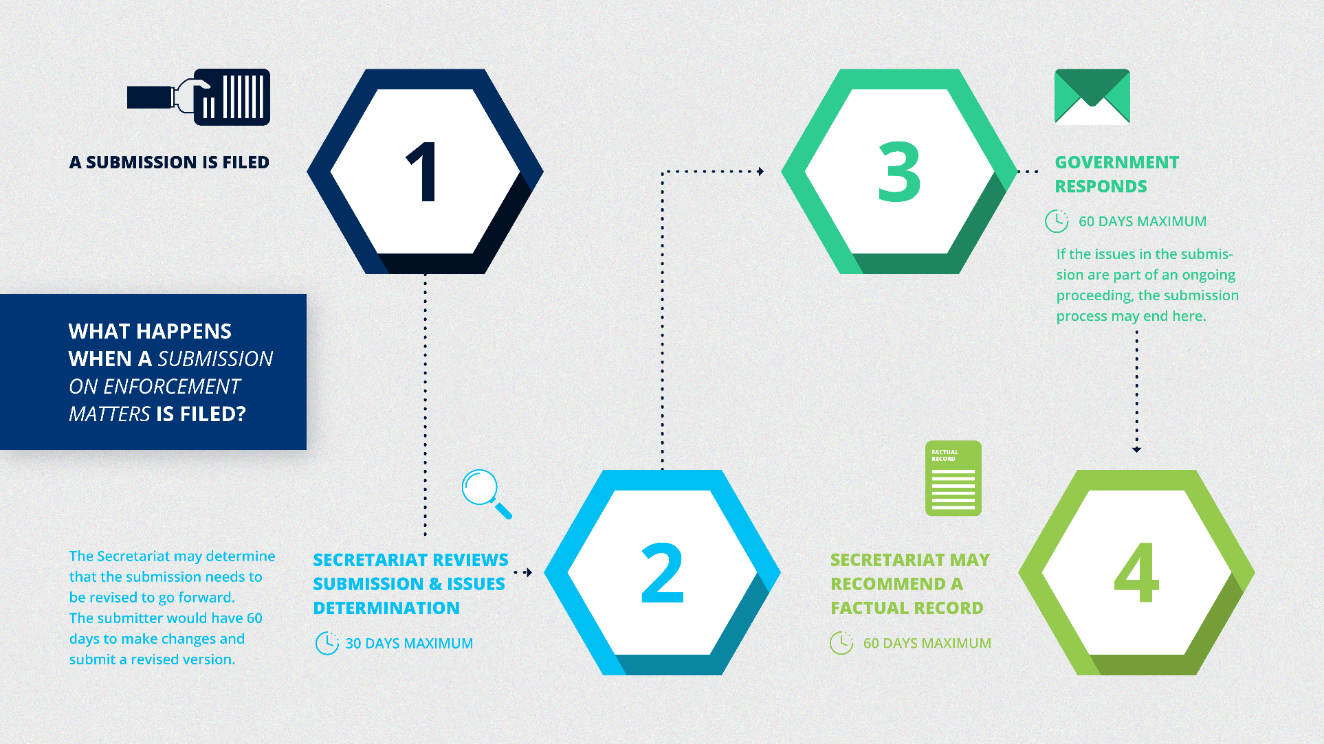

Slide 9

Article 24.28 Factual Record
Following the Party response, the Secretariat determines whether to recommend preparation of a factual record
The Council votes on whether
to authorize the Secretariat to develop a factual record
Notes:
The CEC Secretariat shall prepare a factual record if at least two members of the Council instruct it to do so.
The CEC Secretariat shall submit a draft factual record to the Council within 120 days of the Council’s instruction to prepare a factual record. 30 days for comments from the parties and then Secretariat submits the final factual record to the parties.
The CEC Secretariat shall make the final factual record publicly available, normally within 30 days following its submission, unless at least two members of the Council instruct it not to do so.

Slide 10
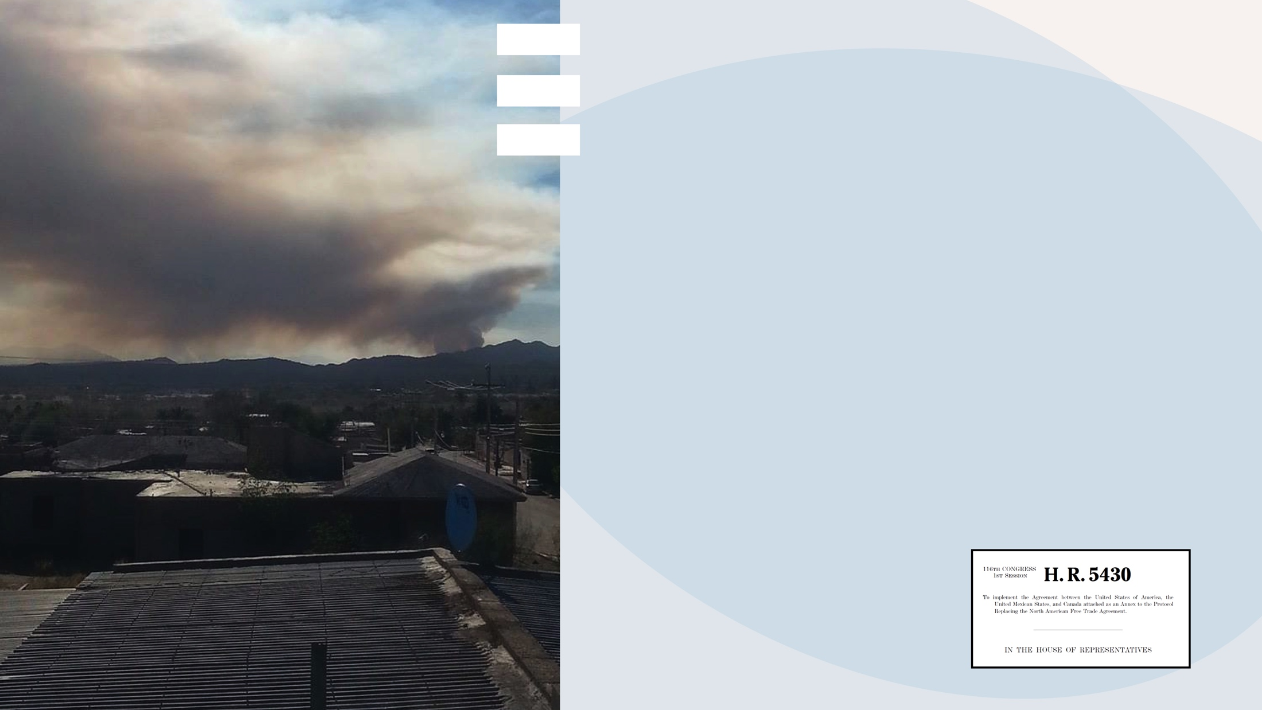
Follow up to Factual Records
Within the framework of CUSMA:
Environment Committee can recommend that the CEC Council develop cooperative activities
The Parties will provide updates to the Council and Environment Committee on closed Factual Records
In the United States: Review process under the USMCA Implementing Legislation
Notes:
Review of CEC Secretariat Submissions.
(1) In general.--Not later than 30 days after the date on which the Secretariat of the Commission for Environmental Cooperation prepares a factual record under article 24.28 of the USMCA relating to a submission filed under article 24.27 of the USMCA with respect to a USMCA country, the Interagency Environment Committee--
(A) shall review the factual record; and
(B) may, based on findings of the review under subparagraph (A) that the USMCA country is not in compliance with its environmental obligations, request enforcement actions under section 814 with respect to the USMCA country.

Slide 11
Number of submissions
Total: 100
24 Factual Records:
MEX (14), CAN (8), US (2)

Slide 12
Active Submissions
Metrobús Reforma Factual Record in preparation
City Park Project Council vote pending
Hydraulic Fracturing Council vote pending
in Nuevo León
Loggerhead Turtle Awaiting Mexico’s response
Fairview Terminal Awaiting Canada’s response

Slide 13
Who may file a submission?
Under CUSMA Article 24.27(1), “Any person of a Party may file a submission asserting that a Party is failing to effectively enforce its environmental laws.”
CUSMA Article 1.5: a “person of a Party means a national of a Party or an enterprise of a Party;”

Slide 14
What is a “environmental law” under the CUSMA?
Article 24.1: “environmental law means a statute or regulation of a Party, or provision thereof…the primary purpose of which is the protection of the environment….”
  There are definitions of “statute or regulation” for each country.
  For example: “(a) for Canada, an Act of the Parliament of Canada or regulation made under an Act of the Parliament of Canada that is enforceable by action of the central level of government”

Slide 15
How much information should a submission include?
One of requirements for submissions in Article 24.27(2) is:
  “(b) provides sufficient information to allow for the review of the submission, including any documentary evidence on which the submission may be based and identification of the environmental law of which the failure to enforce is asserted”

Slide 16
Have the relevant authorities been notified?
Another requirement in Article 24.27(2) is:
  “(e) indicates whether the matter has been communicated in writing to the relevant authorities of the Party and the Party’s response, if any”.

Slide 17
Has a private remedy been tried?
Article 24.27(3) provides four criteria to guide the Secretariat’s review process, including: “(c) private remedies available under the Party’s law have been pursued”.
This can be met by filing a complaint or referencing a complaint filed by another person, organization, or entity.
  This criterion is evaluated according to a standard of reasonableness, keeping in mind that in some cases barriers exist to pursuing such remedies.

Slide 18



QUESTIONS?

