Slide 1

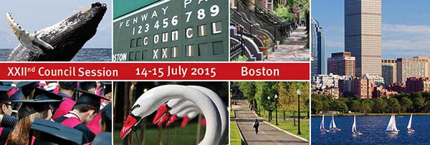


Water and Climate Change: Adaptation through Green Infrastructure
Meeting LA’s Water Challenges in a Water-Scarce Future

Slide 2
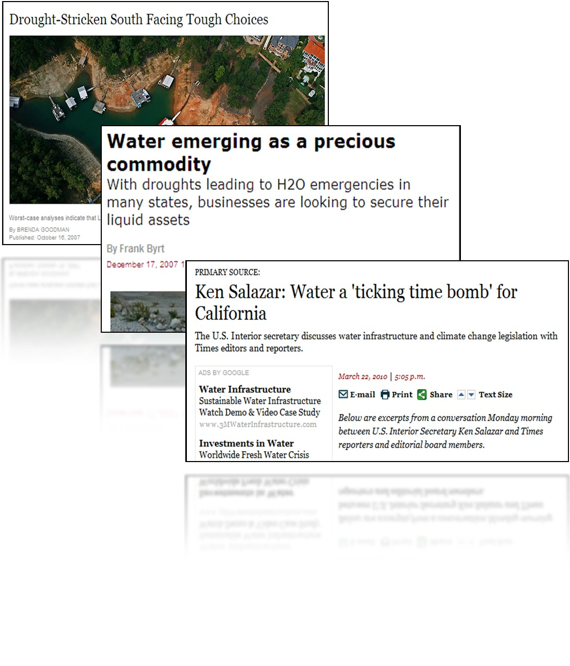
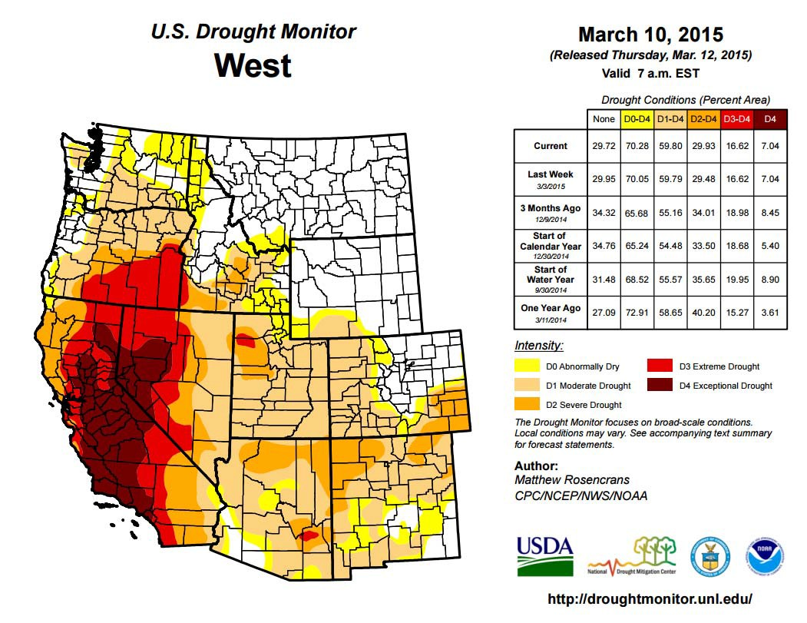
Record drought in the West

Slide 3
Water shortages will be more widespread

Slide 4
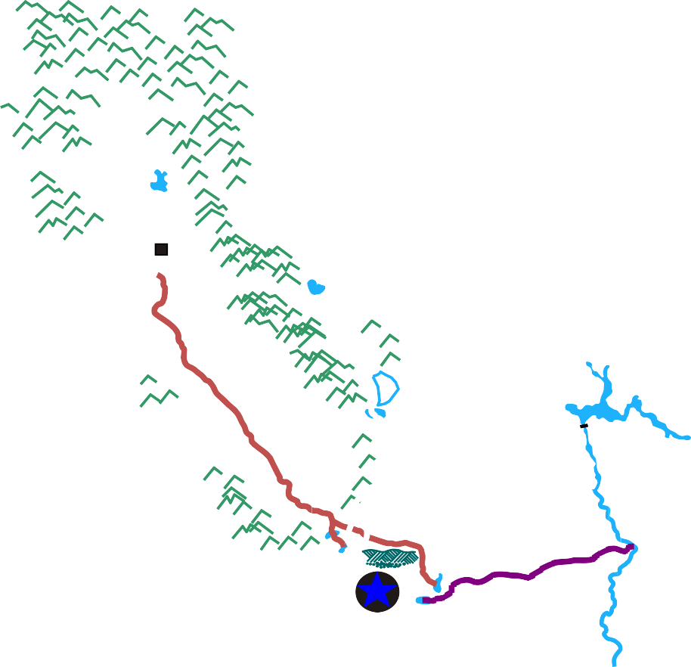
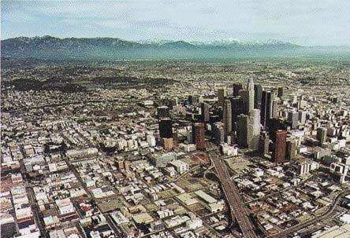

LA’s Water Challenges
 Drought
 Increasing population
 Aging infrastructure
 More stringent regulations
 Limited funding
 Dependence on imported water
 Climate Change
90% of L.A. water supplies impacted by climate change, environmental and legal issues
Lake Oroville
Sacramento
Mono Lake
Hoover Dam
7/13/01
Los Angeles
San Diego

Slide 5
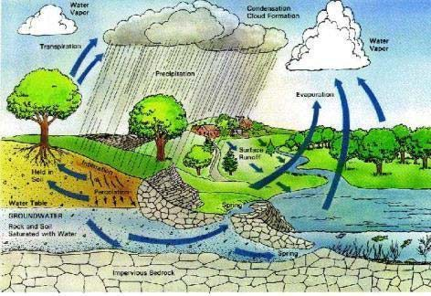







The Solution
A Sustainable Approach:
Manage all water as One Water:
 Drinking Water
 Rain/Storm Water
 Groundwater
 Recycled Water
 Wastewater
 Conservation

Slide 6
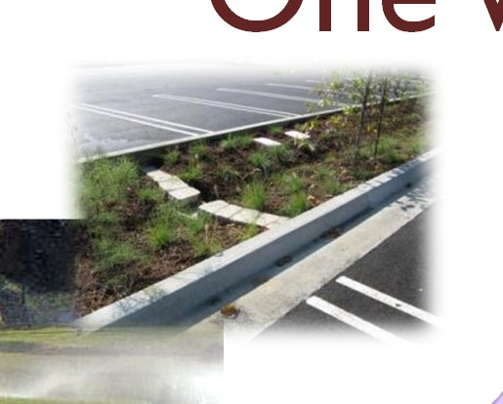


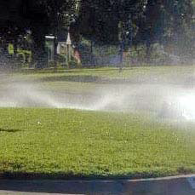

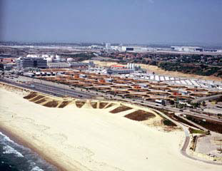
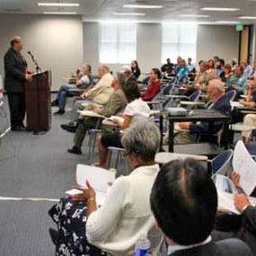
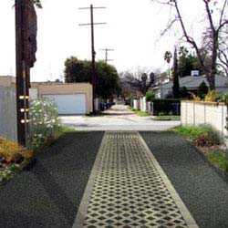


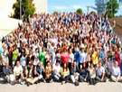
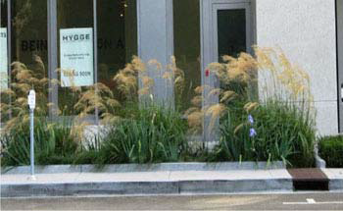
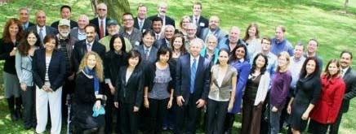
One Water LA Plan
Integration
One Water
Inclusion
Innovation

Slide 7
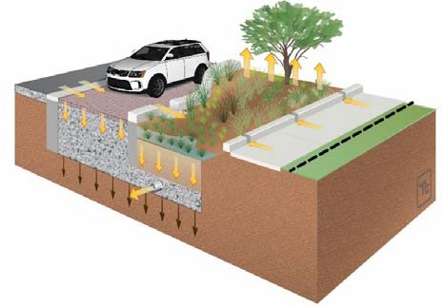
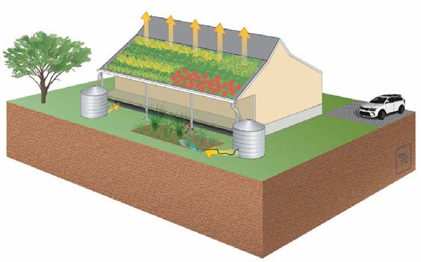
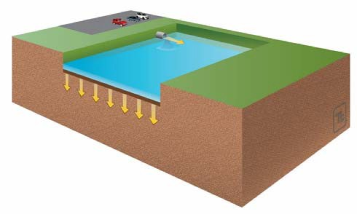
Three Primary Strategies
Capture stormwater, reduce pollutants and
provide multiple benefits including potable water offset
2. Green Streets
1. Low Impact Development
3. Regional
BMPs

Slide 8
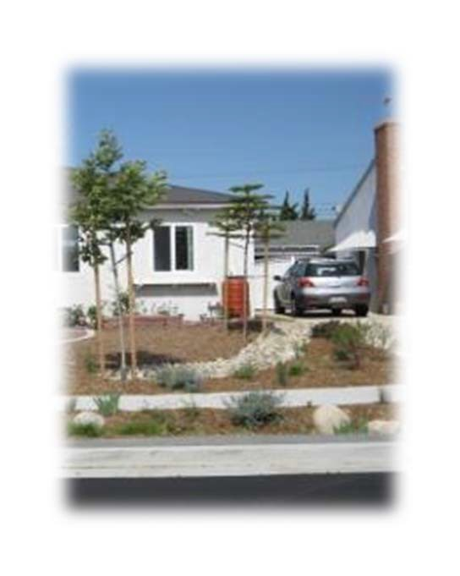
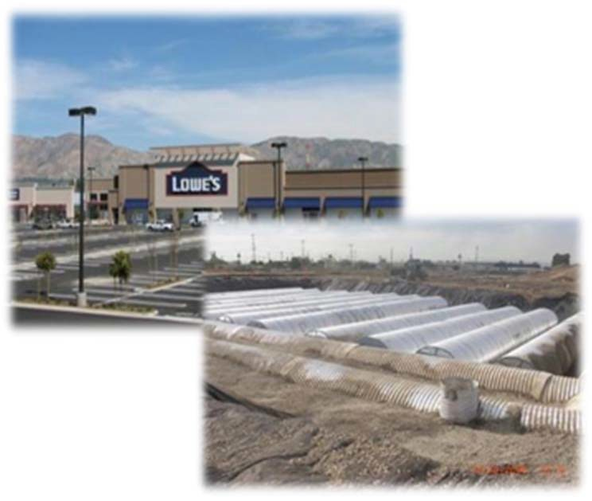
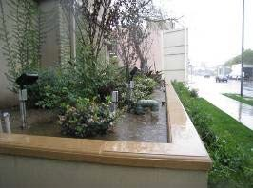
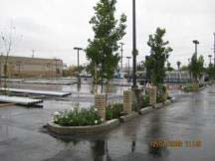
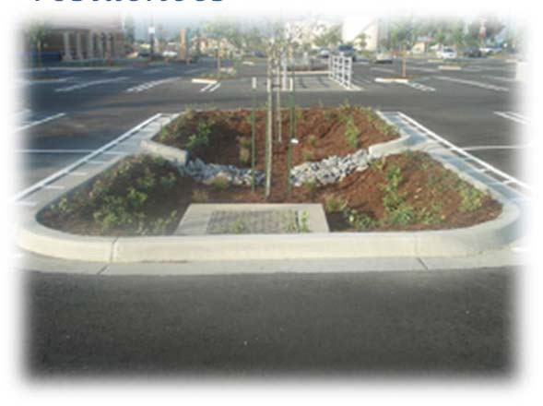
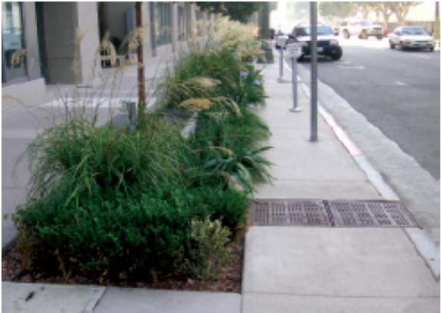
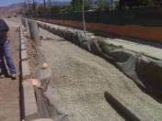
Low Impact Development
Cisterns
- Lowe’s
Planter Boxes ‐ Versailles Luxury Apartments Oxford St, Los Angeles
Rain Barrels, Rain Gardens at single family residences
Infiltration ‐ Costco
Bioretention ‐ Sam’s Club Parking Lot
Parkway Infiltration Swale
₁₁th
St & Hope St – Los Angeles
8

Slide 9
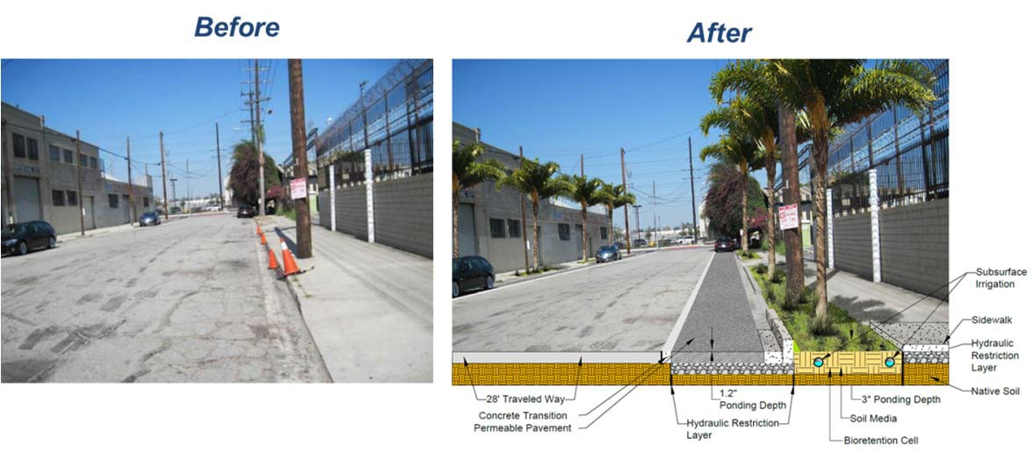
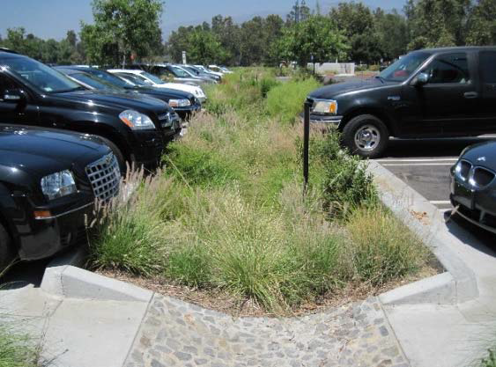
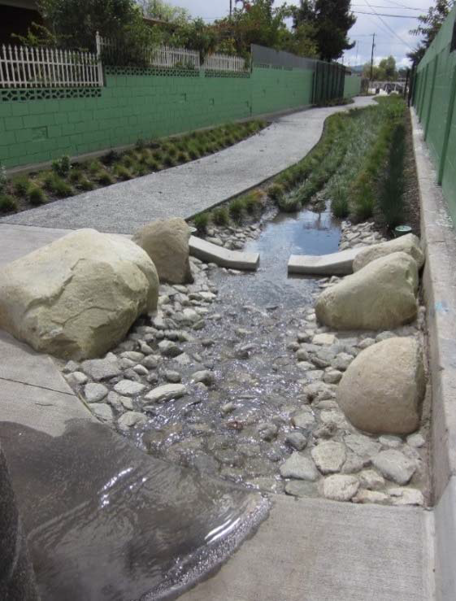
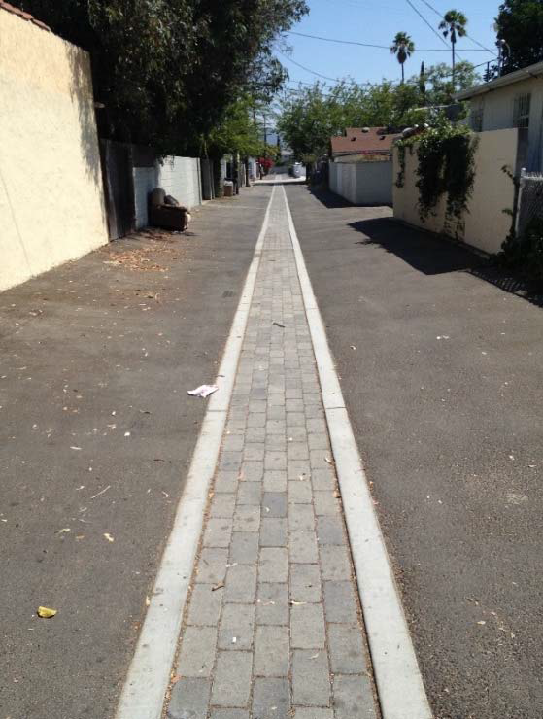
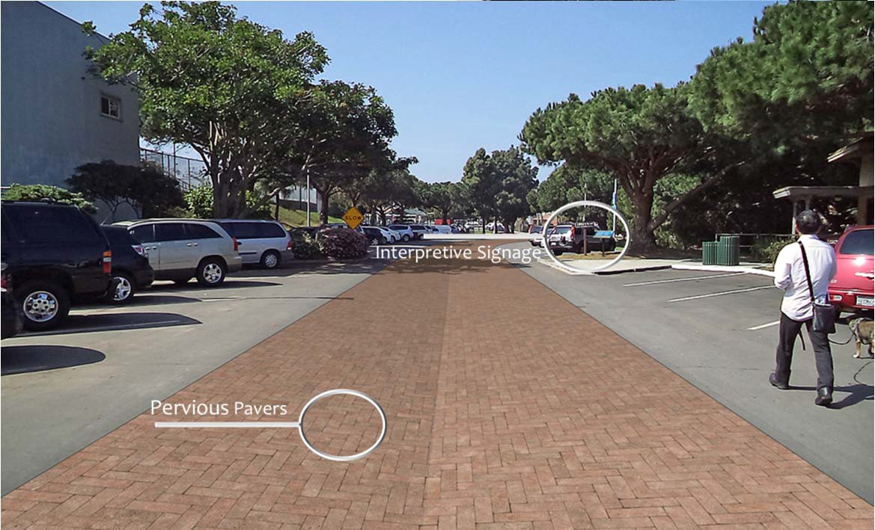
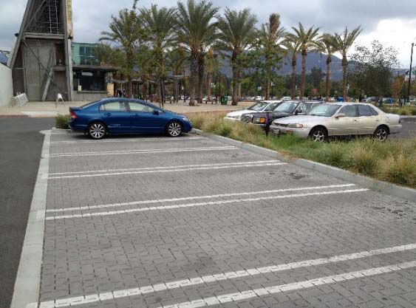
Green Streets

Slide 10
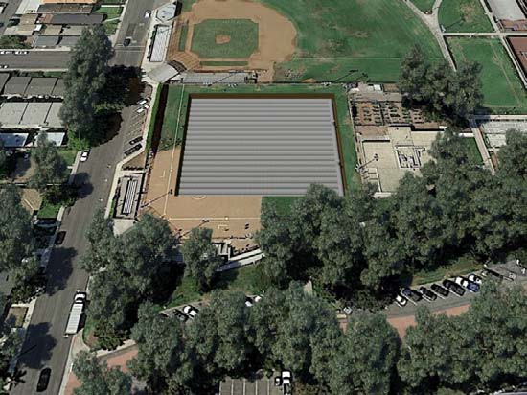
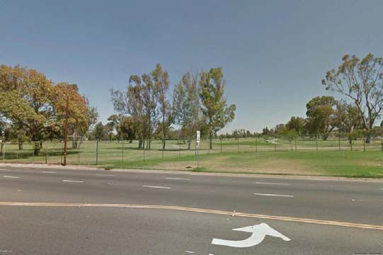
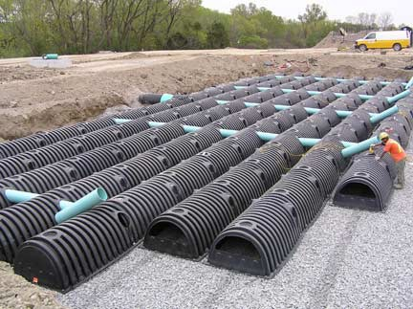
Regional BMPs
Over 100 regional projects
Leverage and improve existing parks
Increase recreational access for public
Recreation Park
Golf Course
10

Slide 11
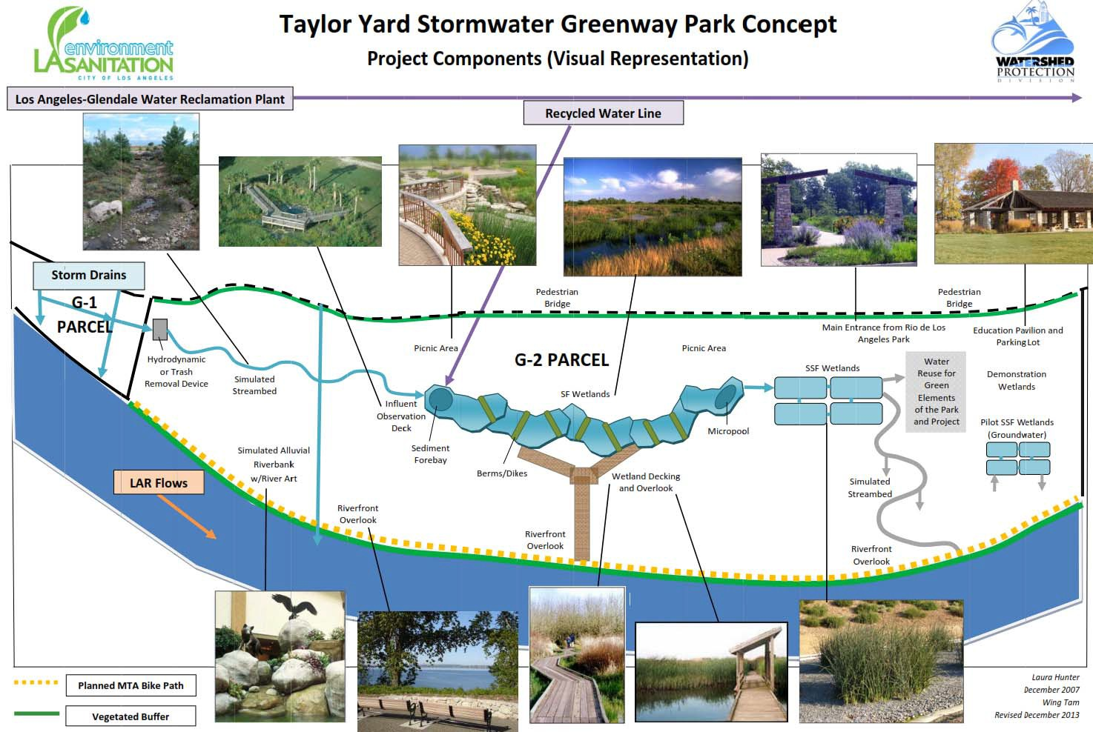
Regional BMPs
River Front

Slide 12
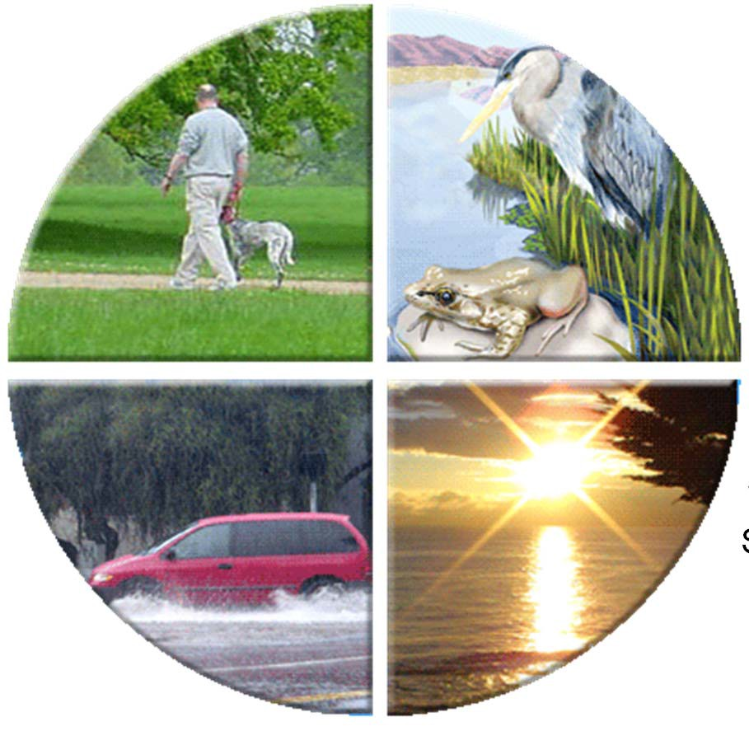


The Future is Bright
in Meeting LA’s Water Challenges
PUBLIC USE
HABITAT RESTORATION
S
OPEN SPACE
CLIMATE ADAPTATION
JOBS
WATER UPPLY
FLOOD PROTECTION
WATER
QUALITY

Slide 13
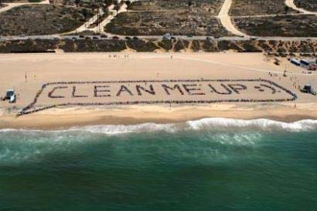
Questions
Additional Information: www.lacity.org www.lacitysan.org www.lastormwater.org
Wing Tam, P.E. Green Infrastructure Program Manager LA Sanitation
July 14, 2015
13

