Slide 1

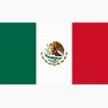
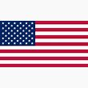
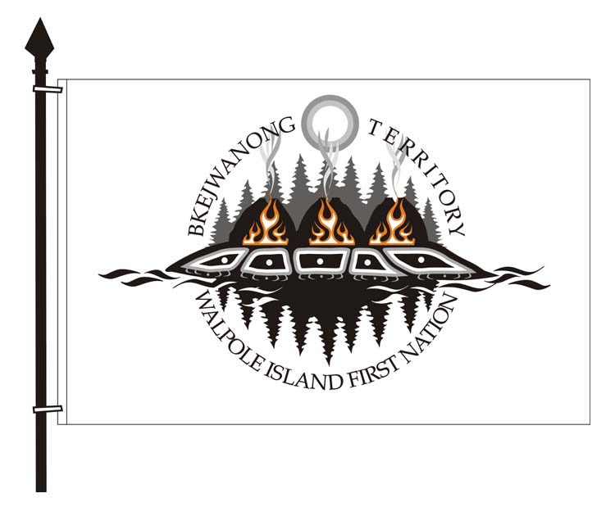
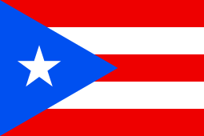
“Community-based Approaches to Disaster Resilience: A View from Walpole Island First Nation”
Dean M. Jacobs CEC/JPAC
Consultation Manager San Juan, P.R.
Walpole Island First Nation October 24, 2019

Slide 2
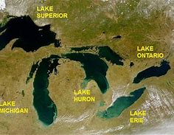
Great Lakes Basin

Slide 3
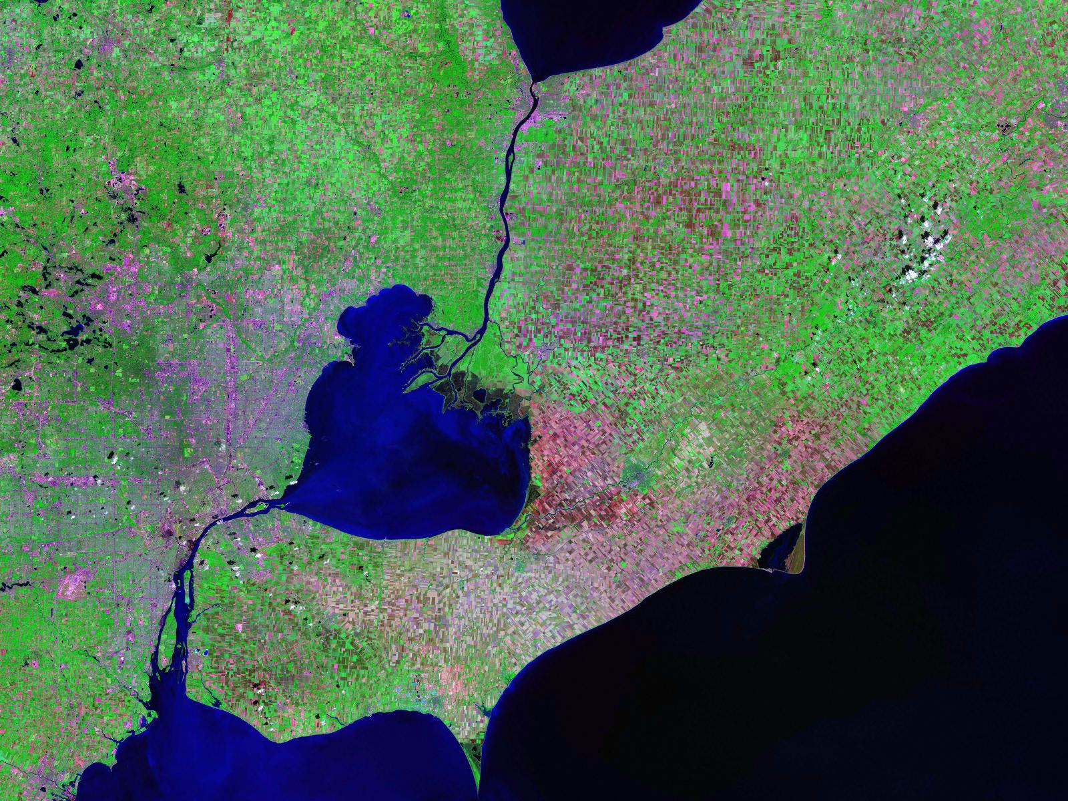
Notes:
I thought this was a nice view of our Traditional Territory

Slide 4
Traditional Economies
Hunting
Trapping
Fishing
Gathering
Trading

Slide 5
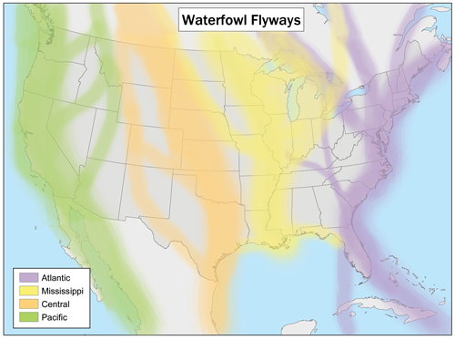

Slide 6
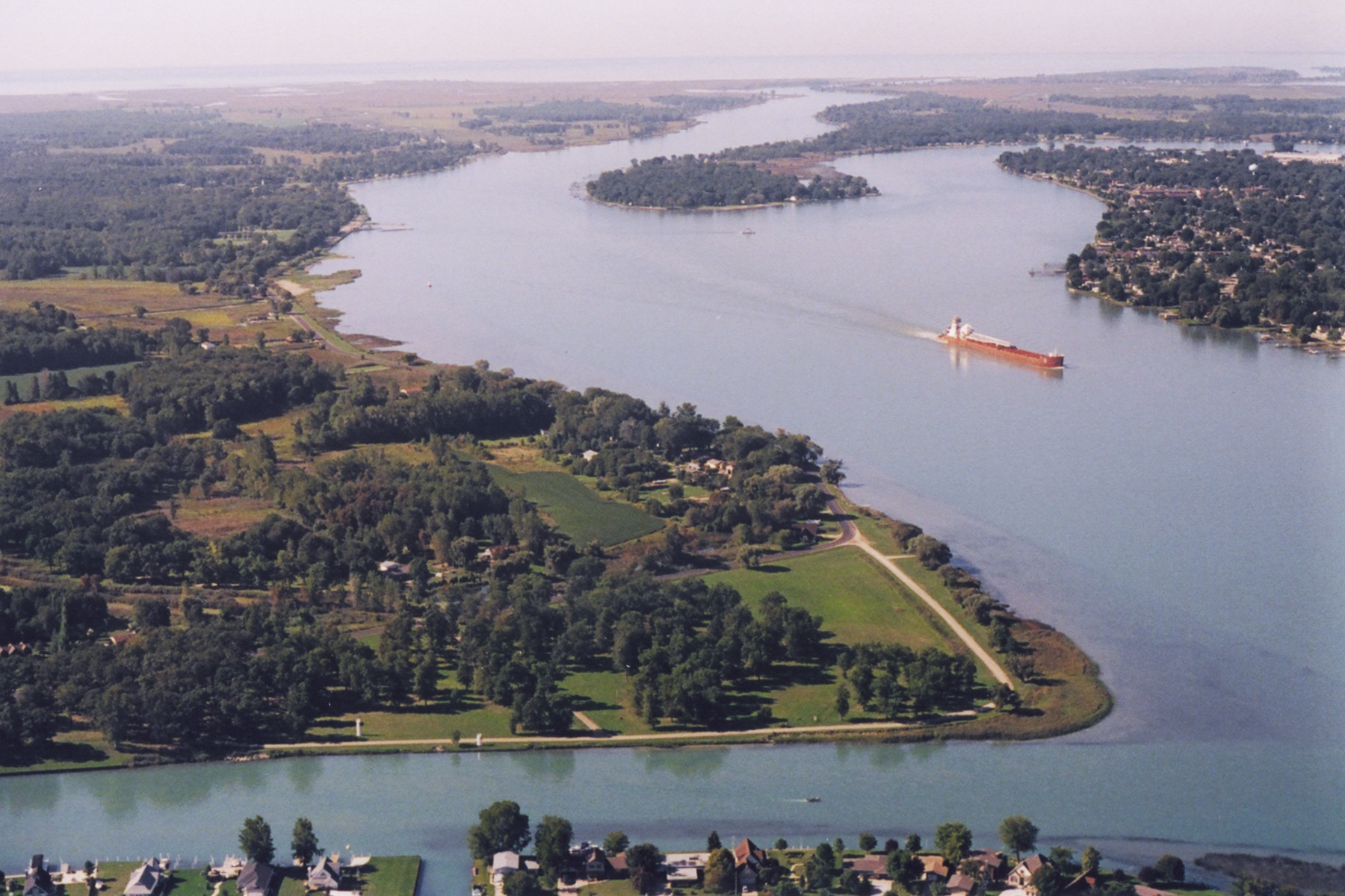
Waterways

Slide 7
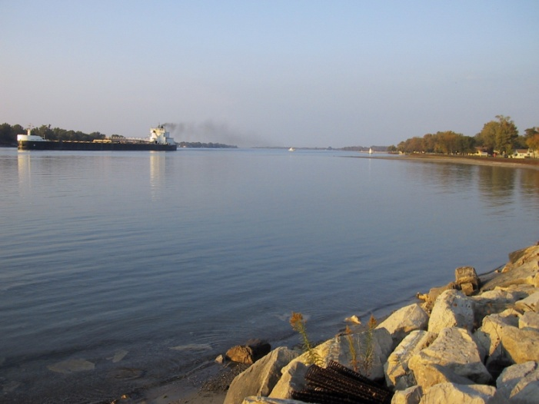
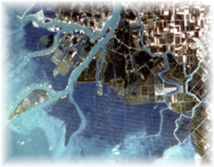
Profile of Walpole Island
Council of the Three Fires
4,980 Ojibwe, Potawatomi, and Odawa Citizens
Young and growing population
6 islands covering 91 square mi.
11,000 acres of agriculture
17,000 acres of wetlands
6,400 acres of deciduous forest
cover
2,050 acres of tallgrass prairie
and oak savanna habitat

Slide 8
Modern Economies
Recreation
Tourism
Agriculture
Bureaucracy
Business Development

Slide 9
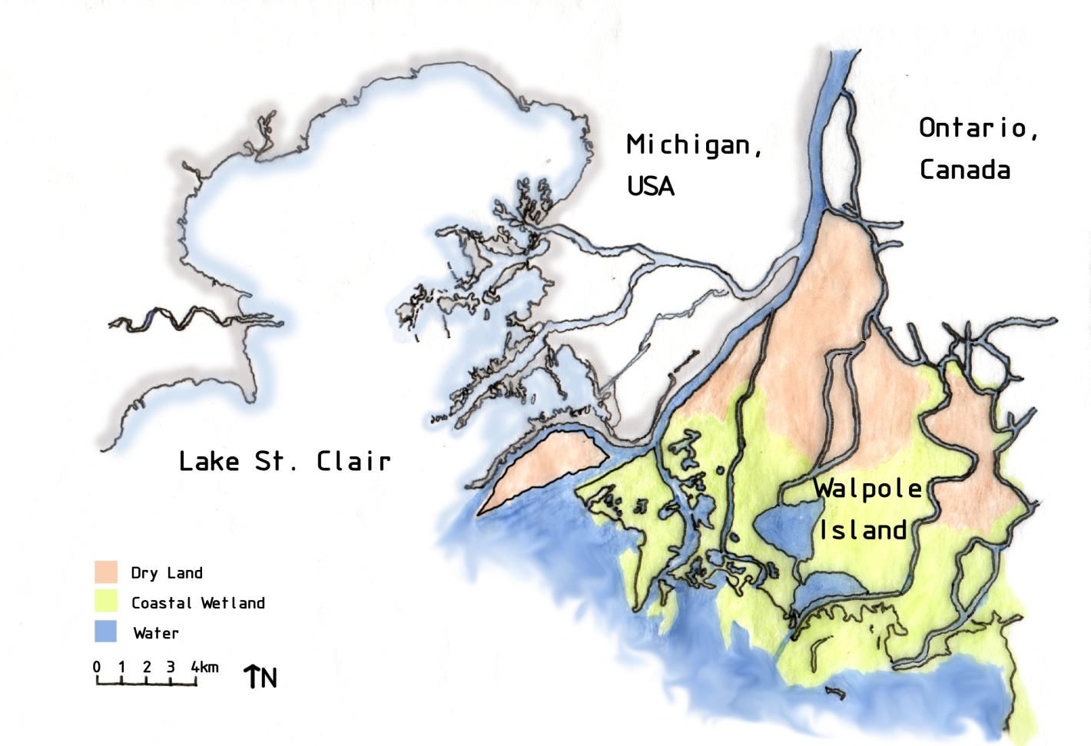
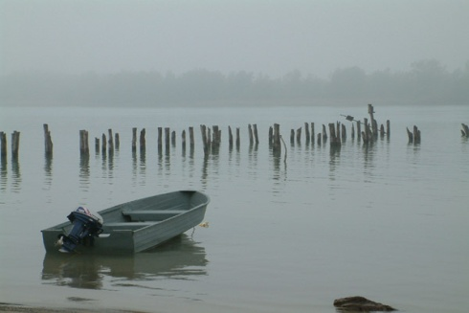
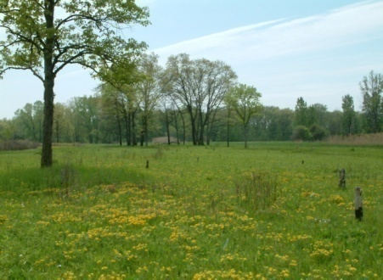
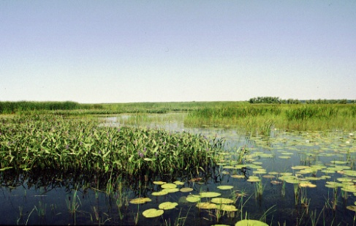
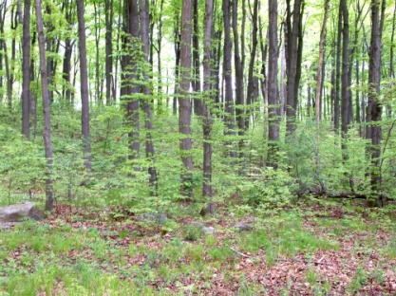
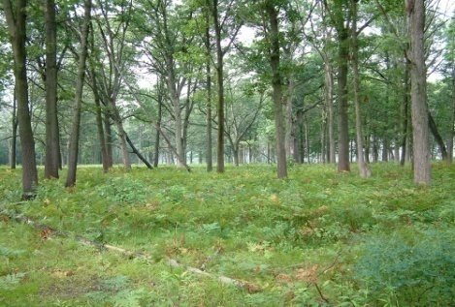
Walpole Island’s Ecosystems
Walpole Island…
supports a rich mosaic of natural areas including some of the most biologically diverse areas in Canada.
Coastal
waterways
Tallgrass
Prairies
Wetlands
Deciduous
forests
Oak Savannas

Slide 10
Land & Community Matter
Good development is about shifting the conversation from impact avoidance, risk management, mitigation, and justifiable infringement to collaboration and partnership. Meaning sustainable development, community well-being, equity participation and resources revenue sharing.

Slide 11
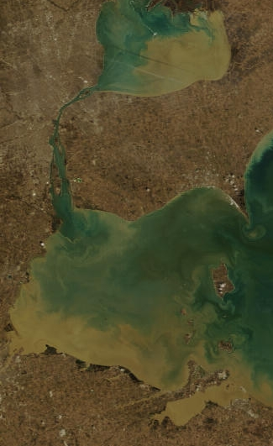
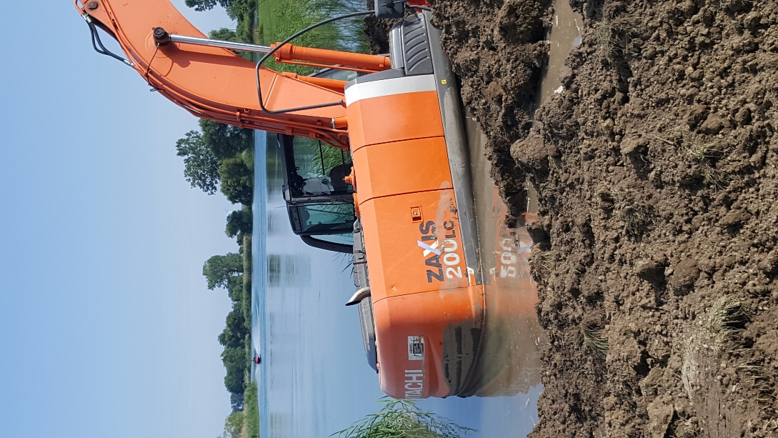
Extreme Weather Events

Slide 12
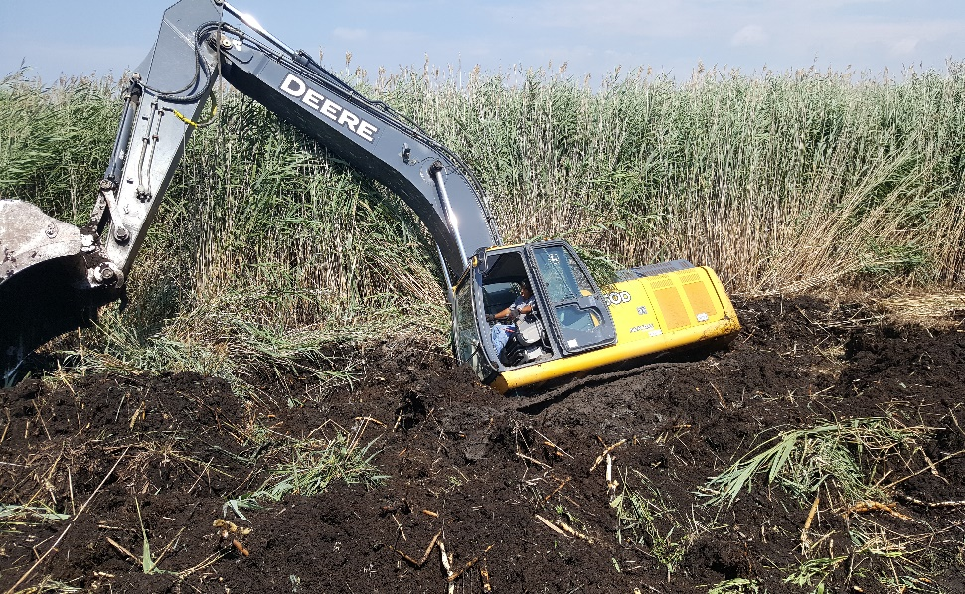
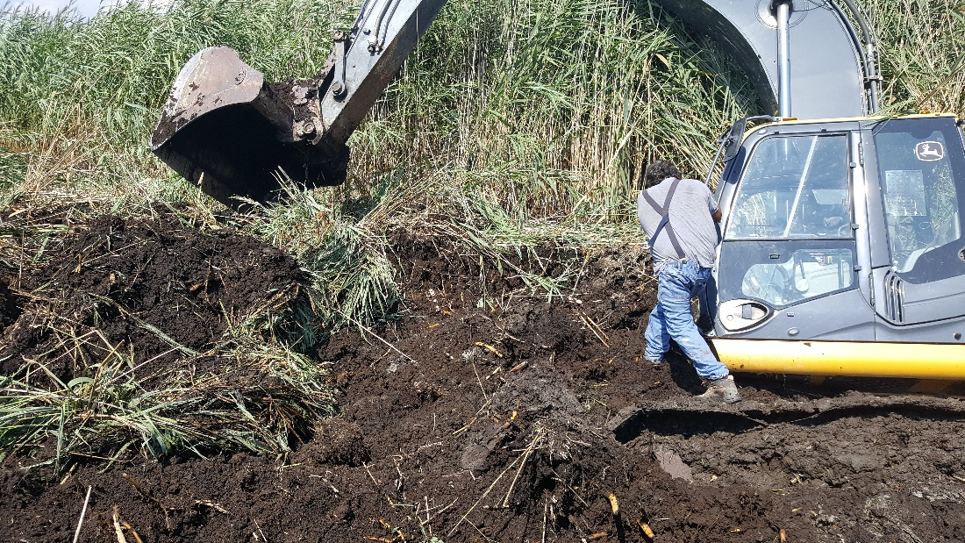
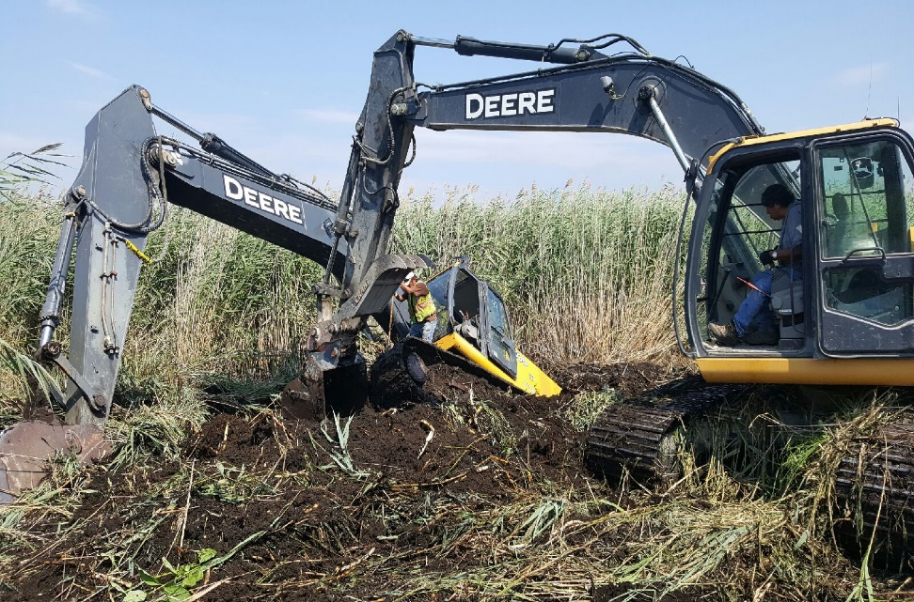
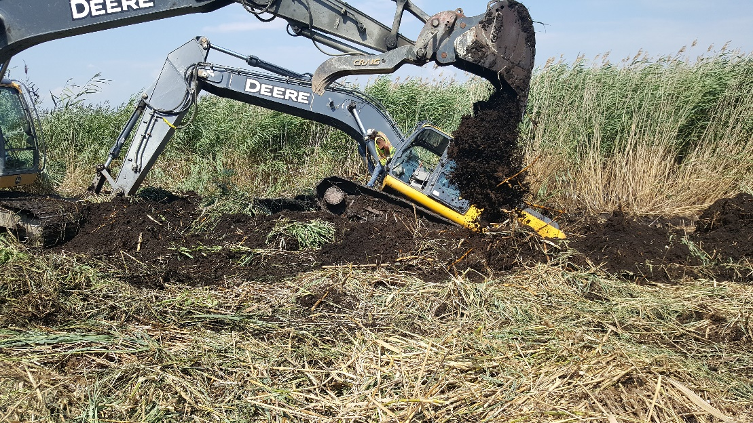

Slide 13
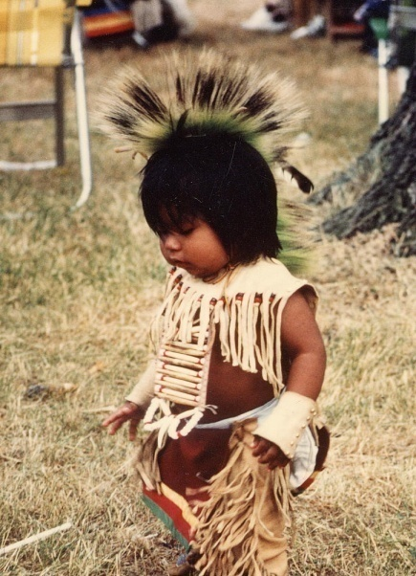
Opportunities
Developing new partnerships in Canada, Mexico, U.S.A. and beyond
Utilizing global markets, case law, legislation and policy statements to advance and promote truth and reconciliation, Indigenous self-determination, well-being and resiliency
Moving from the recognition of Indigenous Law and Traditional Knowledge to respecting its value

