Slide 1
Sustainable Use of Water in North America; a proposal
Commission for Environmental Cooperation of North America
XXII Regular Session of the CEC Council and
Sessions of the Joint Public Advisory Committee
14–15 July 2015
Boston, Massachusetts

Slide 2
Private Philanthropic Organization
Established in 2000
Still very young
Grants to organizations executing specific projects
on Health, Addictions and Water

Slide 3
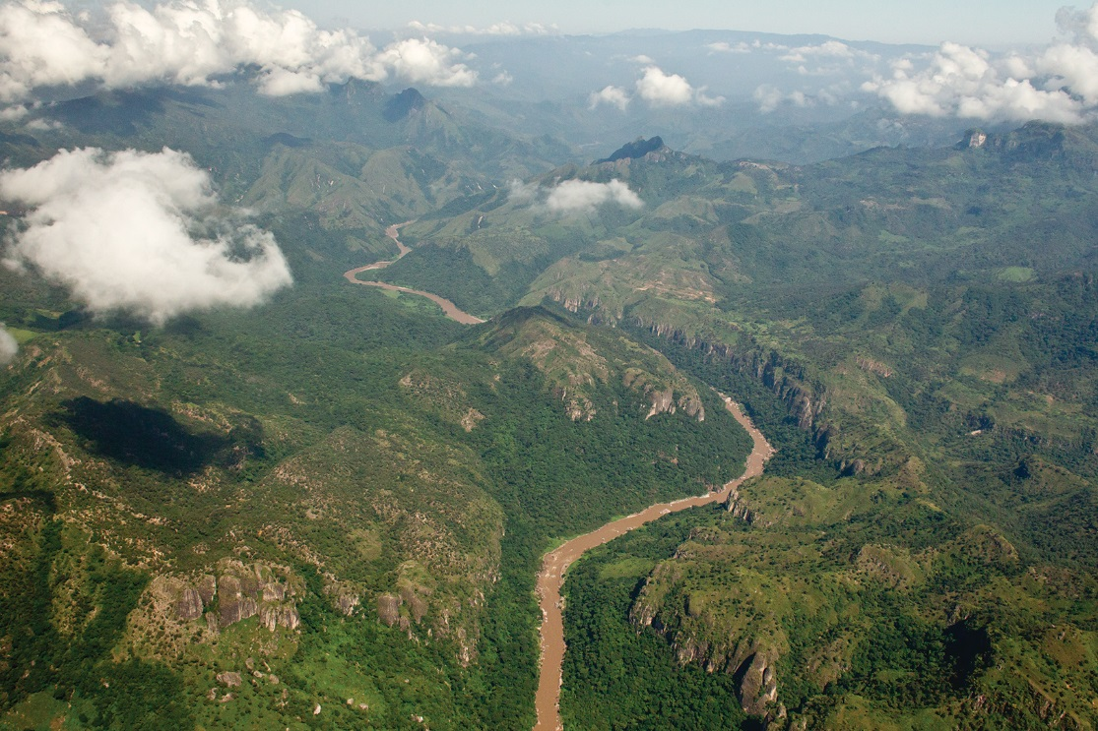
Water Programme not hydraulic
Mexico “Sustainable” in water
∴ Conserving the natural “water factories”
Water Watershed Vegetation
(functional ecosystems)
∴ “Optimization of Water Uses”
Integral-Holistic Watershed-Basin Management
RFP Water for marginalized communities (RFP Watershed or Basin approach)
Detonator-trigger Actions

Slide 4
Water Importance: water and…
Industry
Food Production
Recreation
Energy
Culture
Environment
Health
Forestry
Well-being
...many other

Slide 5
Water Use in North America
Currently water use in North America is more than 600,000 million cubic meters per year:
CANADA | USA | MÉXICO
Availability 90,767 m³/hab/year | Availability 6,902 m³/hab/year | * Availability 4,416 m³/hab/year
Extraction 1,590 m³/person | Extraction 1,575 m³/person | Extraction 664 m³/person
Use: agriculture 11 % | Use: agriculture 40 % | Use: agriculture 77 %
Use: industries 69 % | Use: industries 46 % | Use: industries 9 %
Use: domestic 20 % | Use: domestic 14 % | Use: domestic 14 %
Coverage: potable water & drainage 100% | Coverage: potable water & drainage 100 % | Coverage: potable water & drainage 87 %
Sources: FAO Aquastat; *CONAGUA, México

Slide 6
Quality of Water Population Urbanization
More and more Over-exploited aquifers
Infiltration Habitat Fragmentation
Deforestation Pollution of water bodies be it dams,
Ponds, lakes or rivers
Waste and uses
Trends

Slide 7
The planet needs solutions NOW, yet, these are not built or devised overnight

Slide 8
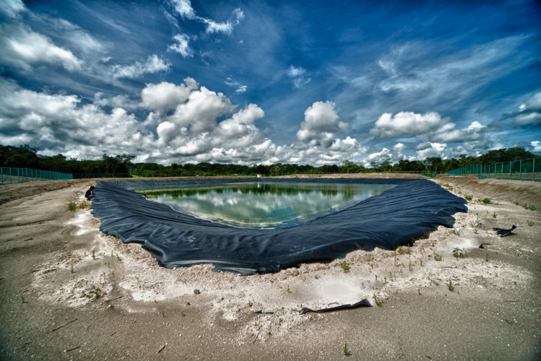
USE
Rational
NO squandering
Measured
Optimized
SUSTAINABLE
We need changes in the patterns of consumption, use, re-use, recycle.
Innovative solutions. At different levels and scales
Local: Eco-tecniques diversification productive
of cultivars change-conversion
National: Public policies; programmes coordination
Regional / global: International Agreements

Slide 9
In North America WE ALREADY have: a Commission on Environmental Cooperation that could be instrumental in, as its own name indicates, fostering cooperation (i.e. our three countries better articulation).
In North America WE ALREADY have :
Differentiated offer of products and services
Water
Technology
Capacities
Complementarities (due to different skills and abilities)
Examples for the region, the continent and for the world
Experiences
Similarities
Differences
Lessons learned
Business and synergy opportunities.

Slide 10
The proposal (1):
Launch a Tri- national
FORUM on Sustainable Use of Water,
as a means to devise ways to:
Reduce vulnerability, both in ecosystems and human populations to the effects of climate change.
Promote multidisciplinary experts participation.
Foster and prioritize the launching of projects, programmes and concrete actions in this sector´s agenda in the three countries, individually and collaboratively.
Etcetera...

Slide 11
The proposal (2):
Meetings and debates by country and tri-national.
The Forum
At least three national and one tri-national meetings
(multidisciplinary experts beyond the expected water sector)
Resulting Documents and abridged versions
Results validation process, proposals for action
Drafting of final consolidated strategic documents
Submission to CEC´s Council (end of 2016)
Public launching of the Consolidated Strategy for the Sustainable Use of Water in North America

Slide 12
Thank you very much
Boulevard Adolfo López Mateos,
Número 1009 – Piso 1
Col. Los Alpes
Del. Álvaro Obregón
México, 01010, D.F.
programaagua@fgra.org.mx
www.fgra.org.mx
www.agua.org.mx

