Slide 1
District of Columbia Water and Sewer Authority
George S. Hawkins, General Manager
Briefing on:
DC Clean Rivers Project Overview
Briefing for:
Commission for Environmental Cooperation of North America
Joint Public Advisory Committee
Panel II: Adapting to Changing Stormwater Quantities Through Land-use Planning
July 14, 2015

Slide 2
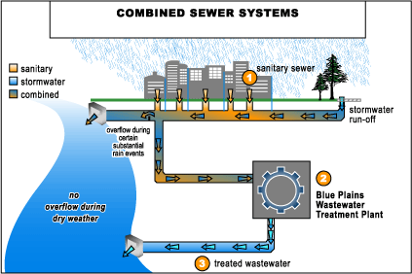
Separate and Combined Sewer Systems
2 Pipe System
1 Pipe System
100% of suburbs
67% of DC
0% of suburbs
33% of DC

Slide 3
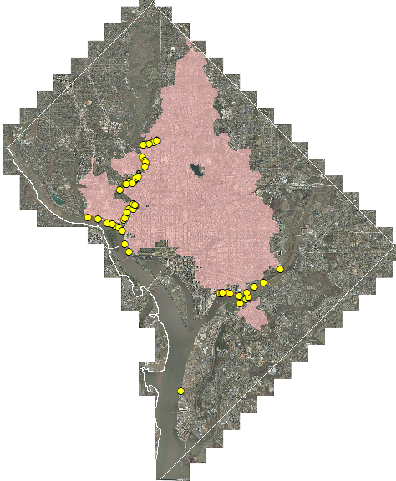
Background: Combined Sewer Area
1/3 area is combined (12,478 acres)
47 CSO outfalls
13 to Anacostia
10 to Potomac
24 to Rock Creek
Three receiving waters
Anacostia River
Potomac River
Rock Creek
Combined Sewer Drainage Area
CSO Outfall
Blue Plains
Municipal Separate Storm Sewer System (MS4) Area

Slide 4
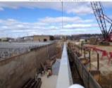
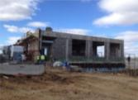
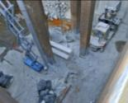
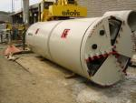
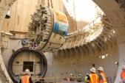
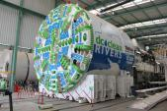
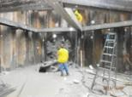
Background: DC Clean Rivers Project (LTCP) Development
DC Water working with DOJ/EPA throughout development and implementation.
2011 - DC Water begins evaluating GI for Potomac and Rock Creek
2007 - New Nitrogen limits require changing LTCP
2014 - DC Water proposes changing LTCP to include Green Infrastructure
2005 – Consent Decree Signed
May 20, 2015- EPA/DOJ lodge Consent Decree Modification in District Court
1998 - LTCP Started
2003 – LTCP Meets WQS (EPA/DC)
2002 – Final LTCP
Public Participation
Total Nitrogen implementation
LTCP implementation

Slide 5
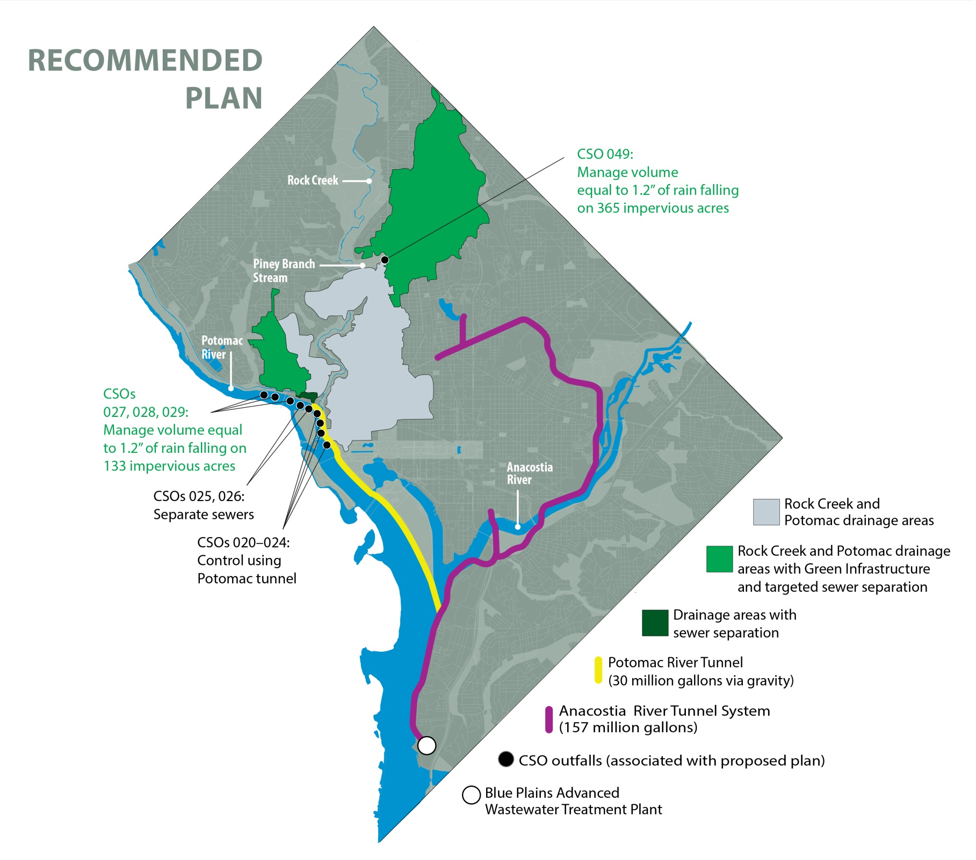
DC Clean Rivers Project
DC CLEAN RIVERS PROJECT AND
NITROGEN REMOVAL PROGRAMS
DC Clean Rivers Project: $2.6 Billion
Nitrogen Removal: $950 Million
Total > $ 3.5 Billion
20 yr implementation (2005 – 2025)
96% reduction in CSOs & flood relief in Northeast Boundary
Approx 1 million lbs/yr nitrogen reduction predicted
Complete by 2030

Slide 6
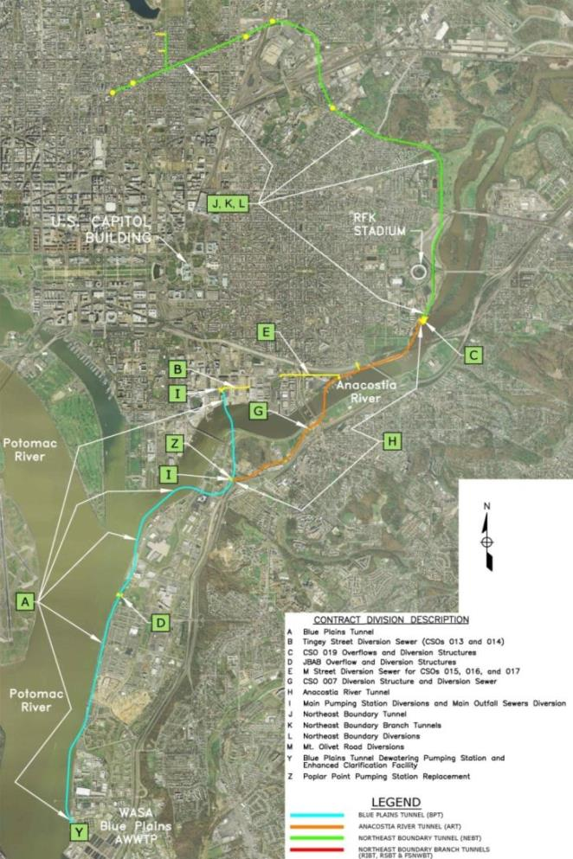
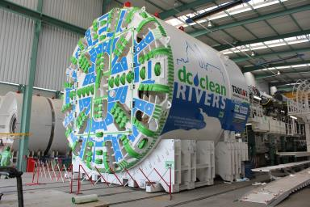
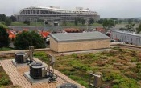
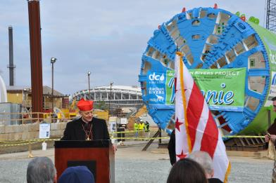
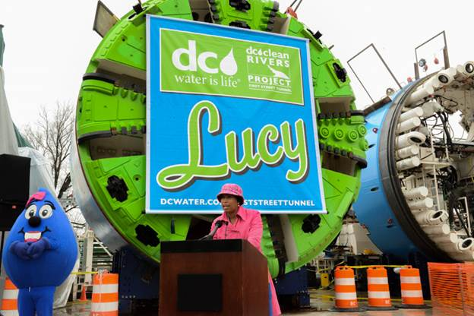
DC Clean Rivers has let more than $1.3 Billion in Construction and Engineering Contracts
Legend
Completed
Design
Construction
First St Tunnel
Northeast Boundary Tunnel
LID at DC Water Facilities
J
Tingey St Div. Sewer
M St Div. Sewer
Main PS Diversions
Poplar Point PS
CSO 019
CSO 007
JBAB Diversions
Anacostia River Tunnel
Blue Plains Tunnel
A Blue Plains Tunnel
B Tingey Street Diversion Sewer
C CSO 019 Overflow and Diversion Structures
D JBAB Overflow and Diversion Structures
E M Street Diversion Sewer (CSOs 015, 016 and 017)
G CSO 007 Diversion Structure and Diversion Sewer
H Anacostia River Tunnel
I Main Pumping Station Diversions
N LID at DC Water Facilities
P First Street Tunnel
J Northeast Boundary Tunnel
S Irving Street Green Infrastructure
Y Blue Plains Dewatering Pumping Station and ECF
Z Poplar Point Pumping Station Replacement

Slide 7
Project Benefits: CSO Reduction

Slide 8
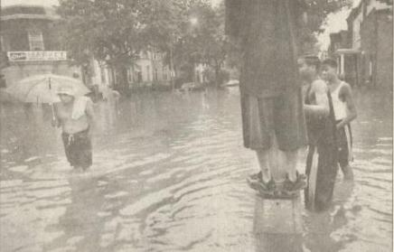
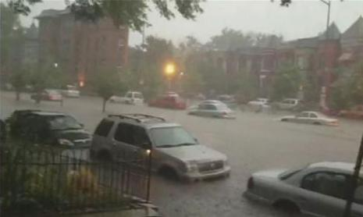
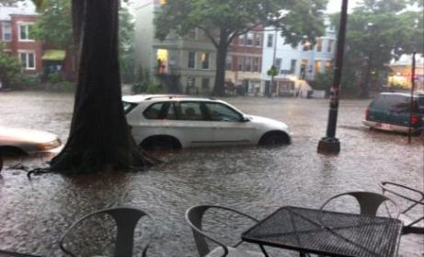
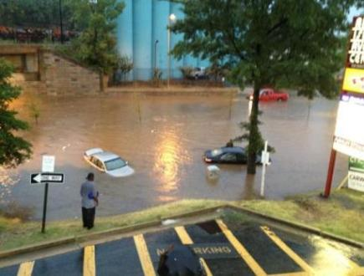
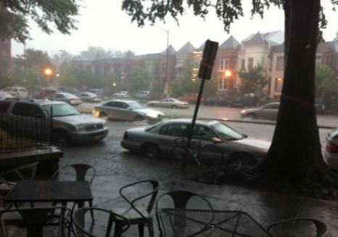
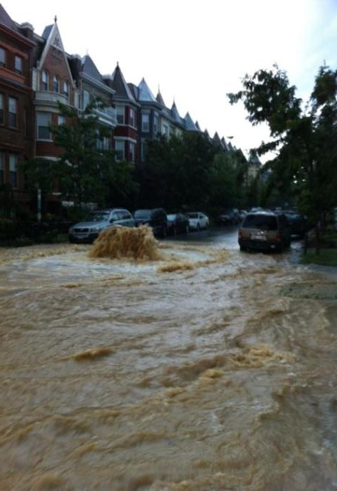
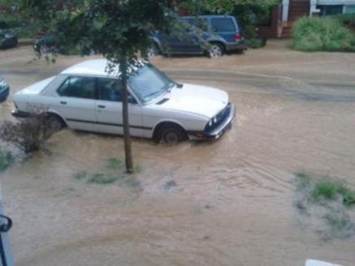
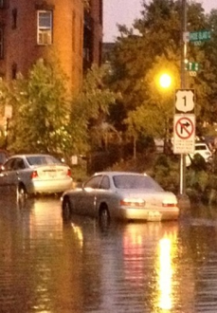
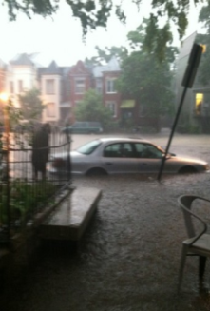
Project Benefits: Flood Relief
First & P St NW
Rhode Island & T St NW
Rhode Island & First St NW
Rhode Island Metro
Rhode Island & T St NW
Flagler St NW
Rhode Island Between First & 2nd St
First & V St NW

Slide 9
Project Evolution
Existing Consent Decree
Consent Decree Modification
Manage volume equivalent to 1.2” falling on 365 impervious acres
9.5 mg Piney Branch Tunnel
Manage volume equivalent to 1.2” falling on 133 impervious acres
for CSO 027, 028, 029
58 mg Potomac Tunnel
(CSO 020-029)
Separate CSO 025-026
Pump Station
126 mg Anacostia Tunnel System
157 mg Anacostia Tunnel System
Pump Station
30 mg Gravity Potomac Tunnel
225 mgd Pump Station and Enhanced Clarification Treatment

Slide 10
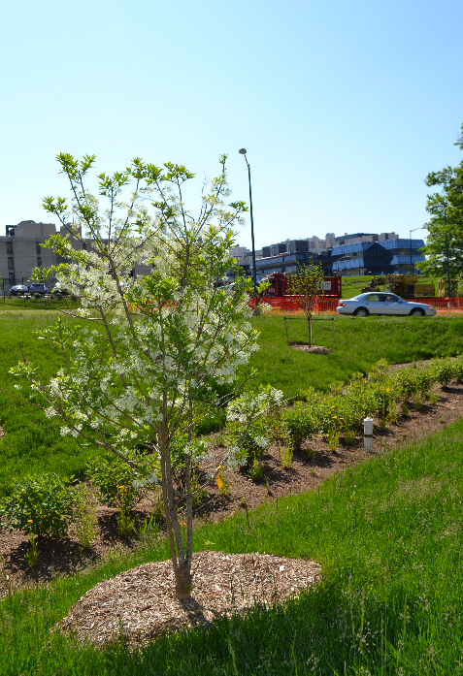
Irving Street Green Infrastructure Project
To help mitigate flooding in the Bloomingdale area, the DC Clean Rivers Irving Street Green Infrastructure Project included:
Installation of 14 bioretention facilities
Located along Irving Street corridor between Michigan Avenue and North Capitol Street
Approx. 400,000 gal of storage provided
Flooding in Bloomingdale and LeDroit Park
Recently planted bioretention

Slide 11
Previous Experience – Indianapolis
Pogue’s Run
Multipurpose project: provided control for CSOs and flooding
Offline basins store peak storm water flows
Reduction in peak flows allows conversion of downstream culvert to CSO storage facility
Green Infrastructure and Sewer Separation implemented on smaller scale for localized control
WHITE RIVER
I-65
I-70
POGUE’S RUN
OFFLINE STORMWATER DETENTION FACILITIES
I-70
2.2-MILE CULVERT (1915)
ONE BARREL RETROFITTED FOR CSO CONTROL
I-65

Slide 12
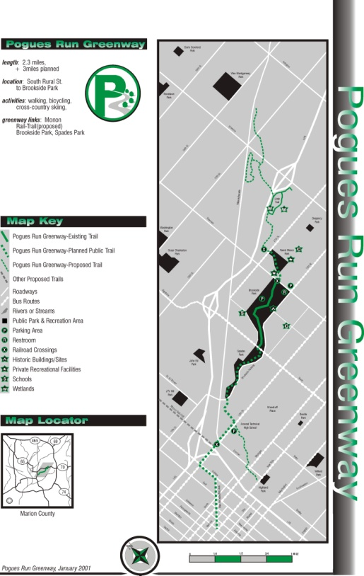
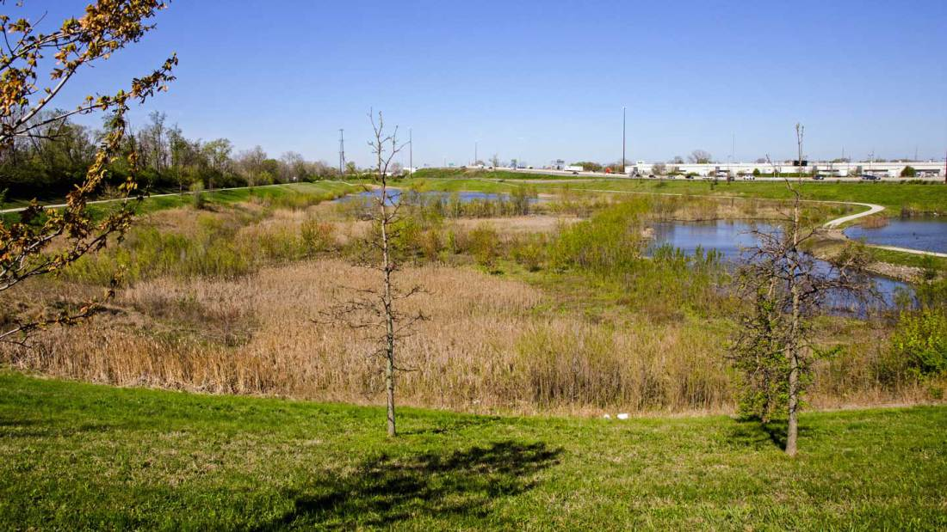
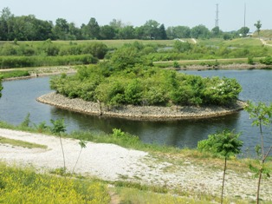
Previous Experience – Indianapolis
Benefits Realized
Reduction of flood hazards, insurance requirements, etc.
Improved water quality
CSO reduction
Peak storm flow reduction
Engineered wetland filtering
Improved recreational and educational opportunities
Property with history of crime and illegal dumping converted to community amenity

Slide 13
Added Environmental, Social, and Economic Benefits
Environmental
Reduce runoff
Social
Enhance aesthetics
Economic
Create green jobs
Improve air quality
Reduce summer temperatures
Reduce energy usage
Offset climate change
Habitat improvement
Enhance property values
Improve quality of life
Improve liveability through green space
Reduce scope and duration of disruption during construction

Slide 14
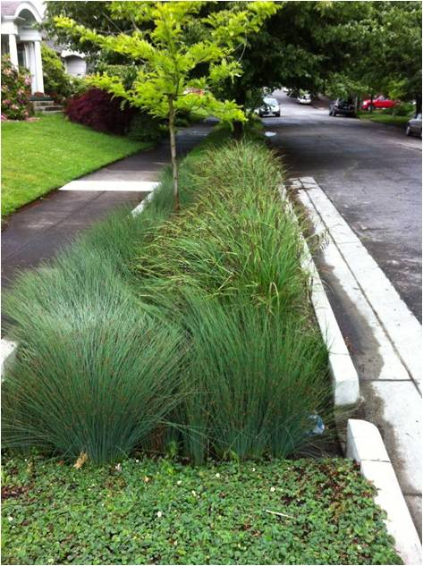
Approach to Adapting to Climate Change
Technologies selected based on strengths
Small CSOs, less dense areas – GI
Large CSOs, ultra dense areas – gray infrastructure
GI addresses water at the source and leaves space for downstream technologies if needed for additional control
Conservatism in design – 20% safety factor
Interconnected tunnel system with live pumping is more resilient to changing weather patterns
Gravity system (rather than reliance on pumping station) more reliable and provides redundancy

Slide 15
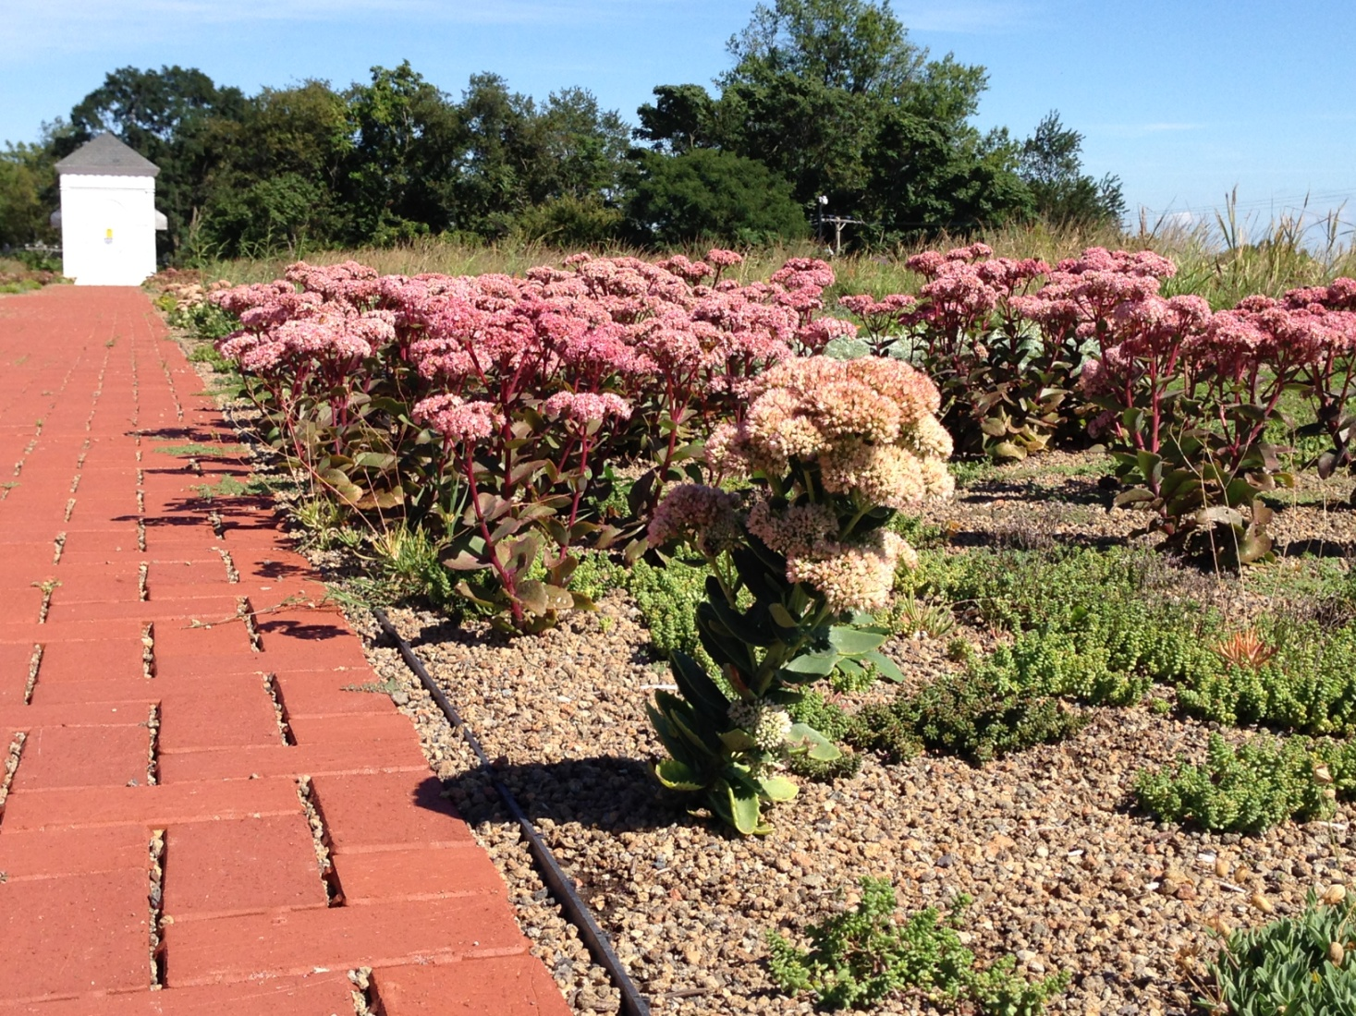
Questions?

