Slide 1
Reducing emissions from goods movement via maritime transportation in North America
Joint Public Advisory Committee (JPAC) Regular Session 16-03

Slide 2
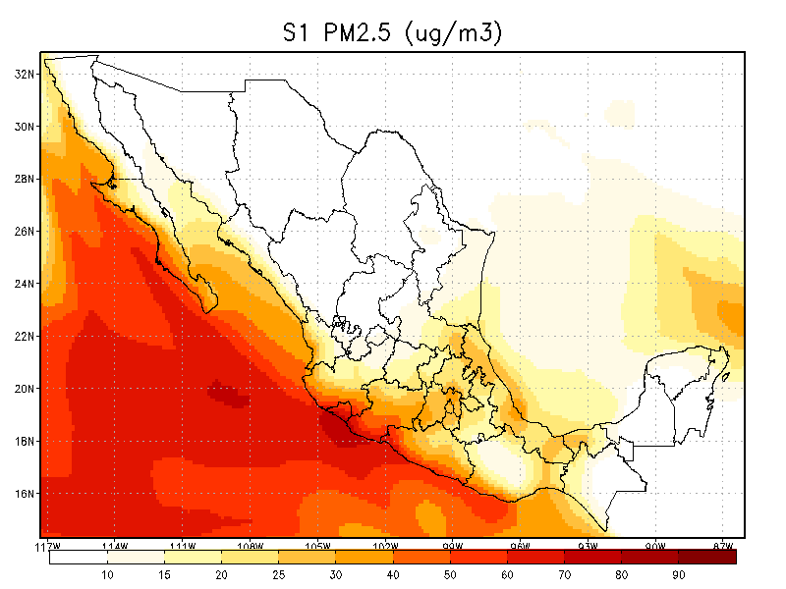
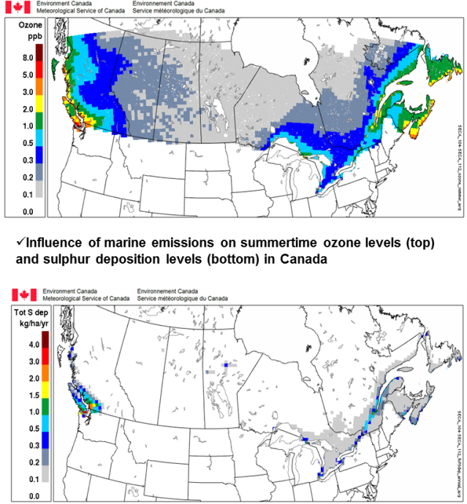
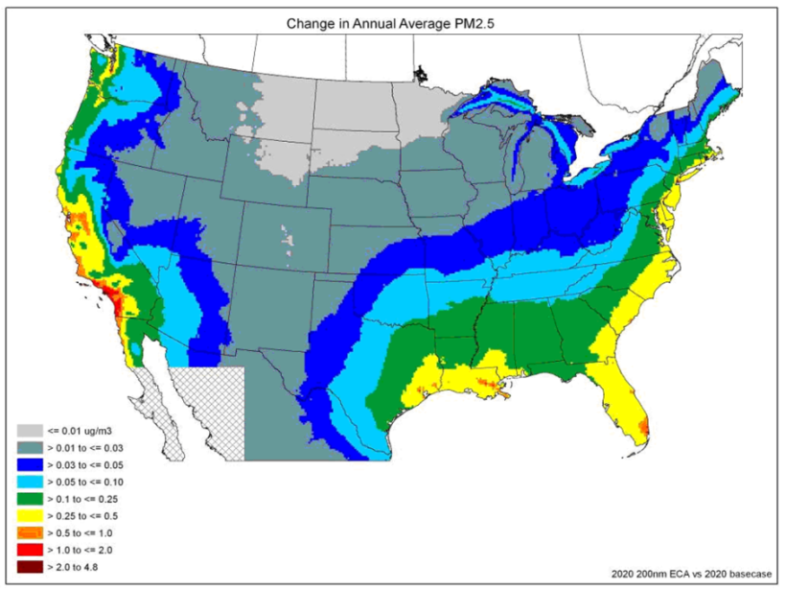
Impact on North American Air Quality

Slide 3
Reducing Emissions from Goods Movement via Maritime Transportation in North America (Phase II); and
Enhancing North American Enforcement of the IMO Maritime Fuel Sulfur Limits
Notes:
Projects 6 & 7: Reducing Emissions from Goods Movement via Maritime Transportation in North America (Phase II); and Enhancing NA Enforcement of the IMO Maritime Fuel Sulfur Limits
Goals: Support Mexico’s effort to create an Emission Control Area (ECA) under the International Maritime Organization; and enhance North American capacity to assess compliance with maritime fuel sulfur standards in the ECAs.
Relevance to Canada: a consistent approach involving the 3 countries should result in increased health and related economic benefits for the region; level the playing field for ship operators transiting North American ports; and through the sharing of information and best practices, facilitate national compliance enforcement activities.
NALS:
We are committed to reducing greenhouse gas emissions from maritime shipping and will continue to work together and through the International Maritime Organization (IMO) to support implementation of a North American Emission Control Area that includes Mexico.
Continue ongoing collaboration through the Commission for Environmental Cooperation in support of the finalization and submission to the IMO of a Mexican Emission Control Area (ECA) designation proposal.
Steering Committee: Maritime Emissions – Transport Canada, Semarnat, EPA.

