Slide 1
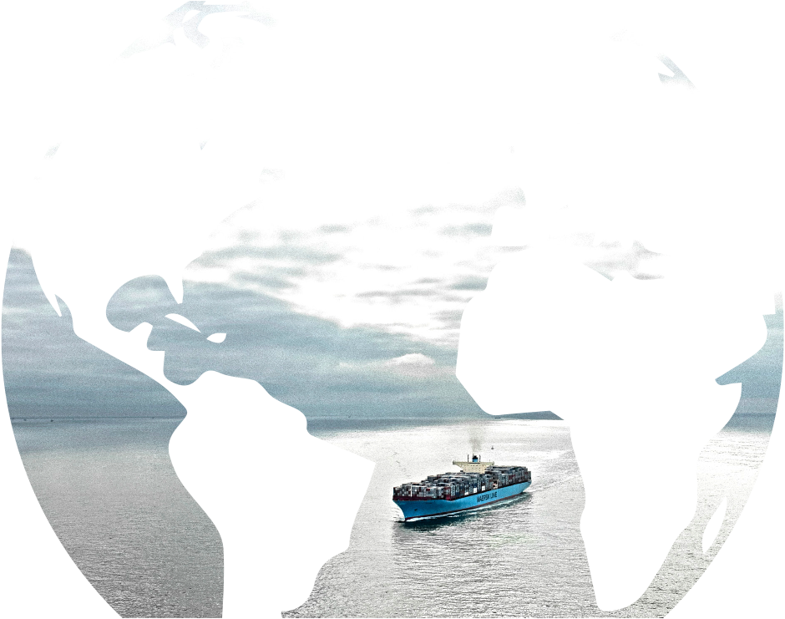
Reducing supply chain emissions – Ocean
Lee Kindberg
Maersk Line North America

Slide 2
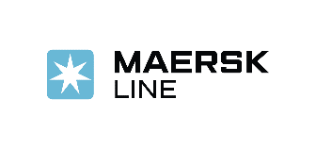

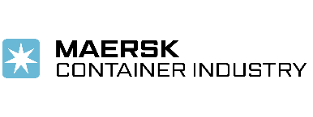


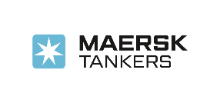
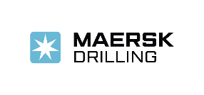
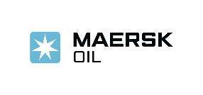
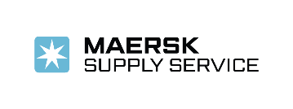
Maersk is an integrated transport & logistics company
Maersk Group is organised into two divisions
TRANSPORT & LOGISTICS
ENERGY
The Maersk Line brand includes Safmarine, Seago Line, SeaLand, Mercosul Line and MCC Transport
Notes:
We headquartered in Copenhagen Denmark and serve our customers through 306 offices in 114 countries.
We employ 7,700 seafarers and 22,000 land-based employees and operate 616 container vessels with a capacity of 3.1million TEU (Twenty-Foot Equivalent Unit)

Slide 3
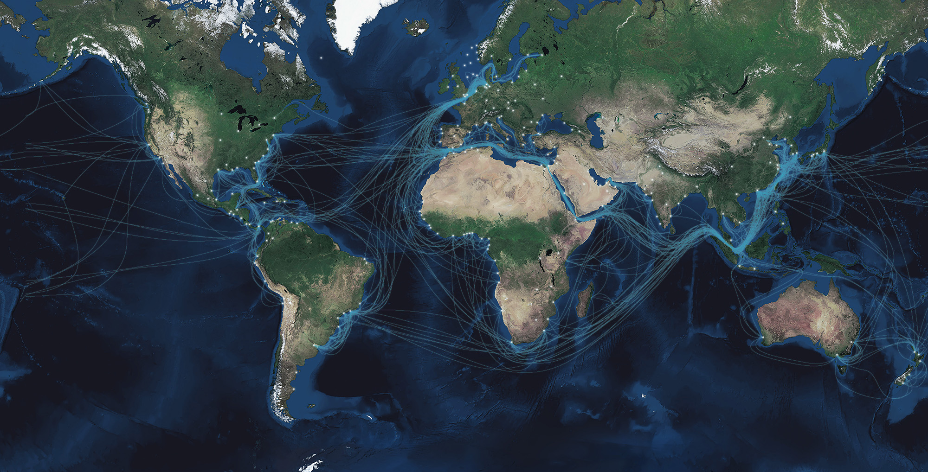
Shipping enables trade and affects the lives of billions
90%
of internationally traded goods are transported by sea
3
Notes:
Shipping affects the lives of billions of people, with 90% of the world’s international trade travelling by sea.
Our role in the world is to enable trade by transporting goods via the sea
We do that using 500+ vessels
The size, footprint and global reach of this large operation highlights the importance of becoming more sustainable
We believe in the growth of international trade and the growth of or company
We therefore must grow responsibly and continue to improve our environmental performance

Slide 4
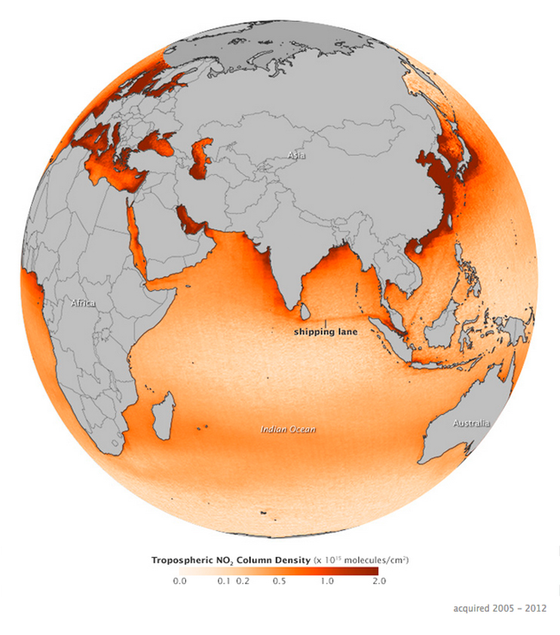
Ocean shipping is the most energy-efficient way to move cargo long distances…
But is impacting the planet
90% of all goods transported globally are carried by ship.
Ocean shipping generates ~2% of all man-made CO₂.
http://climate.nasa.gov/news/860
Notes:
Ocean shipping (as part of global supply chains) is the most energy-efficient way to move cargo…
But is impacting the planet
(CO2 emitted total by industry??)

Slide 5
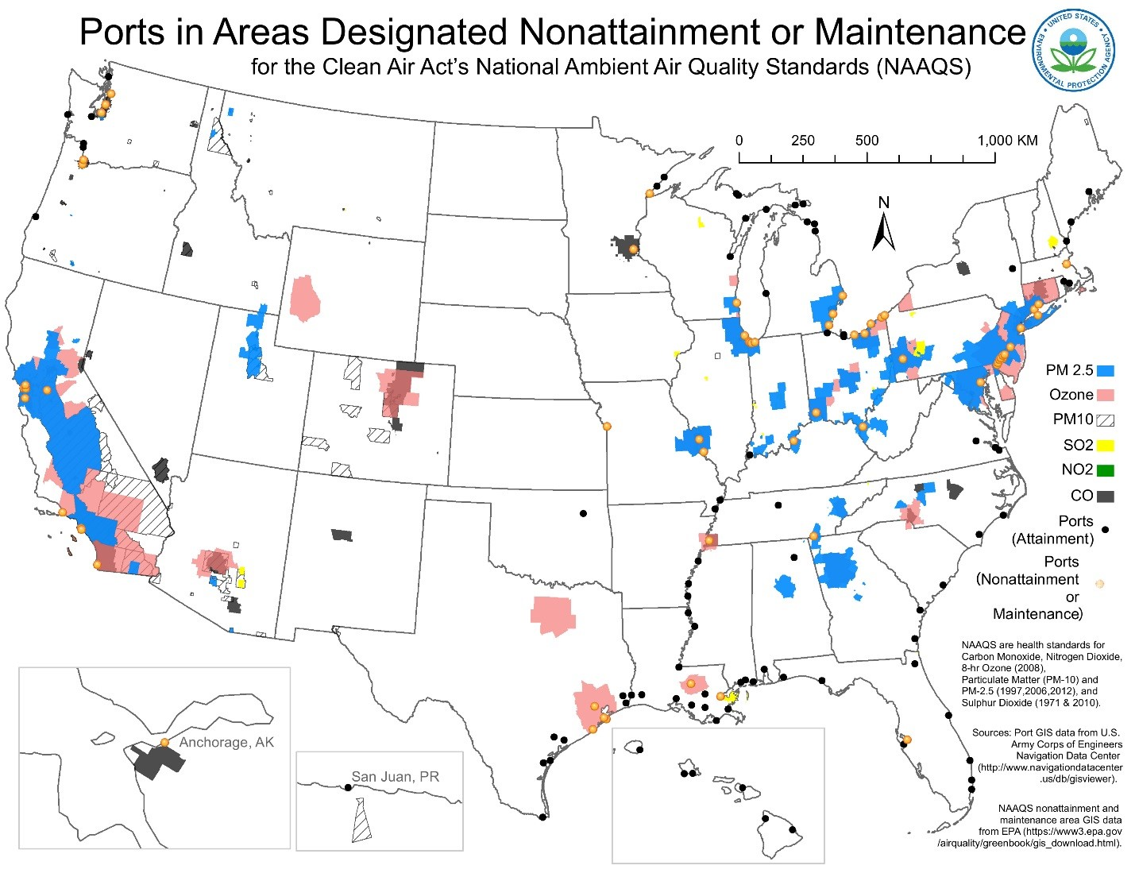
Port-related operations are significant sources of air emissions and greenhouse gases.
Many ports are in areas with existing air quality challenges and nearby populations.
The largest sources of port-related emissions are vessels and trucks.
Notes:
Million of people live near ports and rail yards, including a disproportionate number of low-income households, African-Americans, and Hispanics
Trade is growing, and port expansion projects are underway.
Emission reduction technologies and strategies have been slow in implementation
NON-ATTAINMENT IS JUST ONE INDICATOR OF AIR QUALITY AND IMPACTS
Based on GIS data, approximately 40% of “Principal Ports” were located in or near current nonattainment or maintenance areas (see Figure below).
However, nearby community and worker exposure to diesel emissions can occur at all ports.
The map was based on a comparison of GIS data on the Army Corps of Engineer’s 2014 list of 150 “Principal Ports” and EPA’s latest NAAQS designations. Nonattainment and maintenance area maps reflect the latest EPA NAAAQS for all pollutants

Slide 6
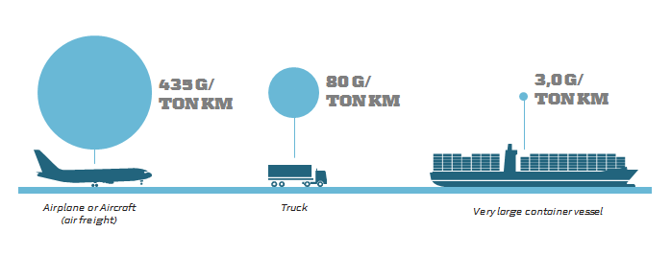
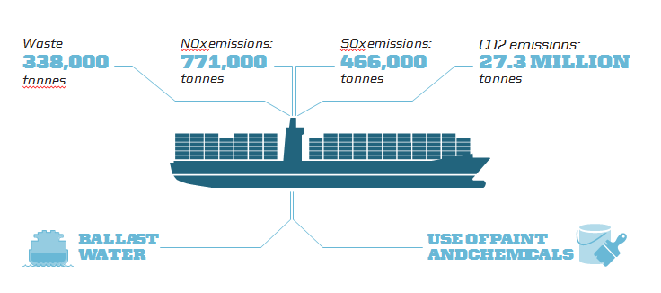
Notes:
Triple E
Setting new standards on energy efficiency
Emitting approximately 35% less CO₂
Optimising the recycle process in registering 75% of material used in building

Slide 7
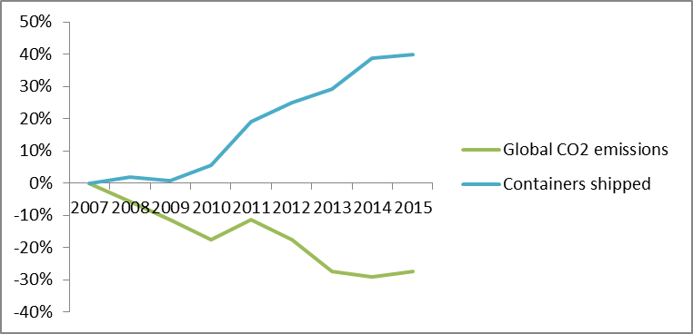
Decoupling growth, fuel use and environmental impact
Since 2007, Maersk Line has managed to grow our business while reducing emissions to the environment.
Changes in Global Containers Shipped and Total CO₂ Produced
Notes:
Absolute totals of CO2 shown.
11 million tonnes reduced 2007-2014
In relative terms:
8% per TEU km in 2014
40% per TEU km from 2007 to 2014
60% per TEU km by 2020, from 2007

Slide 8
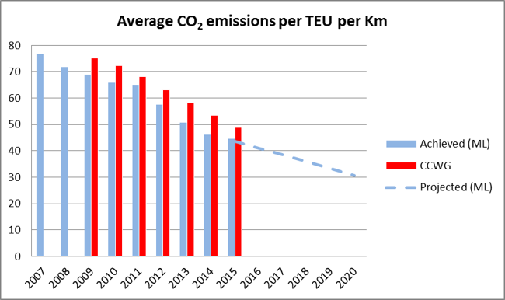


Vessels are increasingly fuel efficient.
This reduces fuel use, CO₂ and other air emissions.
How? Efficiency in
New vessels
Eco-Retrofitting vessels
Network design
“Smart steaming”
verified by:
2015 results: 42%
less CO₂ per container per km vs. 2007
Methodologies
2020 goal: Reduce fuel use and CO₂ by 60% vs. 2007
Notes:
Energy efficiency → sustainable

Slide 9
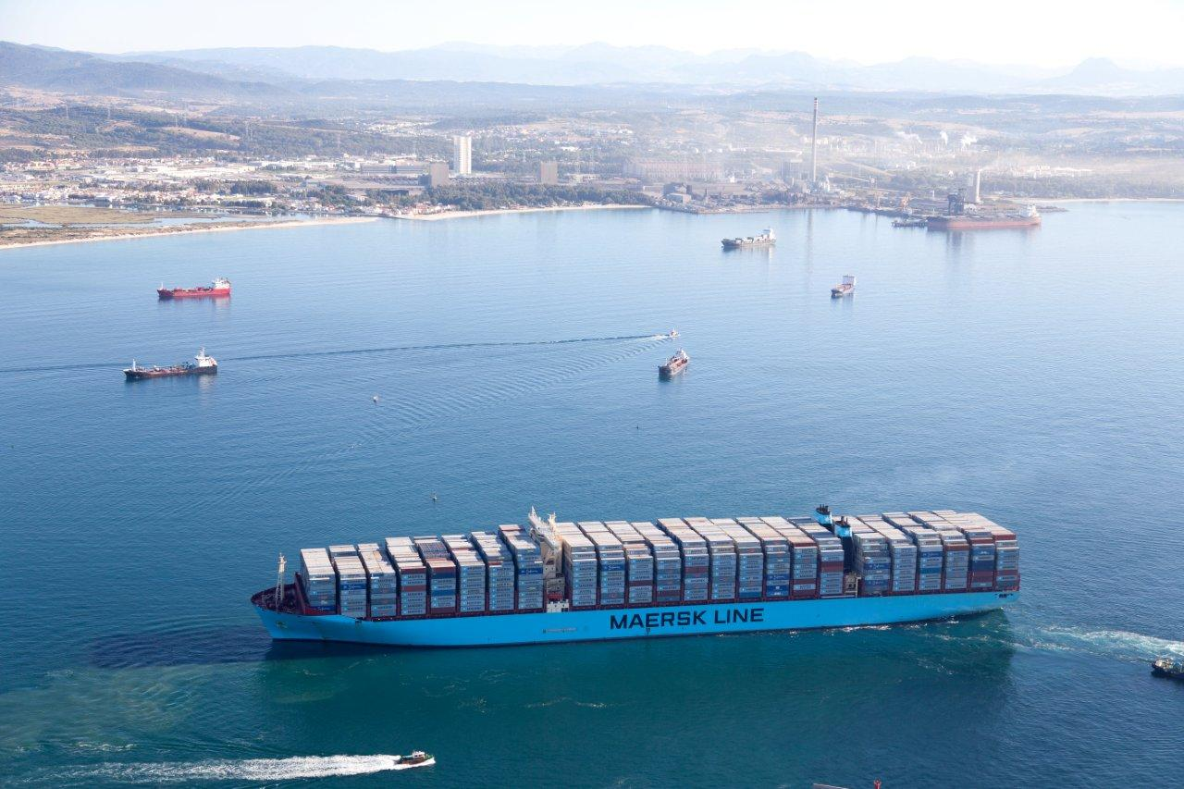
New ships have higher efficiencies and provide enormous economies of scale – and lower emissions per unit.
Mary Maersk leaving Algeciras Spain
21 July 2014 with 17,603 TEU
Notes:
New vessels carry more AND are more efficient
Our Triple E vessels keep setting new records. This photo shows Mary Maersk sailing from Algeciras Spain with 17,603 TEUs on its eastward journey, bound for Tanjung Pelepas, Malaysia
I believe the current record is Maersk McKinney Moller leaving Algeciras Spain 26 JAN 2015 with 18,168 TEU.
But it’s not just the biggest or newest ships – it’s having the right ships for the service needs.

Slide 10
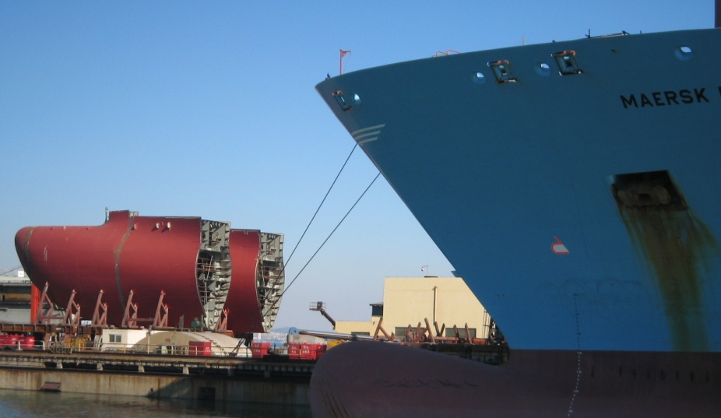
Extreme Makeovers
for our existing Fleet
Notes:
85 vessels owned by Maersk Line were retrofitted in 2013-14. 60 chartered in vessels were also retrofitted. Some retrofits were financed by Maersk Line alone, others through cost sharing with the ship owner.
Projects incl. replacing bulbous bow, raising the navigation bridge, engine modifications etc.
Investments of 5-10 million USD per ship, can have a payback of only 1-2 years.
In September 2014, Maersk Line announced an investment plan of 1 billion USD in upgrades over the next 5 years.

Slide 11
Terminal Efficiency
Working with terminals to reduce port stays through process improvements
A
Previous port to Pilot
Example: performance (hours)
1
Arrival at sea
Buoy/pilot station
25,3
0,1
-26%
2
Pilot time
3,5
1,0
18,8
3
Arrival
(first line to first move)
0,0
3,0
0,2
16,5
12,2
4
Operations
1,1
3,2
0,4
2,9
5
Departure
(last move to last line)
More timely and accurate planning
Optimized port stay
and
reduced emissions
Vessels on time
6
Pilot time
B
Pilot to next port
Notes:
Port Captains are now in place at all major US ports
Port stay will be optimized across all parts of the voyage (6 steps) from arrival at sea buoy to pilot embarkation upon departure
Objective: to remove unproductive time in each part of the 6 step chain (waiting time, delays, double work etc) – by working together to identify and correct root causes

Slide 12
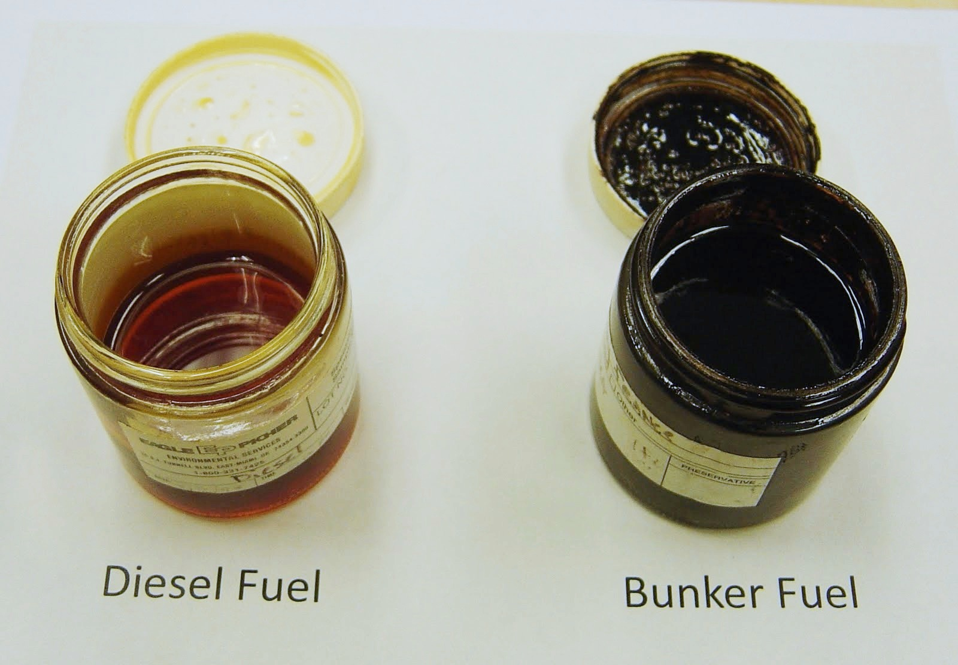
The Difference in Fuels
Changing fuels means
97% reduction in SOx
86% reduction in PM
6-10% reduction in NOx

Slide 13
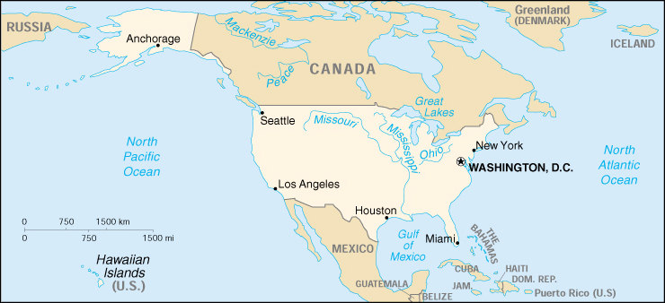
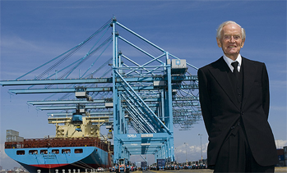
Voluntary use of 0.1% Sulfur fuel reduced air emissions significantly.
Maersk Line made >2200 port calls with voluntary fuel changes 2006 - 2012
Became mandatory
  California 2009
  North American ECA 2012 and 2015
What we learned:
  Fuel sourcing
  Port incentive programs work!
  Experience before the ECA
  Mandatory programs need to be enforced!
at berth
24nm from port or coast
Demonstration, 24 nm from port
Notes:
Prevented >4 million kg. of air emissions

Slide 14
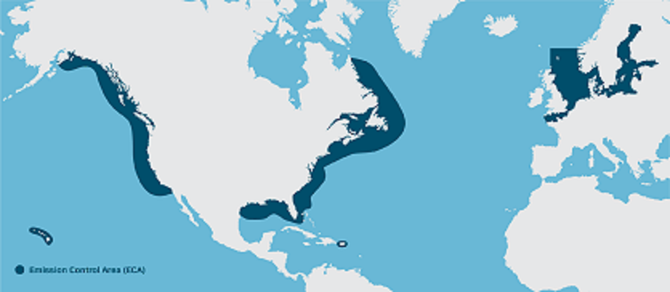

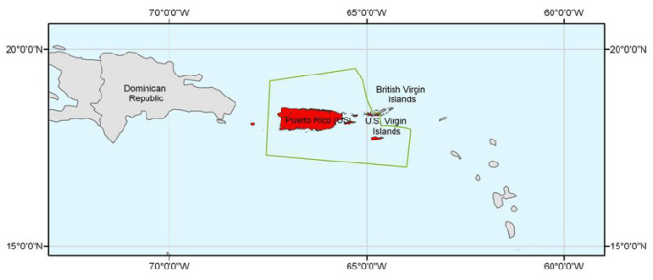
The fuel used in the Emissions Control Areas must be <0.1% Sulfur in 2015.
The ECAs require 0.1%S
MDO, MGO or “ULSFO”
California is stricter.
Work done to prepare:
Additional MGO fuel capacity
Vessel tank changes and cleaning
Fuel inventory management
Internationally
China implementing local ECAs
Mexico ECA analysis is underway
14

Slide 15
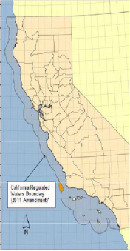
How is the ECA different from other fuel programs?
Fuel
    California requires MGO/MDO within 24nm
      Other fuels <0.1% or scrubber use allowed with an experimental exemption.
Area covered
    California zone is 24 nm from the coast vs. 200 nm for ECA.
Enforcement
  NAM ECA is enforced by the US Coast Guard, the US EPA and Canada.
  CARB enforces the California Fuel rule.
    Vessel inspections with fuel sampling

Slide 16
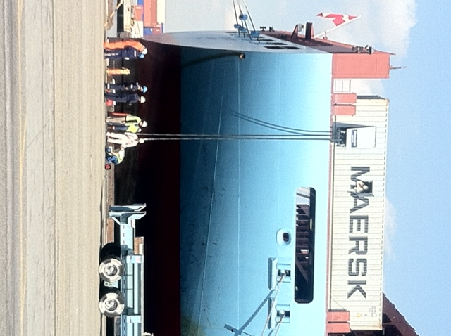
Reducing emissions at berth
  Shore Power (“cold ironing”)
  Reducing vessel NOx and PM emissions at berth in California.
    Quarterly fleet average minimum reduction in each port:
  2014-16: >50%
    2017-19: >70%
    2020: >80%
  Results must be reported and certified annually
16
Notes:
Two compliance options:
Shore Power only (most carriers)
Equivalent Emissions Reduction starting in 2010 (Maersk & NYK)
Status: Maersk Line chose the more flexible EER option.
2010 – 2013 ML complied with credits from early fuel switch programs
2014 AMP for a 50% reduction; continue to search for alternatives.

Slide 17
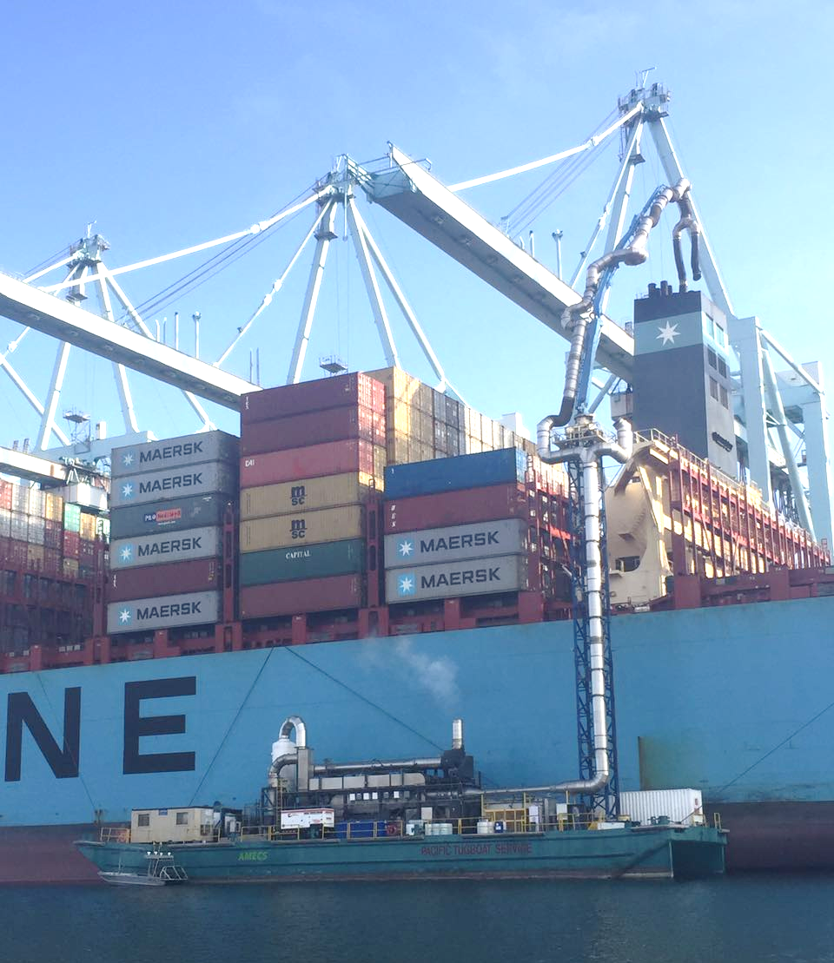
Shore power alternatives
Barge-mounted stack gas treatment systems require no change to the vessel
California has approved two alternative systems
17

Slide 18
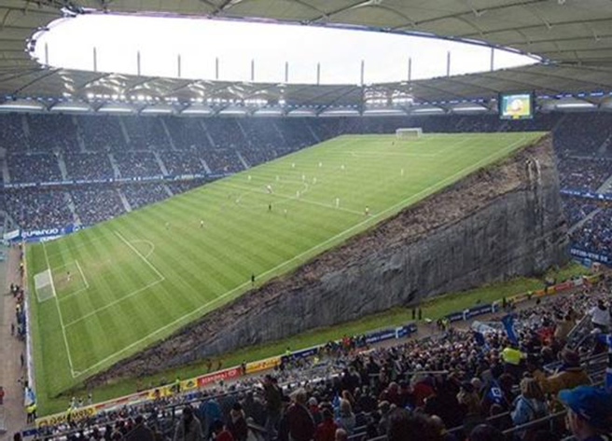
Enforcement is essential to maintain a level playing field.
Robust Enforcement and proper deterrents ensure compliance across the shipping industry
  Without enforcement the good are punished and the bad are rewarded
Robust Enforcement protects the Ocean environment and human health
  Without enforcement the full benefit of regulations is not realized
Robust Enforcement shows investors and innovators that there will be a market; solutions will be created
  Weak enforcement deters investors and hampers innovation
Notes:
Trident:
A large vessel can save 500-1000 $/h
We have surveyed all EU states, and the picture is rather depressing…
Norwegian Maritime Authority:
Sardius, De Bock Maritiem BV, breached the 0.10% sulphur limit within the ECA twice. The fine was NOK 100,000 (ca $12,200).
Denmark has as many as 8 cases under preparation but over a year later we have seen no outcomes.
Clear legal framework
Timely and dissuasive penalties
Adequate resources
Effective implementation

Slide 19
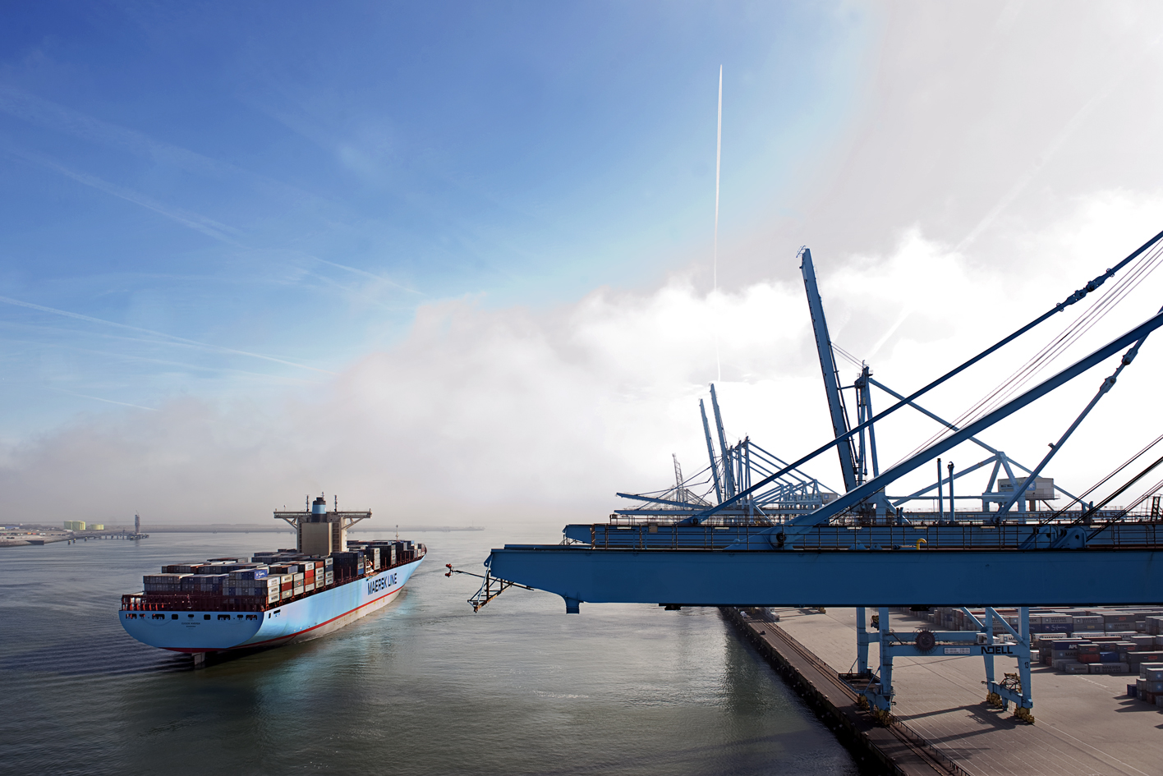
Thank you

