Slide 1
Cruise Ship Industry
Perspectives of the NA ECA
Greg Wirtz, President
Cruise Lines International Association – North West & Canada

Slide 2
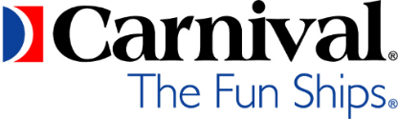
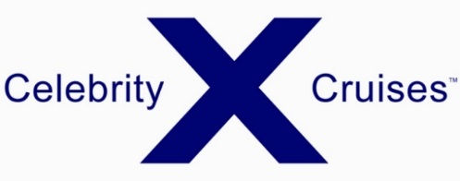


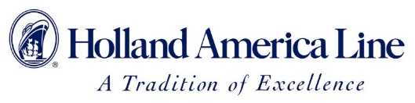




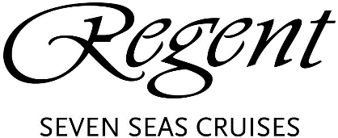




CLIA NORTH WEST & CANADA MEMBER LINES

Slide 3
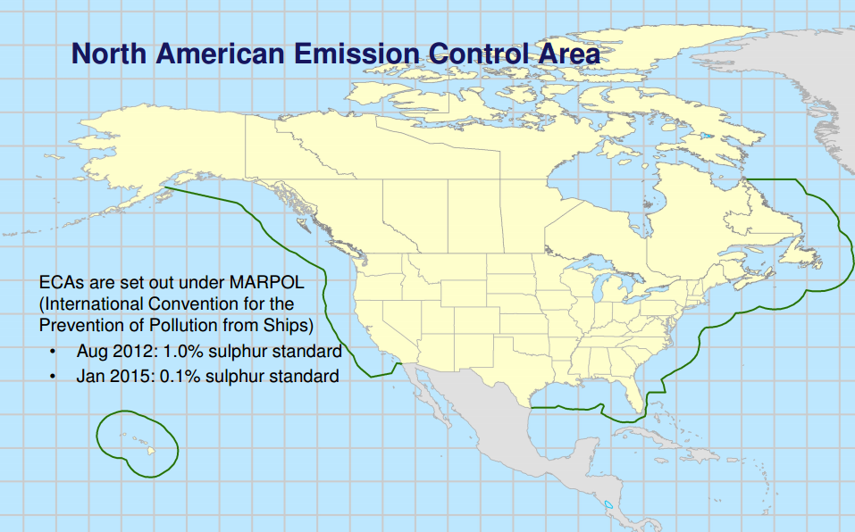

Slide 4
North American ECA
Cruise Industry Observations
Coastal vessel operators like cruise uniquely affected vs transocean
Cruise lines can’t just “pass along” fuel cost increases to consumers
Disproportionate impacts on Alaska and Canada/New England cruises
Potential impact on NA cruise industry spurred innovation / investments in new technology

Slide 5
Currently, the average ECA compliant fuel (MGO) costs less than the average Bunker Fuel cost pre-ECA
Average Marine Fuel Price Comparisons, 2011-2016

Slide 6
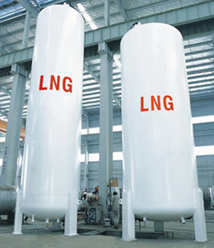
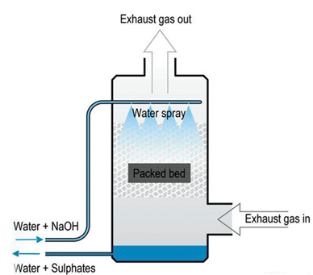
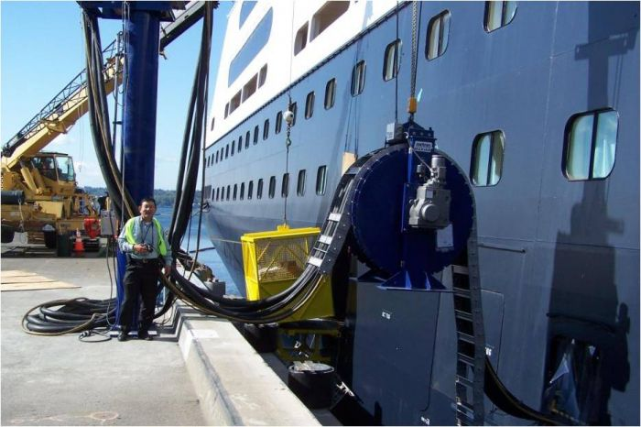
ECA Compliance
Cruise ships must meet or exceed SO2 emissions requirements at all times.
Cruise Ships reduce SO2
Low sulphur fuels
Treatment technologies (scrubbers)
Shore power while berthed

Slide 7
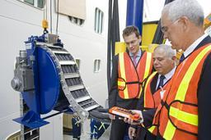
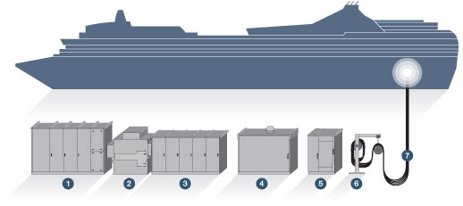
Cruise Ship Shore Power Installations
West Coast:
Juneau, AK
Vancouver, BC
Seattle, WA
San Francisco, CA
Los Angeles, CA
San Diego, CA
Long Beach, CA
East Coast:
Brooklyn, NY
Halifax, NS
…..

Slide 8
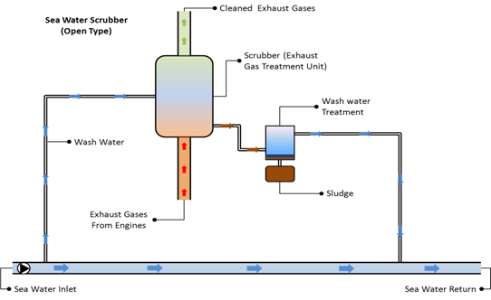
Sea Water Exhaust Scrubber Example

Slide 9
Alaska Cruise Ship Fleet
31 Member cruise line vessels operating in Alaska market in 2016:
  22 vessels with scrubbers installed or planned
  15 vessels shore power enabled
  6 vessels meeting ECA compliance on fuel (MGO) only

Slide 10
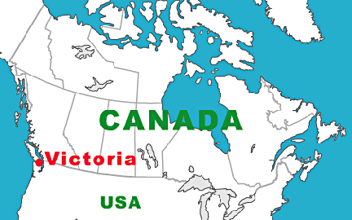
Victoria BC Case Study
Port of call on Alaska cruise itineraries
Cruise ships are virtually the only deep sea vessels operating in the harbour (May-Sep)
Cruise terminal adjacent to residential neighbourhood
Continuous air monitoring and live online reporting
Overall excellent air quality, but occasional elevations of SO2 emissions in harbour area

Slide 11
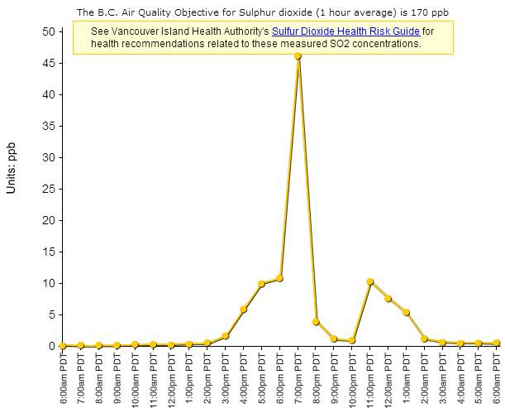
Victoria BC (James Bay)
Example SO2 monitoring chart
August 15, 2014
Vessel A
Vessel B
Vessel C

Slide 12
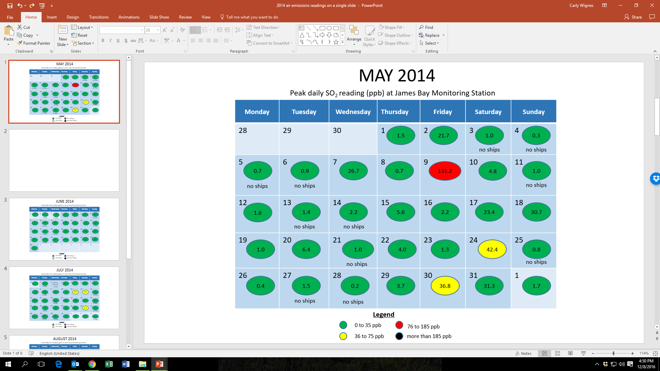
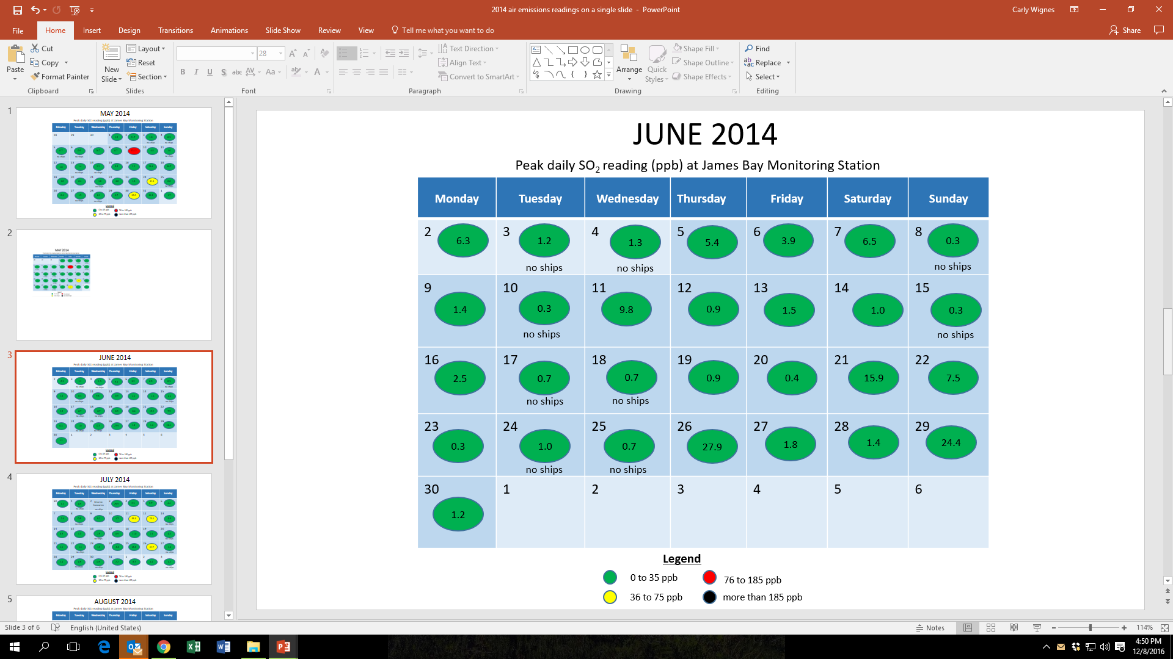
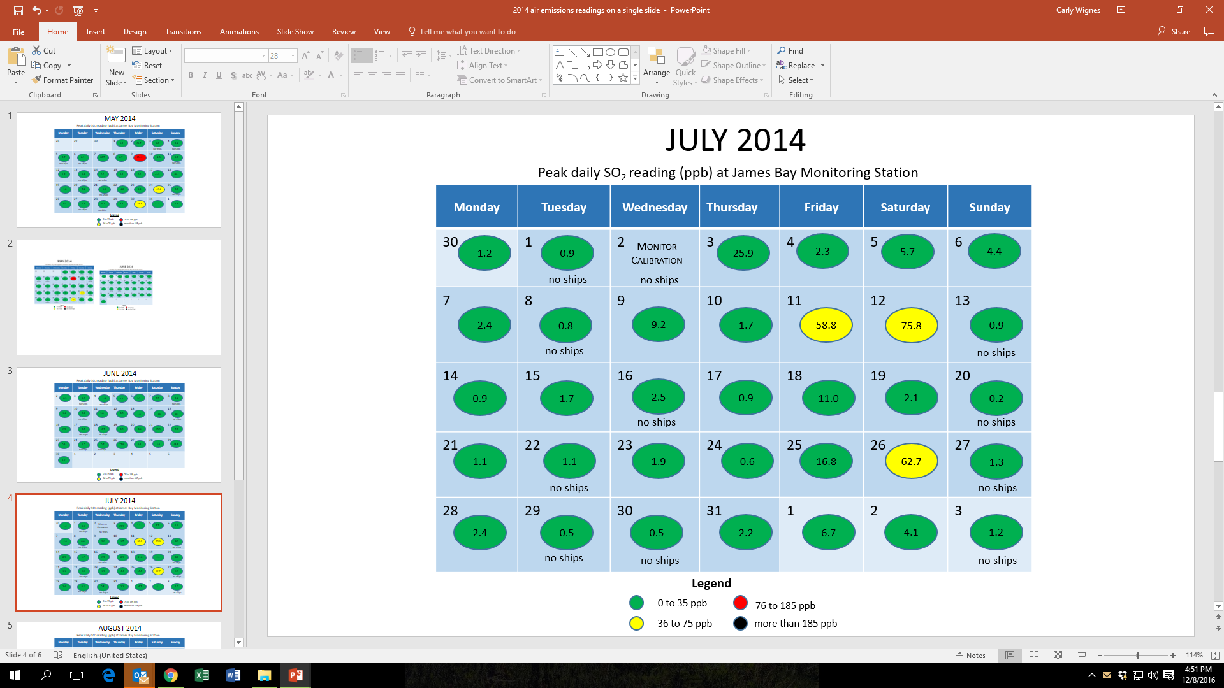
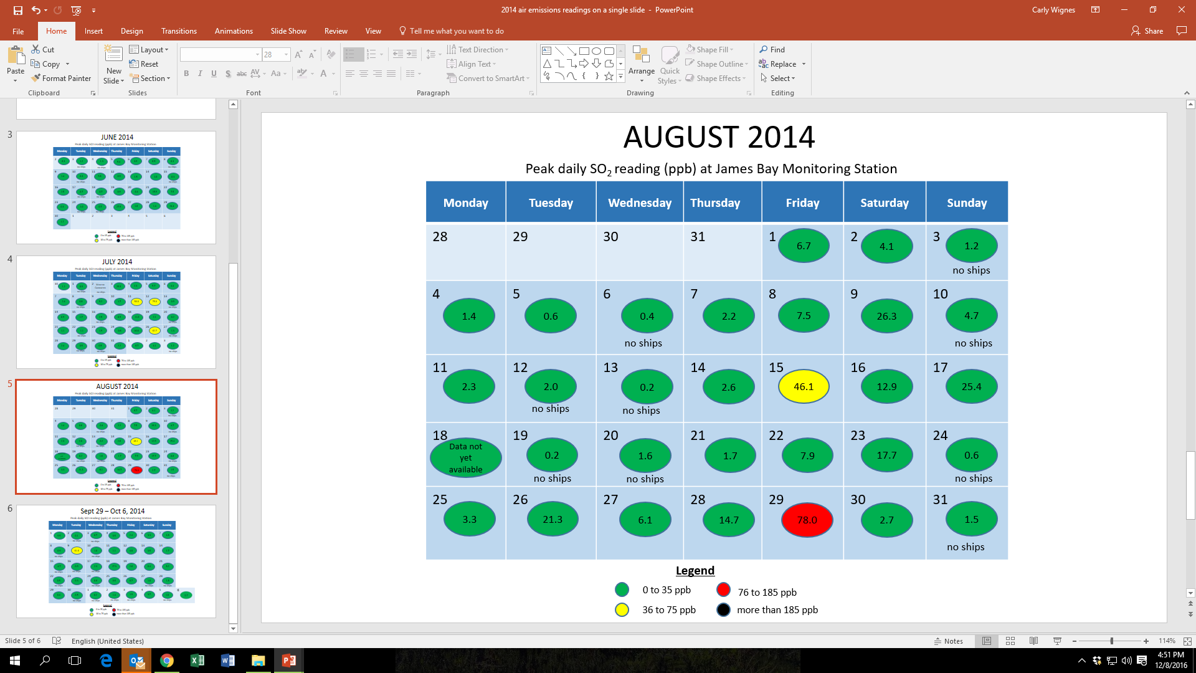
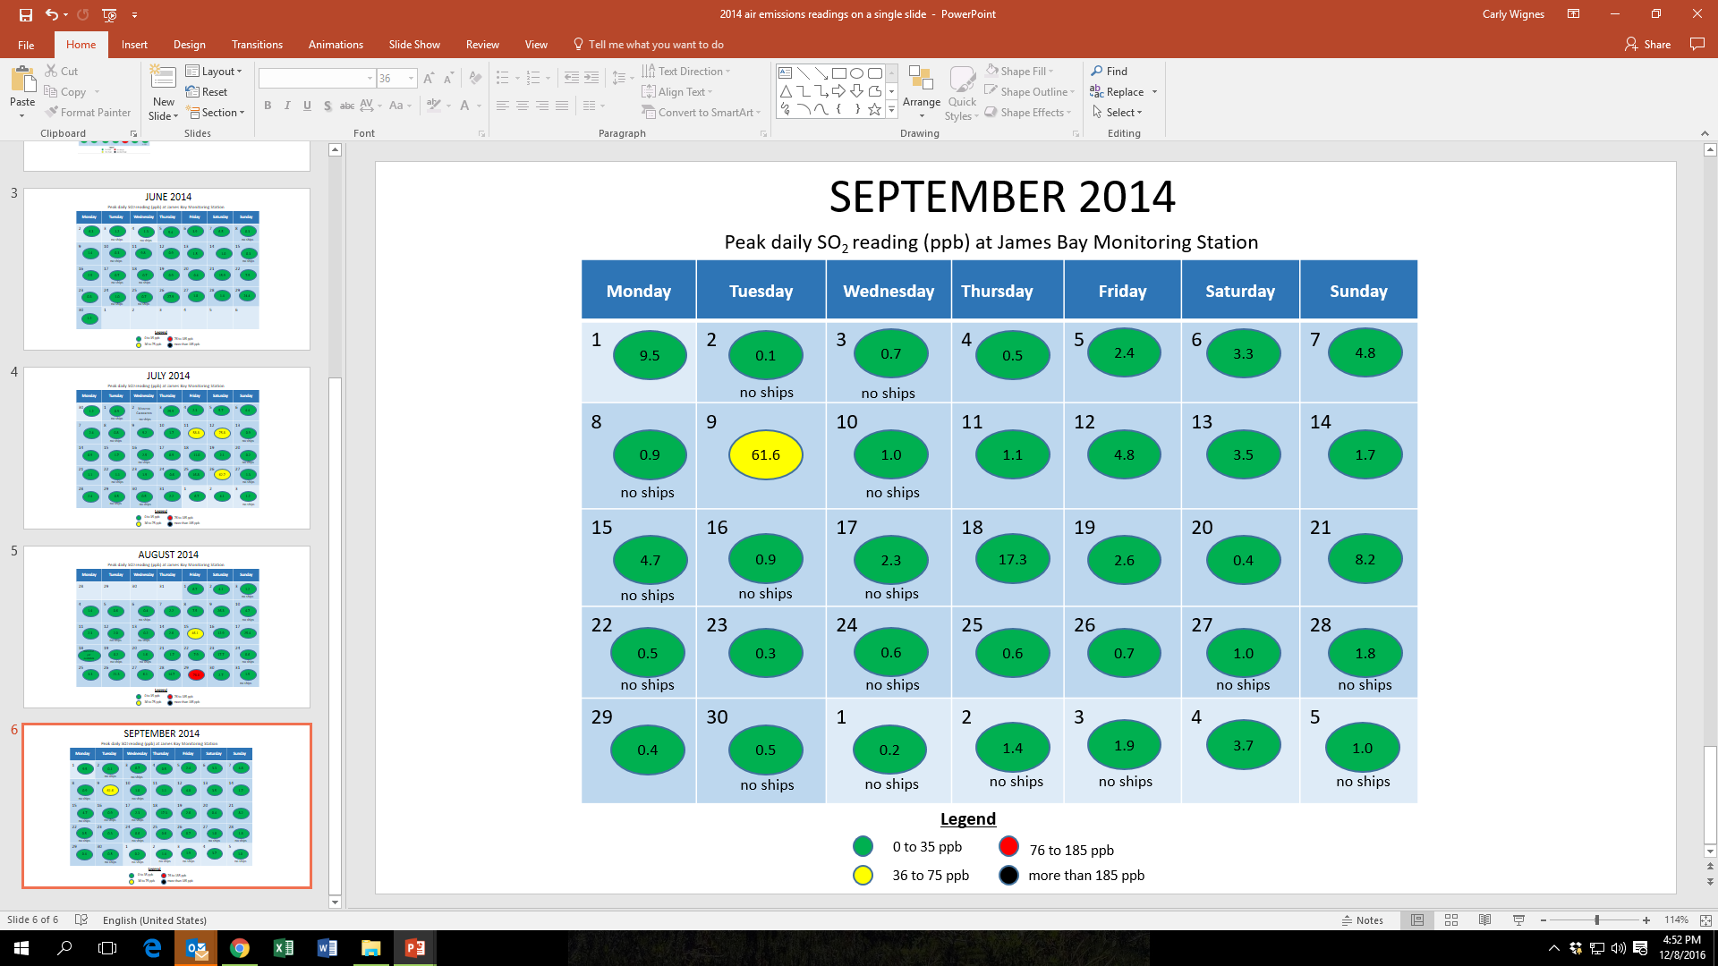
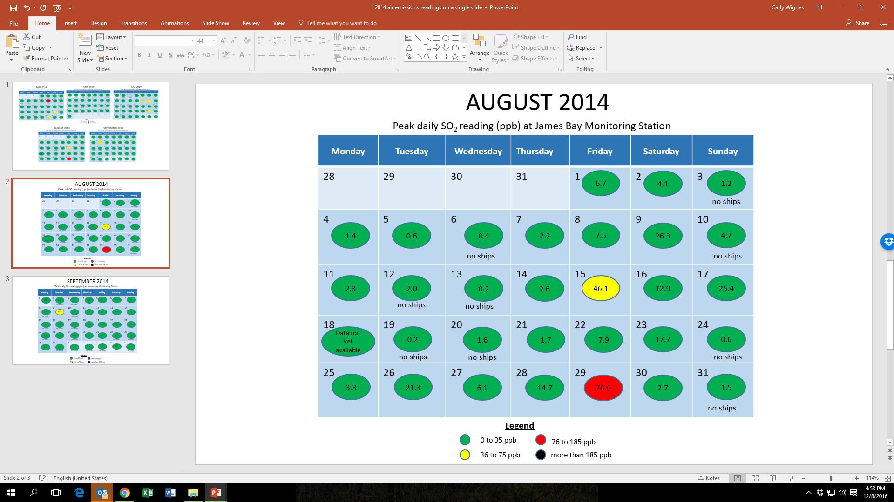
Daily Peak SO2 Reading Summary
Victoria (James Bay) 2014 Cruise Season

Slide 13
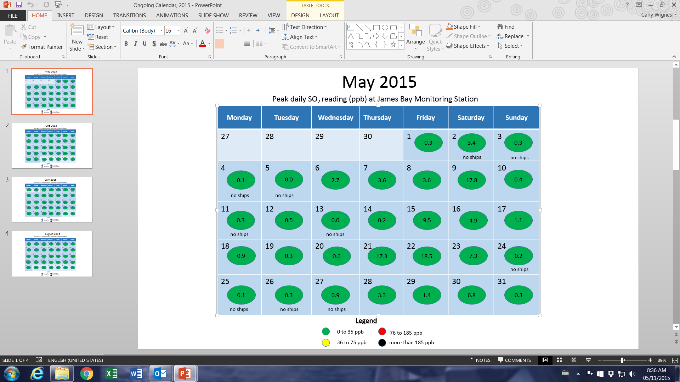
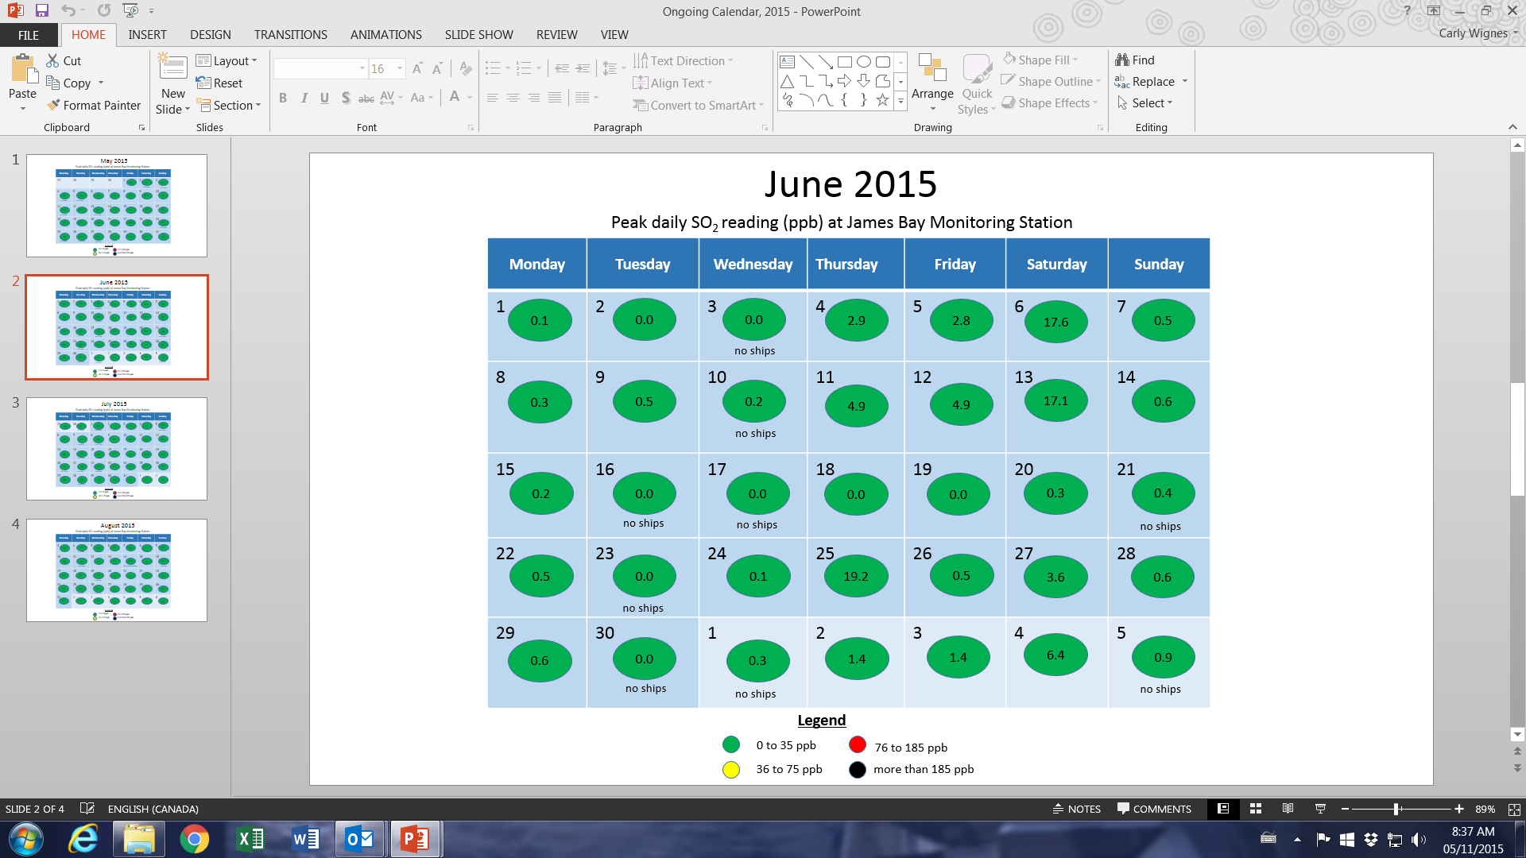
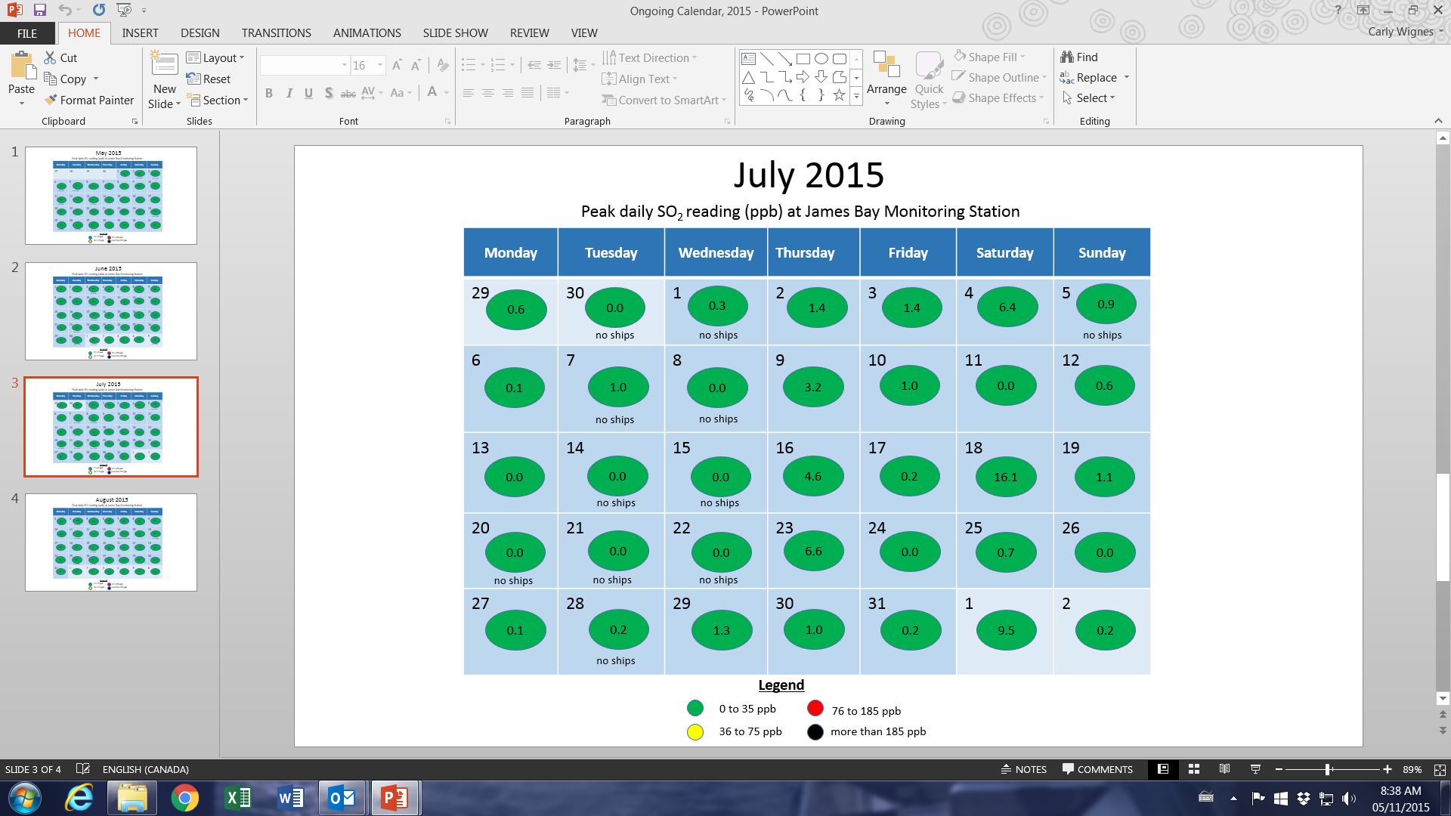
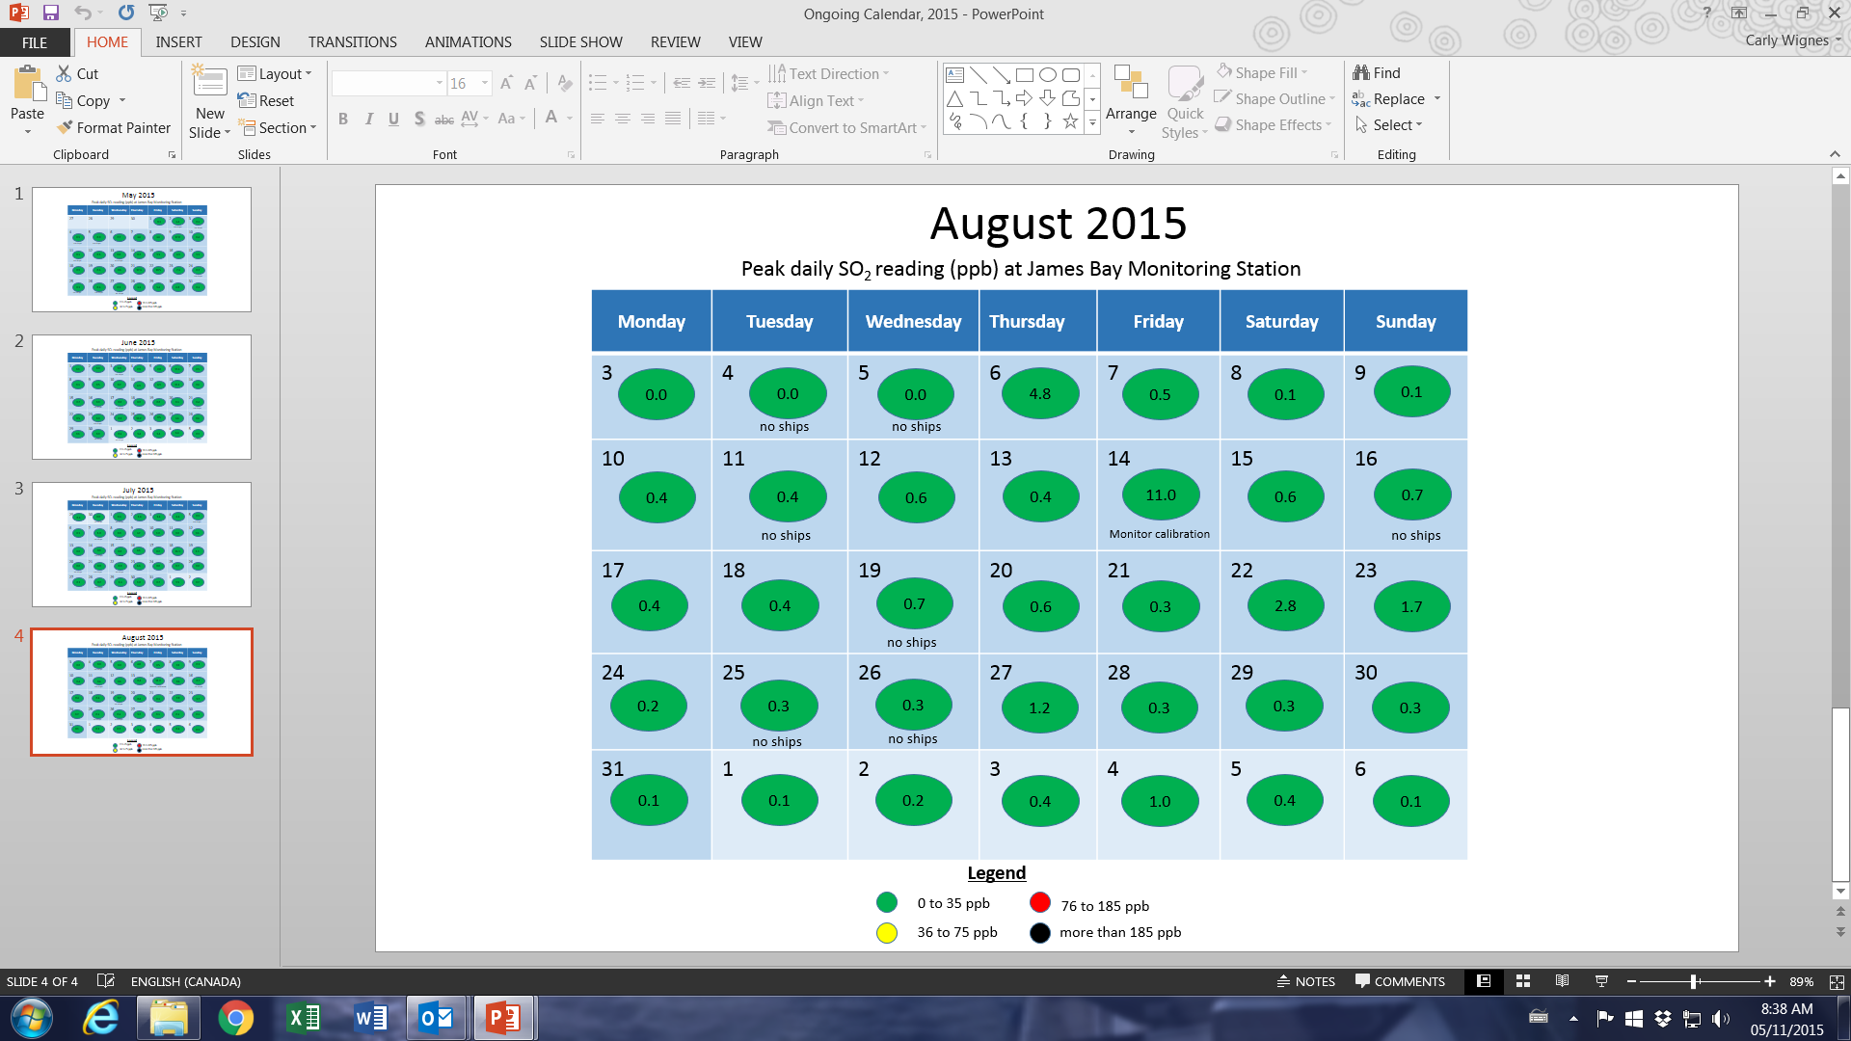
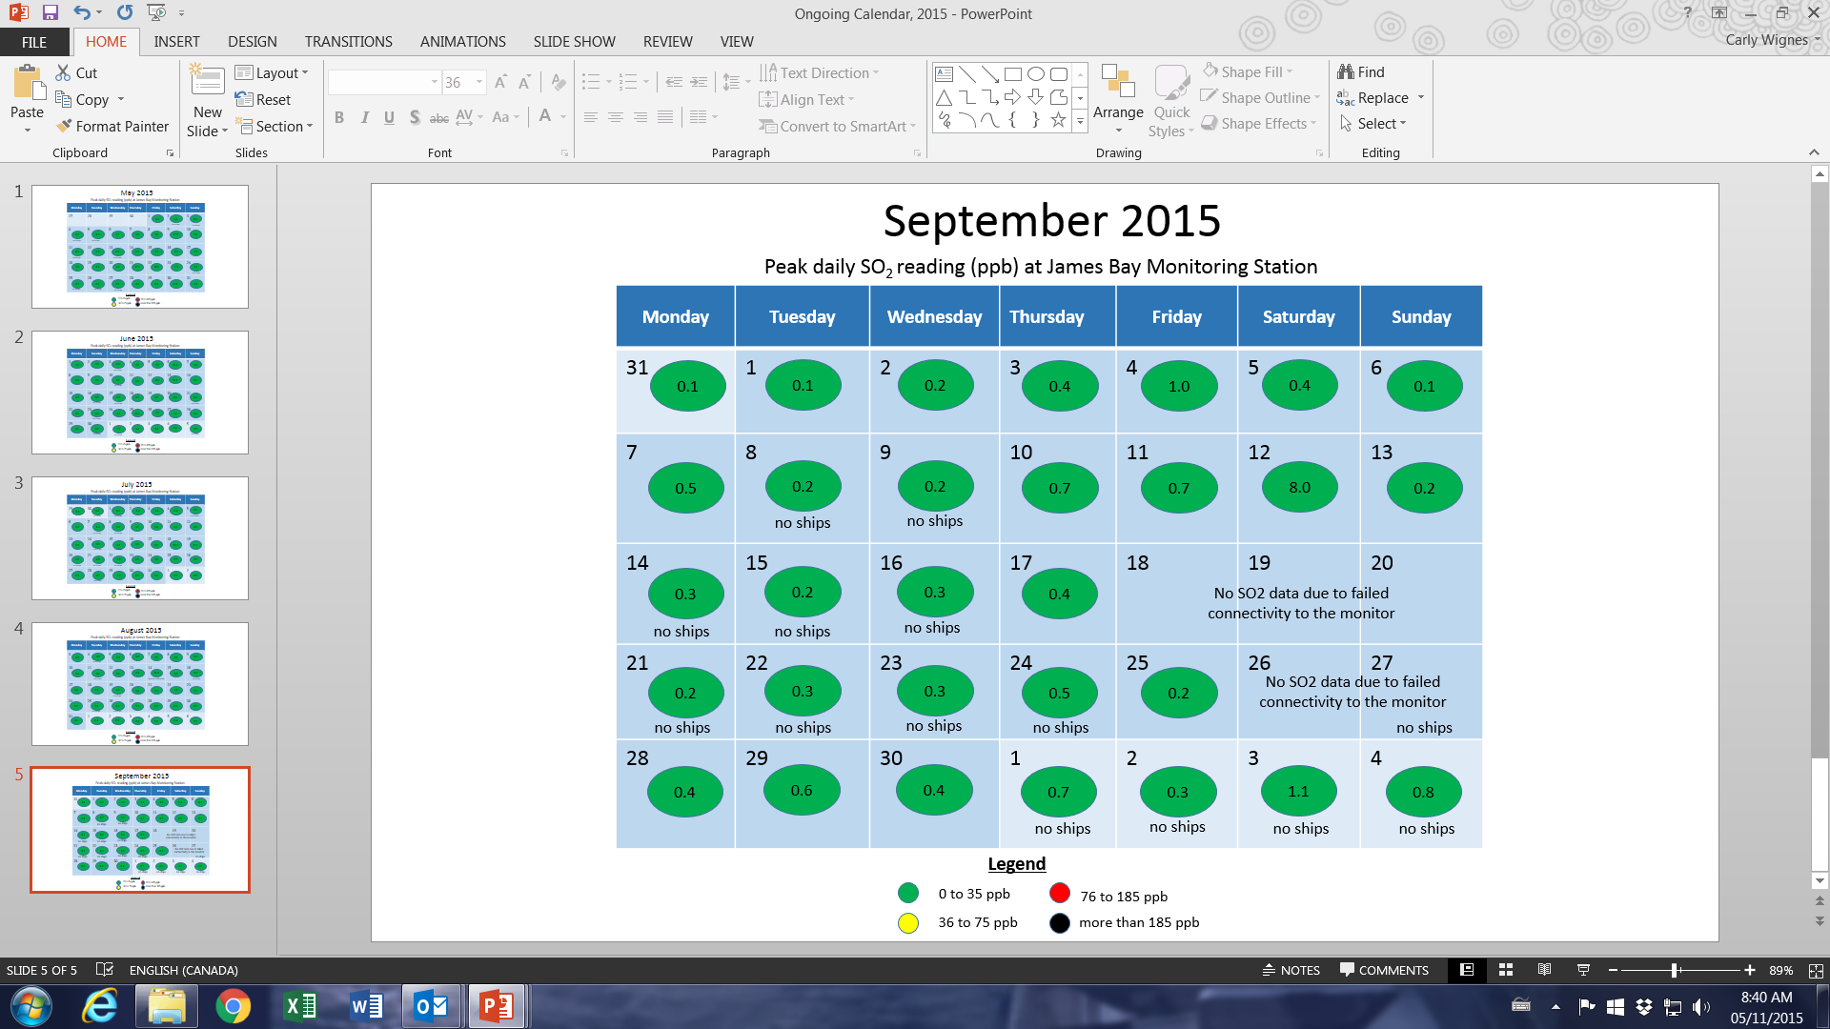
Daily Peak SO2 Reading Summary
Victoria (James Bay) 2015 Cruise Season

Slide 14
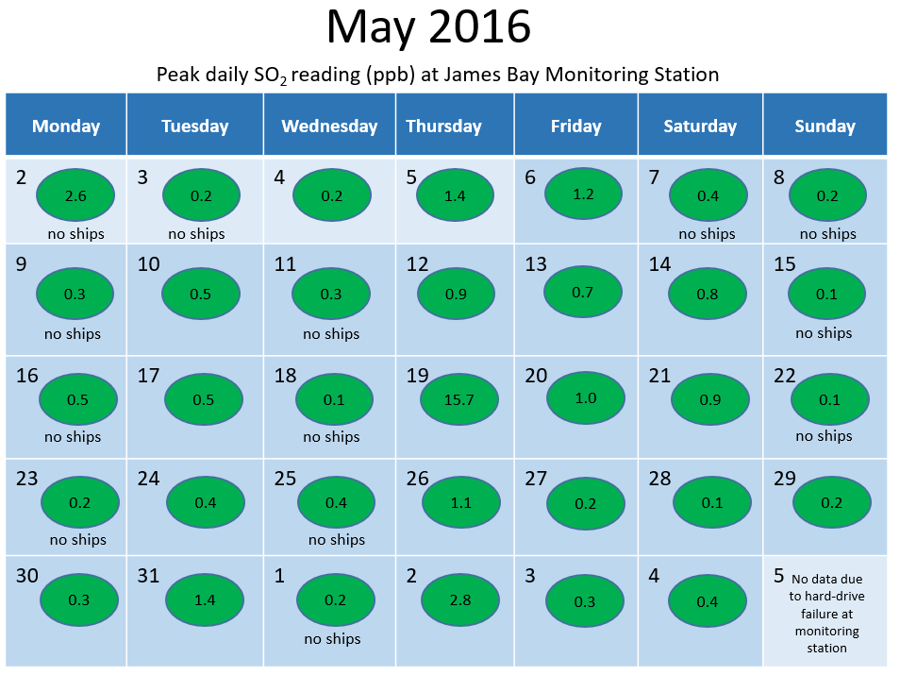
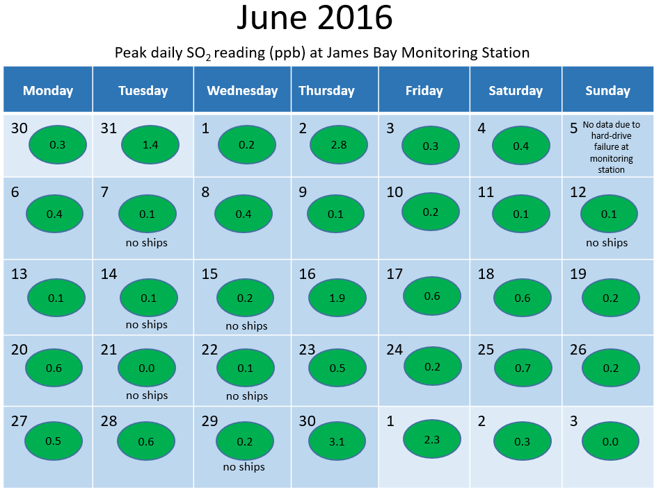
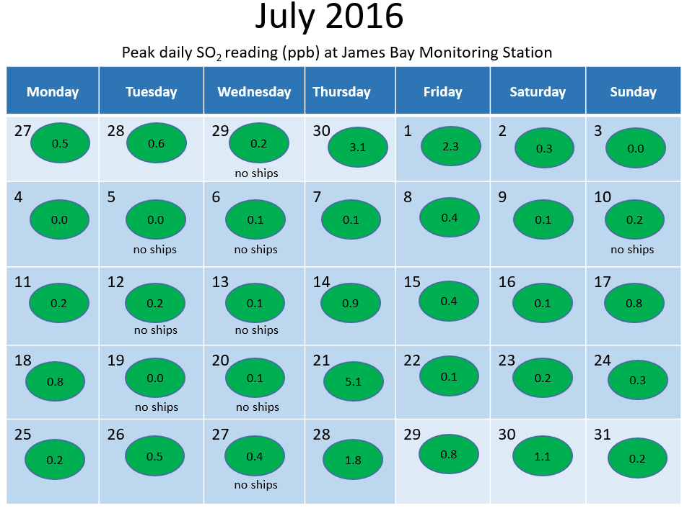
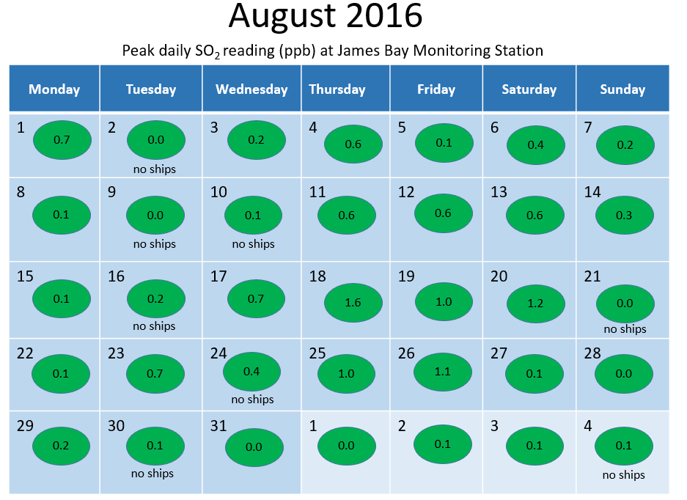
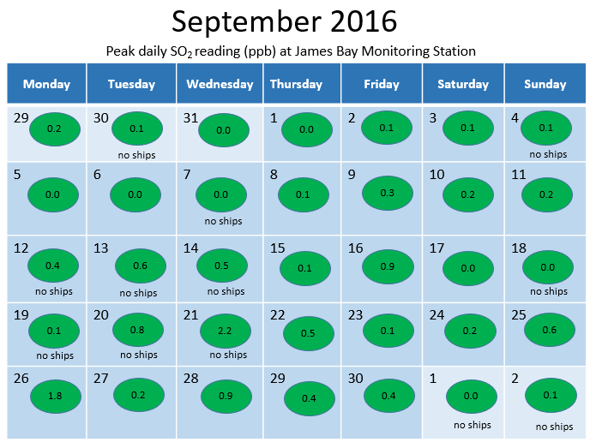
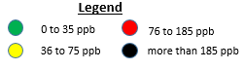
Daily Peak SO2 Reading Summary
Victoria (James Bay) 2016 Cruise Season

Slide 15
Thank you!
Greg Wirtz, President
CLIA North West and Canada

