Slide 1

Commission for Environmental Cooperation (CEC)
Joint Public Advisory Committee (JPAC)
Greening Freight Operations Across America
December 12, 2017
CAAP 2017
Richard D. Cameron

Slide 2

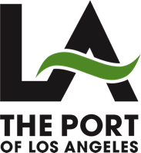
Joint Meeting of the Board of Harbor Commissioners

Slide 3
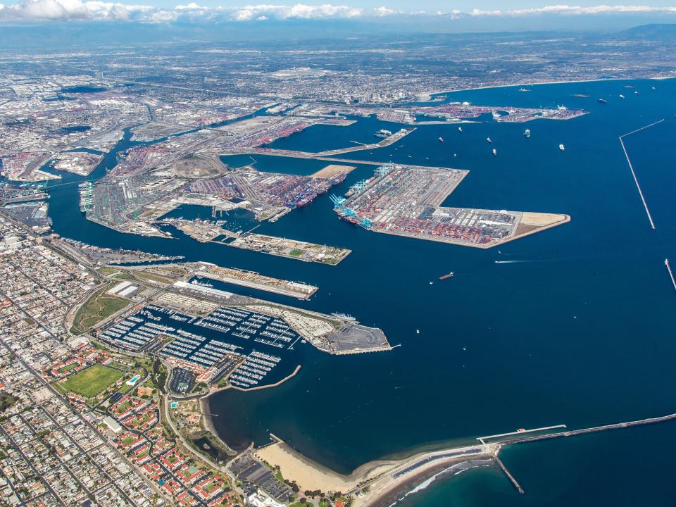
San Pedro Bay Ports
Partners for environmental improvements

Slide 4


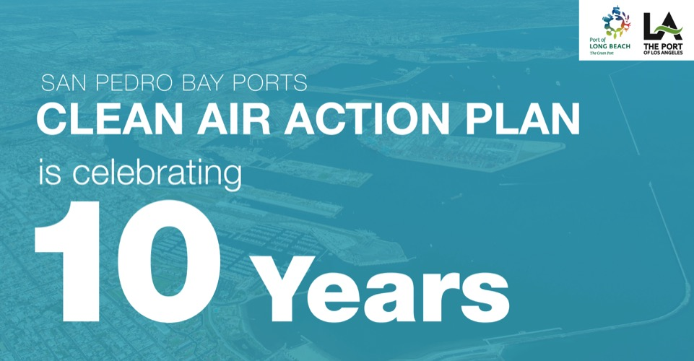
Notes:
Background:
Jointly Adopted in November 2006 by POLA and POLB
Goal to significantly reduce air pollution and health risk from sources related goods movement
Developed in coordination with USEPA, CARB, AQMD
Updated in 2010: San Pedro Bay Standards for 2014, 2020 and 2023
Successful Measures:
Clean Truck Program
Shorepower for Ships
Vessel Speed Reduction
Switching to Clean Fuels
Fleet Upgrade /Turnover for Cargo Handling Equipment, Harbor Craft, Trains
Technology Advancement Program

Slide 5

Combined 2015 Air Emissions Results
Diesel Particulate Matter:
DOWN
Nitrogen Oxides:
DOWN
50%
84%
2014
2023
22%
59%
Sulfur Oxides:
DOWN
2014
72%
2023
77%
Greenhouse Gases:
DOWN
97%
12%
7%
2014
2023
TEUs
UP
93%
93%
Notes:
These strategies have led to the substantial improvement in air quality in this area. Compared back to 2005, we’ve seen significant reductions.
At the same time, our cargo throughout is up since 2005, so these are real reductions as a result of our strategies and state laws.
We have already met the aggressive goals we set for ourselves in the first CAAP for our milestone year of 2014, and we’re well on our way to meeting our 2023 goals. However, we have a lot of work to do, and it won’t be easy.

Slide 6
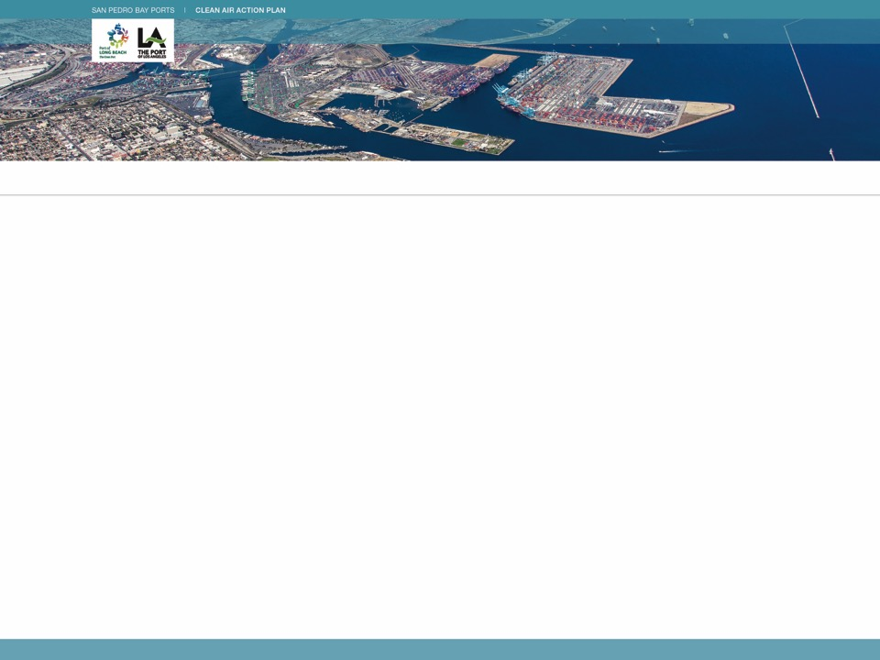
Draft Clean Air Action Plan 2017 Update
Supports the State’s Sustainable Freight Action Plan
Establishes New Long-Term Greenhouse Gas Reduction Goal
Proposed Strategies:
  Clean Vehicles, Equipment Technology and Fuels
  Freight Infrastructure Investment and Planning
  Freight Efficiency
  Energy Resource Planning

Slide 7
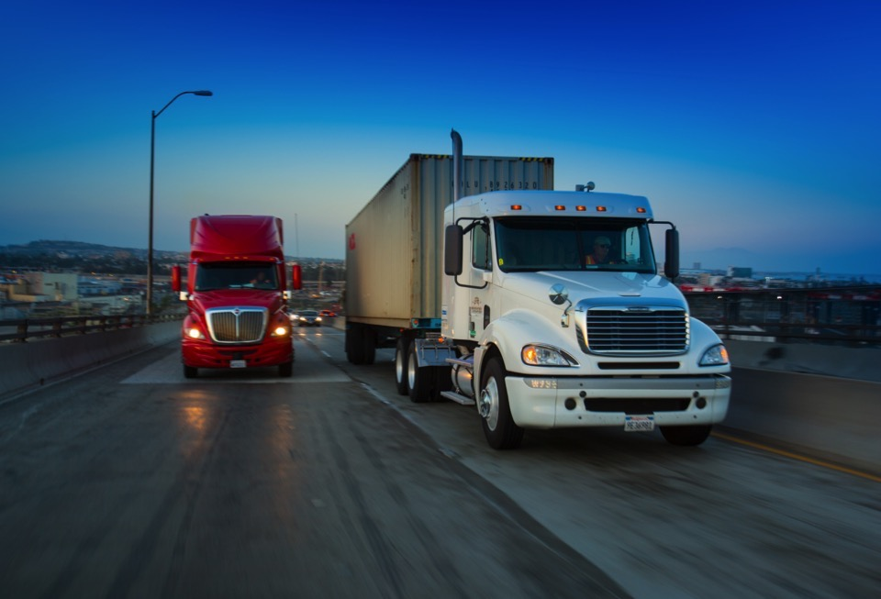
Heavy-Duty Trucks
Advance the Clean Trucks Program and transition to zero-emission trucks by 2035
Adopt a “Green Truck Priority” program at terminals to accelerate deployment of zero and near-zero emission trucks
Notes:
These strategies targeted trucks, which were once one of the largest sources of port-related pollution. Today, those emissions have dropped by more than 95% through our landmark Clean Trucks Program, which banned older diesel trucks from entering the ports.

Slide 8
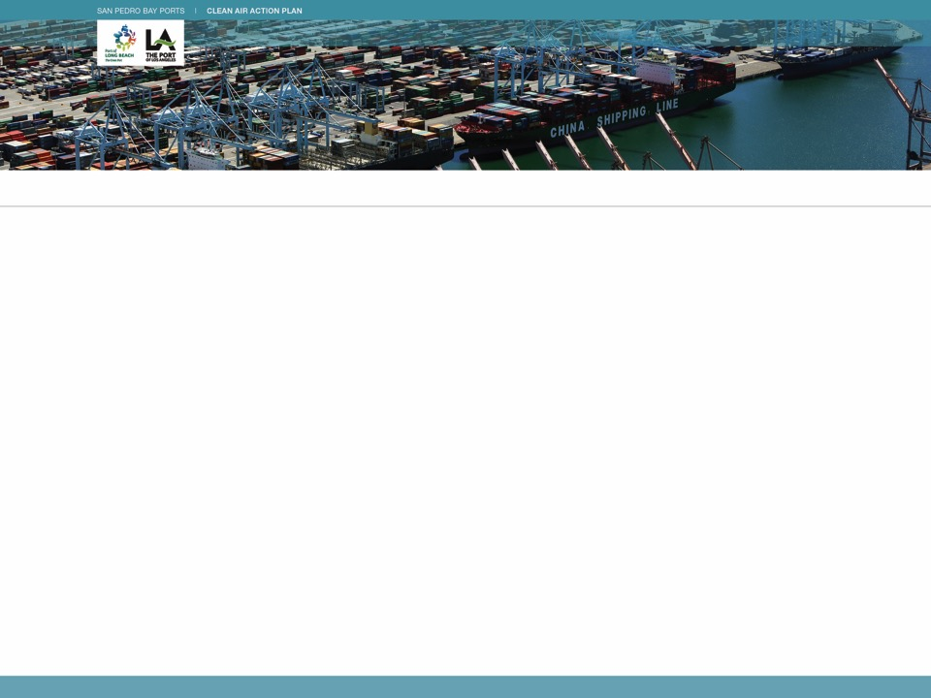
Proposed Clean Truck Program Strategy
Beginning in early 2018, all trucks with engines 10 years or older must pay a fee with the exception of near-zero and zero-emissions trucks
Beginning in 2020, all trucks must meet the federal 2010 engine emission standard
Beginning in 2023, or when the State’s near-zero-emission engine standard takes effect, new trucks entering the Ports Drayage Truck Registry must meet this standard or better
Beginning in 2035, all trucks must be zero emissions
Notes:
Our cargo throughput is rising, and as more containers come through these ports, we will be challenged to hold onto the emission reductions we’ve already achieved.
At the same time, there are no new state or federal regulations on the horizon that could help us accelerate new emissions reductions.
Our partners have already invested millions of dollars to replace old diesel equipment – for example, the trucking industry spent over $1 billion to comply with our Clean Truck Programs – and it’s unlikely that we’ll see substantial new fleet turnovers any time soon.
And lastly, there are very few commercialized clean-air technologies, particularly zero emission technologies, which is what we’re really after.
This time around there are no easy strategies. This will be our toughest CAAP yet.

Slide 9
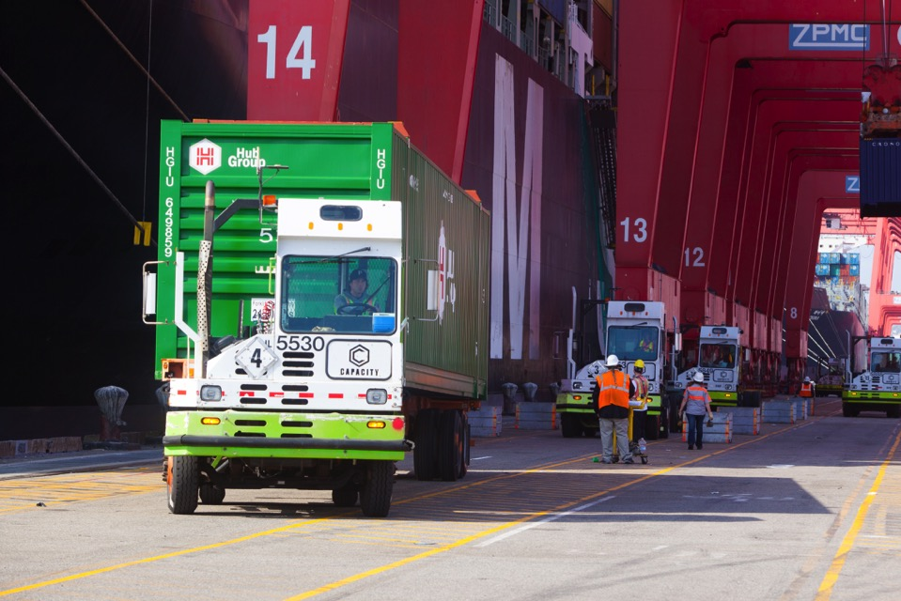
Terminal Equipment
Transition to zero emissions terminal equipment by 2030, with procurement planning starting in 2020
Establish a Terminal Equipment Idling Reduction Program
Develop charging standards

Slide 10
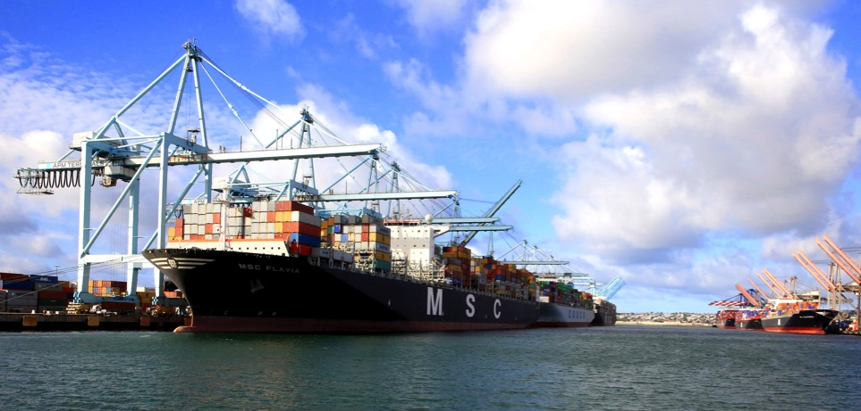
Ocean-Going Vessels
Expand vessel speed reduction compliance to 40 nautical miles
Use at-berth emission reduction technologies
Incentivize energy efficiency upgrades and clean technologies
Develop a Clean Ship Program to transition the oldest, most polluting ships out of the fleet

Slide 11
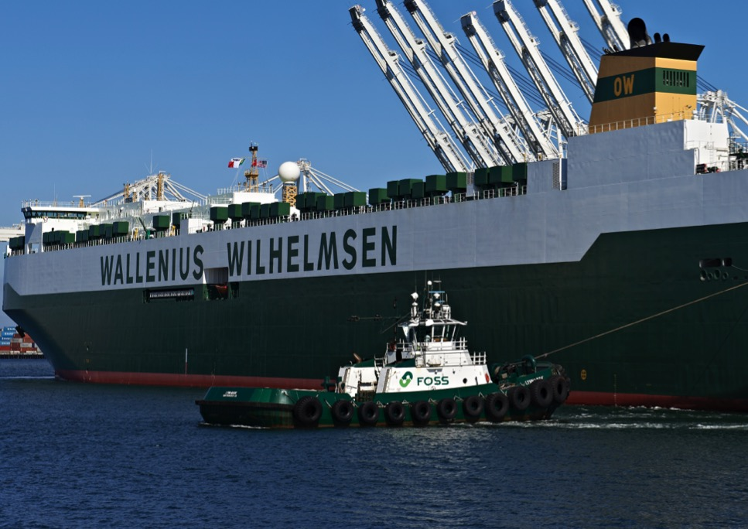
Harbor Craft
Accelerate the deployment of cleaner harbor craft engines and operational strategies to reduce harbor craft emissions.

Slide 12
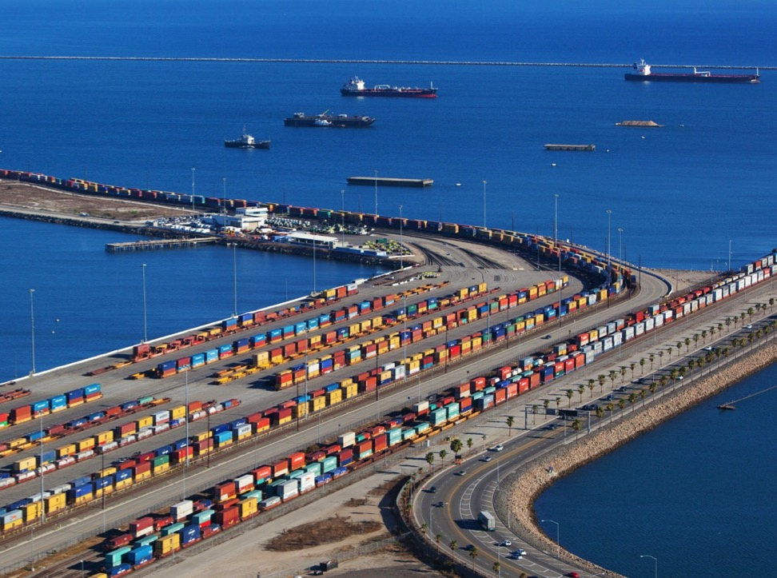
On-Dock Rail
Notes:
Rail Locomotive emissions have also decreased as a result of rail efficiency improvements and the turnover to cleaner locomotives. We also saw a dramatic increase in the amount of cargo shipped via on-dock rail compared to 2005.

Slide 13

Freight Efficiencies
Develop Green Terminal Program
Study strategies to enhance systemwide efficiencies

Slide 14
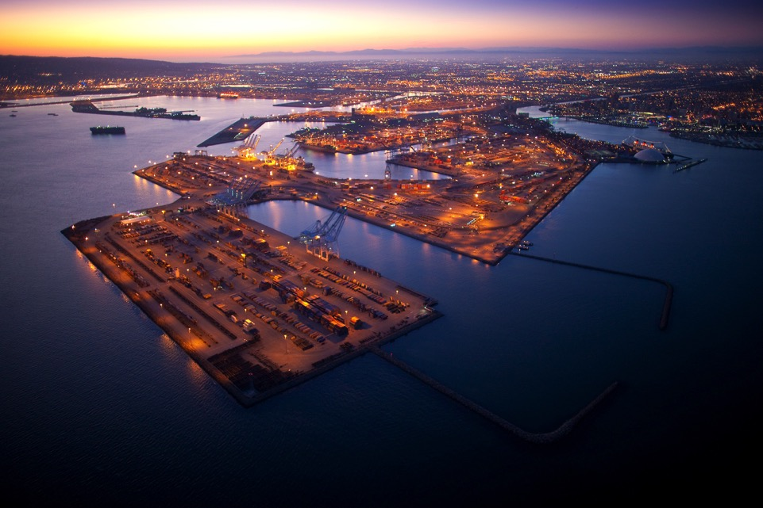
Energy Resources
Develop design criteria and infrastructure plans

Slide 15
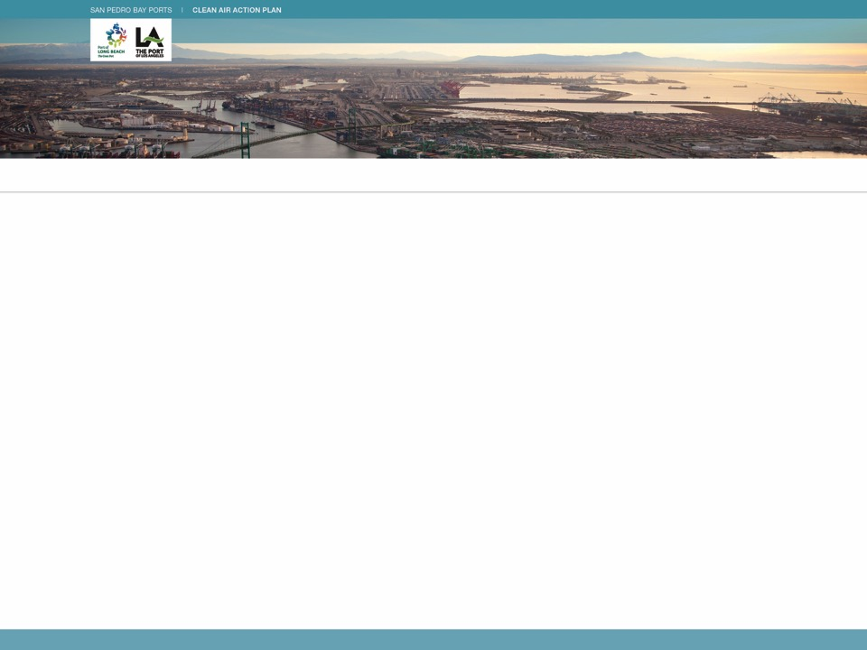
CAAP 2017 Discussion Document available at:
www.cleanairactionplan.org
Please provide comments:
caap@cleanairactionplan.org
Community Meeting - January 2017
Comments are due by Friday, February 17, 2017

Slide 16

Joint Meeting of the Board of Harbor Commissioners
Questions?

