Slide 1
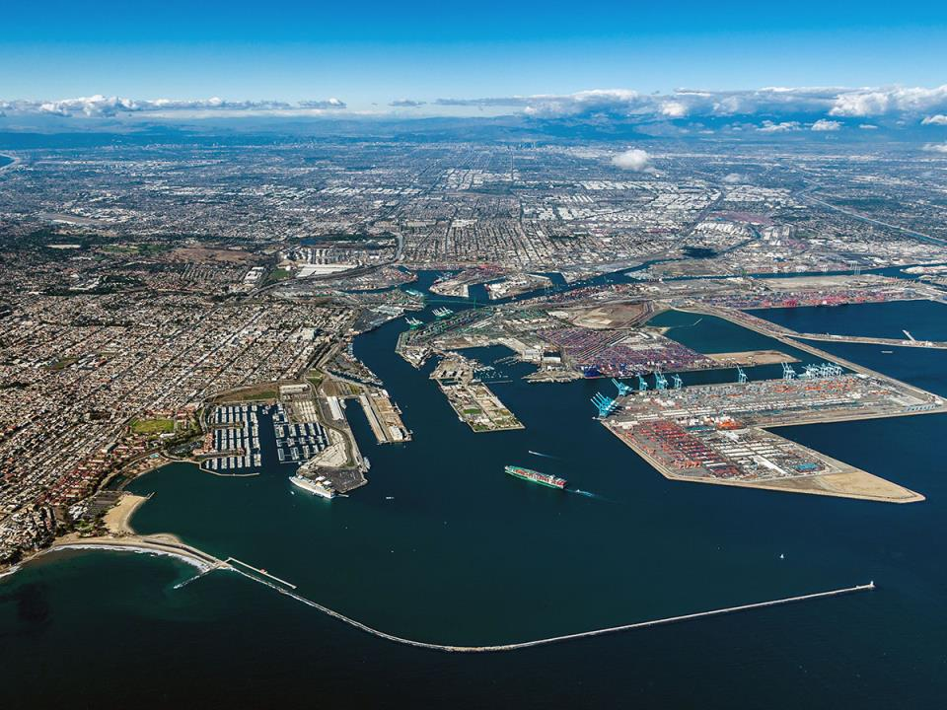

Sustainable Operations to Achieve Climate Goals

Slide 2
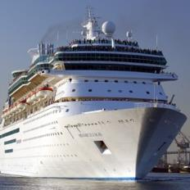
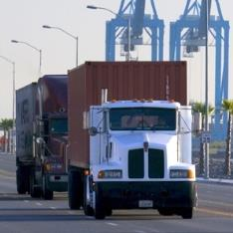
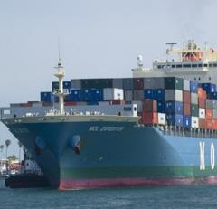
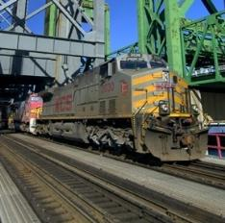
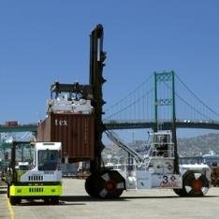
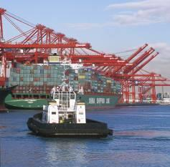
Mobile Pollution Sources at Ports
Notes:
However, 3 of our 5 sources are not directly controlled by the Port. We need a coordinated effort to address these sources.

Slide 3
Clean Air Goals and Reductions
(from 2005 baseline)
 | 2014 Goal | 2014 Actuals | 2015 Actuals | 2023 Goal
DPM | 72% | 85% | 85% | 77%
NOx | 22% | 52% | 51% | 59%
SOx | 93% | 97% | 97% | 93%
Notes:
These are our long term goals that were adopted as part of the 2010 CAAP Update. We have reached all of goals for 2014. Does this mean we need to stop? “No.” As other factors like cargo throughput continue to grow, emissions will grow and we will need new strategies to reduce pollutants. This is the main reason why we are currently updating the CAAP.
The small increase in NOx between 2014 and 2015 is due to the increased period of congestion that occurred throughout the San Pedro Bay Ports from Fall 2014 to Spring 2015

Slide 4
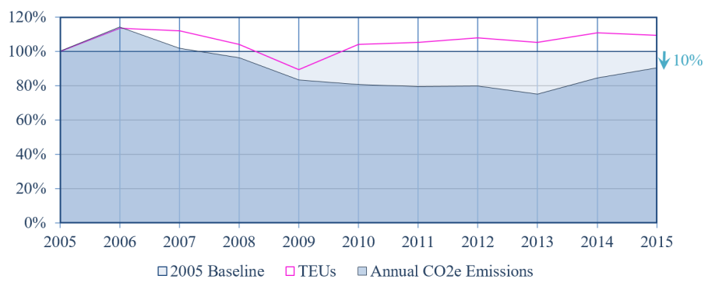
CAAP CO₂e Progress
25%
10%
Notes:
Points of interest
Noted on slide
We anticipate that CO₂e will resume tracking similar to pre-2014 trends starting in 2016, however OGVs will tend to increase boiler usage (a big CO₂e source) due to the CARB shore power regulation implementation requirements (cruise, container, reefers).
Increase in CO₂e due primarily to period of temporary congestion, increase use of boilers by OGVs using shore power, increased cruise activities compared to 2013. YELLOW CIRCLE

Slide 5
National/International Challenges
Continued Emission Reductions for Non-Attainment Areas to Address Community Health Impacts
Greenhouse Gas Reduction and Climate Change
Alternative Fuel, Near Zero (hybrid) and Zero Emission Vehicles and Equipment Demonstration/Availability
International Regulation of Ships
  Level Playing Field
  Consistent and Comprehensive Enforcement

Slide 6
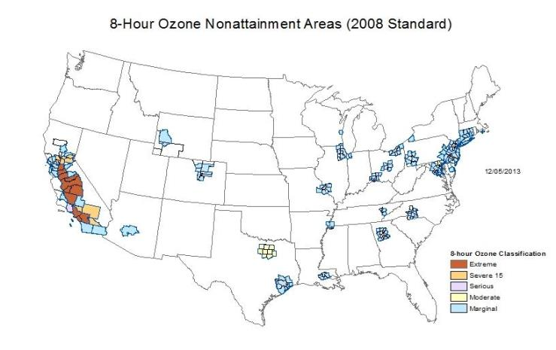
National Ambient Air Quality Standards Nonattainment
Notes:
We still have work to do. First, our SCAB is not in attainment for Ozone (extreme non-attainment),
Describe graphic…
6

Slide 7
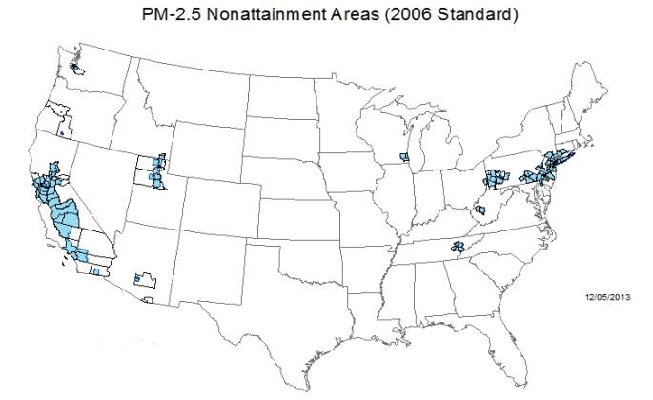
National Ambient Air Quality Standards Nonattainment
Notes:
…and PM2.5.
PM 2.5 areas of non-attainment
7

Slide 8
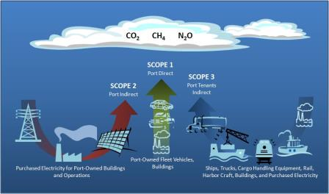
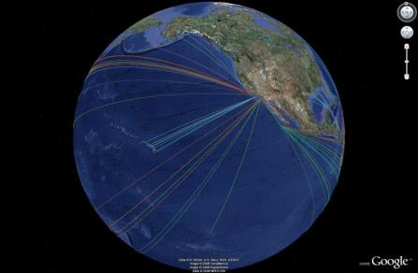
Greenhouse Gas Reduction
AB32
1990 Levels by 2020
80% Below 1990 Levels by 2050
City of Los Angeles
45% Below 1990 Levels by 2025
60% Below 1900 Levels by 2035
Notes:
In addition, AB32 set an 80% GHG emission reduction goal by 2050.

Slide 9
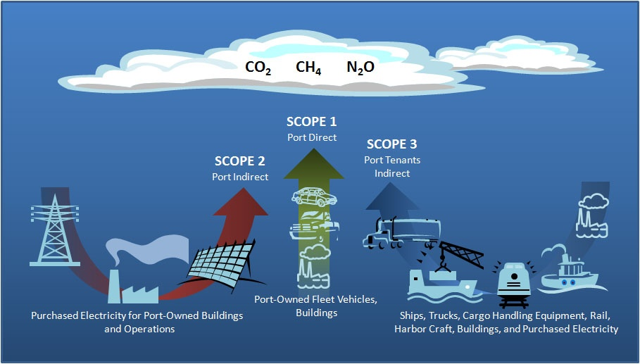
Scope 1, 2, and 3 Emissions
Notes:
POLA landlord port, Definition of scopes, 99%+ supply chain emissions Scope 3

Slide 10
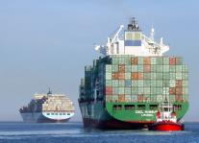
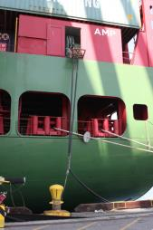
CAAP GHG Co-Benefits
Vessel Speed Reduction
  Fuel consumption benefit per visit (as of 2015) – 10 metric tons
  CO2 reduction per year (as of 2015) for Ports of Los Angeles and Long Beach – 99,991 tons
Shore Power
  As of 2015, CO2 reduction per visit – 11 tons (includes electricity generation offset)
  In 2015, POLA had 741 AMP calls – CO2 reduction/year = 8,151 tons

Slide 11
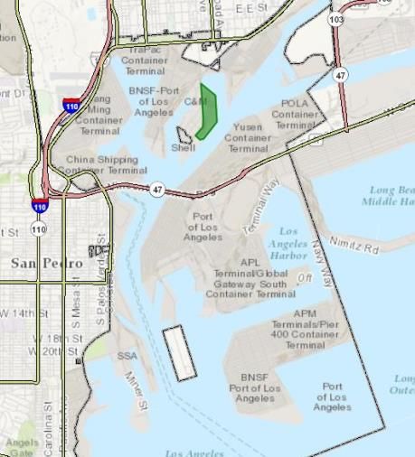
CARB Multi-Source Grant - Pasha Green Omni Terminal
  40 acre “Omni” terminal (break bulk and containerized cargo)
  Size and activity level a good model for other terminals or industrial facilities
  Testing ground for various zero and near-zero emission technologies
  Expandable and can be replicated
  Located near Disadvantaged Communities
PASHA TERMINAL
Notes:
“Omni” refers to the multiple types of cargo that Pasha receives including containerized and non-containerized materials.
Project Ideal Candidate….
Pasha’s vision is to become a laboratory for the integration of zero and near-zero emission goods movement technologies into a solar-powered micogrid.
Smaller marine Terminal - equipment duty cycle suited for pre-commercial testing of Zero- and near zero-emission cargo handling equipment technologies
Pasha Terminal serves as a testing ground for various electric and other non-polluting technologies that move both break bulk and containerized cargo
Advanced Technologies tested at this terminal have a broad application to multiple goods distribution centers
Zero- and near zero-emission cargo handling equipment technologies tested are scalable and can be distributed throughout the region

Slide 12
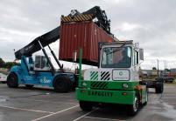
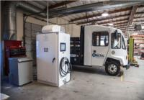
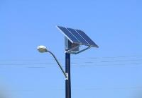
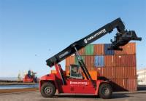
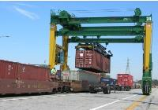
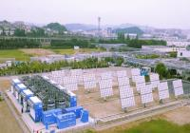
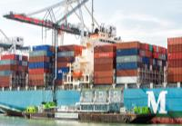
CARB Multi-Source Grant, Zero- and Near-Zero Emissions Technologies
Electric yard tractors
Standardized bi-directional charging systems
Solar-powered LED lights
High tonnage electric forklifts (8-ton & 15-ton)
Electric rubber tired gantry (RTG) cranes
Integrated 1 MW solar photovoltaic and battery storage system
At-berth ship emission control systems to reduce harmful emissions

Slide 13
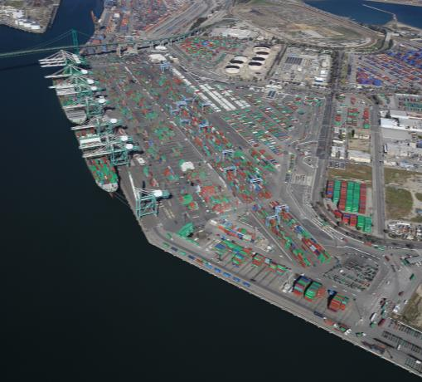
EVERPORT – CEC Advanced Yard Tractor Demonstration
  205-acre container terminal
  Demonstrate near-zero and zero CHE in container terminal
  Testing ground for various zero and near-zero emission technologies
  Expandable – can be replicated at other terminals
Notes:
Demonstrate near-zero and zero cargo handling equipment can be introduced and utilized in conventional container terminals

Slide 14
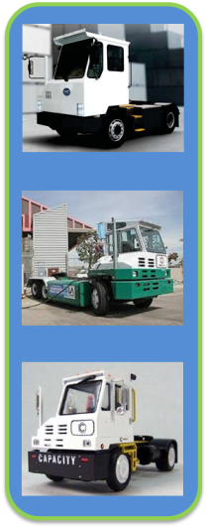

EVERPORT – Advanced Yard Tractor Demonstration
  Battery Electric Yard Tractors
    4 BYD Yard Tractors
    1 Balqon Yard Tractor repower
  Low NOx Natural Gas Yard Tractors
    20 Capacity yard tractors w/ Cummins-Westport near-zero 0.02 gram/bhp-hr NOx engine
  Clean Energy
    Temporary renewable natural gas fueling system
  Emission Reductions
    1,099 tons per year (TPY) CO2e
    240 LB diesel particulate matter (DPM)
    12,820 LB nitrogen oxides (NOx)
Notes:
- Everport terminal operates 100 yard tractors
- If demonstration equipment is successful, 25% of Everports’s fleet will be near-zero and zero emissions

Slide 15
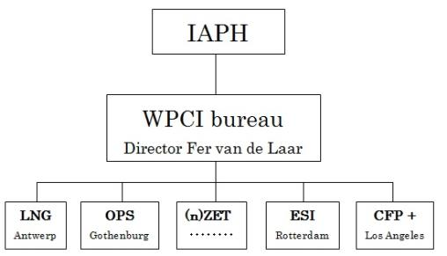
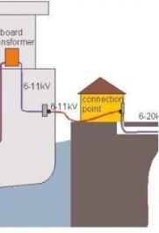
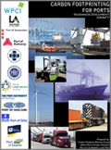


World Ports Climate Initiative

Slide 16

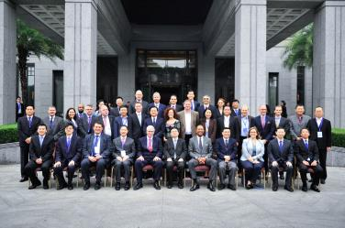
Pacific Ports Clean Air Collaborative
Mission: collaboration to improve operations, efficiency, air quality at Ports along the Pacific Rim
Founding Members
  United States Environmental Protection Agency
  United States Maritime Administration (MARAD)
  Port of Los Angeles
  Port of Shanghai
Partners
  Ports along the Pacific Rim
  Regulatory Agencies
  Shipping Industry Partners
  Non-governmental Organizations

Slide 17
Coordinated Goods Movement Planning is Essential
Broad range strategic planning is more efficient
Focused on mobile sources that cannot be regulated locally
  Ships
  Trains
  Trucks
Collaboration among stakeholders is critical
  Government
  Business
  Community

Slide 18
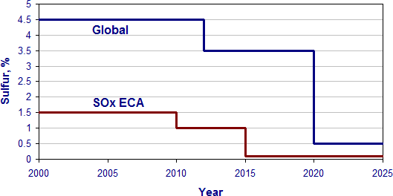
Case Study – North American Emissions Control Area (ECA)
Local voluntary incentive in the CAAP
State of California waters to 24 nm
ECA to 200 nm
Marpol Annex VI

Slide 19

Planning Efforts Must Be Sustainable
North American ECA is excellent start
Planning Efforts must be:
  Comprehensive
  Coordinated with Existing Efforts
  Action Oriented (goals and timelines)
  Fair and not anti-competitive
Federal and State Grants must be coordinated based on goods movement priorities
Notes:
The North American ECA is a great example of a coordinated effort that reduces emissions while maintaining a level playing field.

Slide 20
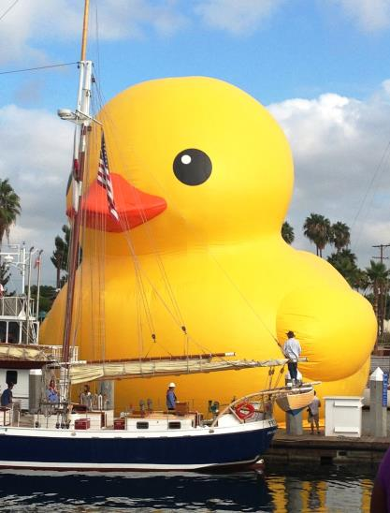
Thank You!
Lisa Wunder
Port of Los Angeles
  lwunder@portla.org

