Slide 1
Joint Public Advisory Commission
Public Forum
MWRA at 30:
Then and Now
Frederick A. Laskey
Executive Director
July 14, 2015

Slide 2
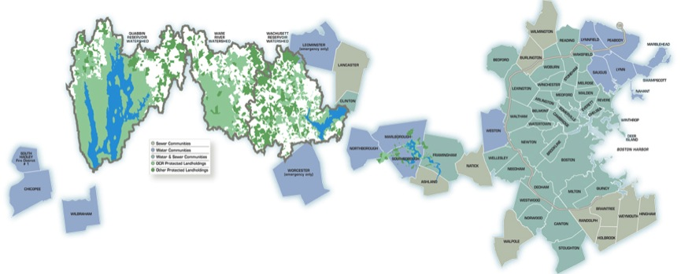
MWRA Service Area
MWRA provides wholesale water and wastewater services to over 2.5 million customers in 61 communities
On average, MWRA delivers an average of 200 million gallons per day to its water customers, with a peak demand of 350 million gallons
MWRA collects and treats an average of 350 million gallons of wastewater per day, with a peak capacity of 1.2 billion gallons

Slide 3
Make-Up Of MWRA Service Area
51 communities that get water service – over 6,000 miles of water pipe
43 communities that get sewer service
Of those, 30 get both water and sewer
  39 Towns
  20 Cities
  1 Fire District
  37 Boards of Selectmen
  20 Mayors
  3 Council Presidents

Slide 4
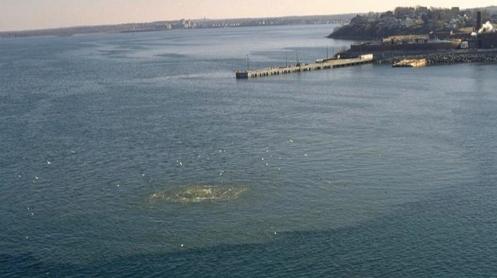
Violation Of The Clean Water Act
In 1982 and 1983, civil suits were filed against the MDC and other state agencies claiming that the Massachusetts Clean Waters Act had been violated as a result of discharges of untreated and partially treated sewage from Nut and Deer Islands

Slide 5
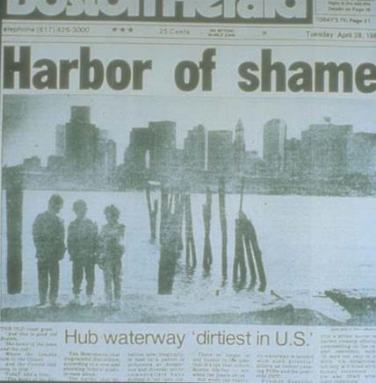
A New Agency Was Needed
MDC was determined to be unable to fulfill its mission
Comprehensive legislation was ready for consideration by the legislature in 1984
But over the summer, progress was slowed as lawmakers, regulators, lawyers, environmentalists and citizens wrangled over the details
A Federal Judge brought the process to a head by declaring a moratorium on new sewer hookups

Slide 6
On July 1, 1985, The MWRA Opened
MWRA assumed responsibility for the water and sewer infrastructure serving greater Boston, and to end the pollution of Boston Harbor from obsolete treatment plants
MWRA was created as an independent authority charged with raising its revenue from ratepayers, bond sales and grants
MWRA had to establish wholesale water and sewer rates to cover all costs, including a massive capital program to repair and upgrade the systems
MWRA was also charged with promotion and enforcement of water conservation and planning for the future
In compromise with Western and Central Massachusetts, MDC retained watershed management, but MWRA covers costs

Slide 7
What did we inherit?

Slide 8
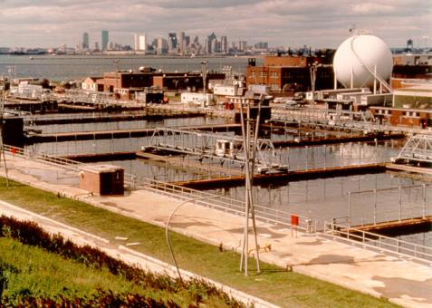
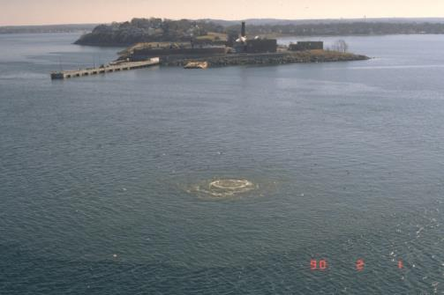
Two Obsolete Wastewater Treatment Plants

Slide 9
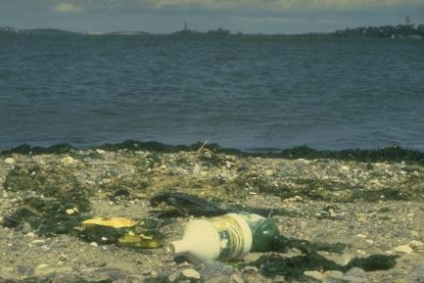
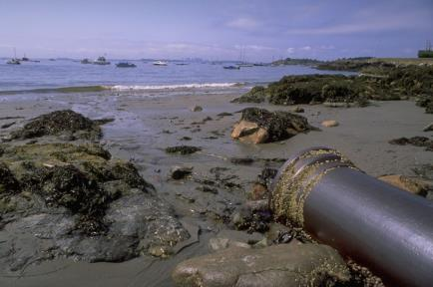
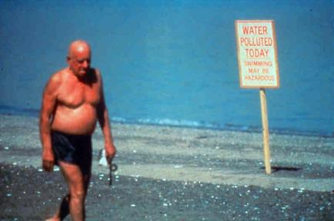
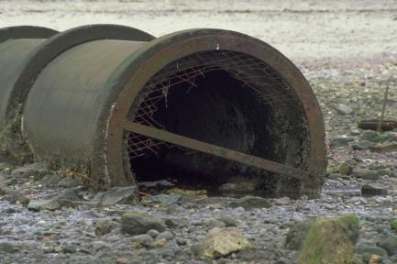
Raw Sewage Pouring Into Boston Harbor Daily

Slide 10
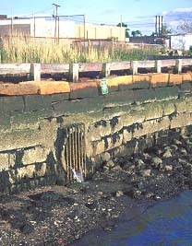
Dry Weather CSOs

Slide 11
On The Water Side, Things Were Pretty Grim
Thousands of miles of aging pipelines were leaking millions of gallons of water
No plans were in place for upgrades to carry the water system into the next century
And the Northeast Drought of the late 1960s cast doubt on the adequacy of existing sources
Little covered storage
  Open reservoirs after treatment
  Crude and inconsistent disinfection

Slide 12
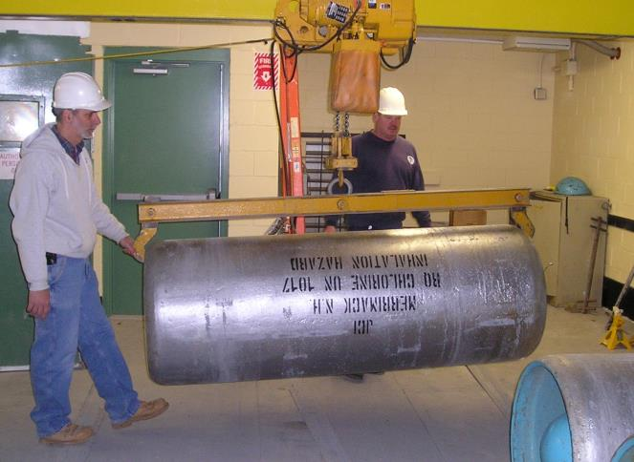
Gaseous Chlorine

Slide 13
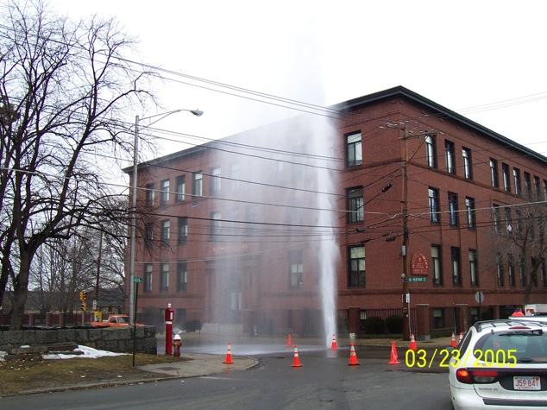
And A Lot Of Leaky, Old Pipes

Slide 14
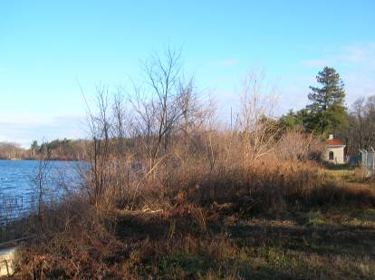
Neglected Dams And Unprotected Watersheds

Slide 15
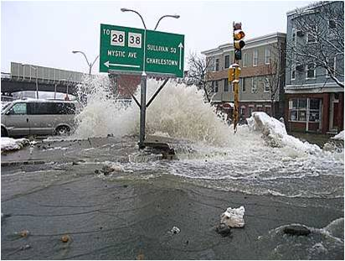
And A Lot Of Leaky, Old Pipes

Slide 16
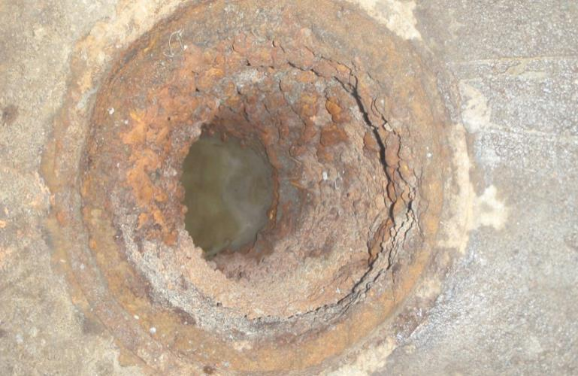
Tuberculated Pipe

Slide 17
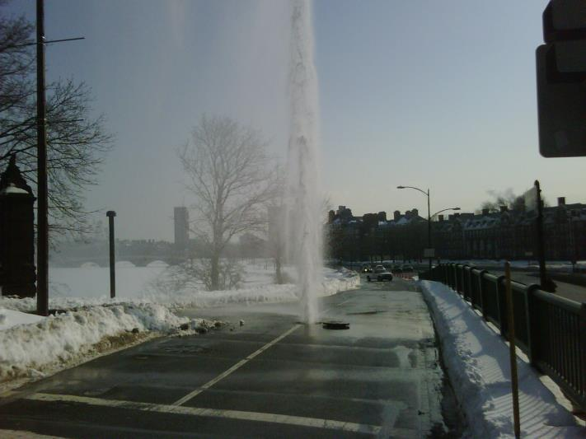
And A Lot Of Leaky, Old Pipes

Slide 18
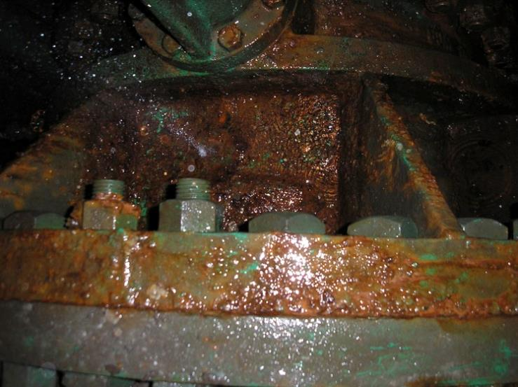
Leaking Valve Assembly

Slide 19
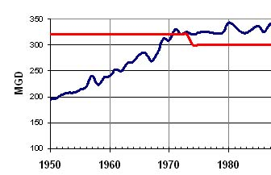
Water System Demand Exceeded Safe Yield
1987

Slide 20
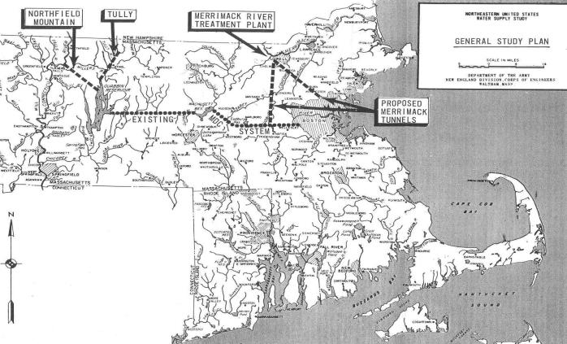
Studies For Alternative Sources
The Northfield Project was a proposal for skimming Connecticut River spring flood flows and diverting them into the Quabbin Reservoir

Slide 21
What did we have to do?

Slide 22
MWRA’s $7 Billion Capital Improvement Program
Boston Harbor Project
Deer Island Asset Protection
MetroWest Supply Tunnel
Hultman Aqueduct Rehab
Spot Pond Supply Mains
Covered Storage Projects
Braintree-Weymouth Relief Facilities
Weston Aqueduct Supply Mains
Carroll Water Treatment Plant
UV Treatment
Union Park
East Boston Branch Sewer
South Boston CSO
Community Managed CSO Projects

Slide 23
80% Of Capital Spending Has Been Mandated
$700,000
Mandated (Court & Consent Orders)
$600,000
$500,000
$400,000
$ Thousands
Non-Mandated
$300,000
$200,000
$100,000
$0
FY86
FY88
FY90
FY92
FY94
FY96
FY98
FY00
FY02
FY04
FY06
FY08
FY10
FY12
FY14
FY16
FY18

Slide 24
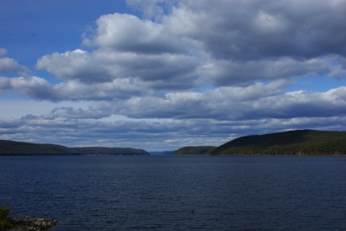
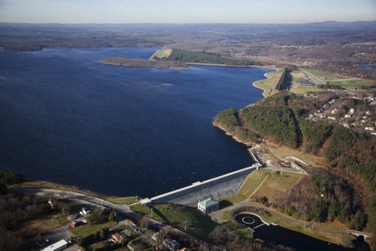
Restore One Of The World’s Greatest Water Systems
Quabbin Reservoir
Storage: 412 billion gallons
Depth: 150 feet
Length: 17.9 miles
Width: 3 miles
Wachusett Reservoir
Storage: 65 billion gallons
Depth: 129 feet
Length: 8.5 miles
Width: 1 mile
24

Slide 25
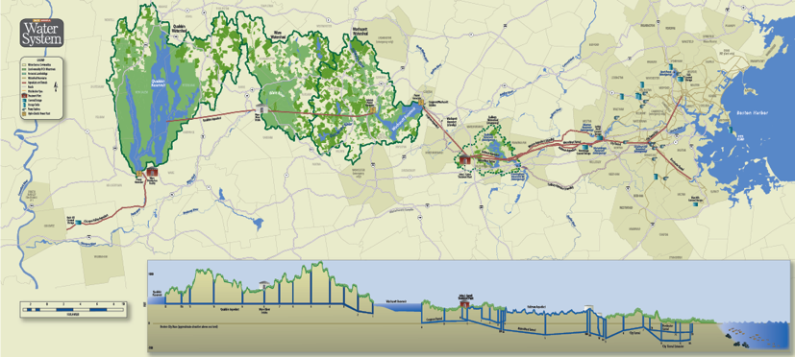
An Civil Engineering Marvel
  102 miles of active transmission mains and tunnels (43 miles on standby)
  284 miles of distribution mains with over 4,700 valves
  About 85% of the water is delivered by gravity
  11 pump stations
  5 years of storage

Slide 26
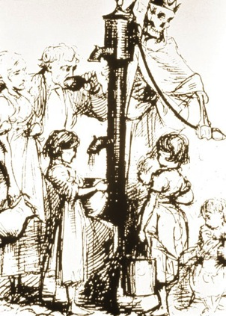
Words To Live By
“…as we progress and find that we can control the quality of the water by our own acts, we realize it is a wicked thing to turn water containing a large amount of organic matter into a city or town for people to drink – children, invalids and people whose constitutions are too weak to overcome the effects of bad water.
I think we should realize the responsibility that rests on us as superintendents and engineers to do all that we can to raise the standard; to insist that a city or town should have good water and that they should judiciously spend enough to make it good.”
-Desmond Fitzgerald, Boston Water Works 1895 annual meeting of the
New England Water Works Association

Slide 27
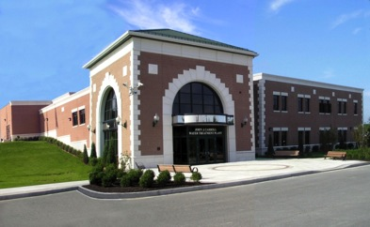
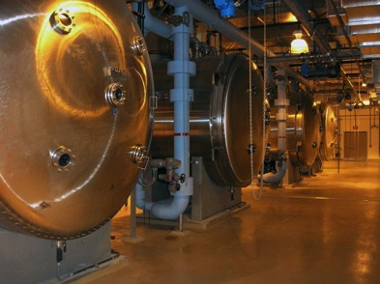
John J. Carroll Water Treatment Plant
Completed in July 2005
Treatment Processes:
  Ozonation for primary disinfection
  Corrosion control
  Chloramination for secondary disinfection
  Fluoridation

Slide 28
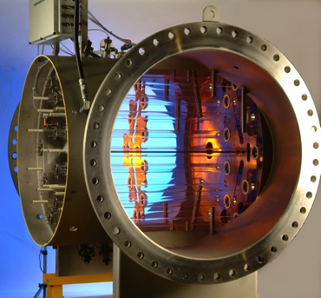
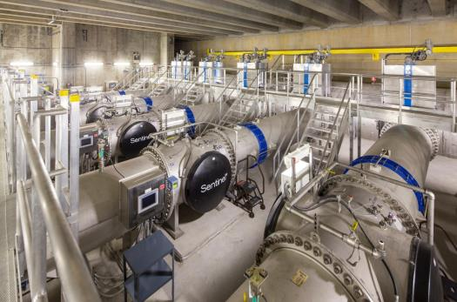
Addition Of Ultraviolet Light Disinfection
New regulations required that unfiltered systems must have two primary disinfectants, one of which must achieve Cryptosporidium inactivation
UV facilities at the Carroll Treatment Plant came on-line in April 2014

Slide 29
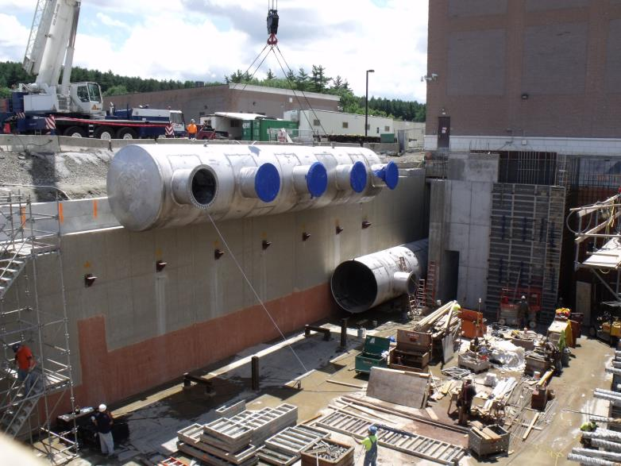
UV Header Pipe

Slide 30
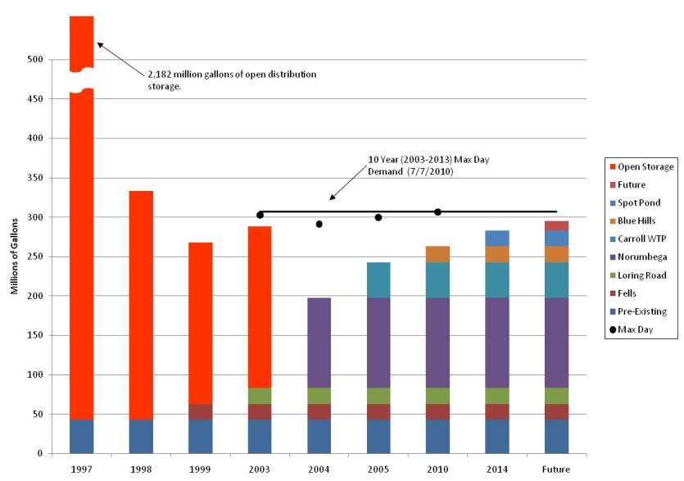
MWRA Metropolitan Area Storage Capacity Over Time

Slide 31
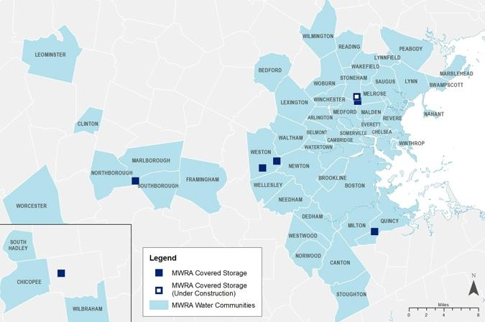
Covered Storage Projects
MWRA has built six new covered storage tanks to replace all open reservoirs
The last one is just about complete

Slide 32
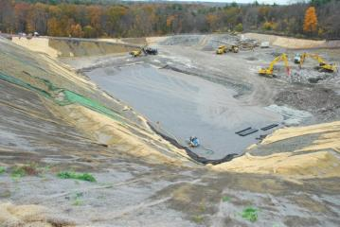
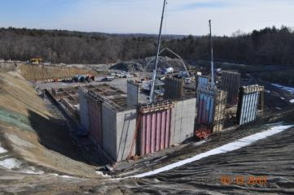
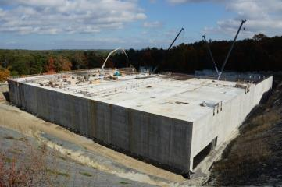
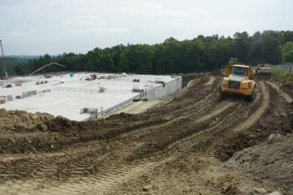
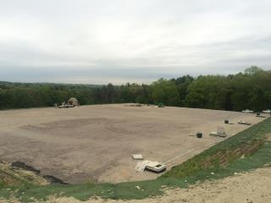
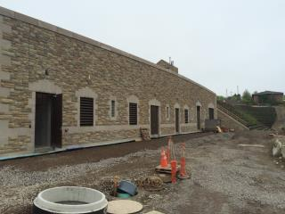
Spot Pond Covered Storage And Pump Station

Slide 33
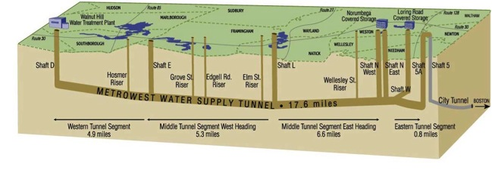
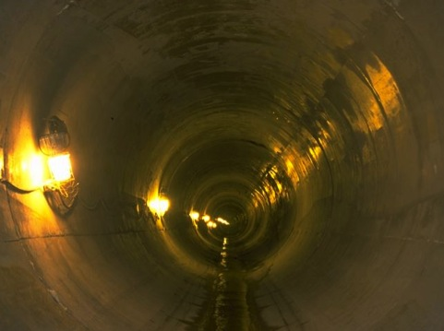
MetroWest Water Supply Tunnel
The MetroWest Water Supply Tunnel was brought on-line in November 2003
By March 2004, the Tunnel was being fully utilized allowing the shutdown of the Hultman Aqueduct for repair

Slide 34
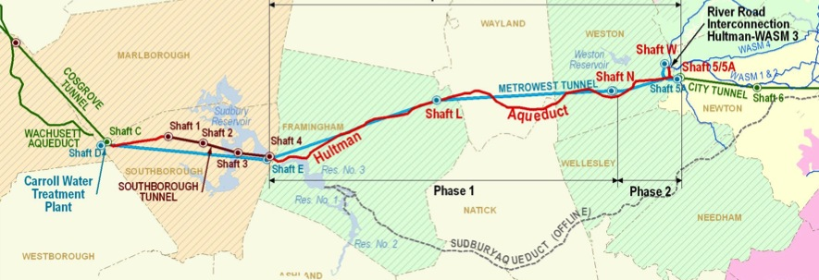
Hultman Aqueduct Rehabilitation
Since 2013, for the first time since originally planned in the 1930s, the Metropolitan Water System has redundancy for the Hultman Aqueduct from Marlborough to Weston

Slide 35
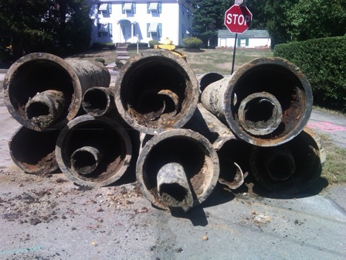
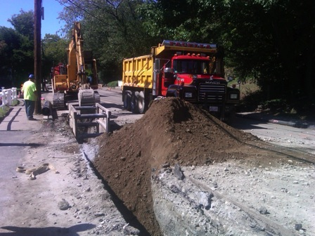
Water Pipeline Rehabbed Or Replaced
81 miles of MWRA-owned pipeline
474 miles of community-owned pipeline

Slide 36
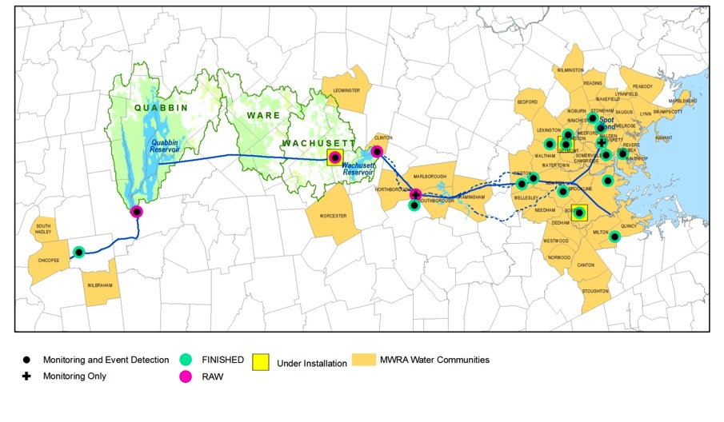
State-Of-The-Art Monitoring System

Slide 37
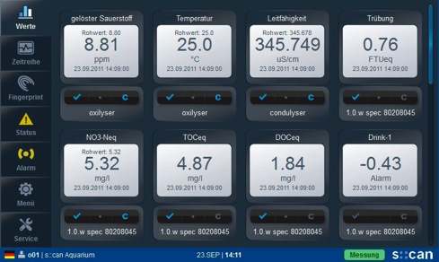
s::can Parameters Monitored At 18 Locations
pH
Temperature
Conductivity
Turbidity
Dissolved Organic Carbon
Total Organic Carbon
Nitrate-N
UV 254
Oxidation-Reduction Potential
Monochloramine
Free Chlorine
Total Dissolved Solids

Slide 38
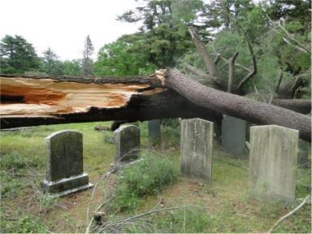
Investments In Watershed Protection
Since 1985, $133 million has been invested in land preservation
So well protected, the Safe Drinking Water Act requires only disinfection
Watershed | % of Watershed
Wachusett Reservoir | 56%
Ware River | 62%
Quabbin Reservoir | 80%

Slide 39
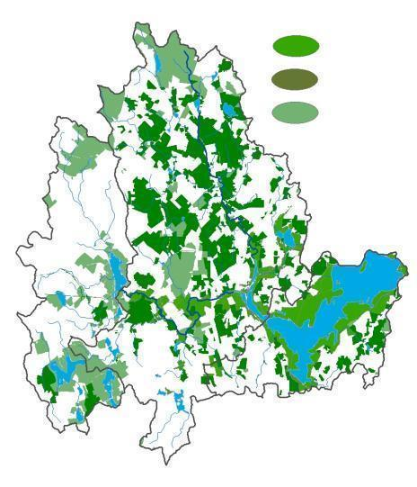
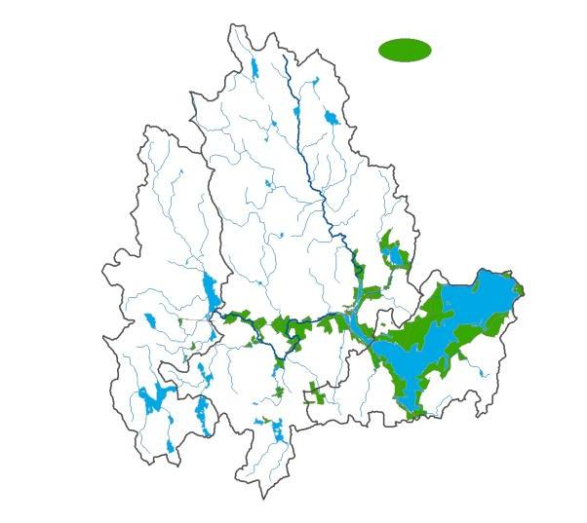
Wachusett Watershed Protected Land: 1985 - 2014
1985 Fee
1985 Fee
1985 Fee
1985-2014 Fee, WPR
Other Protected Lands

Slide 40
Fecal Coliform Sampling Results At Wachusett Reservoir

Slide 41
Community Total Coliform Rule Compliance

Slide 42
Disinfection By-Products
EPA Standard

Slide 43
Lead Levels In MWRA Communities

Slide 44
Water Conservation Worked

Slide 45
Boston’s Usage Is At A 110-Year Low

Slide 46
Collateral Issues
Size of the treatment plant
Storage size and water age
Plumbing issues
Rate setting

Slide 47
Hourly Flows By Month - 2014
405 mgd
Monthly Maximum
Monthly Median
270 mgd
165 mgd
Monthly Minimum
Month
Percentage of flows lower than
165 mgd

Slide 48
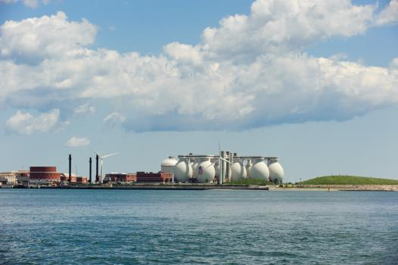
On The Wastewater Side
The 15-year, $3.8 billion Boston Harbor Project was completed in 2001
About 380 million gallons of wastewater is treated at the new Deer Island Treatment plant every day, with a peak capacity of 1.2 billion gallons
Treated wastewater is discharged 9.5 miles out into the deeper waters of Massachusetts Bay
Notes:
The $3.8 billion Boston Harbor Project is done, except for the landscaping.
The new plant provides:
Primary Treatment - settling tanks separate solids from wastewater. Solids are send to gravity thickeners to reduce water content and to sludge digesters (those 12 eggs) where solids are broken down.
Wastewater goes on to Secondary Treatment where oxygen is added to help “good” bacteria consume organic matter (little Pac men).
Treated water is then dechlorinated and discharges 9.5 miles out into Massachusetts Bay.
Digested sludge is barged to Quincy and recycled into fertilizer pellets.

Slide 49
Metals In Deer Island Effluent

Slide 50
Solids In Deer Island Effluent

Slide 51
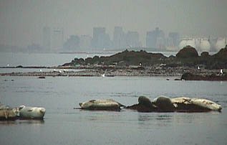

The Harbor Continues To Recover
Water quality in Boston Harbor continues to improve dramatically
  Sewage solids discharged from Deer Island have been reduced by 85%
  Toxic pollutants have been reduced by 90%
  Water is three times as clear

Slide 52
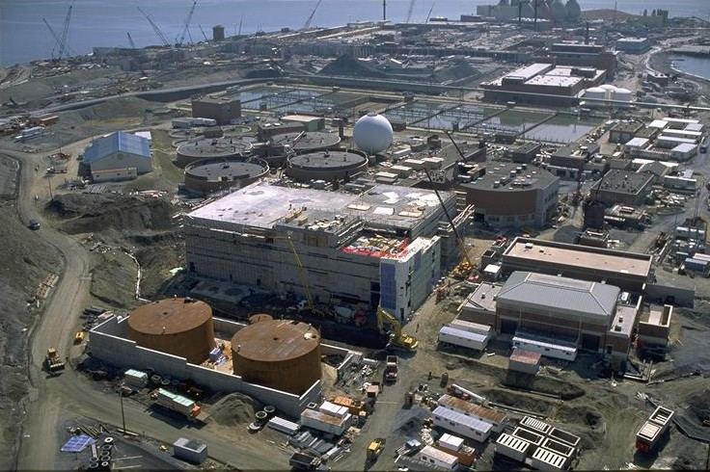
Deer Island Construction

Slide 53
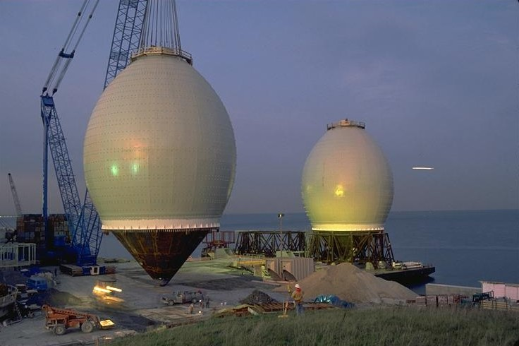
Deer Island Construction

Slide 54
Sewer System Pumping Capacity

Slide 55


Combined Sewer Overflow Control Program
Five communities - Boston, Brookline, Cambridge, Chelsea and Somerville - have combined sewer systems that connect to MWRA's sewer system
Since 1996, 94 miles of new storm drains and sanitary sewers have been installed

Slide 56



South Boston CSO Tunnel

Slide 57


Brookline Overflow Conduit

Slide 58

Union Park Detention/Treatment Facility

Slide 59
Annual CSO Volume Has Been Reduced Dramatically
$900 million program
32 of 35 projects have been completed to date
Annual CSO volumes have already been reduced by 2.7 billion gallons
By 2015, 93% of the remaining CSO flows will be treated

Slide 60


Dramatic Improvements In Water Quality – Even In Wet Weather
1987-1998 (Before Secondary Treatment and South System transfer)
1999 - 2014 (After Secondary Treatment
and New Outfall)
1987 - 1991
1999 - 2014
Average Enterococcus counts in Boston Harbor in wet weather
The lighter the blue, the better

Slide 61

And We Love Being Green!
Of our $40 million annual energy budget, $22 million comes from renewable sources

Slide 62

Water System Profile
About 85% of the water is delivered by gravity
Carroll Water
Treatment Plant

Slide 63




Hydroelectric Power
63
63
Notes:
63
63

Slide 64


Methane Utilization At Deer Island
98% of methane is utilized

Slide 65



Solar Power

Slide 66



Wind Power

Slide 67


Public Access

Slide 68


Alewife Stormwater Wetland

Slide 69


Aqueduct Trails

Slide 70
What have we learned?

Slide 71

Utility Conflicts Abound In Older Cities

Slide 72

(And It’s Nothing New)

Slide 73
Creative Construction Technologies
Means and methods
New technologies are developed all the time
Need to choose the right tool for the job
If it seems too good to be true, it probably is

Slide 74


Microtunneling East Boston Branch Sewer

Slide 75


Pipebursting East Boston Branch Sewer

Slide 76


Soft-ground Tunneling South Boston

Slide 77


Slurry Walls For South Boston Pump Station

Slide 78

Horizontal Directional Drilling The Fore River Siphon

Slide 79

Horizontal Directional Drilling Mill Cove Siphon

Slide 80

Wachusett Aqueduct Pumping Station

Slide 81
But No Matter How Well You Plan…
…things can go wrong

Slide 82

A Water Main Break

Slide 83

A Geyser

Slide 84

A Sinkhole

Slide 85

Another Sinkhole

Slide 86


A Heave In The Street

Slide 87


A Pipeline Collapse

Slide 88
Future challenges

Slide 89
How Clean Is Clean?
NPDES Permit
MS4 Stormwater
Pharmaceuticals

Slide 90
Continued Maintenance
Preventive Maintenance
Predictive Maintenance
Corrective Maintenance
Emergency Work Orders
67,000 work orders completed per year
Less than 0.1% are emergency

Slide 91
Climate Change In Our Service Area
Currently, we average 104 rain events per year with an average of 44 inches of rainfall
Models suggest we’ll see longer dry spells with shorter, heavier rain
For an overall modest increase in total rainfall

Slide 92

Large Reservoirs With Large Storage Capacity + More Precipitation = Plenty Of High Quality Water

Slide 93


Drinking Water System Is In Good Shape
Quabbin Reservoir, Belchertown
  65 miles west of Boston
  Elevation 528 feet
Wachusett Reservoir, Clinton
  35 miles west of Boston
  Elevation 395 feet
Water treatment plant is in Marlborough
85% of water delivered by gravity
Lowest elevation of a water tank is 192 feet above sea level

Slide 94

On The Wastewater Side, Sea Level Rise Was Anticipated In The Design of Deer Island Treatment Plant
Deer Island plant fully protected
  100-year flood
  1.9-foot sea level rise
  Wave runup of 14 feet on east side and 2 feet on west side
On-site power plant ensures uninterrupted power supply
Nut Island headworks in Quincy similarly designed for sea level rise

Slide 95

A Rising Sea Impacts The Hydraulics Of The Outfall Tunnel
The effluent from the sewage treatment plant is discharged by gravity to the 9.5 mile
To maintain hydraulic capacity, plant process tank elevation raised 1.9 feet and tunnel diameter was up-sized from 24 feet to 24.25 feet
Notes:
One significant issue was the capacity of the outfall. The capacity of a given tunnel diameter and length is determined by the difference in elevation between the plant and the surface of the bay over the end of the outfalls. To maintain the desired capacity, the entire plant was raised by 1.9 feet, which was the best guess in the late 1980’s for sea level rise through 2050

Slide 96

21 Of MWRA Coastal Sewer Facilities Are Within
15 Feet Of Mean Sea Level
Notes:
MWRA has looked at all of its water and wastewater facilities to see which would be affected by various hurricane intensity storms and by various degrees of sea level rise.
This map shows the worst case analysis for a Category 1 Hurricane at each facility. The yellow dots are sewer facilities with some degree of potential flooding, and the green are a couple of water valve chambers which could be flooded. Most are 1 to 2 feet, but a couple could see up to 6 feet of flooding from a storm with just the right charactistics
MWRA has also set up the NOAA Hurricane model SLOSH to better understand both the general risk, and the risk for any particular as it moves up the coast.

Slide 97

Envelope Flood Protection Measures
Flood logs (exterior)
Flood logs (interior)
Watertight hatch
Flood logs (interior)
All flood logs to el 115.6
97

Slide 98

Climate Change/Sea Level Rise
  MWRA facilities on a 20-year rehab schedule
  Future contracts will include
    Flood protection
    Alternative energy
    Security upgrades

Slide 99
Age Of Wastewater Pipes

Slide 100
Age Of Water Pipes

Slide 101


Age Of Pipes

Slide 102

Transmission System Redundancy

Slide 103


City Tunnel Top Of Shaft

Slide 104

City Tunnel Redundancy

Slide 105

Mountain Of Debt

Slide 106

Deer Island Co-Digestion
DEP’s new organic waste ban presents an opportunity from co-digestion at Deer Island
Introduction of non-wastewater derived organic waste material into anaerobic digestion process can:
  Increase digester gas for increased green energy production
  Decrease purchase of electricity
Bench test showed positive results
Full-scale project pending resolution of logistical issues

Slide 107


Deer Island Combined Heat and Power Technology Change
CHP Technology Change
Change from Bottom to Top cycle generation
Improve efficiency
Increased electrical production
Better use of all digas - summer months
Continue to meet plant heating needs
CHP Benefit from Co-Digestion
Expected 29-42% increase in biogas
Results in more electrical output
Heat demand increase 5-10%
Electrical demand increase <2%

Slide 108
Hopefully, the next 30 years
will be as successful

Slide 109


Deer Island Received Its 4th Platinum Award
No permit violations for 8 years in a row!

Slide 110

Charles River Gets High Marks
In its latest annual report card, the EPA has given the Charles River a grade of B+ for water quality

Slide 111

Boston Now Has Some Of The Cleanest Urban Beaches
In The Country

Slide 112



Boston’s Waterfront Is The Region’s Fastest Growing Zip Code

Slide 113



“Best Drinking Water” In The Country

Slide 114

MWRA
1985-2015

