Slide 1
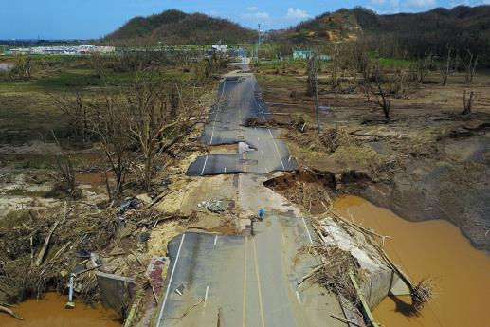
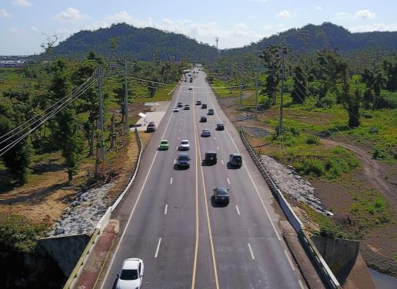
ON THE ROAD TO
RECOVERY…
BUILDING LOCAL RESILIENCE IN PR’S DISASTER
RECOVERY AND RECONSTRUCTION EFFORTS

Slide 2
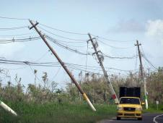
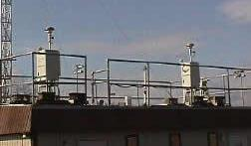
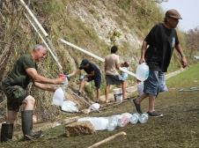
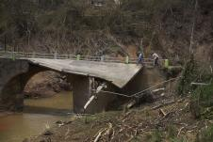
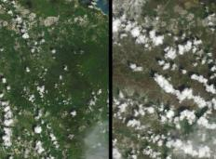
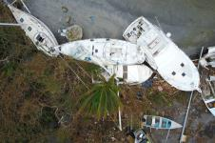
ENVIROMENTAL AND PUBLIC HEALTH IMPACTS
Air Quality: Lack of Electricity Led to Increase in Use of Generators / Impacts to PREQB’s Air Monitoring Network and Env. Laboratory
Loss of Electricity: Vulnerability of Centralized Electrical Distribution System
Drinking Water: Lack of access to safe drinking water / Communication of public health advisories
Water Quality: Impacted by sewage overflows, erosion and sedimentation, debris, others
Defoliation/Deforestation/
Urban Flooding: Mortality Rate of 10% (144M trees) and Severe Damages (avg. 42% of height) / Old, inefficient stormwater systems
Debris: Solid waste collection / Staging and collection areas / Hazardous wastes / 377 sunken and grounded vessels

Slide 3
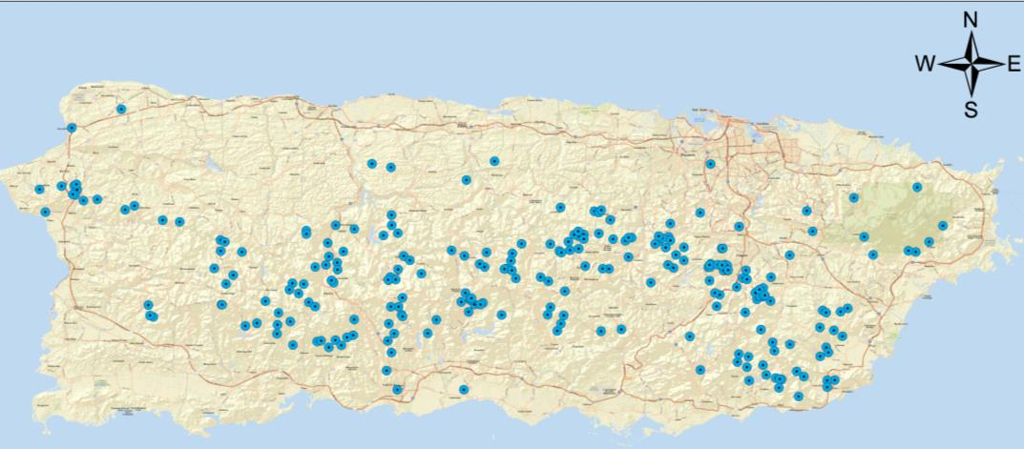
IMPACTS TO COMMUNITY AQUEDUCT SYSTEMS
  Approximately, 241 community aqueduct systems in Puerto Rico
  ~ 40% of systems use surface water sources and ~ 60% use ground water sources

Slide 4

IMPACTS DISASTER DEBRIS
ENTITY THAT MANAGED DISASTER DEBRIS | TOTAL CUBIC YARDS (CY)
USACE (57 municipalities) | 4,393,603
Municipalities (21) | 4,383,303
DTOP (estimate) | 2,803,444
USDA NRCS | 210,000
Coastal debris | 15,000
TOTAL | 11,805,350
USACE = 53% construction debris and 44% vegetative debris (only 35% of vegetative debris was used as mulch or composting material).
Landfill Capacity Assessment Results:
  Lost up to 2 years of landfill capacity due to debris
  Have approximately 1 to 3 years of landfill capacity remaining

Slide 5
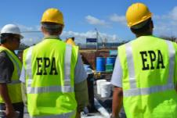
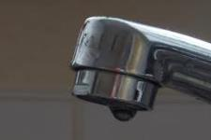
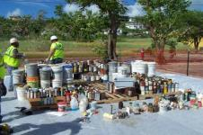
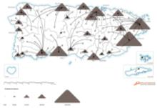
FEMA MISSION ASSIGNMENTS TO EPA
Assessment of Superfund (19) and Regulated Facilities (177)
Support PRDOH and VIDPNR in collecting drinking water samples
Collection of Household Hazardous Wastes (HHW), White Goods, E-Waste, and Medical Waste (322,148 containers collected)
Restoration of PREQB’s Environmental Laboratory /
Restoration of PREQB’s Air Monitoring Network
Assessment of sunken and grounded vessels and removal of hazardous substances (377)
Conduct Landfill Capacity Assessments at PR’s 29 Landfills and Open Dumps

Slide 6
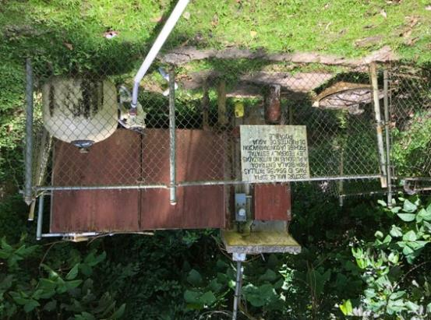
FEMA MISSION ASSIGNMENT TO SERVE
COMMUNITY AQUEDUCT SYSTEMS
  Determine operational status in coordination with USACE, FEMA, local DOH and NGOs.
  Preliminary assessments of 241 systems to determine emergency repairs and temporary power needs.
  Conduct emergency repairs and provide temporary power generators to address needs.
  Develop spreadsheet describing findings and EPA assessment data to help FEMA PA team during recovery.
  Assist community aqueducts reach private non-profit (PNP) status to streamline access to federal funds.
Patillas, PR

Slide 7
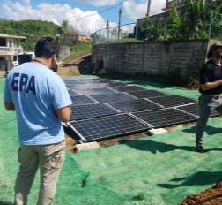
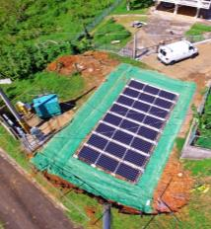
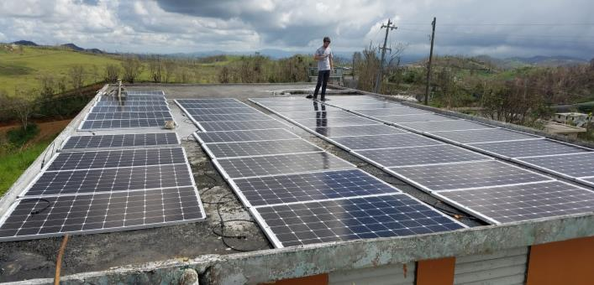
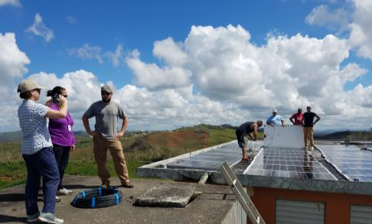
COMMUNITY ORGANIZATION AND
NGO SUPPORT
Non-operating systems needed generators and support activities (bulk water, water purification tablets, water filtration systems, etc.)
Solar PV with batteries at the Buenos Aires community water system Caguas and Sabana community water system in Orocovis thanks to Water Mission

Slide 8
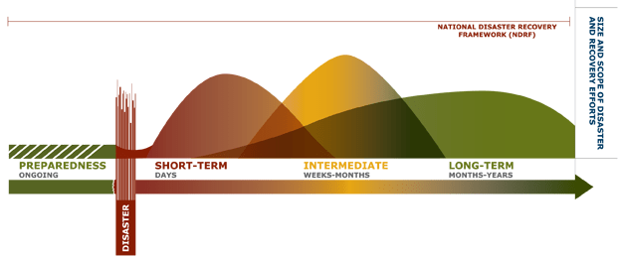
Recovery Timeline
NATIONAL DISASTER
RECOVERY FRAMEWORK (NDRF)
National Disaster Recovery Framework (NDRF)
SIZE AND SCOPE OF DISASTER AND RECOVERY EFFORTS
PREPAREDNESS
ONGOING
SHORT-TERM
DAYS
INTERMEDIATE
WEEKS-MONTHS
LONG TERMS
MONTHS-YEARS
The National Disaster Recovery Framework is a FEMA guide that enables effective recovery support to disaster-impacted States, Tribes, Territorial and local jurisdictions. It provides a flexible structure that enables disaster recovery managers to operate in a unified and collaborative manner.

Slide 9
NATIONAL DISASTER
RECOVERY FRAMEWORK (NDRF)
The Recovery Support Functions (RSFs) comprise the coordinating structure for key functional areas of assistance in the NDRF.
Their purpose is to support local governments by facilitating problem solving, improving access to resources and by fostering coordination among State and Federal agencies, nongovernmental partners and stakeholders.
RSFs for Hurricane María include:
Community Planning and Capacity Building (CPCB) Recovery Support Function (U.S. FEMA)
Economic Recovery Support Function (U.S. Department of Commerce)
Health and Social Services Recovery Support Function (U.S. Department of Health and Human Services)
Housing Recovery Support Function (U.S. Department of Housing and Urban Development)
Infrastructure Systems Recovery Support Function (U.S. Army Corps of Engineers)
Natural and Cultural Resources Recovery Support Function (U.S. Department of Interior)

Slide 10
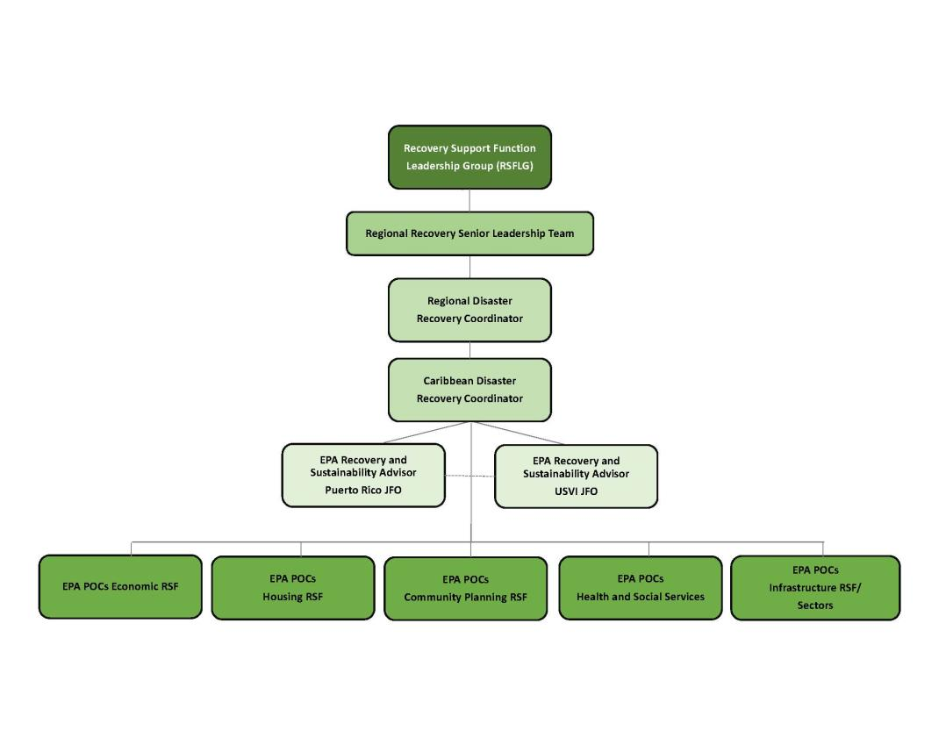
EPA CARIBBEAN DISASTER RECOVERY TEAM
Water Advisor

Slide 11
RECOVERY PLAN FOR PUERTO RICO
Solid Waste Management =
$800 M

Slide 12
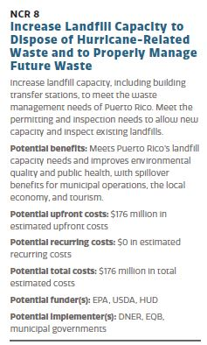
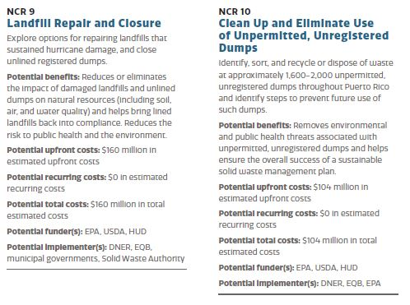
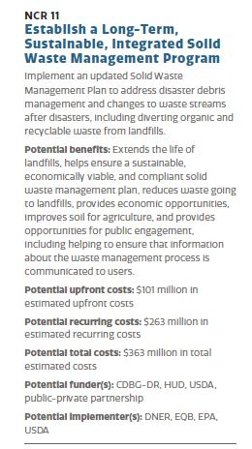
RECOVERY PLAN FOR PUERTO RICO
$803M

Slide 13

LEVERAGING FEDERAL FUNDING SOURCES
US ENVIRONMENTAL PROTECTION AGENCY:
$40M - “hazardous waste financial assistance grants program and for other solid waste management activities” related to HIM / “State and Tribal Assistance Grants (STAG)”
PR Clean Water State Revolving Fund
Brownfields Redevelopment Program
OTHER FEDERAL PARTNERS:
FEMA Public Assistance (406) and Hazard Mitigation (404 - $3B)
$165M - USDA’s Rural Water and Waste Disposal Program Account for grants to repair drinking water systems and sewer and solid waste disposal systems impacted by HIM.
$18.5B - HUD’s Community Development Fund for “disaster relief, long-term recovery, restoration of infrastructure and housing, economic revitalization, and mitigation in the most impacted and distressed areas.

Slide 14

KEY RECOVERY INITIATIVES

Slide 15
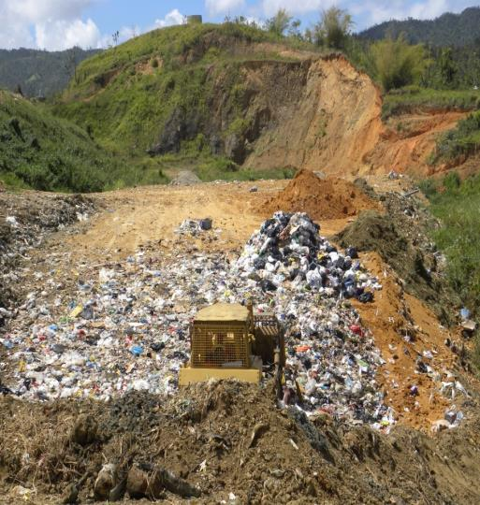
$40M IN SUPPLEMENTAL APPROPRIATION
SUPPLEMENTAL APPROPRIATION GUIDANCE:
DNER Permitting and Enforcement Program Needs
Waste Characterization Study
Revise/Update Solid Waste Management Plans
Close Open Dumps
Economic Market Analysis
Address Illegal Dumping/Dump Sites
Construct/Repair Solid Waste Infrastructure
Source Reduction and Diversion: Composting and Recycling
Management and Disposal of Debris (Construction and Demolition Debris)
Development of Demonstration Projects
Trainings

Slide 16
FEMA-EPA
ACTION ITEMS
FEMA Guidance - Sustainable Materials Management in PR Disaster Recovery
Solutions Team – Private Property Debris Removal (PPDR) Program (~6M CY of additional disaster debris)
Unclaimed Damages and funds availability (training workshops)
Updated Disaster Debris Management Plans for Municipalities
Clandestine/Illegal Dumps Strategy in partnership with NOAA and NGOs

Slide 17
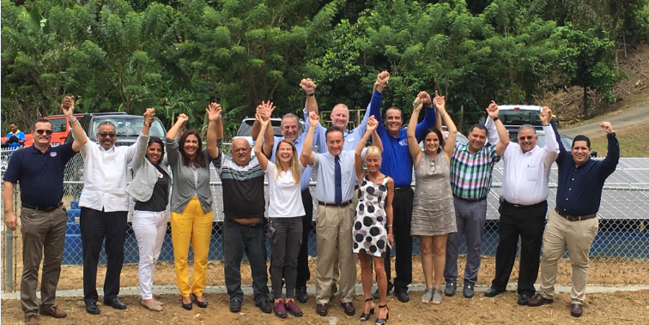
COMMUNITY AQUEDUCTS
MULTI-SECTORAL ENGAGEMENT
WATER COALITION
Signing of Memorandum of Understanding with
NGOs that are Engaged in Recovery and Resiliency Efforts in Puerto Rico
September 18, 2018

Slide 18
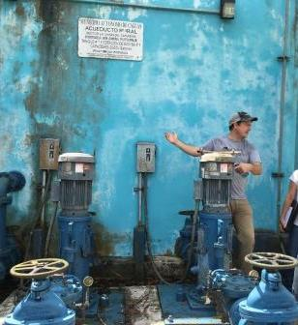
COMMUNITY AQUEDUCT SYSTEMS
SUPPORT AREAS
Capacity Building and Technical Assistance
Community Organization
Infrastructure Design and Construction
Capital improvement plans
Maintenance
Equipment and Materials
Operator Certifications
Emergency Management Plans
Water Quality Monitoring Analysis
Compliance with SWDA and local DOH Regulations
Finance Structure / Budget Bookkeeping / Accounting
Outreach and Education and many others

Slide 19
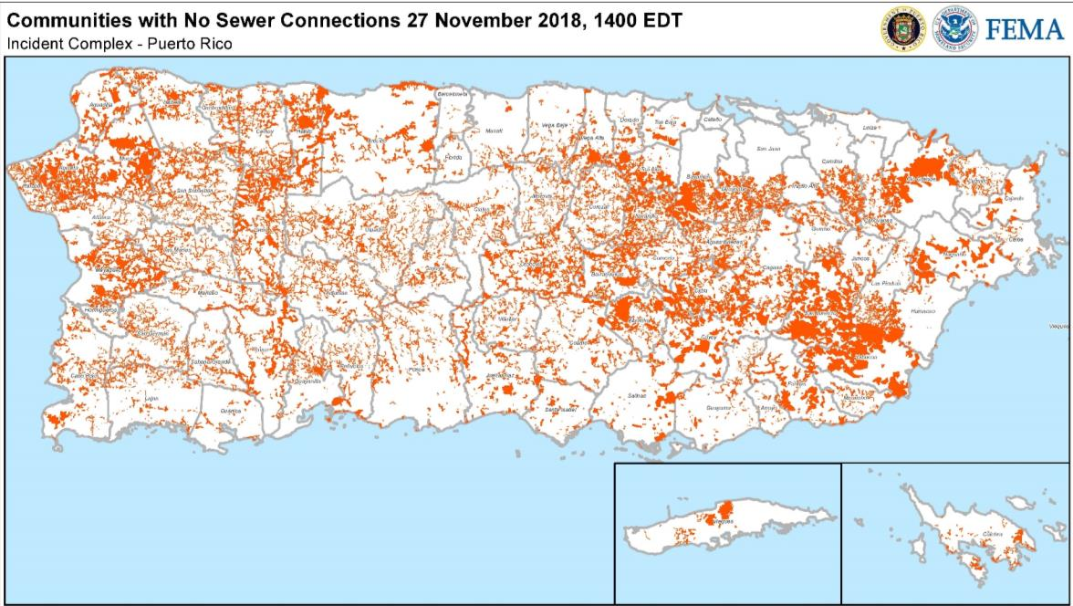
SEPTIC SYSTEMS
Estimated Inventory:
Residential = 550,000 a 600,000
Commercial = 20,600
Government = 3,800
Industry = 230

Slide 20
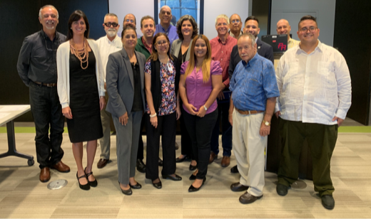
CARIBBEAN SEPTIC SYSTEMS WORKGROUP
Community outreach, training and capacity building
Grants
Communications and Education Plan
Septic SMART (www.epa.gov/septicsmart)
Septic Systems Guidebook
Comment and Review New PR Construction Code and Other Local Regulations
Research and Development (Academia)
Pilot Projects / Demonstration Projects (Watershed Stewardship, RCAP Solutions, SJBEP)

Slide 21
Flood Control And drainage Solutions Team Relationships
FLOOD CONTROL AND DRAINAGE (STORMWATER)
PR-COR3
SHMO
Territory Agencies
DNER
Planning Board
RSF Lead-EPA
CPCB
FEMA Sector Lead-Water
NCR
OFA
USACE
USGS
FHWA
USDA-NRCS, RD
NGO and Academia
Cross-Sector Relationships
Municipalities, Transportation, Public Buildings, Energy

Slide 22
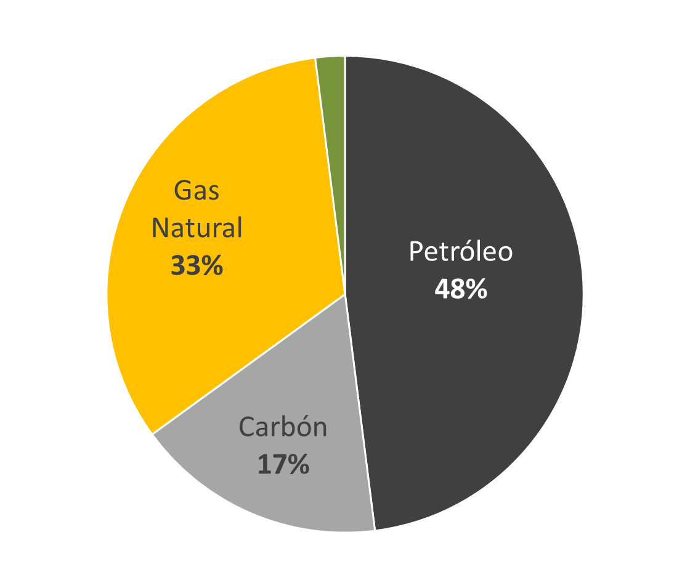
ENERGY GENERATION IN PUERTO RICO
Natural Gas
Oil
Renewable sources and Hydroelectric power
2%
Coal

Slide 23
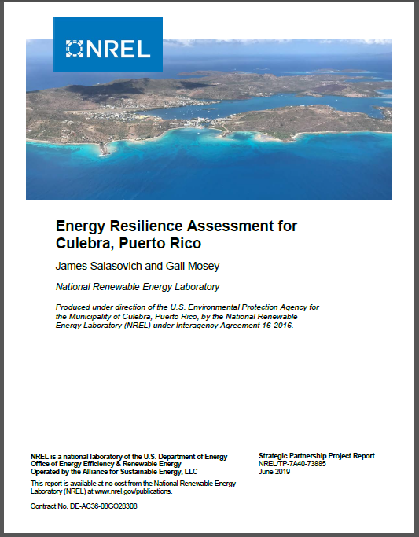



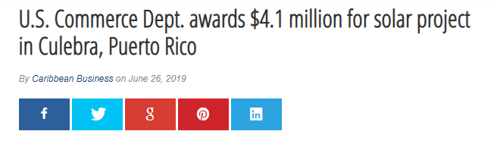
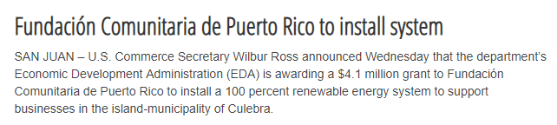
MICRO GRID ASSESSMENT IN CULEBRA

Slide 24
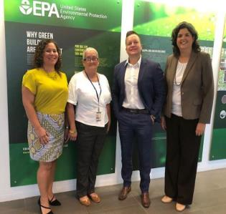


BROWNFIELDS
152 Brownfields Sites in Puerto Rico
-----
Inventory will be updated
Aimed at redevelopment and transforming towns into sustainable communities.
Provides funding to plan, inventory and asses abandoned properties contaminated with hazardous substances, pollutants, contaminants, petroleum products.
Promotes partnerships between state, municipal governments with potential partners such as non-profits, universities, private developers, investors and banks.
Naranjito, Puerto Rico to receive a $300,000 Brownfields Assessment Grant to assess sites for hazardous substances and petroleum contamination. Grant funds will also be used to prepare cleanup plans, update and prioritize a brownfield inventory, and conduct community involvement activities. The target areas for this grant are the PR5/152 Corridor and the Anones District.
www.cclr.org

Slide 25
CHALLENGES AND OPPORTUNITIES
Pre-existing conditions: Deterioration of infrastructure (~53% water loss, sedimentation levels in dams) / Lack of maintenance
Fiscal situation / Limited funds / Lack of access to markets / Leveraging Federal Funding Sources
Historical non-compliance / Permitting process
Degradation and threats associated with pollution sources and extreme weather events (hurricanes, droughts, extreme precipitation events, sea level rise, critical condition of southern aquifer, salinity intrusion, extreme sargassum accumulation events, others)
Islands as Laboratories of Resiliency (Local 2030 Islands Network) (2020-2030 = The Decisive Decade)
Building community resiliency…
Disaster Relief Request:
PR = $94.3 Billion

Slide 26


Slide 27
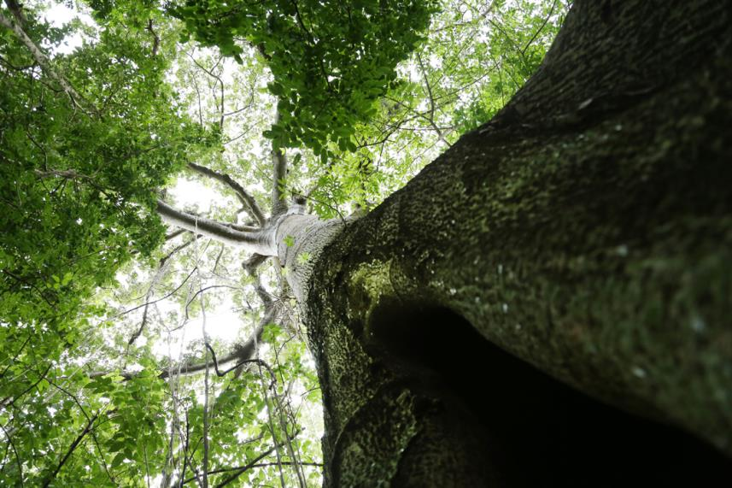
GRACIAS…
CONTACT INFORMATION:
CARMEN GUERRERO PÉREZ
CEPD-EPA
787-977-5875
guerrero.carmen@epa.gov

