Slide 1

Recovery Program Overview
The Central Office for
Recovery, Reconstruction, and Resiliency
Thursday, October 24, 2019
Ottmar J. Chávez
Executive Director / GAR

Slide 2
Agenda
Recovery By The Numbers
Funding Streams
Current Recovery Priorities
Transparency
Economic and Disaster Recovery Plan for Puerto Rico

Slide 3



The Numbers of Recovery
The below summarizes the key numbers of recovery:
OVERVIEW
FUNDING STATUS
CHALLENGES
Of the $42.80B allocated,
$20.96B have been obligated by agencies such as FEMA, DHS-HUD, DOD-USACE, SBA, DoEd, DHS, and HHS.
Permanent work is critical to “building back better” – yet only $38.74M has been disbursed to it.
$91 Billion
Internal estimate by the Federal Government
for total expected Federal liabilities over the life of the disaster
$20.96B
$14.18 Billion
Disbursed by the Federal Government for response activities, emergency work, and individual assistance.
Of the $14.18B, $6.29 Billion has been disbursed by FEMA to Puerto Rico for individual assistance, emergency work, and administrative costs.
$55 Billion
Available from recovery funds
Estimated cost of recovery by FEMA, according to the Stafford Act
Obligated
Of the $20.96B obligated funds, $14.18B has been disbursed.
$38.74 Million
Disbursed to Permanent Work
$14.18B
1% of the total number of Permanent Work PWs have been obligated to Puerto Rico since Hurricane Harvey.
$42.80 Billion
Allocated by Congress
Since Hurricane Harvey in 2017, FEMA has obligated a total of 15,221 PWs for Permanent Work. Of these, only 161 PWs have been obligated to Puerto Rico.
Disbursed
Note: Numbers subject to change as the recovery continues.
As of October 18th, 2019
Notes:
Refresh Instructions:
As of date for the funds appropriated by Congress: https://www.fema.gov/media-library/assets/documents/179306
Refer to when the file was dated – not when the file was published.
$42.80 Billion: https://recovery.fema.gov/state-profiles
Filter to Puerto Rico only and refer to “Allocated”
$20.96 Billion: https://recovery.fema.gov/state-profiles
Filter to Puerto Rico only and refer to “Obligated”
$14.18 Billion: https://recovery.fema.gov/state-profiles
Filter to Puerto Rico only and refer to “Outlayed”
$6.28 Billion and $38.74 Million: COR3 Transparency Portal
Utilize template to sum numbers from COR3 Transparency Portal
15,126 PWs: Download Spreadsheet: https://www.fema.gov/openfema-dataset-public-assistance-funded-projects-details-v1
Download the data
Develop a pivot table with:
Rows: disasterNumber
Filters: damageCategoryCode
Select C - G
Values: Count of pwNumber
Sum the “Count of PwNumber” in the Pivot Table from disasterNumber 4332 and onwards
153 PWs: Contact the Analytics Team

Slide 4
Funding Streams
Investing in Puerto Rico Recovery
Deadline: | Pending
Requirements: | Collaboration at each step of the Project Formulation Process
Focus: | Prepare documentation to request extension by Mid September
Actions: | Process operational metrics to measure efficiency and results
PA 428
Public Assistance
404
Hazard Mitigation
Deadline: | October 31, 2019, per FEMA to complete all 404HM packets
Focus: | Prepare documentation to request extension
Actions: | Task force assigned to work with all sub-recipients to submit Letter’s of Interests (LOI’s)
PPDR
Private Property Debris
Removal
Deadline: | February 15, 2020, per FEMA to complete construction
Focus: | Verification of properties identified to potentially participate in the program
Actions: | RFP for multi-award contractor selection to support program through ASG

Slide 5

Current Recovery Priorities
Priority
Fixed Cost Estimate (FCE) Deadline
Small projects
FEMA standard Process
Flexible Match (FlexMatch)
Capital Revolving Fund (CRF)
Introduce Licensed Engineers
FCE deadline extensions will be reviewed by FEMA across all Sectors on case-by-case basis.
The industry standards needed for these requests have not been determined by FEMA.
FEMA hast treated the small projects similar to large ones, further delaying recovery progress via 428 alternative guidelines.
Identify innovative approach to meeting Public Assistance Cost Share requirements.
Some Subrecipients have limited access to capital to begin permanent work projects
Additional capacity is needed to expedite accepted cost estimates
Challenge
Work with FEMA on a project by project basis, but introduce: segmentation of Large Projects: Settlements, Sampling, Project Prioritization to accelerate recovery
.
Work with FEMA to implement model consistent with other disaster areas.
Approve proposed Flexible Spending for Cost Share
Ease administrative complexity created by combining PA and CDBG-DR
Create $750 Million CRF account to provide liquidity to begin recovery projects and guarantee funds are segregated for recovery.
Approved for both Sandy Act and DRRA 2018
Grant FEMA ability to accept scope and cost estimate certified by licensed engineer
Solution

Slide 6
Transparency
COR³ Initiatives to Create Trust Through Transparency
Transparency Portal: https://recovery.pr/ - Public access to information about the disaster recovery efforts across agencies, sectors, municipalities, and programs
Key Initiatives Moving Forward
COR3 Consultants and Subcontractors Contacts & Invoices available on-line.
Sworn Statements for COR3 Contractors & Subcontractors
All Recovery Metrics ( PW Status by Subrecipients) available.
Ethics Education Program for Sub Recipients
All Recovery Contracts Available On-line

Slide 7
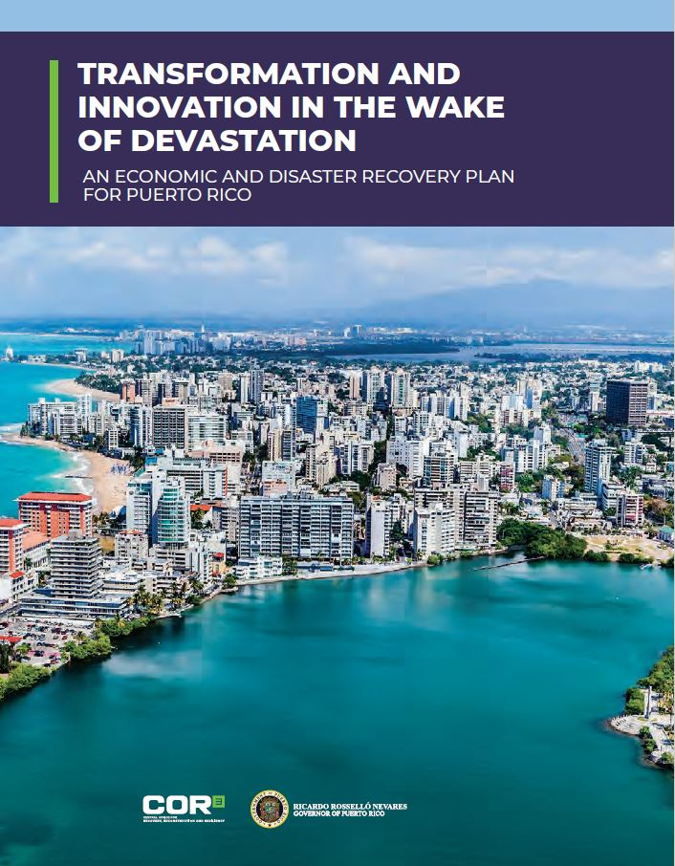
Economic and Disaster Recovery Plan for Puerto Rico
Congressional Mandate
Defines priorities, goals, and expected outcomes of the recovery efforts for the Government of Puerto Rico (GPR), based on damage assessments prepared pursuant to Federal Law
Outlines 276 Courses of Action (COAs)
$139 billion projected investment from various funding sources with FEMA PA funding accounting for ~39%
Plan submitted to U.S. Congress on August 8, 2018 and certified by F.O.M.B
Oversight and Coordination led by COR3
Implementation led by GPR Agencies assigned COAs
Update reports due to Congress every 180-days
  First update submitted February 4th, 2019
  Second update submitted August 2nd, 2019

Slide 8
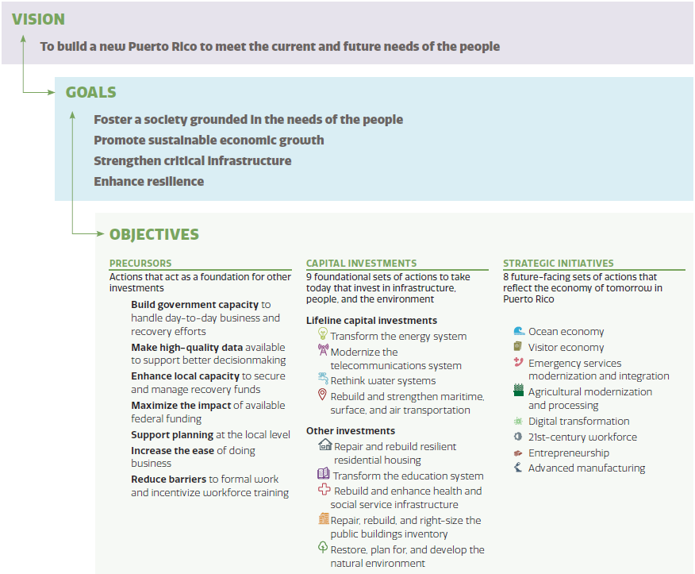
Recovery Plan
Overview
ACTIONS
276 Courses of Action (COAs) to act on the Vision, Goals, and Objectives
*Data from original Recovery Plan (page #11)

Slide 9
COR3 Strategy Team Goals and Objectives
Targeted development and monitoring of projects to accelerate recovery and help the Island build back better
Maintenance of a comprehensive data-set for developing the mandatory bi-annual updates to Congress on the progress of the recovery
Tracking GPR agencies’ use of Federal funds outside of PA, increasing COR3’s scope of transparency (PA only encompasses ~39% of recovery needs)
Providing insights regarding portfolio level schedules and associated spend curves with drill down capability to sector, agency and project levels
Coordinate the development of COA Action Plans in partnership with GPR agencies and Federal partners ensuring the timely identification of funding needs for the entire recovery plan
Provide ongoing support to agencies to accelerate work plans including project formulation and execution
SPEED
TRANSPARENCY
OVERSIGHT & ACCOUNTABILITY
OVERSIGHT & ACCOUNTABILITY
Reduce the risk of implementing redundant projects and de-obligation of funding
Assess funding gaps, align funding sources, and assist with coordination and prioritization strategy across the Island
Monitor cost and schedule performance as well as key risks to execution

Slide 10

Disclaimer
www.recovery.pr
The materials contained in this presentation are for informational purposes only. This document does not constitute an offer to sell or a solicitation of an offer to buy any securities. This document is a summary of certain matters for discussion only. You may not rely solely upon this document in evaluating the merits of a project, investment venture, or any business referred to herein. This document does not constitute and should not be interpreted as either a project recommendation, investment advice or any other recommendation including legal, tax or accounting advice.
Future results are impossible to predict. Opinions, figures, estimates and market trends offered in this document constitute a preliminary assessment and are subject to change without notice. Data on this document are based on current market conditions but should not be relied upon without further assessment and verification. This presentation may include forward-looking statements that represent opinions, estimates and forecasts, which may be subject to significant uncertainties, many of which are outside the control of the Puerto Rico Public-Private Partnerships Authority, the Government of Puerto Rico and its agencies and instrumentalities.
10

