Slide 1
Canada, Climate Change Adaptation and Green Infrastructure: Responses to Stormwater in Canada
Commission For Environmental Cooperation
JPAC Public Forum
Christopher Hilkene
Clean Water Foundation
Boston
July 14, 2015
Notes:
Good morning
It is a pleasure to be here.
My sincere thanks to the Hon. Pauline Browes and the CEC for the kind invitation to come and share some Canadian experience.

Slide 2
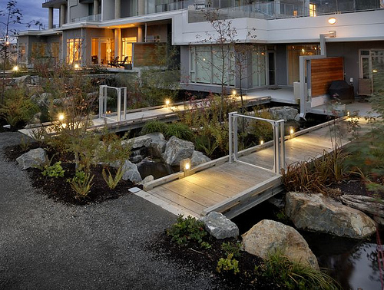
Introduction
Background
National Efforts
Examples From Across Canada
Notes:
We have been asked to focus on local or municipal project examples. So that will be the bulk of my presentation.
But before getting into that I want to very briefly provide some context around the Canadian experience.

Slide 3
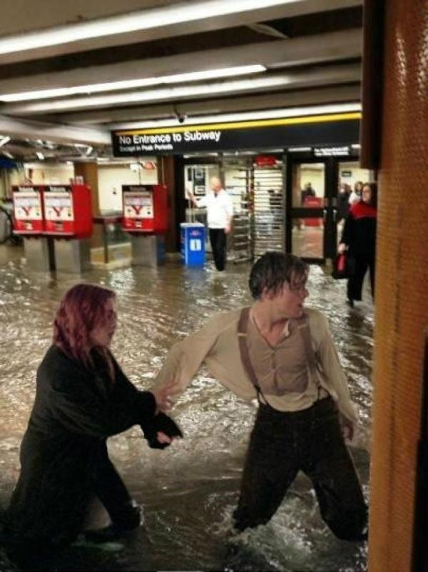
Background
Major storms in Canadian cities have had catastrophic impacts
More than $3.2 billion in weather-related claims in 2013
Damage to infrastructure
Replacement cost for Canada's aging sewer and stormwater infrastructure at $55 billion.
Significant work being done on climate change adaptation, particularly on stormwater
Notes:
A number of extreme rainfall events over the last 10-15 years have had catastrophic impacts on Canadian cities and surrounding areas. The storms that affected Halifax, Toronto, Calgary, and a number of other municipalities, in 2013 caused major damage to homes, businesses and municipal infrastructure. The associated insurance claims in 2013 exceeded $3.2 billion. That’s more than the four previous years combined.
In addition, the Federation of Canadian Municipalities estimates Canada’s municipal sewer and stormwater infrastructure deficit to be about $55 billion.
The projected impacts of climate change complicate things.
We have seen a significant increase in national activity to related to climate adaptation and infrastructure, particularly stormwater infrastructure.

Slide 4
National Context
Municipalities
Federation of Canadian Municipalities
Federal and Provincial Governments
Federal Climate Change Impacts Adaptation Platform
Regional Adaptation Collaboratives
Canadian Council of Ministers of the Environment
Non-Government
International Institute for Sustainable Development
Academia
Western: Institute for Catastrophic Loss
Waterloo: Intact Climate Change Adaptation Project
Simon Fraser: Adaptation to Climate Change Team
Notes:
This is just a small sample of organizations that are active nationally on the climate change adaptation front.
The Canadian Federation of Canadian Municipalities, which is an association of municipalities, provides project funding through the Green Municipal Fund, which is financed by the federal government, as well as municipal level guidance.
Federal, provincial and territorial governments are working on their own as well as collaboratively to advance climate change adaptation science, decision-making and policy. They also provide technical and financial support to local and regional projects.
I would just note the work of the work of the CCME. The team I work with helped to set-up their program on climate change adaptation, flood and drought and may lead the way to a new paradigm of government decision-making and policy development related to climate change adaptation.
There are also a host of non-governmental actors that are conducting research, providing policy advice and funding projects. I have just listed 4 that I am most familiar with.

Slide 5
Examples
Notes:
What I would like to do is provide a sample of some very different projects from Canadian cities.
They vary in terms of the types of green infrastructure used, scale and complexity.
I am going to go from East to West, which also means we will start with the smallest project and end with the largest. I will present of new build and restoration/retrofit projects. Coincidentally, it also means we go from the newest project to the oldest and we start and finish in places where the receiving waters are named Coal Harbour.

Slide 6
HALIFAX, NOVA Scotia Bioremediation
Notes:
This is the St. Mary’s Boat Club in Halifax, Nova Scotia
Built in 1905, and owned and operated by the Regional Municipality of Halifax, the St. Mary’s Boat Club is beloved Halifax landmark and a popular recreational spot. It is the most popular wedding venue in Halifax.
It is located in an urban area just north of the downtown core.
In addition to the boat club itself, the site hosts a turfed park, that is popular for picnics, (located just outside the picture on the right) and active recreation areas, six tennis courts and parking (out of sight in the picture, but behind the trees about the boat club).
Behind the boat club is a mostly low density residential area.
The site has a fairly steep grade and consists of mostly impervious surfaces with limited tree canopy and vegetation.
Stormwater run-off through the park has led to significant erosion, particularly at the lower reaches and along the shoreline. Erosion is compounded by storm surge. So they are losing shoreline, vegetation and a coastal break wall is being threatened.

Slide 7
HALIFAX, NOVA Scotia Bioremediation
Slow and retain surface runoff
Vegetate the perimeter of the Park and shoreline
Incorporate a rain garden
Notes:
The Ecology Action Centre, which is an NGO, in partnership with Halifax, and with financial support from Intact Insurance created The Living Shoreline Project to demonstrate the effectiveness of bioremediation for stormwater management and erosion control and to make the site more resilient to extreme weather.
The project consisted of restoring indigenous vegetation along the perimeter of the park below the hard surfaces as well as along the shoreline to create an area that more closely resembles the pre-development coast of the area. The objective being to slow down the movement of runoff through the site.
A key challenge was that the park area needed to retain a significant turfed area for active recreation and picnicing and that is major pathway for runoff. So a rain garden was integrated into the middle of the turfed area.

Slide 8
HALIFAX, NOVA Scotia Bioremediation
Planting beds designed for water infiltration
Native plants
Lots of volunteers
Notes:
The planting areas were designed to enable greater water infiltration
The plant mix consisted of native grasses, shrubs and trees
Planting was done by over 100 volunteers

Slide 9
HALIFAX, NOVA Scotia Bioremediation
Simple solutions
Low cost
Community engagement
Notes:
Rows of hay bales were used throughout the site to slow runoff until the plants are established and the site matures
Trees were also planted through the hay bales to protect the trees until their roots have established and it provides nutrients as the hay bales decay.
A series of sensors line the entire a slope. Installed pre project so that changes in flow rate can be monitored over time. Data collection is supported by a community monitoring network.
The Ecology Action Centre continues to the support the project through interpretive signage and on-going community outreach.
Total cost of the project was $15,000, not including staff time or volunteer hours.
This small project has generated significant support from the Halifax community and Nova Scotians more broadly. Two new projects in Halifax are already under development as is one Cape Breton on the north shore of Nova Scotia. The province is examining what role it might play to encourage broader application.

Slide 10
BOUCHERVILLE, QUEBEC Wet and dry retention ponds
Notes:
The City of Boucherville is a suburb of Montreal to the southeast. Boucherville wanted to grow and welcome new development. When the City decided to develop the Harmonie neighbourhood, they faced a stormwater management problem. The Sabrevois River located nearby could only safely cope with a limited amount of stormwater runoff before encountering the risk of environmental problems. Also, the cost of installing new high-capacity sewer systems and rainwater collectors would be expensive - a cost that the City did not want to impose on developers and new residents.

Slide 11
BOUCHERVILLE, QUEBEC Wet and dry retention ponds
2 wet urban lakes
2 dry ponds for capacity
Drainage pathways
Water quantity and quality benefits
Notes:
Research identified an approach using double drainage principles. There would be wet and dry detention ponds in the neighbourhood. Two ponds, or small urban lakes, would have permanent
water retention (wet detention ponds), and two ponds would be dry most of the time but would have capacity to temporarily hold water in the eventuality of heavy rainfall events (dry detention ponds). Drainage pathways were created to connect the dry ponds to wet ponds.
The four ponds help to reduce peak stormwater runoff during heavy rainfall events. The four ponds protect the quality of urban water runoff from roads, parking lots, residential neighbourhoods and other impervious areas. The wet detention ponds have plants that provide a natural filter for storm water. Dry detention ponds are designed to drain within 24 hours after a storm. The
four ponds provide a capacity to retain extreme rainfall water volumes similar to that present before the development, minimizing the risk of increase stormwater flowing into established neighbourhoods and resulting in flood risk reduction.

Slide 12
BOUCHERVILLE, QUEBEC Wet and dry retention ponds
Urban lakes were basis of development
Connected to parks
Connected to the city
Increased popularity
Reduced river erosion
Notes:
The small urban lakes created in Boucherville were used as the starting point of the neighbourhood’s development. After their construction, they were connected to municipal parks by multifunctional corridors for cyclists and pedestrians. These corridors surrounded by drainage ditches were used for draining purposes, but also to connect the new parts of the neighbourhood with the rest of the city.
Through this land use planning, the city created ‘blue’ and ‘green’ networks that increased the popularity of the area. One of the urban lakes created in the project was also conceived as a mitigation measure to control erosion on the Sabrevois River by procuring better waterflow control. This same lake also allowed best stormwater management practices because of its high retention capacity that helps prevent flooding in the event of a one in 50 year extreme rainfall, compared to the one in 10 year capacity of traditional systems in the City.

Slide 13
TORONTO, ONTARIO Sustainable Neighbourhood Adaptation Retrofit Action Plan (SNAP)
Notes:
The Sustainable Neighbourhood Retrofit Action Plan (SNAP) is an innovative pilot program led by Toronto and Region Conservation (TRCA) in collaboration with many municipal and community partners. The SNAP program aims to accelerate the implementation of environmental improvements and urban renewal at the neighbourhood scale and build resiliency against climate change. It takes an integrated approach to overcome urban retrofit challenges and address a broad range of objectives with locally tailored solutions. There are currently 5 communities involved. Each SNAP neighbourhood features unique initiatives to inspire residents, businesses and governments to take action.
The SNAP program, as one of the first of its kind, attempts to examine and develop the process for neighbourhood-wide sustainable retrofit. It guides strategic infrastructure investments that will implement watershed and municipal plans and climate change strategies at the ground level. It identifies and find ways to overcome barriers to implementation. Most importantly it is meant to engage a new public and inspire new players. Lessons learned from SNAP pilot projects can be used to accelerate the transformation of other urban communities

Slide 14
TORONTO, ONTARIO Sustainable Neighbourhood Adaptation Retrofit Action Plan (SNAP)
Five neighbourhoods, five core themes
Stormwater
Water use
Water conservation
Energy
Natural heritage
Notes:
Although each SNAP is unique based on the neighbourhood, all SNAPs share a common approach.
Focus on making sustainable changes across five core theme areas which include: stormwater management, water use and conservation, energy, and natural heritage. The SNAPs also seek synergies with a number of complementary themes including health and well-being, transportation, waste management, community identity and culture.
Science-based process for identifying and evaluating integrated solutions that achieve multiple objectives.
Quick-start local demonstration projects such as naturalized landscaping, rain harvesting and renewable energy production to bring the plan to life for neighbourhood residents.
Emphasis on collaboration and building partnerships with various stakeholders throughout the process. Local residents, businesses, community groups and institutions are all engaged in the design of the SNAP and efforts to build local capacity for implementation.
Community-based Social Marketing research, social innovation approaches and extensive consultation with the local community to identify and understand the barriers and motivations to behavioural change and develop strategies to overcome these barriers.
Analysis of the business case for retrofits.
Monitoring framework of sustainability indicators for measuring long term success with reference to baseline data collected before the plan and targets set during the planning process.

Slide 15
TORONTO, ONTARIO
Notes:
This is a snap shot of one neighbourhoods, called County Court, which is located in the north-western part of the Greater Toronto Area in the City of Brampton
Activities happening here include:
A green home make over program – Discounted design services for things like rain gardens and financial incentives to home owners for other water and energy related upgrades.
And a number of demonstration sites including:
Park renewal – focused on recreational needs and environmental education
Greener streetscapes - biorentention retrofits of boulevards for better stormwater infiltration and establishment of a healthy urban forest
Pond transformation – to address water stormwater volume and quality objectives
Habitat restoration – along and through the golf course
Rainwater harvesting – for golf course irrigation
Green Park lots
And urban forestry

Slide 16
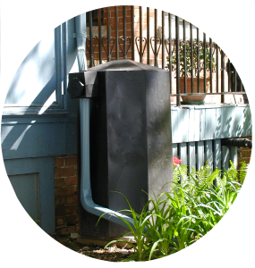
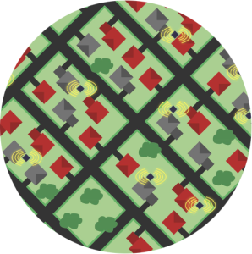
TORONTO, ONTARIO RainGrid
Smart Automation
Stormwater
Control
Resilient
Cities
Notes:
A small start up with an innovative new take on residential stormwater management.

Slide 17
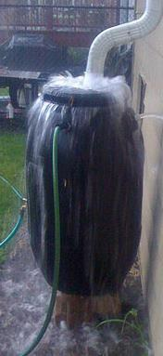
TORONTO, ONTARIO RainGrid
Traditional rain barrels tend to be:
Too small
Inconvenient for many homeowners
Participation in municipal programs is spotty
Notes:
There are few challenges associated with traditonal rain barrels. They tend to be:
Too small, so they don’t always have the capacity to capture the water associated with extreme rainfall
Many homeowners find them inconvenient. They require maintenance etc. and often become neglected. They don’t get drained before storms and they don’t get drained before the winter and end up getting damaged as a result of ice build-up. So they can end up not performing the function they were meant to.
Participation in municipal rainbarrel programs and has tended to be spotty.

Slide 18
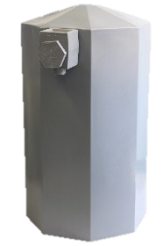
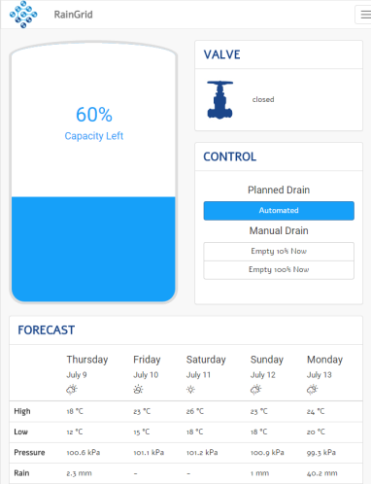
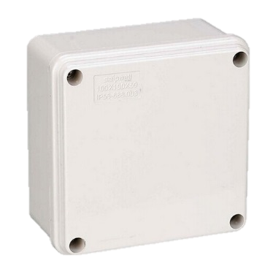
TORONTO, ONTARIO RainGrid
RainGrid has developed a
smart grid approach to
residential stormwater
RiverSides RainBarrel
RainGrid Controller
RainGrid Data Platform
Notes:
RainGrid has developed a smart grid approach to residential stormwater that they call “rainfrastructure”
RiverSides RainBarrel*
Larger capacity
Rapid installation for stormwater control
Made of UV-stabilized HDPE recycled plastics
Durable design requires little maintenance;
West Nile Virus safe
RainGrid Controller
Monitors inflow, volume stored and overflow data
Remotely actuated valves respond to input from RainGrid Data Platform
RainGrid Data Platform
Smart phone app - drains stored rain prior to predicted rainfall
Predictive algorithm correlates storage capacity to rain forecast
Remotely managed

Slide 19
TORONTO, ONTARIO RainGrid
Notes:
RainGrid’s Rainfrastructure, a network of automated lot level cisterns, reduces the risk of sewer backups, overland flooding and property damage at half the cost of grey infrastructure.
RainGrid has the potential to help reduce the costs of severe storms by capturing and storing more than 90% of average annual roof runoff.
RainGrid can be applied to greenfields or can retrofit existing residential rainbarrel programs. Installation is quick and cheap and can be rolled out on a house by house basis and scaled as needed.
Regional and Municipal Benefits
Reduced property damage due to 90% diversion of average annual roof runoff
✓ Improved water conservation through access to stored non-potable water
✓ Extends life of existing built infrastructure
✓ Reduced runoff and sewer overflows & increase watershed ecosystem health
✓ When used with a soak-away system, RainGrid restores groundwater hydrology
✓ Potential stormwater fee incentive
Developer Benefits
✓ Reduced land, design and build costs for stormwater management
✓ Unique branding opportunity for housing communities
✓ Up to 5 points towards LEED green building Certification
✓ Quick and efficient install
✓ Attracts homebuyers with potential stormwater fee offsets
*Can be replaced with 1320 gal subterranean cisterns installed under garage excavation. Integrating a RainGrid system into the building envelope during construction achieves overall reduction in stormwater management costs.

Slide 20
CALGARY, ALBERTA Rain Gardens and Swales
Notes:
Canada Lands Company and the City of Calgary were looking to redevelop Currie Barracks, a former military site near the downtown of the City. This brownfield site was to become
a medium- to high-density residential development. Calgary was seeking an innovative approach to stormwater management because of restrictions in the capacity of the downstream storm
sewer system stormwater systems to accept the projected increases in runoff from the site.
The consulting engineer for this project developed a Low Impact Development design to ensure that the rate of the runoff leaving the site would not exceed the capacity of the downstream
stormwater system. In particular, abandoned fields were converted into rain gardens, vegetated swales and gravel infiltration trenches were incorporated at strategic locations as
part of the green space in the new urban fabric.

Slide 21
CALGARY, ALBERTA Rain Gardens and Swales
Designed soil
1.0 m thickness compared to traditonal 10-15 cm of topsoil
Combined with use of vegetated swales
Area allows rainwater to seep and replenish groundwater
Hard surfaces in the area are higher than predevelopment.
Landscaped areas act as a sponge
Water is distributed around the site rather than
Does not overwhelm the city’s stormwater system
Notes:
The rain gardens were designed with topsoil blended with compost and drywall surplus materials with a thickness of over 1.0 m compared to 10 to 15 cm of topsoil in a traditional development. This type of soil combined with the use of vegetated swales made it possible for the area to accumulate most of the rainwater long enough for it to seep and replenish groundwater. The amount of hard area in Currie Barracks is similar to, or actually even higher than pre-development conditions because of the higher density. However, it is dealt with in a better way by making the
landscaped areas act as a sponge. The water is then distributed around the site and does not overwhelm the city’s stormwater system.

Slide 22
CALGARY, ALBERTA Rain Gardens and Swales
Retains most peak rainfall/limits discharge
Address functionality concerns re: LID
Basis for Stormwater Souce Control Handbook
Currie Barracks was a pilot project in Canada for LEED
Notes:
The Currie Barracks brownfield project has been successful in retaining most peak rainfall on site, meeting the design challenge of limiting discharge from the property. The project also addressed concerns about the functionality of the design feature during winter freeze-thaw events. Low Impact Development projects rely on soil moisture, evapotranspiration and infiltration to absorb heavy rainfall but these natural processes may not perform as well in cold climates. In addition, traditional catch basins tend to clog during Chinook conditions, common in Calgary, due to the bottom outlet design being at risk of clogging and freezing. This problem was addressed in the project with the design of a raised outlet with a non-clogging tie-in to the storm sewer system.
In parallel, the City of Calgary developed a Stormwater Source Control Handbook to address design criteria for Low Impact Development applications within the city. Before releasing the
Handbook, the City of Calgary made sure that the personnel assessing the design and granting approval were well trained and had a good understanding of Low Impact Development principles.
The Currie Barracks brownfield redevelopment project was also used as a pilot project in Canada for LEED

Slide 23
CALGARY, ALBERTA Rain Gardens and Swales
Notes:
The approval process was more challenging since City staff was not familiar with the specificities of Low Impact Development as many of the proposed features were not standard.
Were able to resolve that through this development.
Currently, the City of Calgary continues to develop Low Impact Development applications throughout the City. “Any upcoming greenfield development and redevelopment will need to be very Low Impact Development intensive to meet new stormwater targets and guidelines,”

Slide 24
VANCOUVER, BRITISH COLUMBIA Green Roof
Notes:
Owned and financed by the Province of British Columbia, the VCC was final touch on a 20 year transformation of a previously industrial neighbourhood
More than tripled the functional use of the VCC
Served as the international broadcast media centre during the 2010 Winter Olympics
Designed to be a showcase sustainable building
Constructed to meet the LEED Gold Standard in sustainable building design, but received Platinum certification
Led by 3 consulting firms and required 60 individual consultants
Features the 2nd largest green roof in North America. Largest non-industrial green roof.

Slide 25
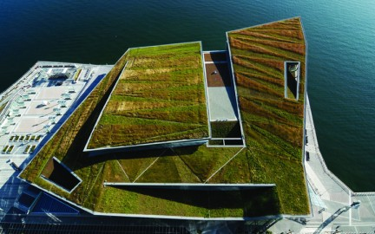
VANCOUVER, BRITISH COLUMBIA Green Roof
“It’s all about water!”
How to manage water from a six and a half acre roof between Vancouver’s drought and downpour conditions was key challenge
Three point strategy
minimize expense
keep the water on the roof
release it slowly
Notes:
The green roof is all about water. Addresses a key challenge, which how do you effectively manage water from a six and half acre roof between Vancouver’s drought and downpour conditions.
Consultants came up with a three point strategy
minimize expense by not custom-designing “super” drains
keep the water on the roof as long as possible
release it slowly so as to allow it to move to conventional drains equally spaced along the roof edge and eventually into the adjacent Coal Harbour.
The roof was divided up into individual 800-square-metre drainage areas based on drainage basin size, stormwater volumes and flow rates.
This is the largest area that a conventional-sized roof drain can accommodate under planted conditions.
The excess stormwater from each drainage basin was directed to a roof drain via a conveyance runnel system.
The runnels zigzag down the sloping roof planes much like a grassland stream moves through the landscape collecting excess stormwater,

Slide 26
VANCOUVER, BRITISH COLUMBIA Green Roof
Benefits
No additional demand on municipal water infrastructure.
Reduces demand on municipal wastewater infrastructure
No potable water required
Reduced impervious surfaces by 30 percent
Creates coastal prairie habitat
Energy efficiency
HVAC – increased life and noise reduction
Notes:
No additional municipal demand on municipal stormwater infrastructure. It has, in fact, reduced the demand on existing municipal stormwater infrastructure thereby creating more capacity and extending its life.
During periods of drought, sensors trigger an integrated drip irrigation system supplied by an onsite blackwater recycling plant. So no potable water is required for irrigation
The VCC saves over $21,000 per month in utility costs as result of it’s water management
The decrease in site impervious surfaces is almost 30%, mitigating total suspended solids and phosphorus content from stormwater and reducing the site’s heat island contribution
The coastal grassland habitat of the Vancouver Convention Centre green roof is an integral part of Vancouver’s nature-based, green stepping stone network that encourages birds, honeybees and other insects to move between the existing natural areas within urban Vancouver. Planted with over 400,000 native plants and 4 bee colonies housing 60,000 bees each. Other plant varieties are being introduced naturally increasing biodiversity.
The green roof is designed to act as an insulator, estimated to reduce summer heat gains by up to 95 percent and winter heat losses by up to 35 percent.

Slide 27
Closing Comments
Climate Change adaptation efforts widespread
All levels of government
All sectors
New decision-making paradigm emerging
Green infrastructure to become more popular
Resilient
Scalable
Integrated design
Responds to community risk/desires
Notes:
What I have shown is just a small snapshot of some of the things that are going on
Climate Change adaptation is something receiving a lot of attention: We have all levels of government all sectors doing work on resilience
As a result of that work, we are likely to see a decision-making paradigm emerge that will reinforce the importance of green infrastructure in climate change adaptation responses.
The solutions need have to be
Resilient
Scalable
Cost effective
They also need to be responsive to
The level of risk that communities are willing to accept
And they will have to be able to be integrated in to strategies and plans to achieve other community objectives.
Green infrastructure can do all that.

Slide 28
Thank you!
Christopher Hilkene
Email: chilkene@cleanwaterfoundation.org
Web: www.cleanwaterfoundation.org
Twitter: @cleanwaterfdn

