Slide 1

Implementation of the
North American Emission Control Area in the United States:
Lessons Learned for a Mexican ECA
Angela Bandemehr
U.S. EPA Office of International and Tribal Affairs
Long Beach, California
December 12, 2016
Notes:
1

Slide 2
What is an ECA?
An ECA puts in place stringent standards for ship emissions (SOx, NOx, PM)
ECAs can be established under the Air Pollution Annex of the International Maritime Organization’s Convention on the Prevention of Pollution from Ships (MARPOL Annex VI)
MARPOL Annex VI also establishes global standards that are much less stringent
ECAs provide substantially more public health benefits than MARPOL Annex VI

Slide 3

Why ecaS ARE IMPORTANT
Ships use some of dirtiest fuel
This is why such benefits are seen
from ECA clean fuel standards
The global fuel limit is 3.5% sulfur
(35,000 ppm sulfur)
  Cars use 15 ppm sulfur fuel in US
ECA: 2012: 1% sulfur (10,000 ppm)
2015: 0.1% sulfur (1,000 ppm)
2016: 80% reduction of NOx

Slide 4
Air POLLUTION IS A SEVERE HUMAN HEALTH PROBLEM: recognized globally
Findings
WHO: air pollution is the world’s largest single environmental health risk and caused almost 15% of all deaths in 2012
Ranks as the 8th leading cause of deaths worldwide
Heart disease, strokes, lung cancer and other illnesses
Global commitments
2014 UN resolution on air pollution
2015 World Health Assembly resolution on air pollution

Slide 5
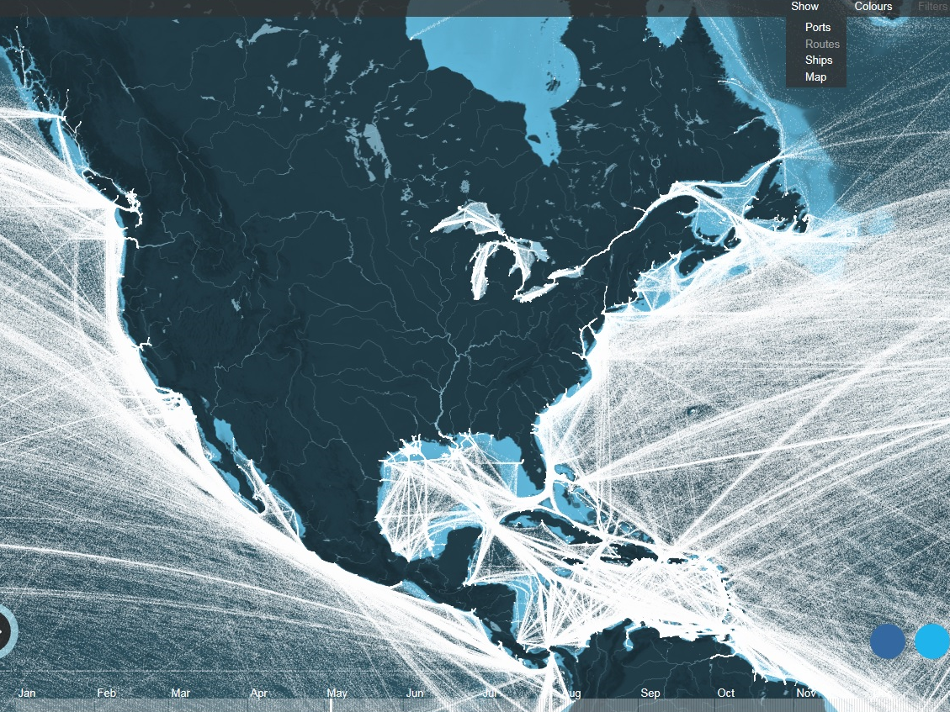
SHIPS ARE MAJOR SOURCE OF AIR POLLUTANTS
NORTH AMERICAN SHIPPING ROUTES IN 2012
TRAFFIC IS PROJECTED TO GROW IN THE FUTURE
Source: University College – London; Kiln; IMO Third GHG Study 2015
Notes:
D

Slide 6
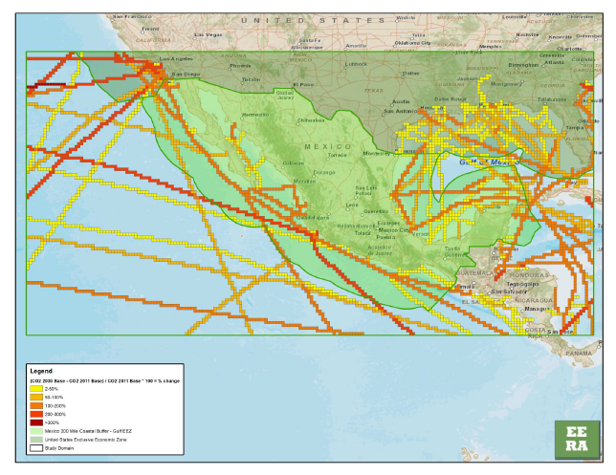
Mexican ship traffic projected to increase by 50-200% by 2030
Percent change (increase) in energy use and/or CO2 emissions attributed to growth in shipping within the Mexican modeling domain

Slide 7
Ship Emissions Relative to Other Mobile Source
PM2.5 Emissions in U.S.
Why the US has an ECA:
Ship Emissions in a No Action Scenario
Source of inventory estimates: C3 Marine NPRM (July, 2009)
Does not reflect IMO MARPOL Annex VI Amendments (October 2008)

Slide 8
WHY THE USA HAS AN ECA
MARPOL Annex VI global controls are necessary but not sufficient
ECAs require cleaner fuels and lower emission standards
Prefer to meet domestic air quality goals with an ECA
Consistent standards across all U.S. ports and internationally

Slide 9
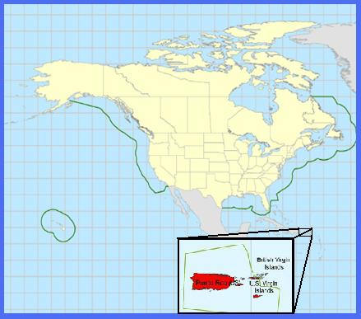
U.S. Emission Control Areas
North American ECA
  US becomes party to MARPOL Annex VI: January 8, 2009
  NA ECA proposed by US/approved by IMO: July 2009
  Adopted by IMO: March 26, 2010
  Entry-into-force: August 1, 2011
  Enforcement: August 1, 2012
U.S. Caribbean Sea ECA
  Adopted by IMO: July 15, 2011
  Entry-into-force: January 1, 2013
  Enforcement: January 1, 2014

Slide 10
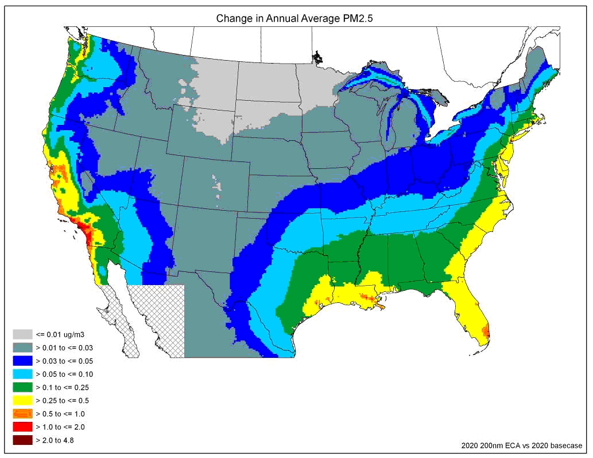
2020 Projected ECA pm2.5 reductions

Slide 11
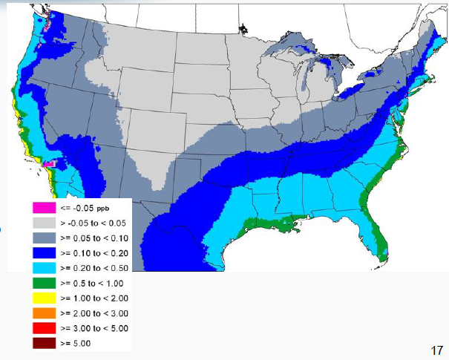
2020 Projected ECA Ozone Reductions

Slide 12
AIR QUALITY GAINS FROM MARINE FUEL SULFUR STANDARDS
Results from US west, east and Gulf coast air quality monitoring shows average 74% reduction in ambient PM2.5 levels
These reductions are definitively linked to the use of cleaner marine fuels required by California and the NA ECA
These reductions reflect air quality data collected before and after the switch to 0.1 % sulfur ECA fuels
You cannot get such results from emission controls on land-based sources

Slide 13
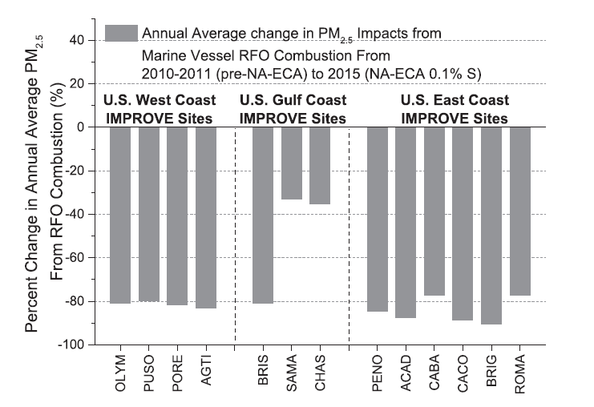
IMPLEMENTATION OF THE ECA IN THE USA –AIR QUALITY GAINS FROM MARINE FUEL SULFUR STANDARDS
Percent change in annual average PM2.5 from marine vessel RFO combustion
From pre-NA-ECA (2010-2011 to NA-ECA 0.1% S (2015) – Kotchenruther, 2017

Slide 14
IMPLEMENTATION OF THE ECA IN THE USA – OVERALL APPROACH
US Coast Guard (USCG) is lead for vessels – verify compliance with Annex VI/ECA during vessel exams
EPA is lead for protection of human health and air quality
Coast Guard and EPA are jointly:
  Enforcing the ECA
  Developing a vessel fuel sampling program
  Coordinating with Canada and the EU on enforcement

Slide 15
IMPLEMENTATION OF THE ECA IN THE USA – FUEL AVAILAbility
We are seeing good compliance with fuel requirements
Compliant fuel is available in US and most regions globally

Slide 16
High level commitment to working with mexico on an eca
Environment Ministers endorse projects under Commission for Environmental Cooperation
  Phase I ECA– 2014-1015: technical analyses
  Phase II ECA – 2016 – 2017: IMO proposal
  Fuel Sulfur Enforcement – 2016-2017: exchange lessons learned in North America
Presidential-level commitment made at the North American Leaders Summit (June 2016)
  “We are committed […] to work together and through the International Maritime Organization (IMO) to support implementation of a North American Emission Control Area that includes Mexico.”

Slide 17
Emissions reductions with a Mexican eca much greater than with global marpol fuel standard
 | NOx | SOx | PM | BC
2030 no MX ECA + MARPOL Annex VI | 12,738,000 | 1,472,000 | 208,000 | 6,200
2030 with MX ECA + MARPOL Annex VI | 2,372,000 | 289,000 | 60,000 | 1,800
Emissions Avoided (tonnes) | 10,366,000 | 1,183,000 | 148,000 | 4,400
Emissions Avoided (%) | 80% | 80% | 70% | 70%
Source: EPA-160-R-15-001, May 2015

Slide 18
Cost-Benefit of AN ECA
Estimated Benefits in 2030 | US | Mexico
Average prevented premature deaths | 21,000 | 20,000
Average Health Cost Benefits | $ 190 billion | $ 58 billion
Benefit to Cost Ratio | 60:1 | 20:1

Slide 19
MARPOL Annex VI provides flexibility for every member State
MARPOL Annex VI – Regulation 18.1: “Parties shall take all reasonable steps to promote the availability of fuel oils…”
Phase I of CEC Mexico ECA project found that clean fuel demand associated with a Mexican ECA will be met by the global marine fuel refining and distribution community
SUPPLY of eca compliant fuel for A Mexican eca

Slide 20
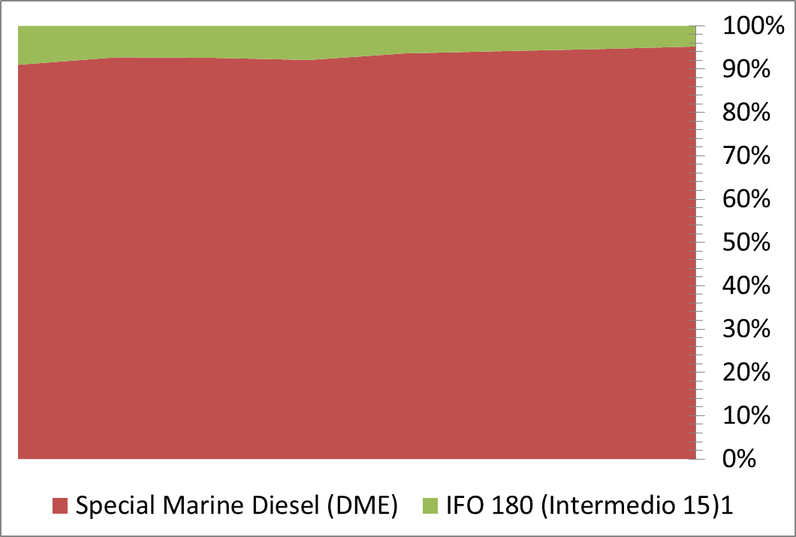
SUPPLY of eca compliant fuel for A Mexican eca
Mexico is a very minor provider of marine fuels to the global shipping sector
Mexico’s production of heavy marine fuel (IFO) is small and decreasing
The global marine fuel sector will adapt and provide for the needs of a potential Mexican ECA
Sales of fuels 2007-2014
Data source: PEMEX

Slide 21
Lessons Learned
Build on Mexico’s existing MARPOL Port State Control regime to enforce MARPOL Annex VI
Fuel sampling is an easy and definitive way to determine compliance
One year grace period between entry into force and enforceability of the ECA allows for preparations

Slide 22
BENEFITS TO MEXICO OF AN ECA
Without an ECA, increased shipping traffic will increase pollutant levels
Reduces PM2.5, sulfur dioxide, ozone levels
Improved air quality
Fewer deaths and illnesses

Slide 23
Summary
Because ships have high pollutant emissions compared to other sources, such high emissions reductions and health gains are hard to obtain with other sources
Tremendous health benefits of an ECA, more protective than global standards
Good experiences in the US implementing the NA ECA
US lessons learned are being shared with Mexico for the development of an ECA

