Slide 1
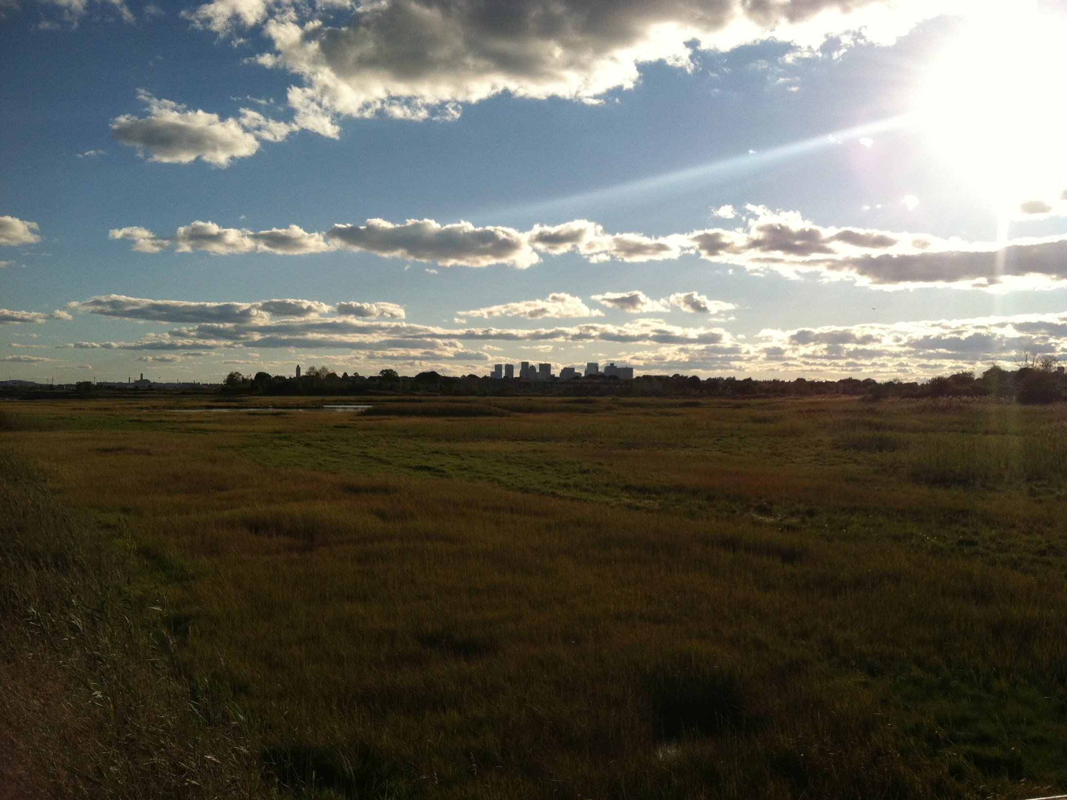



Austin Blackmon, Chief of Environment, Energy, and Open Space, City of Boston

Slide 2

Boston 1630

Slide 3
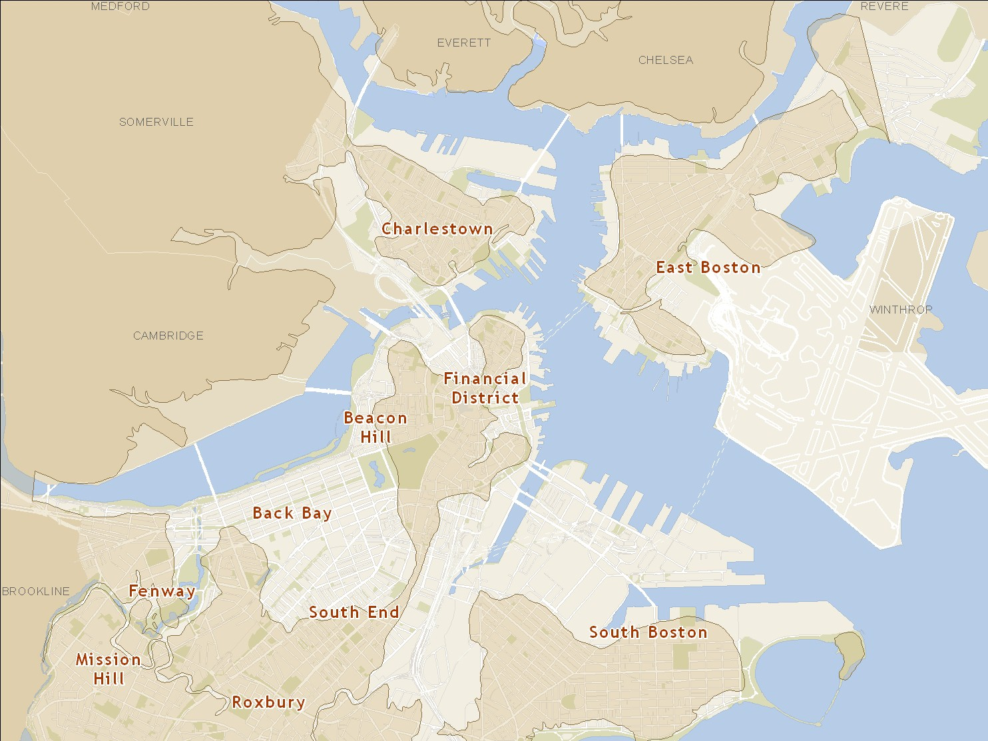
Boston 1630 - 2015

Slide 4
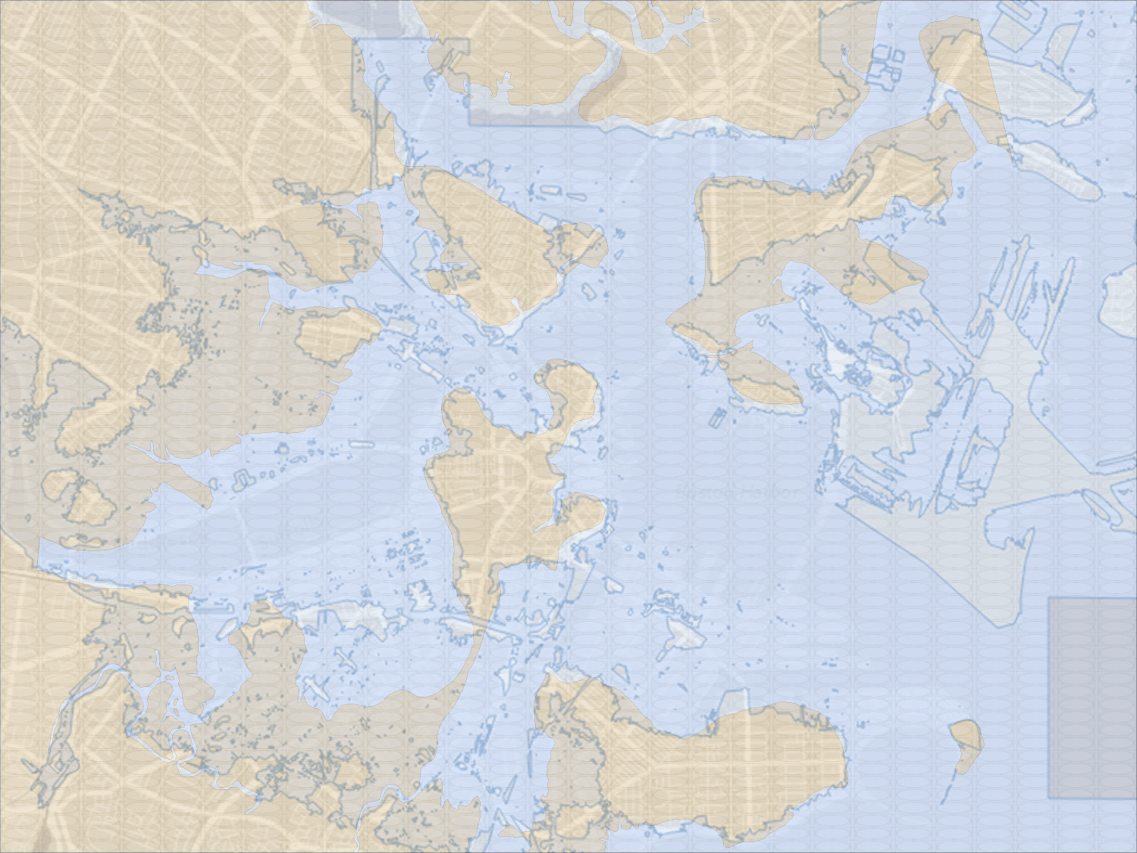
Boston 2100?

Slide 5
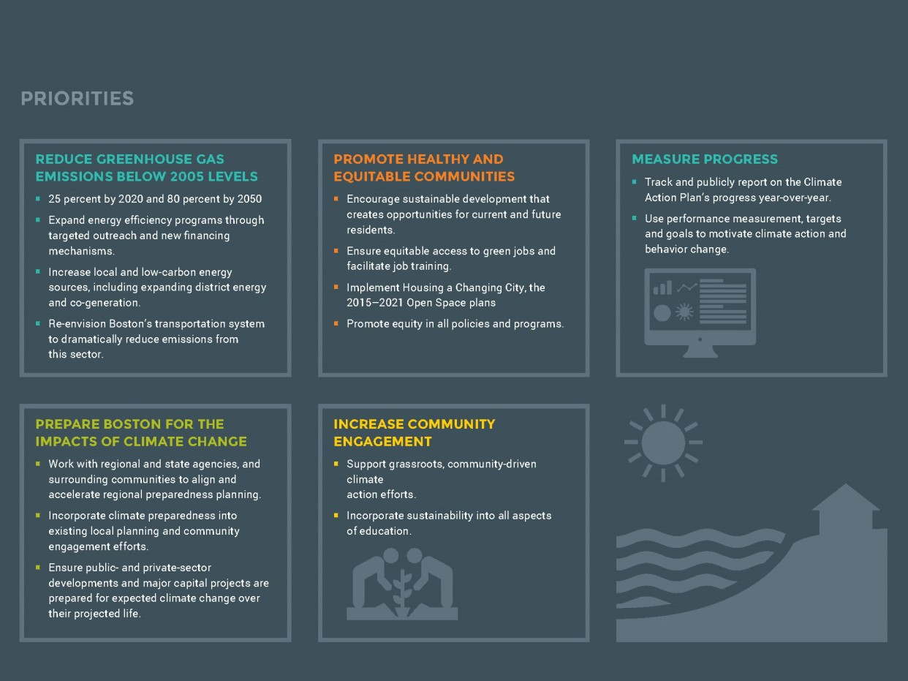

Slide 6

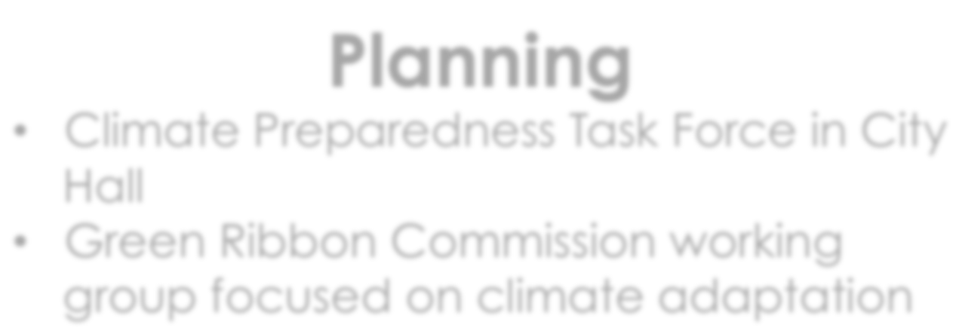

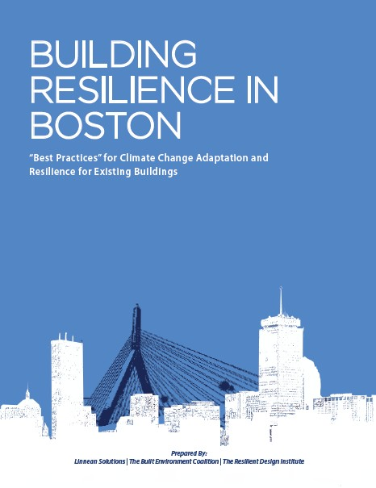

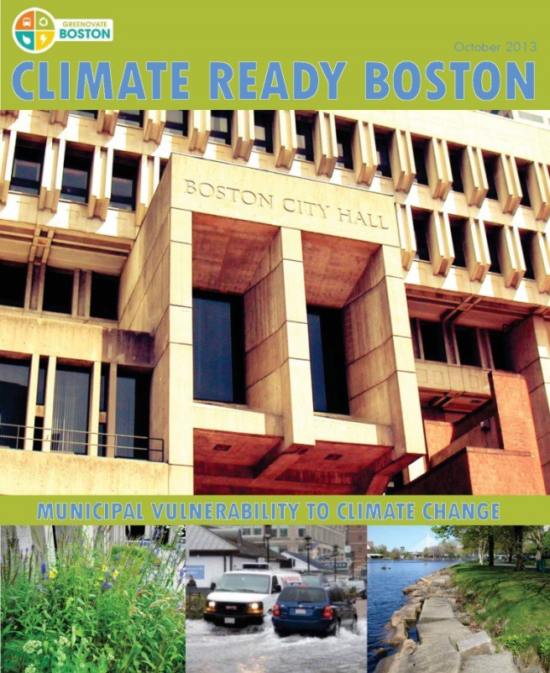

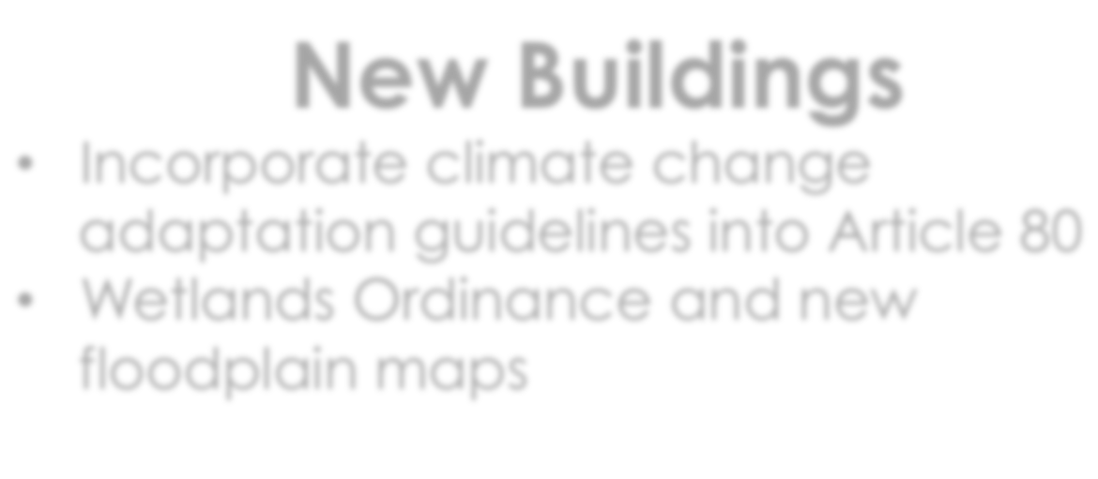


Planning
Climate Preparedness Task Force in City Hall
Green Ribbon Commission working group focused on climate adaptation
Climate Ready Boston
Feb. 2013
Existing Buildings
Assess vulnerabilities of buildings and infrastructure through BRA survey
Better enforcement of flood proofing building standards
New Buildings
Incorporate climate change adaptation guidelines into Article 80
Wetlands Ordinance and new floodplain maps
Emergency Response
Review emergency operation planning
6

Slide 7
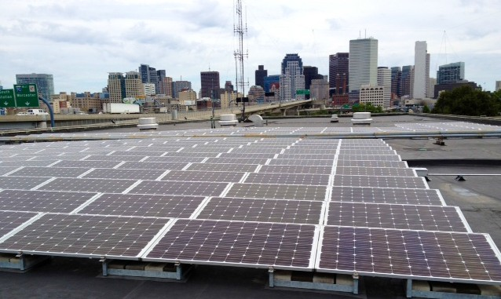

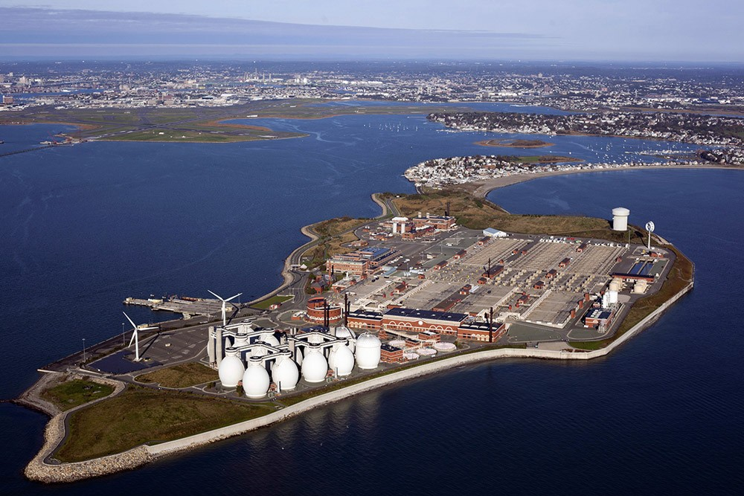

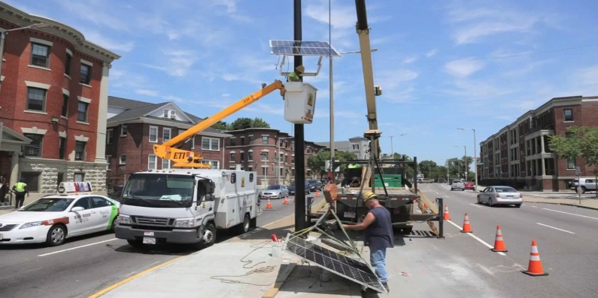

Solar Powered Fueling Stations for Emergency Vehicles at 400 Frontage Road 120 kW
Deer Island Constructed to Withstand 2 Feet of Sea-Level Rise
Solar Powered Traffic Signals Along Evacuation Route

Slide 8
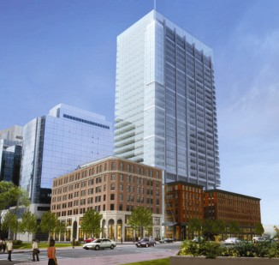
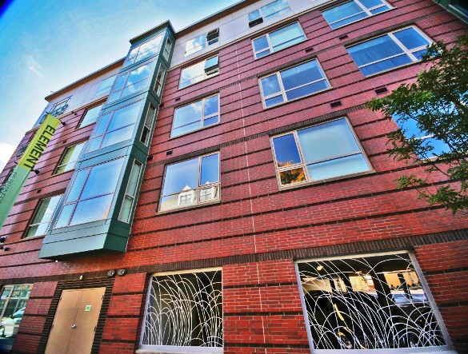
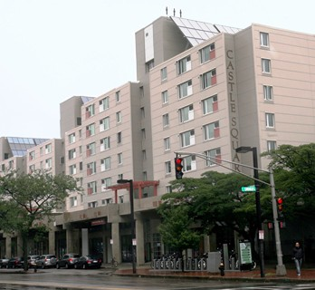
Green & Resilient Buildings
Study expansion of Article 37, Green Buildings
Continue to incorporate Climate Change Preparedness and Resiliency Checklist
Enhance energy codes & reporting standards

Slide 9
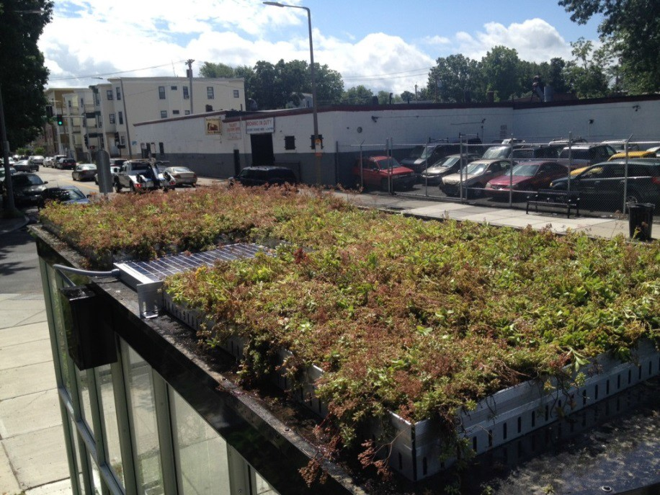
Green Bus Shelters
Living roofs – local, drought-­‐ tolerant plants
Hold up to 24 gallons of water during a major rainstorm
3 bus shelter green roofs installed (Talbot Ave)
Part of the Fairmount Line Bus Shelter Living Roof Ini;a;ve

Slide 10
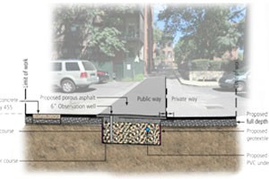
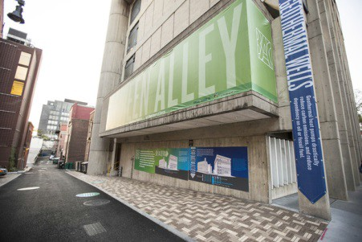
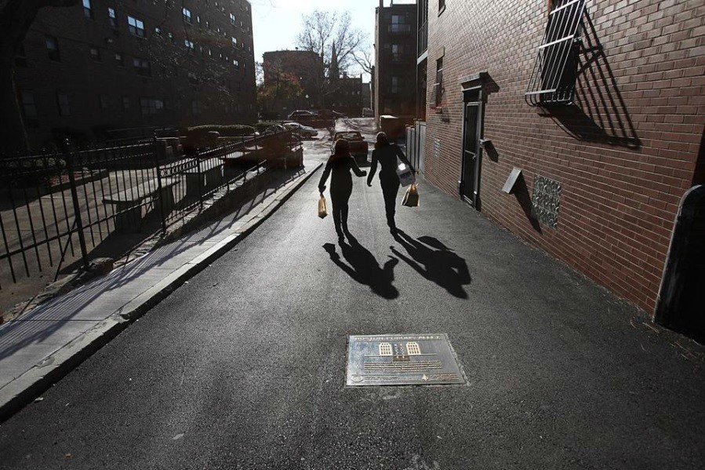
Green Alley Projects
Capture stormwater runoﬀ & recharge groundwater
Permeable asphalt & permeable unit paver systems, gravel bed designed to collect, store, and drain rain water from the surface

Slide 11


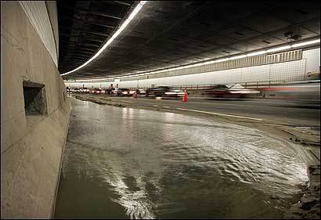
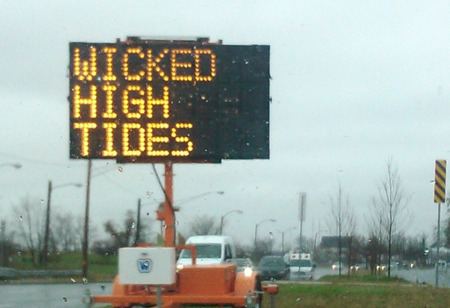
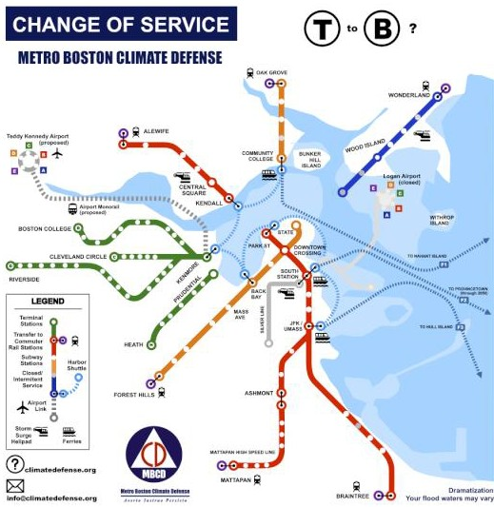
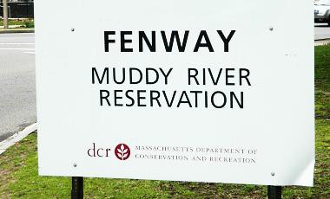
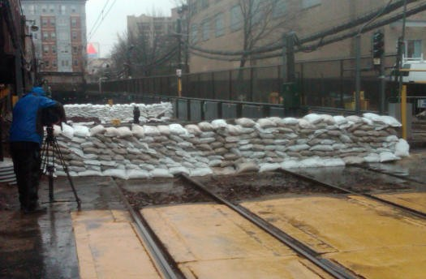
Regional Preparedness Efforts

Slide 12
Building Energy Reporting & Disclosure Ordinance (BERDO)
2013
2014
City of Boston discloses energy and water use
2015
Non- Residential buildings greater than 50,000 sq.
ft.
2016
Residential buildings with 50+ units or 50,000+
sq. ft.
2017
Non- Residential buildings greater than 35,000 sq.
ft.
Residential buildings with 35+ units or 35,000+
sq. ft.

Slide 13
Mayor’s Carbon Cup
Calling on large hospital, university, commercial real estate owners and property managers to participate in the Carbon Cup, by pledging to a 35% GHG reductions by 2020.
Current Carbon Cup Participants
Achieved in 2014
Committed by 2020
Massachusetts General Hospital
– Partners Healthcare
5.6 million sq.ft (35%)
5.6 million sq.ft (35%)
Brigham and Women’s Hospital
– Partners Healthcare
3.1 million sq.ft (35%)
30% absolute reduction across entire North American campus by 2016
Harvard University
1.1 million sq. ft (35%)
Boston University 1.1 million sq.ft (35%) 5.2 million sq.ft (35%)
Boston Properties 1.5 million sq.ft (35%)
Boston Medical Center 2.8 million sq.ft (35%)

Slide 14
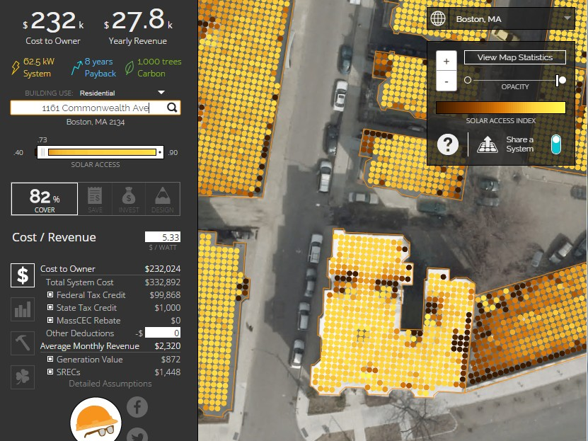
Launched in September 2014
A map of all 127,000 buildings & data on solar potential in Boston
Helpful tool for homeowners & businesses to determine feasibility and costs
A partnership with Mapdwell ® (MIT-based)
Goal: 25 MW of solar throughout Boston by 2020
Solar Map of Boston

Slide 15




Austin Blackmon
Chief of Environment, Energy and Open Space
Email: EnvironmentalEnergy@cityofboston.gov
Visit: cityofboston.gov/EEOS/
greenovateboston.org plan.greenovateboston.org
Like us on Facebook Greenovate Boston
Follow us on Twitter
@GreenovateBos

Slide 16


Slide 17


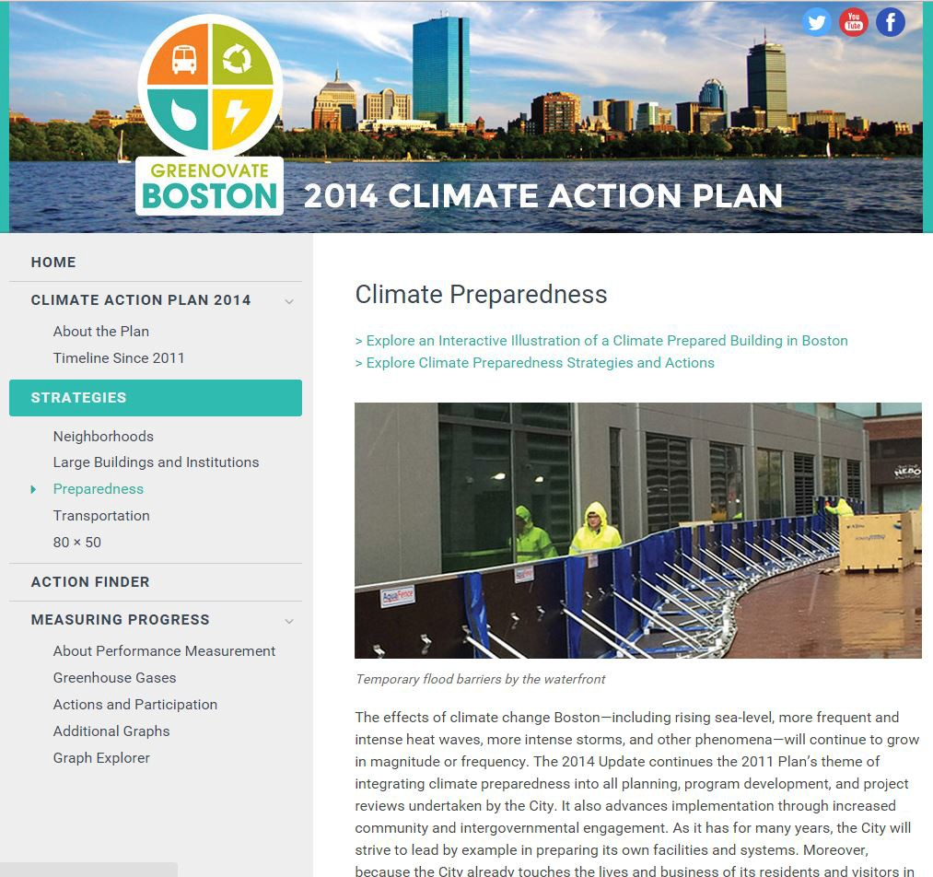
plan.greenovateboston.org

Slide 18
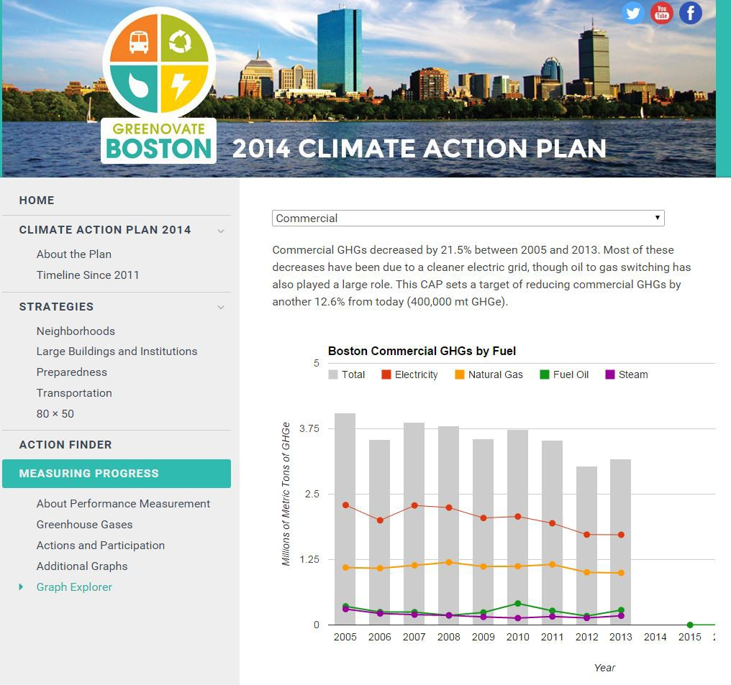
plan.greenovateboston.org

Slide 19
