Slide 1
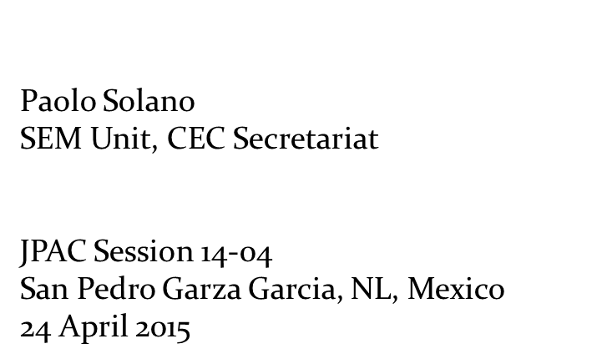
Status Report
Submissions on Enforcement Matters (SEM)

Slide 2
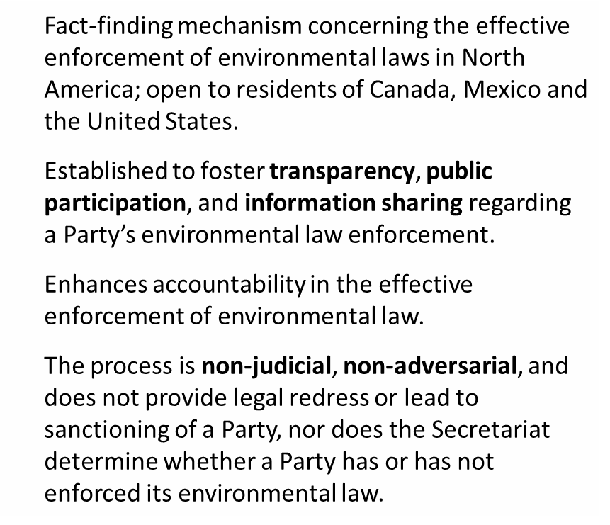

Slide 3
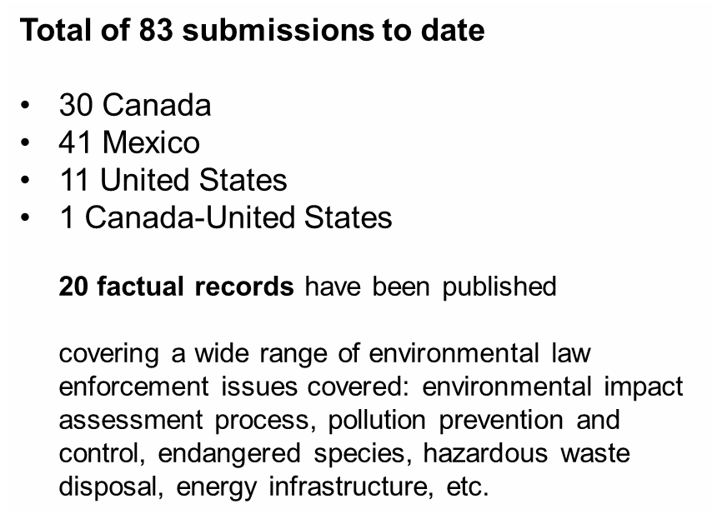

Slide 4
Canada
BC Salmon Farms (Council vote 9 December 2014)
Alberta Tailings Ponds (Council vote 28 January 2015)
Notes:
Since our last update in Arlington, Virginia, Council voted on two submissions.
On 9 December 2014, two of the three members of Council voted against the preparation of a factual record in the British Columbia Salmon Farms submission (filed in 2012). Consequently, the submission was terminated.
On 28 January 2015, the Council voted unanimously against the preparation of a factual record in the Alberta Tailings Ponds submission (filed in 2010). Consequently, that submission was also terminated.

Slide 5
Mexico
The Secretariat is preparing factual records in
Wetlands in Manzanillo
Sumidero Canyon II
The Council is expected to vote in
Tourism Development in the Gulf of California

Slide 6
Notes:
Since the last JPAC meeting in Virginia in November, legal officers have presented the SEM process in talks at the International Book Fair in Guadalajara, Mexico, at the Canadian Council on International Law in Ottawa, and at a law faculty’s public interest career day.
Thus far in 2015, the Secretariat has also made presentations at the Association of International Petroleum Negotiators Conference in Mexico City, and in 5 law school classes at three law schools in western Canada; held two webinars; and organized a public panel discussion at Concordia University, comparing the NAAEC SEM processes with the similar chapter of the CAFTA-Dominican Republic and United States Free Trade Agreement.
I also presented the Ex Hacienda El Hospital II and III factual record at the Instituto de Investigaciones Jurídicas of the Universidad Autónoma de México in Mexico City.
Yesterday’s meeting in Monterrey

Slide 7
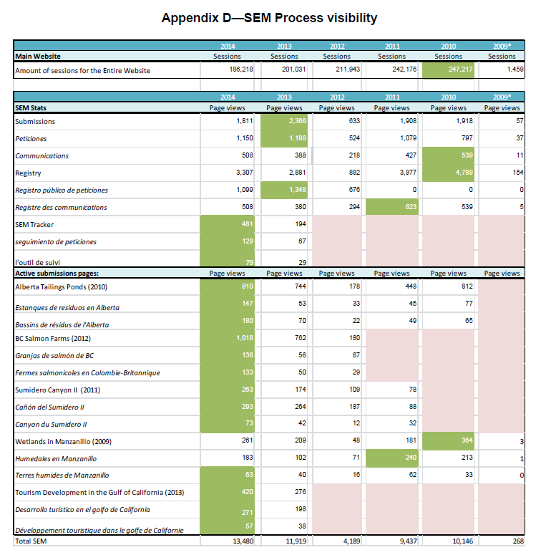
2012: 4,189
2014: 13,480

Slide 8
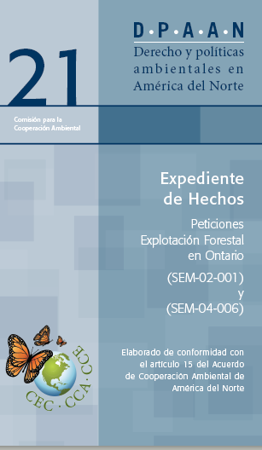

Slide 9
www.cec.org/peticiones
SEM@cec.org
Paolo Solano, Legal Officer
psolano@cec.org
514-350-4321
Notes:
For questions on making a submissions – or to get information on each Party’s designated point-of-contact

