Slide 1
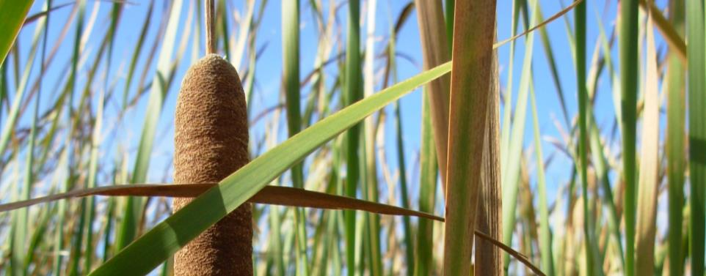
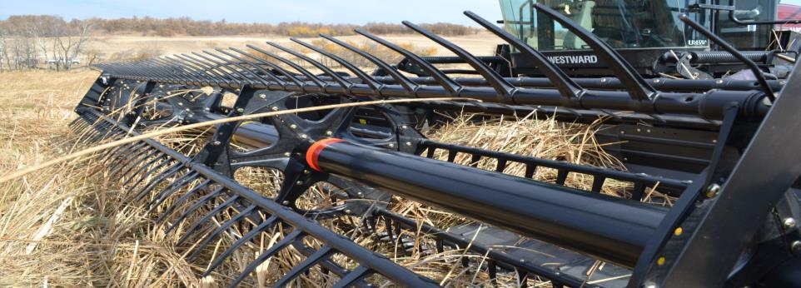
Watershed-based Bioeconomies
Implementing watershed management for multiple benefits
Dimple Roy
Director, Water Program
www.iisd.org ©2015 The International Institute for Sustainable Development

Slide 2
The International Institute for Sustainable Development (IISD)
Independent, non-profit organization that undertakes policy analysis to help governments, institutions and companies make tangible advances in the development and implementation of policies that promote equity and a healthy planet
Areas of focus: resilience, economic law and policy, energy, water and knowledge for integrated decisions
Based in Canada with approximately 200 staff and associates, and offices in Winnipeg, Ottawa, Geneva, New York and Beijing

Slide 3
IISD: Programs of Work
IISD’S PROGRAMS |  |  |  | SERVICES
 | Energy | Water | Resilience | Reporting Services
Economic Law & Policy | Subsidies Climate Mitigation Electricity | Bridging science and water policy (IISD-ELA) Watersheds & Bioeconomy Water-Energy-Food | Climate Adaptation Fragile States Food Systems | Earth Negotiations Bulletin Knowledge Management
Investment Sustainability Standards Public Procurement & Infrastructure Finance Sector Reform Green Industrial Policy
Knowledge for Integrated Decisions
Indicators & Measurement Foresight & Scenarios Adaptive Planning Alternative Progress Measurement

Slide 4
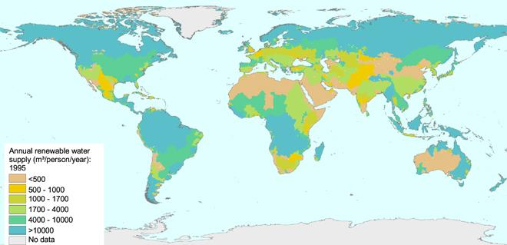
Water- A complex issue
Global Water Security: Includes water quality, quantity and access for all…
Water shortages
Water technology
Ecosystem Services
Drinking water
Water and livelihoods
Water- Energy-Food Nexus
Water infrastructure
Water Pollution and Health
Climate Change

Slide 5
Integrated Water Resource Management
“Integrated Water Resource Management integrates land use and water management at a watershed level to optimize economic, social and environmental outcomes simultaneously”
IWRM Briefing Note, Jun 2004, Policy Research Initiative, Govt. of Canada
Key IWRM principles:
Watershed as unit of water resource management
Integration of land use, water use and stakeholder perspectives
Economic Valuation of water to be integral part of management
IWRM Briefing Note, Jun 2004, Policy Research Initiative, Govt. of Canada

Slide 6
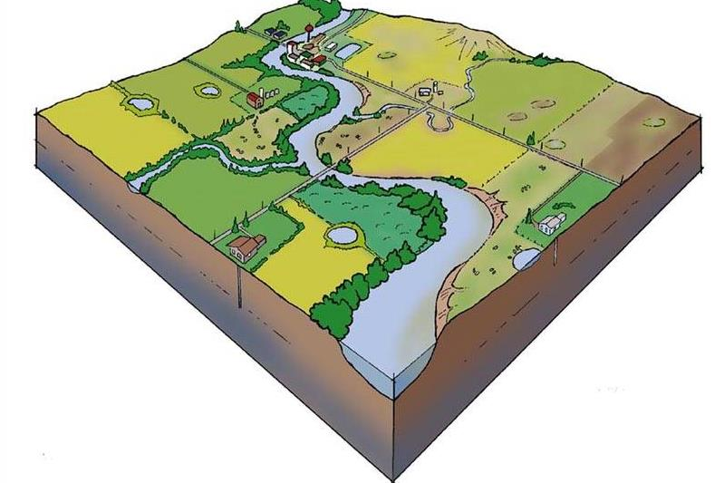
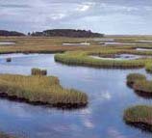
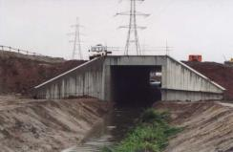
Functional Watershed
Dysfunctional
Watershed
Ecosystems provide critical Environmental benefits (EGS)
Ecosystems impacted – reduced EGS
Natural buffers gone or severely degraded
Flood storage
Agricultural production
Drought resilience
Nutrient capture
Wildlife habitat
Biomass
Recreation
© Ducks Unlimited Canada

Slide 7
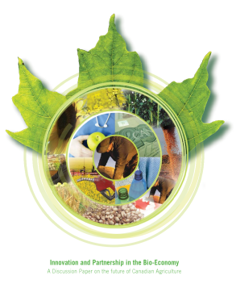
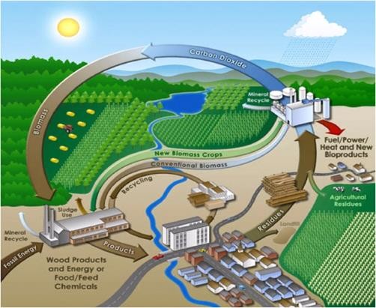
What is the Bioeconomy?
The bioeconomy encompasses the use of renewable biological resources and their conversion into food, feed, bio-based products and bioenergy via innovative and efficient technologies.

Slide 8
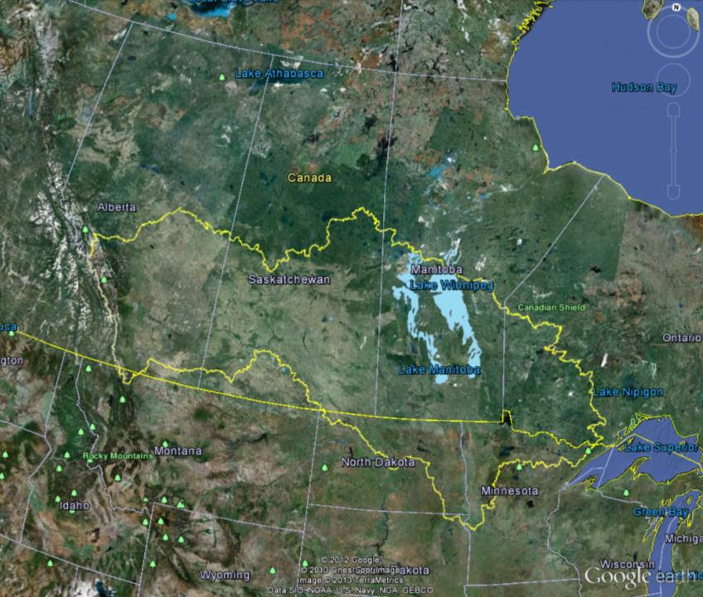
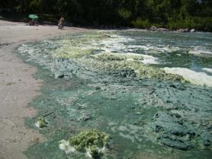
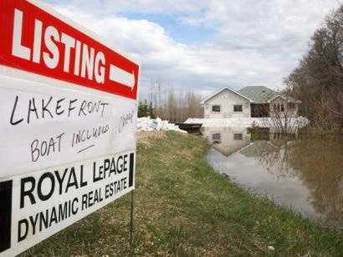
The Lake Winnipeg Watershed a large and complicated ecosystem

Slide 9
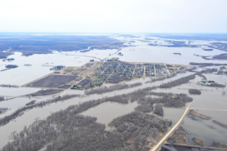
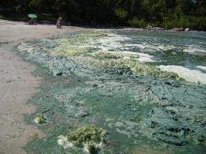
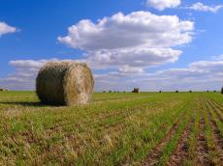
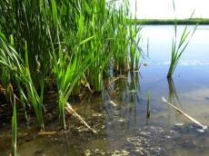
Lake Winnipeg and The Manitoba Bioeconomy
Lake Winnipeg - one of the most eutrophic large lakes in the world
Flooding and nutrient management issues provide economic opportunity through innovative solutions
Surface water management
Phosphorus capture & recycling
Wetland Restoration
Biomass – Bioenergy, biofuels, Bioproducts
Notes:
-Define Bioeconomy
-The use of current technologies and the development of new technologies that facilitate the replacement of significant amounts of fossil fuels by biomass.
-Transition from a fossil economy to a biobased economy

Slide 10
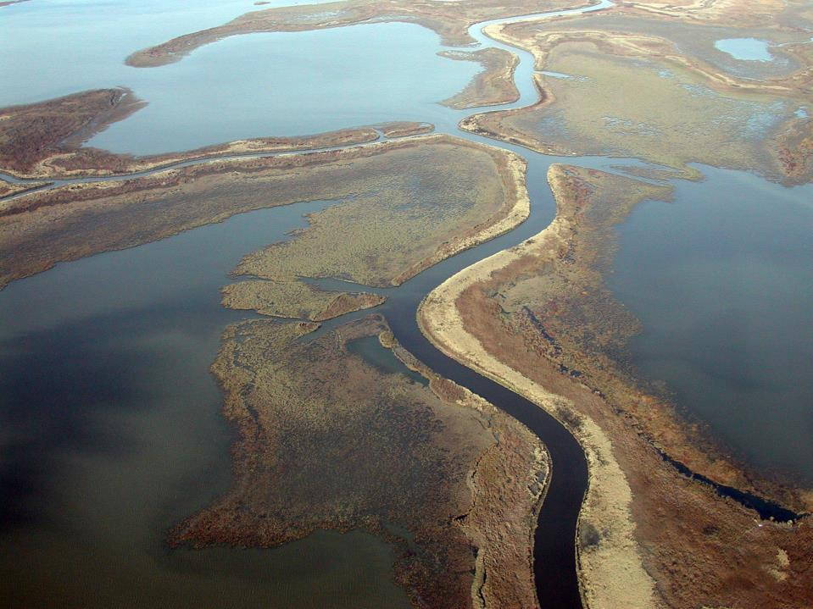
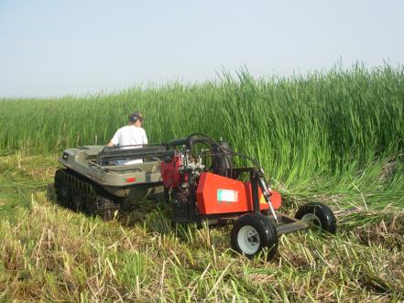
Cattail Biomass
IISDs Nutrient-Bioenergy Project (2006-2010)
P
P
P
P
P
P N CO₂
Wetland plants act as great sponges, absorbing nutrients for their growth, but releasing them again if not harvested.
Cattail plants absorb nutrients through roots – phosphorus (P) and nitrogen (N), and sequester carbon from the air (CO2)
If harvested, these fast growing plants act as a source of sustainable renewable biomass for bioenergy and higher value bioproducts
Combines bioremediation with habitat renewal and GHG reductions
Fundamental concept - we’re turning a waste/pollution stream into an input for sustainable biomaterial production – key building block of the Bioeconomy.
Notes:
Last line of defence before the Lake
Netley-Libau Marsh shows integrated systems thinking and showcases practices that inform new value chains based on natural systems management and enhancement. Research conducted in Netley-Libau Marsh by IISD and the University of Manitoba reveals harvesting cattail biomass can remove 20 to 60 kg of phosphorous from litter and sediment per hectare per year. Once harvested, nutrients locked in plant tissue are prevented from being released into the environment via natural decomposition. Additionally, cattail carbon sequestration research in California demonstrated that cattails can annually sequester up to 75 metric tonnes of carbon per hectare. A further benefit can be gained from using harvested cattail biomass for bioenergy feedstock to displace fossil fuels used for heating or electricity. Finally, the potential for harvesting phosphorous from the biofuel ash is being explored for use in fertilizers. The harvest of cattails for bioenergy production, carbon sequestration, eutrophication mitigation, and phosphorous recovery would help increase and diverse rural economic activity while also providing increased energy security and access to phosphorous.
Integrated systems thinking through practices that provide multiple benefits and enable new value chains based on natural systems management and enhancement.
Research conducted in Netley-Libau Marsh reveals nutrient capture potential through harvesting cattail biomass that can remove 20 to 60 kg of phosphorous from litter and sediment per hectare per year.
Additionally, cattail carbon sequestration research in California demonstrated that cattails can annually sequester up to 75 metric tonnes of carbon per hectare.
A further benefit can be gained from using harvested cattail biomass for bioenergy feedstock to displace fossil fuels used for heating or electricity.
Finally, the potential for harvesting phosphorous from the biofuel ash is being explored for use in fertilizers.
The harvest of cattails for bioenergy production, carbon sequestration, eutrophication mitigation, and phosphorous recovery would help increase and diverse rural economic activity while also providing increased energy security and access to phosphorous.
Chinese story about value chain mainstreaming…
10

Slide 11
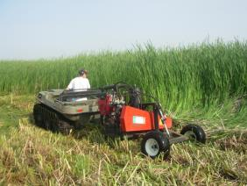
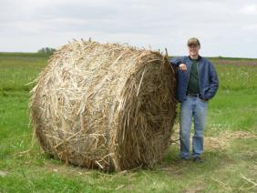
Phosphorus captured (kg/hectare) in harvested Typha
20 to 60 kg of P
per Hectare of Typha
----------------------------------------------------------------------------
10 to 20 tonnes DM per hectare yield

Slide 12
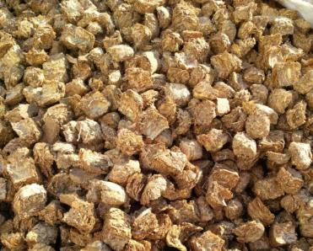
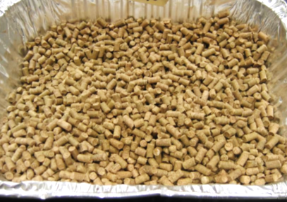
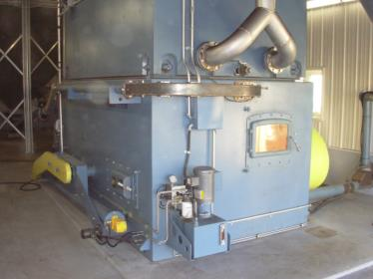
Fuel products: cubes and pellets
Residential and Commercial Users

Slide 13
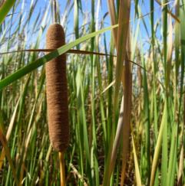
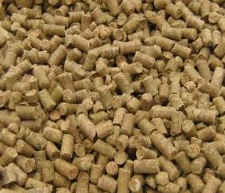
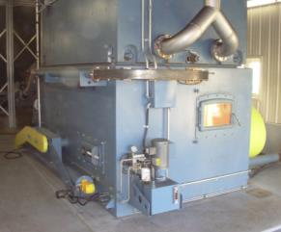
Lower GHG emissions
The Multiple Co-benefits
turning a waste stream into a sustainable input for the Bioeconomy
CO₂
N
Cattail Biomass
Pellets for fuel
Bioenergy - Heat
Captured
P N C …
Exported
P N C …
P
ASH Recovery
Harvesting cattail captures stored P and N – recovery of P
Sustainable renewable biomass feedstock for bioenergy (displace fossil fuels, i.e. coal) or higher value bioproducts
Carbon credits from production of “low carbon” bioenergy, while reaping benefits of Phosphorus (P) capture from Lake Winnipeg – “Lake Friendly” biomass
Opening wetland site for wildlife habitat renewal
Bioremediation + habitat renewal + GHG reductions
Notes:
Last line of defence before the Lake
Netley-Libau Marsh shows integrated systems thinking and showcases practices that inform new value chains based on natural systems management and enhancement. Research conducted in Netley-Libau Marsh by IISD and the University of Manitoba reveals harvesting cattail biomass can remove 20 to 60 kg of phosphorous from litter and sediment per hectare per year. Once harvested, nutrients locked in plant tissue are prevented from being released into the environment via natural decomposition. Additionally, cattail carbon sequestration research in California demonstrated that cattails can annually sequester up to 75 metric tonnes of carbon per hectare. A further benefit can be gained from using harvested cattail biomass for bioenergy feedstock to displace fossil fuels used for heating or electricity. Finally, the potential for harvesting phosphorous from the biofuel ash is being explored for use in fertilizers. The harvest of cattails for bioenergy production, carbon sequestration, eutrophication mitigation, and phosphorous recovery would help increase and diverse rural economic activity while also providing increased energy security and access to phosphorous.
Integrated systems thinking through practices that provide multiple benefits and enable new value chains based on natural systems management and enhancement.
Research conducted in Netley-Libau Marsh reveals nutrient capture potential through harvesting cattail biomass that can remove 20 to 60 kg of phosphorous from litter and sediment per hectare per year.
Additionally, cattail carbon sequestration research in California demonstrated that cattails can annually sequester up to 75 metric tonnes of carbon per hectare.
A further benefit can be gained from using harvested cattail biomass for bioenergy feedstock to displace fossil fuels used for heating or electricity.
Finally, the potential for harvesting phosphorous from the biofuel ash is being explored for use in fertilizers.
The harvest of cattails for bioenergy production, carbon sequestration, eutrophication mitigation, and phosphorous recovery would help increase and diverse rural economic activity while also providing increased energy security and access to phosphorous.
Chinese story about value chain mainstreaming…
13

Slide 14
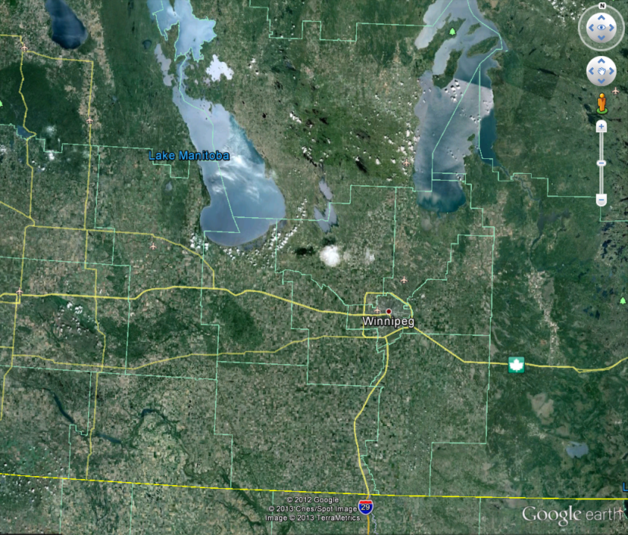
Pilot Scale
harvesting
2012 to 2013
Lake Winnipeg
8. google earth snapshots of high-biomass sites

Slide 15
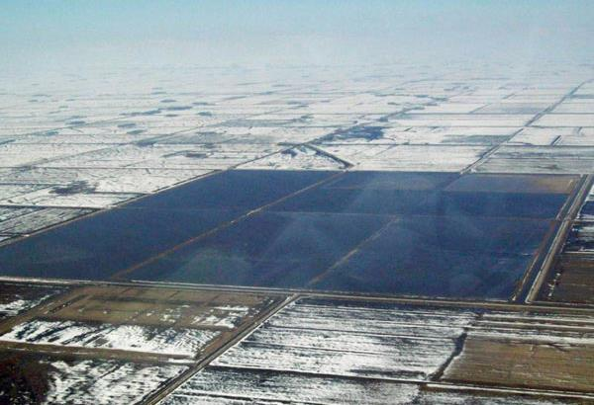
Surface water retention projects, Minnesota USA

Slide 16
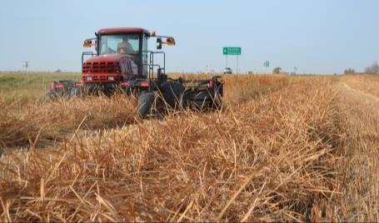
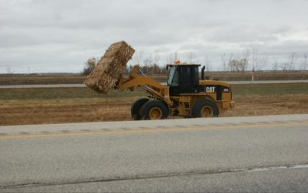
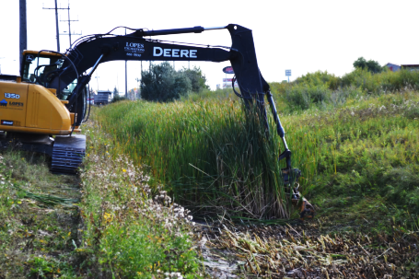
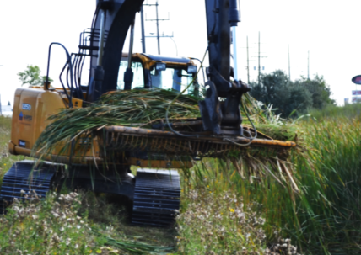
Ditch Harvesting: City of Winnipeg and Rural Municipalities

Slide 17
Some Summary Data
Biomass and Phosphorus captured (2012-2014)
TOTALS | 2012 | 2013 | 2014
Harvested cattails (dry basis) | 260 T | 150 T | 120 T
Phosphorus in harvested cattail | 230 kg | 165 kg | 132 kg
Biomass yield per area | 10-15 T/ha | 10-15 T/ha | 10-15 T/ha
Estimate of Field Operation Costs (2012)
Cost Per Bale (575 round bales): |  |  |  | $20.08
Cost Per Dry Tonne (260 tonnes): |  |  |  | $52.46
Cattail carbon offsets & GHG emission credit potential displacing coal
Biomass | Yield (T/ha) | Energy Content (MJ/T) | Energy Content (MJ/T) at 80% efficiency | Emissions (T CO₂/T biomass) | CO₂ offset per T
cattail | 15 | 17500 | 14000 | 0.5 | 1.05
coal | - | 25800 | - | 2.44 | -

Slide 18
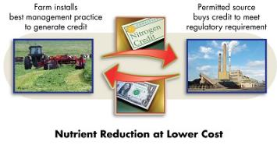
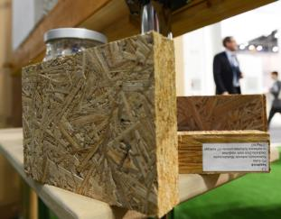
Additional Revenues – EGS and Higher value bioproducts
Nutrient capture + biomass supply + Carbon offsets + habitat renewal
+ Surface Water Management – hold water to reduce flood damages and irrigation in times of drought
+ Carbon Offsets – accessing voluntary markets for GHG
+ Water quality trading credits – payments for service of removing Phosphorus ($/kg)
+ Higher value bioproducts – biocarbon, fibres, composites, ethanol, bioplastics, biogas, fertilizer

Slide 19
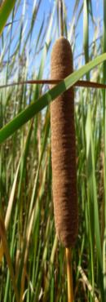
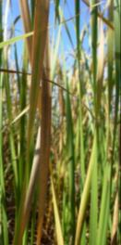
Summary
IWRM and EGS provide the principles and framework for basin-scale water management to help understand, articulate, value and manage benefits from watersheds.
Watershed-bioeconomies have the potential to provide self-sustaining watershed benefits including climate resilience, economic development and conservation
Important proof of concept - demonstrates harvesting ecological biomass, which soak up nutrients that would cause eutrophication, key driver for regional bioeconomy
Nutrient management + novel biomass production combined with surface water management - applied to engineered wetlands, storm water basins, and ditches for greater economic gains
Creating value for ecological biomass - incentives for conservation and restoration of wetlands on marginal agricultural land
Alternative revenue for landowners - otherwise unproductive land

Slide 20
Watershed- Bioeconomy Process and elements
Landscape Analyses
Watershed assessment for multiple benefits (land, water and related systems); multipurpose water storage
Ecosystem services, benefits, values and implications
Biomass assessments (ag. residue, wetlands, etc.)
Spatial assessments, mapping, prioritization for optimising decisions
Prioritization and targeting
Logistics & Implementation
Harvesting and baling of biomass from strategic areas for SD benefits
Shredding, pelletizing, burning, etc. for multiple uses and reducing waste
Burning for local bioenergy, and GHG sequestration through offsetting coal energy
Recovering phosphorus for fertilizer and food production
Markets & Policies
Markets for water quantities and quality (water quality/quantity trading, offsets)
Carbon sequestration markets
Policies for enabling bioeconomy as integrated solutions, e.g. phased coal ban in MB, biomaterials strategy encouraging regional growth, surface water management strategy,
Education, certification, procurement etc.

Slide 21
Thanks
Dimple Roy
Director, Water Program
International Institute for Sustainable Development
Email: droy@iisd.ca
www.iisd.org
www.iisd.org ©2012 The International Institute for Sustainable Development

