Slide 1
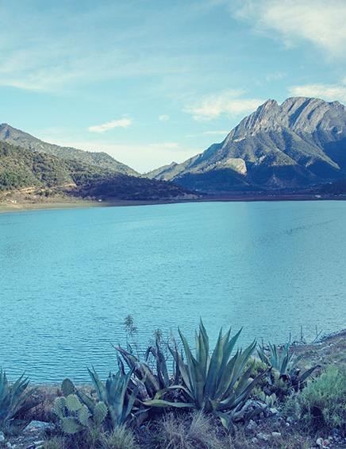
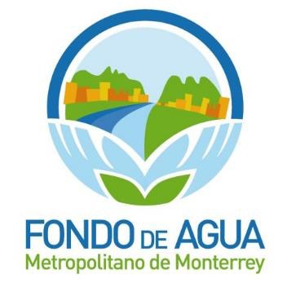
Commission for Environmental Cooperation
of North America
Water and Climate Change:
Sustainable Management of
Natural Resources
April 23, 2015
Eugenio Clariond-Reyes

Slide 2
Contents
• Challenges related to water resources
• Metropolitan Water Fund of Monterrey
• Sustainable management of water resources
• Conclusions

Slide 3
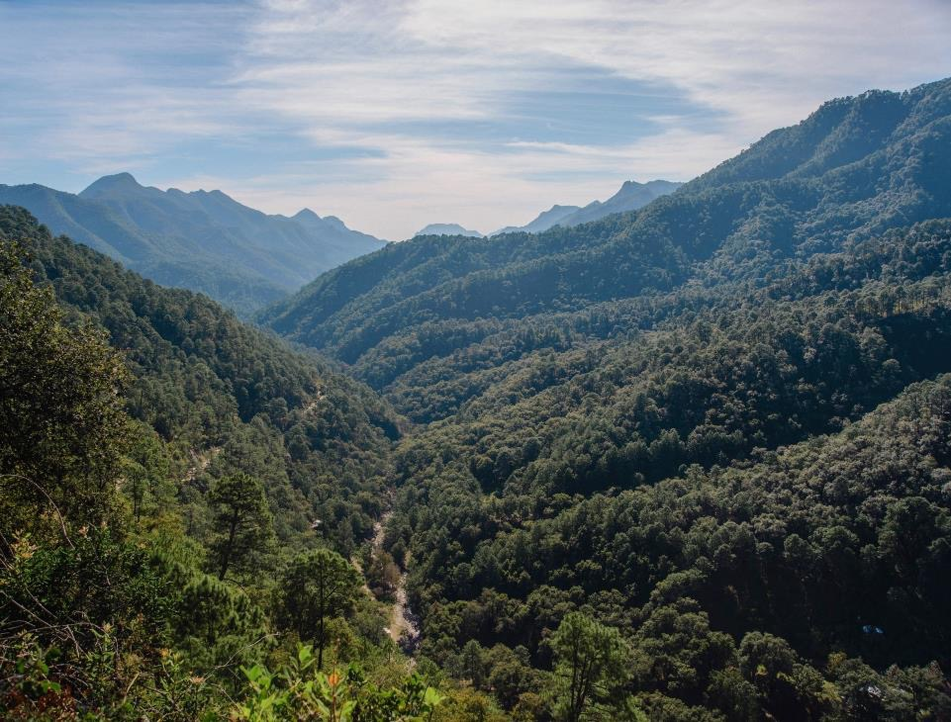
Challenges related to water resources
Challenges in Monterrey
Towards a long term solution

Slide 4
Climate change is causing extreme hydrometeorogical events to become more frequent (hurricanes and droughts).
Strong growth in water demand.
Inefficient use of water (especially in underdeveloped and developing countries).
Lack of incentives for efficient use of water (inappropriate water rates).
Inefficient water management (high levels of unaccountable water, lack of incentives for water reuse, etc.).
Lack of institutions with a global vision of water management (addressing the entire water cycle).
Lack of a strong water culture.
Some challenges in Monterrey
Notes:
Fuente de sequías: http://www.agua.org.mx/index.php/biblioteca-tematica/hidrometeorologia/sequias/27177-impacto-de-las-sequias-en-nuevo-leon
Demanda de Agua: SADM, “Agua para la vida de Monterrey”
Fuente de agua no contabilizada: Cuenta Pública publicada por SADM.
Fuente de costos del Alex: http://www.reconstruccionnl.org.mx/Alex/Descripci%C3%B3n.aspx
Fuente del acceso a agua: http://www.data.unicef.org/corecode/uploads/document6/uploaded_pdfs/corecode/JMP_report_2014_webEng_100.pdf

Slide 5
The first step towards an efficient long term solution is accepting this is not the responsibility of an individual, a single organization or sector. This can only be achieved in a collective form.
Another key aspect is awareness of this topic should be addressed with an integral and non fragmented vision.
The creation of a multi-sectoral organization with a long term holistic vision of water is fundamental in achieving efficient solutions to Monterrey’s challenges regarding this topic.
Towards a long term solution

Slide 6
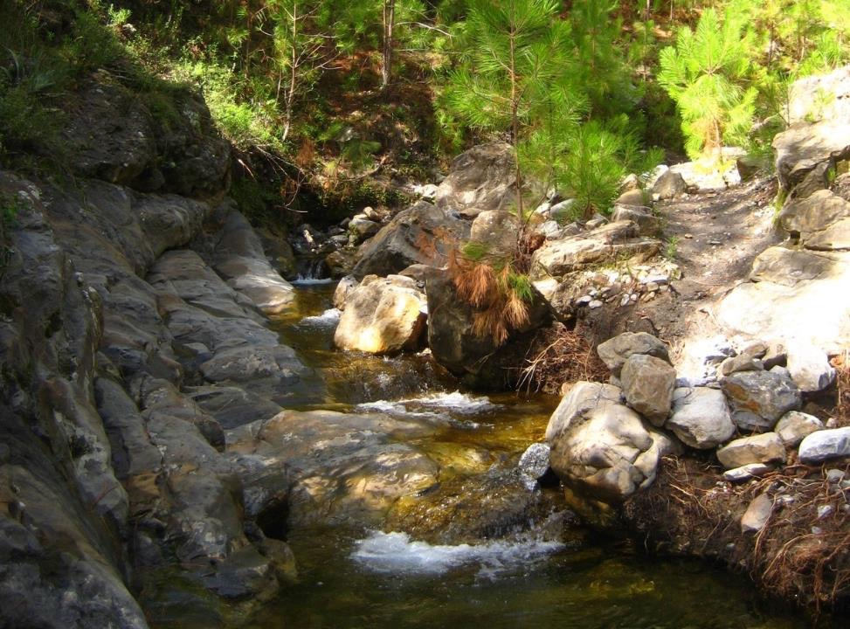
Metropolitan Water Fund of Monterrey
Description
Objectives
Partners
Zone of influence
Water sources
Water use by sector

Slide 7
FAMM is an NGO with more than 60 partners from different sectors (private enterprise, government, academy and civil society).
It is the result of the effort of many organizations to become part of an institution focused on the water topic in the region.
When the FAMM was formed there was special attention in making it:
Independent
Effective and efficient
Based on science
With a clear governance
With total transparency and focused on results
Water safety in Monterrey and the reduction of risks associated with floods are fundamental for FAMM.
Metropolitan Water Fund of Monterrey

Slide 8
Objectives:
Reduce floods damage
Improve the infiltration in the basin
3. Develop and promote a water culture
4. Develop management abilities for natural resources
Metropolitan Water Fund of Monterrey

Slide 9
Partners

Slide 10
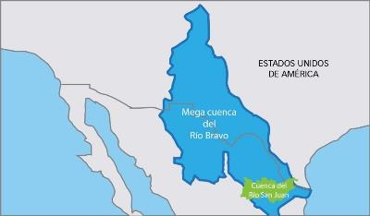
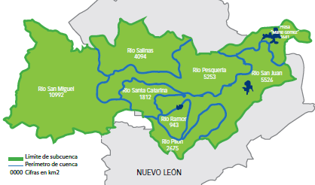
The San Juan river basin is really a sub-basin of the Bravo river basin.
UNITED STATES OF AMERICA
San Juan river basin
The San Juan river basin passes through 3 Mexican States: Coahuila, Nuevo León and Tamaulipas.

Slide 11
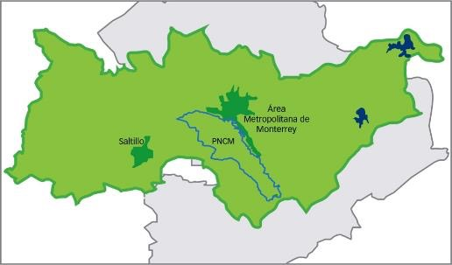
Water sources
On average Monterrey is supplied 55% from superficial water and 45% from groundwater.
More than 60% of the water used in the Metropolitan area of Monterrey comes from the “Cumbres de Monterrey” National Park.
This is why the C.M. National Park is a critical zone for the city’s survival and development.

Slide 12
Consumption per sector
Agriculture
Agriculture
Industry
Industry
Public supply
Public supply
Thermoelectric
Thermoelectric
The greatest consumption of water in Nuevo León and in all of Mexico comes from the agricultural sector; this is the sector paying less, using it more, and taking less care of it.
Source: CONAGUA

Slide 13
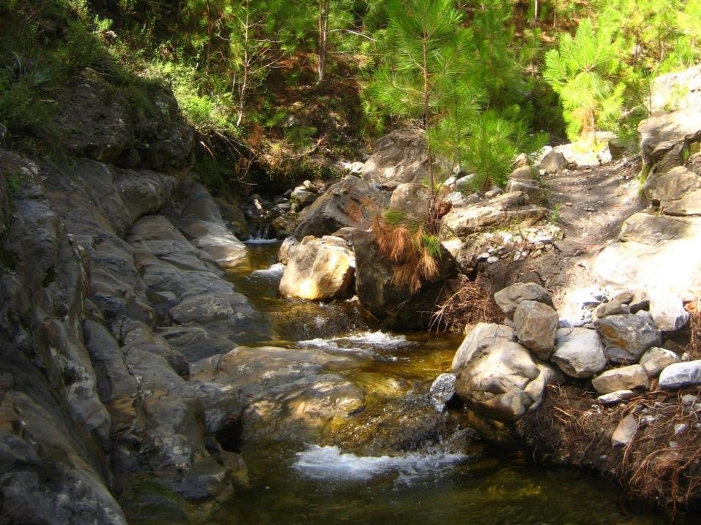
Sustainable water management
Conservation
Gray and green infrastructure

Slide 14
The conservation of the upper watershed is a powerful tool for:
Reducing the risks of floods: The amount of water that flows in the Santa Catarina River can be reduced up to 750 m³/s during a catastrophic rain.
Conservation is the Reconstruction Council’s #1 recommendation to prevent another disaster like Hurricane "Alex".
Increasing the infiltration capacity: it could be increased up to 20%.
Reducing the effects of climate change: Conservation helps building resilience for adaptation to climate change.
Conservation

Slide 15
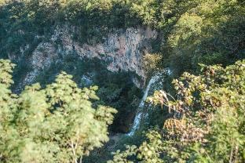
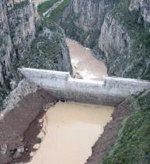
Nevertheless, conservation cannot do all of the work by itself. Green and gray infrastructures are complements not substitutes.
For the topic of associated risks to floods additional "Rompepicos" dams are needed.
With an increase in the groundwater recharge we won’t reach a long term water security. We need to:
Implement efficient technologies in the irrigation districts;
Improve the network to minimize losses;
Use economic incentives (tariffs) to impulse water recycling technologies and more efficient water use in the agricultural sector.
Gray and green infrastructure

Slide 16
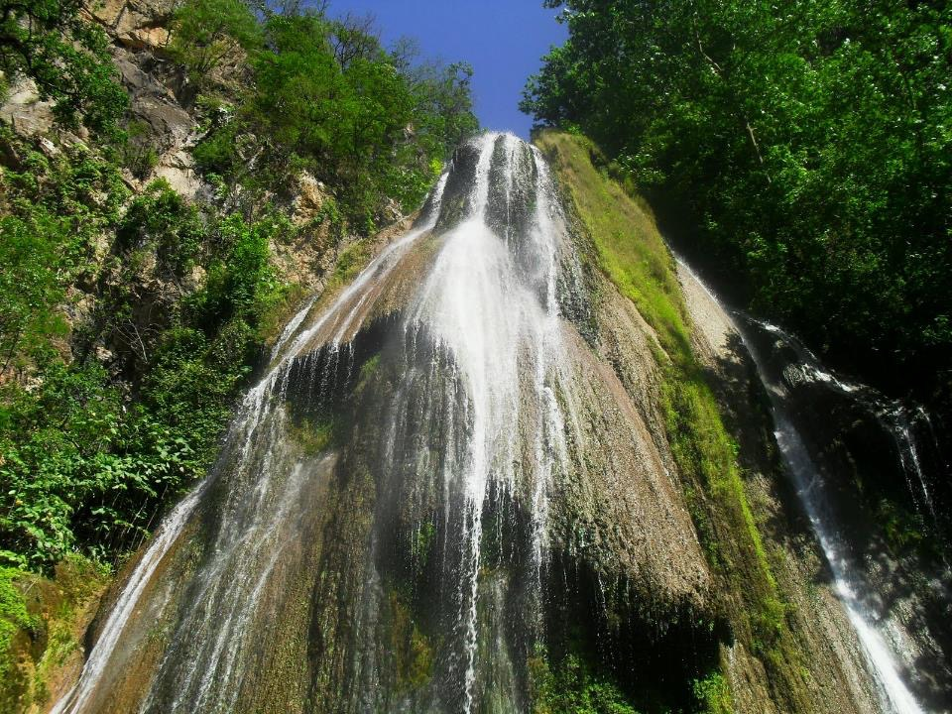
Conclusions

Slide 17
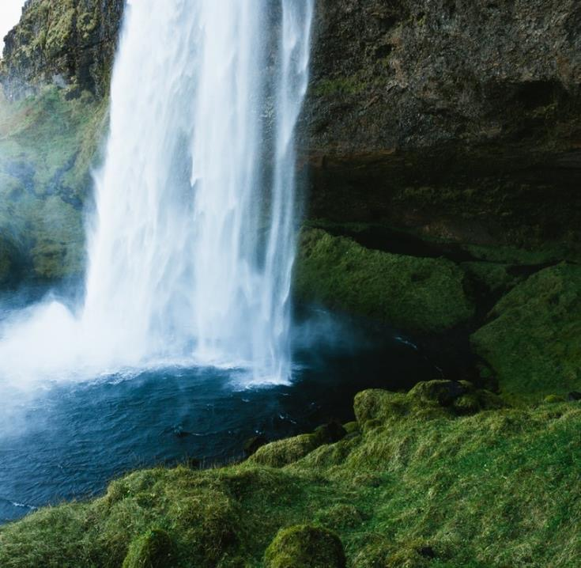
Conclusions
The main water-related challenge in Monterrey is not a supply issue, but a demand related one. We need to have a more efficient water usage.
Big basin water transfer projects, like Monterrey VI, will seriously impact the environment of the donor basin, and are insufficient since the root cause of the problem is not addressed: the great inefficiency in the use and reuse of water, primarily in the agricultural sector.
In the case of Monterrey VI project there is an additional issue: the water transfer from the Panuco river is not needed now, but in several years.
Challenges cannot be solved with a simplistic view; a holistic approach is strongly required.

Slide 18
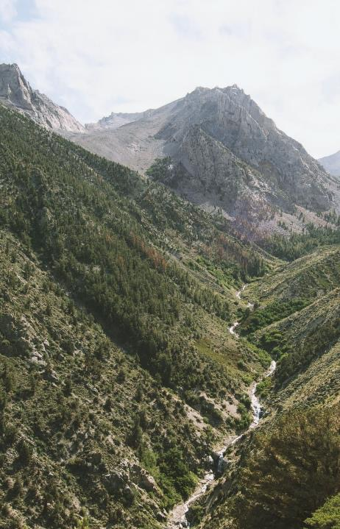
Conclusions
FAMM has an integral view and can be a solid premise for real solutions.
A paradigm shift is needed: Investing in the conservation of the basin is not a luxury. Not investing in its conservation is a luxury we can’t afford; it is a big cost.
Monterrey is an industrial city and FAMM is in favor of its economic development. However, we are also convinced this development can and should be achieved in a sustainable way.

Slide 19
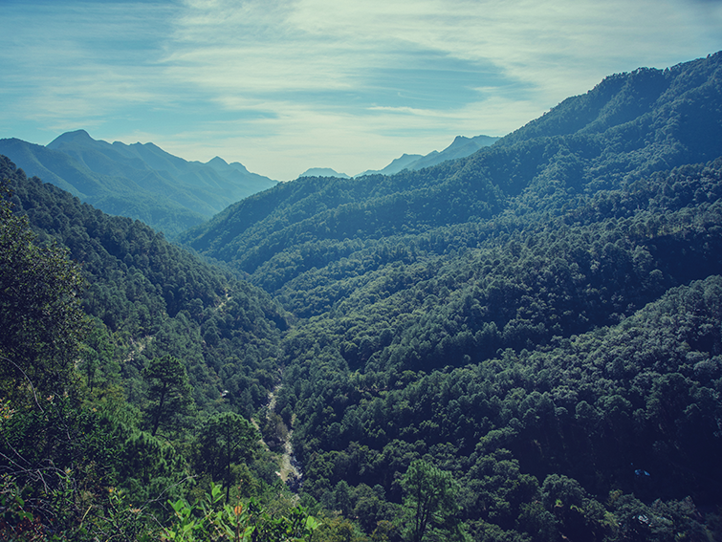
Thank you!
April 23, 2015
San Pedro Garza Garcia, N.L.,
Mexico
www.famm.mx

