Slide 1
Canadian Electricity Sector’s Progress Toward Green Growth and Sustainable Energy
David Morrison
Retired Utility Executive
(Ex-President & CEO, Yukon Energy; Vice-Chair, Board of Directors, Canadian Electricity Association)
Commission for Environmental Co-operation in North America
Green Growth and Sustainable Competitiveness
April 23, 2015

Slide 2
Addressing Green Growth and Sustainability in the Canadian Electricity Sector
Sustainable ElectricityTM Program
  Launched in February, 2009
  Mandatory for all Corporate Utility Members of the Canadian Electricity Association (CEA)
Program Vision
  CEA Corporate Utility Members are trusted to provide energy services to current and future customers in an environmentally sustainable, safe, reliable, and cost-effective manner
Program Goals
  Integrate Sustainability: Integrate and embed sustainability within company operations and business models
  Continuous Improvement: Continuously improve environmental, social, and economic performance to meet our collective vision through innovative solutions, management approaches, and best practices
  Public Acceptance and Support for Utility Operations: Advance the public acceptance and support for utility operations through meaningful engagement, collaboration, transparency, and accountability

Slide 3
Role of Generation in Driving Sustainability Outcomes:
Generation Profile in Canada
Source: Statistics Canada, Electric Power and Generation -Annual (CANSIM 127-0007), 2013. Retrieved September 10, 2014
*Numbers may not sum to 100 percent due to rounding.

Slide 4
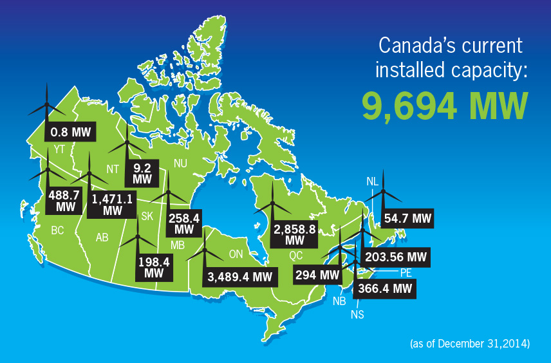
Installed Wind Capacity is Growing Across the Country
Source: Canadian Wind Energy Association, December, 2014
Notes:
Notes:
The industry is also investing in emerging renewable energy sources.
For example, wind capacity increased significantly from 444MW in 2004 to 9, 694 in 2014. Ontario made up bulk of that capacity, followed by Quebec and Alberta.
The National Energy Board (NEB) projects wind capacity to grow to 16,400 megawatts by 2020.
However, wind is a variable source of energy. This means it does not generate all the time — in fact, it typically blows hardest
when demand is light (such as at night). As a result, wind will always require a stable energy source, such as hydro power or
natural gas, as a back-up.

Slide 5
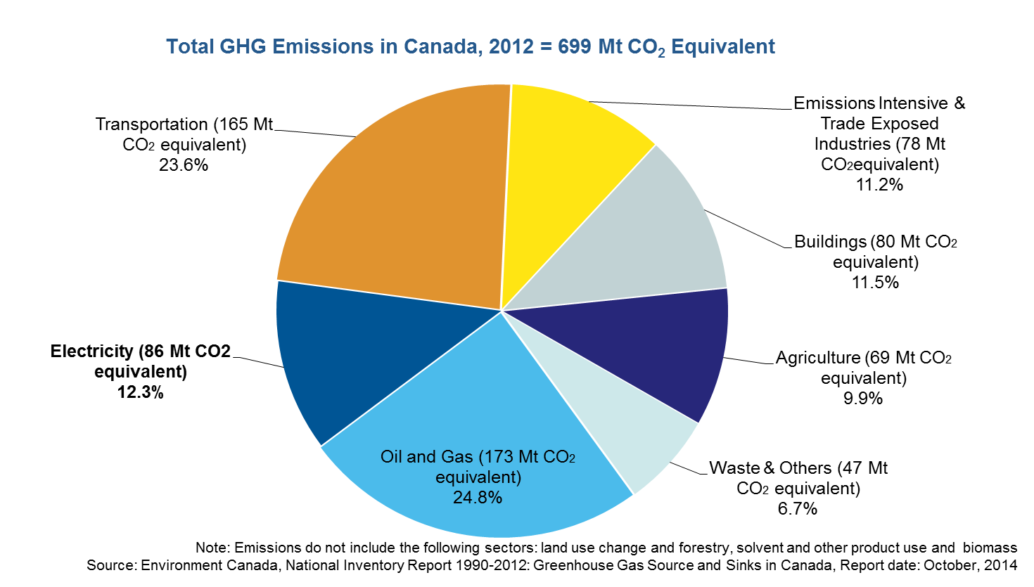
Greenhouse Gas Emissions in Canada by Sector, 2012
Notes:
Electricity sector is a small contributor to GHG emissions in Canada (12.3 percent) relative to transportation (23.6 percent) and oil and gas (24.8 percent).
The electricity sector can have a positive impact in “greening” the transportation sector given the low GHG profile of electricity in many Canadian provinces.

Slide 6
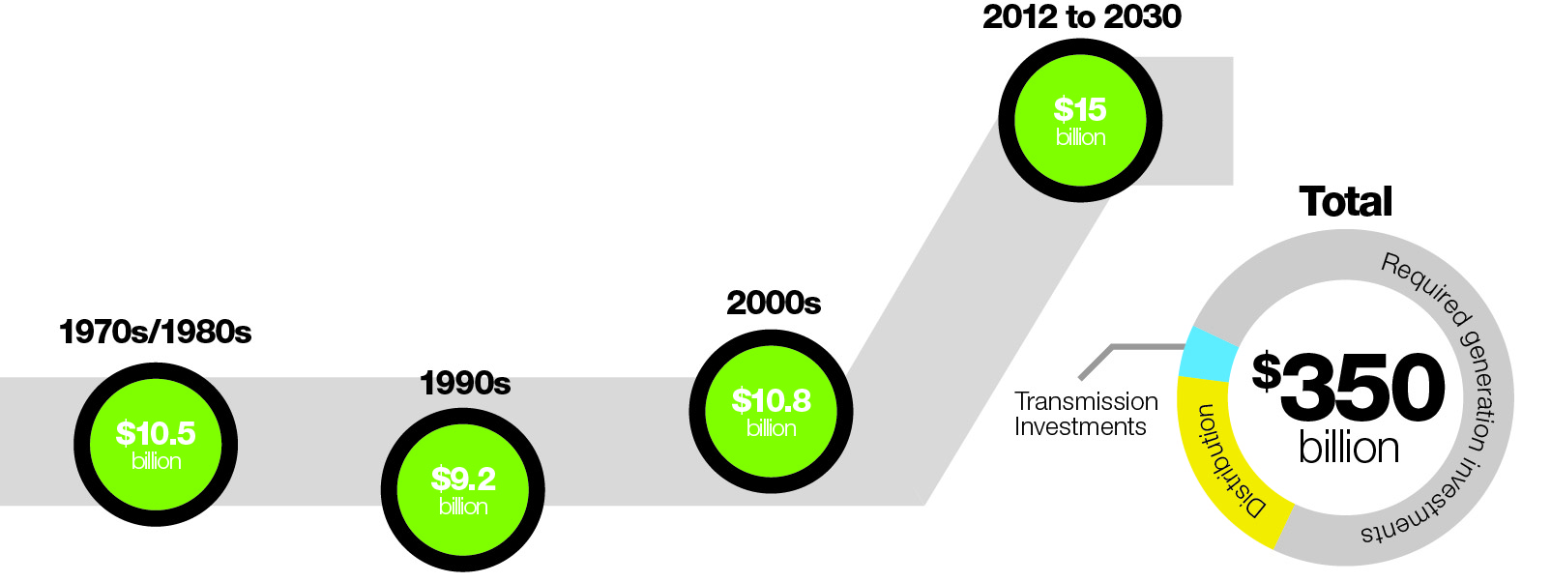
Canadian Outlook: Infrastructure Investment Requirement
Canada’s electricity system is in need of massive infrastructure renewal in the next few decades – This is a significant challenge as well as an opportunity to modernize the electricity system
Notes:
The Canadian electricity system is in need of massive infrastructure investment in the next two decades
The Conference Board of Canada estimates that by 2030, close to $350 billion in new investment will be required just to maintain the existing electricity capacity, with most of Canada’s non-hydro assets needing renewal or replacement by 2050.

Slide 7
Canadian Outlook: Generation Mix
Hydropower will continue to play a significant role. Some of the existing hydro projects include:
  1,100-megawatt Peace River Site C facility in British Columbia
  695-megawatt Keeyask Generation Project in Manitoba
  3,074-megawatt—824 MW Muskrat Falls (phase I) and 2,250 MW Gull Island (phase II)—Lower Churchill generation project in Labrador, Newfoundland
Renewable generation will be an integral part of the future supply mix
  The National Energy Board (NEB) projects wind capacity to grow to 16,400 megawatts by 2035
  Wind energy targets in Quebec (4,000 MW by 2015) and Manitoba (1,000 MW by 2016))—Manitoba target is not likely to be met
  Ontario is aiming for 7,500 MW of wind by 2018 through its Feed-in-Tariff program
  Nova Scotia has a Renewable Energy Standard (RES) with a goal of achieving 40 percent of its electricity requirements through renewable energy sources by 2020
  Similar targets and policies in other provinces (BC, Alberta, Saskatchewan, New Brunswick and Prince Edward Island)
Sources: CEA, CanWea, and National Energy Board, Canada’s Energy Future 2013
Notes:
Total installed wind power capacity increases three-fold over the projection period, reaching 16 GW in 2035, with the largest capacity additions occurring in Quebec, Ontario, Alberta and B.C. The share of wind-based generation increases from less than two per cent of total generation in 2012 to over four per cent by 2035.
Hydropower: Challenges to Development
First Nations — Many hydropower projects in Canada are developed in remote communities, including those of Aboriginal Peoples. These hydropower projects have the potential to affect surrounding ecosystems, lifestyle, and activities of these communities.
Local Communities — The development of hydropower projects including infrastructure and reservoir development have an impact on local communities. The projects may displace communities, affect outdoor recreational activities due to reduced public access and affect travel routes.
Federal and Provincial Regulation Process — The federal EA process in combination with provincial processes represent a major obstacle to the development of new hydro projects. There is an inadequate coordination of the EA process between federal and provincial jurisdictions
Renewable Energy Standards (RES)
The maritime provinces of New Brunswick, Nova Scotia and Prince Edward Island (PEI) currently have RES in effect for the next few years.
Specifically, New Brunswick is committed to increase the amount of electricity from new renewable sources to ten per cent of its total use by 2016.
In November 2008, the PEI government announced its intention to double its renewable energy portfolio standard from 15 per cent to 30 per cent by 2013 with plans to build up to 500 MW of additional wind power over five years. In April 2010, Nova Scotia released its Renewable Energy Plan, which commits to an RES of 25 per cent by 2015, and targets 40 per cent by 2020.

Slide 8
Canadian Outlook: Generation Mix (Cont’d)
Natural gas will play a greater role in the future
  Several factors support a greater role for natural gas power generation in Canada, including: low natural gas prices, lower GHG emissions (compared to coal), and shorter construction times
  Gas-fired capacity in Canada is expected to increase from around 20 GW to 37 GW by 2035 (NEB projection)
Coal will decline but will still play a role in Western Canada
  Coal generation will decline with GHG regulations coming into force on July 1, 2015
  These regulations set an emission performance standard of 420 tonnes/GWh for new coal-fired units & existing units after a defined number of years (e.g. 50 years)
  Ontario became the first Jurisdiction in North America phase-out coal generation in 2014
  Alberta and Saskatchewan are well-positioned to become leaders in CCS
  Boundary Dam Carbon Capture Demonstration Project in Saskatchewan is the world’s first and largest commercial scale CCS project
Nuclear will continue to play a role (e.g. Ontario)
  Nuclear energy accounts for about 16 percent of total generation in Canada, but it plays a greater role in Ontario where it accounts for nearly 55 percent
  Over the next two decades, several Ontario nuclear pants will have to be refurbished, but no new nuclear units are anticipated to be built
Notes:
Nuclear
Challenges to Development
If nuclear power is to continue its contribution to meeting Canada’s growing electricity demand, the industry will have to manage high amounts of capital risk and long lead construction times. Furthermore, the industry must maintain a full life-cycle approach in order to safely dispose of radioactive waste and maintain healthy communities.
Federal and Provincial Regulation Process — The federal EA process in combination with provincial processes represent a major obstacle to the development of nuclear projects. There is an inadequate coordination of the EA process between federal and provincial jurisdictions. These timely processes pose a threat and/or delay in development.

Slide 9
Canadian Outlook: Sustainable Generation Technologies -
Opportunities and Challenges
Resource | Opportunities | Challenges
Wind Power | No fuel cost, no direct emissions, price becoming more competitive | Variable resource, transmission/land use issues, environmental concerns with regards to noise and interaction with birds
Small Hydro | Low capital costs, many potential sites in Canada, well established technology | Regulatory approval can be costly and time consuming, access to grid, local opposition
Biomass | Uses landfill gas, wood pellets, and waste products to create electricity, reduce GHGs | High capital equipment and fuel costs, access to transmission, competition for biomass materials
Solar PV | Renewable source, can be grid-connected or stand alone, can reduce the need for extensive transmission lines when used locally | Access to the grid (working with a traditional grid) and intermittency
Ocean Energy | Costs are expected to decline as technology develops, intermittent but predictable source of green energy | Potentially intrusive to marine life, investment is needed to promote research and development
Clean Coal | High potential for GHG reductions | High capital costs and high energy penalty
Energy Storage | More efficient grid, greater use of renewables, use of stored energy during peak periods, potential for reduction in air emissions | High capital cost, technology availability

Slide 10
Canadian Outlook: Transmission and Distribution
Grid automation is improving operational efficiency and reducing the cost to transmit electricity from generating stations to end customers. Key technologies include:
  Distribution Management Systems
  Smart switch gear
  Integrated systems including outage management, asset management, GIS and customer support
A more dynamic grid will ease integration of end-use technologies such as electric vehicles and distributed generation
There is no single Canadian smart grid model – each utility is driven by local considerations such as existing asset mix, political drivers and customer preferences
Over time, a winning set of technologies will emerge and this will comprise the new Canadian standard for building and operating electricity networks. CEA expects general convergence by about 2025

Slide 11


Canadian Electricity Association’s
Vision 2050
Recommendation One: Accelerate Innovation and Customer Management of Energy
Recommendation Two: Implement Financial Instruments for Carbon Reduction
Recommendation Three: Enable Electric Vehicles
Recommendation Four: Expand
Collaboration Across Borders
Notes:
Accelerate Innovation and Customer Management of Energy
Customers are increasingly looking for ways to manage their own energy and to choose the type of energy from which they obtain electricity; to act as both suppliers and customers; and to customize how they use their energy
We must accelerate greater innovation this area so this can be done in an integrated manner
CEA recommends that governments review policies, laws and regulations to ensure they do not serve as obstacles but rather facilitate and enable two-way electricity flows, micro-generation, emerging forms of generation like solar and biomass, and flexible demand response.
Implement Financial Instruments for Carbon Reduction
Second, we recommend implementing financial instruments that support carbon reduction at multiple levels: for households, for the electricity sector, for electricity in conjunction with transportation and for the economy as whole.
Loan guarantees can also be supported for unique circumstances (e.g., interprovincial electricity projects) as they do not draw on taxpayer money, and the benefit goes to the customer.
Enable Electric Vehicles
Third, we should take proactive steps to accelerate the electrification of the transportation sector through policy support and collaboration, and implementation of enabling infrastructure so that electric vehicles can grow to very high levels of market penetration.
Expand Collaboration Across Borders
And finally, we want to optimize electricity assets from a more integrated North American approach and expand the scope for electricity storage and export of low-carbon electricity to the United States, thereby expanding collaboration across borders.

Slide 12
Ensuring a Sustainable Energy Future
Industry, government and stakeholders must work in partnership to make this sustainable future a possibility
Utilities must continue to invest in innovative technologies to ensure they meet the needs of customers in a safe, reliable and sustainable manner
Governments must ensure clarity, consistency, and predictability of legislation and regulations (e.g. environmental assessments, species protection, climate change)
Governments have a constructive role to play in creating the conditions for new investments in infrastructure and attraction of skilled labour
Customers are key to reducing demand and ensuring energy conservation
  Technology advancements such as smart grid and smart meters will allow them to take a more active role

Slide 13

Questions?
Contact Information:
David Morrison
Email: morrisondavid68@gmail.com
Tel: 1-867-334-9100

