Slide 1


Commission for Environmental Cooperation (CEC) of North America Joint Public Advisory Committee (JPAC) Regular Session 15-01
“Green Growth and Sustainable Competitiveness in North America”
Panel I – Sustainable Energy and Climate Change: The Role of Renewables and Emerging Technologies Dr. Luis Farias
Monterrey, N.L., April 23rd, 2015

Slide 2
The Energy Transition Law (LTE)
The Constitutional Energy Reform, issued on December 20th, 2013, set an obligation to Congress to establish clean energy and contaminants reductions obligations to the electric industry participants
Under the Reform, renewables, large hydro and nuclear were defined as Clean Energy
The Electric Industry Law adopted a Renewable Portfolio Standard (RPS), a market model that establishes Clean Energy compliance standards at a lower cost to society
The LTE approved by Mexico’s Lower Chamber and under discussion by the Senate mandates 35% of Clean Energy by 2024

Slide 3
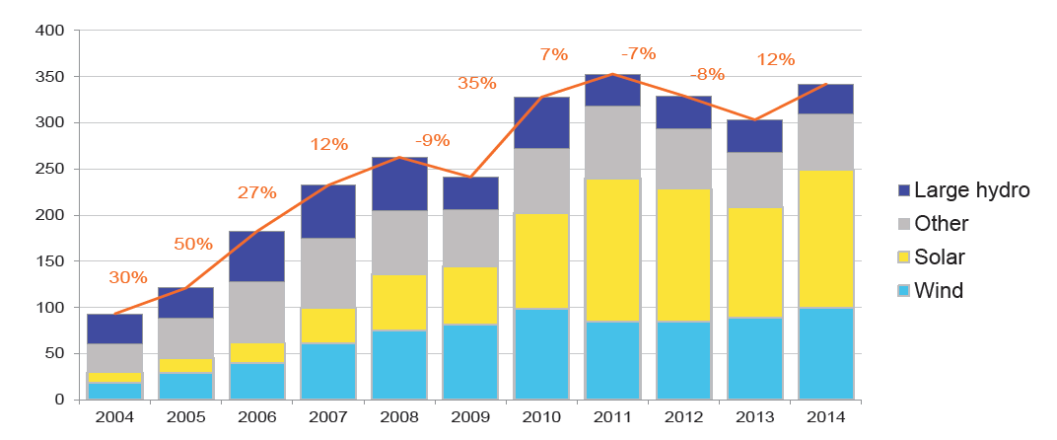
Global investment in renewables and large hydro reached almost 350 billion USD in 2014
New Investment in Clean Energy
BN USD
Bloomberg estimates the this investment needs to be doubled to
contain global warming
Source: Bloomberg New Energy Finance

Slide 4
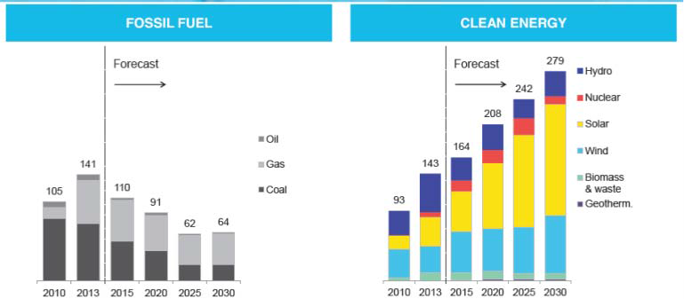
The world is now adding more capacity for renewable power each year than fossil. And there's no going back
Global Gross Power Generation Capacity Additions
GW
The shift will continue to accelerate, and by 2030 more than four times as much renewable capacity will be added
Source: Bloomberg New Energy Finance

Slide 5
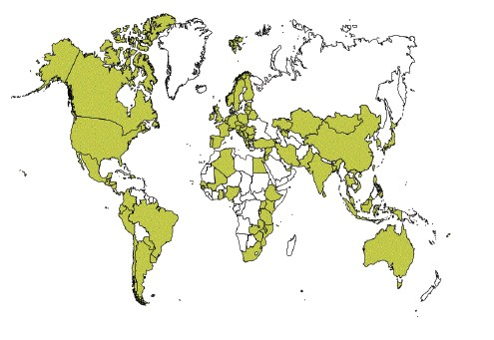
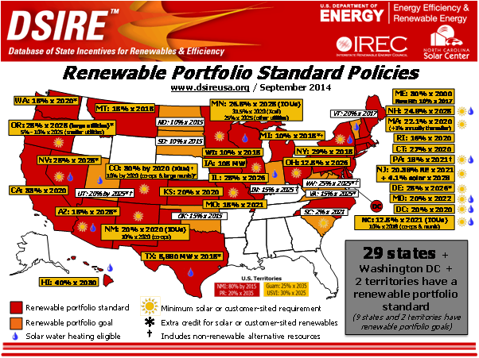
100 countries have enacted a policy to promote renewables, either by RPS, Feed-in Tariff, or some other mandate
Countries Implementing Renewable Power Policies, 2014
RPS Policies in the US
GW
Source: REN21, DSIRE

Slide 6





As a result of these policies, many countries now have high percentages of renewables in their electricity mix
Clean Energy Consumption, 2013
100%
91%
82%
82%
80%
72%
60%
Renewables Hydro Nuclear
40%
39%
36% 36%
35%
32%
28%
23%
20%
20%
17%
13%
0%
Source: British Petroleum Statistical Review 2014

Slide 7
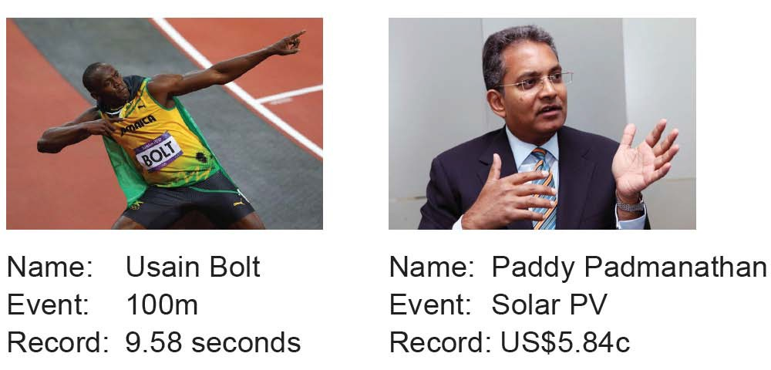
The costs of wind and solar technologies continue to decline and are approaching the cost of fossil power, and are even more competitive in some sites with great renewables resources
Source: Bloomberg New Energy Finance

Slide 8
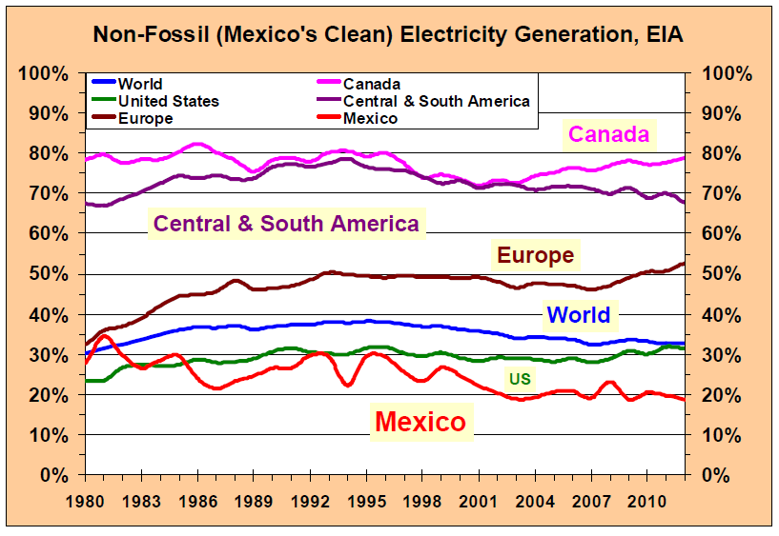
Mexico’s share of renewables has been declining in the past 30 years
The LTE’s goal of 35% by 2024 will only take Mexico to the same level it had in 1981 and to the current global average

Slide 9
Final Thoughts
Mexico is blessed with plenty of renewables resources, and has the potential to attract investments in Clean Energy to create a manufacturing industry for these technologies
A recent (May 2014) study by the National Renewable Energy Laboratory (NREL) and the Lawrence Berkeley National Laboratory (LBNL) concluded that the average cost of meeting the RPS in the US in 2010 to 2012 was less than 1% of the retail electricity price
Although nuclear power is considered to be clean under the LTE, its costs are higher, and construction periods are longer
Development banks favors investment in clean energies
Mexico’s move towards establishing Clean Energy goals is the
right way to go

