Slide 1
Commission for
Environmental Cooperation (CEC)
Three countries. One environment.

Slide 2

CEC Update
Joint Public Advisory Committee
April 23-24, 2014
Monterrey, Nuevo León

Slide 3
CEC Update
Administration/Human Resources/Finances
Cooperative Work Program
NAPECA

Slide 4
Administration
Best practices in the stewardship of government resources
Accountability and transparency
Excellence
Leadership development
Proactive communications and outreach

Slide 5
Operational Plan
Current Operational Plan 2013-2014
16 projects on track for completion June 30th
Project deliverables will be made public this summer

Slide 6
Recommendations from Evaluators for 2013-2014 OP
Link project outputs to environmental outcomes
Be more specific and focused, less aspirational
Consider longer timeframes for projects to show significant and sustainable results

Slide 7
Results OP 2013-14
North American AirNow-International Project
Improving Indoor Air Quality in 8 indigenous communities in Alaska
Beneficial Management Practices for native grasslands cattle ranching
Big Bend-Rio Bravo region ecosystem monitoring also aids eco-tourism

Slide 8
Results OP 2013-14
Forest management linked to carbon estimates
Blue Carbon habitats vital in removing GHG
An improved truck and bus supply chain
Greener building construction
Mexico-International Maritime Organization

Slide 9
New OP 2015-2016
Conference calls with government experts
Workshop on writing terms of reference
Performance Measurement Outcomes
Planning ahead- timing
Quality/Quantity deliverables
Rigorous consultant selection process

Slide 10
New OP 2015-2016
Turning in deliverables in installments
Using software to detect plagiarism
A focus on end user
Vigilance on editing/translation costs
Proactive communications and outreach and strategies and plans for deliverables

Slide 11

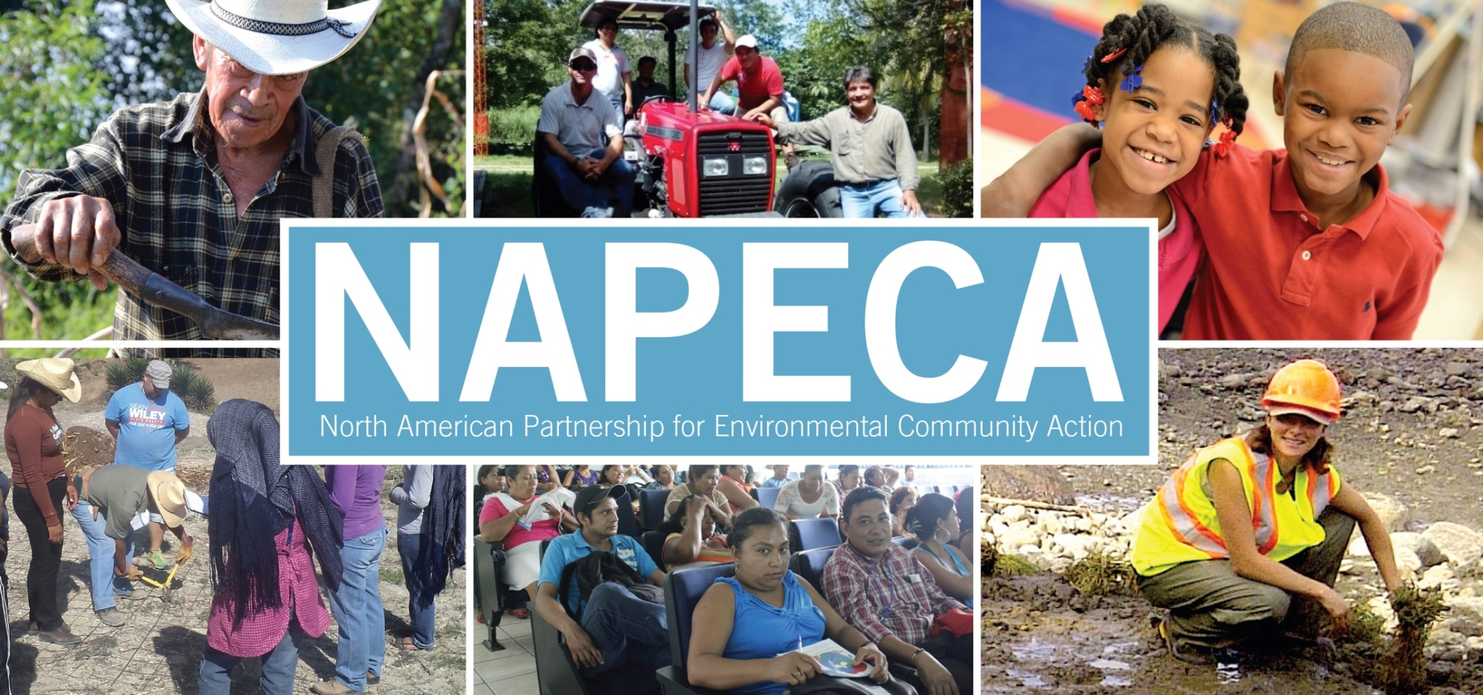

Slide 12
Preliminary Findings NAPECA Evaluation
Large organizations (50 staff members +) more successful in reaching more people
Centro de Alimentación y Desarrollo (CIAD)
Project: Community-based Monitoring of Pollutants
in the Gulf of California
Universidad Autónoma de San Luis Potosí (UASLP)
Project: Sero Riesgos para las Comunidades Indígenas
en Regiones Bajo Riesgo por Conflicto
Green Communities Canada (GCC)
Project: Depave Paradise
*CIAD reached 1,000 people on $27,600 of CEC funding
Notes:
people (CIAD-
UASLP and GCC)
*CIAD reached 1,000 people and received $27,600
EDF reached 1,600 and received $100,000
ELI reached 200 people and received $120,000

Slide 13
Preliminary Findings
NAPECA Evaluation
Ecologic Development Fund (EDF)
Project: Carbon Market links between California and Mexico - La Sierra Cojolita Model REDD Project in Chiapas
EDF reached 1,600 people and
received $100,000

Slide 14
Preliminary Findings
NAPECA Evaluation
Environmental Law Institute (ELI)
Project: Developing Legal Tools for Climate Change Adaptation with ejidos in the
Lacandona Tropical Forest
ELI reached 200 people and received $120,000
Pollution/Assessment and Mitigation requires less money to reach more people (CIAD)

Slide 15
Preliminary Findings
NAPECA Evaluation
Sustainable Housing and Agriculture requires more funding to reach more people
Comunidad y Biodiversidad (COBI)
Project: Building a Sustainable Coastal Community on Magdalena Island, Baja California Sur
Ranchers Stewardship Alliance Inc. (RSAI)
Project: Grassland Stewardship Conservation Programming on Natural Grasslands used for Livestock Production
Notes:
There are reasons for this- rural nature of the location and remoteness of the community especially in the case of Isla Magdalena

Slide 16
How JPAC can help
Assist with launch of NAPECA call this summer
Leverage your networks to promote JPAC meetings, webcasts, consultation periods and CEC outreach materials
Help disseminate Council Session announcements and updates
Notes:
JPAC consultation on the new OP yielded 18 comments
SLABS technical guidelines public comments received 20

Slide 17


Slide 18
Commission for
Environmental Cooperation (CEC)
Three countries. One environment.

