Slide 1
Connecting Risk, Opportunity and Knowledge for Innovation in
Water Management
Bernadette Conant
Executive Director
Canadian Water Network
CEC JPAC Meeting
Monterrey, Mexico
April 23, 2015

Slide 2
Canada’s Network of Centres of Excellence (NCE) Program – CWN established 2001
Goal-- to mobilize capacity in the academic sector to address key water challenges
Non-profit corporation
Governed by a national independent Board of Directors
www.cwn-rce.ca
Focus on complex, shared water problems shared concerns requiring a multi-disciplinary, collaborative approach.

Slide 3
Expert Advisor and Trusted Manager of Water Knowledge Investments for Innovation
Understanding where and how bringing evidence to the table can benefit key decisions
Enabling coordinated public and private-sector support and action on water

Slide 4
The “Opportunities”

Slide 6
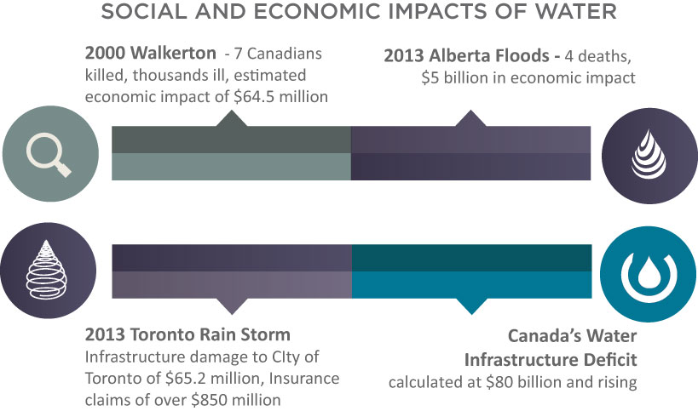
Experiencing the “Risk” as Real --Canada

Slide 7
Natural Resources and Agriculture (Trade-Related)
Water Risk and Opportunity

Slide 8
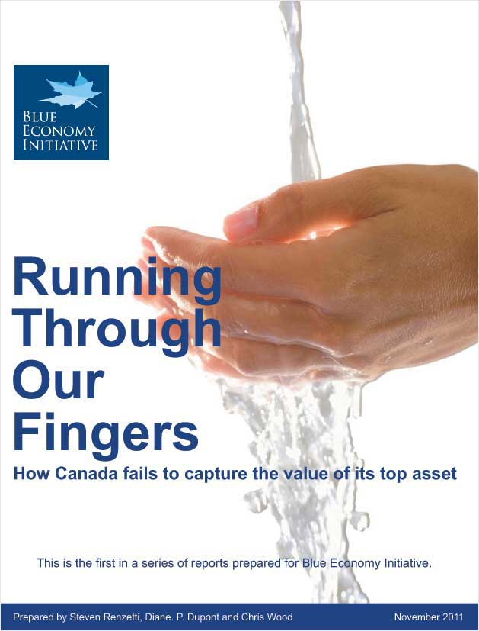
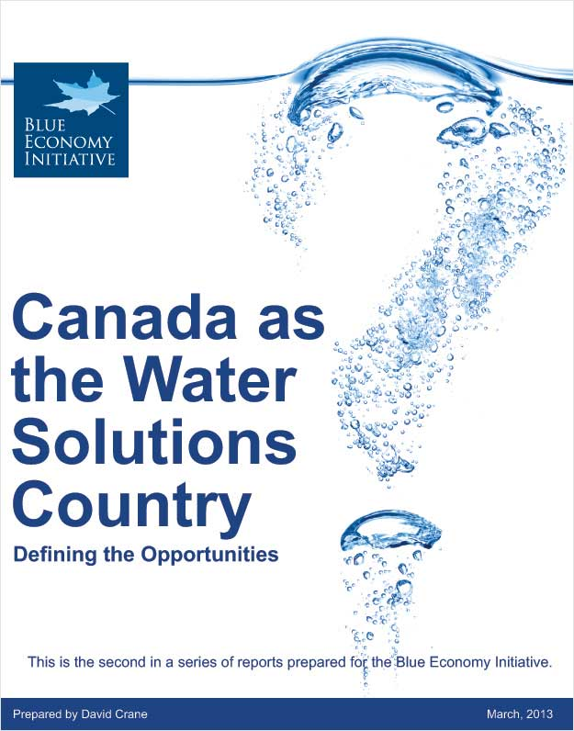
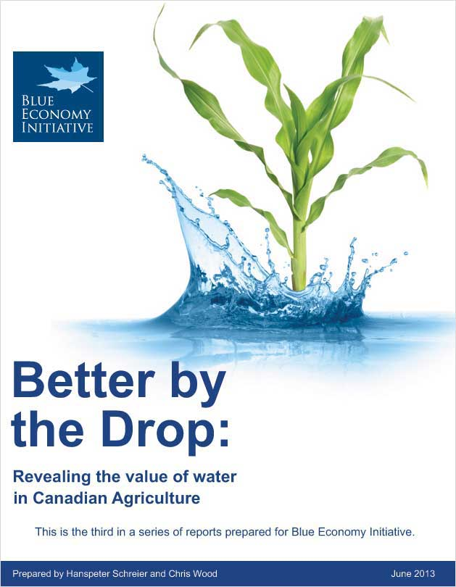
Blue Economy Initiative
www.blue-economy.ca

Slide 9
Seeing Water
as Gateway
Water connects everything -- runs through the entire socio-economic fabric
Water risks occur and impact across systems and sectors (including industry directly)
-- Managing water risk across sectors = opportunity
Innovations in water management provide an opportunity to address key priorities – a gateway to complex systems

Slide 10
National Challenges with Water Solutions
Resilient Blue Cities
Sustainable Agriculture
Healthy Small and Aboriginal Communities
Responsible Energy and Resource Development
Notes:
10

Slide 11
What Does Success Look Like?
Strong energy and resource sectors recognized as leaders in environment and public health protection
– water is at the heart.
Canadian communities that embrace resiliency and adaptation to achieve effective and affordable systems
– water management is the gateway
An agri-food sector that supplies increasing domestic and global demands by effective use of Canada’s competitive advantage
– water is our clear advantage
Healthy, self-sufficient and economically successful aboriginal and small communities
-- water is the unifying theme

Slide 12
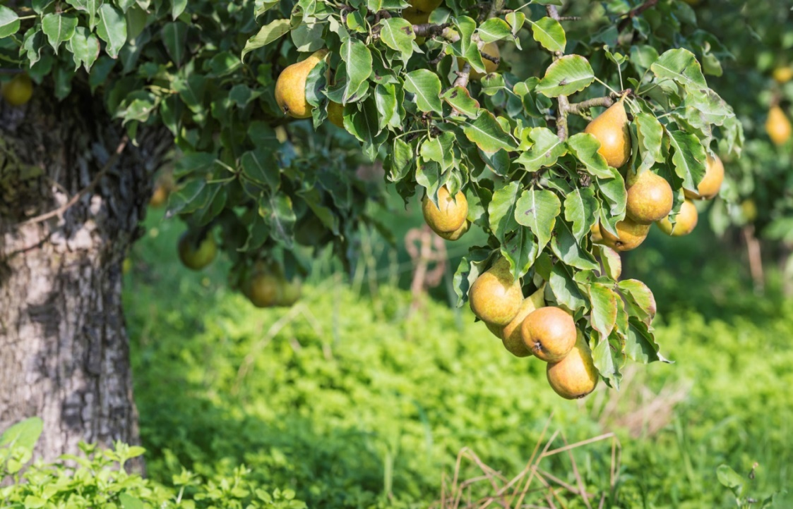
Innovating for Water
Lots of complexity around innovation chain for water
The knowledge capacity for innovation generally exists – new technology is very important, but its lack is not the central issue
An area with lots of low-hanging fruit…
but getting it harvested is challenging

Slide 13
Innovation = Getting to Implementation
requires knowledge uptake and implementation
innovative ideas/approaches and filling knowledge gaps are important, but…
clear understanding of what the “end users” need and can really use is key
beyond “gaps to work in” --to “what can impact decisions”
addressing practical realities and contexts

Slide 14
Getting to Innovation -- the real “water crisis”
Three big issues emerge repeatedly
Eroded trust – in sources/credibility of advice
Lack of effective “pull” framing for knowledge and innovation that fits decision realities
Lack of consideration of where the key risks are and where they are best dealt with (flip side is opportunity)

Slide 15
Going from “Push” to “Effective Pull”

Slide 16
CWN Approach – Impact through Trust + Knowledge
Get the right people together
Identify shared challenges, goals and opportunities
Ensure that end-user needs define effective questions
Identify knowledge gaps that inhibit decision making.
Identify research advancements that address gaps and support decision making.
“Success happens when the right people and leading knowledge are combined to identify the possible and achieve shared goals for water management in Canada”
Notes:
For those who prefer diagrams, this slide presents the iterative CWN research approach
Knowledge management (or K*) involves understanding the drivers, questions, and who is involved.
K* is an iterative process

Slide 18
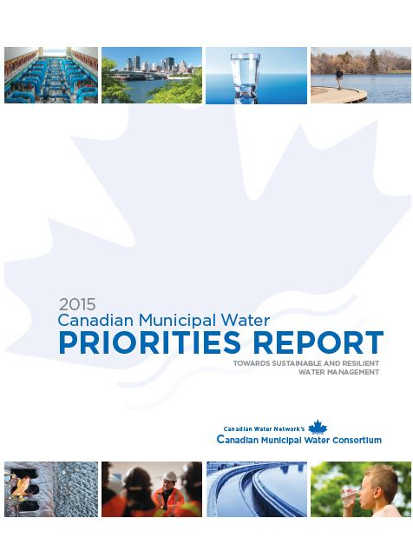
Canadian Municipal Water Consortium
Notes:
18

Slide 19
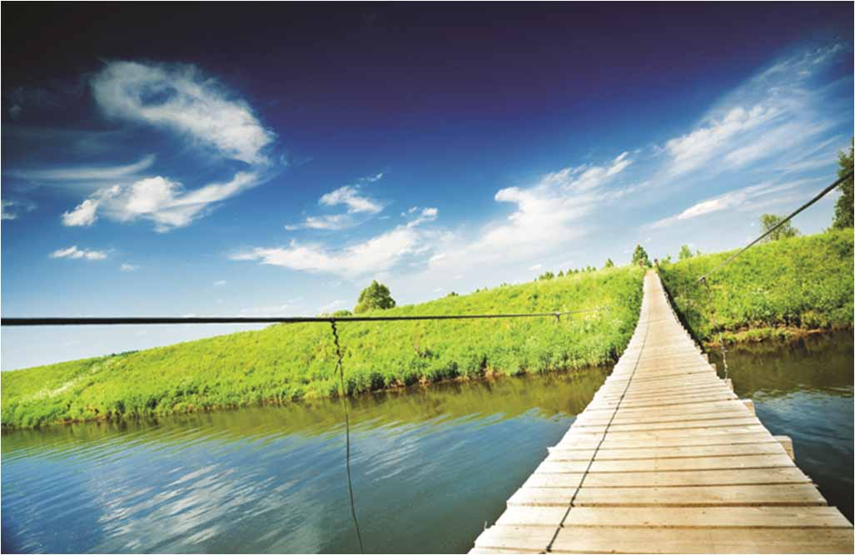
The ultimate goal is water management to support the communities we want with infrastructure that is:
Sustainable in all respects (including financial)
Resilient to short term shocks
Adaptable to accommodate long term change

Slide 20
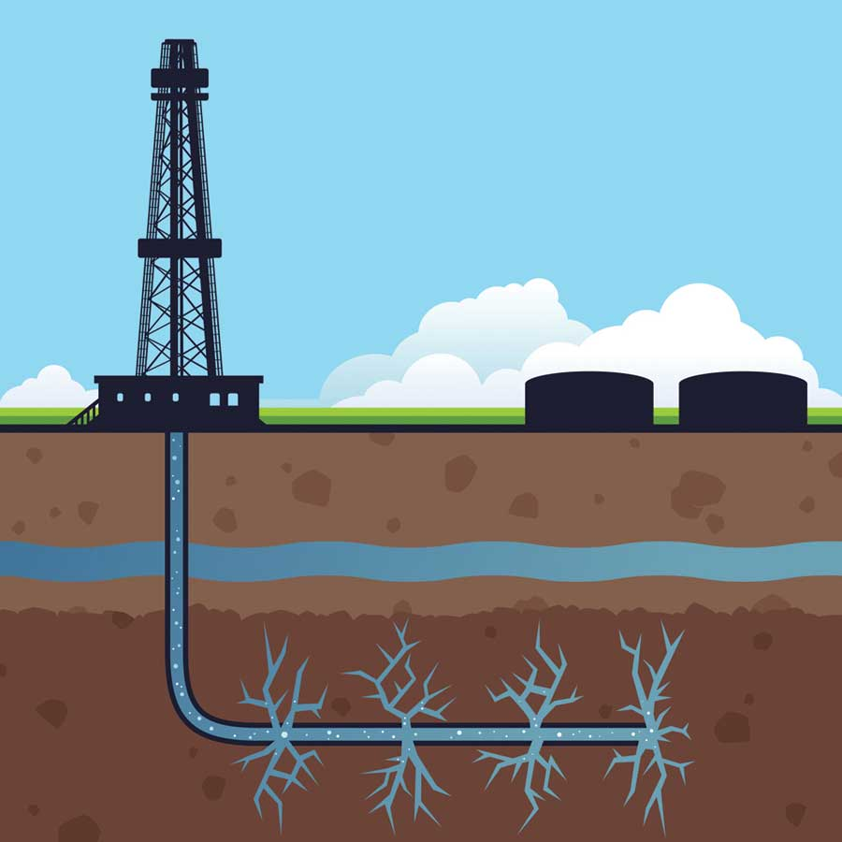
Developing Consortium What is needed to advance key decisions for Hydraulic Fracturing and Water?

Slide 21
Managing Shared Risk -- Areas of Opportunity
Resilient Blue Cities:
Agriculture and Water:
Water Use/Conservation/Re-Use
Nutrient Impacts and Cycling
Droughts and Flood Mitigation
Notes:
21

Slide 22
Some CWN Key Lessons
Trust is #1 – in people, credibility of the science, organizational authenticity
relationships
governance and transparency
identifying coalitions of the willing
setting the right table
Questions need to be well articulated – if answered, do they help move forward?
Most practical questions are about “priorities”–effectiveness and efficiency
Decision Contexts are Key – does the knowledge/technology fit that context?

Slide 23
Some Key Lessons (cont’d)
Not linear process or a waiting game: start with coalitions of the willing and what we know now
–then deepen going forward --iterate.
Can’t avoid the critical knowledge management function by downloading to knowledge/technology providers
Create and support knowledge mobilization systems that recognize and support the research role/value ensure and get what is needed

Slide 24
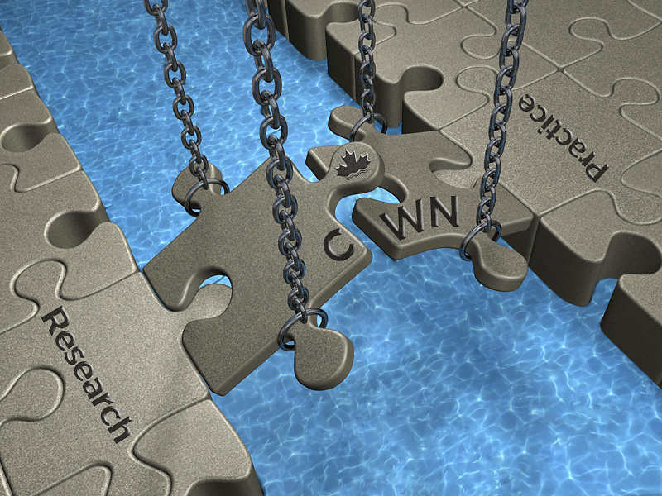
Thank You
Contact Information:
Bernadette Conant
Executive Director Canadian Water Network bconant@cwn-rce.ca
Visit our website:
www.cwn-rce.ca

