Slide 1

CEC AT 23, A CERTAIN REGARD
JPAC Regular Session 17-03
Commission for Environmental Cooperation
Cesar Rafael CHAVEZ
Chicago, Illinois, USA, November, 2017

Slide 2
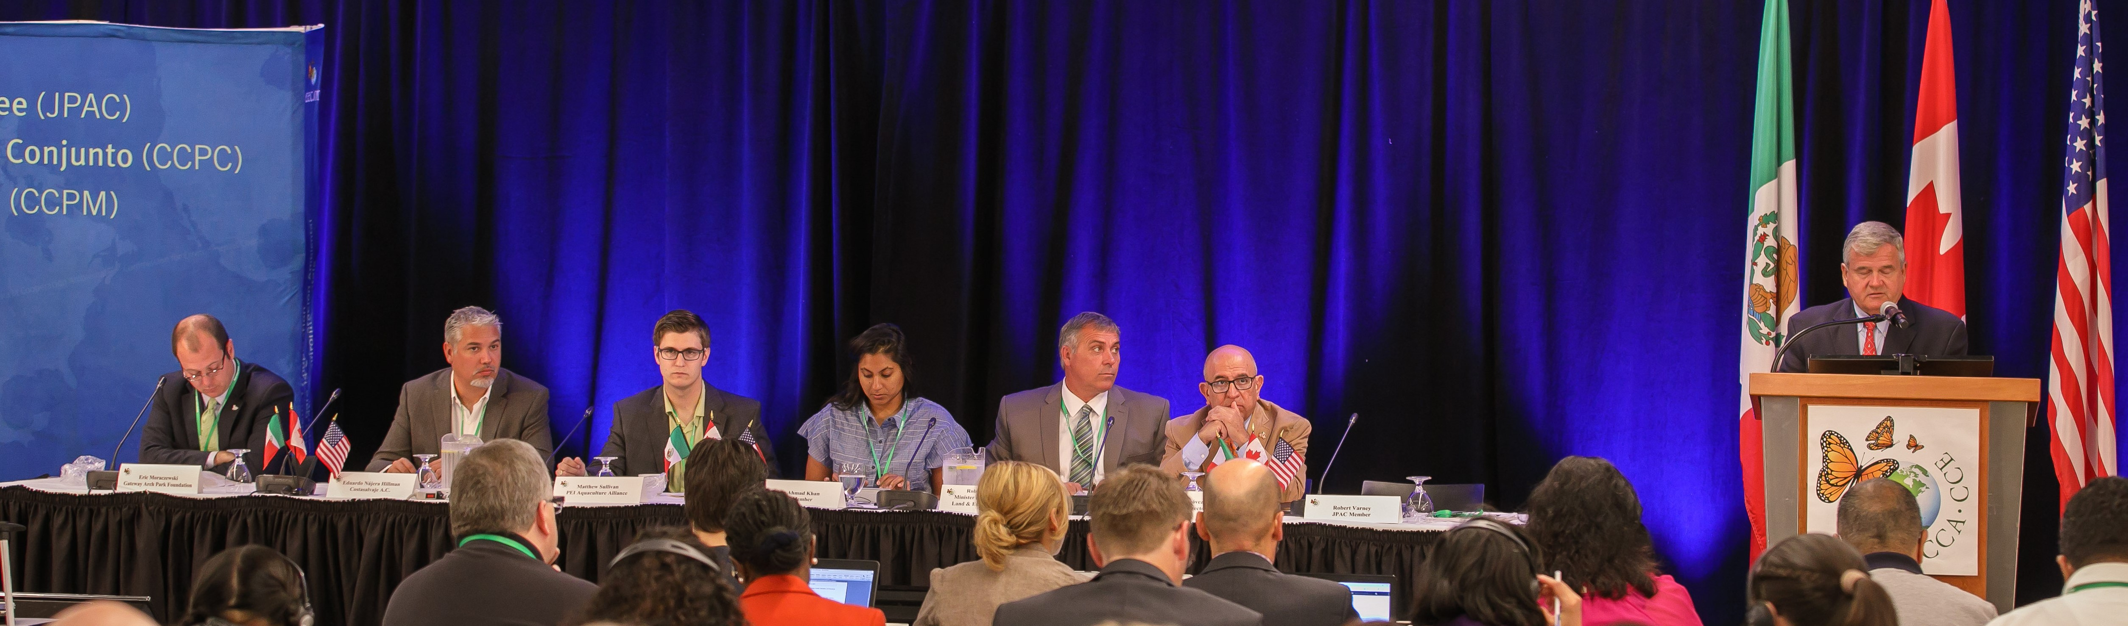
QUESTIONS?
What is the CEC? Why the CEC? Where the CEC?...
A regional environmental institution? What do we represent in the region?
What have we done so far? Have our role changed throughout these years?
What is the future for environmental institutions in our region?
Have we made a difference?

Slide 3
THE CEC, ORIGINS
Almost 23 years, Canada, Mexico and the United States of America working together for the environment.
The North American Agreement for Environmental Cooperation (NAAEC, 1994) has been the environmental arm of the North American Free Trade Agreement (NAFTA): commitment to accompany trade liberalization and economic growth with cooperation for protecting the environment
NAAEC: the Commission for Environmental Cooperation (CEC) composed of a Council, a Secretariat and a Joint Public Advisory Committee (JPAC)
  Council, governing body, cabinet-level environmental representatives of the Parties to the NAAEC
  Secretariat, based in Montreal, responsible of technical, administrative and operational support to the Council, committees and groups
  JPAC, five citizen volunteers from each country who provide advice within the scope of NAAEC (appointed by the Council)

Slide 4
WHAT WE HAVE BEEN…
A key role player in North America
A unique, innovative and important institution that creates linkages between countries and sectors and develops modern and creative tools for the environment
The CEC / trilateral dialogue and cooperation
CEC, a neutral forum for emerging / complex issues and possible strategies; success can be attributed to being a convener and facilitator of consensus among experts and policy makers
The CEC / cooperation programs
Built around ministry-to-ministry work supported by a small secretariat, they generated an innovative collection of environmental information across the region. Through these data streams we have been able to track transboundary pollution, migratory species and shared ecosystems to create a picture of the rich and fragile North American region

Slide 5
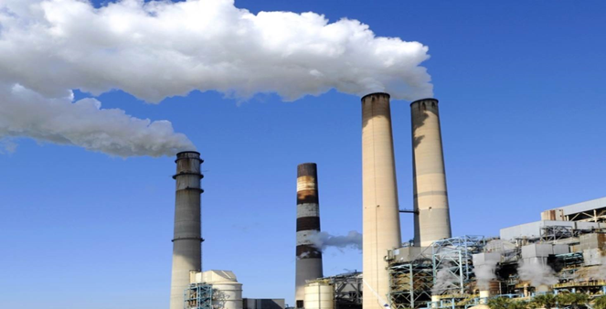
WHAT WE CONTRIBUTED TO…
The CEC ensures a level-playing field, has enhanced domestic capacity in Mexico to achieve environmental objectives of the NAAEC (pollution prevention, toxic chemicals, and pollutant release inventories)
SMOC Initiative (Sound Management of Chemicals –Regional Action Plans); key outcome: contributing to halt the DDT use in Mexico; shared lessons with other countries in Latin America
FIPREV – Financing pollution prevention projects / loans to SMS businesses: 6 years, 83 loans, US$21.9 million; 3,675 tons of chemicals per year prevented
RETC – establishment of a Pollution Release and Transfer Registry in Mexico
Notes:
Through the CEC, US and Canada have helped enhancing domestic capacity in Mexico to achieve environmental objectives of the NAAEC (pollution prevention, toxic chemicals, and pollutant release inventories)
Sound Management of Chemicals (SMOC) initiative, designed to eliminate / reduce use of toxic chemicals of common concern; included development / implementation of North American Regional Action Plans for toxic chemicals (DDT, chlordane, PCB, mercury, and lindane), and environmental monitoring and assessment
Key outcome of SMOC was contributing to halt the DDT use in Mexico (2000), that shared lessons learned with other countries in Latin America
Success story from FIPREV (in partnership with Mexican Industrial Chambers); a mechanism for financing pollution prevention projects providing loans to small and medium-size businesses (6 years, 83 loans, US$21.9 million, 3,675 tons of chemicals per year preventing from entering the environment)
RETC (Registro de Emisiones y Transferencias de Contaminantes) – establishment of a Pollution Release and Transfer Registry in Mexico

Slide 6


WHAT WE CONTRIBUTED TO…
Leader in environment – economy - trade links, towards a greener economy
Pioneered environment and trade linkages, promoting “win-win” opportunities
Contributed to promoting environmentally-friendly products and supply chains in industrial sectors (building, transportation, automotive)
Assisted small businesses: shade-grown coffee farmers to participate in market-based approaches to biodiversity conservation
Partnered with the private sector (nine large scale companies) in accelerating adoption of international energy performance standards
Helped establish the North American Grasslands Alliance to protect grasslands and sustain ranching communities
Notes:
Created in response to public concerns about the effects of a trade agreement on the environment, the CEC was a pioneer among international institutions in examining environment and trade linkages and promoting “win-win” opportunities
The CEC contributes to promote environmentally-friendly products and supply-chains, sustainable transportation and building sectors, renewable energy and energy efficiency, and market-based mechanisms for biodiversity conservation in North America.
It also assisted the establishment of self-sustained coalition of auto suppliers and manufacturers in the region aimed to improving the economic and environmental performance of the automotive industry supply chain
From assisting small businesses like coffee growers for shade-grown coffee farming, to partnering with the private sector (nine large scale North American companies) in accelerating adoption of international energy performance standards
Since 2009, a focus on North America’s grasslands and consultation with over 120 stakeholders have led to the establishment of the North American Grasslands Alliance to protect grasslands and sustain ranching communities.

Slide 7
ENVIRONMENTAL LAW AND ENFORCEMENT
Improvement of environmental law and standards, a key objective partnership
A training program to support more than 600 environmental, wildlife and customs officials in identifying illegal shipments of environmentally regulated materials and wildlife
The submission on enforcement matters process (SEM), a unique mechanism to ensure government accountability in enforcing environmental laws
  Non-judicial, non-adversarial
  Does not lead to sanctioning of a Party
  Provides transparency in environmental matters
Secretariat’s 2013 independent report on spent lead-acid battery trade and recycling resulted in legislative changes in Mexico and in bolstering the US EPA’s determination to revisit related import/export regulations
Notes:
Improvement of environmental law and standards has been a key objective of the region’s partnership.
The CEC developed a training program to support more than 600 environmental, wildlife and customs officials in identifying illegal shipments of environmentally regulated materials, such as ozone-depleting substances, hazardous waste materials, as well as endangered species of wildlife subject to illegal trafficking.
The submission on enforcement matters (SEM) process is a unique mechanism to ensure government accountability regarding enforcement of environmental laws. Through the SEM, members of civil society can submit an allegation to the CEC Secretariat that a Party is not effectively enforcing its environmental law and request an independent, objective review and presentation of the facts. This process is non-judicial, non-adversarial, and does not lead to sanctioning of a Party, but provides transparency in environmental matters, including responses from the Party in question and contributes to policy development
For instance, an independent report on spent lead-acid battery trade and recycling (2013), resulted in legislative changes in Mexico related to air pollution from secondary lead smelting, as well as bolstering the US EPA’s determination to revisit the import/export regulations related to spent lead-acid batteries

Slide 8
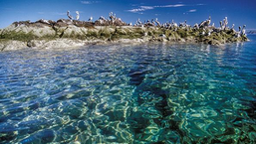
WHAT WE ARE KNOWN FOR…
Monarch butterfly – tri-national actions to conserve the habitat for this emblematic species and migratory phenomenon
Collaboration for the conservation
of species and ecosystems of common
concern
  North American Conservation Action
  Plans for 8 marine and terrestrial species
  North American Marine Protected Area
  Network (NAMPAN) - a decade of
  marine work
  Blue carbon ecosystems: mangroves, seagrass and saltmarshes
Analyses of continental-wide persistent pollution and mitigation actions:
  Supported efforts to reduce the risks to public health and environmental contamination from chlordane, PCB, mercury and lindane
Notes:
Monarch Butterfly: tri-national actions to reduce threats and promote sustainable economic activities along the Monarch flyway; forum to share expertise and provide key information to the public and wildlife officers related to habitat conservation for this emblematic species and migratory phenomenon.
Collaboration for the conservation of species and ecosystems of common concern such as migratory shorebirds, grasslands and marine protected areas.
-From 2004-2008, the CEC worked on 33 marine and terrestrial species of common conservation concern and completed eight detailed North American Conservation Action Plans.
-CEC’s North American Marine Protected Area Network (NAMPAN) culminated a decade of marine work with the publication in 2012 of two guides for designing marine protected areas networks in a changing climate and the development of five films on the benefits of marine protected areas
-Since 2011, the CEC has conducted a series of projects on the amount of carbon stored in different ecosystems, how those levels of carbon fluctuate, and what can be done to protect ecosystem storage of carbon.
Analyses of continental-wide persistent pollution, including assembling scientific assessments of the extent and patterns of long-range air pollutants such as acid rain, persistent organic pollutants, mercury and ozone-depleting substances
Pollution mitigation action; supported efforts to reduce the risks to public health and environmental contamination from chlordane, PCB, mercury and lindane

Slide 9
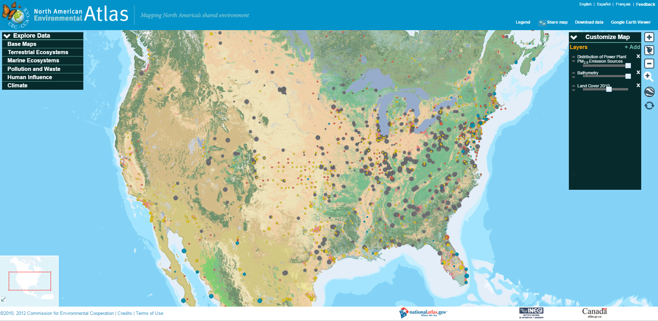
WHAT WE ARE KNOWN FOR……
Innovative approaches and tools such as:
Taking Stock report and database provide annual updates and tracks some 500 different industrial pollutants from 35,000 facilities in North America. This initiative has become a model of best practice to other countries
North American Environmental Atlas, interactive mapping tool to research, analyze and manage environmental issues
Notes:
Annual Taking Stock report and database provide annual updates and tracks some 500 different industrial pollutants from 35,000 facilities in North America, helping communities and vulnerable populations to gain access to timely and place-based pollutants. The North American Pollution Release and Transfer Registry initiative has become a model of best practice to other countries
North American Environmental Atlas, interactive mapping tool to research, analyze and manage environmental issues. A model in assembling and making accessible geo-referenced data to visualize environmental information and to integrate socio-economic and key environmental statistics. Examples of thematic maps include:
Key marine ecoregions in North America, which are vital to migratory wild salmon, whales and other species
Mapping shared grasslands and migratory patterns of the iconic monarch butterfly, and other 800 species that migrate across North America, used as a tool to raise awareness in different communities, conservation groups, local authorities and others
Depicting information about land cover and land cover change in a seamless, consistent and automated way across North America at regular intervals

Slide 10
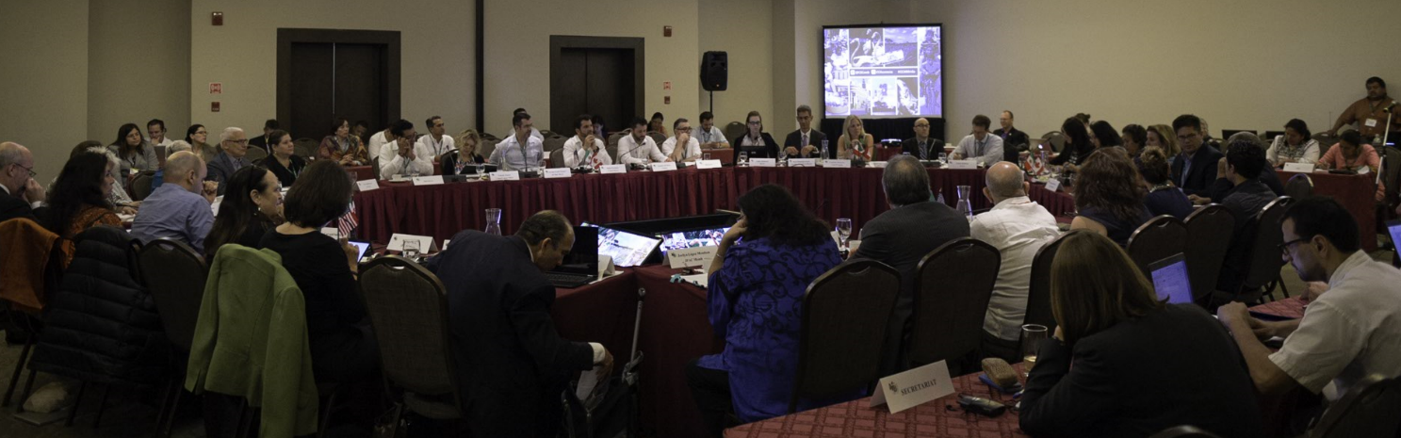
COMMITTED TO MAKE A DIFFERENCE
NAAEC signing and the creation of the CEC marked a turning point in how North America works as a region to protect our shared environment
More than 22 years of cooperation on shared regional priorities and the very existence of a unique international institution that allows North America’s three most senior environmental officials to meet and discuss trilateral environmental issues has become an important asset to the three countries

Slide 11
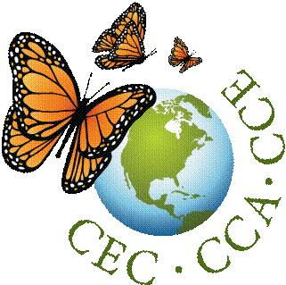
KEY CEC ACTIVITIES
  STRATEGIC PLAN 2015 – 2020
  Climate Change: Mitigation and Adaptation
  Green Growth;
  Sustainable Communities and Ecosystems
OPERATIONAL PLAN 2017 – 2018 (10 collaborative projects)
INITIATIVES (ongoing)
  North American Land Change Monitoring System (NALCMS)
  North American Environmental Atlas
  North American Pollutant Releases and Transfers
    North American Portal on Climate Pollutants
OTHER PROGRAMMES
  SEM, NAPECA, TEK, Communications, Youth Engagement

Slide 12

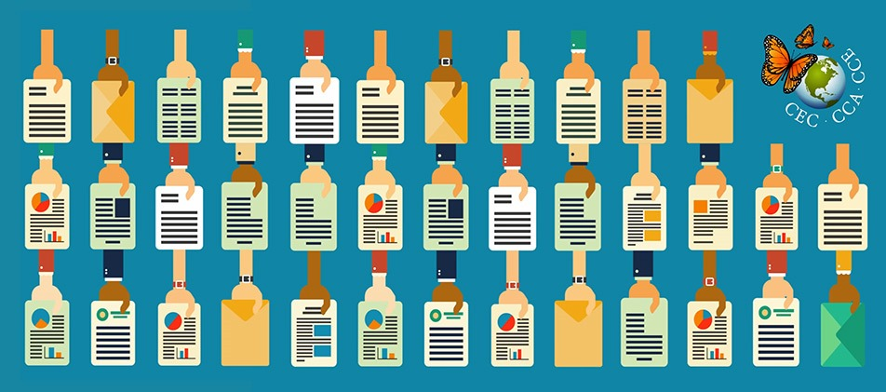
CEC – THE SUBMISSIONS ON ENFORCEMENT MATTERS PROCESS
A fact-finding mechanism concerning the effective enforcement of environmental laws in North America, administered by the Secretariat
Established to foster transparency, public participation, and information sharing regarding a Party’s environmental law enforcement
Initiated by residents / NGOs in North America
88 submissions to date (30 Canada, 45 Mexico, 12 United States, 1 Canada – USA)
22 Factual Records published to date, 3 submissions currently active

Slide 13
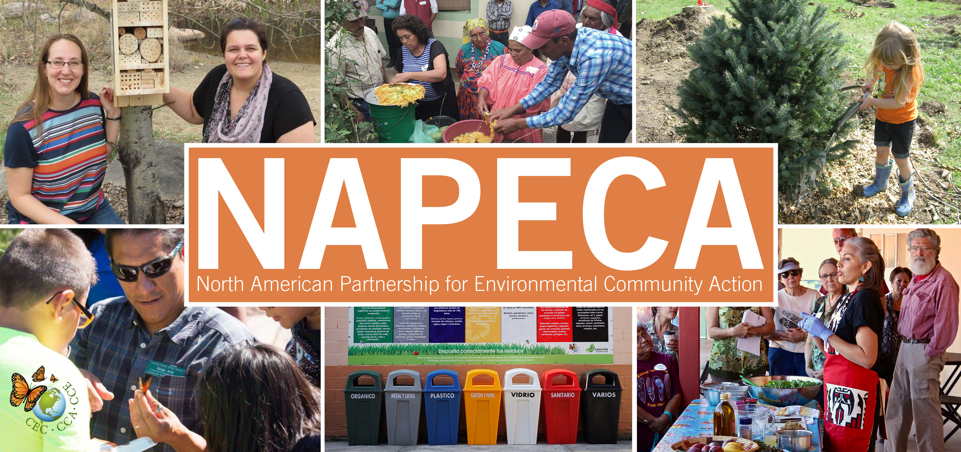
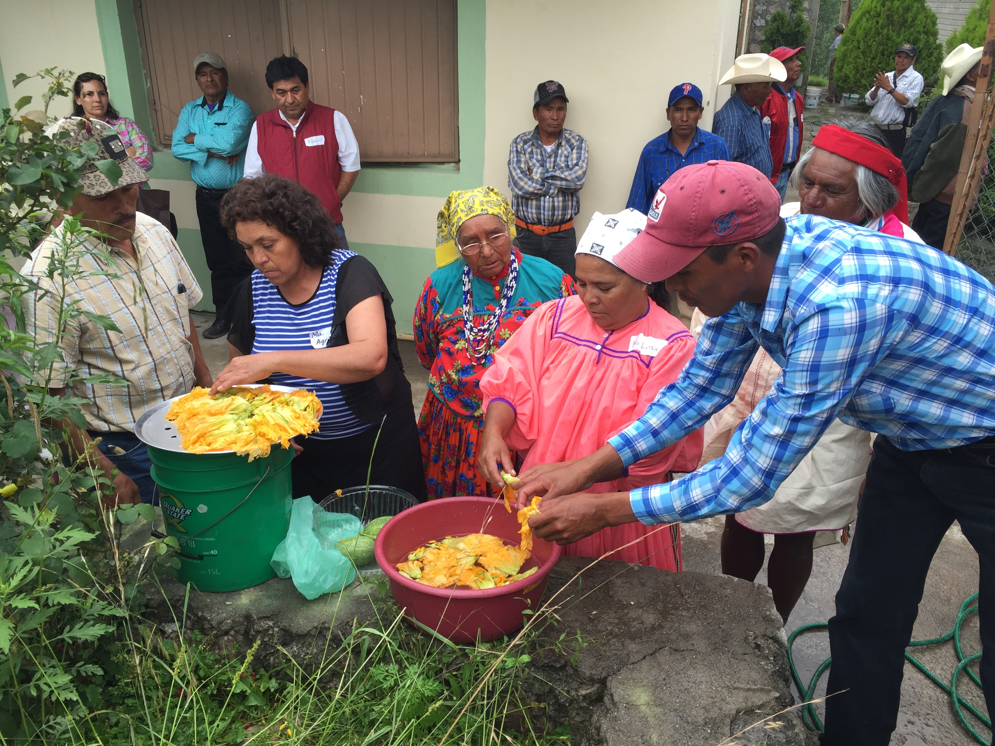
NAPECA…
A natural heir of the former North American Fund for Environmental Cooperation, NAPECA is the North American Partnership for Environmental Community Action
CEC’s Environmental Community Grants Program
Help communities improve their health and local environment
Build partnerships at the community level
1st Call for proposals (CFPs) – June 2011
1700+ preliminary applications: 2011, 2013, 2015, 2017
Funded 57 community projects throughout North America
C$3.9 million awarded to date
Currently selecting applications to award 2018 grants

Slide 14
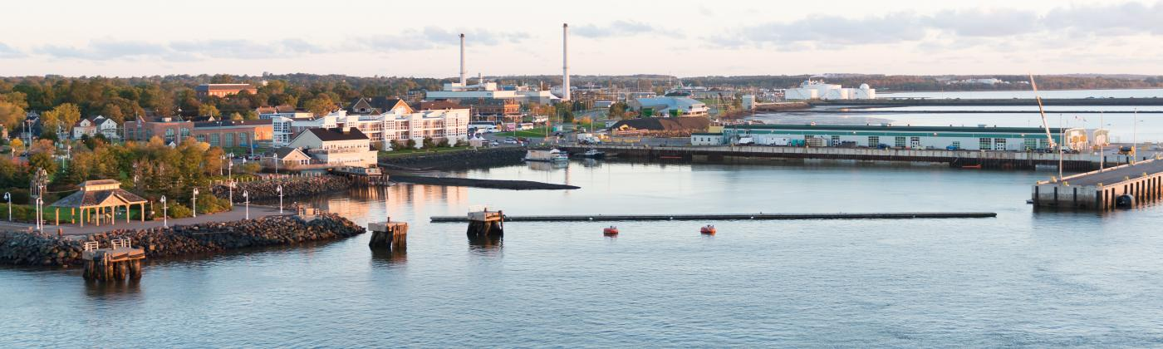
CEC - COMMUNICATIONS
CEC Virtual Library - Over 400 publications
Food Waste Video Contest – Jointly with UN Environment
Youth Innovation Challenge – Launching in January 2018 Public Advisory Committee meeting on reducing food and organic waste streams – March 2017
2017 CEC Council Session in Charlottetown, Prince Edward Island - 27-28 June 2017

Slide 15
CEC
INTERNATIONAL

Slide 16
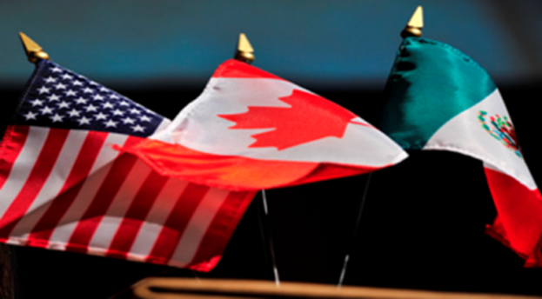
THE CEC: LOOKING TO THE FUTURE
VALUE-ADDED OF THE CEC:
Strengthening nexus between trade and the environment
Promoting enforcement of environmental laws
Facilitating public participation
Platform for high-level trilateral decision-making
Trilateral platform for engagement of experts and stakeholders
Regional data collection, and inventory of practices to replicate
Holding forums on research on trilateral issues
Regional approach to inform/fulfill multilateral commitments

Slide 17
THE CEC: LOOKING TO THE FUTURE
CHALLENGES AND OPPORTUNITIES MOVING FORWARD:
Further strengthening nexus between trade and environment
Ensuring better continuity of work
Tracking long-term performance of the organization and projects
Improving scope and effectiveness of public participation
Improving effectiveness of communications and messaging to the public
Ensuring CEC’s work leads to tangible results
Strengthening link between project activities and Council’s strategic vision

Slide 18
REFLECTIONS…
CEC has a track record of effective results that have contributed to the protection of the environment in North America
Environmental problems cut across borders
North America’s ecosystems are irrevocably connected
Achieving long-term results requires coordinated approaches and a proven ability to adapt to changing governments and national priorities
Notes:
The CEC has a track record of effective results that have contributed to the protection of the environment in North America, the growth of sustainable industries, and the health of its citizens and has also provided useful information on the North American environment to a large variety of audiences
Regardless of domestic policy orientations on trade, many environmental problems cut across borders: whether air quality, invasive species, hazardous waste, migratory wildlife or the long-range atmospheric transport of toxic pollutants.
The CEC’s work has demonstrated that North America’s ecosystems are irrevocably connected and that achieving long-term results requires coordinated approaches and a proven ability to adapt to changing governments and national priorities

Slide 19

Three countries. One environment.
Cesar Rafael CHAVEZ
crchavez@cec.org
© Commission for Environmental Cooperation / 2013

