Slide 1

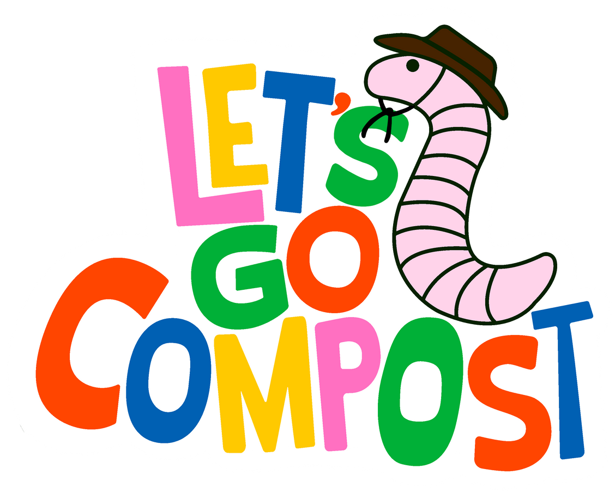
The
MISSING LINK
In U.S. Food Waste Infrastructure
Notes:
Food waste is one of the largest contributors of methane emissions in the United States, a toxic greenhouse gas with 34 times greater global warming potential than carbon dioxide. For the next five minutes, I will be discussing how the U.S. can rapidly reduce one of the largest sources of methane gas emissions in the United States while building the green economy.

Slide 2
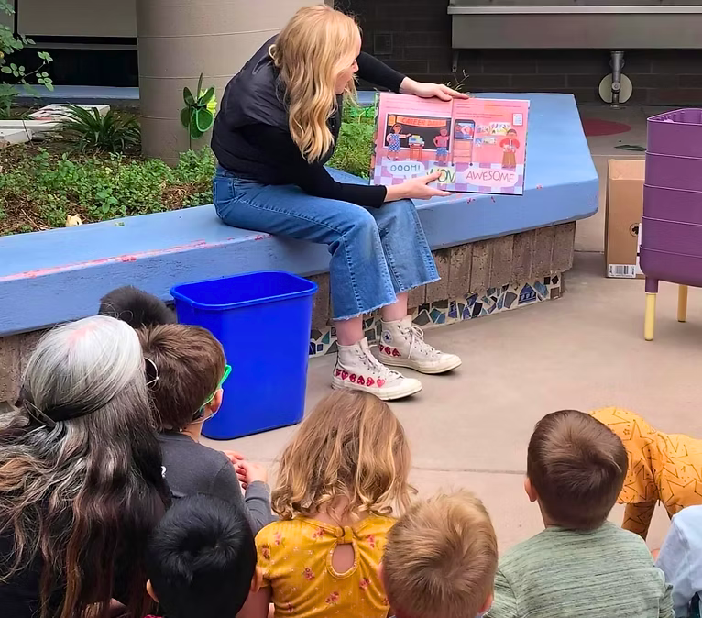
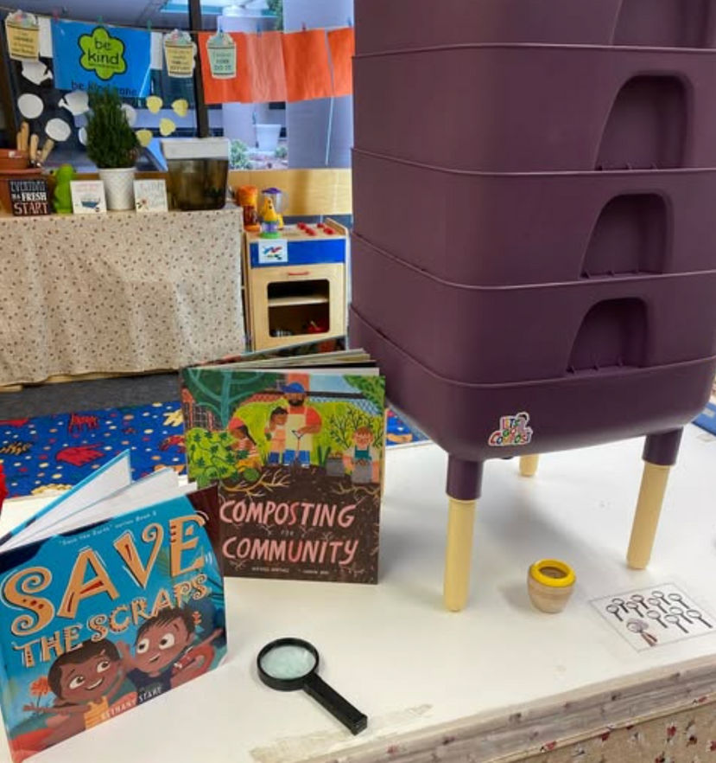
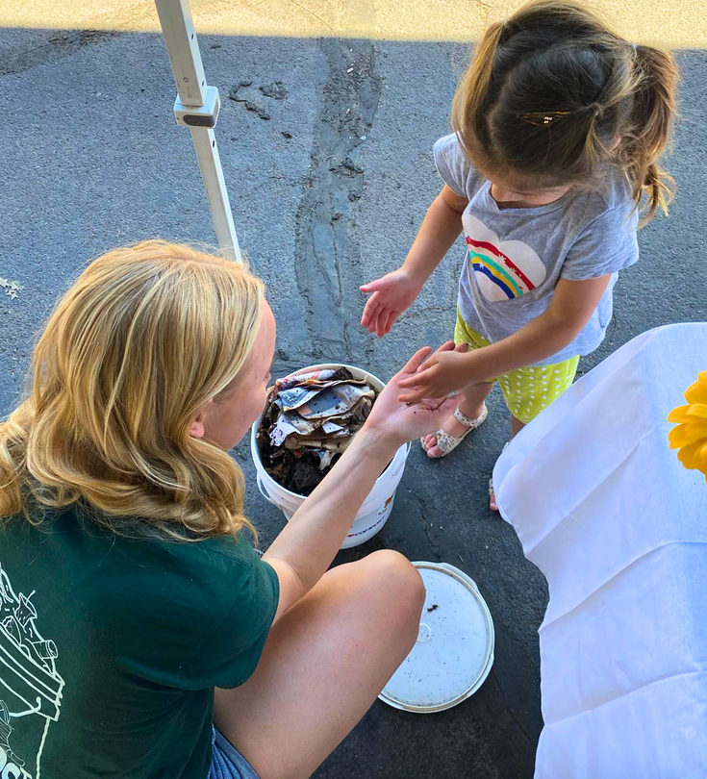

Slide 3
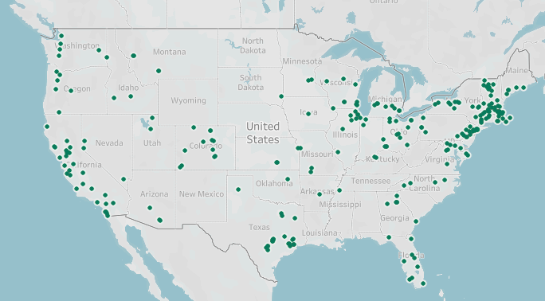
U.S. COMPOSTING FACILITIES
Tableau
Updated June 2023

Slide 4

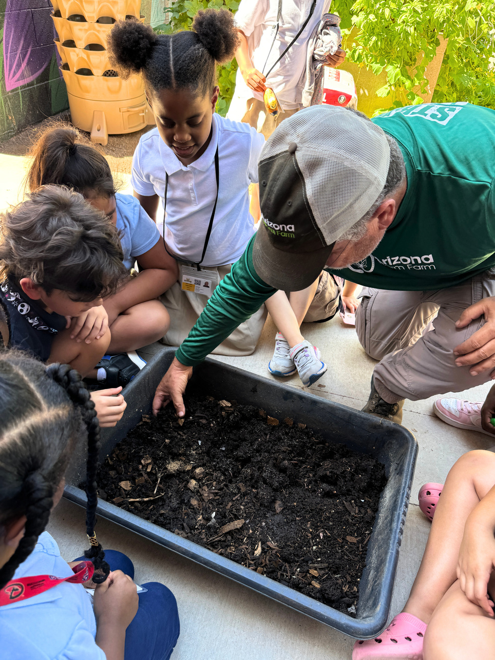
2021
SCHOOLS DRIVE REAL CHANGE
Founded
2022
501c3 Nonprofit Status Obtained
  We deliver free composting curriculum, consulting, and kits
  Create early-stage behavior change
  Drive collective demand for infrastructure
2023
1 School Supported
2024
100+ Schools Supported
2025
200+ Schools Supported
Notes:
My name is Lauren Click, and I am the founder of Let’s Go Compost. We are a national 501c3 nonprofit solving this systems gap.
Our goal is to institutionalize composting in K-12 public schools through staff training, curriculum alignment, and facilities integration. We've launched an educational model for K-12 school settings that is low-cost, scalable, and tailored to schools that are otherwise left out of the conversation.
Each classroom we support with begins with one small kit and strategically scales every semester for their unique needs,
all while giving students the agency they need to champion change in their community.
And, as a note, we were selected to expand this program to an additional 54 schools along the Gulf Coast region as of this week.

Slide 5
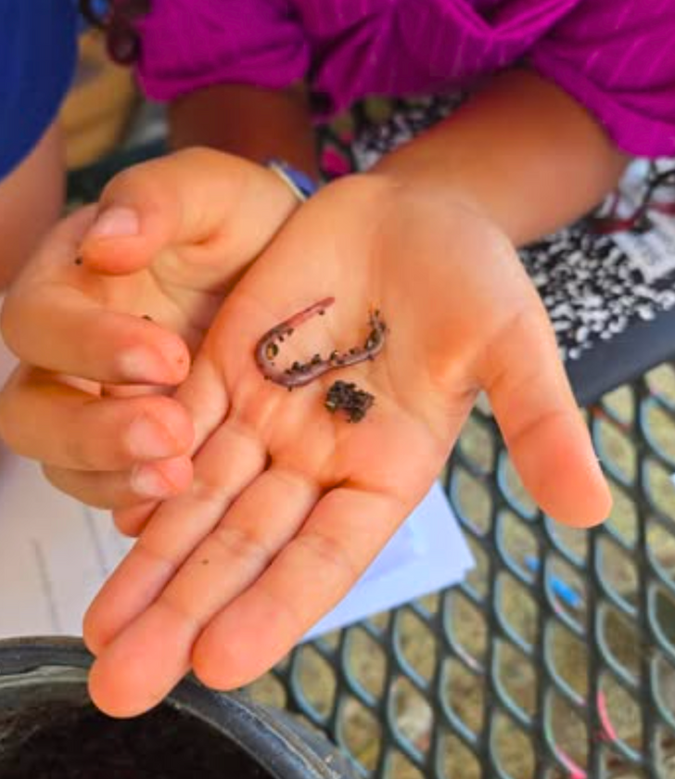
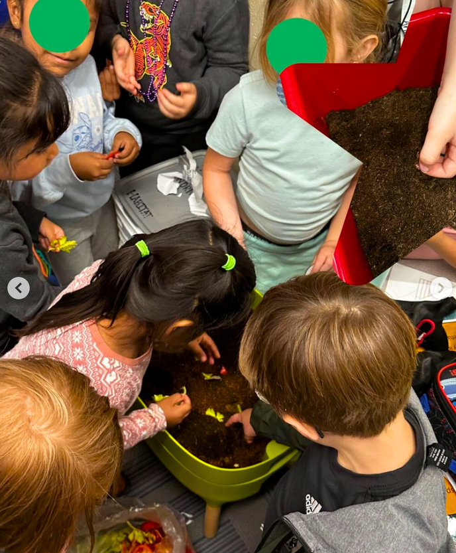
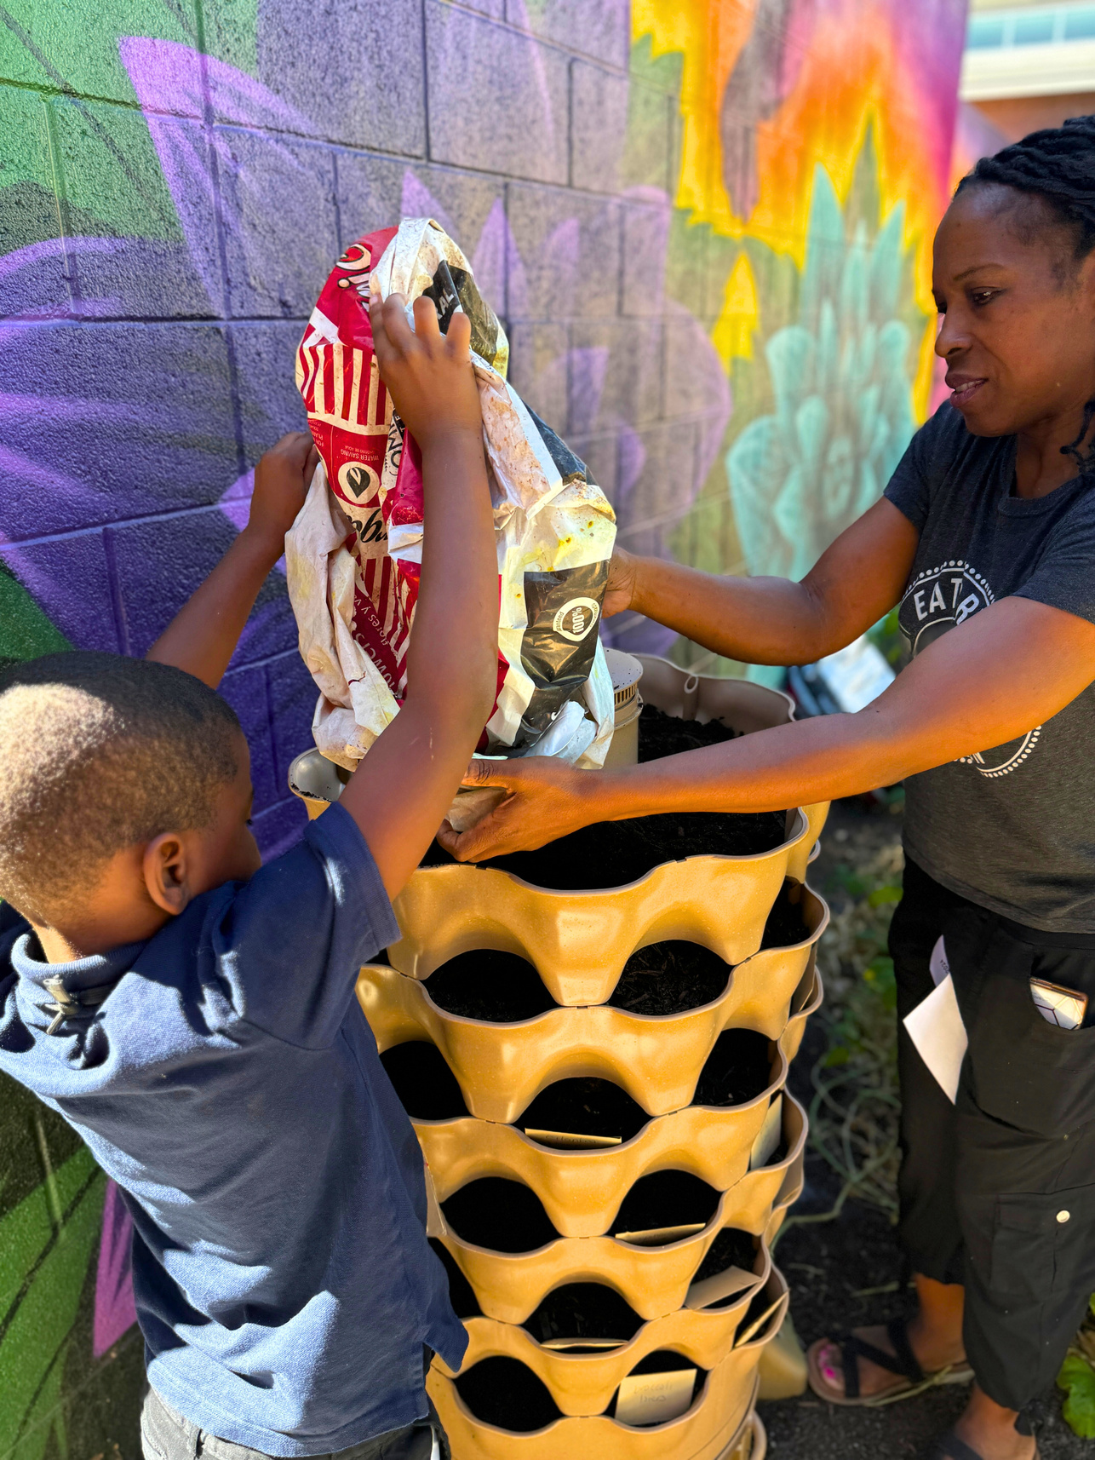
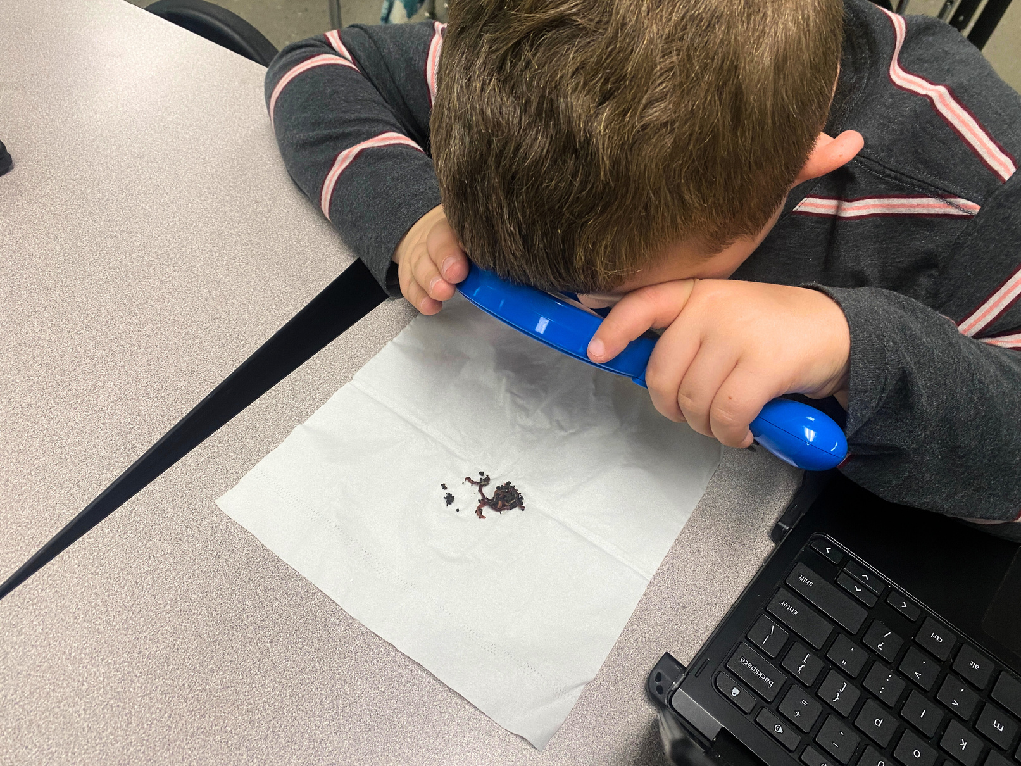
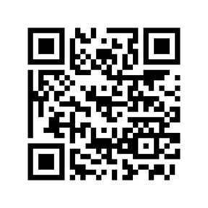
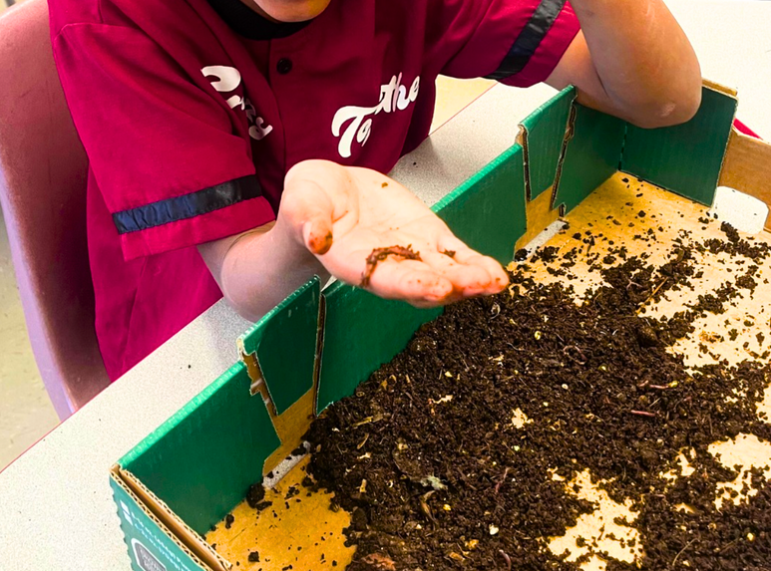
THANK YOU!
Notes:
I firmly believe that composting integration in K-12 public schools supports nationwide infrastructure, workforce and economic development, and is a necessary intervention for climate mitigation, soil regeneration, and waste systems reform.
Thank you for your time and consideration. I am happy to answer any questions at this time.

