Slide 1
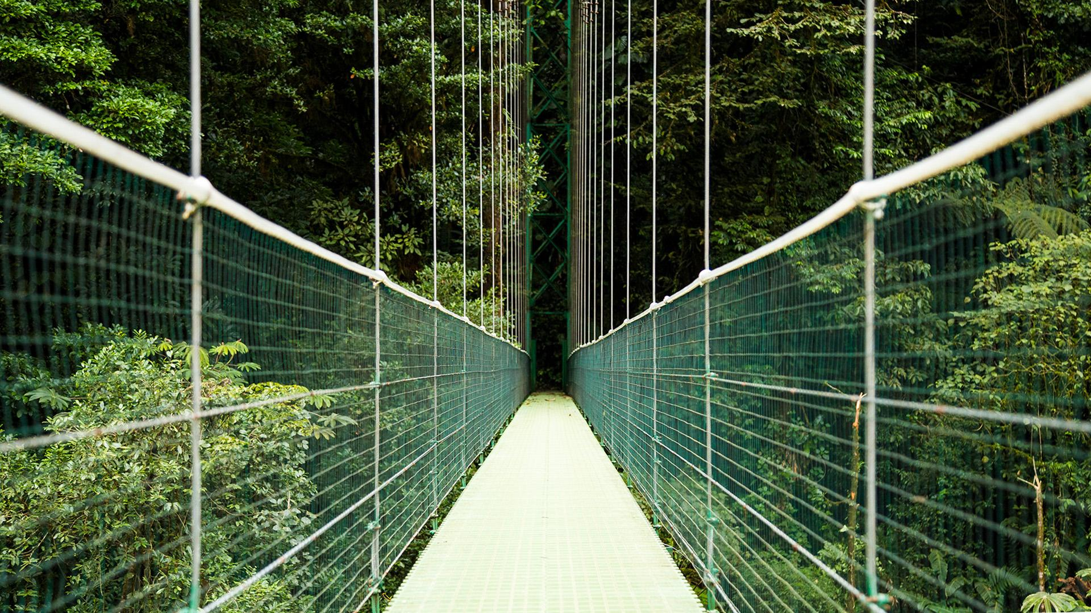
Justice in the Environmental Movement

Slide 2
TABLE OF CONTENTS
1
2
3
04
INSPIRATION
HOW WE VIEW THE MOVEMENT
WHAT NEEDS TO CHANGE
MEET PEOPLE WHERE THEY ARE AT

Slide 3
ENVIRONMENTAL JUSTICE?

Slide 4

INSPIRATION
How do we IGNITE the spark?

Slide 5


HOW WE’RE DOING?
Where we are at?
Where we need to go?
It has a beautiful name and is the second planet from the Sun

Slide 6
MEET PEOPLE WHERE THEY ARE AT

