Slide 1
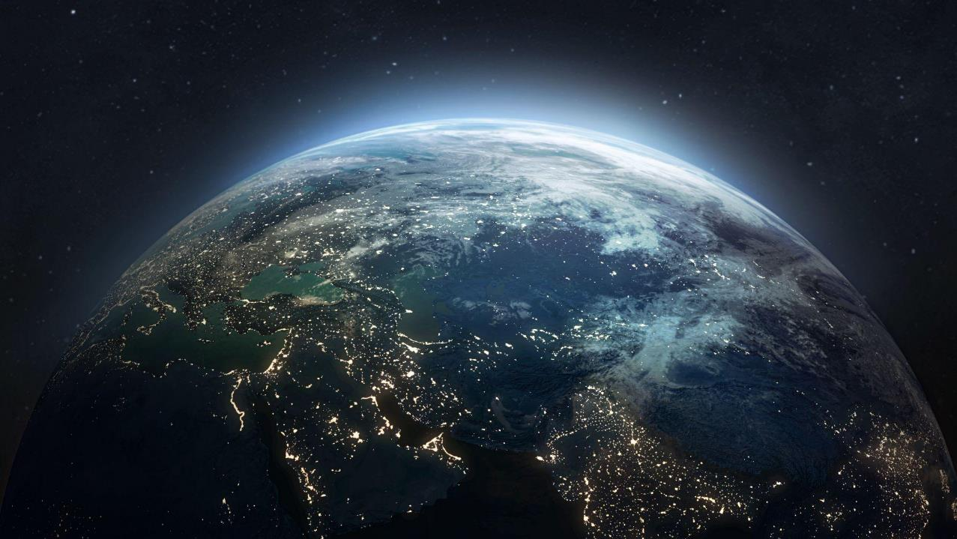
Our vision:
A thriving economic system designed to eliminate waste and pollution, circulate products and materials (at their highest value), and regenerate nature. A system that delivers better outcomes for people, and the environment.

Slide 2
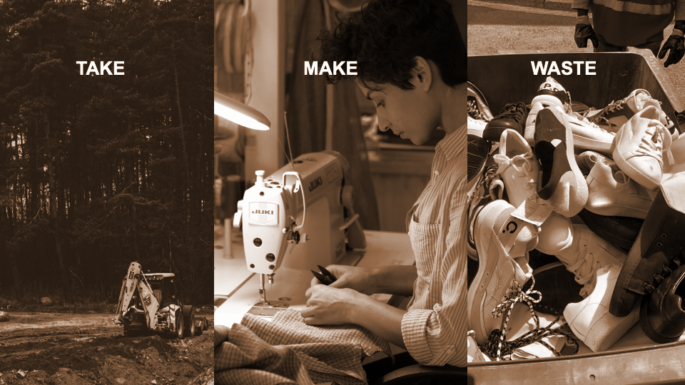
Notes:
The easiest way to describe it is starting with what we know.
acknowledge that our current system has sustained a growing population and brought economic development.
But it is also extractive, wasteful, polluting.
Today, in industries like fashion, food and plastics packaging, products and surrounding systems are designed in such a way that most materials are destined for landfill, incineration or leaked into natural environments. We have never produced more clothes - nor worn them less (clothing production has doubled but usage has dropped 40% ), while a third of all food produced goes to waste. It’s not just the materials that are wasted but embedded energy, resources, labour, and creativity are lost too.
But what is the common response? - use less, be more efficient, recycle more.
This won’t solve the problem in the long run as they treat symptoms rather than the root cause.
We need a fundamental rethink - to imagine an economy that by design. can run in the longer term
.
So what are some of the external impacts of a linear economy?
It is enormously wasteful. One third of all the food produced globally is wasted and a truckload of clothes is landfilled or incinerated every second.
There are huge economic losses. Not only from the waste of resources (eg. $5.7tn lost due to the linear nature of the modern food system) but also the underutilisation of assets - The average car in the EU spends 92% of its life parked. Office spaces are unused 60% of the time even during office hours.
It is unpredictable - reliance on finite materials creates volatility and supply chain risks
And then there’s the impact on our environment - biodiversity is under threat, with global wildlife populations falling by 58% between 1970 & 2016; and 45% of all emissions that cause climate change coming from the way we make and use products and food in this system (the other 55% coming from our energy system).

Slide 3
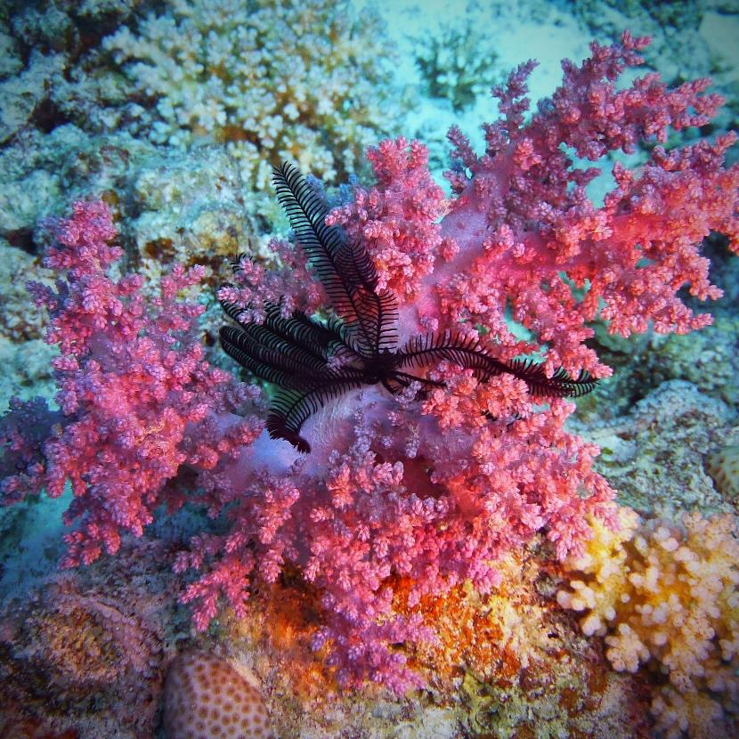




90% of biodiversity loss
$1T Economic opportunity
Supply chain resilience
45% GHG emissions
Notes:
Our immediate 2030 goal is to normalize the circular economy - which allows growth within planetary boundaries, a trillion dollar economic opportunity, supply chain resilience, GHG emissions and biodiversity loss

Slide 4
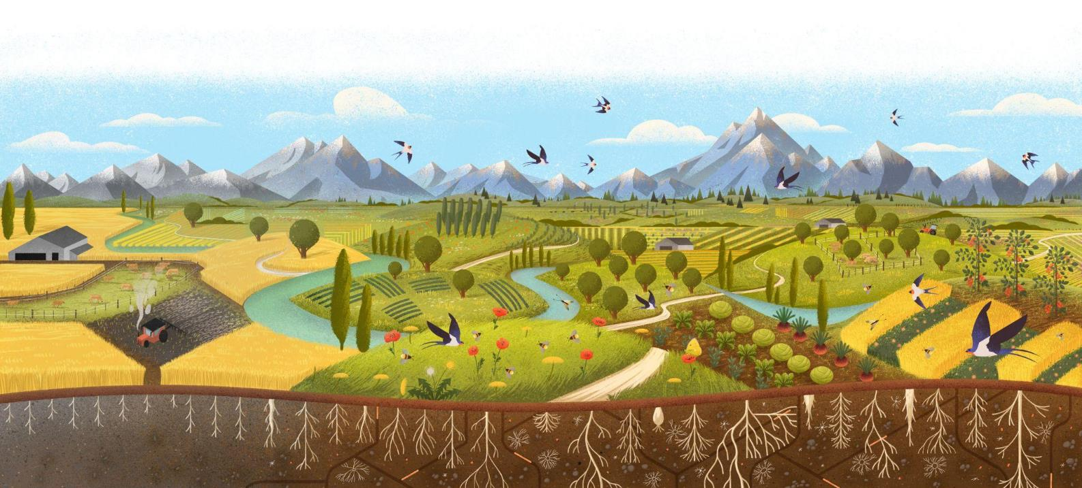
Humble and heroic.

Slide 5
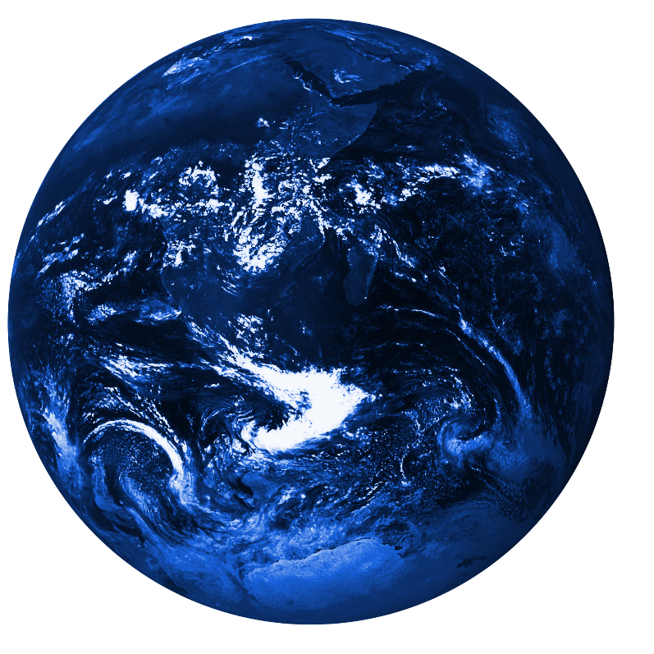
The circular economy is gathering momentum
75% of businesses recognize circular economy as important, and 55% have circular economy targets
75+ countries have circular economy roadmaps
200+ higher education institutions have included circular economy in their core curriculum
225 million tons of material flows have shifted from linear to circular
Capital flow and investment is up 87%, at more than an estimated $140 billion total capital
Notes:
We are at a critical moment in our journey towards a more circular economy. We’re seeing great signs of progress.
We now have more than 75 countries with circular economy roadmaps
75% of businesses recognize circular economy as important (up 40% from just a few years ago)
Capital flows and investments in circular economy is up 87%

Slide 6
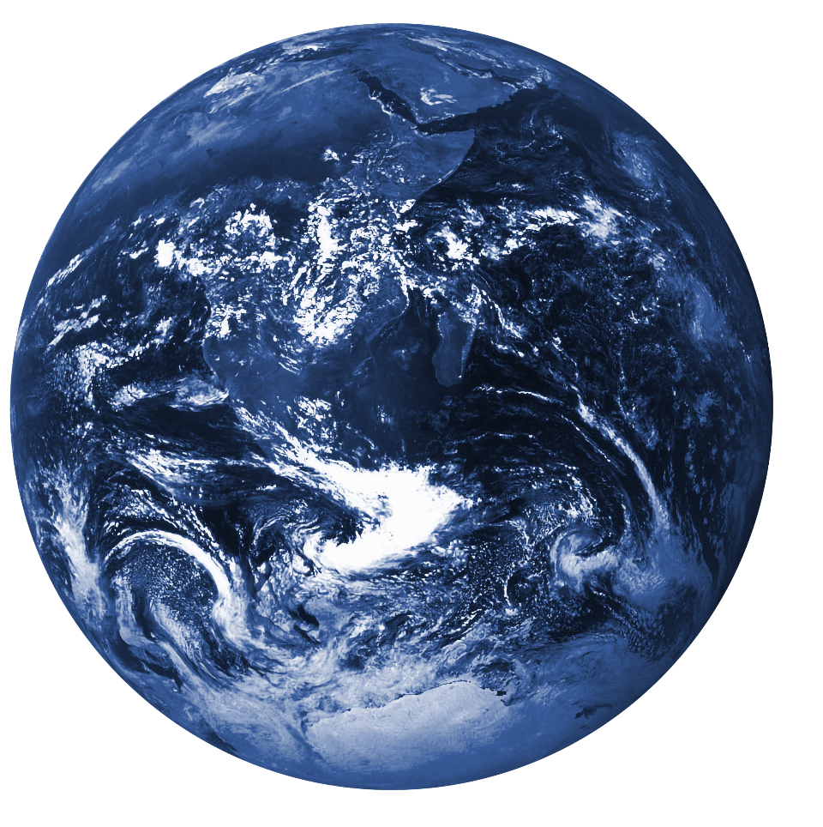

But the gap is widening…
6.9%
of economy is currently circular
Circular Gap Report 2025
© Ellen MacArthur Foundation
Notes:
Still, our continued progress is not guaranteed. And, indeed, we’re at a moment where we need to act together to pick up the pace of lasting change
The % of the economy that is circular has declined to 6.9%, from 7.2% last year from a high of over 9% when first tracked
The majority of the materials entering the top of the supply chain are virgin materials
This decline is not because circular activity and approaches are decreasing - it’s because the pace of extraction and material production is growing faster than circular solutions are scaling

Slide 7
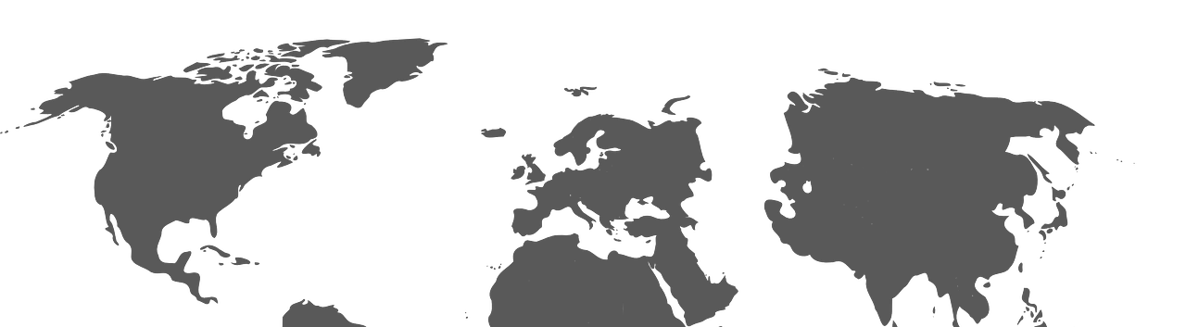
6% of world’s population
15% of world’s landmass
25% of GDP
33% of global
tech
Notes:
Our immediate 2030 goal is to normalize the circular economy - which allows growth within planetary boundaries, a trillion dollar economic opportunity, supply chain resilience, GHG emissions and biodiversity loss

Slide 8


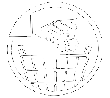
2nd highest GHG emissions
12% of world’s trash
34% of plants and 40% of animals at risk
33% of global
tech
Notes:
Our immediate 2030 goal is to normalize the circular economy - which allows growth within planetary boundaries, a trillion dollar economic opportunity, supply chain resilience, GHG emissions and biodiversity loss

Slide 9
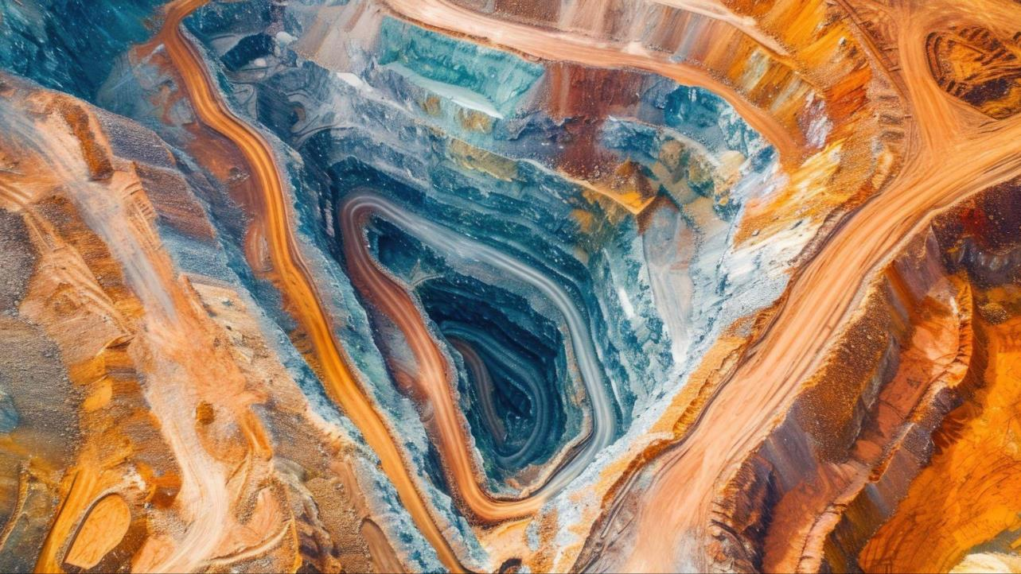

© Ellen MacArthur Foundation
Notes:
Anyone here know what we’re looking at?
This is one of the largest gold mines in the world. It takes an incredible amount of energy to extract even 1 ton of ore.
For all of that effort, it is estimated to yield 10 grams of gold (roughly the weight of a gold coin or large wedding band).

Slide 10
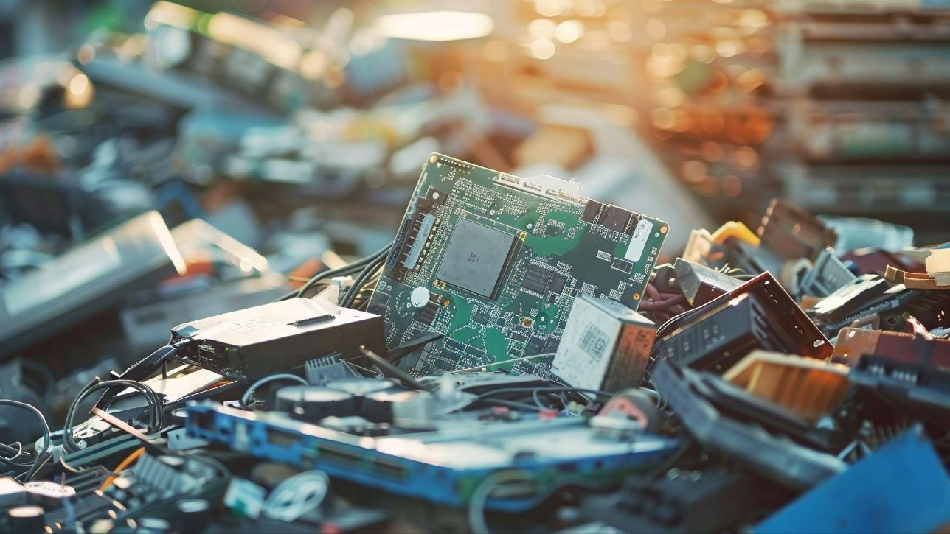
© Ellen MacArthur Foundation
Notes:
Yet if we were able to collect a ton of smartphones, it could yield up to 350 grams - about 31x as much.
This pile of e-waste is a literal gold mine - representing nearly 100B dollars in critical minerals and metals. But capturing its value is fully dependent on having better collection systems.
But right now, most of the electronics produced ends up in landfills, or gather dust in people’s drawers.
E-waste is the fastest growing waste stream, being produced 5 times faster than it is being recycled

Slide 11
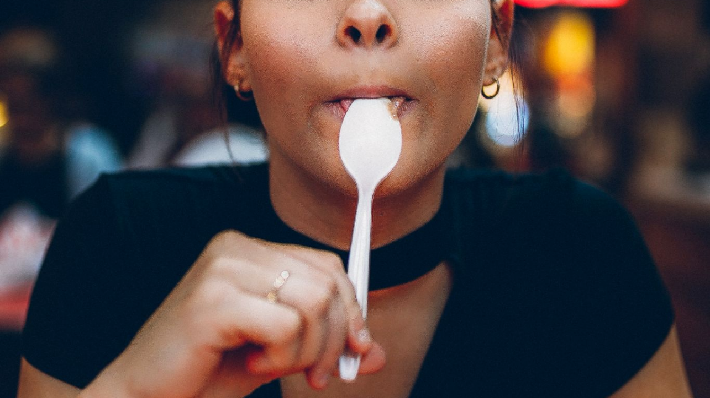
Notes:
Let’s talk about plastics
Of the 78 MM tons of virgin plastic that is fed into our systems every year, only 14% is collected for recycling, and only 4% is actually recycled.
Much of it sits in landfills
Much of it leaks into our environment. By 2050, there will be more plastic than fish in the ocean.
Now let me tell you about this spoon
The plastic takeout spoon that accompanied yesterday’s lunch,
it was designed.
The handle, curved in a way that makes it both ergonomic and stackable; the material choice, lightweight and cost-effective; the colour, immediately signalling the brand.
Design decisions determined where the plastic was sourced, the colouring agents used, and the machinery that pressed and formed the polymer sheets.
Design decisions influenced how the spoons were individually wrapped, bagged, boxed, and sealed – and how they were shipped and delivered to retailers around the world.
Design determined whether it could be used again, whether it could be recycled, or whether it ends up in landfill.
Design also powerfully shapes our desires, our imagination, our aspirations and what’s possible for our planet and our livelihood.
Design shaped the very need for a takeout spoon in the first place.

Slide 12

Notes:
Globally
Globally binding treaty at INC 5.2
US
States based legislation ever more relevant now (EPR), incredibly important how the first mover states policy is implemented to ensure other states follow suit; build up of state by state legislation can force federal legislation or global industry compliance due to nature of complexity
Federal: Plastics is one of the few places in environment and climate where environmental advocates close to the White House have hope
Industry: Pre-competitive collaboration on suppliers to produce alternative feedstock and materials, and to build infrastructure for ReX models.

