Slide 1
THE QUEST FOR ENVIRONMENTAL AND CLIMATE JUSTICE
Robert D. Bullard, Ph.D.
Distinguished Professor of Urban Planning and Environmental Policy
Texas Southern University

Slide 2
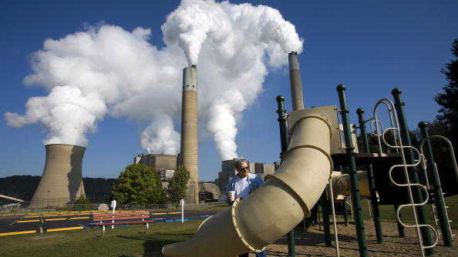
CONNECTING THE DOTS…
Running a “Marathon-Relay” for JUSTICE

Slide 3
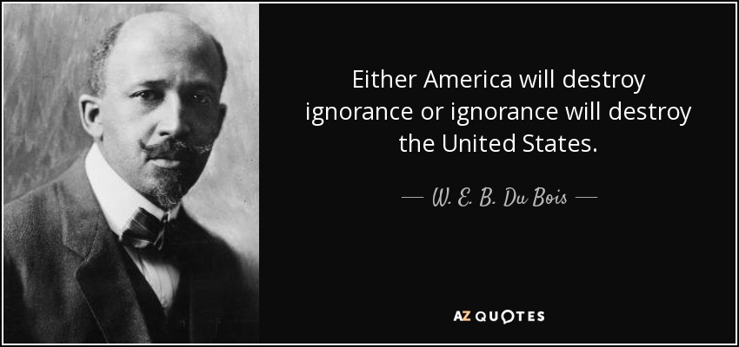

Slide 4
Books I’ve Written:
It’s just one book, but don’t tell anybody…
Invisible Houston
Dumping in Dixie
People of Color Environmental Groups Directory
In Search of the New South
Growth and Decline of a Sunbelt Boomtown
Confronting Environmental Racism
Residential Apartheid
Unequal Protection
Just Transportation
Sprawl City
Highway Robbery
Just Sustainabilities
The Quest for Environmental Justice
Growing Smarter
The Black Metropolis in the Twenty-First Century
Race, Place, and Environmental Justice After Hurricane Katrina
Environmental Health and Racial Equity in the United States
The Wrong Complexion for Protection
Notes:
4

Slide 5
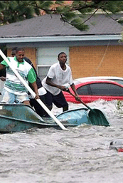
Climate Change
Climate change is more than parts per million and greenhouse gases. It’s also about JUSTICE:
Environmental Justice
Climate Justice
Economic Justice
Health Justice
Housing Justice
Energy Justice
Transportation Justice
Food & Water Justice
Reproductive Justice
Racial Justice
Notes:
-income

Slide 6
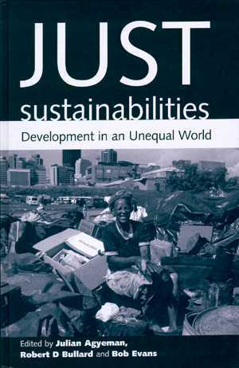
Time to Build Just and Sustainable Communities for All
Sustainability and climate action plans must address environmental and racial justice
  Transportation injustice
  Energy, food, and water insecurity
  Equitable development
  Families below poverty
  Health, income, and wealth gap
Addressing equity is a prerequisite to achieving healthy and climate resilient communities
Notes:
6

Slide 7
Thank You!
Robert D. Bullard, Ph.D.
Barbara Jordan-Mickey Leland
School of Public Affairs
Texas Southern University
Houston, TX 77004
Phone: 713-313-6840
Fax: 713-313-7153
E-Mail: Robert.Bullard@tsu.edu
Twitter: @DrBobBullard

