Slide 1
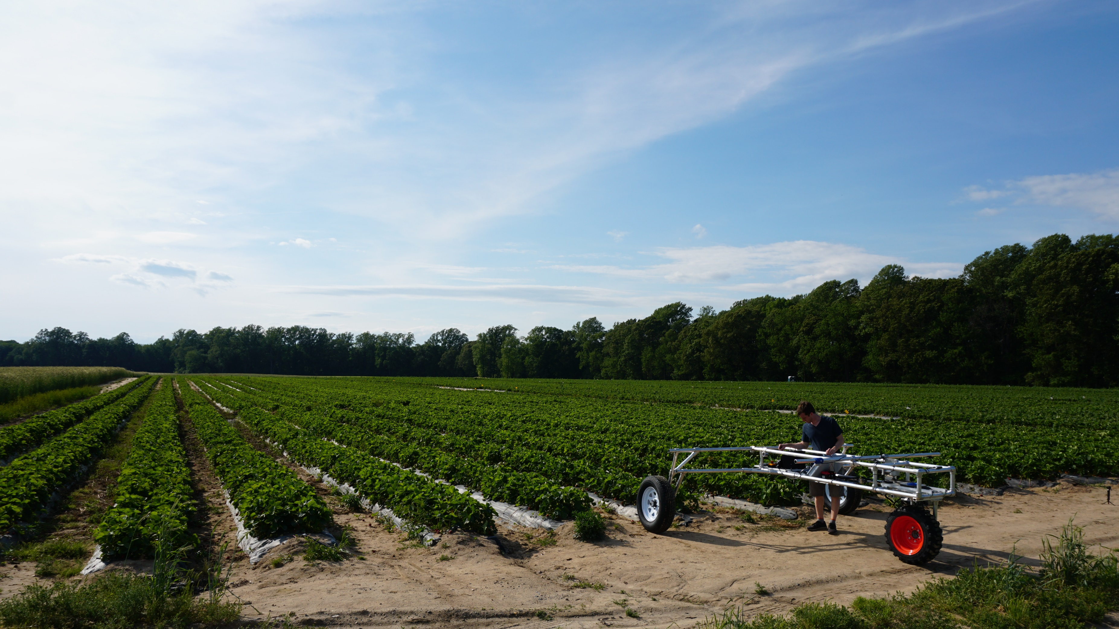
Non-Chemical Treatment Replacing Pesticides
Adam Stager
Founder/CEO
astager@udel.edu
Notes:
Hello everyone, I’m Adam Stager the founder and CEO of TRIC Robotics.
We are developing a non-chemical method to replace pesticides and we are starting with strawberries.

Slide 2
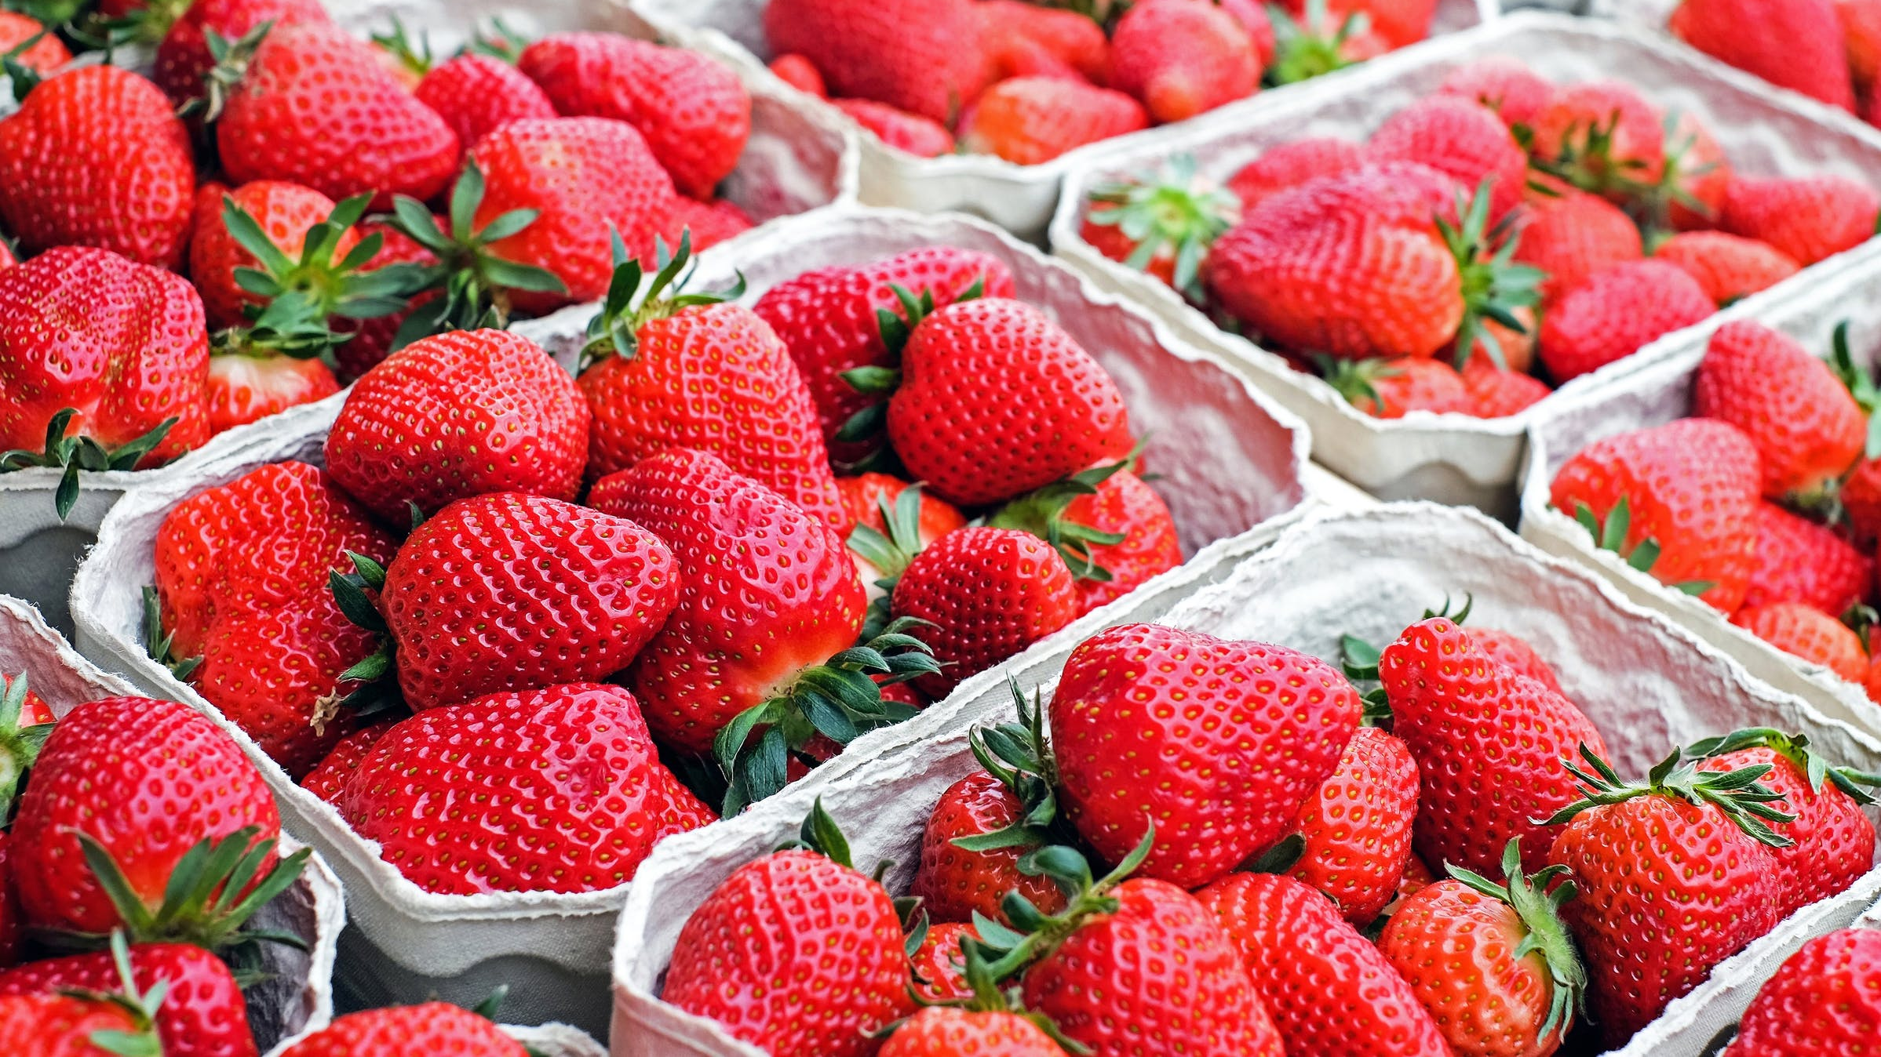
Notes:
Now if you’re a consumer like me this is what comes to mind

Slide 3
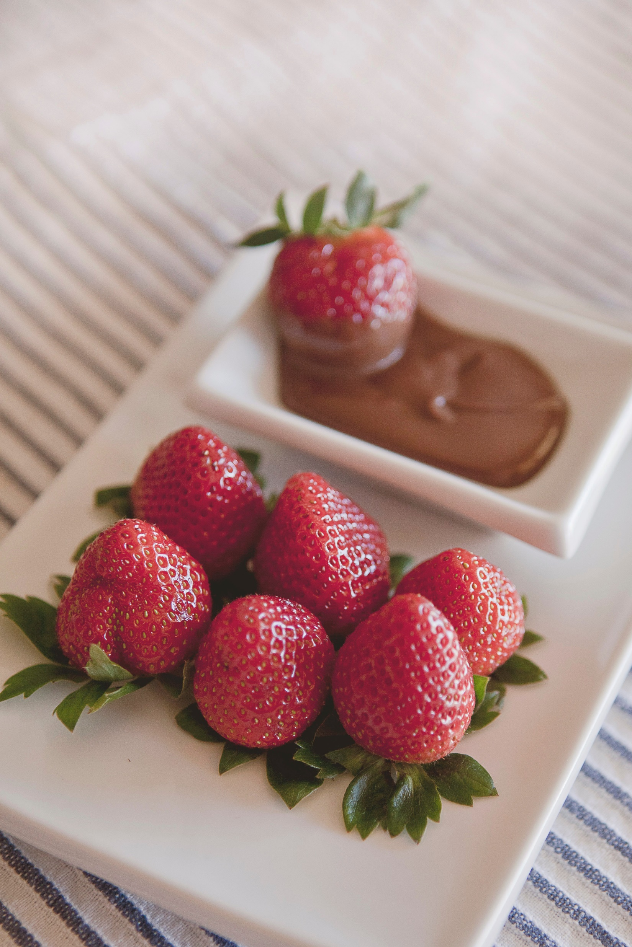
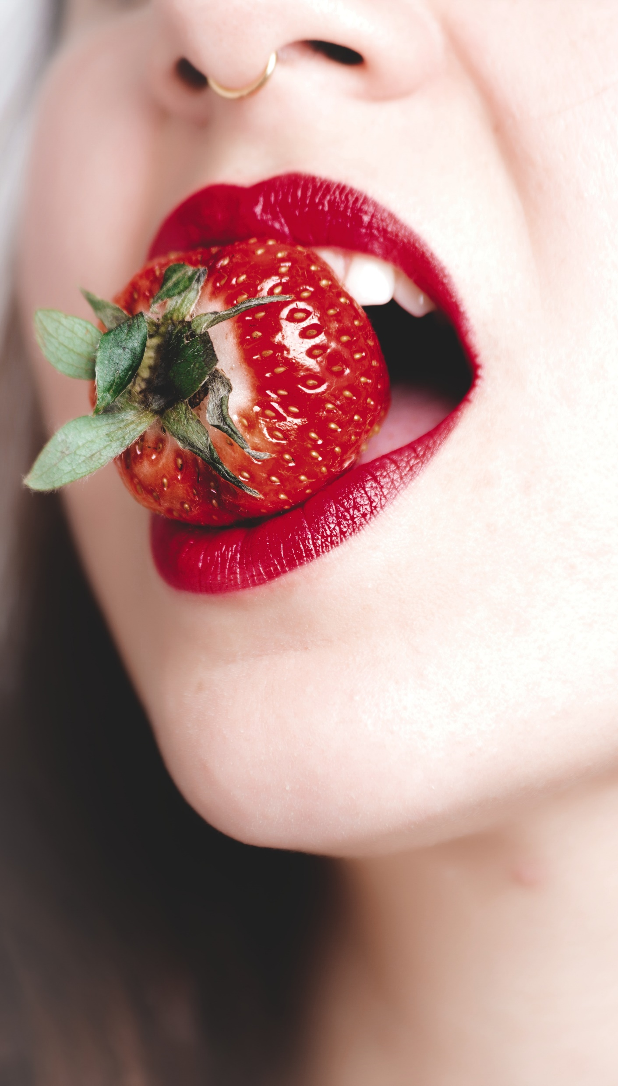
Notes:
This sweet, sexy, irresistible fruit

Slide 4
22 Pesticide Residues on Average
Notes:
But here is what they’re not telling us. When you buy strawberries at the store, your bringing home an average of 22 pesticide residues. Strawberries are number one on the dirty dozen, but they are just one example of how much pesticide is used on the food we eat and the land that we live on.

Slide 5
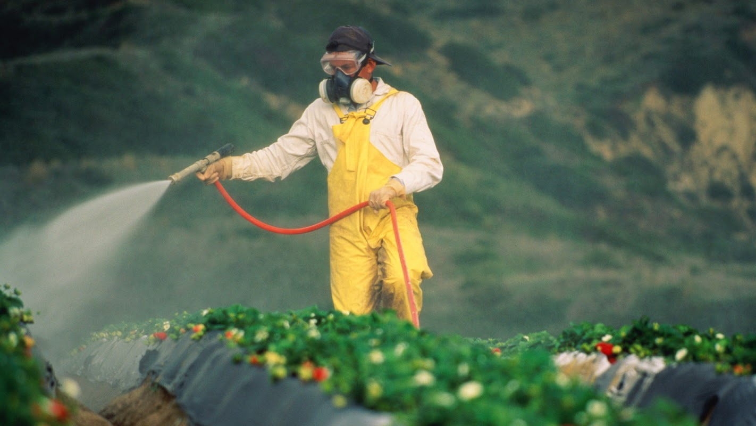
Notes:
Here’s what it looks like when they get sprayed, and it’s not just a problem for us. It’s a big problem for the farmer too.

Slide 6
$2,500/Year per Acre
Notes:
But it’s costing them an average of $2,500/year for every acre they own.

Slide 7
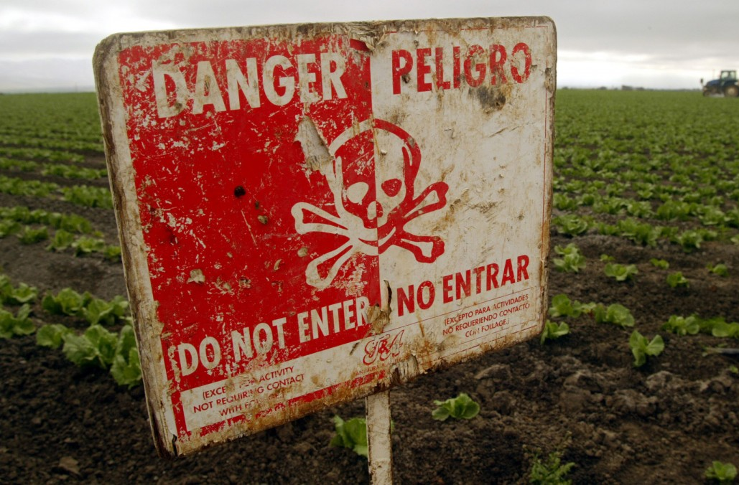
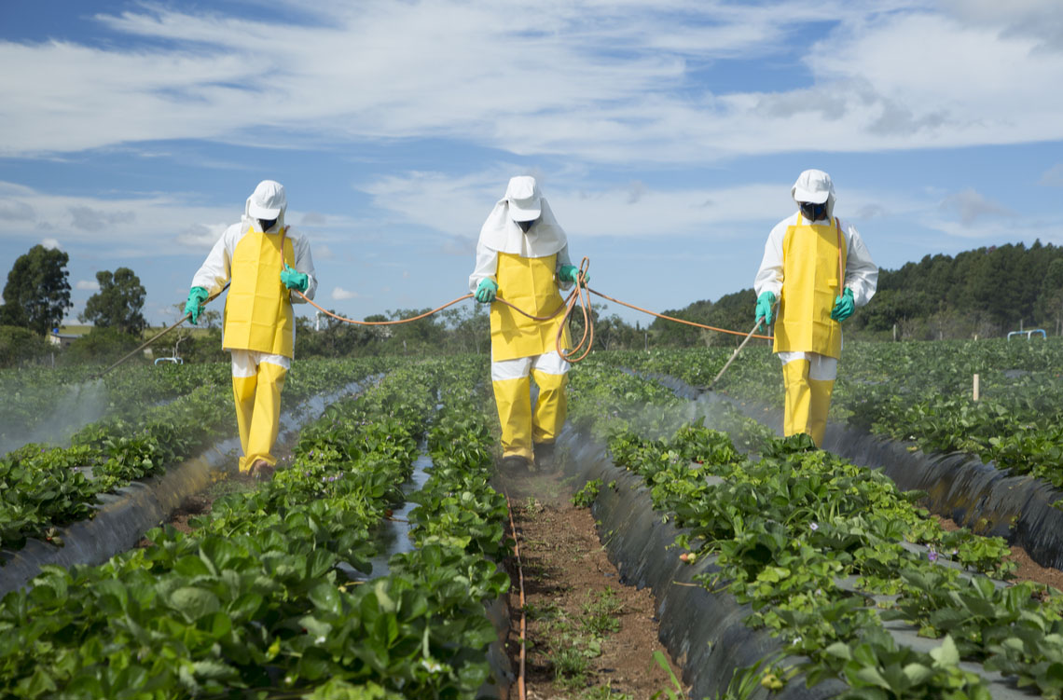
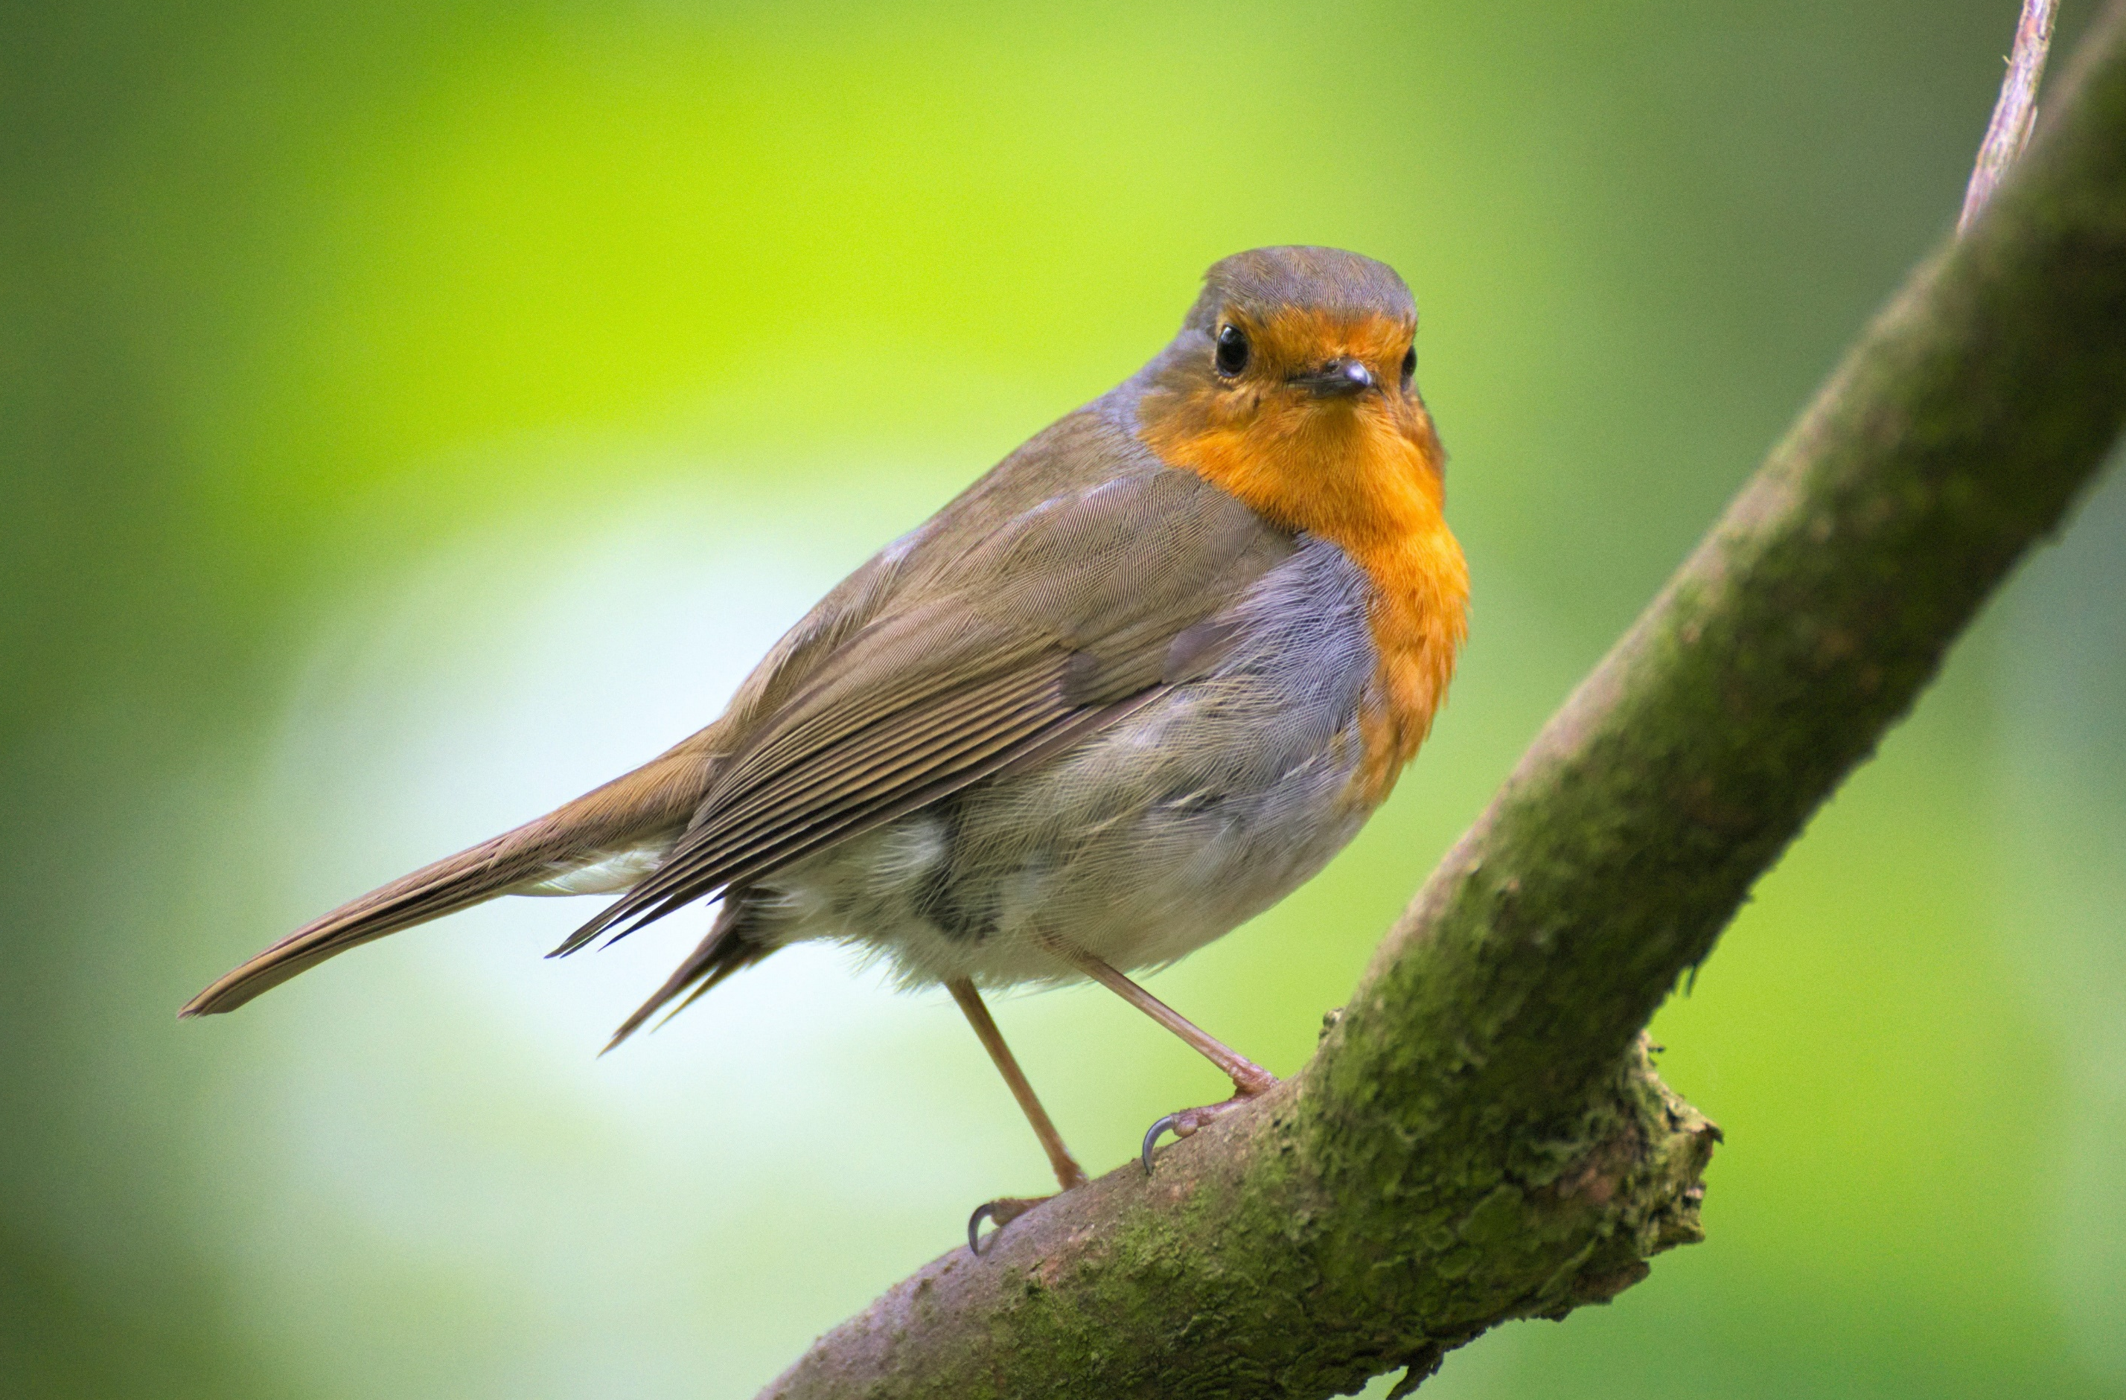
$2,500/Year per Acre
Notes:
Pathogens in the field build up resistances so they may have to spray several times which leads to uncertainty and instability in the market.
Spraying these chemicals are not only dangerous for the farmers, but they leach into the waterways raising toxicity levels for local communities and harming wildlife. It’s estimated that 70 million birds die each year due to pesticide use in the US alone.
With all of these problems associated with pesticide use why don’t more farmers grow non-chemically? The reason is there is a lot of risk associated with not using chemicals. They can lose as much as 80% of their crop to pathogens like gray mold.

Slide 8
What if there was a non-chemical alternative?
Notes:
But what if there was a non-chemical alternative just as effective as pesticides?
Until recently this wasn’t possible

Slide 9
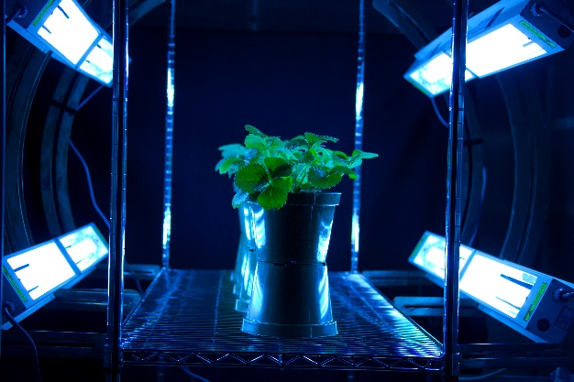
PhylloLux
FDA
15 Seconds per Plant
2 Treatments / Week
30 Hours / Week
At Night
Notes:
After nearly ten years worth of research the USDA discovered a method they call PhylloLux that uses UV-C light in place of pesticides.
They have shown that treating plants with FDA approved method it’s possible to treat strawberries as effectively as pesticides.
The method itself is quite simple, just hang the lights over the plants for 15 seconds per plant twice per week. But when start adding these number you get about 30 hours of labor and the big problem is that these treatments have to happen at night.
Now the USDA realized that these night treatments would never be commercialize so they reached out to us.

Slide 10
PhylloLux
FDA
15 Seconds per Plant
2 Treatments / Week
30 Hours / Week
At Night
+
Notes:
At TRIC Robotics we are experts in designing autonomous systems.
Through this partnership we give them a way of continuing their field studies and they give us the exclusive rights to use this technology.

Slide 11
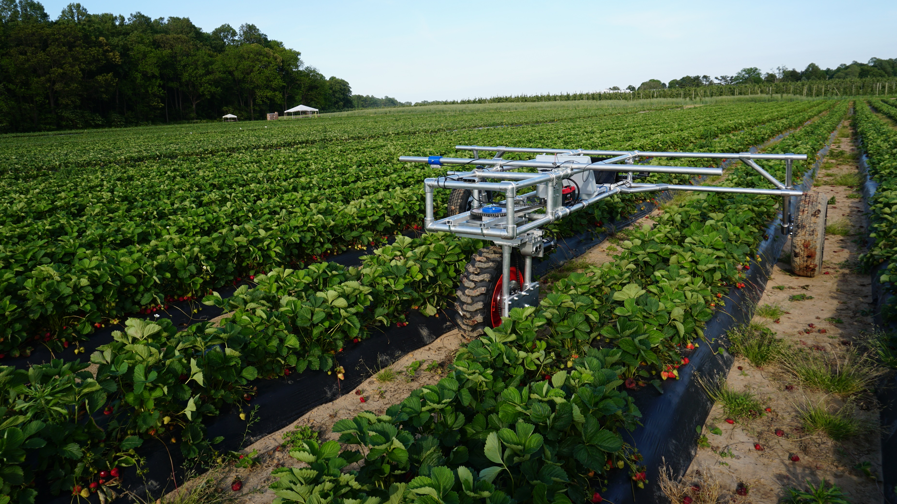
Notes:
So we developed this robot which is about the size of a car, but you can think of it as a field Roomba that sits on the side of the field using solar panels to charge its batteries during the day and at night instead of cleaning carpets it uses UV-C light to treat strawberries.
I am happy to say that we are currently working with Fifer orchards, the largest strawberry farm in Delaware and we are learning that we can do even more then just treat their field. With the onboard cameras we can capture valuable data that can provide yield estimates and streamline logistics.
Now once we show that this technology works in real fields, we can go to growers and say…

Slide 12
Non-chemical replacement for pesticides
provided as a service
Notes:
We have a non-chemical replacement for pesticides that we can provide to you as a service

Slide 13
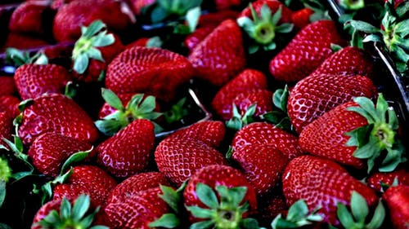
USA
Pesticides $9B+
California
Strawberry
Pesticides $32M+
Notes:
Because out treatment method can be applied to other produce we plan to expand and capture the larger pesticide industry starting in the USA where over $9 billion is spent annually.
In California alone there is over 32 million spent for pesticides on strawberries each year, but this is just the tip of the iceberg for us.

Slide 14
Cost of Goods
$7,000/robot
Robot as a Service
Revenue per Robot
$3,500/season
Return on Investment
16:1
(8-year service life)
Notes:
Instead of selling these robots we plan to capture this value in the form of a robot as a service. Initially our field technicians will deploy our robots in the field, but as we grow we hope to build a community of farmers who can act as localized service technicians and extend the reach of our company. Our platform is flexible enough to be used in many environments including high tunnels found in Canada and Mexico. The robot itself cost about $7,000 to build and in California where strawberries are grown year round we can expect a return on investment of about 16 to 1.

Slide 15
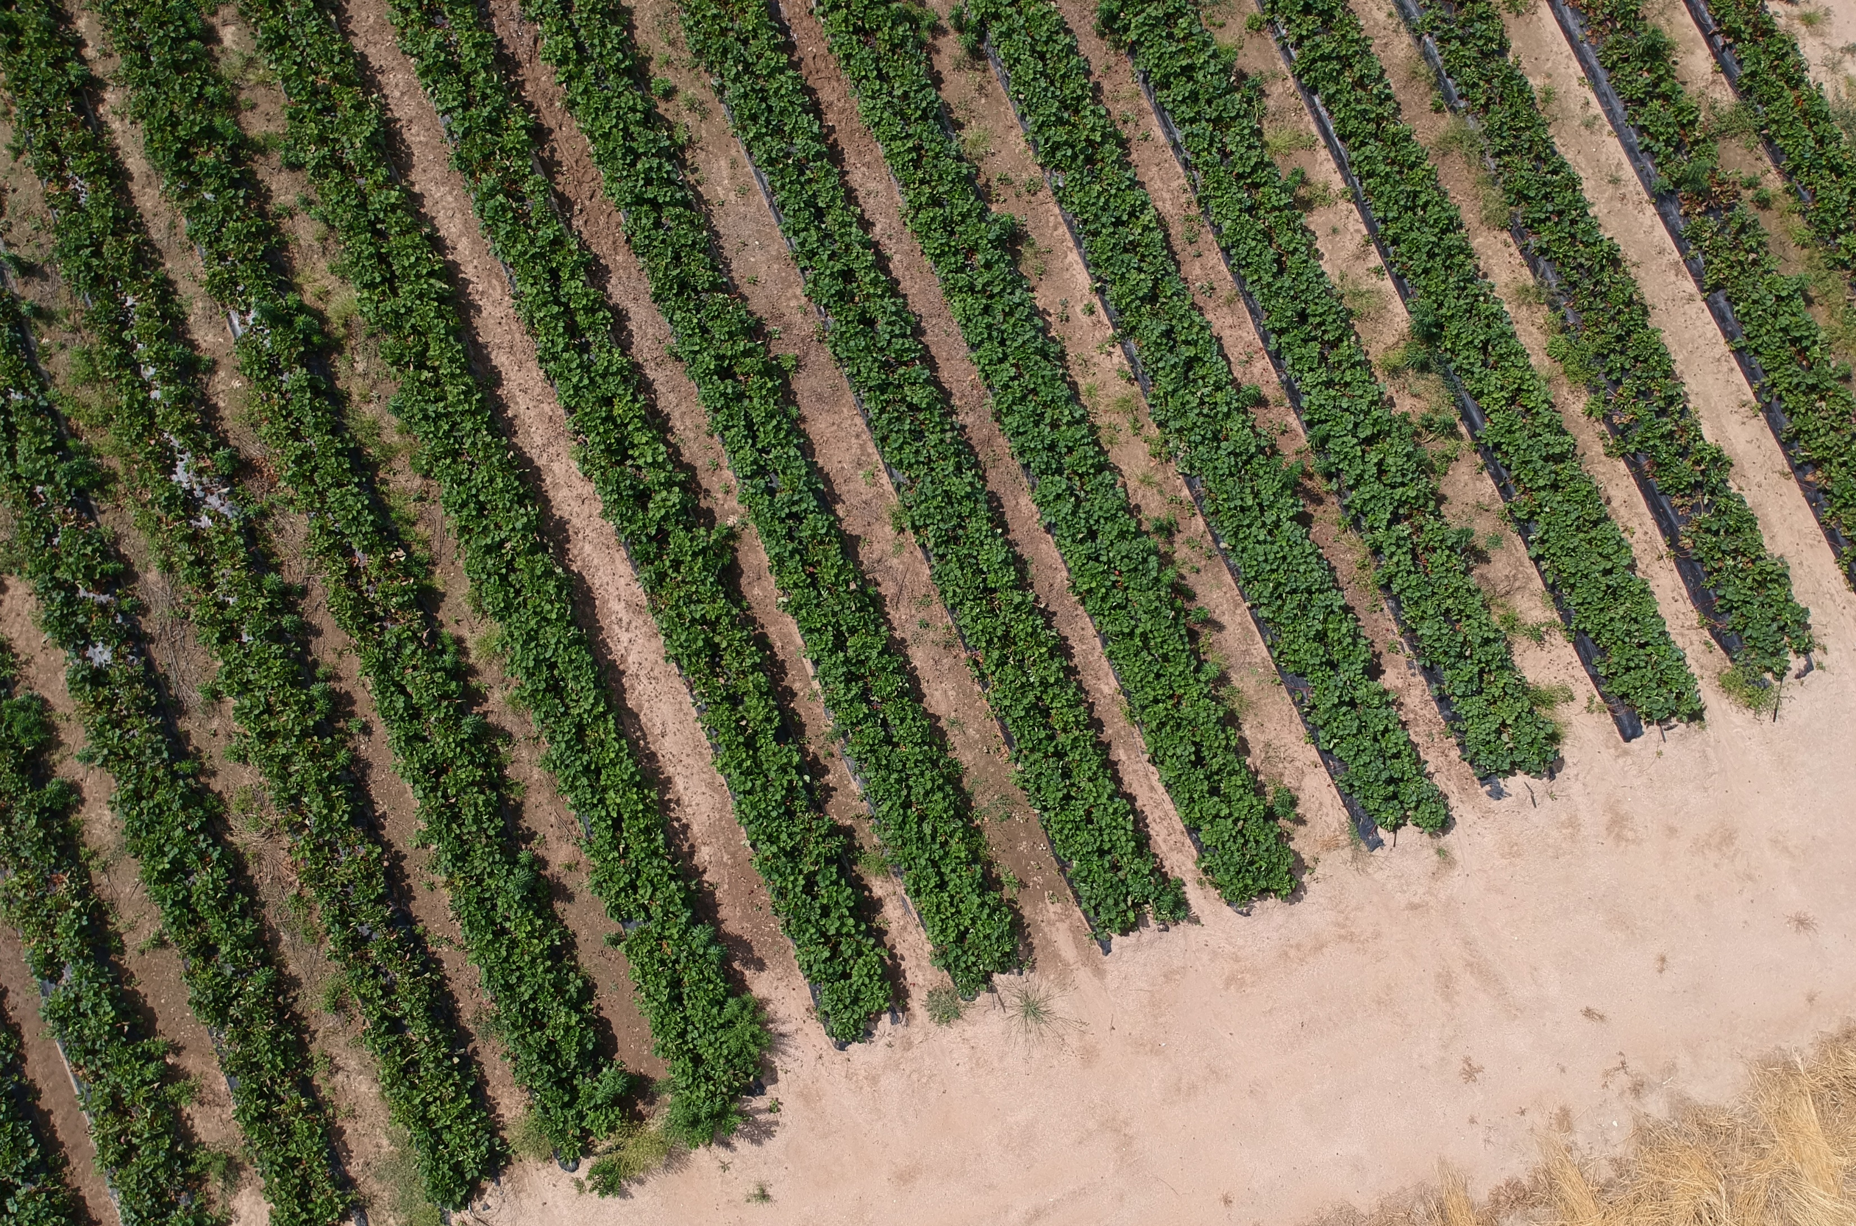
Validation
Growth
Leverage
Notes:
We are currently in the validation stage and will be planting three dedicated testing sites this year. Once we prove that our technology works in realistic field conditions we can leverage our supporters who are some of the biggest names in the strawberry industry to help us spread the word. And because farmers can make as much as 25% more profit by selling a non-chemical fruit we believe our technology will spread by word of mouth.
With this said our ultimate goal is to use our non-chemical method as a way to get many, many robots in the field. While they are treating the field they can collect valuable data that we can leverage to increase profitability. We are already seeing how yield estimates can help streamline logistics and we are excited to discover more ways to capture value from this data.

Slide 16
Non-Chemical Treatment Replacing Pesticides
Adam Stager
Founder/CEO
astager@udel.edu
Notes:
And with that I hope you can see how much impact this technology can have on how we grow our food and I’d like to open it up for any questions.

