Slide 1
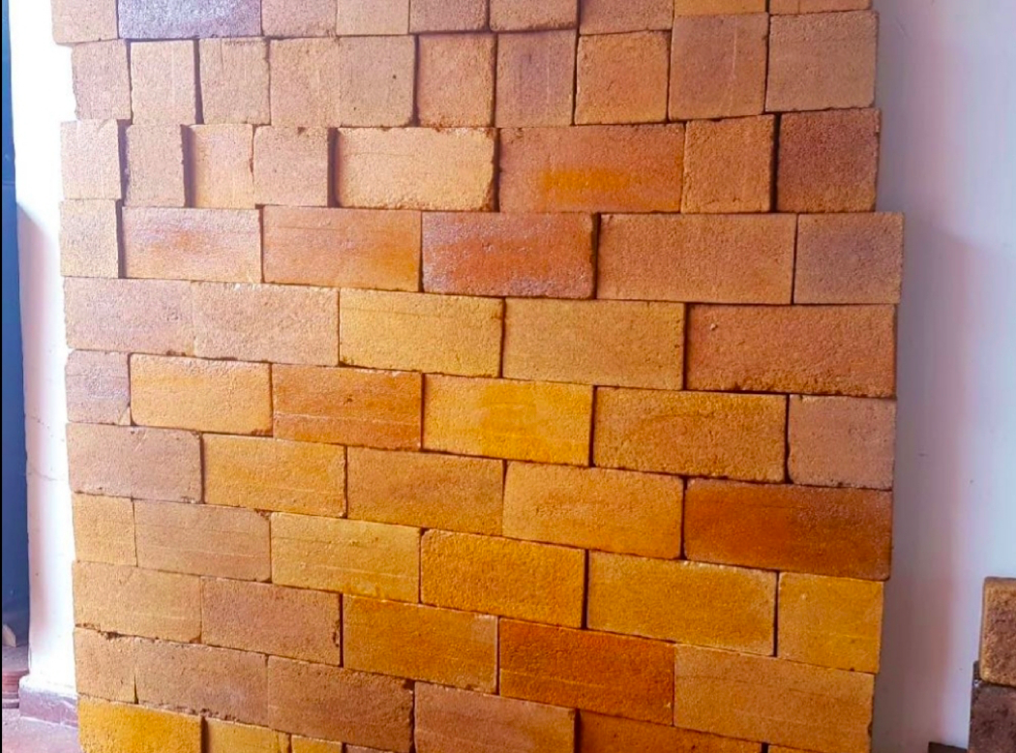
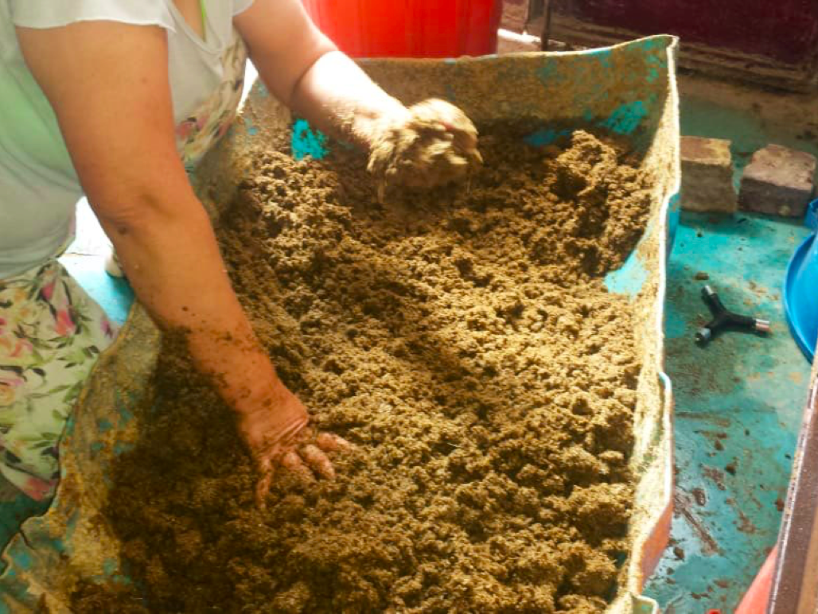
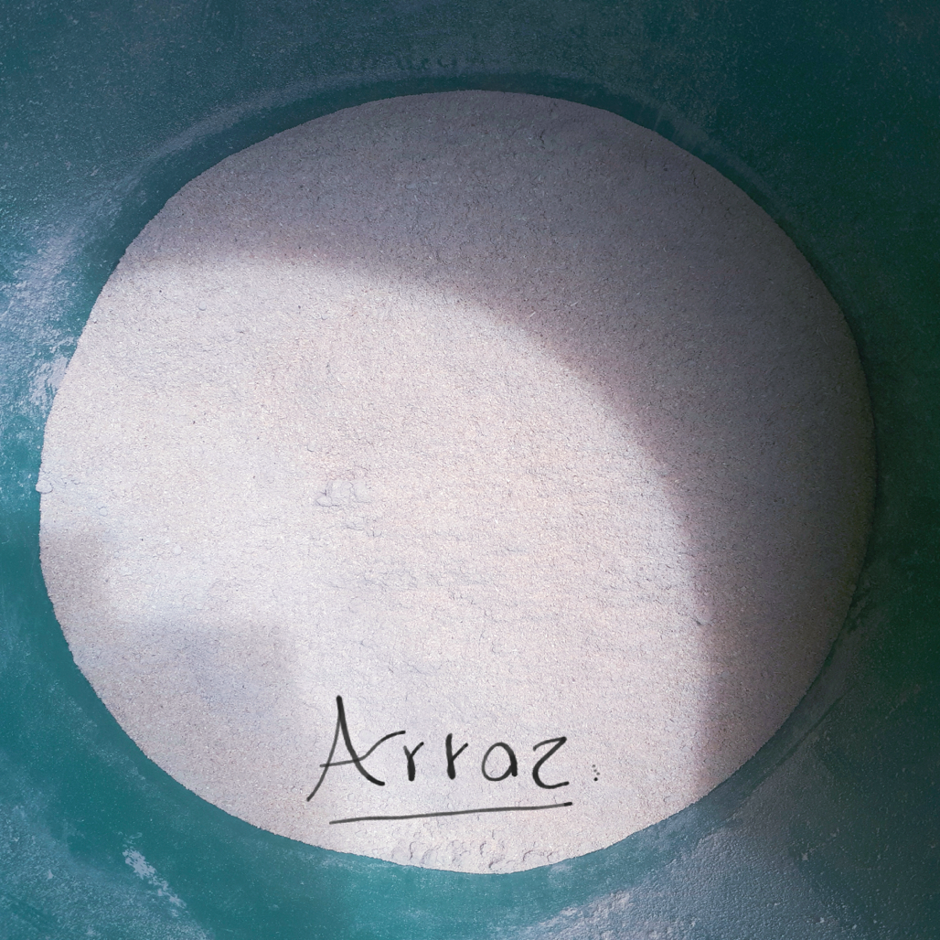
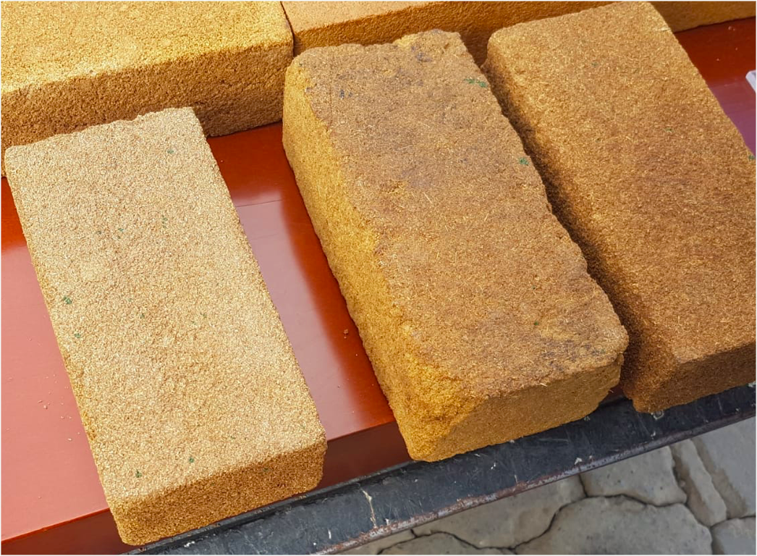
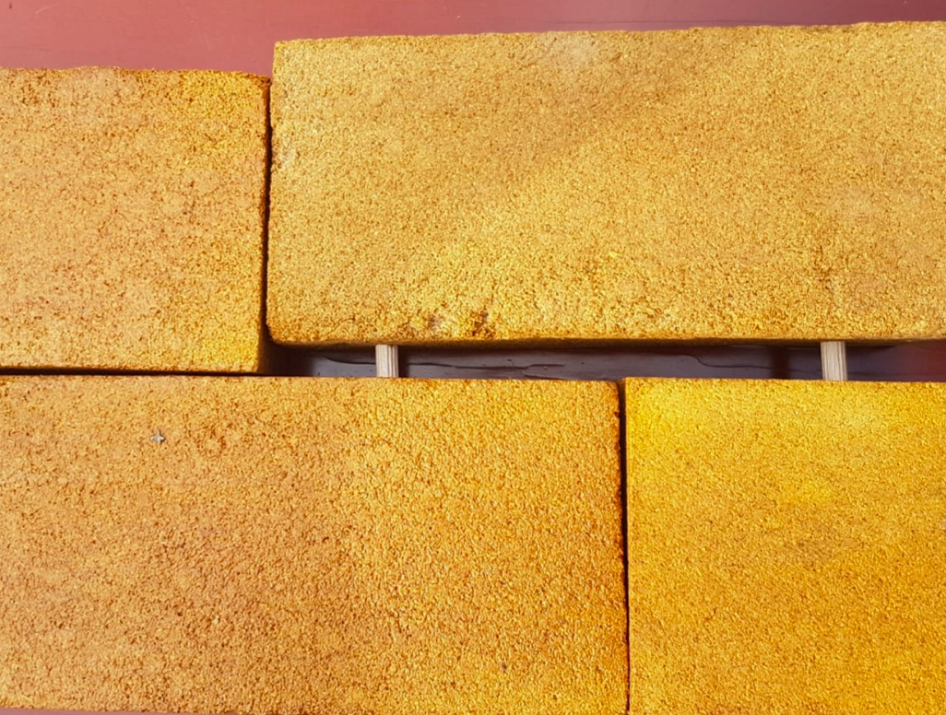
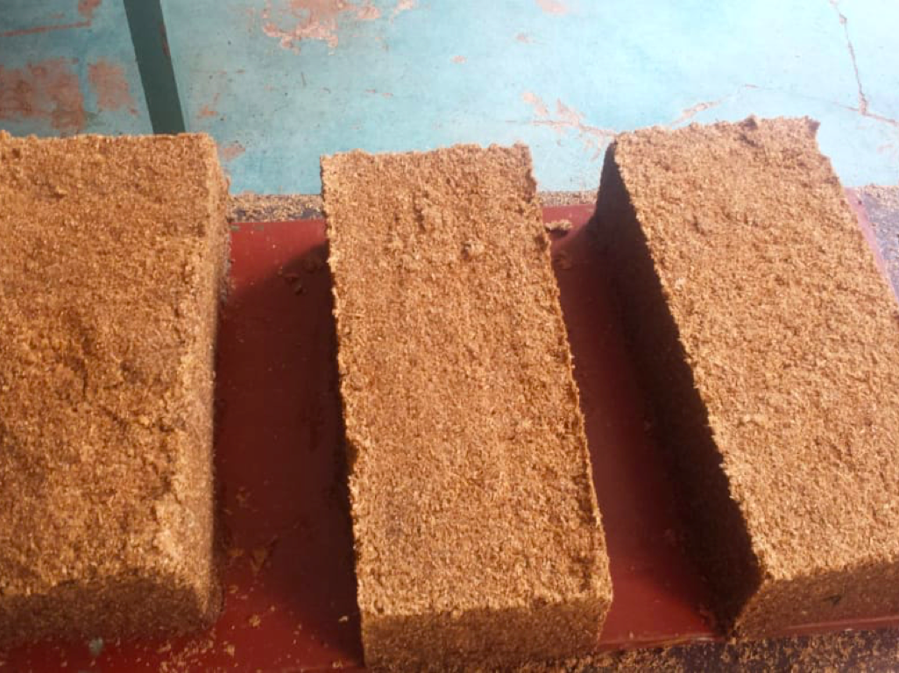
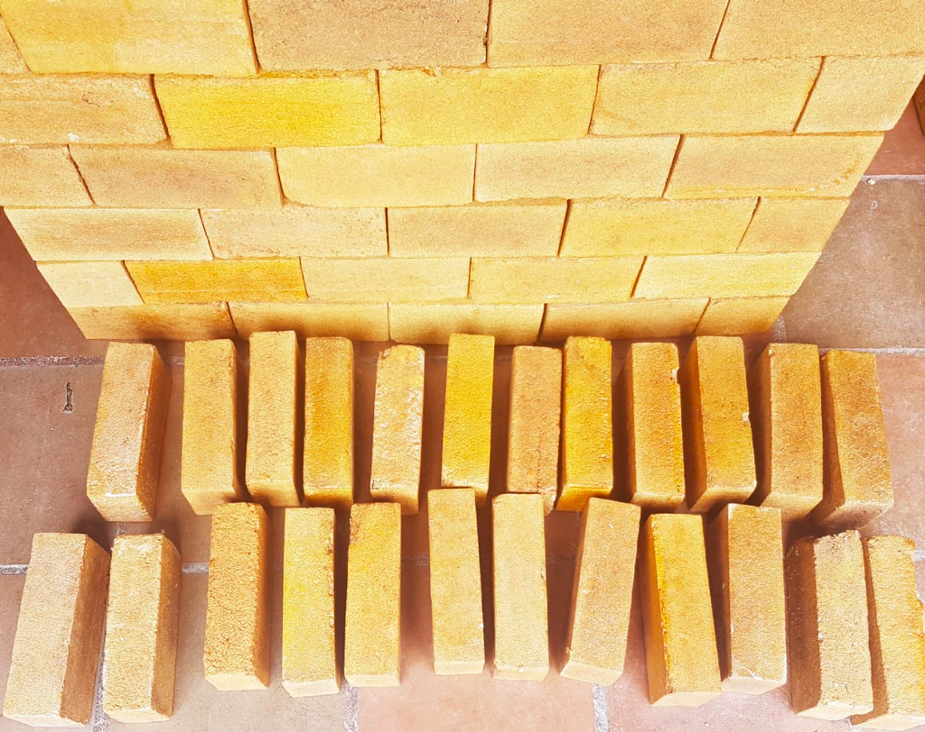
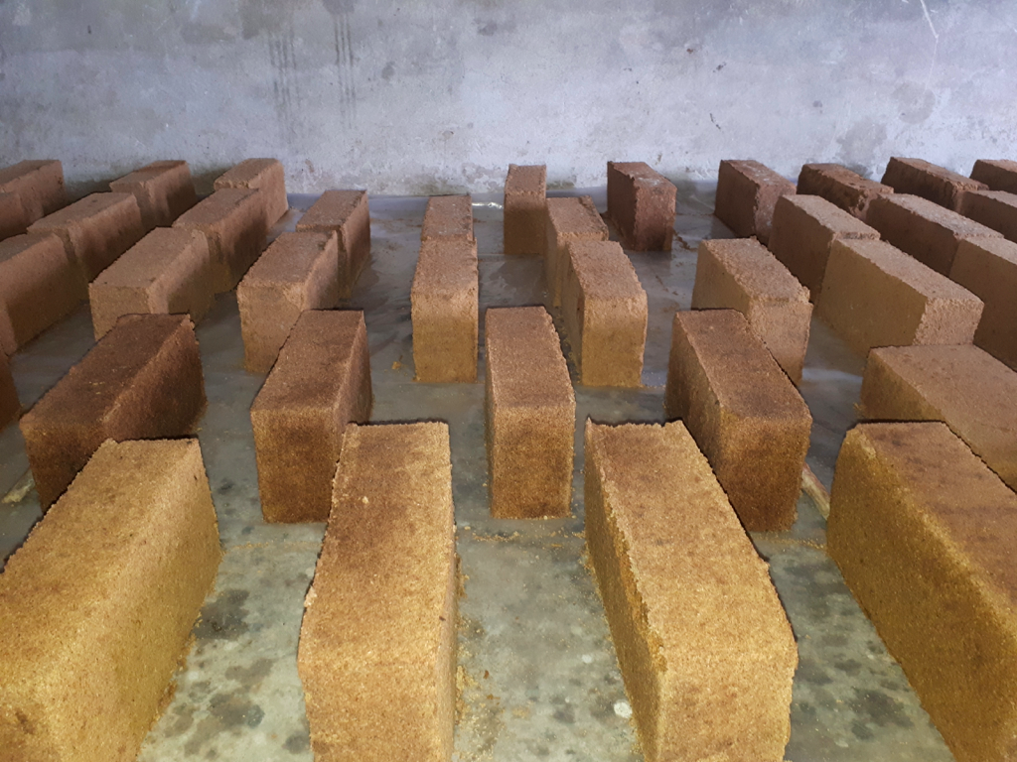
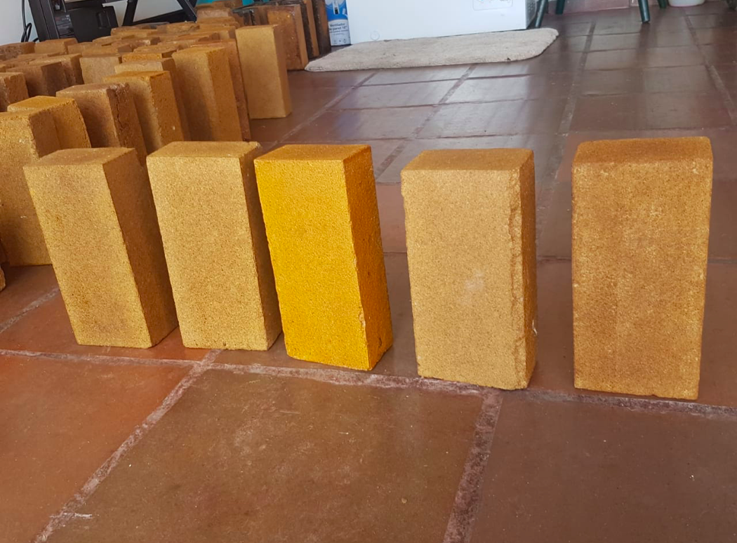
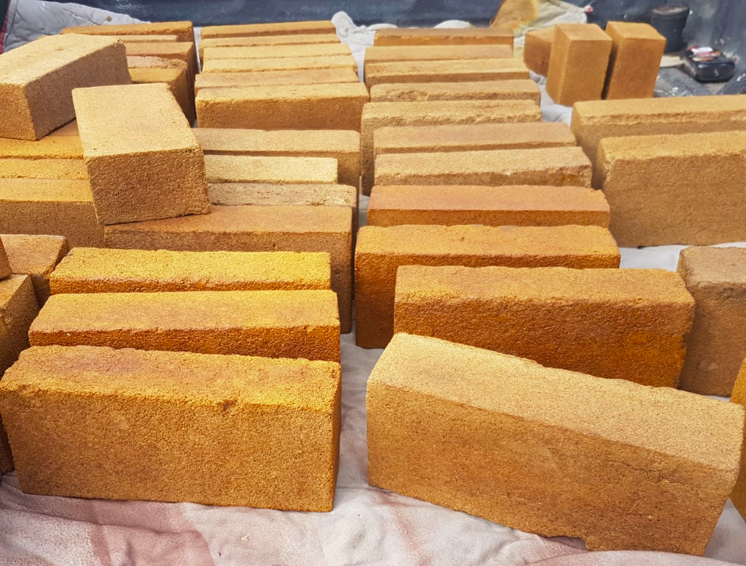
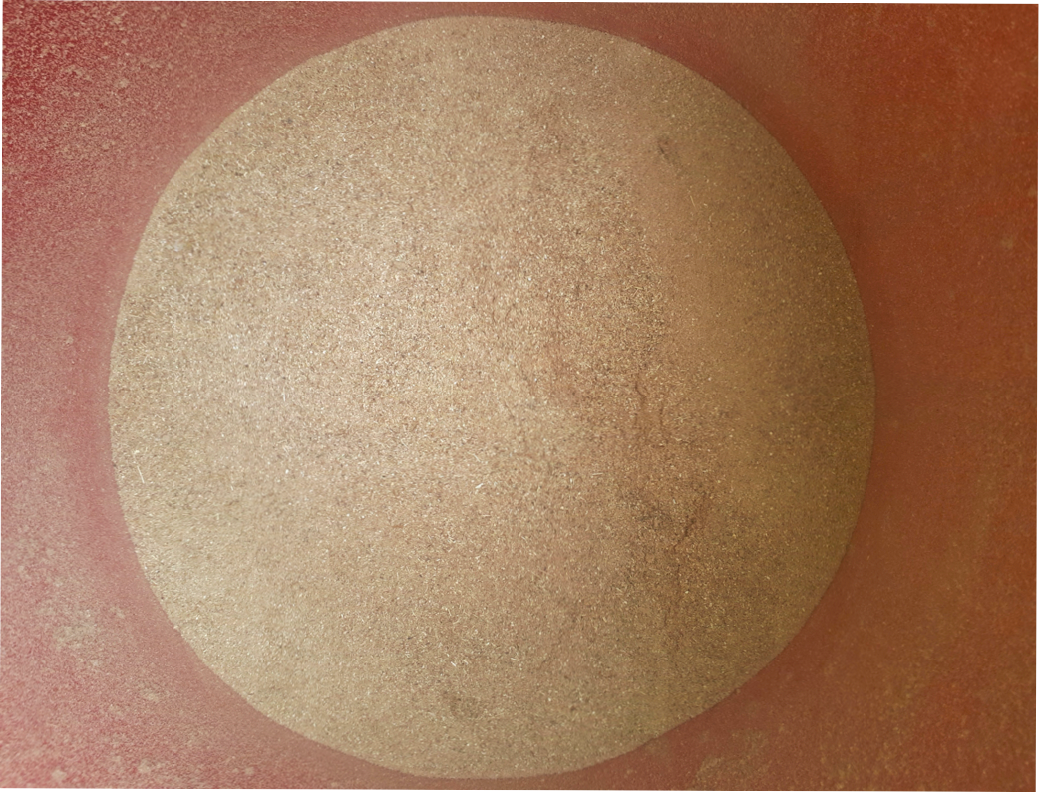
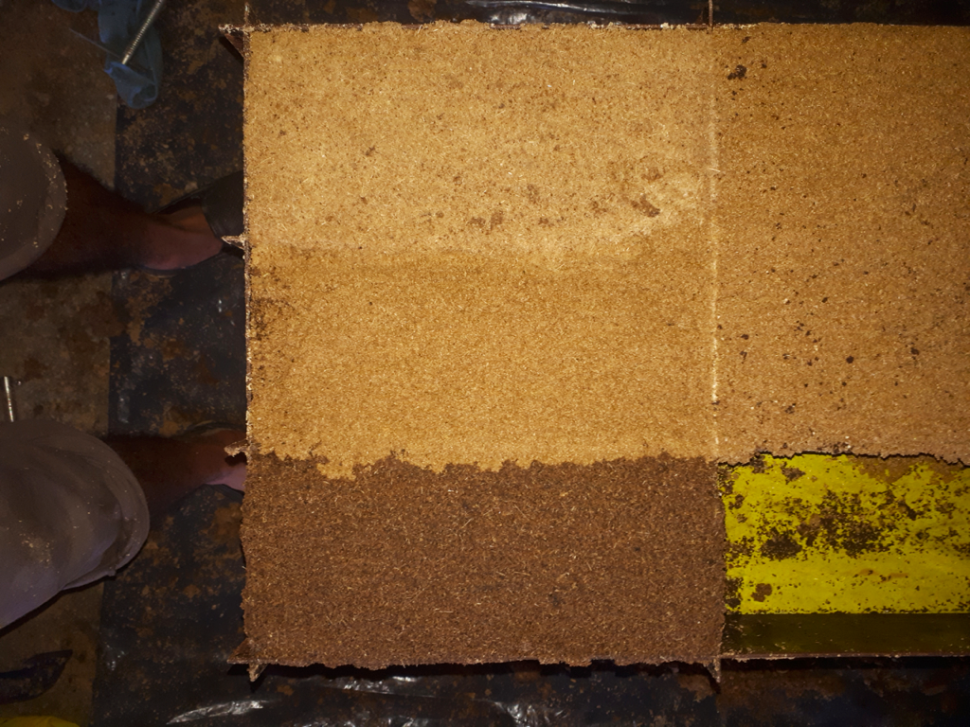
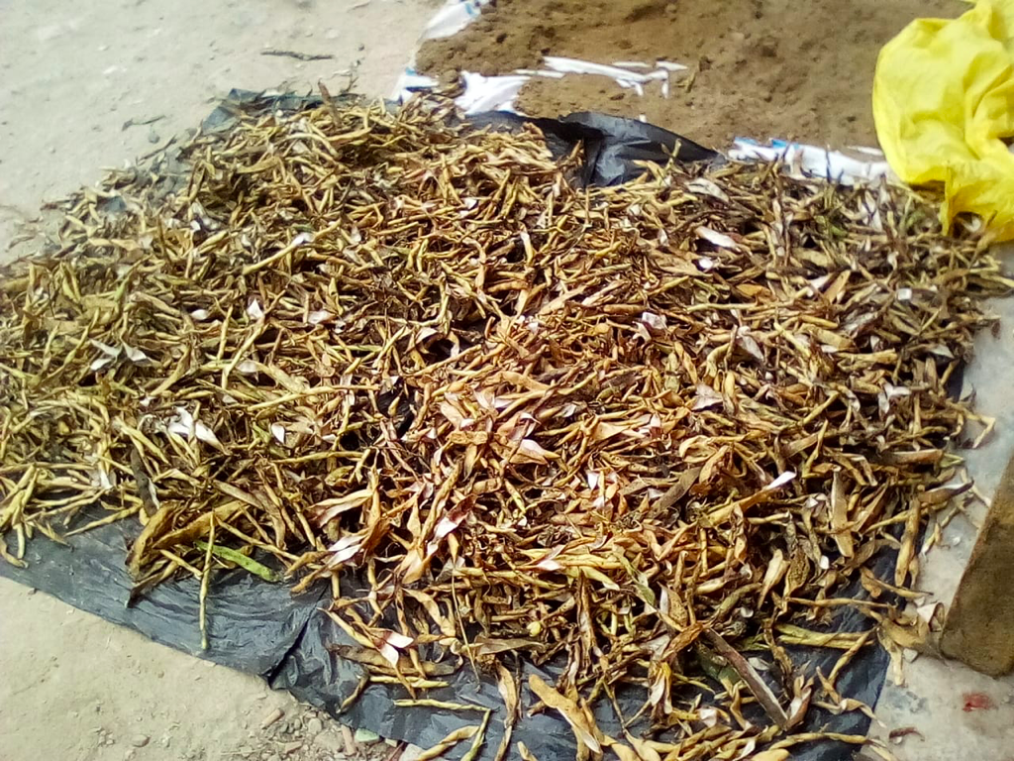

Slide 2
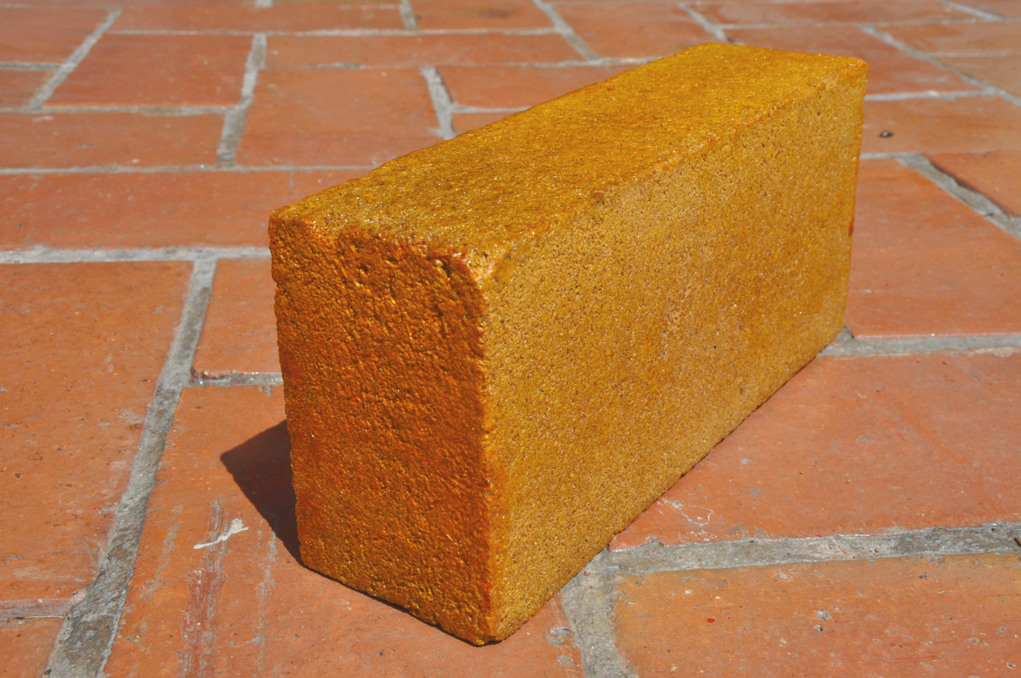
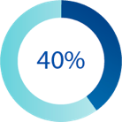
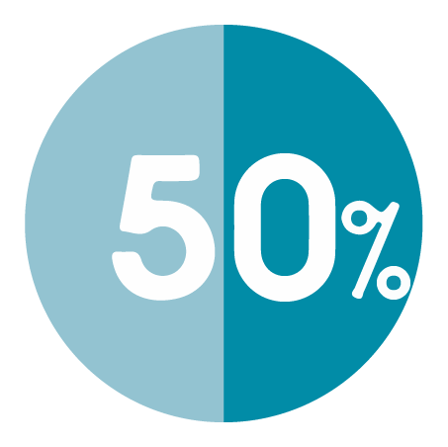
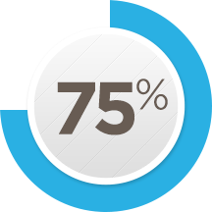
PROBLEM
Extractio of Natural resources
Waste in landfills
OPPORTUNITY
Fiber Recovery
Notes:
The construction industry alone accounts for 40% of extracted raw material use and this use is expected to double in 2060 to 167 billion tons.

Slide 3
SOLUTION
MATERIAL PERFORMANCE
CROPS FIBERS
AESTHETIC VALUES
PHYSICAL PROPERTIES
ENVIRONMENTAL ADVANTAGES
FISH WASTE
Notes:
Furthermore, a connected problem is the C&D waste
The C&D is often a significant component, representing 20–30 % and sometimes more than 50 % of the total municipal solid waste.
It is estimated that the construction industry in Canada generates about 9 million tons of C&D waste annually. This amount accounts for one-third of solid waste stream of the country
Add costs and social impacts and negative environmental impacts
These pictures are a serious reality check on the status of landfills in Canada.
References:
Transforming construction operations (August 2016, McKinsey)
https://www.mckinsey.com/industries/capital-projects-and-infrastructure/our-insights/beating-the-low-productivity-trap-how-to-transform-construction-operations-infographic
2. Construction Safety and Waste Management: An Economic Analysis (Li, Rita Man Yi)
3. An overview of construction and demolition waste management in Canada: a lifecycle analysis approach to sustainability

Slide 4
INCREASED VERSATILITY
MARKET SIZE
(SUPPLIERS & CUSTOMERS)
Corn fibers
Bean pods
Rice husks
%
Wheat
Coffee pods
Hemp fibers
Notes:
Overall, industry revenue has risen at an annualized rate of 2.6%, including forecast growth of 2.3% in 2018 which will help revenue reach $2.1 billion.
Ontario’s aggregate industry contributes almost $1.4 billion to Ontario’s economy
In 2018, white Portland cement is expected to generate an estimated 8.9% of total industry revenue. All other Portland cements, mostly the grey variety and typically less expensive than white Portland, are projected to generate 71.2% of revenue.
In 2018, white Portland cement is expected to generate an estimated 8.9% of total industry revenue.
The sale of cement clinkers is expected to account for 11.8% of industry revenue in 2018.
It is well known that mining activities result in climate related disasters, but I want to focus on GHG emissions that further contribute to climate change
GHG emissions for concrete are about 5% of global emissions and this is also because the industry is very slow to adopt new, cleaner production technologies.

Slide 5
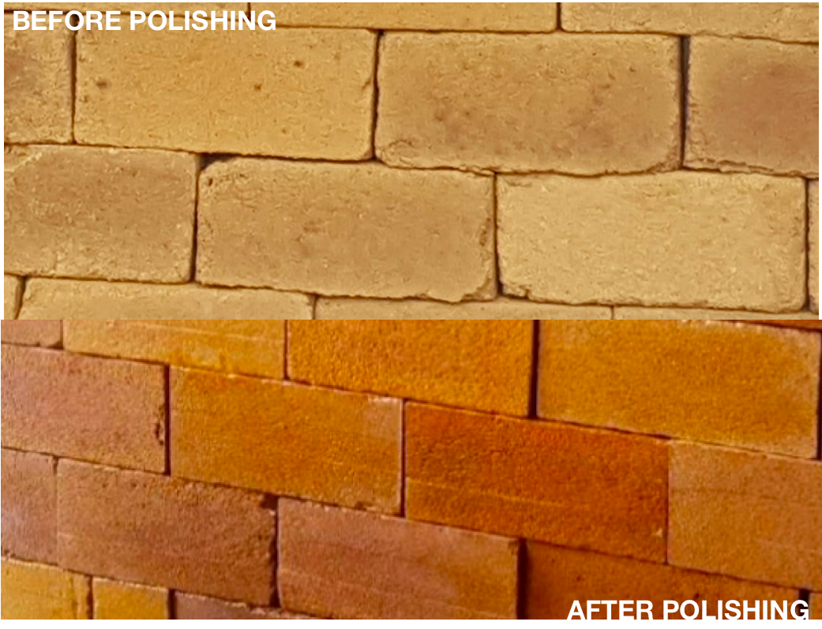
CAPITAL REQUIRED
Environmental
Social
Economic
Notes:
Lafarge operated six cement plants and two grinding plants in Canada, with annual production capacity reaching 5.8 million tonnes.
Further, it disturbs a lot of land and has additional costs associated with reclaiming land from mining activities used for cement production.
Furthermore, they have to pay additional costs per ton for the land disturbed. These costs are adding up and ultimately cost the contractor a lot more in additional costs.
Licensing, land rehabilitation and waste disposal

Slide 6
THANK YOU!!!!

