Slide 1
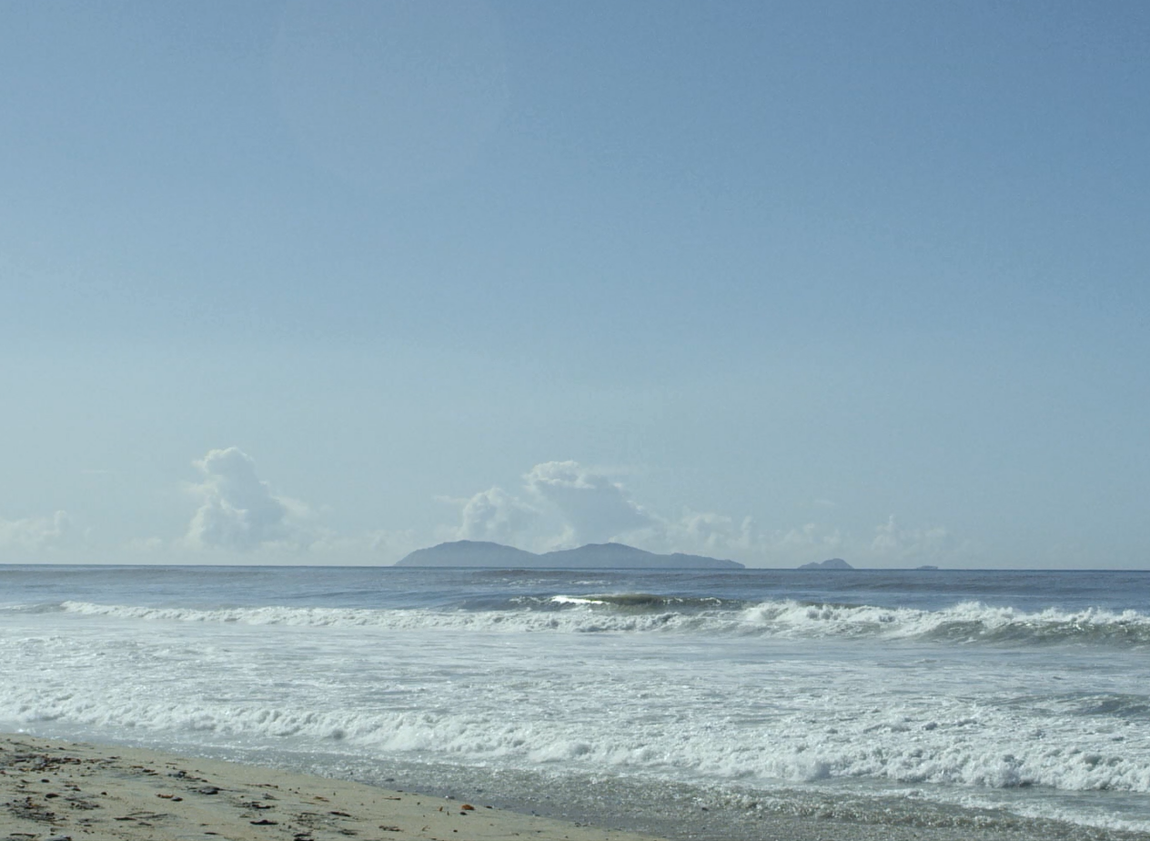
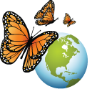
Finding Community Solutions to Reducing Marine Litter
CEC Project Overview
Catherine Hallmich
Project Lead, Commission for Environmental Cooperation
25 June 2019

Slide 2
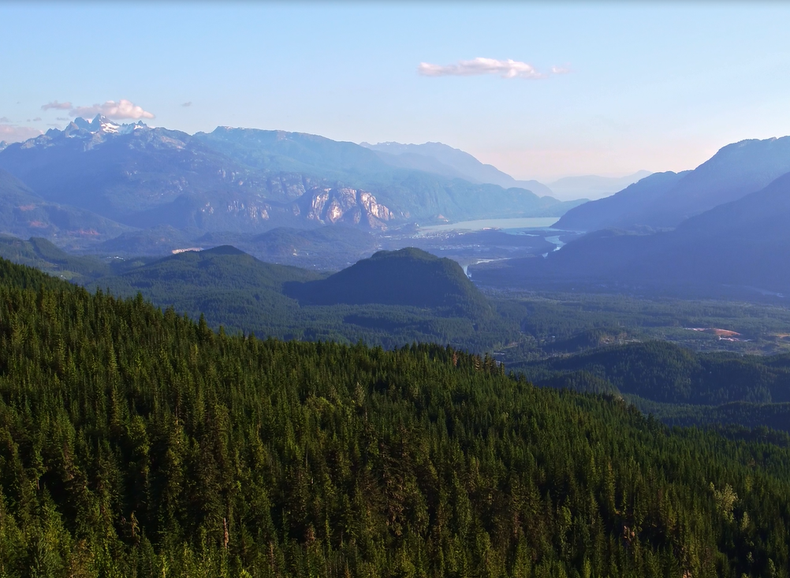
Land-based Litter
About 80% of all marine litter originates from land. Most of it is single-use plastic. Plastics are persistent and break down into small pieces that accumulate in the environment.
Litter accumulates in the watershed and enters the ocean through several pathways, including inadequate waste management, littering, and illegal dumping.
The problem is global, but solutions can be identified and implemented at the local level:
Engagement with communities in coastal areas and watersheds.
Coordination across multiple jurisdictions and stakeholder interests.
Notes:
About 80% of all marine litter originates from land. Most of it is single-use plastic. Plastics are persistent and break down into small pieces that accumulate in the environment and enter the food chain.
Marine litter and plastic is now found in every marine environment, from the polar regions to the deep ocean, and in all levels of marine life, from zooplankton to fish, seabirds, whales, and even seafood.
Every year, litter from land enters the ocean through inadequate waste management, littering, or illegal dumping in communities located in coastal areas and within a drainage basin.
Marine litter is a global problem, but since litter is introduced to ocean locally in coastal communities, it’s a good opportunity to address the problem locally. There are challenges to working at that scale however: you have to find and engage with a multitude of stakeholders who may not share the same point of view, or interests. And you often have to deal with multiple levels of jurisdiction (local, regional, state), or even across borders.
This is the approach taken by the CEC in our project over the two years to engage local with caostal communities to address marine litter at the watershed level.

Slide 3
Implementation Approach
Multi-stakeholder Engagement
Describe the local marine litter status
Identify and engage local marine litter stakeholders
Convene stakeholders to identify solutions to local marine litter
Design and implement low-cost and low-technology solutions
Share the results and replicate the approach in other communities across North America
Notes:
It’s a process that was adapted from the US EPA’s trash free waters program. It can be applied across jurisdictions, in our case on international borders, and can be replicated in other coastal communities and watersheds across North America.
Describe the local marine litter status
Identify and engage local marine litter stakeholders
Convene stakeholders to identify solutions to local marine litter
Design and implement low-cost and low-technology solutions
Share the results and replicate the approach in other communities across North America

Slide 4
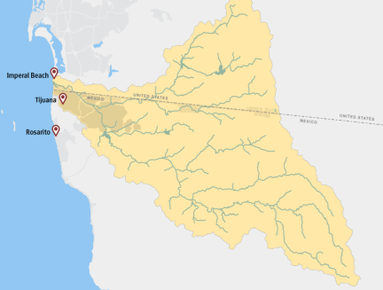
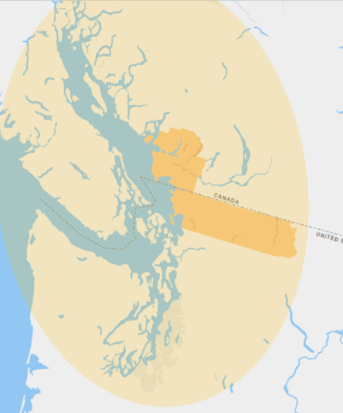
CEC Project Pilot Sites
Tijuana River watershed
US-Mexico border
Communities:
Imperial Beach, CA
Tijuana and Rosarito, BC
Salish Sea watershed
US-Canada border
Communities:
Metro Vancouver, BC,
Whatcom County, WA
Metro Vancouver
Whatcom County
Notes:
This is what the CEC has done. In coordination with our government partners, we selected two watersheds: the Tijuana River watershed and the Salish Sea watershed. Both watersheds sit on an international border and are both ecologically rich, economically important transboundary areas.
Tijuana River Watershed
The Tijuana River watershed is on the US-Mexico border. 75 percent of its area is in Mexico (Baja California) and 25 percent is in the United States (California). Near 3 million residents live within its boundaries, with the majority of them residing in Mexico. The Tijuana River flows from Mexico and through the United States before reaching the ocean in Imperial Beach, California. Along its path, the river picks up litter that ends up in the estuary or in the ocean. For this project, we focused on the municipalities of Imperial Beach in CA, and Tijuana and Rosarito, BC.
Salish Sea watershed
The Salish Sea watershed is located on the US-Canada border. Over 7 million people live within the watershed. And we’ve focused on the Metro Vancouver and Whatcom County regions, which comprise near 3 million people, 28 municipalities and several Tribes and First Nations.
For the rest of my presentation, I will give you an overview of what we accomplished with the CEC in each site.

Slide 5
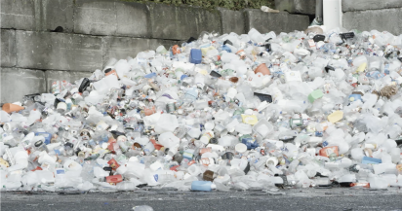
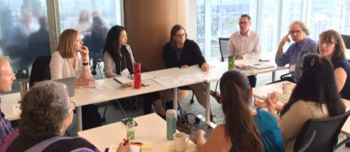
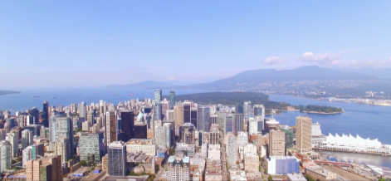
Salish Sea Watershed
Consultations
Review of land-based litter and meetings with stakeholders from Metro Vancouver and Whatcom County in Spring 2018.
Litter of concern identified: single-use plastics, cigarette butts, microplastics from textiles, particles from tires and artificial turf fields, and litter from stormwater.
Current and proposed efforts shared between jurisdictions and stakeholder groups.
25 local actions identified, including six that are low-cost and low-technology. 3 actions implemented.
Notes:
Working through a local NGO, Ocean Wise,
We conducted a review of the marine litter status in Spring 2018.
We did outreach to stakeholders and organized a meeting in Spring 2018
Litter of concern identified: such as single-use plastics, cigarette butts, microplastics from textiles, particles from tires and artificial turf fields, and litter from stormwater.
There was a lot of sharing between the stakeholders of current and proposed efforts.
In the end, 25 actions were identified, including six that are low-cost and low-technology (which were criteria for the CEC project). Of these, 3 actions were implemented as part of the CEC project.
Low-cost and Low-technology Actions to Prevent Litter in the Salish Sea Watershed
Create a “skip the line” system at coffee shops for those with a reusable mug.
Promote the use of a recycling bin sorting game to improve sorting performance.
Inform the public that cigarette butts contain plastic and harm the environment.
Create cigarette butt-free zones with local partners.
Educate the public about microfibers and on how to reduce their shedding from clothing.
Conduct a characterization of litter in storm drains.

Slide 6
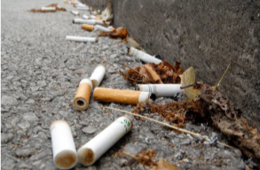
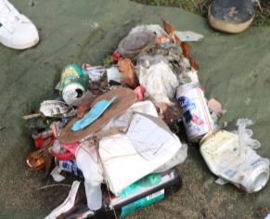
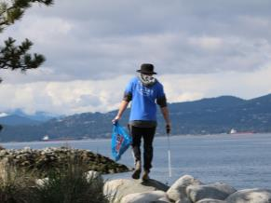
Salish Sea Watershed
Action 1: Citizen Science Litter Collections
Citizen science events at Jericho Beach Park, in Vancouver, British Columbia, and in Heritage Park, in Bellingham, Washington
Litter items identified using the Great Canadian Shoreline Cleanup methodology. Most commonly found litter items:
cigarette butts
single-use plastics (e.g., food wrappers, bottle caps, and plastic bags)
tiny pieces of foam
Single-use plastic was the most common item of land-based litter and can easily end up in the ocean via streams, rivers and stormwater.
Notes:
The first action was citizen science litter collection events. There are events where you ask a groups of volunteers to collect and record the type and quantity of litter in a given area. This is a strong engagement tool to raise awareness, and it also generates useful data for decision-making.
Two events were organized at Jericho Beach Park, in Vancouver, British Columbia, and in Heritage Park, in Bellingham, Washington, using the methodology of the Great Canadian Shoreline Cleanup, which is a program used across Canada.
At these events, cigarette butts, single-use plastics (e.g., food wrappers, bottle caps, and plastic bags) and tiny pieces of foam were among the most commonly found litter items.
At both sites sampled within the study area, single-use plastic was the most common item of land-based litter and can easily end up in the ocean via streams, rivers and stormwater.

Slide 7
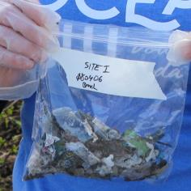
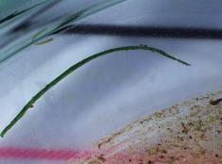
Salish Sea Watershed
Action 2: Micro- and Macro- Plastic Fragments Study
Micro (< 5 mm) and small macro (≥ 5 mm) plastic fragments collected at Jericho Beach Park and analyzed.
Micro plastic fragments present in all soil samples:
Mostly polyester and polypropylene (80% of fragments were polyester fibers).
Abundance of microplastics is not correlated to proximity to high traffic or litter areas. Large green fibers collected adjacent to an artificial turf sports field.
Small macro plastic fragments identified:
Single-use plastics (polyethylene, propylene, PVC), including candy bar wrappers, straws, lids, cigarette filters, and thin plastic bags.
Notes:
The second action was to study the presence and type of micro- and macro-fragments of plastics in a public park.
The fragments were analyzed in a laboratory to identify their polymer type and origin. The study found that small plastic fragments of various types and sizes were present throughout the park, and could easily be carried from there by runoff or wind into the Salish Sea.
80% of the fragments were fibers, and of these, polyester was the most common polymer, followed by polypropylene.
Abundance of microplastics between different sites was not correlated to proximity to high traffic or litter areas. However, large green fibers were collected adjacent to an artificial turf sports field, making it the likely source.
Polyester: Synthetic textiles, curtains, furniture, carpet
Polypropylene: Chip bags, straws, insolated coolers, toys, cups, plates, cutlery, fruit and vegetable packaging, and bottle caps.
Small macro plastic (≥5mm) fragments identified: Single-use plastics (polyethylene, propylene, PVC), including candy bar wrappers, thin plastic bags, straws, lids, cigarette filters. Day users. Again, easily transportable to nearby shoreline by runoff or wind.

Slide 8
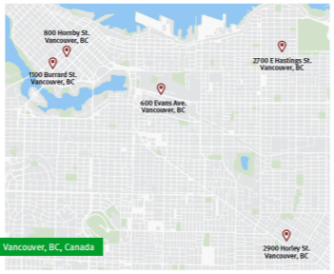
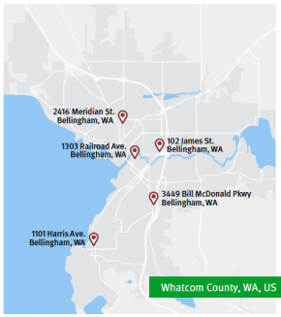
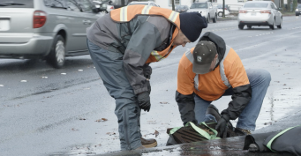
Salish Sea Watershed
Action 3: Storm water drain
Amount, types and sources of litter entering stormwater infrastructure studied in Vancouver and Bellingham.
Litter in ten storm drains (5 in each city) was collected over a period of 2 weeks.
Most common type of litter in both cities: cigarette butts, paper scraps and single-serving food packaging.
More litter found in Vancouver, most items captured after heavy rainfall and in commercial areas.
Storm drains can act as pathways for land-based litter to enter the Salish Sea watershed.
Notes:
In close collaboration with city staff in Vancouver and Bellingham, a pilot study was conducted to gather information on the amount, types and sources of litter entering stormwater infrastructure. Litter in ten storm drains (5 in each city) was collected over a period of 2 weeks and categorized according to the Great Canadian Shoreline Cleanup data card.
The most common type of litter found in both cities was cigarette butts, followed by paper scraps and take-out food packaging. Food-packaging litter was typically most prevalent in commercial areas near fast food restaurants and other businesses selling packaged food for takeout. Overall, more litter was found in Vancouver, with the most items captured after heavy rainfall and in commercial areas.
This study shows that storm drains can act as pathways for land-based litter to enter the Salish Sea watershed.
This is it for the Salish Sea watershed.

Slide 9
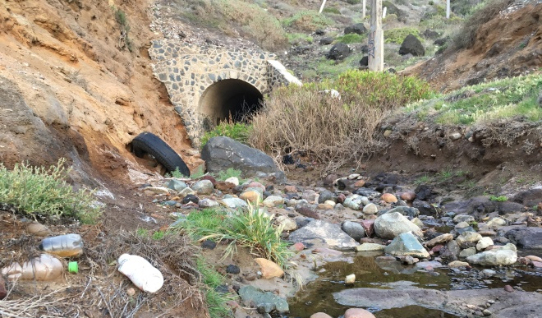
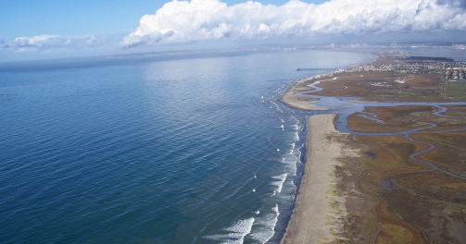
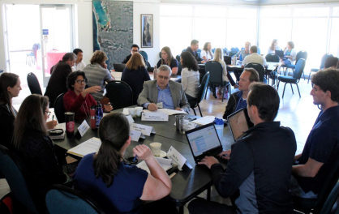
Tijuana River Watershed
Consultations
Review of land-based litter in Imperial Beach, Tijuana and Rosarito, and meetings with their stakeholders from in Spring 2018.
Litter of concern identified: plastic bottles, plastic bags, polystyrene and cigarette butts.
Current and proposed efforts shared between jurisdictions and stakeholder groups.
15 local actions identified, including 7 low-cost and low-technology. 3 pilot actions were implemented.
Notes:
Working through the local NGO WILDCOAST, we identified and convened stakeholders from Imperial Beach, Tijuana and Rosarito, in spring 2018, and presented the status of land-based litter in the area.
They identified and shared knowledge on several types of litter of concern: plastic bottles, plastic bags, polystyrene and cigarette butts. And current efforts and ideas from both countries to reduce this liter.
The stakeholders proposed over 15 actions, including 7 that are low-cost and low-technology. Of those, 3 actions were implemented for the project.
Low-cost and Low-technology Actions to Prevent Litter in the Tijuana River Watershed
Design an awareness campaign to reduce cigarette butts on Rosarito beach
Create conservation-themed murals in public areas in Rosarito
Hold art-based community awareness events in Imperial Beach
Install trash boom in Tijuana
Provide environmental education to youth, industry and the public
Visit litter hotspots in the Tijuana River valley and throughout the watershed
Conduct characterization of litter accumulated in the Tijuana River estuary

Slide 10
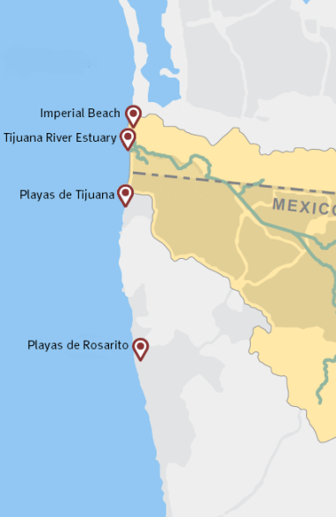
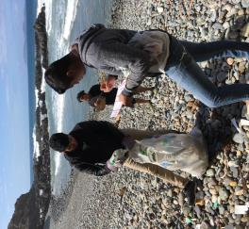
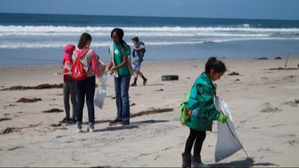
Tijuana River Watershed
Action 1: Citizen Science Litter Collection
Events organized at four beaches on both sides of the border.
The type and amount of litter varied from site to site:
In the US : single-use plastic (food wrappers, plastic bottle caps and straws) and cigarette butts.
In Mexico: additional litter items such as glass and plastic bottles, foam cups and plates, reflecting different litter sources and local regulations.
Notes:
The first action was to organize four citizen science events in four beaches on both sides of the border, using a methodology similar to the Great Canadian Shoreline Cleanup, adapted from NOAA and Ocean Conservancy.
The type and amount of litter varied greatly from site to site. On the US side, the most common litter was single-use plastic (e.g., food wrappers, plastic bottle caps and straws) and cigarette butts. Additional litter items, such as glass and plastic bottles, foam cups and plates were found on the Tijuana and Rosarito public beaches, reflecting different litter sources and local regulations.

Slide 11
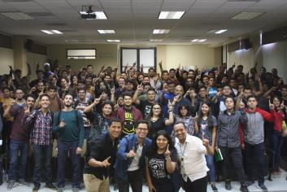
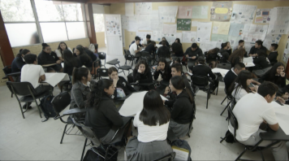
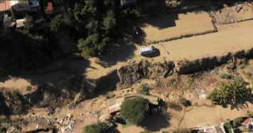
Tijuana River Watershed
Action 2: Environmental Education
Education workshops were presented in schools and universities, at industry association meetings and public events in Tijuana and Imperial Beach.
Presentations were given to over 1,300 students and private sector representatives, with an additional 1,500 from the public.
Field trip organized with university students to the trash boom located in Border Field State Park just north of the border to see the large amount of trash that is carried by the river across the border and into the estuary.
Notes:
The second action aimed at raising awareness on the marine litter issue with youth, industry and the general public through education.
A total of 13 education workshops were presented in schools and universities, and at industry association meetings and public events in Tijuana and Imperial Beach. Presentations were given to over 1,300 students and private sector representatives, with an additional 1,500 from the public. To complement this effort, a group of university students was brought to the trash boom located in Border Field State Park just north of the border to see the large amount of trash that is carried by the river into the estuary.

Slide 12
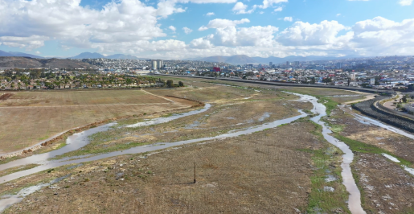
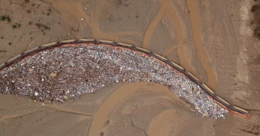
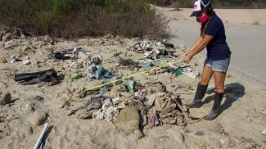
Tijuana River Watershed
Action 3: Litter Characterization in the River Basin
Litter characterization conducted on the US side of the border, in Border Field State Park, by the trash boom.
Two classifications used: State of California (to complement Border Field State Park data) and Ocean Conservancy/NOAA (to compare with existing citizen science data across the region).
Data contributes to long-term monitoring of changes in litter flow across the border and informs the development of a binational mitigation program.
Consultations and a framework for installing a trash boom in Tijuana’s Los Laureles sediment basin presented to the City of Tijuana.
Notes:
The third action was to identify the litter that comes from across the border through the Tijuana River and into the California State Park. Two classification methodology were used, the first one from CalRecycle (State of California) to complement annual Border Field State Park data, and the second one using the same as for citizen science events.
With both methods, the results showed a predominance of plastic litter: many domestic items, plastic bottles. Although the source of this litter has not been confirmed, it is believed that a lot of this domestic litter could be reduced by improving solid waste management in communities located upstream of the study area in Tijuana.
These data will contribute to long-term monitoring of changes in litter flow across the border over time and under various conditions, and inform the development of a binational mitigation program.
In parallel to this, installing a trash boom on the Mexican side of the border, in Tijuana’s Los Laureles, was studied and discussed by the City of Tijuana. A boom installed in Tijuana would act as an additional barrier to litter in the Tijuana River. Various scenarios considering technical specifications, permitting, ownership, maintenance and storage were studied and provided to the City of Tijuana for consideration.

Slide 13
Conclusions
Reducing litter by promoting behavioral changes through education campaigns and investigating sources of litter.
Preventing litter from reaching the ocean by designing physical barriers that prevent litter from entering waterways or the ocean.
Through this project, the CEC and its partners:
Improved coordination and networking between stakeholders and jurisdictions.
Created new knowledge and capacity for communities to take action and continue marine litter reduction efforts in each region.
Piloted an approach that can be replicated in other coastal community areas and watersheds.
Notes:
As conclusion, in both regions, stakeholders identified and implemented two main types of low-tech, low-cost actions – which are complementary to each other:
Reducing litter by promoting behavioral changes through education campaigns and investigating sources of litter.
Preventing litter from reaching the ocean by designing physical barriers that prevent litter from entering waterways or the ocean.
Through this project, the CEC and its partners:
Improved coordination and networking between stakeholders and jurisdictions.
Created new knowledge and capacity for communities to take action and continue marine litter reduction efforts in each region.
Piloted an approach that can be replicated in other coastal community areas and watersheds.

Slide 14
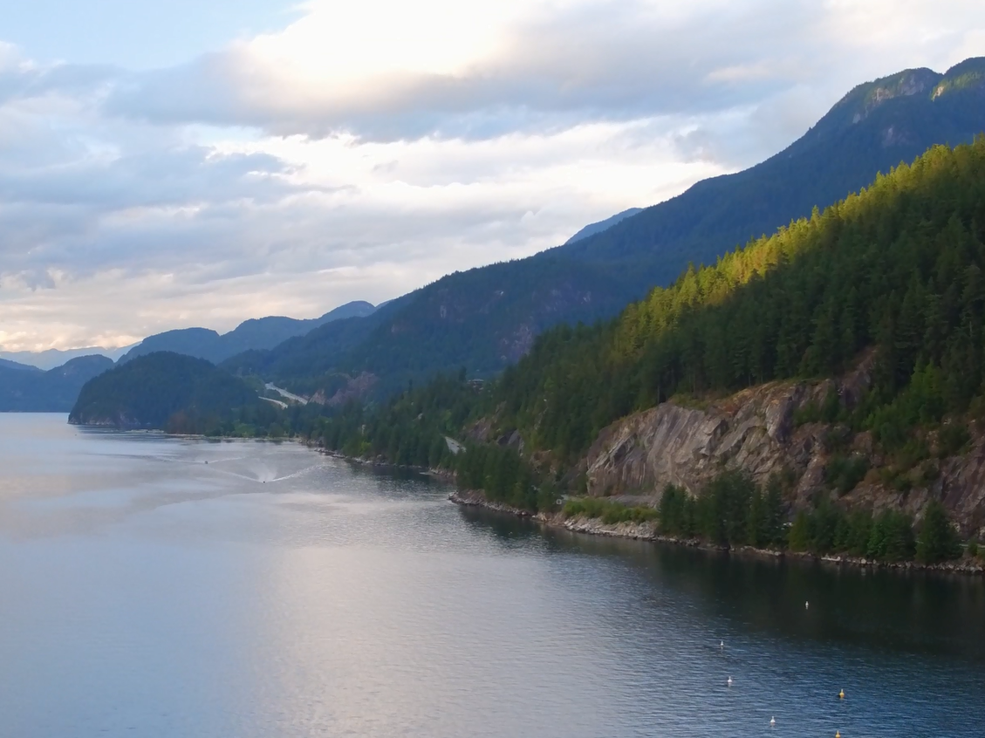
Case studies and videos available at: www.cec.org/marinelitter
Catherine Hallmich
challmich@cec.org
Notes:
Play video

