Slide 1
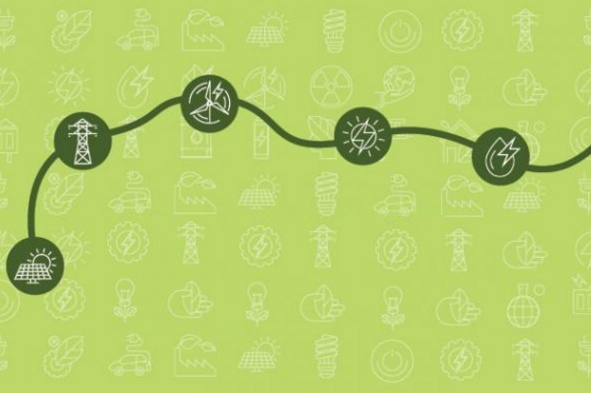


Policy & Regulatory Paths
The collateral challenges of high-efficiency luminaires & intelligent control systems
Dr. Eric Dannenmaier
Dean and Professor of Law, Northern Illinois University College of Law
Moderator

Slide 2

Great ideas …..
at the time
….. unintended consequences
Exit Signs that glow in the dark
High-temperature lubricants
Plastic (polycarbonate) bottles
Amalgam dental fillings
Insulation – heat & sound
More efficiently-burning gasoline
Quick-drying, long-lasting paint
Efficient energy transmission
Radioactive Tritium
Polychlorinated Biphenyls
Bisphenol A (BpA)
Mercury
Asbestos
Lead
Lead
Property expropriation (takings)

Slide 3
Great ideas …..
…….............. Unintended market obstacles
Household & commercial electricity
Railroads
Analog recording technology
Digital recording technology
Weight measurements
Energy efficiency measurements
Distance measurements
110, 220 volt systems
Variable gauges
Betamax, VHS
HD/DVD, Blu-Ray
Kilograms, pounds, stone
EER = -0.02 × SEER² + 1.12 × SEER
fathoms, rods, chains, furlongs, nautical miles, stadia, leagues

Slide 4
Great ideas …..
……………….….. unintended consequences?
High efficiency luminaires
  Maximizing luminaire center beam candlepower (candela), per total input watts (W), taking into account efficiency & efficacy (lumens/W), coefficient of utilization (CU) and comparative yearly energy cost of light ($/1000 lumens)
Intelligent Energy Controls
Control systems using artificial intelligence to gauge, learn & anticipate user behavior to ensure optimized energy consumption within a building (HVAC, boilers, etc.) through intelligent switching of loads, and integration into a smart grid
What unintended consequences and obstacles might these important energy efficiency innovations present?

