Slide 1

Commission for Environmental Cooperation of North America
Joint Public Advisory Committee Regular Session 16-02
Advancing Sustainable Clean Energy Cooperation in North America:
Policy and Regulatory Paths – The collateral challenges of high-efficiency luminaires and intelligent control systems
Ottawa, Canada,
November 07, 2016

Slide 2

Regulatory Cooperation: concept
“Regulatory Co-operation” as such is not explicitly mentioned in the TBT Agreement nor in NAFTA…
…now TPP article 8.9 (Cooperation and Trade Facilitation), specifically talks about it…
Regulatory cooperation refers to activities that aim to reduce unnecessary barriers to trade, but more importantly, to promote elimination or reduction of barriers in areas where regulations are necessary and consistent with trade agreements.

Slide 3
Regulatory Cooperation: types
Formal
Informal
Horizontal
Sectorial
Product/service specific
Public
Private
Hybrid
Legislation
Regulations

Slide 4
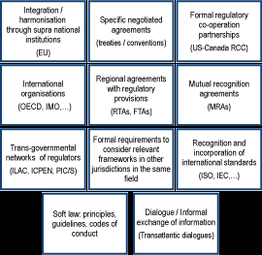
Regulatory Cooperation: types (OECD)
2013 OECD
International Regulatory Cooperation: Addressing Global Challenges

Slide 5
Regulatory Cooperation: activities
Pre- rule making process
Exchange if information
Regulatory dialogue
Regulatory Development
Harmonization with international (ISO/IEC), regional (CANENA) or foreign standards (UL).
Technical assistance
Compatibility with foreign technical regulations (US/CA)
Enforcement
Equivalency
Compatibility
Conformity Assessment
Equivalency
Mutual recognition Agreeements/ Arrangements
Acreditation
Horizontal Dialogue
Customs procedures

Slide 6






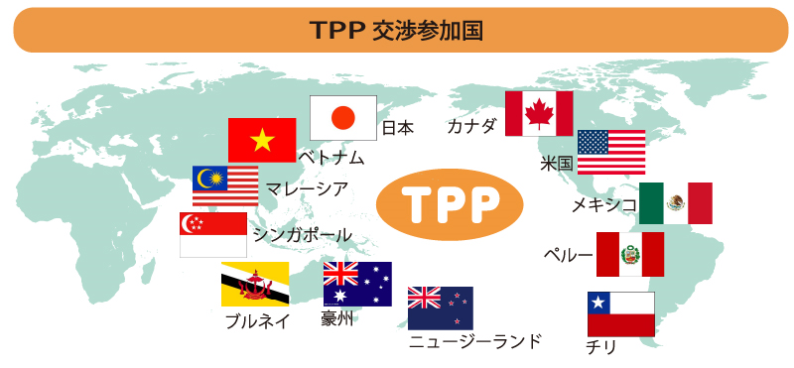


Regulatory Cooperation: examples
Same regulatory body in most of the sectors: EC. Same legal framework: technical regulations, standards and conformity assessment procedures. Different enforcement Authority. Treaty commitments
Same regulatory body in the food sector. Same legal framework. Different enforcement Authority (AS/NZ Food Code). Treaty commitments.
Same regulatory body in selected sectors: (i.e. Commisions). Subsecuent incoporation of reg’s to domestic system. Different enforcement Authority. Treaty commitments.
Treaty commitments: Disciplines + Sectoral Annexes
Same TR/CAPs
Treaty commitments: Disciplines

Slide 7
Regulatory Cooperation: some lessons for success
Private sector support (in all countries involved) facilitates the identification of priorities and type of activities subject to Regulatory Cooperation.
Is better to choose specific measures and activities with specific goals and timeframes., than target generalities.
Not a one-size fits all: analyze what result is better for each sector.
Sometimes baby steps are better than big announcements!
It is essential to create confidence building among regulators and to favor technical assistance.

Slide 8
Regulatory Cooperation: some lessons for success
Success can only be assured with high political involvement and definition of priorities.
Is necessary to devote human resources: regulatory cooperation demands time and people.
Success should not be linked to reciprocity in the same sector.
BE PATIENT!!!!!

Slide 9

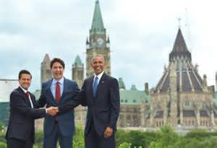
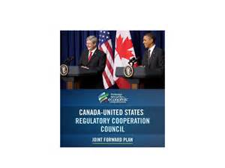

Regulatory Cooperation: work in progress

Slide 10

Many thanks/Merci beaucoup/Muchas gracias!

