Slide 1
North America Cooperation to
Boost Sustainability through ISO 50001
CEC JPAC “Advancing Sustainable Energy Cooperation in North America”
7, November 2016
Ottawa, Canada
Ms. Graziella Siciliano
Coordinator - Energy Management Working Group
U.S. Department of Energy
graziella.siciliano@hq.doe.gov

Slide 2
Agenda
  ISO 50001 – A New Approach to Energy Efficiency in Organizations
  International Cooperation to Boost Effective ISO 50001 Implementation
  The North American Experience

Slide 3
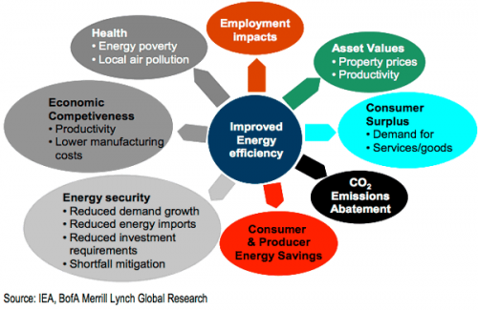
Energy Efficiency: Key to the Paris Agreement
Approximately 40% of the emissions reductions required by 2050 to limit global temperature increase to less than 2 degrees centigrade would potentially come from energy efficiency. - 2015 IEA Energy Efficiency Market Report
Notes:
http://www.ukbusiness-today.co.uk/sites/default/files/imagecache/lead_image_500/Benefits-energy-efficiency.png

Slide 4
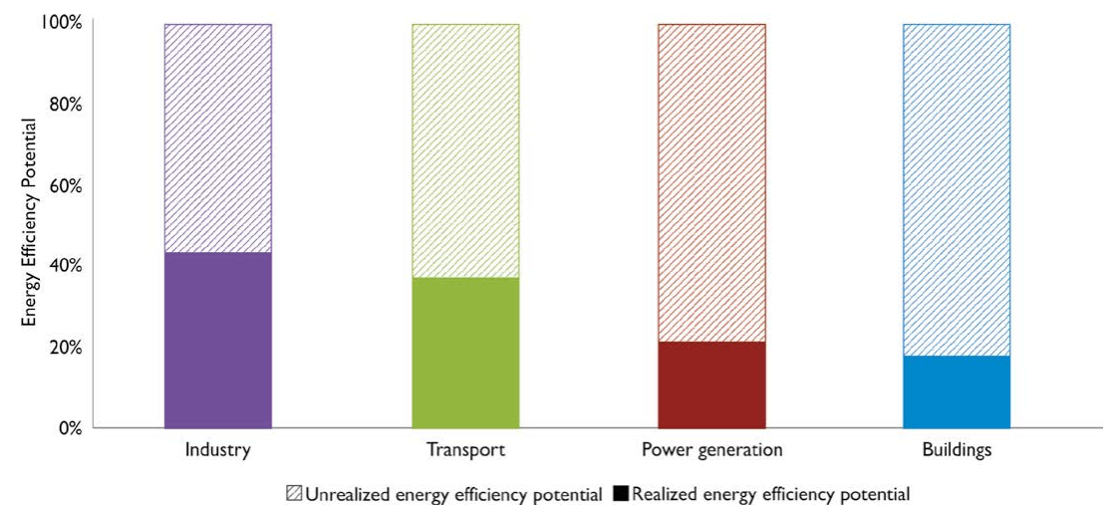
Despite Significant Benefits…Lots of Untapped Potential
Source: World Energy Outlook, IEA 2012
Supportive policies are needed to remove barriers and facilitate market adoption

Slide 5





What is Missing in the Project-Based Approach to Energy Efficiency?
But what about…
Project-Based Focus on Technological Change
People?
Organizational Barriers?
Overall Energy-Use Strategy?
Controls and Verification of Savings?
Notes:
Operational control
Commitment to do large projects
Maintenance of the small stuff
Culture and behavior

Slide 6
A More Comprehensive Approach To Energy Efficiency Is Needed
Organizations that target behavioral and organizational barriers, as well as technological, can achieve continual improvement in energy performance.
Comprehensive Energy Management
Technological Change
Organizational Change
Behavioral Change
Continuous improvement!
Energy & Cost Savings
(over time)
Staff at every level of an organization need to be engaged and involved in order to achieve energy goals!

Slide 7


ISO 50001 - A Key Strategy For Fighting Climate Change
Over +50 countries have worked together through ISO to create a globally-relevant standard that countries can leverage to meet their international climate commitments
ISO 50001 is:
  Ambitious and Quantifiable:
    Relevant to sectors that account for over 50% of global energy use
    Data-driven action to improve energy performance on a continual basis
  Transparent, comparable and verifiable:
    Globally-harmonized; transparent certification process; internationally-relevant
  Business Friendly
~15,000 certified sites worldwide since 2011

Slide 8
Potential Global Impact Of Industrial And Commercial Sector ISO 50001 Adoption
  By 2030 implementation of ISO 50001 across the commercial and industrial sectors globally could drive cumulative savings approximately of:
  93 EJ of primary energy,
  $600 billion in energy costs, and
  6,500 Mt of avoided CO₂ emissions.
  The projected annual emissions savings in 2030 are equivalent to removing 215 million passenger vehicles from the road.
Source: Energy Management Working Group, Global ISO 50001 Impact Estimate, IET Tool, 2016,

Slide 9

































Leading Organizations Are Using ISO 50001 To Achieve Energy, GHG Emissions Goals
Early adopters are demonstrating the business value and paving the path for efficient, effective implementation.

Slide 10
International Cooperation To Boost Effective ISO 50001 Implementation

Slide 11

















Energy Management Working Group
(EMWG)
The EMWG leverages the extensive expertise of its 17 member governments to accelerate the adoption and use of energy management systems such as ISO 50001 in industry and in commercial buildings worldwide.
Australia
Canada
Chile
Fora: The EMWG is an initiative of the Clean Energy Ministerial and IPEEC and also reports out to the G20 Energy Efficiency Action Plan.
Partners: A range of organizations promoting energy efficiency and energy management (e.g., UNIDO, Institute for Industrial Productivity, etc.).
The EMWG is a Category A Liaison to ISO TC 301.
European Commission
Finland
Germany
India
Indonesia
Japan
Korea
Saudi Arabia
Mexico
EMWG’s Energy Management Campaign: Driving action to reach 50,001 global certifications to
ISO 50001 by 2020.
www.driveto50001.org
South Africa
Sweden
United Arab Emirates
United States
China (observer)
http://www.cleanenergyministerial.org/EnergyManagement
Notes:
Membership: Government representatives from ministries leading domestic energy efficiency efforts in the public, commercial and industrial sectors.
Governments action is needed to facilitate successful ISO 50001 outcomes in industry:
Develop supportive policies and programs to address barriers to implementation:
Technical and financial resources and tools
Pilot projects and demonstrations
Workforce development programs
Coordination among national bodies to build quality infrastructure for programs
Work with national accreditation, certification, and training bodies to ensure that skilled professionals are available to meet national energy and climate goals.
Provide recognition to businesses that adopt ISO 50001.
Coordinate with international partners to ensure that domestic programs promote and are consistent with international best practices on ISO 50001 implementation.

Slide 12






















EMWG launched the Campaign at the 7th Clean Energy Ministerial Endorsement from 15 countries, 6 companies, 4 supporting orgs

Slide 13

The North American Experience

Slide 14




North American Energy Management Pilot Program
Initiative of the CEC in partnership with Natural Resources Canada, Comisión Nacional para el Uso Eficiente de la Energía and the US Department of Energy.
Objective is to support uptake of ISO 50001 standard and Superior Energy Performance® throughout North American industrial and commercial sectors.
For more information: www.cec.org/energy_program

Slide 15








North American Energy Management Pilot Program
Participants: 9 companies / 19 facilities; ~$750Million USD Annual Energy Spend
Program highlights
Companies receive Step-by-step in-person and remote training including personalized coaching and support; and three multi-day training sessions over a 18-month period and readiness review for ISO 50001 or SEP certification
The pilot is also training ISO 50001 experts to be able to replicate the pilot training approach (end-user group training)

Slide 16



June 2016 High-Level ISO 50001 announcements
Canada, Mexico & the United States
Energy Minister’s Launched Energy Management Campaign at CEM7 in San Francisco
Leaders laid out regional plan for cooperation at North America’s Leader Summit in Ottawa

Slide 17
North America – areas of Technical cooperation
In June 2016, Canada, Mexico and the United States agreed upon technical cooperation in a number of areas to accelerate regional ISO 50001 adoption. Countries will work together to:
  Conduct an analysis of regional ISO 50001 potential and announce a joint target for ISO 50001 adoption in 2017
  Jointly develop tools, resources to estimate ISO 50001 impacts and support end users implementation of ISO 50001;
  Establishment of harmonized training and certification programs for ISO 50001 professionals an accreditation system for ISO 50001 auditors and SEP programs recognized throughout North America;
  Build upon current CEC cooperation, to identify at least one major industry partner to pilot ISO 50001 or SEP adoption throughout its supply chain to further demonstrate technical approaches and benefits of ISO 50001 and SEP.

Slide 18
Wrapping Up
North America leadership recognizes the value of regional cooperation can have in achieving robust implementation of ISO 50001 outcomes.
North American leadership through forums such as the EMWG and the Energy Management Campaign will spur other countries and companies to join the effort to accelerate global uptake of ISO 50001.

