Slide 1


Advancing Sustainable Clean Energy Cooperation in North America
Commission for Environmental Cooperation
Ottawa, Canada
November 7 2016

Slide 2

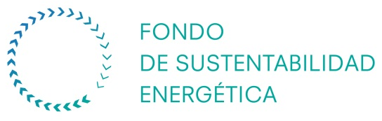
Who we are?
What we do?
Energy Sector Funds
Talent Development
Capacity Building
Research, Development & Deployment
Energy Education and Awareness
0.65% of oil and gas incomes allocated to these Funds

Slide 3
Who we are?
What we do?
Mexico’s Energy Reform
Oil and Gas Sector
Electricity Sector
Access to new investments & technologies
Access to new reservoirs (e.g. deep waters)
Increased production and tax revenues
New electric market (spot and long term market)
Increased competitivity
Better prices
Clean energy adoptions
Energy efficiency industry
Energy
security
Energy Sustainability
Economic Development
Universal
Access

Slide 4
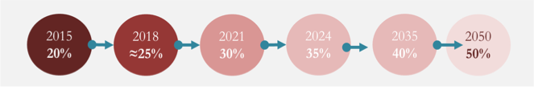
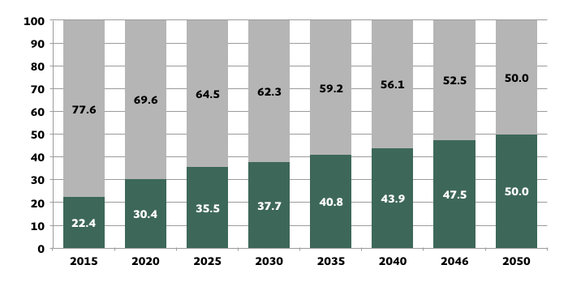
How can North America meet its goal of 50% clean
power generation by 2025 through
energy conservation and efficiency?
Energy Transition Law
Clean Energy Goals
Mexico’s Clean Energy Portfolio Goal
Emissions reduction goals:
2020: 792 MtCO₂e
2025: 888 MtCO₂e
2030: 973 MtCO₂e
Clean
Conventional

Slide 5
How can North America meet its goal of 50% clean
power generation by 2025 through
energy conservation and efficiency?
42% reduction in energy efficiency intensity requirement

Slide 6
How can North America meet its goal of 50% clean
power generation by 2025 through
energy conservation and efficiency?
Figura 34. Potencial de reducción de consumo final de energía en los sectores de industria, transporte y edificios al 2050

Slide 7
How can North America meet its goal of 50% clean
power generation by 2025 through
energy conservation and efficiency?
Built Environment
Agro Industries
Public Services
Transport
Regulation and Public Policy
Institutions
Capacity Building
Markets and Financing
R,D&D
Standard setting & enforcement
EV Goals
Standard setting & enforcement
Standard setting & enforcement
Standard setting & enforcement
Assist municipalities participate in electric markets
Program for assistance in adoption of clean technologies
Cooperation programs between gov. levels
Cooperation programs between gov. levels
Training programs / Auditors / Modelers
Training programs /
Manufacture efficiency specialists
Training programs / Auditors / Installers
Training programs / Auditors / Installers
Vehicle fleet renewal program, EV Tax exemptions
Government ESPC Programs, ESCO’s
Municipal energy efficiency program
Agro industry energy efficiency program
Information infrastructure
(weather data)
Agro industry energy efficiency technologies & best practices
Zero emissions cities roadmap
Municipal services IT platforms

Slide 8
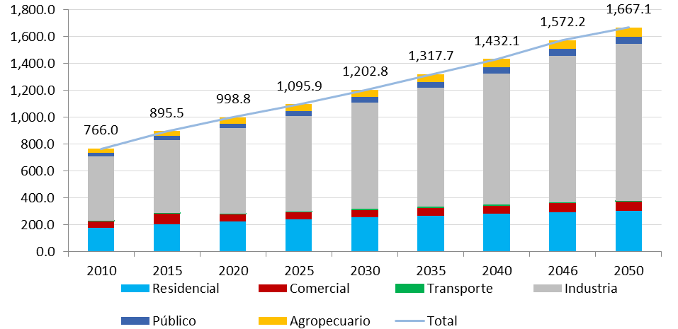
How can North America meet its goal of 50% clean
power generation by 2025 through
energy conservation and efficiency?

Slide 9
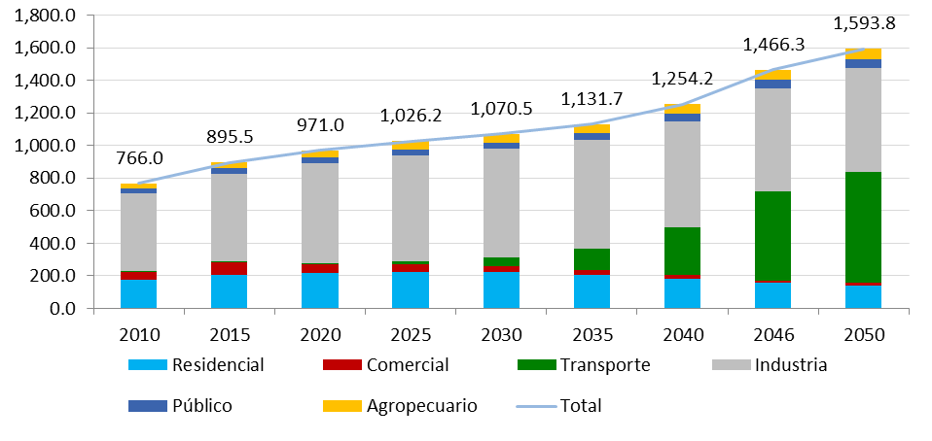
How can North America meet its goal of 50% clean
power generation by 2025 through
energy conservation and efficiency?

Slide 10
Where to?
Mexico’s biggest challenge is in developing a mature and profitable energy efficiency industry.
Learning from US and Canada can go a long way towards:
developing this industry and
opening markets for US and Canadian companies and expertise.
Standard Sharing
Knowledge sharing and best practices
Industry development needs assessment and capacity building: University of California example.
Single market? Complex: Different governments and different government levels.
Joint research
Cooperative capacity building
Information, standards, regulations, enforcement, case studies.
New technologies: highly localized. Mission Innovation Zero Emissions HVAC Technologies.

