Slide 1
Climate change resilience for agriculture in the United States
JPAC June 2019
Dr. Sarah Taber

Slide 2
Tools for resilience: cover crops
Cover crops help soil absorb water, reducing damage from both floods & droughts
Cover crops make money!
https://www.edf.org/sites/default/files/documents/farm-finance-report.pdf

Slide 3
Cover crops & profit
Cover crops add expenses in some categories (seed, herbicides to kill cover crop)
But savings in others (fuel, labor, equipment)
The added costs/savings tend to balance out
Cover crop profits mostly come from increased yield:
  $5-50/acre ($12-125/hectare)
Better soil means farms can also retire one tractor per farm on average ($54,000 savings/year)

Slide 4
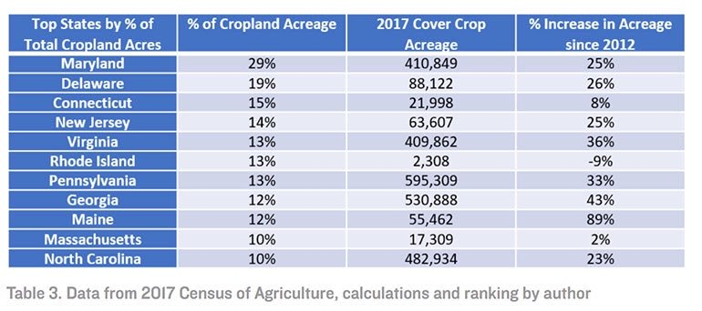
However, US farmers are slow to adopt

Slide 5
Success story: Maryland?

Slide 6

Why is Maryland #1 in the US for cover cropping?
Because it pays farmers $45-90/acre ($112-225) to do it
This is on top of the $5-50/acre ($12-125/hectare) that cover cropping makes
Paying farmers to do something that already pays for itself is very controversial!
But few US farmers will cover crop unless paid to…
even though they’re profitable

Slide 8
Human systems
US farmers are slow to adopt cover cropping
  Even though it’s profitable
  Even when offered extra money to do it!
Why?
Notes:
Image source: https://agcrops.osu.edu/newsletter/corn-newsletter/2018-23/cover-crop-survey-quick-and-painless

Slide 9
Human systems
91% of US farmers work off the farm- more important to minimize labor than maximize profits
The core business model behind US agriculture is not making food. It’s real estate speculation, subsidies, & tax evasion.
Notes:
Sources: Environmental Working Group, https://farm.ewg.org/region.php?fips=00000&regionname=theUnitedStates; https://www.ers.usda.gov/webdocs/publications/43789/40008_eib-117_summary.pdf?v=0

Slide 10
Human systems
Up to 1/5 of American farms don’t actually grow anything, but appear to be registered as farms for tax purposes
Government assistance for US farms is mostly tied to number of acres farmed (or “farmed”)
This is a legacy of early US colonialism- a political strategy of occupying land with pro-colonial landowners & rewarding them with public funds in exchange for political support
Notes:
Farmers Who Don’t Farm: The Curious Rise of the Zero-Sales Farmer https://papers.ssrn.com/sol3/papers.cfm?abstract_id=3104703

Slide 11
Decolonizing US agriculture: Gila River case study
US also has lots of non-colonial agriculture!
Not well known because they don’t have the publicity that family farms, corporate farms, & other pro-colonial forms of agriculture have
Indigenous agriculture- traditional + modern
Hutterites – European immigrants who don’t follow traditional colonial playbook
Notes:
Source: https://civileats.com/2018/11/21/native-american-farmers-are-growing-a-sustainable-market/

Slide 12
Decolonizing US agriculture: Black cooperative case study
Notes:
Sources: http://www.encyclopediaofalabama.org/article/m-6698, Soul Fire Farm

Slide 13
Decolonizing US agriculture: Hutterite case study
Notes:
Source: http://www.hutterites.org/day-to-day/structure/

Slide 14
Decolonizing US agriculture: Tanka case study
Notes:
Source: https://newfoodeconomy.org/tanka-bar-general-mills-epic-provisions-bison-bars/

