Slide 1
POWER TO THE PEOPLE

Slide 2
ENERGY AUTONOMY

Slide 3
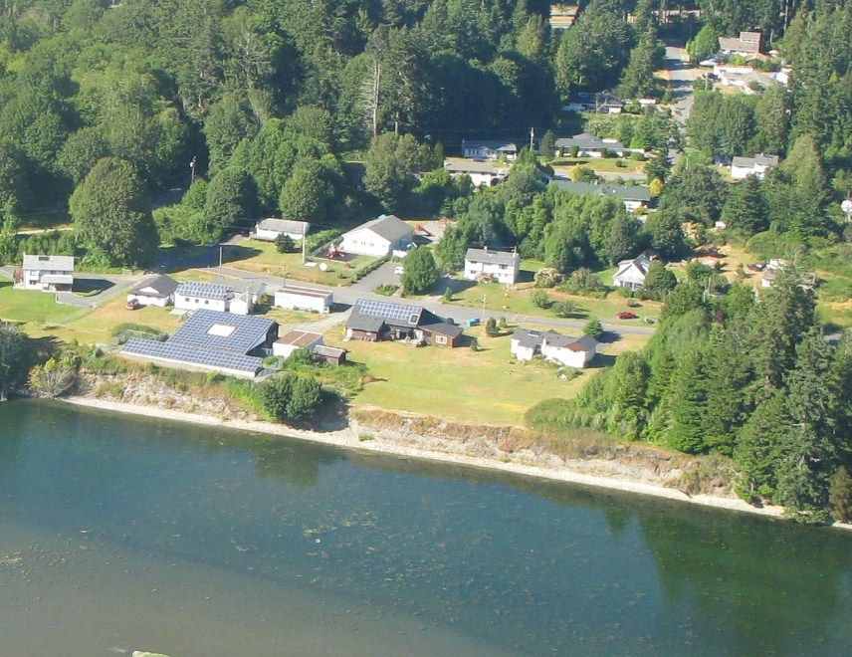
T’Sou-ke Solar from the air.

Slide 4
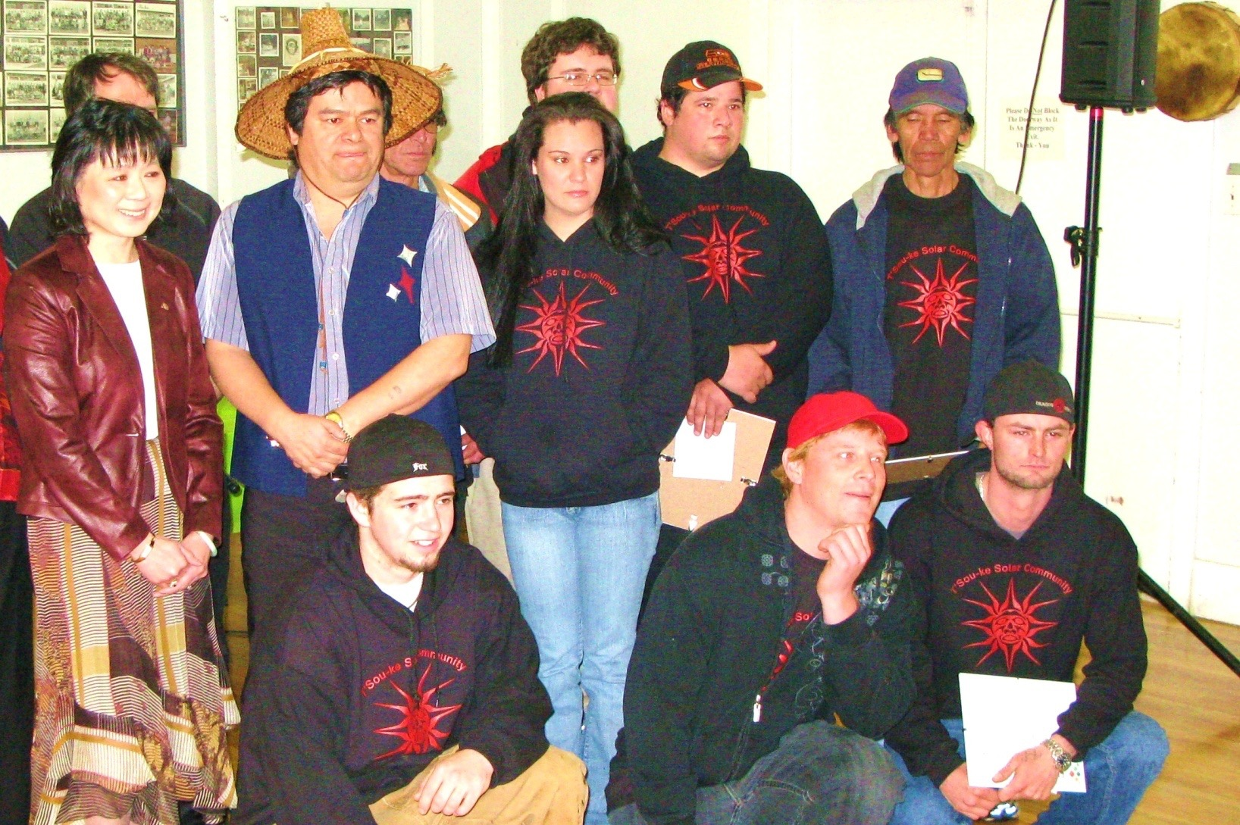
Minister Ida Chong with certificates for trainees

Slide 5
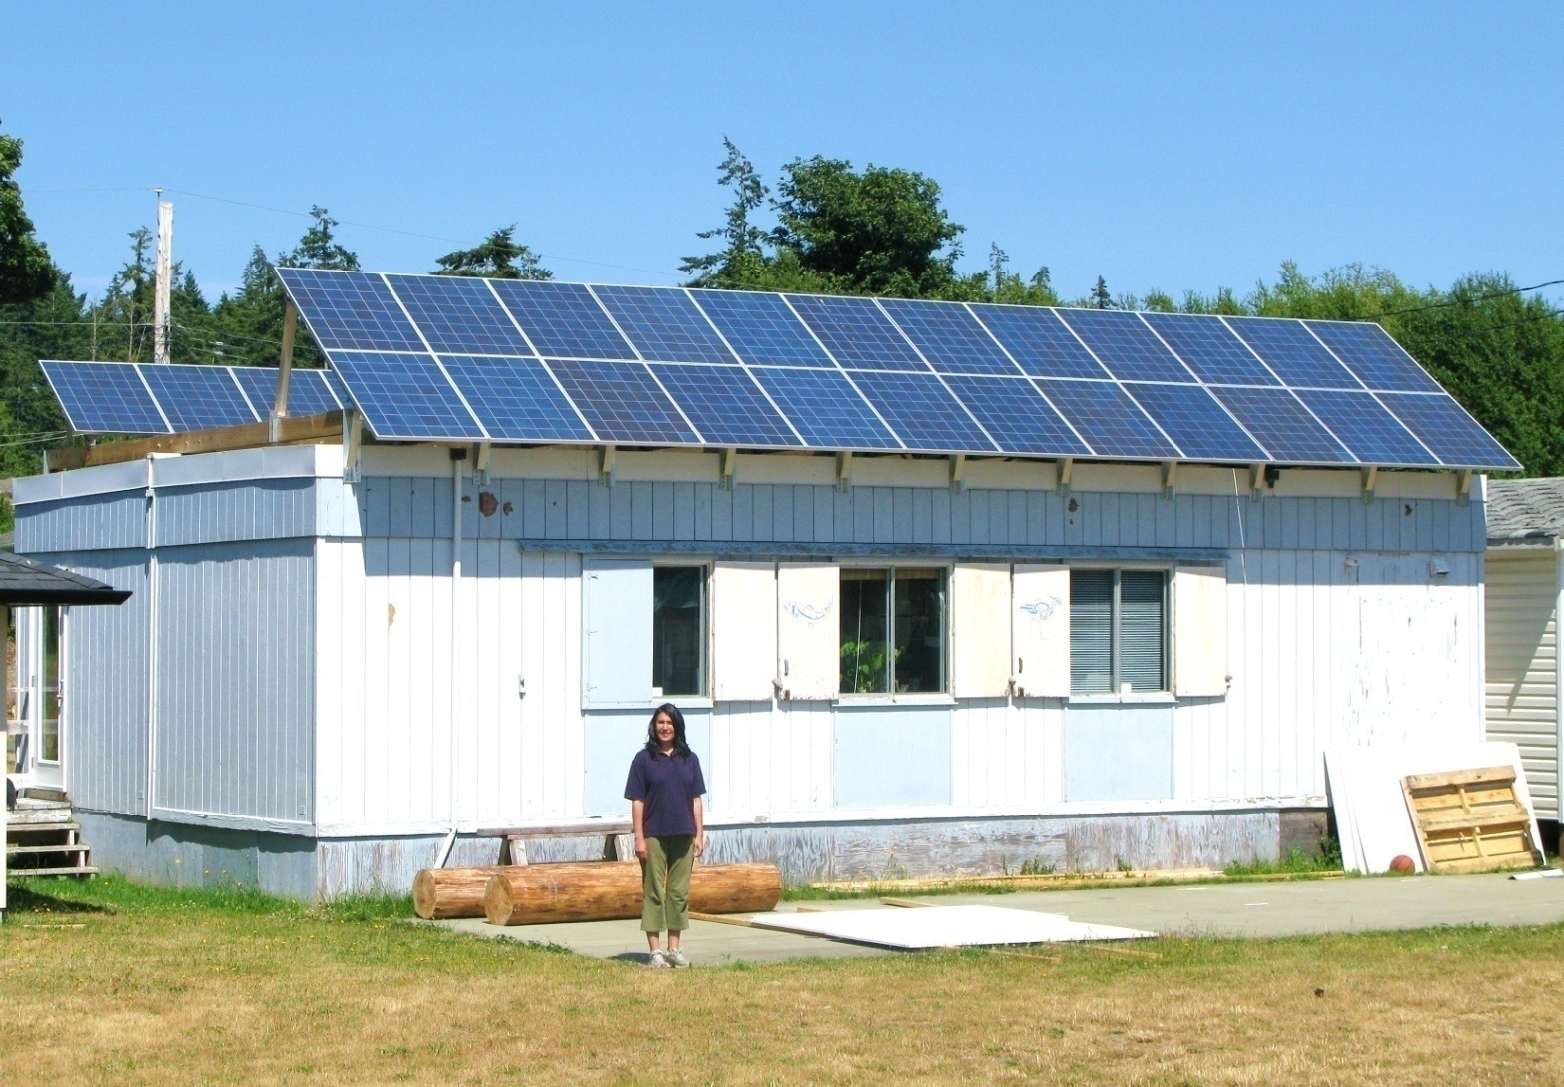
Fisheries building demonstrating ‘Off Grid’ Summer setting

Slide 6
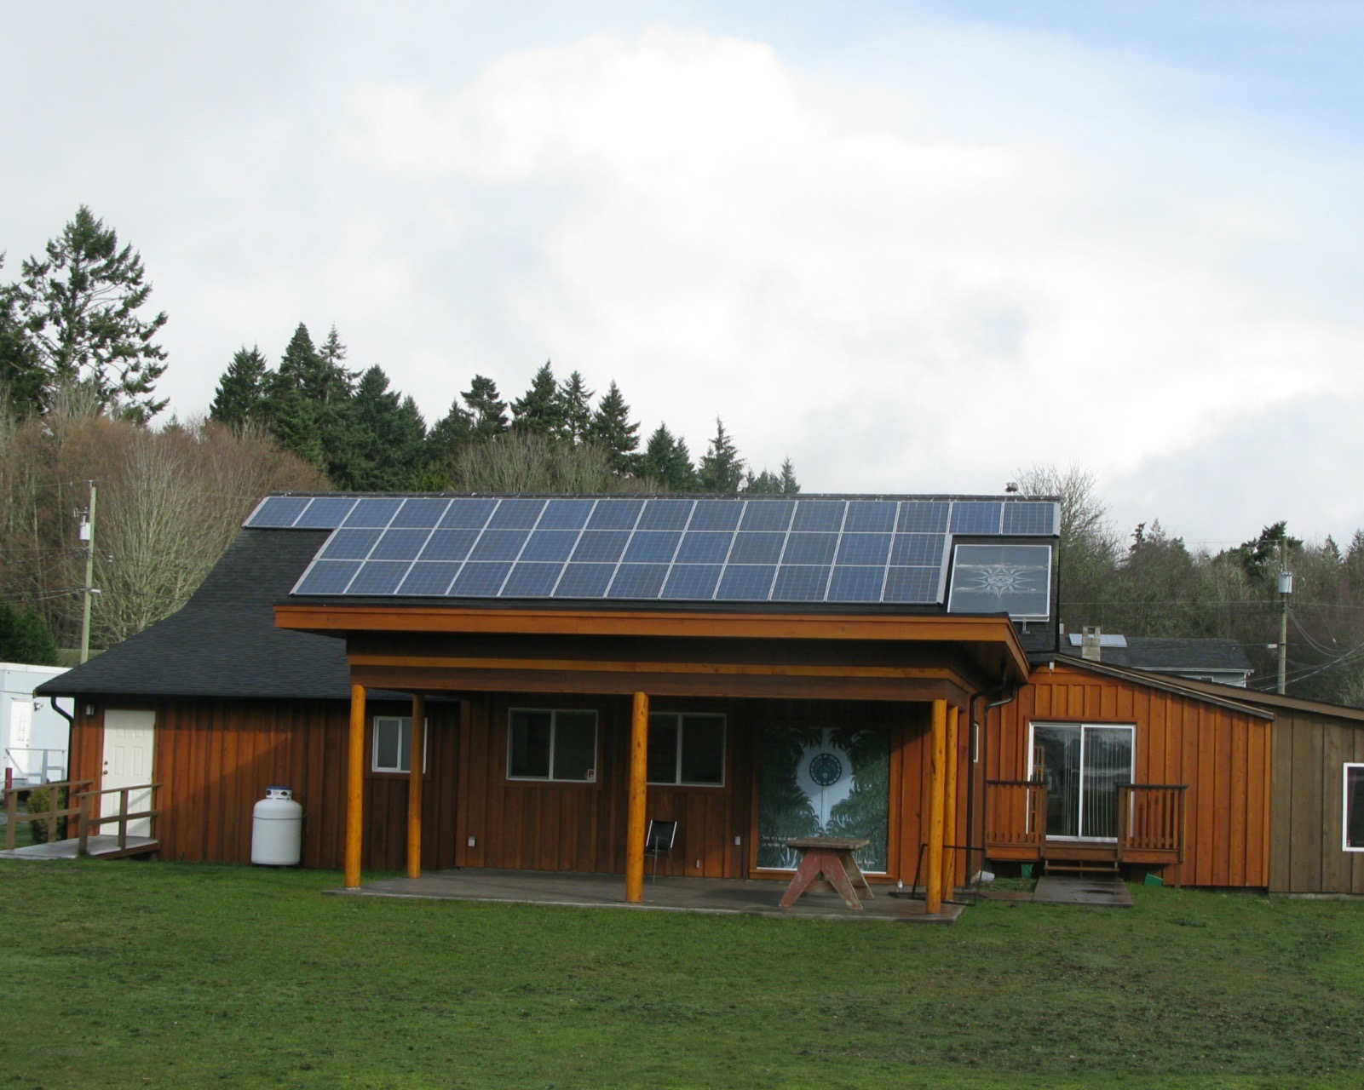
Administration Building demonstrating Net Zero Energy

Slide 7
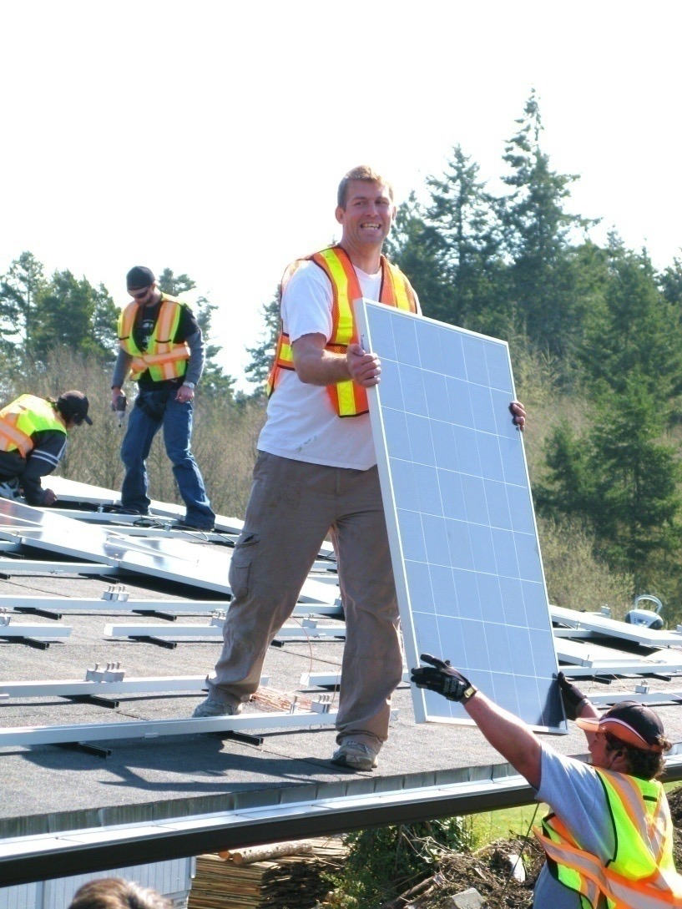
Photovoltaic Installation Canoe Shed extension

Slide 8
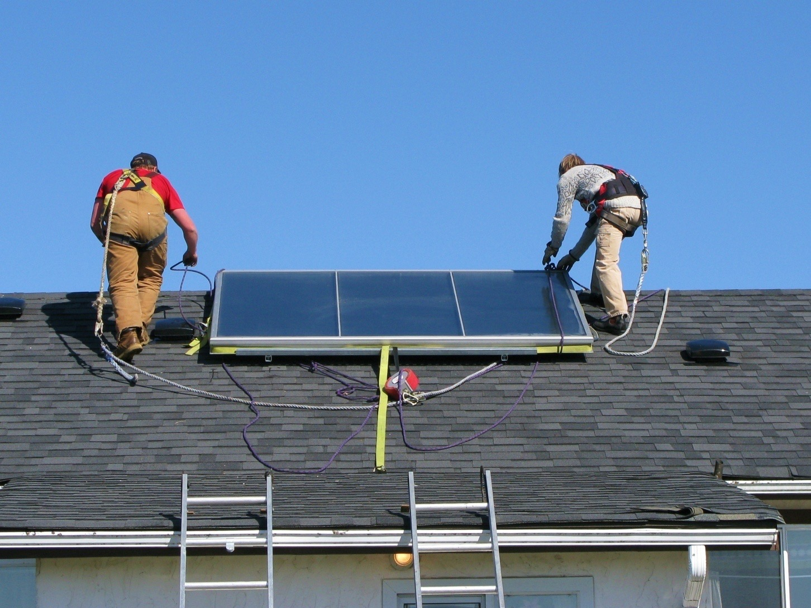
Installing Solar hot water panel

Slide 9
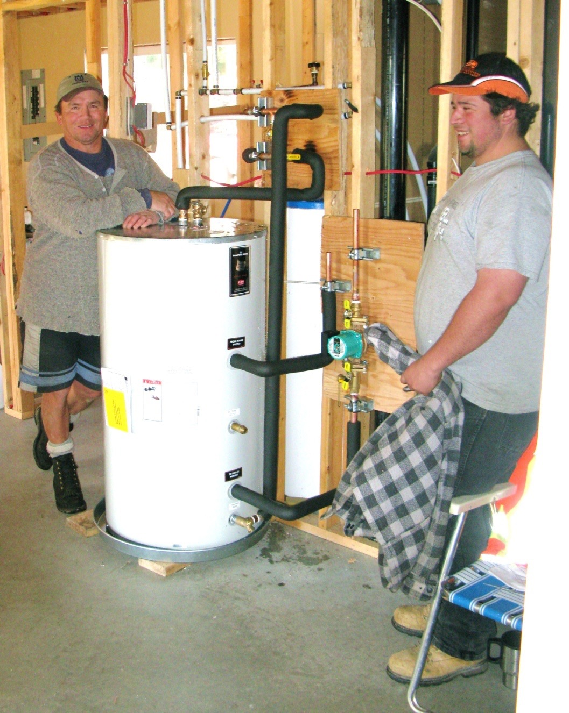
T’Sou-ke Trainees installing Solar Hot Water

Slide 10
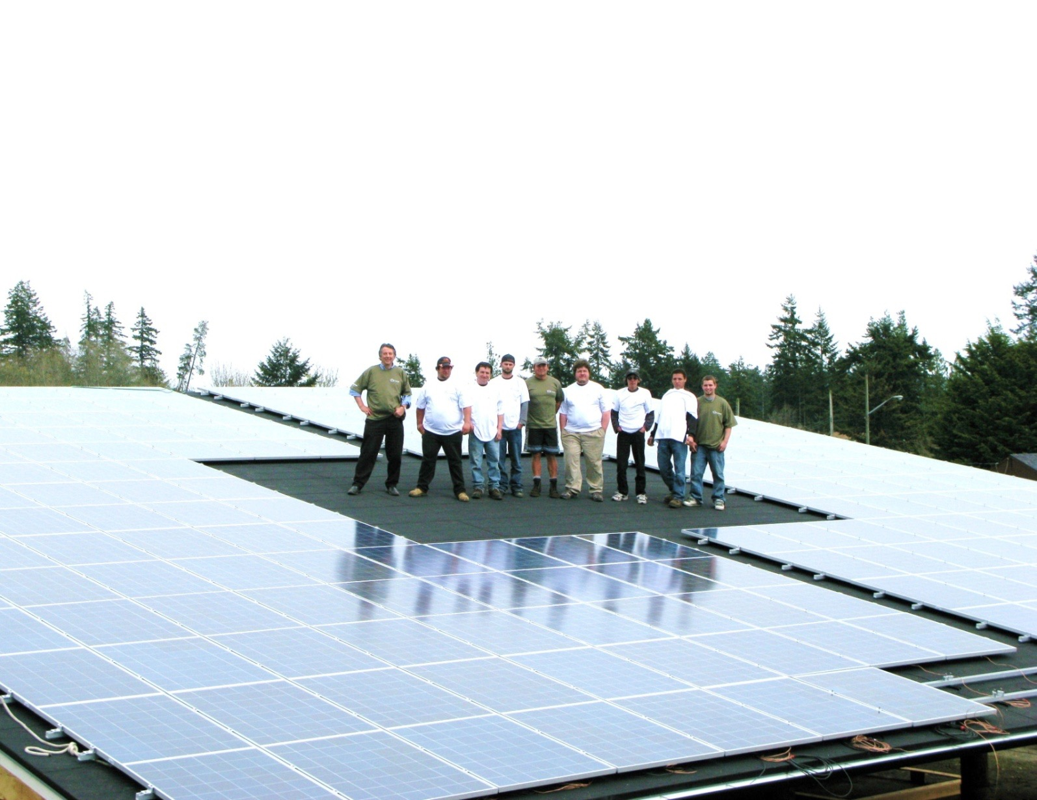
9 Solar trainees employed to install Solar hot water &Photovoltaic panels

Slide 11
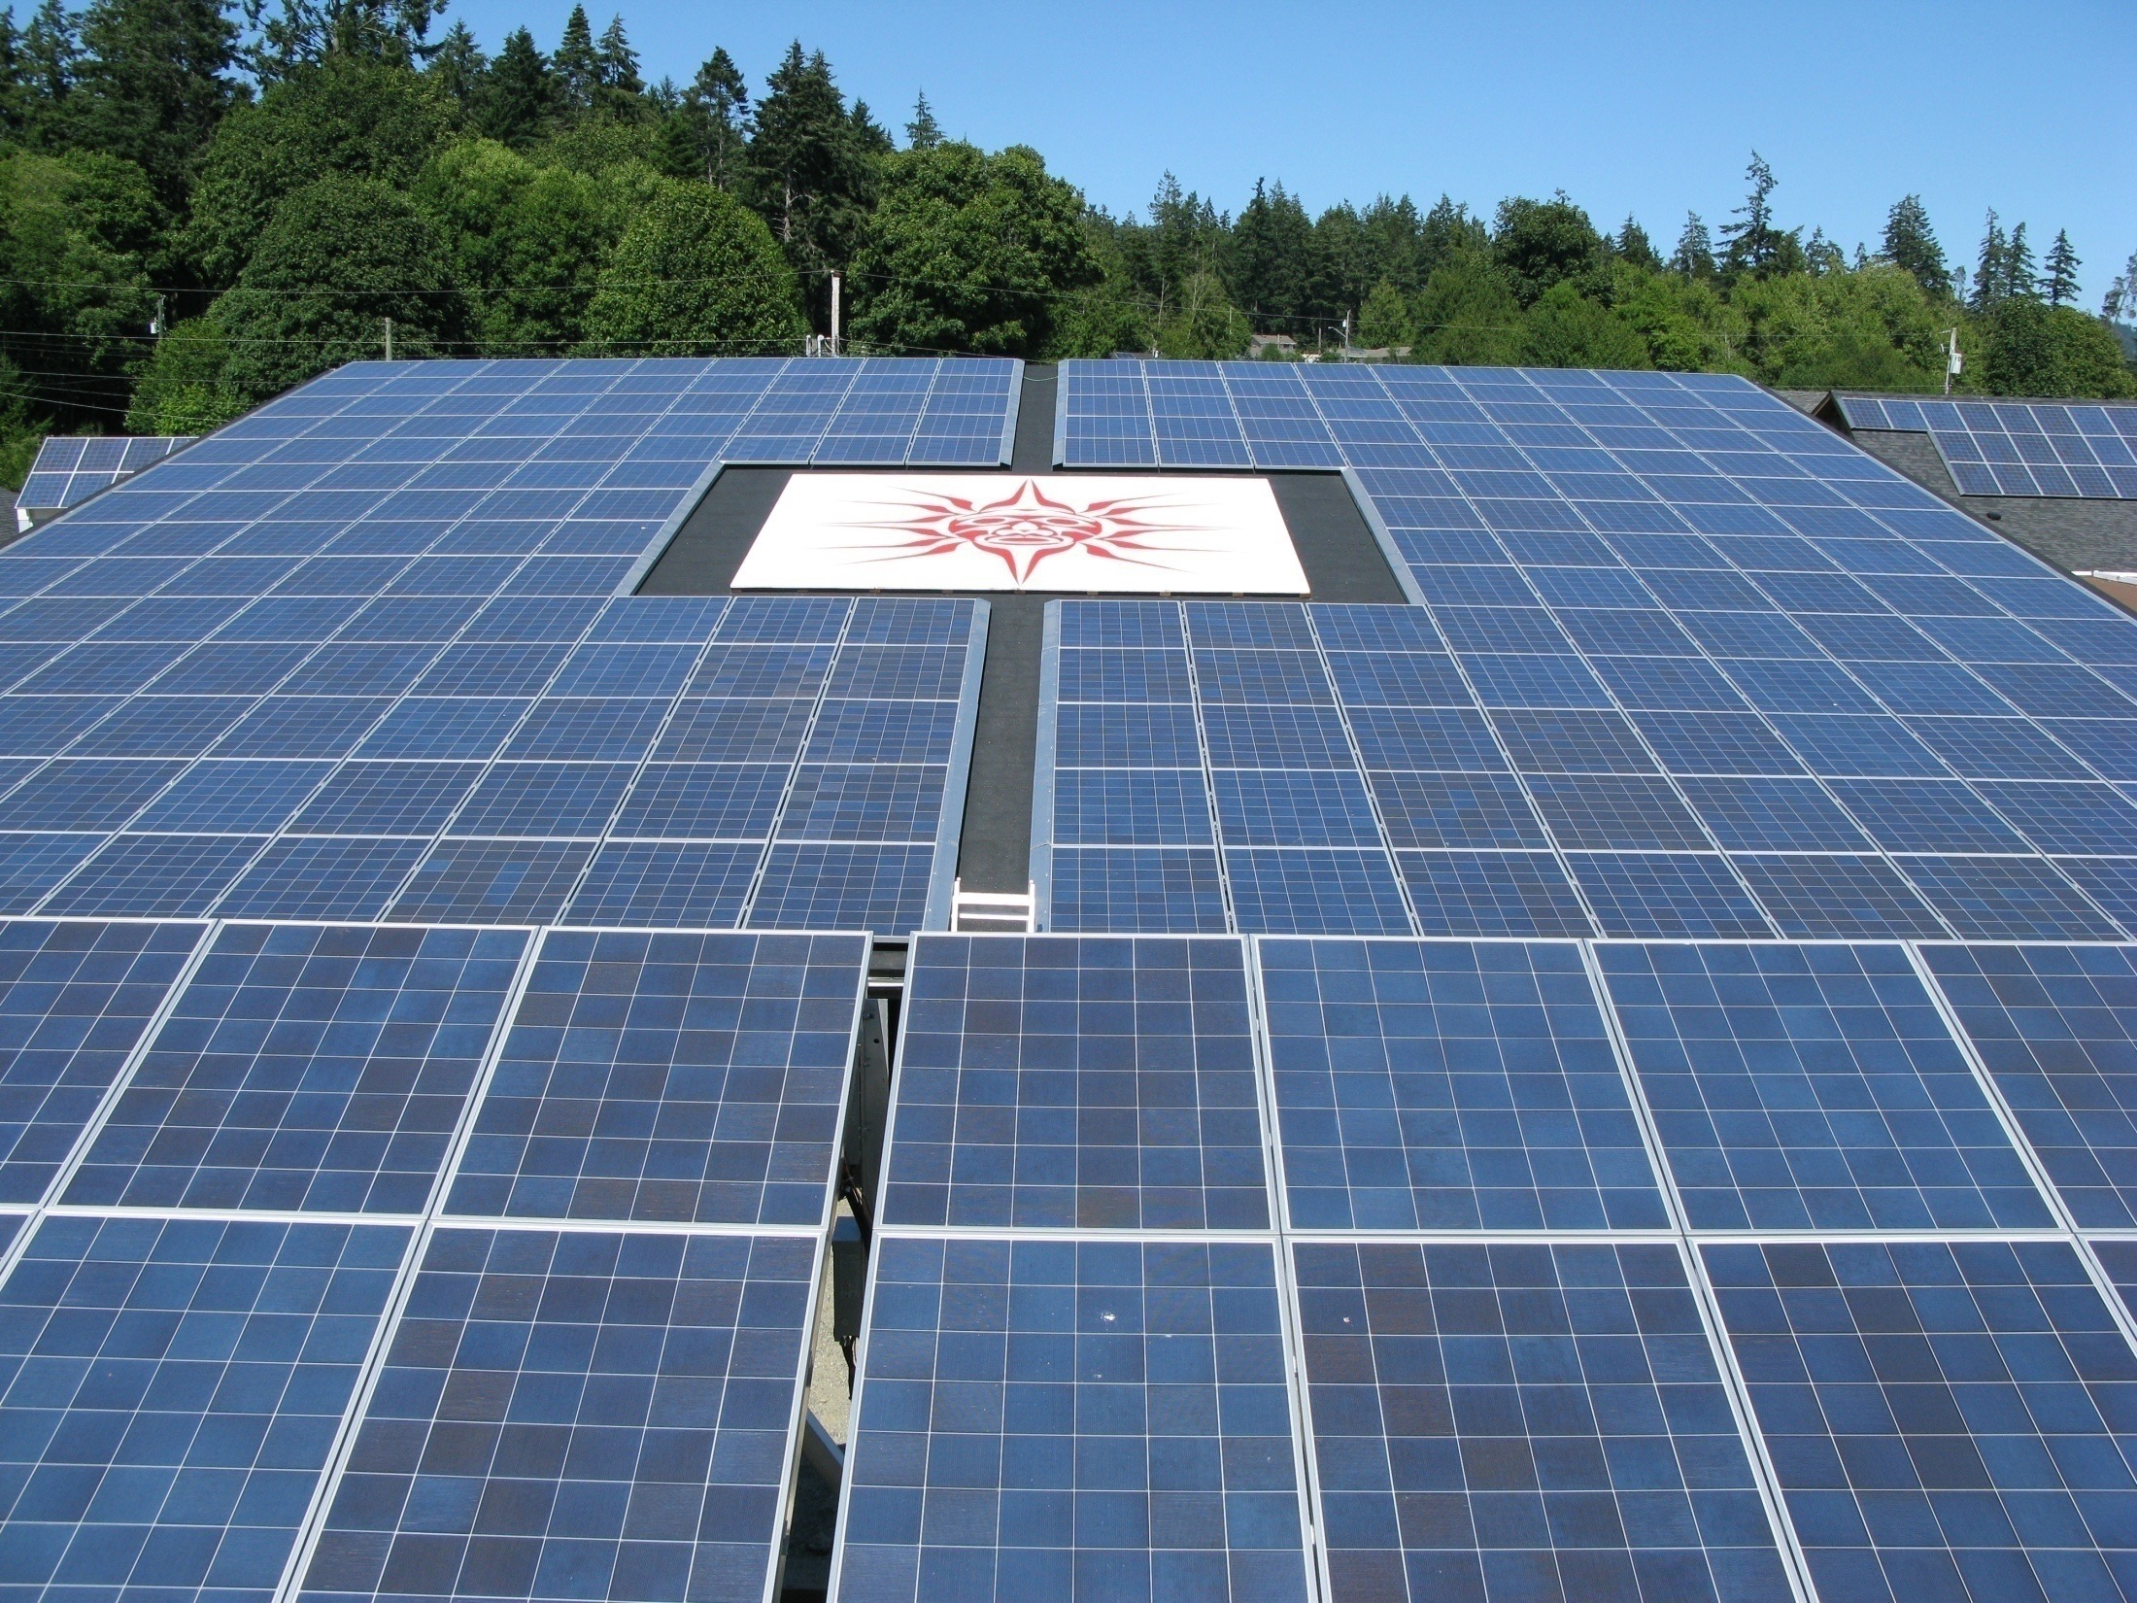

Slide 12
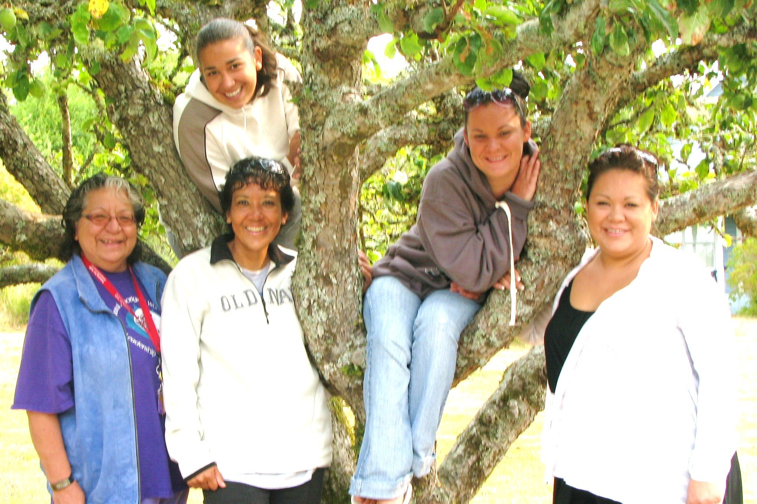
T’Sou-ke Smart Energy Group

Slide 13
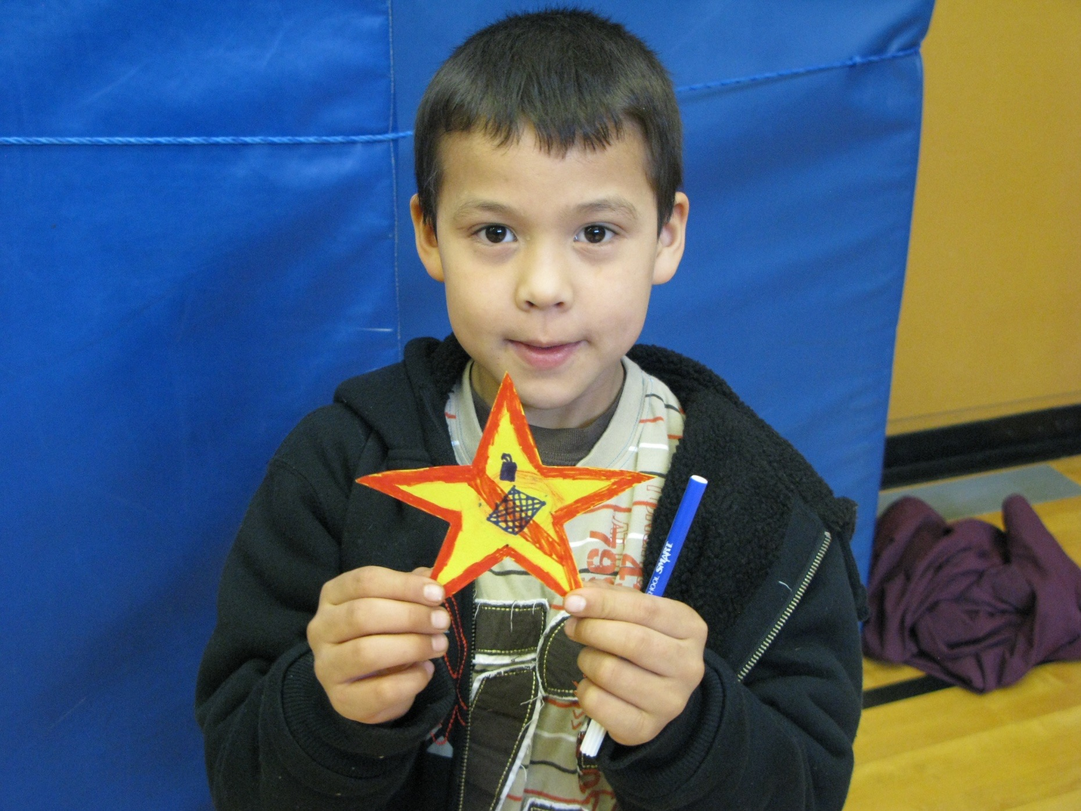
Conservation convert

Slide 14
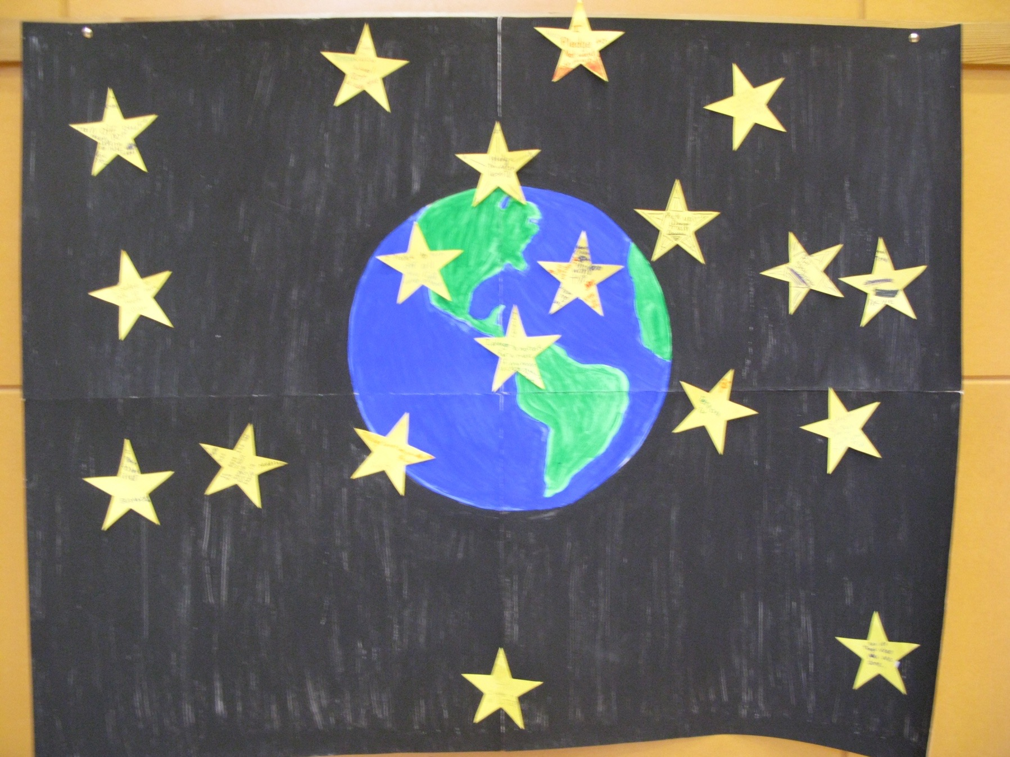
Earth Challenge

Slide 15
FOOD SECURITY

Slide 16
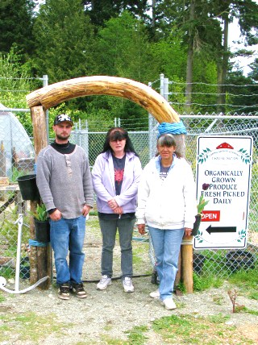
Ladybug Garden

Slide 17
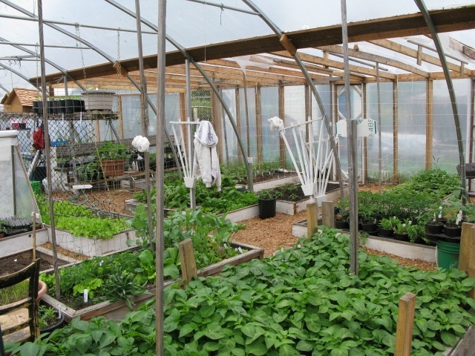
T’Sou-ke Greenhouse

Slide 18
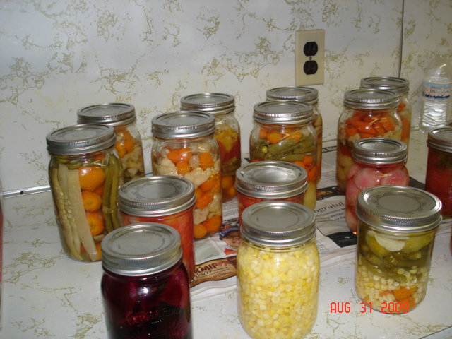
Preserving Vegetables

Slide 19
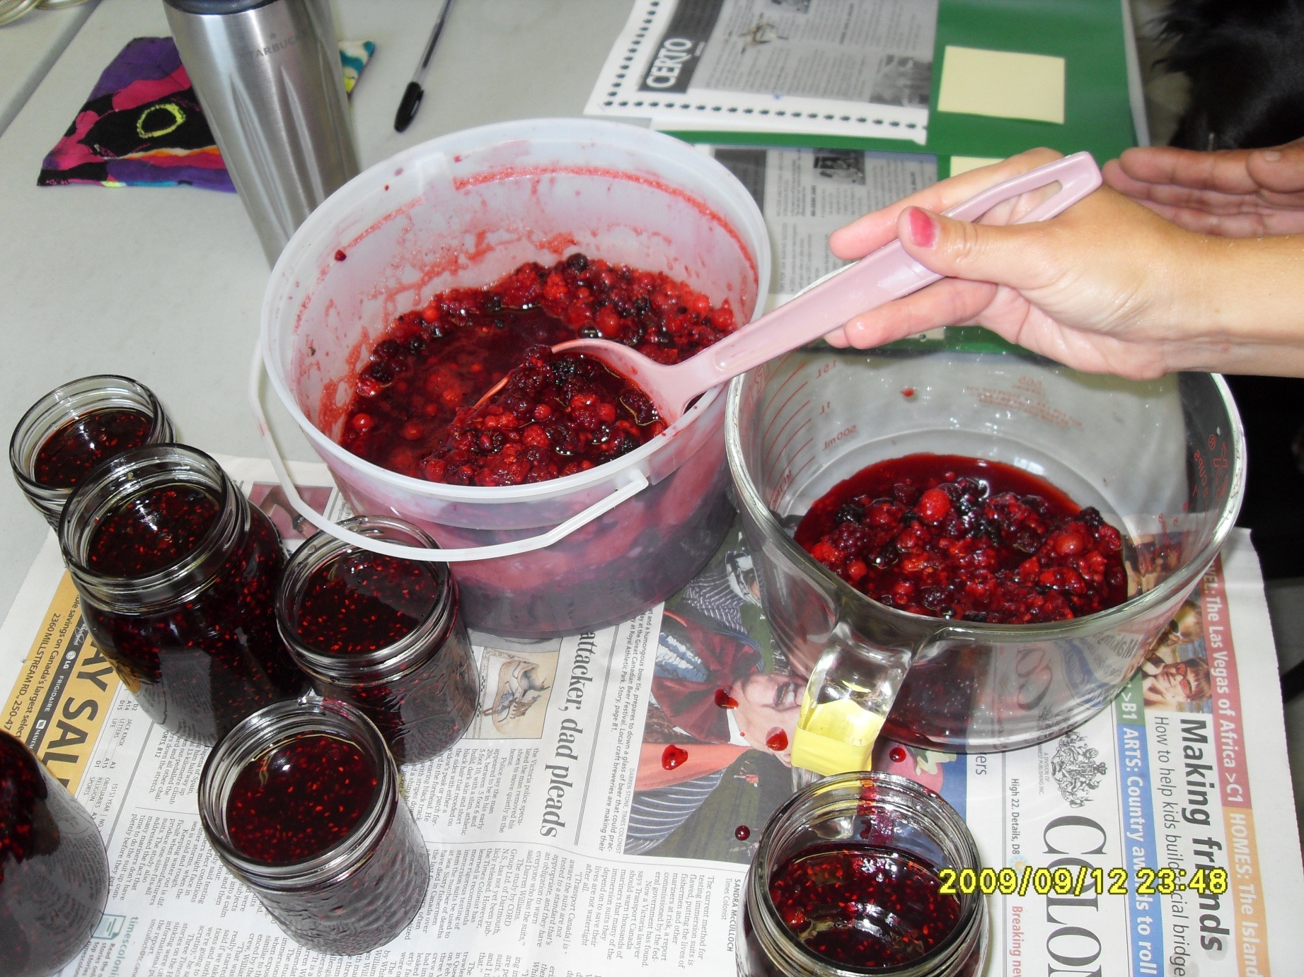
Making Jams

Slide 20
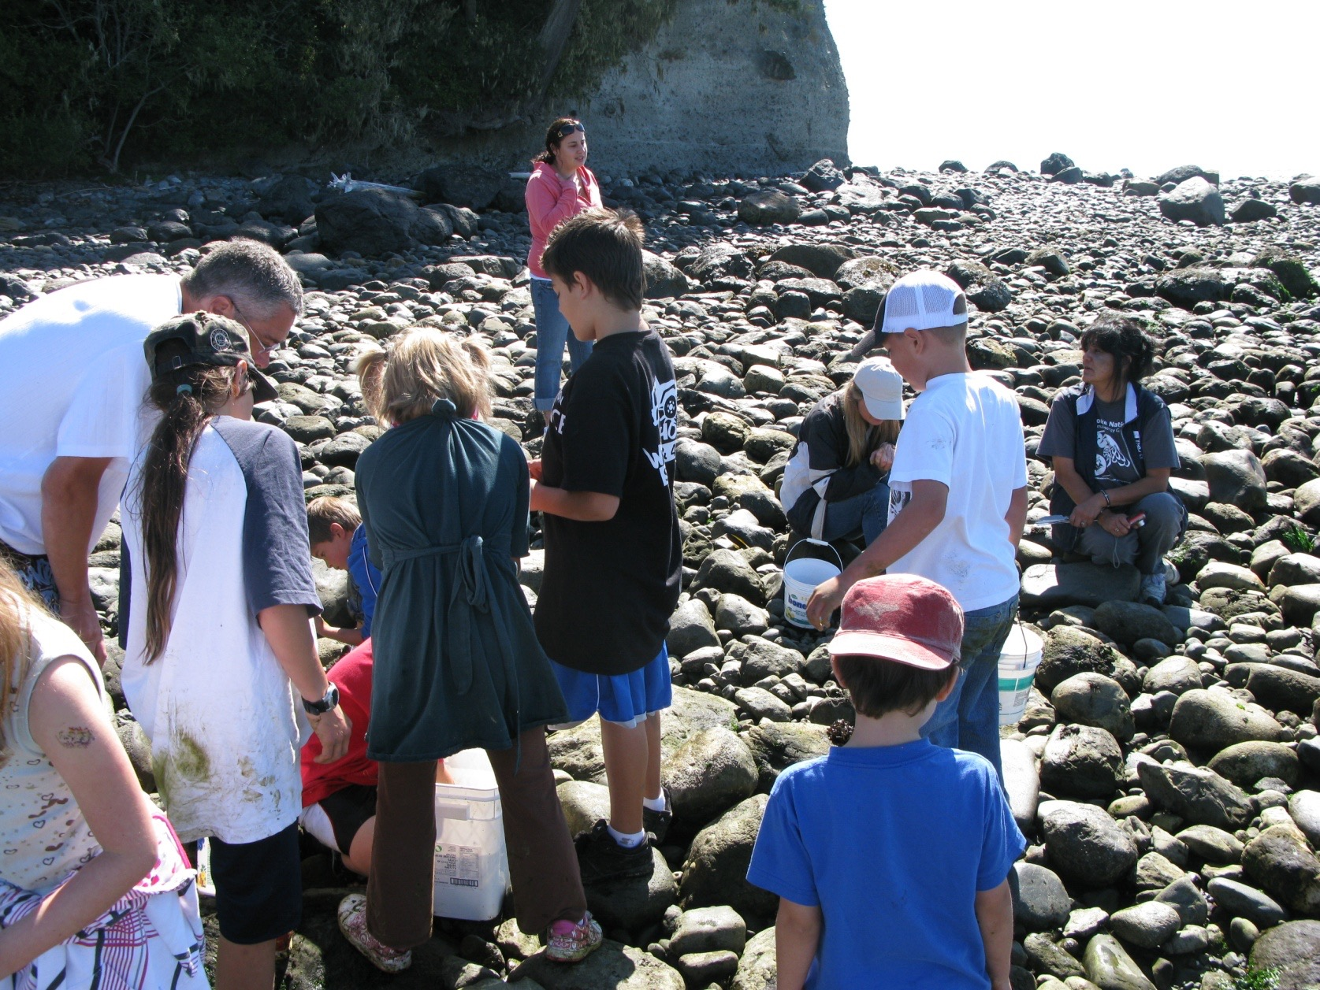
Zero Mile Diet - Beach Party

Slide 21
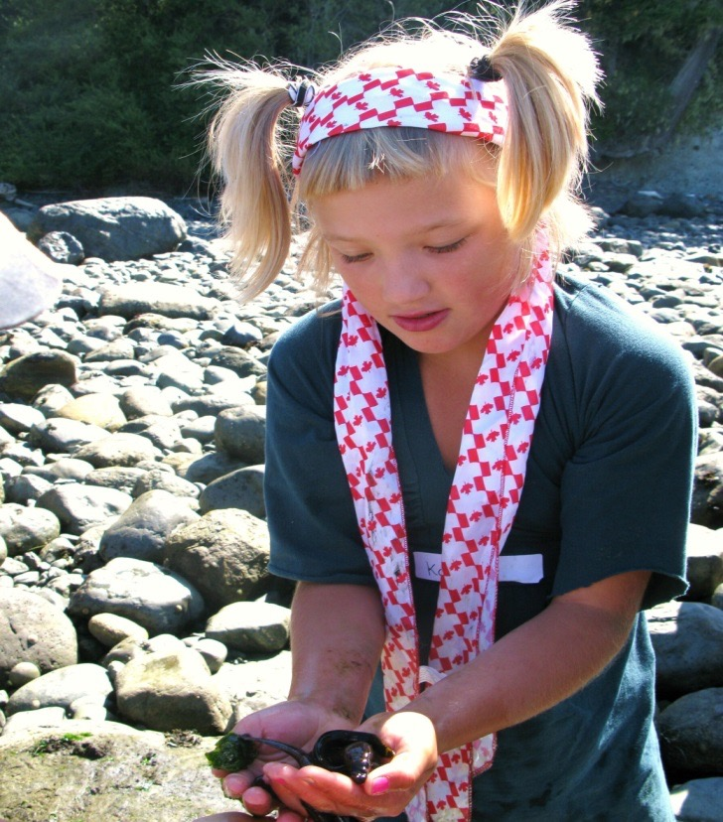
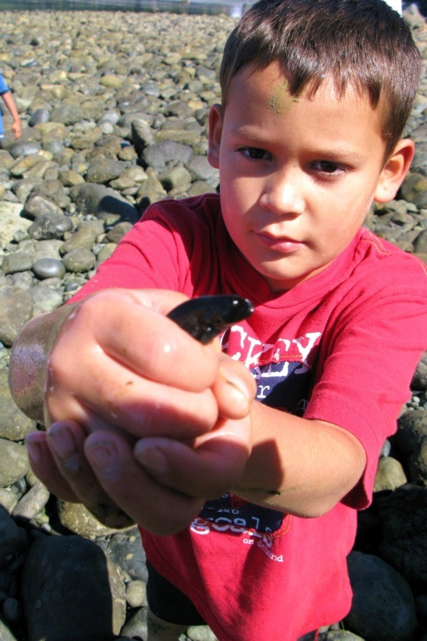
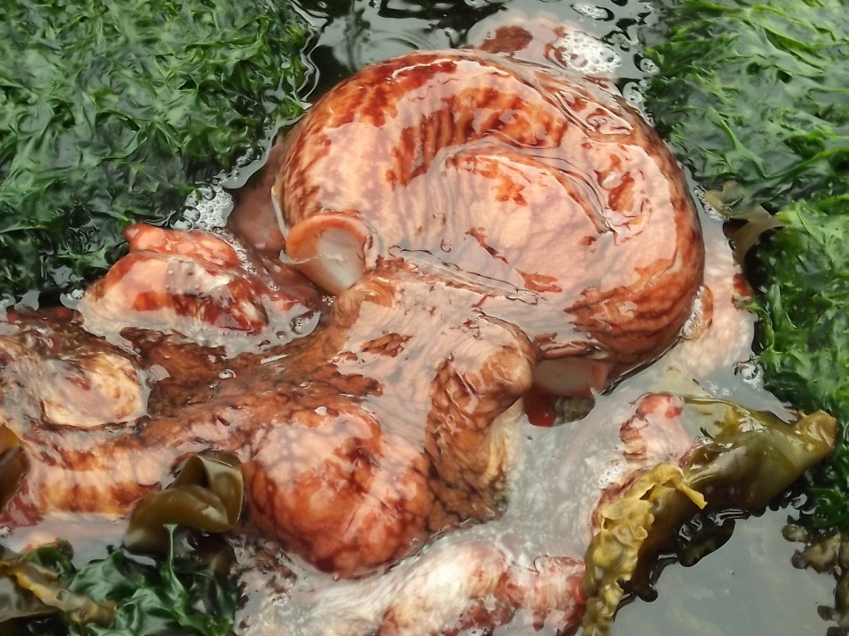
Lunch

Slide 22
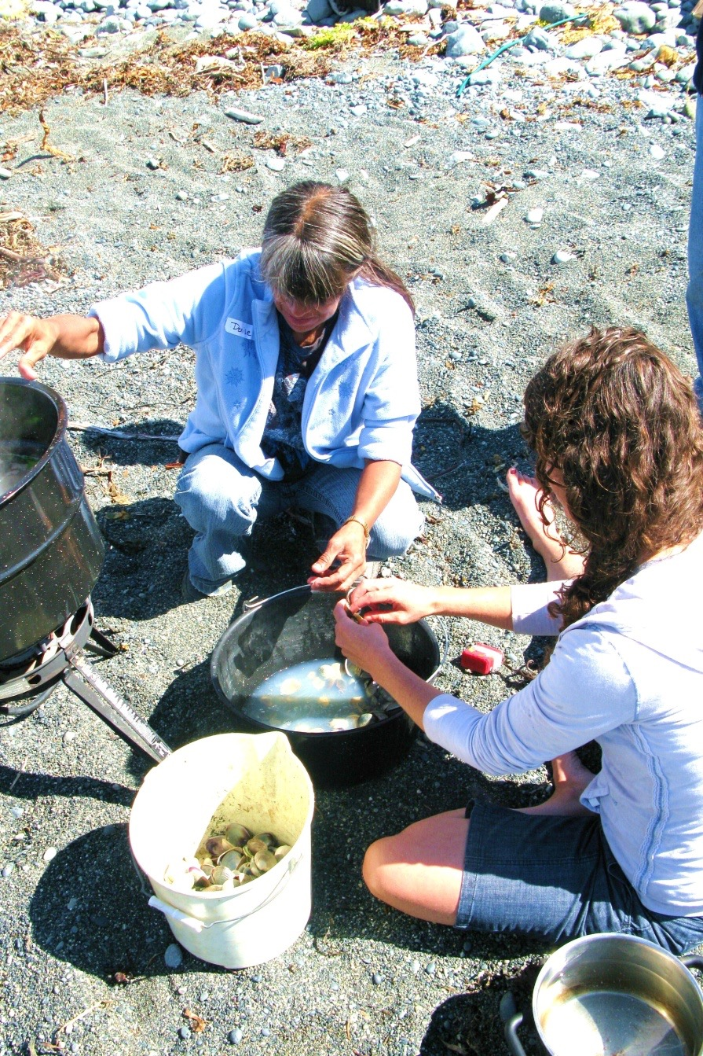
Zero mile diet -Beach Party

Slide 23
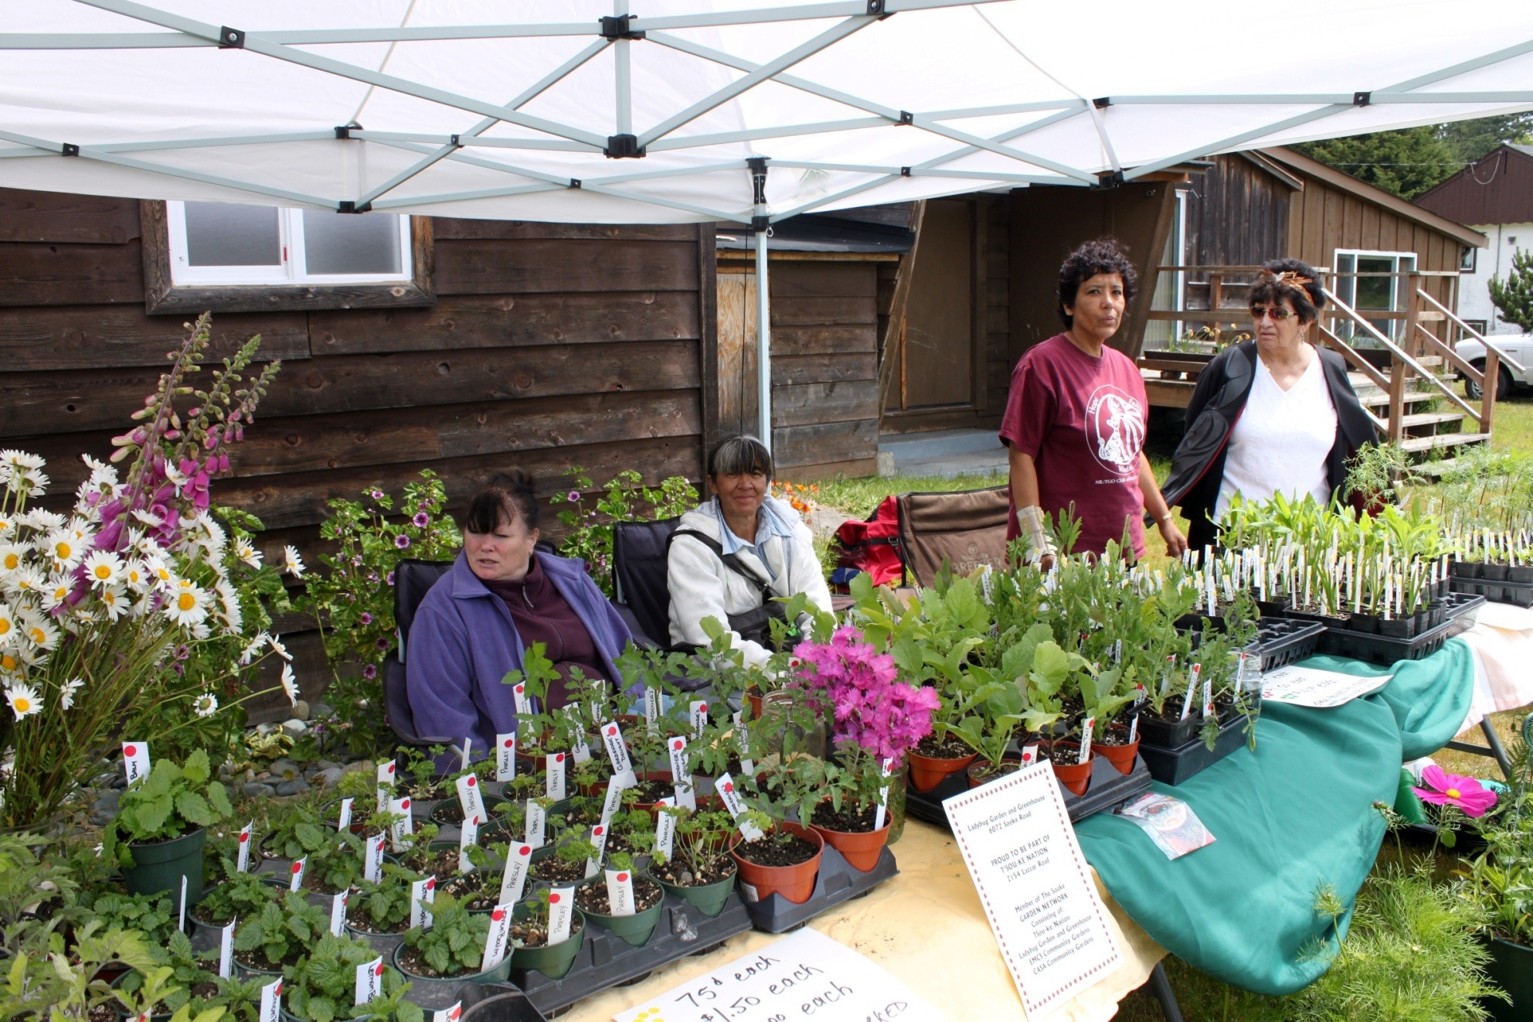
Market Stall

Slide 24
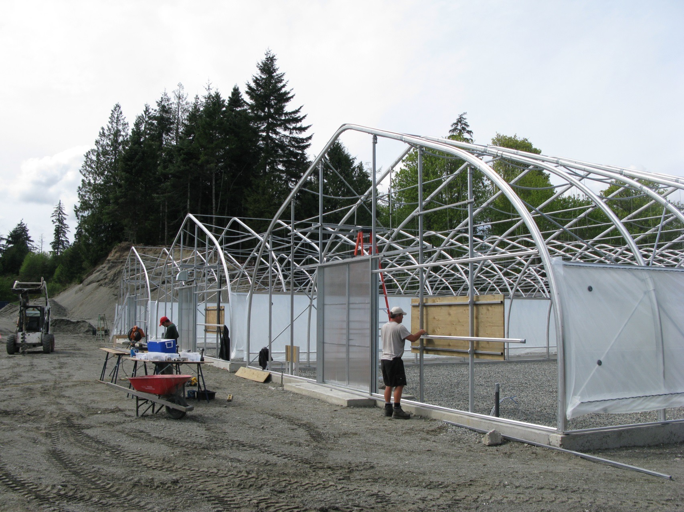
Members building three Greenhouses

Slide 25
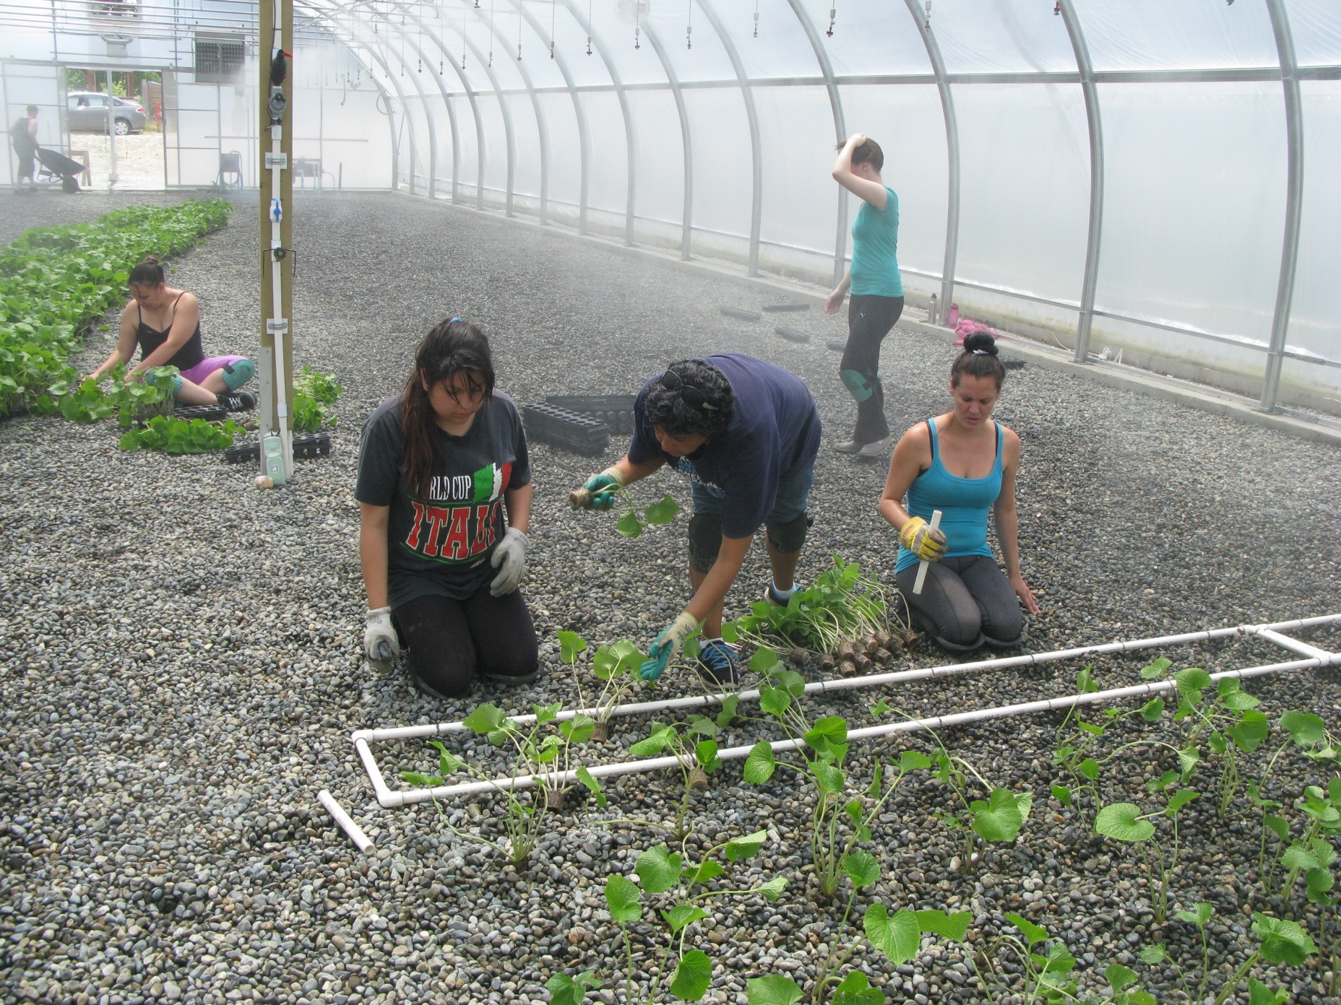
Wasabi Greenhouse planting

Slide 26
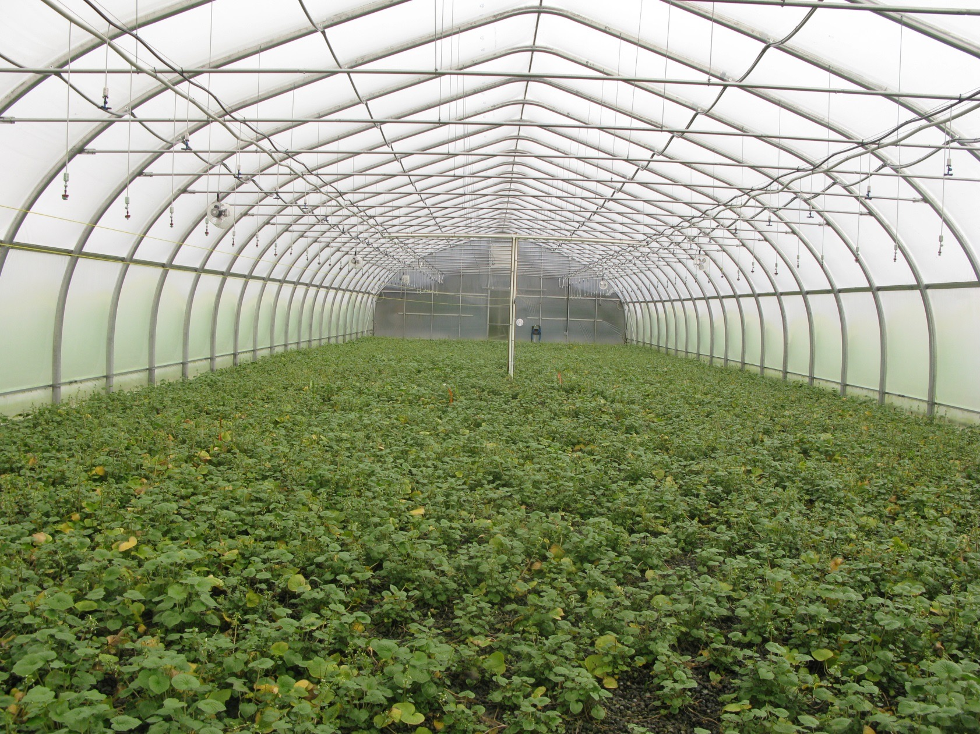
Wasabi Crop Growing

Slide 27
CULTURAL RENAISSANCE

Slide 28
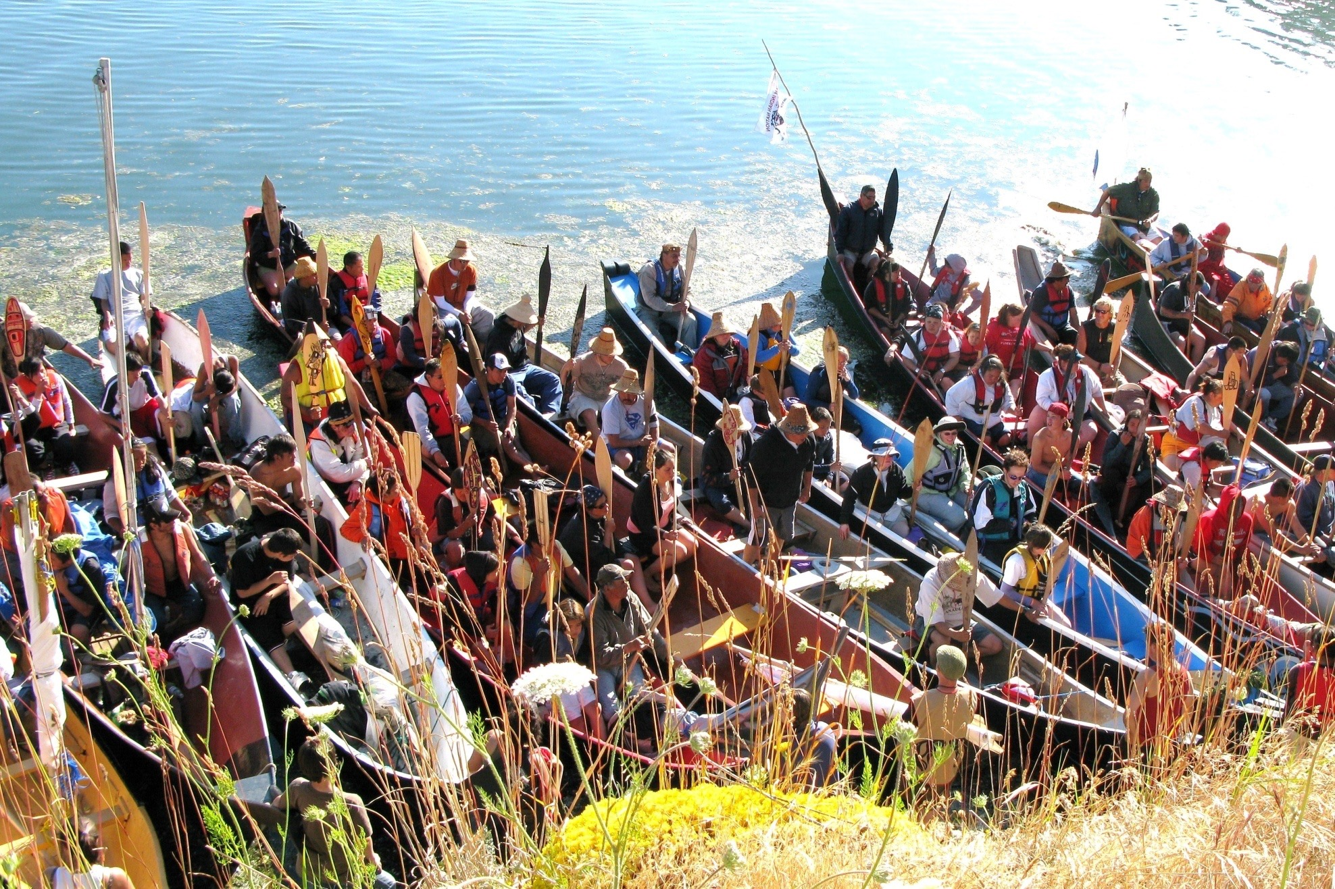
Tribal Journey at T’Sou-ke

Slide 29
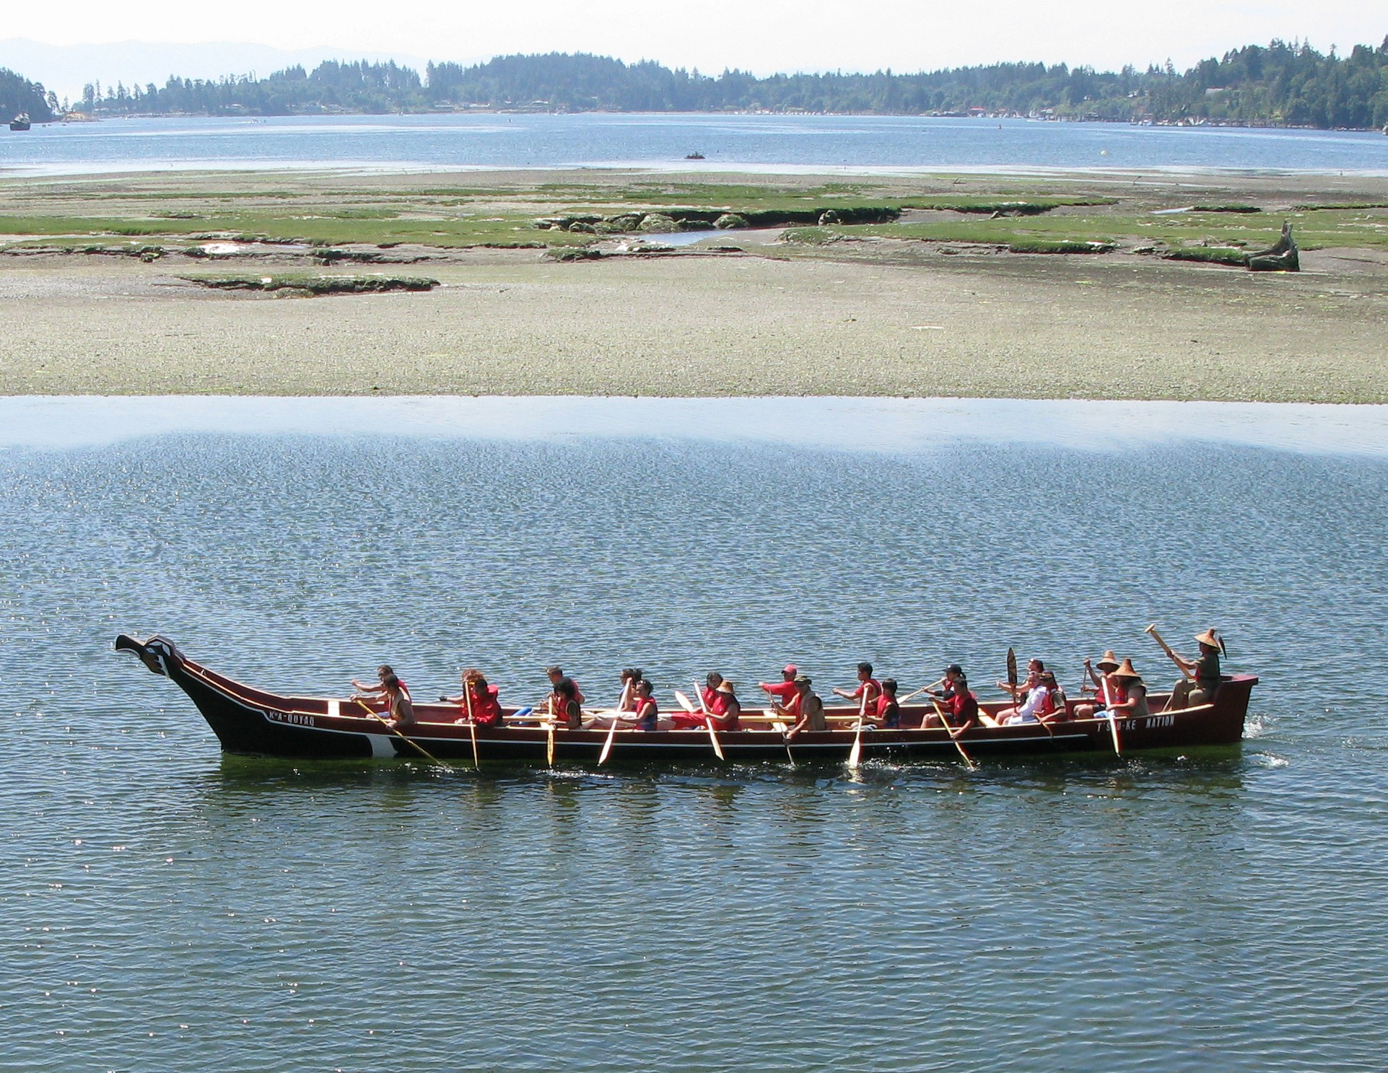
Tribal Journey

Slide 30
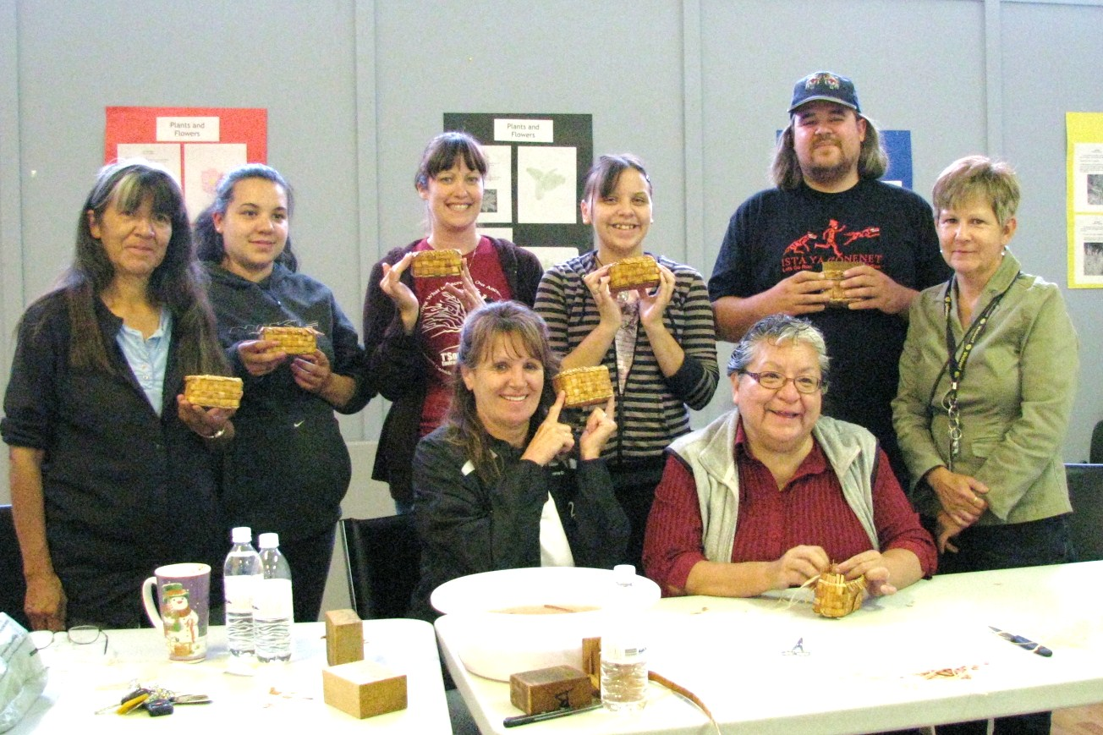
Cedar Bark Workshop

Slide 31
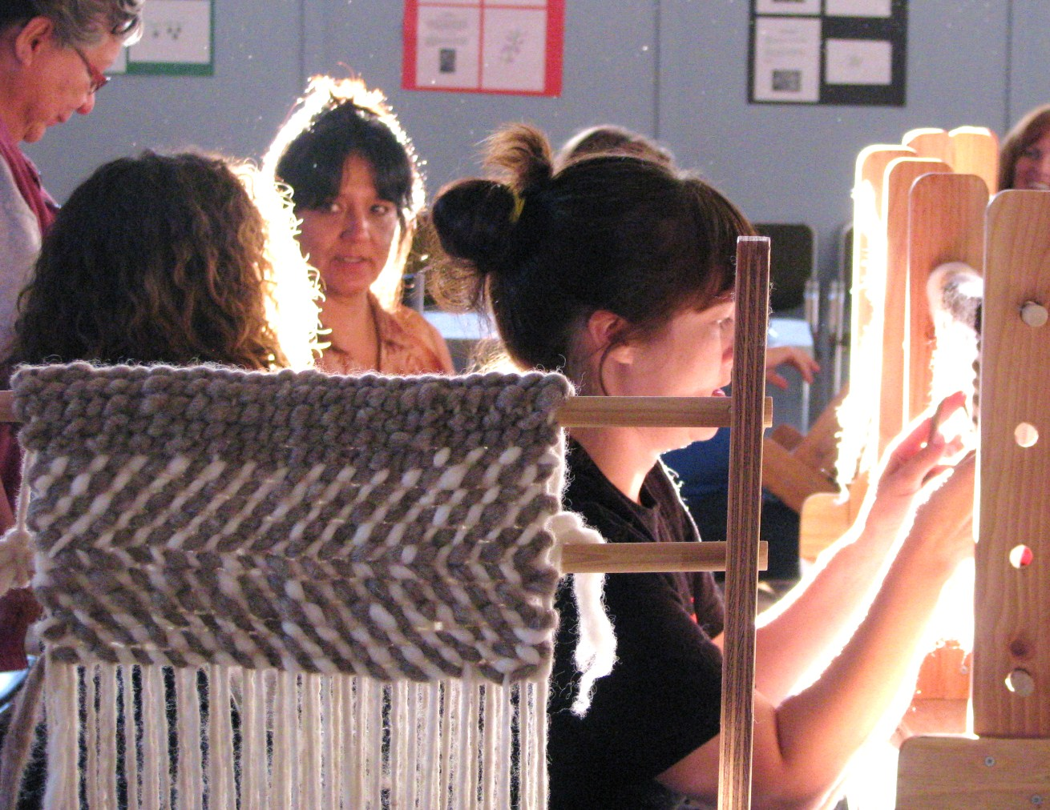
Weaving Workshop

Slide 32
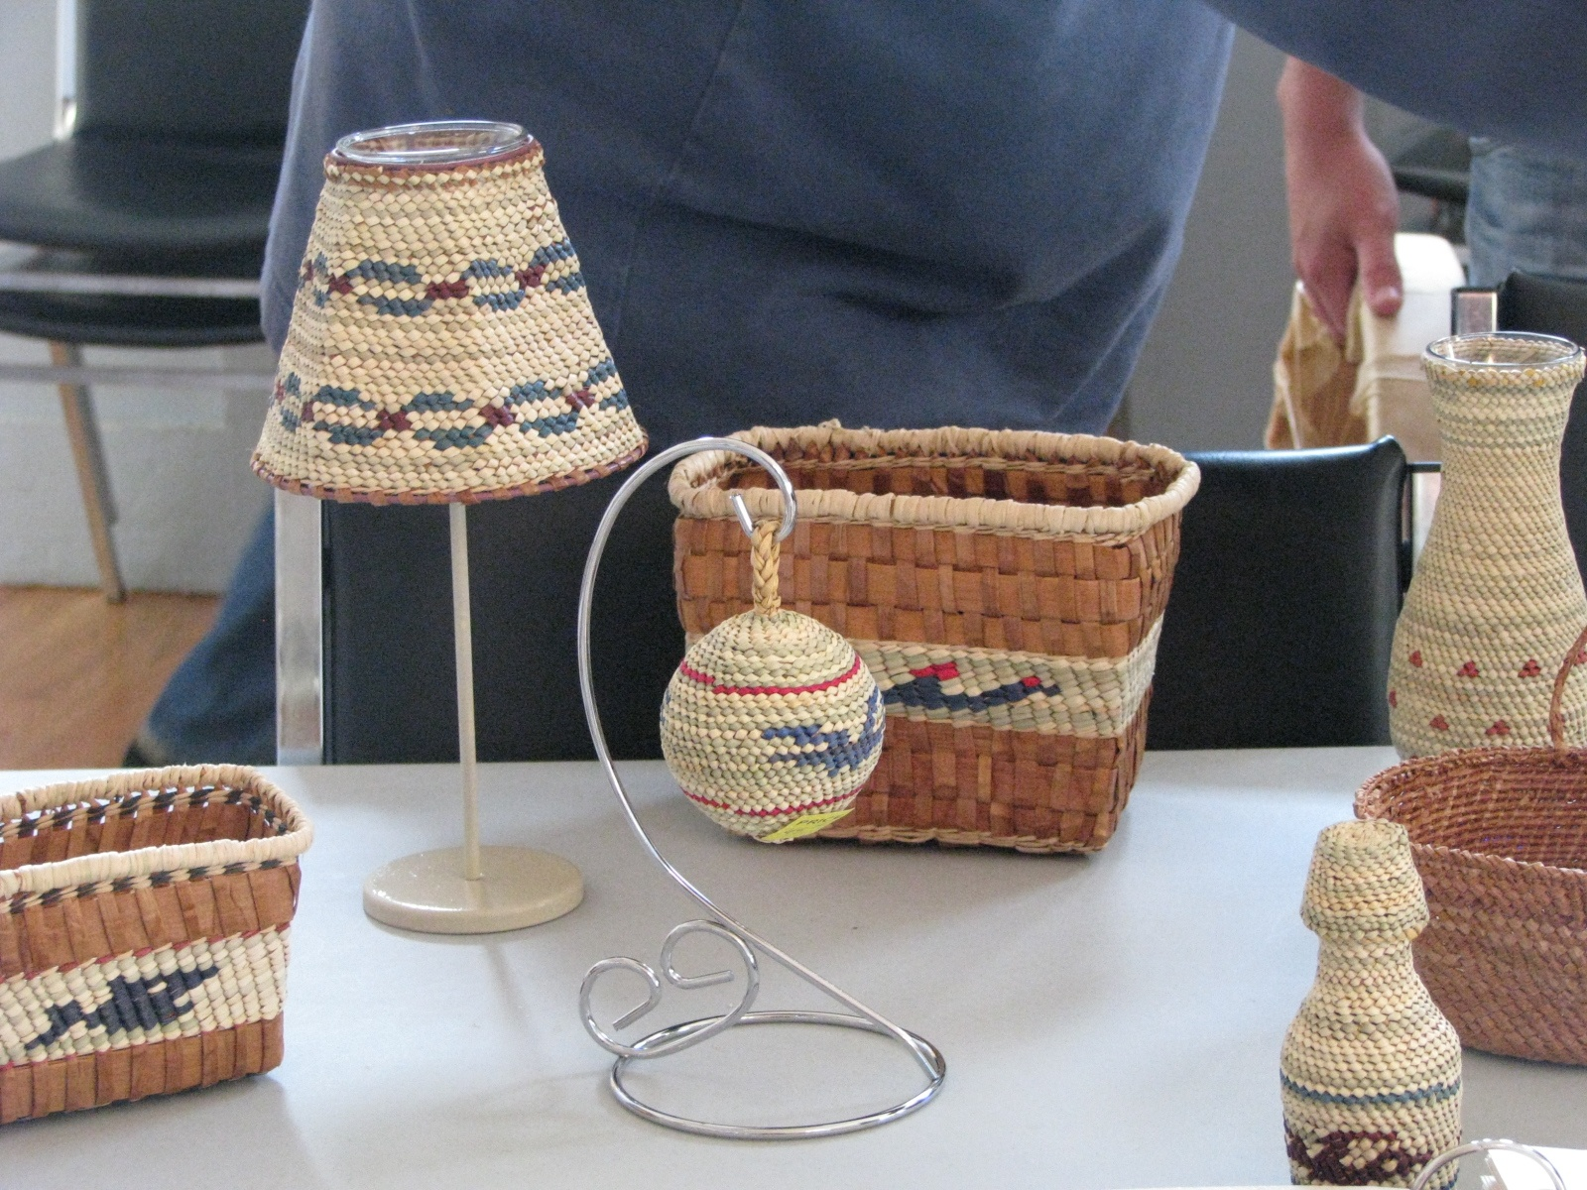
Grass and Cedar Work

Slide 33
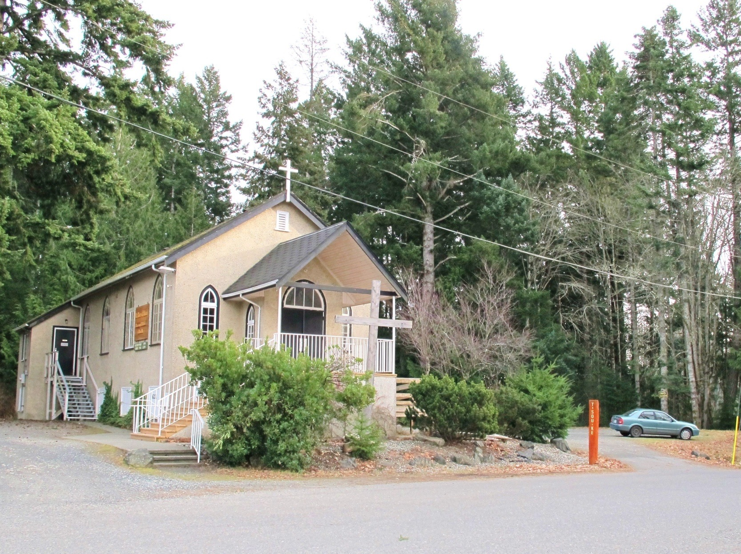
Catholic Church soon to become T’Sou-ke Arts Centre with Gift Shop

Slide 34
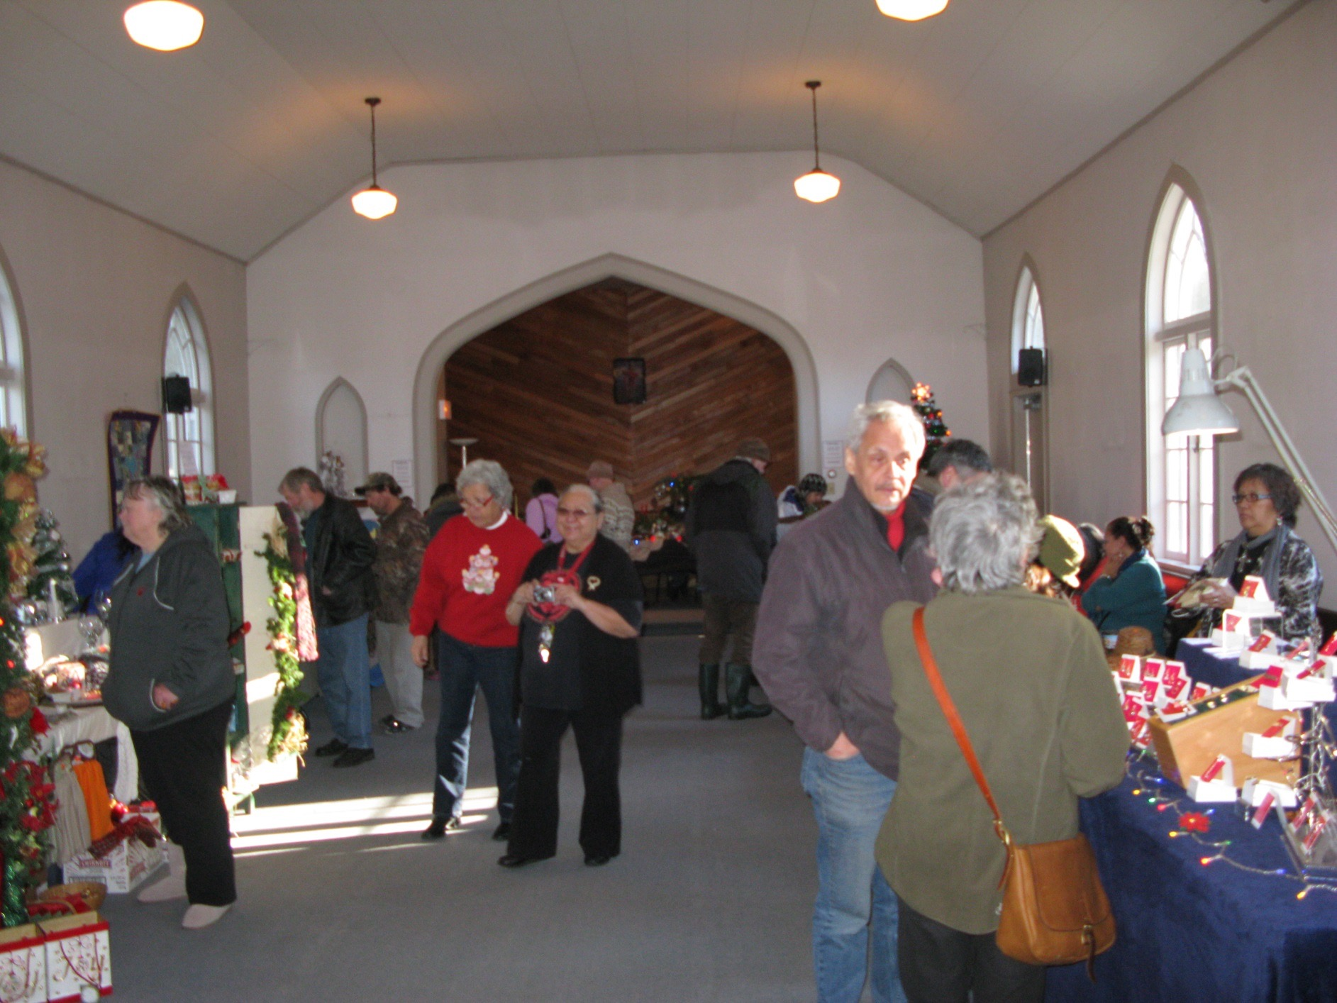
Arts and Craft Centre Sale

Slide 35
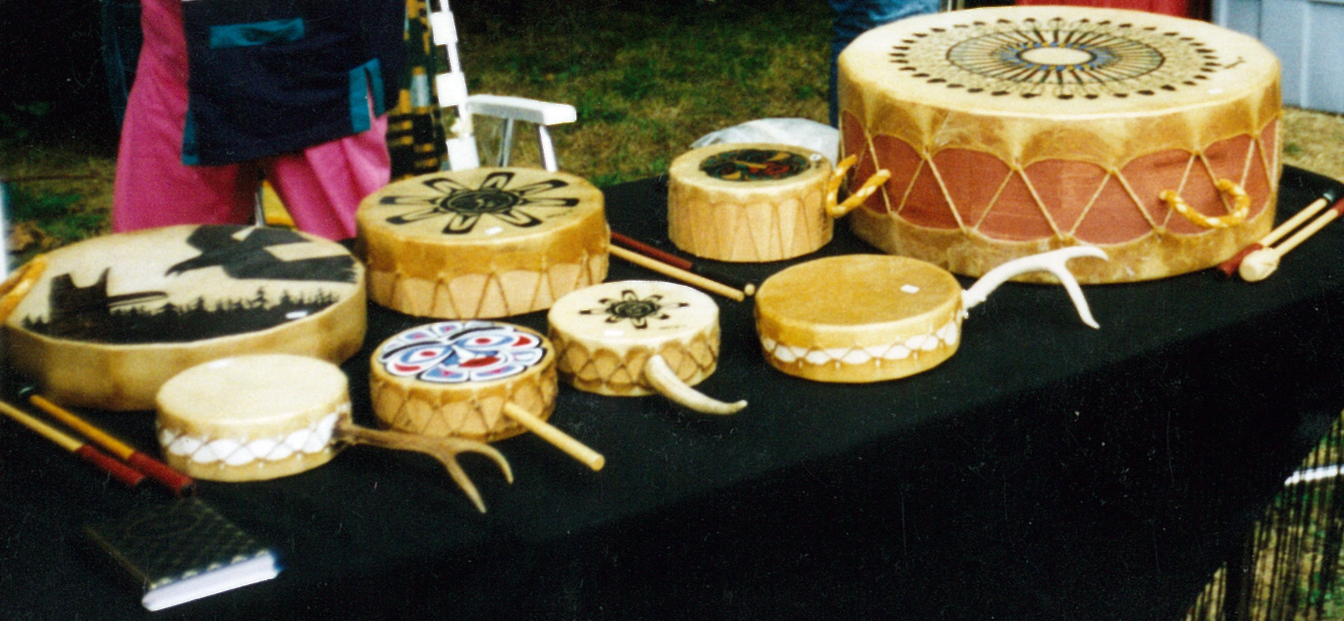
Drums Stall

Slide 36
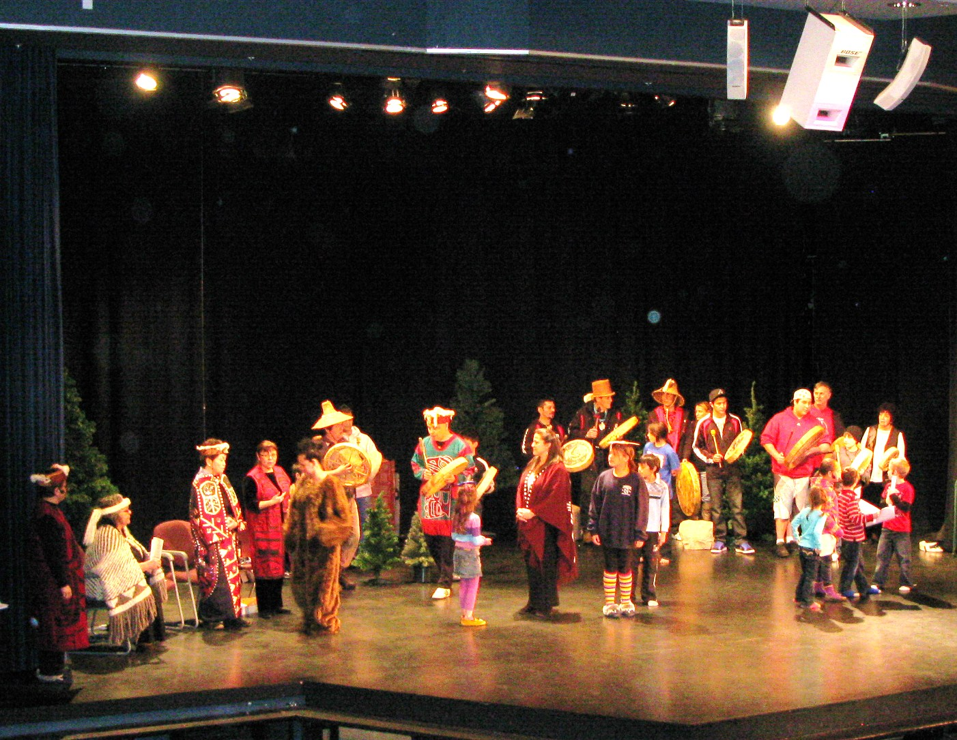
Spirit Festival

Slide 37
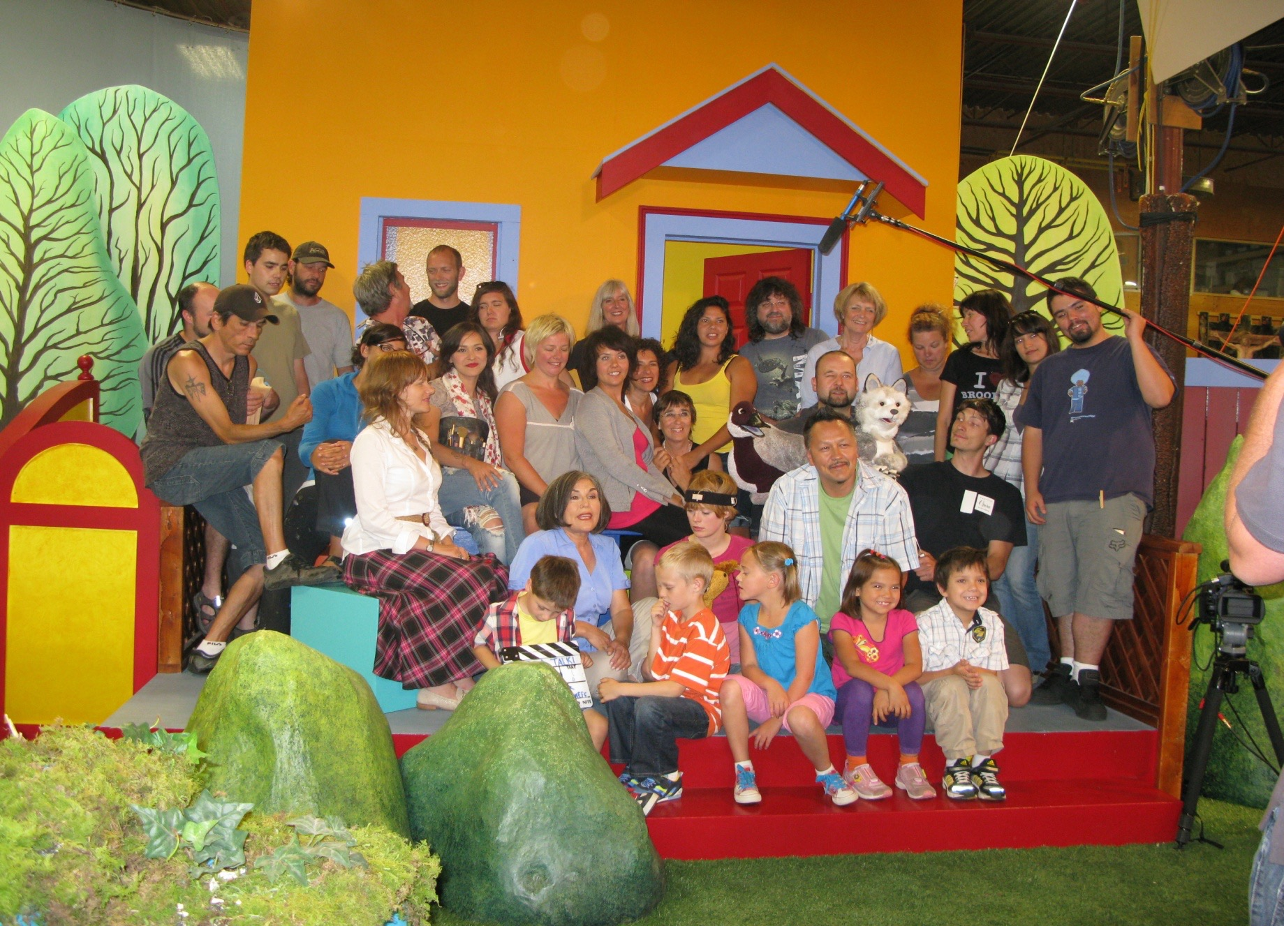
T’Sou-ke children engaged to act in APTN TV series

Slide 38
Hopi Elder Speaks
The time for the lone wolf is over. Gather yourselves! Banish the word struggle from your attitude and vocabulary. All that we do now must be done in a sacred manner and in celebration.
We are the ones we have been waiting for.

Slide 39
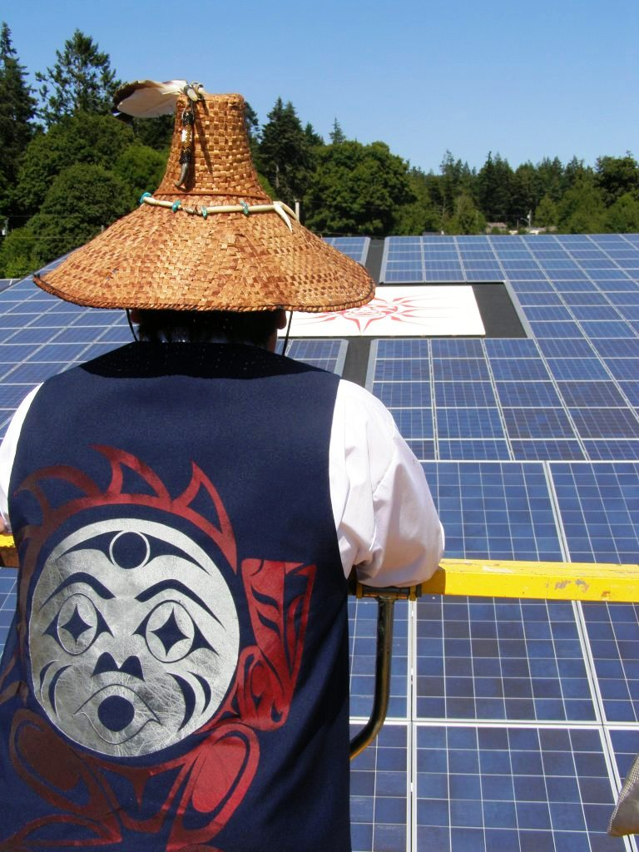
Hisw-ke

