Slide 1
THE COMMISSION FOR ENVIRONMENTAL COOPERATION OF NORTH AMERICA The CEC on Disaster Resilient Communities JPAC Regular Session 19-01 Mexico City, Mexico, June the 24th, 2019

Slide 2
THE CEC ORIGINS
The North American Agreement for Environmental Cooperation (NAAEC, 1994), as environmental arm of the North American Free Trade Agreement (NAFTA), represents the countries’ commitment to accompany trade liberalization and economic growth with cooperation for protecting the environment
The Commission for Environmental Cooperation (CEC) is composed of a Council, a Secretariat and a Joint Public Advisory Committee (JPAC)
Council: governing body, cabinet-level environmental representatives of the Parties to the NAAEC
Secretariat: responsible for technical, administrative and operational support to the Council, committees and groups, based in Montreal
JPAC: 5 volunteer citizens from each country, appointed by the Council, to provide advice within the scope of NAAEC

Slide 3
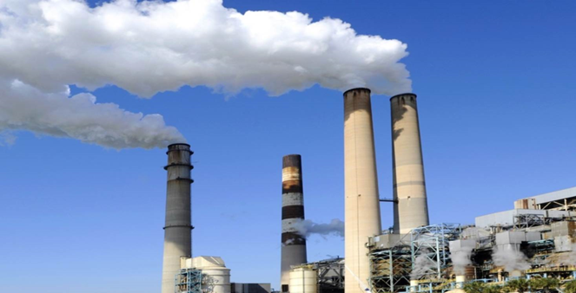
25 YEARS OF THE CEC
Throughout 25 years, the CEC has worked in different fields and paths
In early years priorities were mostly associated with ensuring environmental objectives of the NAAEC were met, while the last 15 years have been mostly focused on environmental cooperation between the countries
Some of the main achievements of the CEC are part of the exhibition that you will be able to walk around starting today, and during this week, located in the Main Lobby
A special feature displayed is the 25th anniversary timeline, where major events involving the CEC are featured
You will also be able to be able to enjoy a video that celebrates our first 25 years and you are invited to visit our website to view special anniversary features
Notes:
Through the CEC, US and Canada have helped enhancing domestic capacity in Mexico to achieve environmental objectives of the NAAEC (pollution prevention, toxic chemicals, and pollutant release inventories)
Sound Management of Chemicals (SMOC) initiative, designed to eliminate / reduce use of toxic chemicals of common concern; included development / implementation of North American Regional Action Plans for toxic chemicals (DDT, chlordane, PCB, mercury, and lindane), and environmental monitoring and assessment
Key outcome of SMOC was contributing to halt the DDT use in Mexico (2000), that shared lessons learned with other countries in Latin America
Success story from FIPREV (in partnership with Mexican Industrial Chambers); a mechanism for financing pollution prevention projects providing loans to small and medium-size businesses (6 years, 83 loans, US$21.9 million, 3,675 tons of chemicals per year preventing from entering the environment)
RETC (Registro de Emisiones y Transferencias de Contaminantes) – establishment of a Pollution Release and Transfer Registry in Mexico

Slide 4
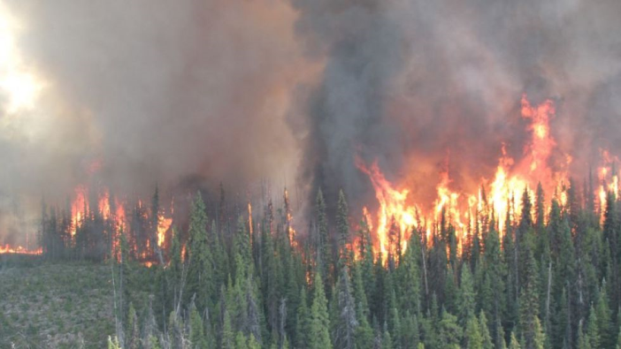
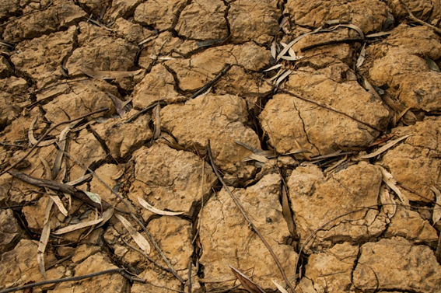
GETTING TO OUR TOPIC
The OP 17 -18 included a project on the topic of extreme heat. Its acceptance and possibilities of being shared by the three countries opened the door to a new initiative to address the topic of extreme weather events.
Hence, last year in Oklahoma, an initiative was launched on creating institutional partnerships to improve prediction, preparedness, response and resilience to extreme events (wildfires, floods, droughts, extreme temperatures) affecting communities in North America; complementing the current CEC work on monitoring health impacts from extreme heat events
Notes:
Through the CEC, US and Canada have helped enhancing domestic capacity in Mexico to achieve environmental objectives of the NAAEC (pollution prevention, toxic chemicals, and pollutant release inventories)
Sound Management of Chemicals (SMOC) initiative, designed to eliminate / reduce use of toxic chemicals of common concern; included development / implementation of North American Regional Action Plans for toxic chemicals (DDT, chlordane, PCB, mercury, and lindane), and environmental monitoring and assessment
Key outcome of SMOC was contributing to halt the DDT use in Mexico (2000), that shared lessons learned with other countries in Latin America
Success story from FIPREV (in partnership with Mexican Industrial Chambers); a mechanism for financing pollution prevention projects providing loans to small and medium-size businesses (6 years, 83 loans, US$21.9 million, 3,675 tons of chemicals per year preventing from entering the environment)
RETC (Registro de Emisiones y Transferencias de Contaminantes) – establishment of a Pollution Release and Transfer Registry in Mexico

Slide 5
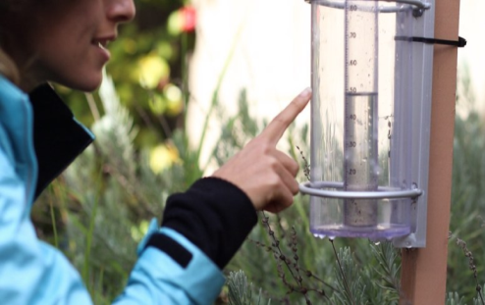
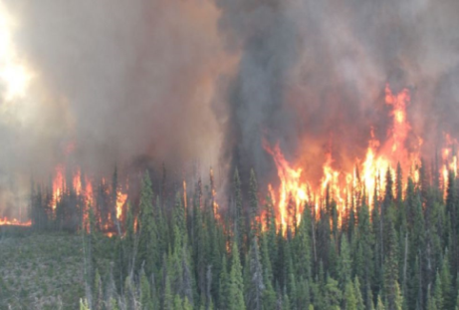
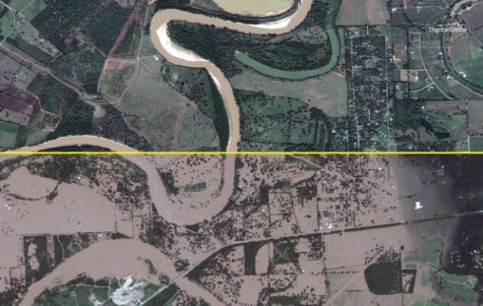
2018 PARTNERSHIP ON BUILDING NORTH AMERICAN RESILIENCE TO EXTREME EVENTS
Improving local capacity of early warning systems for drought across North America
Increase local capacity to use drought information for planning and risk management and develop guidelines for the use of drought indicators tailored to North America.
Using Volunteer Observer Networks to inform Prediction and Monitoring of Precipitation and Wildfires
Assess the expansion of the CoCoRaHS and other networks to address information gaps relative to predicting and monitoring extreme events.
Notes:
Partnerships on preparedness and resilience to extreme events in North America
North American Academic Network for Sustainability and Innovation
Traditional Ecological Knowledge (TEK) Initiative
Objectives: Identify and compile information on communities and experts associated with Traditional Ecological Knowledge (TEK) in North America, including:
A comprehensive inventory and summary of relevant frameworks and mechanisms in each country for the engagement of indigenous communities;
An inventory and summary descriptions of examples of TEK-based projects in universities or other research/public institutions and private sector partners;
A list of indigenous and local communities that have engaged TEK as part of university, other research institution, or private-sector partner consultations.
Progress:
The work is currently underway, and each consultant provided an update on their work at the end of November, and most recently on 15 January. The preliminary final reports are due on 15 February, and will be review by the Parties and the three TEKEG leads.
Once we conclude the review process and if there are no delays, we expect to have their final reports by 15 March.
The Secretariat is currently finalizing an in-house inventory of CEC engagement with Indigenous communities since 1995. This work is expected to be finalized before the end of January 2019.

Slide 6
2018 PARTNERSHIP ON BUILDING NORTH AMERICAN RESILIENCE TO EXTREME EVENTS
2018 COUNCIL INITIATIVES
Costing Floods and Other Extreme Events
Develop a standardized methodology for assessing the cost of extreme floods in the US, Mexico, and Canada
Use of remote sensing to improve preparedness and response to extreme events
Build local and regional capacities of first responders, emergency managers, and decision-makers relative to obtaining and using real-time satellite imagery in the preparation and response to extreme events
Notes:
Partnerships on preparedness and resilience to extreme events in North America
North American Academic Network for Sustainability and Innovation
Traditional Ecological Knowledge (TEK) Initiative
Objectives: Identify and compile information on communities and experts associated with Traditional Ecological Knowledge (TEK) in North America, including:
A comprehensive inventory and summary of relevant frameworks and mechanisms in each country for the engagement of indigenous communities;
An inventory and summary descriptions of examples of TEK-based projects in universities or other research/public institutions and private sector partners;
A list of indigenous and local communities that have engaged TEK as part of university, other research institution, or private-sector partner consultations.
Progress:
The work is currently underway, and each consultant provided an update on their work at the end of November, and most recently on 15 January. The preliminary final reports are due on 15 February, and will be review by the Parties and the three TEKEG leads.
Once we conclude the review process and if there are no delays, we expect to have their final reports by 15 March.
The Secretariat is currently finalizing an in-house inventory of CEC engagement with Indigenous communities since 1995. This work is expected to be finalized before the end of January 2019.

Slide 7
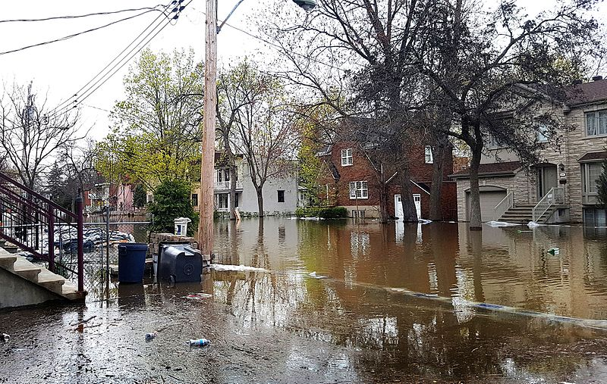
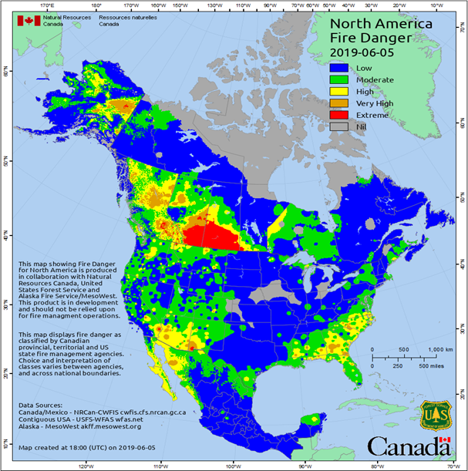
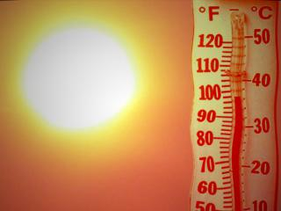
BUILDING DISASTER-RESILIENT COMMUNITIES
The JPAC contributes to the development of the topic of extreme weather events such as floods, drought, hurricanes or wildfires
North American communities, in settlements of every size, face increasing climate instability, raising serious concerns to build local resilience
Therefore, an additional concern is food security and the challenge of enhancing food system resilience in the era of extreme weather events

Slide 8
INTO THE FUTURE OP 2019 - 2020
The Operational Plan 2019-2020 is presented to the Council for its approval
An Operational Plan aiming at contributing to conserve, protect and / or enhance the North American environment and to support national and tri-national efforts of the Parties. Addresses the following priority areas:
Circular economy and resource efficiency
Community adaptation, resilience and air quality
Conservation of species and ecosystems
Engaging tribes, First Nations and local and indigenous communities
A planning tool that is effective, efficient, and results – oriented
The Submissions on Enforcement Matters process, the NAPECA grant program, initiatives (Environmental Atlas, PRTR) are also part of the OP

Slide 9
THE CEC: LOOKING TO THE FUTURE
Further strengthening nexus between trade and environment
Ensuring better continuity of work
Tracking long-term performance of the organization and projects
Improving scope and effectiveness of public participation
Improving effectiveness of communications and messaging to the public
Expanding the life span of CEC projects and initiatives through partnerships
Ensuring CEC’s work leads to tangible results
Strengthening link between project activities and strategic vision

Slide 10
Three countries. One environment.
César Rafael CHÁVEZ
crchavez@cec.org
© Commission for Environmental Cooperation / 2013

