Slide 1

The road forward for the CEC and NAAEC
NAFTA’s Environmental Side Agreement: Assessing the Past, Looking towards the Future
Carlos Véjar

Slide 2
NAFTA 2.0?
Article 50: Withdrawal A Party may withdraw from this Agreement six months after it provides written notice of withdrawal to the other Parties. If a Party withdraws, the Agreement shall remain in force for the remaining Parties.

Slide 3
Unfinished agenda – Impossible goals?
“Canada shall use its best efforts to make this Agreement applicable to as many of its provinces as possible”
“Consultations and dispute settlement”
“avoid creating trade distortions or new trade barriers”

Slide 4
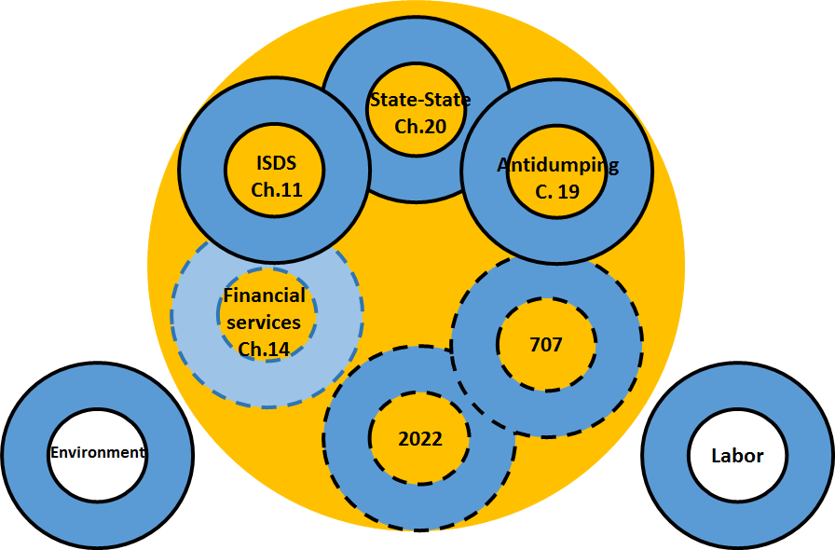
NAFTA Vs NAFTA 2.0
?
State-State

Slide 5
Context
The perception (reality?) is that these are NAFTA parallel agreements, not stand alone Agreements?
Without NAFTA there is no need for “parallel agreements” or NAFTA related institutions? (spillover effect)
NAFTA 2.0 will necessarily entail a revision of “its parallel agreements”, in order to:
    Modernize - identify those areas that merit improvement
    (considering 23 years of experience);
    Renegotiate – Identify areas for improvement
    (eliminate: Chapter 19, ISDS, Side Agreements?)

Slide 6
Context
NAFTA is no longer the only FTA
  (efficient use of financial and human resources, are necessary to address all FTAs needs).
TPP did not contemplated institutions or budget for any institution
(not even a Secretariat for a 12 country treaty)
Unlike Canada and the US, Mexico has not negotiated environmental chapters.
    (why would Mexico have to do it differently under NAFTA 2.0?)
There is no US Free trade agreement without environmental provisions
(should NAFTA move into the same direction? (FTAs have evolved?)

Slide 7
Survival mode?
Committee
Working Group
Secretariat
NGO

Slide 8

FOCUS: “Trade & Environment”
What is the balance of the CEC? How could you translate and dedicate future efforts to promote trade and achieve accountable trade reports..

Slide 9
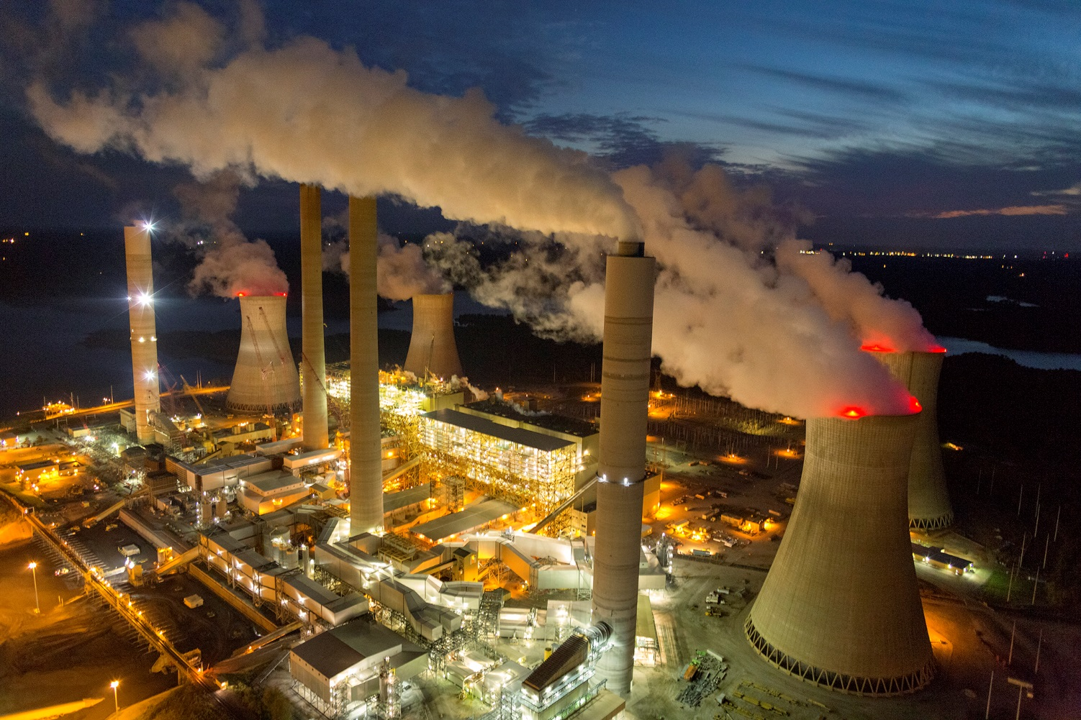
carlos.vejar@hklaw.com
Carlos@Vejar.net
@VEJAR_C

