Slide 1


JPAC Public Meeting
7 November 2016
Advancing Sustainable Clean Energy Cooperation in North America
Submissions on Enforcement Matters (SEM)
Robert Moyer, CEC SEM Director

Slide 2
The NAAEC, the environmental side-agreement to NAFTA, provides that a resident or organization in North America may file a submission with the CEC Secretariat asserting that a Party is not effectively enforcing its environmental law.
This is known as the Submission on Enforcement Matters (SEM) process.

Slide 3

SEM Process
Fact-finding mechanism concerning the effective enforcement of environmental laws in North America, open to residents of Canada, Mexico and the
United States.
Established to foster transparency, public participation, and information sharing regarding a Party’s environmental law enforcement.
Enhances accountability in the effective enforcement of environmental law.
The process is non-judicial, non-adversarial, and does not provide legal redress or lead to sanctioning of a Party, nor does the Secretariat determine whether a Party has or has not enforced its environmental law.
Explainer Video
Notes:
30 Canada
45 Mexico
12 United States
1 Canada-United States
21 factual records have been published. [If Wetlands is published before Council, make that 22!].
Covering a wide range of environmental law enforcement issues covered: environmental impact assessment process, pollution prevention and control, endangered species, hazardous waste disposal, energy infrastructure, etc.

Slide 4
Status of Submissions
Total of 88 submissions filed before the Secretariat since 1994:
30 Canada
45 Mexico
12 United States
1 Canada-United States
5 new submissions since June 2015; 4 submissions currently pending. All concerning Mexican issues.
22 factual records have been published including Sumidero Canyon in 2015 and Wetlands in Manzannilo in 2016.
Notes:
4 current Mexican submissions: La Primavera; Analog TVs; Agricultural Burning in Sonora; and Monterey Aqueduct VI.
22 factual records have been published. Covering a wide range of environmental law enforcement issues covered: environmental impact assessment process, pollution prevention and control, endangered species, hazardous waste disposal, energy infrastructure, etc.

Slide 5
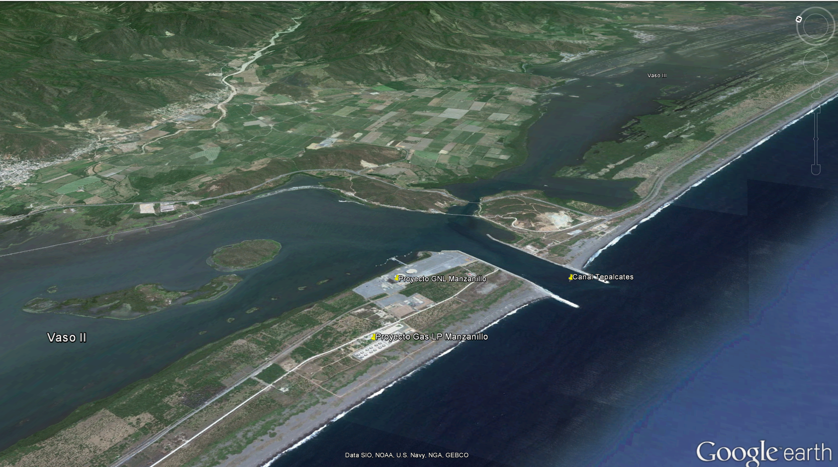
Wetlands in Manzanillo
Final Factual Record published in September 2016.
Notes:
The submission asserts that Mexican authorities should not have granted favorable environmental impact authorizations to two infrastructure projects: a liquified natural gas (LNG) terminal and a liquefied petroleum gas (LPG) terminal. The Submitters assert that the process was conducted without following a proper review under the applicable environmental law.

Slide 6
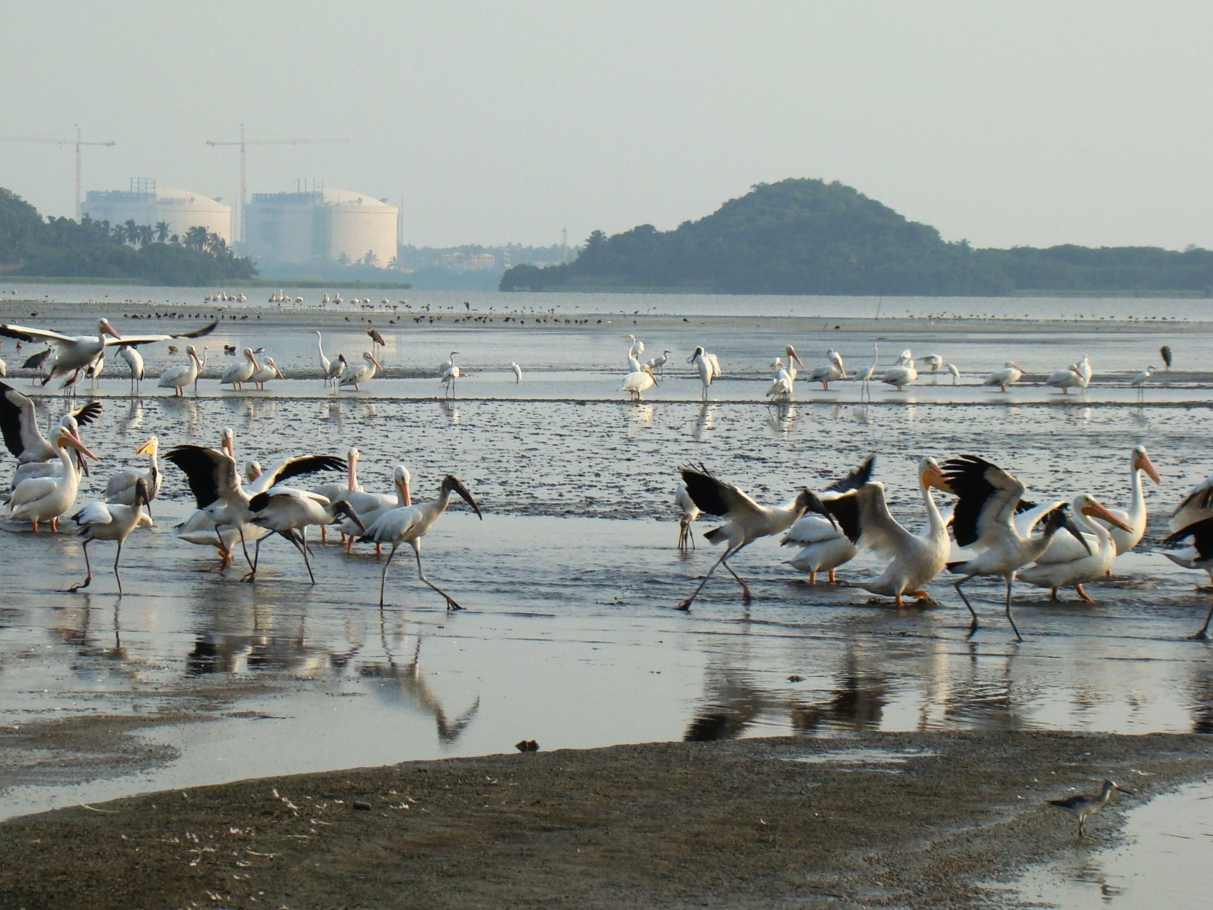

Notes:
This photo shows the LNG tanks under construction. The factual record presents information relevant to the assertions raised in the submission with regard to: i) the relationship between the Liquified Petroleum Gas and the Liquefied Natural Gas (LNG) Terminal projects and the ecological zoning of the territory; and ii) the environmental impact assessment for the LNG Terminal project with respect to the water flow (hydrodynamics) of the Cuyutlán lagoon.

Slide 7
Other Energy-related Submissions
Submissions filed with the CEC Secretariat
Country
Canada | BC Hydro* Ontario Power Generation Alberta Tailings Ponds St Lawrence River Wind Farms
Mexico | Coronado Islands Wetlands in Manzanillo*
United States | Coal-fired Power Plants* Louisiana Refinery Releases Refinery Releases in Shreveport
 | *Factual Record

Slide 8
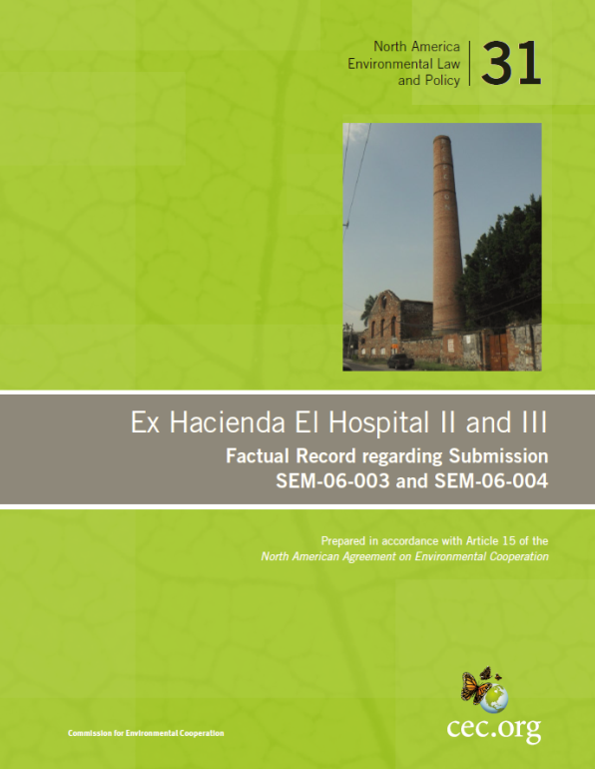
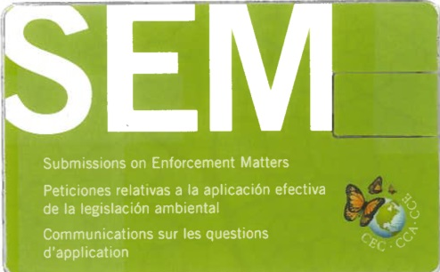
Recent Secretariat Efforts to Improve the SEM Process
Enhanced visibility of and updated SEM webpage
Increased targeted outreach activities, including webinars, outreach events, and strengthening relationships with stakeholders and law schools in the three countries
Continue to develop more accessible factual records
Continue to process submissions timely
Notes:
The SEM Unit has been working in improving accessibility of factual records and make them more attractive to the public.
Increased visibility of factual records was accomplished through:
The SEM USB Cards
Improving Factual Records formatting through Text Boxes and visual elements
Summarizing information in a more concise and accessible manner. A new index structure is now discussed with the Parties

Slide 9
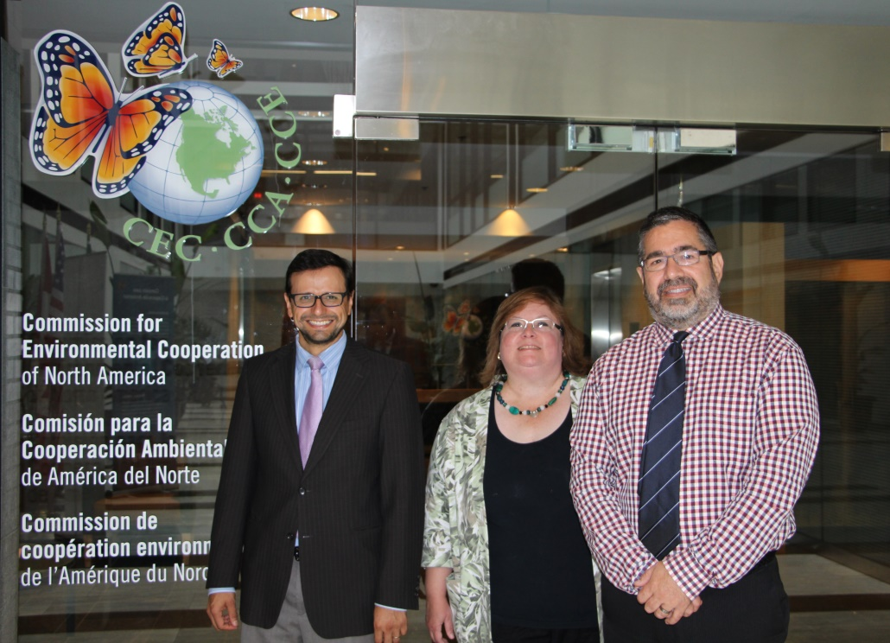
Contact the SEM Unit
Robert Moyer
Paolo Solano
Doris Millan
+1 514-350-4304 (Montreal)
sem@cec.org

