Slide 1
The Direction of Lighting Control
Assistant Professor
Dr. Kevin B. Martin
Commission for Environmental Cooperation (CEC) of North America
Joint Public Advisory Committee (JPAC) Regular Session 16-02
11/7/16

Slide 2
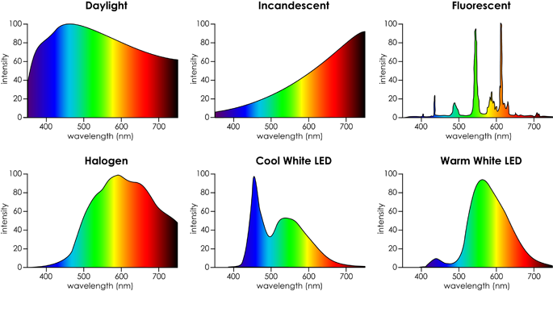
Do These Look The Same?
CIE 1931 and 1976 form the basis for most lighting measurements

Slide 3
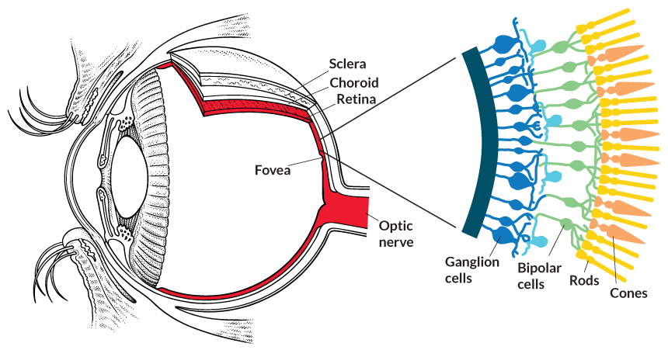
Background
•Rods
– 120 Million - All Over Retina
– Peripheral Vision
– Low Light Levels
•Cones
– 8 Million - Predominantly in Fovea
– 3 Types – L,M,S Wavelength
– Visual Acuity
– Higher Light Levels
•iPRGC (intrinsically Photosensitive Retinal Ganglion Cells) (Berson et al, 2002)
– RGCs affect circadian rhythms (Foseter et al, 1991)
– Influence on pupillary reflex, which influences light reaching the retina (McDougal and Gamlin, 2010)

Slide 4
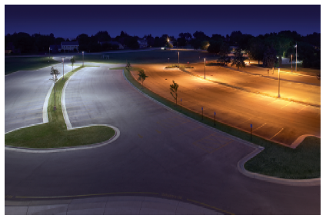
Currently Used Metrics
Luminous flux (lumens)
Appearance depends on spectral distribution of light
Illuminance (lumens/m² or lux)
Appearance depends on spectral distribution of light
Luminous Efficacy (lumens/watt)
Directionality of lumens???

Slide 5
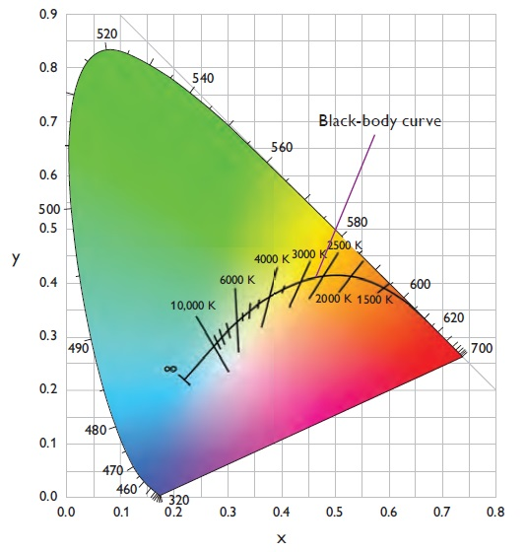
Currently Used Metrics
Correlated Color Temperature (CCT)
Many spectral power distributions (SPD) can have same CCT

Slide 6
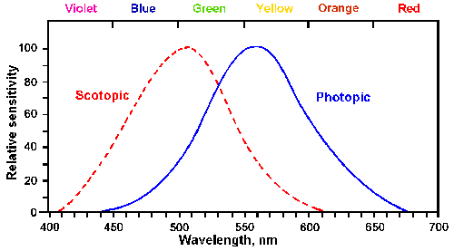
Currently Used Metrics
Photopic Luminous Efficiency Function (V(λ))
Photopic (daylight) and Scotopic (starlight)
Cones (Yellow/Green 555nm) Rods (Blue/Green 505nm)
Each neural channel weights the spectrum differently using different combinations of the same photoreceptors
Winton FR, Bayliss LE: Human Physiology, 5th ed. Boston, Little, Brown, 1962

Slide 7
Currently Used Metrics
V(λ) (Photopic vision)
Only takes into account L & M Cones
Ignores S Cones & Rods contribution to visual perception
Unable to quantify our perception of the physical environment if only one function is utilized
Example Areas That Can Be Over Bright
Roadway lighting
Gathering spaces
Other non high visual acuity task areas
Why Do We Do Things This Way?
It’s simplifies things
One definition is useful for commerce

Slide 8
Motivation for Expansion
International Agency for Research on Cancer issued report that shift work and the associated light at night is “probably carcinogenic to humans”(2007)
Important Factors To Consider
Radiance of the light source (Intensity)
Spectral distribution
Duration of focused exposure on the retina
Time of day
https://www.iarc.fr/en/media-centre/pr/2007/pr180.html

Slide 9
How Do We Improve? Use Control
ASHRAE 90.1 (2010/2013)
Expanded control and daylighting requirements as well as exterior lighting limits
International Energy Conservation Code (IECC) (2012/2015)
Expanded to include digital lighting control system that provides continuous dimming and individual addressability of the lamps and fixtures
ASHRAE 189.1 (2014)
Expansion of 90.1 control requirements

Slide 10
State of Lighting Control
Most are proprietary
Few open protocol commercial systems (DALI)
Cost of digital ballasts, limited choices and architect knowledge -> reduced adoption in North America
Move toward addressable intelligence at the fixture level through an input/output (I/O) module
Not designed for commercial/industrial building needs (DMX)
Controls systems have to take into account quality of lighting for occupant satisfaction and comfort

Slide 11
Moving Forward
Combine Lighting and HVAC Control Systems
Open source communications protocol that has an included wireless standard
Incorporate BACnet
Capable of running optimization algorithms that could take into a variety of data including SPD, productivity enhancement, and demand management requirements not just schedules
Address cybersecurity

Slide 12
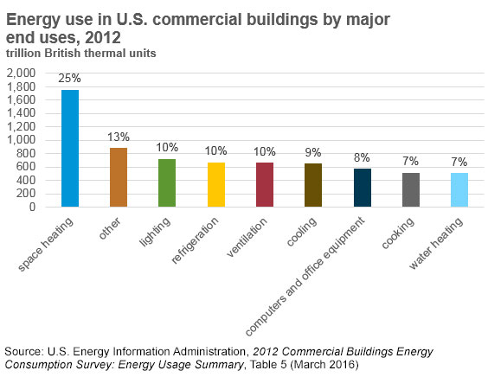
Potential Impact

Slide 13
Conclusions
Expand understanding between light
Physiological Effects (wellbeing, comfort, mood)
Biological Effects (hormones, alertness, CR)
Develop, modify, adopt measurement metrics that are more appropriate for LED lighting
Energy Efficiency
Physiological
Biological

Slide 14
Conclusions
Future control systems need to include more parameters
Physical stimulus characteristics
Spectrum
Amount
Duration
Spatial distribution (avoid double lighting, correct optical distribution)
Timing
Polarization
Biological response characteristics
Spectral sensitivity
Temporal integration (timing of light)
Absolute threshold
Hysteresis

Slide 15
Conclusions
Dept. of Energy Fact Sheet (May 2014)
Lighting for Health: LEDs in the New Age of Illumination
Key Messages:
Non-visual effects of light are clearly shown
Light impacts health and wellbeing
Effects are not comprehensively understood
Effects could be positive/negative depending on situation
“One thing is for certain, however: the lighting industry cannot ignore nonvisual needs indefinitely.”
http://www1.eere.energy.gov/buildings/publications/pdfs/ssl/light_and_health_fs.pdf

Slide 16
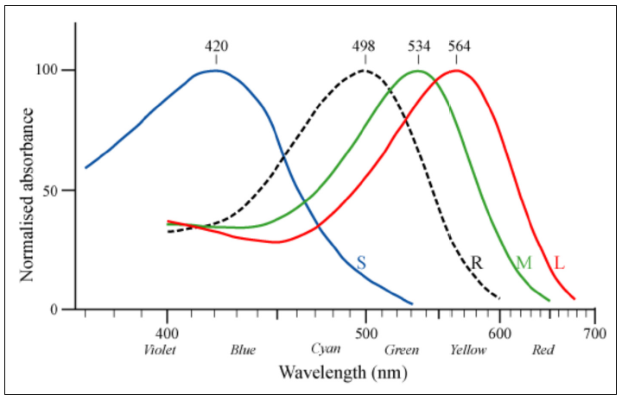
Back Up (Photoreceptor Response)
http://www2.lawrence.edu/fast/GREGGJ/CMSC420/chapter19/color_theory.pdf

