Slide 1
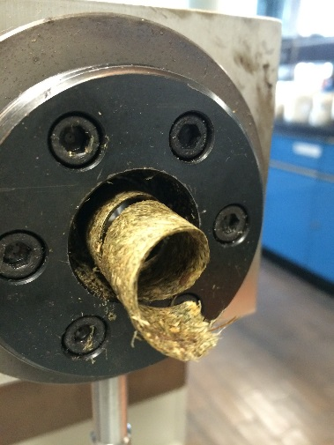
Clean energy and bioenergy in Mexico
Mexican Petroleum Institute
Jorge Arturo Aburto Anell
Copyright © 2016-Instituto Mexicano del Petróleo
Queda prohibido copiar, reproducir, distribuir, publicar, transmitir, o en cualquier modo explotar cualquier parte de este documento sin la autorización previa por escrito del Instituto Mexicano del Petróleo o de los titulares correspondientes

Slide 2



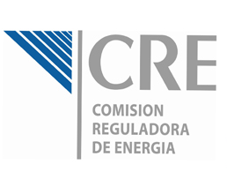




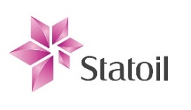








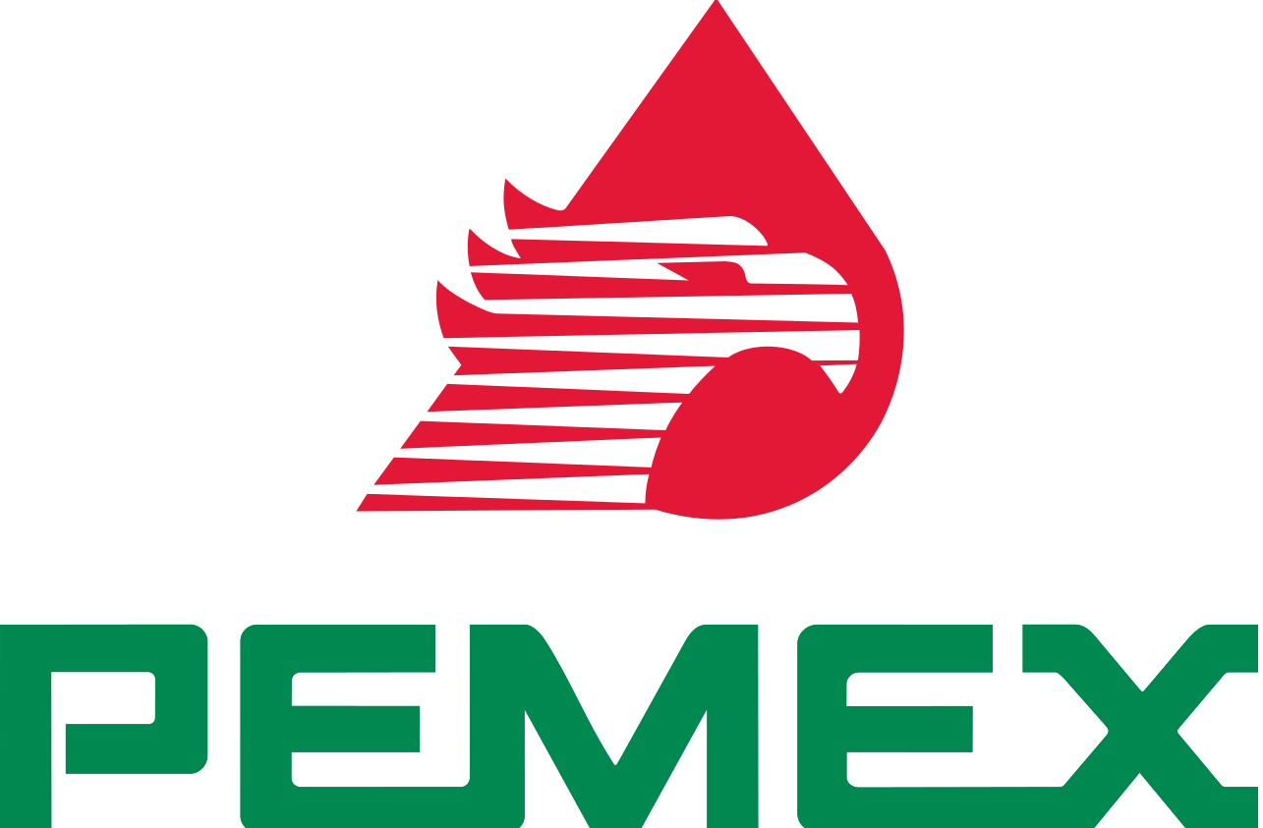
The Mexican Petroleum Institute is the National Laboratory in Mexico for clean energy and bioenergy
AMEXHI
“Foster the technological development of public and private hydrocarbon national sector”
Cosulting
Technical support
Training
Technological services
Training
Strategic partnerships
Innovative solutions
Consulting
Joint R&D
Tecnología diferenciada
Technological services
Training
Development of domestic suppliers

Slide 3



























The Mexican Petroleum Institute as a scientific and technological pole in bioenergy
Biomass
Conversion
Up and downstream application
Clúster
Solid biofuels
LCA, Process integration, sustainability, training and professional formation

Slide 4
Energy matrix in Mexico
(SENER, 2016)

Slide 5
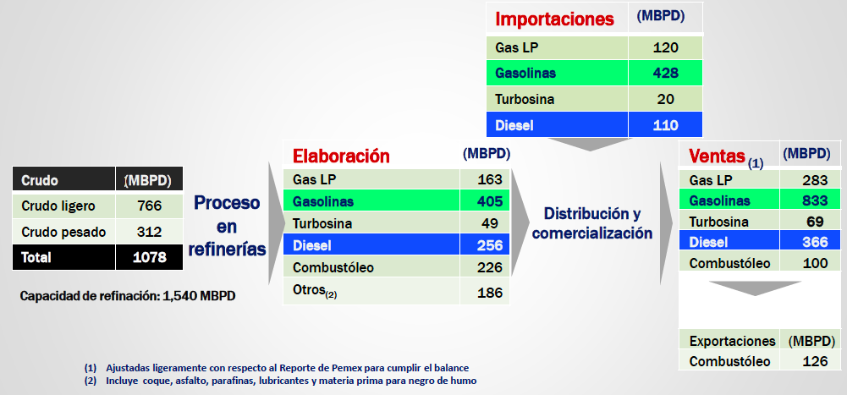
Fuel production and demand in Mexico
Fuel | Importation (%)
LPG | 42
Gasoline | 51
Jet fuel | 29
Diesel | 30
(PEMEX, 2015; IMP, 2016)

Slide 6
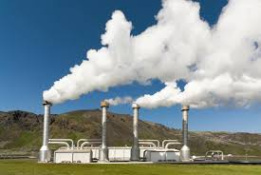
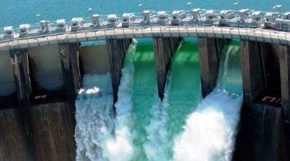
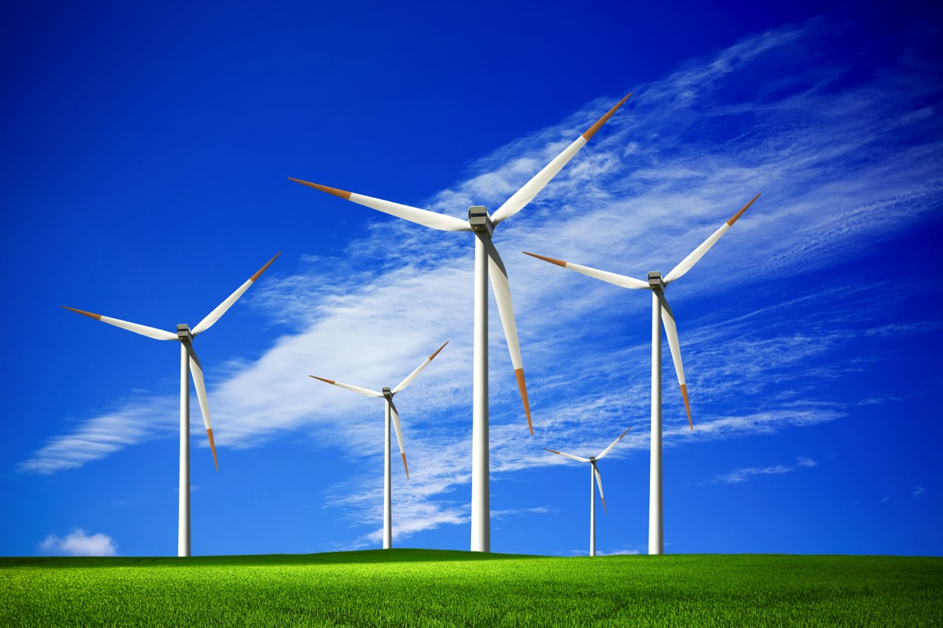

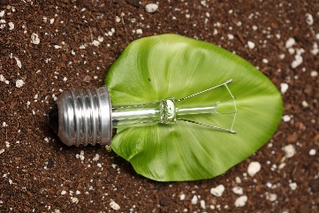
Clean energies in Mexico
Potential of electric generation in Mexico
( GWh, 2015)
Resources | Geothermal | Hydraulic | Eolic | Solar | Biomass
Proven | 2,355 | 4,796 | 19,805 | 16,351 | 2,396
Probable | 45,207 | 23,028 | --- | --- | 391
Possible | 52,013 | 44,180 | 87,600 | 6,500,000 | 11,485
Source: INERE (http://inere.gob.mx/)
© 2016-Instituto Mexicano del Petróleo

Slide 7
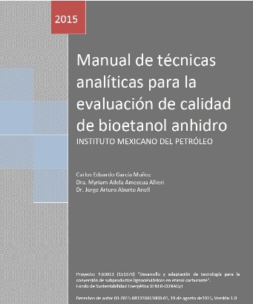

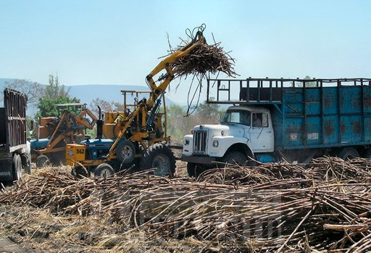

Bioenergy in Mexico
Free importation of fuels
ca. 420 MB/d gasolina
122 MB/d diésel
29 MB/d turbosina
Start of CEMIE BIO
Biodiesel blending to diesel
Potential 2,142 GWh/y from biomass
Electric generation from biomass
974 GWh/y
Energy transition act
2012
2015
2016
2016
2017
2017
2017
2018
TAR Pajaritos,
Perote y Veracruz
37 MML <EtOH anhidro< 52MML
TAR Xalapa
57 MML <EtOH anhidro< 81 MML
TAR Cd. madero, San Luis,
Cd. Mante, Cd. Valle
135 MML <EtOH anhidro< 193 MML
Ethanol blending to gasoline
Logistics: Storage and distribution facilities along the Mexico Gulf
(B. Kovarik, 1998; www.dieselnet.com; www.pemex.com; isea; SIE; Prospectiva de Energías Renovables 2015-2029)

Slide 8
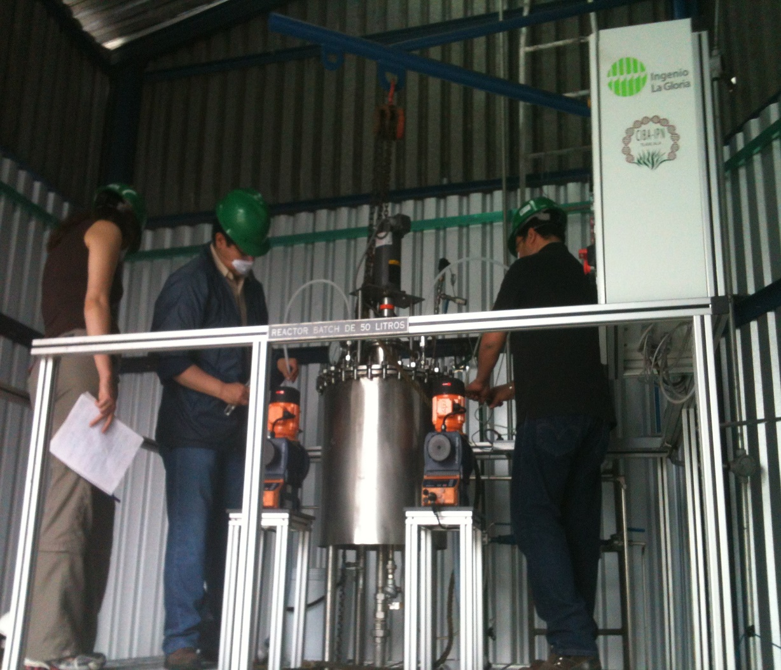
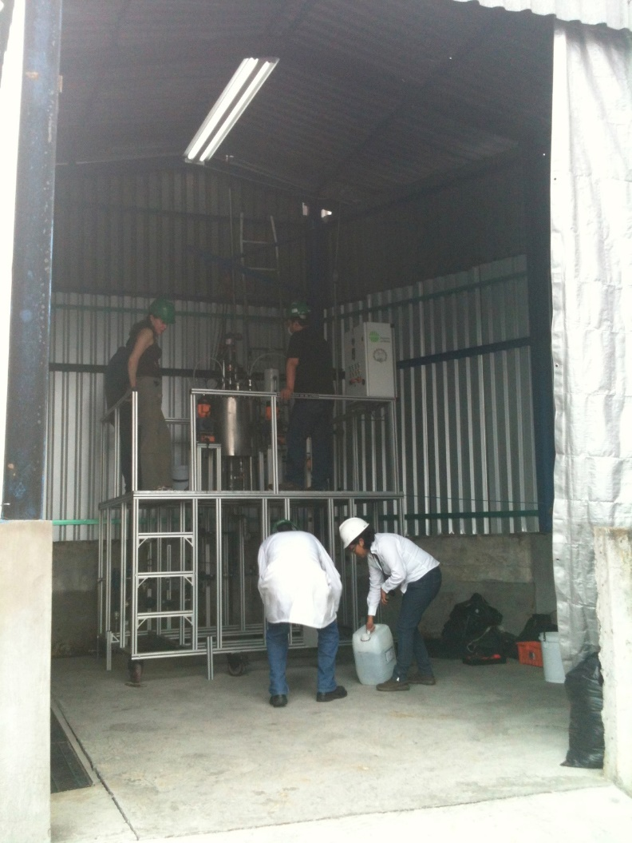
  Opportunities in Biofuels

Slide 9
Ethanol production in Mexico and world
Ethanol production in Mexico is about 189-314 MB/year (30-50 MM L/year, 8-13 MM Gal/year)
1000 times less than in USA
Fuente: Renewable Fuels Association. 2014 Ethanol Industry Outlook.
Estadísticas de la Agroindustria de la Caña de Azúcar 2004-2013

Slide 10
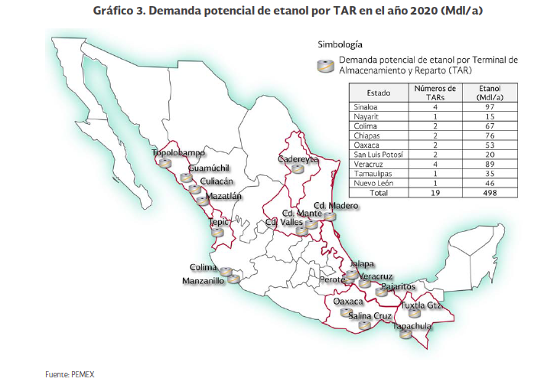
First trial of ethanol use in México
130 MM gal/year ethanol

Slide 11
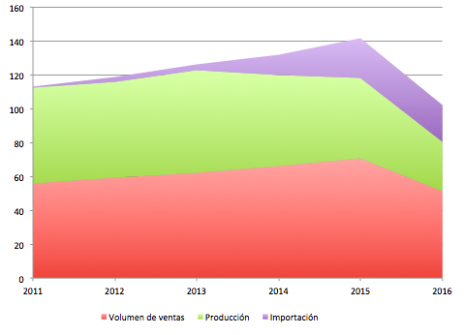

Jet fuel market in Mexico
International Aviation Transport Association (IATA) targets to reduce CO₂ emissions
an average improvement in fuel efficiency of 1.5% per year from 2009 to 2020;
a cap on net aviation CO₂ emissions from 2020 (carbon neutral growth); and
a reduction in net aviation CO₂ emissions of 50% by 2050, relative to 2005 levels.
1% biojet fuel represents 27 e³ gal/d
(650 B/d; 103 mil L/d; 237 e³ B/año; 38 e⁶ L/año)

Slide 12

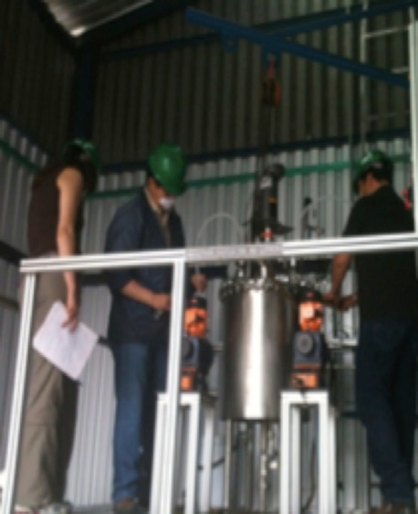
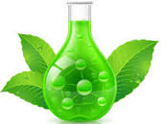
  Initiatives on clean fuels, biofuels and biobased chemicals
Strength Canadian, American and Mexican cooperation
in clean fuels, biofuels and biobased chemicals
Clean low sulfur and carbon fuels
Carbon capture, use and storage
Baseline of the ethanol proof of concept by PEMEX
biodiesel, biojet fuel, green diesel
Pilot plant and demostration facilities
Define market criteria of biofuels
Regulation and certification of biofuels and clean fuels
Biomass
Clean fuels
and biofuels
Foster existing and new biofuel facilities and use in Mexico
Use of biobased chemicals in Mexico
Alternatives uses fo glycerol from biodiesel
Biobased chemicals

Slide 13
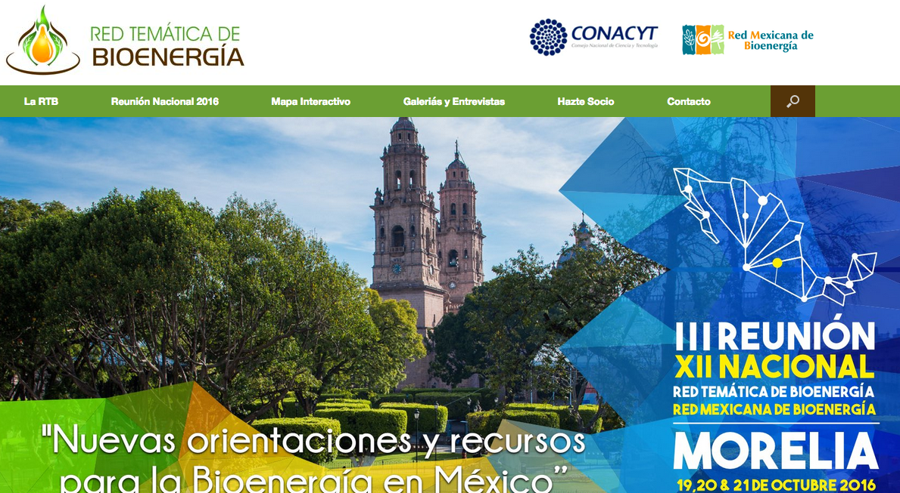
R&D bioenergy network in Mexico
www.rtbioenergia.org.mx

Slide 14
Clean energy and bioenergy in Mexico
Mexican Petroleum Institute
Jorge Arturo Aburto Anell
Copyright © 2016-Instituto Mexicano del Petróleo
Queda prohibido copiar, reproducir, distribuir, publicar, transmitir, o en cualquier modo explotar cualquier parte de este documento sin la autorización previa por escrito del Instituto Mexicano del Petróleo o de los titulares correspondientes

