Slide 1
Commission for Environmental Cooperation (CEC)
Joint Public Advisory Committee (JPAC) Regular Session
Advancing Sustainable Clean Energy Cooperation in North America
Luncheon Keynote – Energy Aspects
Graham Campbell
President, Energy Council of Canada
November 7, 2016

Slide 2

About - Energy Council of Canada
A catalyst for informed dialogue, strategic thinking and collaboration, fostering objective, fact-based policy thinking in Canada
Covers all technologies and forms of energy, and all parts of the energy system from supply through transportation, transmission, energy end-use and energy commodities for industry
Founding member of the World Energy Council (1923),
joining together with 97 member countries across the globe
Membership – 75 executives from industry, governments (federal and 7 provincial), professional service companies, all major energy associations

Slide 3
Energy Council of Canada
Vision, Four Strategic Goals
Addressing Energy Matters
Via Multi-Sectoral Dialogue
Informing Energy Policy
Vision
An affordable, stable and environmentally-sound energy system providing the greatest benefit for all Canadians
Sharing World Energy Council Insights
Creating Value for Members

Slide 4
Energy Positions Canada Globally
Canada - a Top-Ranked Global Player
Canada is one of the world’s largest energy players – production, economy, jobs, expenditures, trade (2015)
  2nd largest generator of hydroelectricity (10% of global total)
  2nd largest Uranium production and Uranium exports (22% of global total)
  3rd largest proven crude oil reserves (173 Billion Barrels)
  4th largest share of hydroelectricity production (63%)
  5th largest natural gas producer in the world
  5th in biofuel production
  7th in installed wind generating capacity
5% of total workforce (2015 - 905,000 direct and indirect jobs)
10.8% of Canada’s GDP (2015, 7.7% from oil & gas)
$90 Billion in capital expenditures (2015, down 23% from 2014)
$124 Billion in energy trade (2015 - $96 Billion exports, $28 Billion imports, 21% of domestic exports)

Slide 5
Energy in Canada
Changing Energy Scene
What’s not changed …
  Rich and diverse endowment of energy resources – envy of the world
  Energy a key component of the Canadian economy – jobs, revenues, trade, investment
  Energy as a key pathway to economic development
  Sound regulatory system – provincial and federal
Energy Situation Today …
  Fundamental change in North America’s oil and gas supply – production “bubble”
  Energy has become a frequent high-profile public issue – pipelines, electricity prices, environment
  New expectations by First Nations for engagement in regulatory processes, exercising traditional rights
  Issues in Canada defined by global agendas – climate change tops the list
  New approaches – shale gas and oil, centralized + distributed generation, smart grid
  New technologies – cheaper wind and solar, IT, electricity and energy storage, refurbished nuclear

Slide 6
The Way Forward for Tomorrow’s Energy Economy
Observations From Recent Energy Council Events
Now looking at energy as an ‘’energy system”, not sector-by-sector
  Integration of hydro and wind, natural gas and wind, nuclear base load with renewables
  Integration of energy storage to make overall system more efficient and effective
Improve public and First Nations engagement when considering major energy projects
  Open dialogue with communities affected by resource development projects – build a relationship
  Early dialogue on the nature of the proposed project, potential opportunities and implications
  Share a portion of the jobs, economic benefits and long-term revenues with the community
  Be ready to modify the configuration and timing of the project in order to align the interests
  of the community and the project proponent
Meet climate change commitments
  Build on current provincial initiatives matched to their jurisdictions, but need to do more
  ‘’Made-in-Canada” combination of provincial and national initiatives
Don’t forget energy end-use – focal point for reducing emissions
  55% of emissions from transportation (23%), Buildings (12%), Trade-exposed industries (10%), Agriculture (10%)

Slide 7
World Energy Issues Monitor - 2016
Issues Identified By Canadian Energy Leaders
Top Issues
Commodity prices
Climate Framework
LNG
China – India
Regional connections
Renewable energies
US Policy
Global recession
Trade barriers
Talent
High Impact
1. Energy Efficiency
Russia
3.
.
ccs
smart grids
2.
Middle East dynamics
4.
1.
.
LNG
EU Cohesion
cyber threats
hydrogen economy
.
Uncertainty
extreme weather risks
unconventionals
China India
climate framework
Brazil
innovative transport
5.
commodity prices
terrorism
.
electric storage
.
regional interconnection
6.
energy water nexus
.
.
.
exchange rates
.
.
.
.
.
.
large scale accidents
capital markets
market design
7.
US policy
land use
electricity prices
renewable energies
.
nuclear
sustainable
cities
trade barriers
energy affordability
10.
9.
global recession
decentralised systems
talent
8.
biofuels
coal
energy subsidies
hydro
11.
.
energy efficiency
energy poverty
corruption
Impact

Slide 8
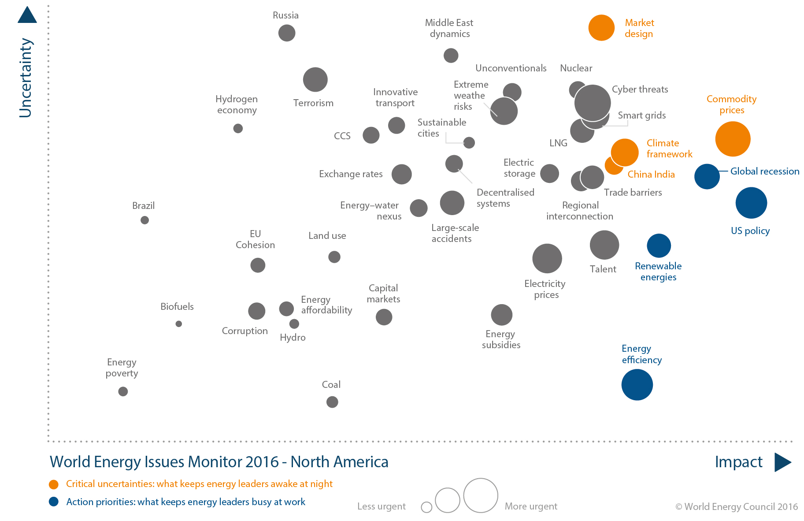
World Energy Issues Monitor - 2016
Issues Identified by North American Energy Leaders
6.
North America
Top Issues
Commodity prices
Global Recession
US Policy
Climate Framework
China – India
Market Design
Cyber Threats
Smart Grids
LNG
Trade barriers
Talent
High Impact
1. Energy Efficiency
Canada
Top Issues
Commodity prices
Climate Framework
LNG
China – India
Regional connections
Renewable energies
US Policy
Global recession
Trade barriers
Talent
High Impact
1. Energy Efficiency
7.
8.
9.
1.
4.
5.
10.
2.
Uncertainty
3.
11.
12.
Impact
Common NA Issues

Slide 9
Trilateral Energy Dialogue via World Energy Council
North American Region Energy Fora
Energy transitions, policy leadership, technology and collaboration
key themes for two events held in 2014 and 2015 and the next planned for 2017 …
Transformations Across the Energy Sector: Past Present and Future
- hosted by Canada in June 2014 in Calgary
How can countries which have development of fossil fuel resources as a key component of their economies contribute to achieving reductions in carbon emissions
- hosted by the United States Energy Association in October 2015 in Washington, DC.
Regional Collaboration on Climate, Clean Energies, and Environmental Issues
- to be hosted by Mexico Energy Secretariat in September, 2017

Slide 10
Trilateral Energy Dialogue
Highlights from North American Region Energy Fora
Major reforms underway in Mexico’s electricity and oil & gas sectors – more open energy markets, regime is moving towards closer similarity with US and Canada, opportunities for North American companies
Energy transformations are underway in each country – recent growth in oil and gas supply, implementation of new technology (electricity storage, carbon capture and storage), new grid management techniques (smart grid), greening of energy mix via wind and solar
Also transformations in market operation – closer integration of electricity with natural gas, combination of centralized and distributed generation, stronger role for electricity system operators
Much more attention to earning public support – abandon term “social licence”, four steps recommended - engage early, build respectful relationships, explore and amend the project in response to concerns, share the proceeds, be flexible
International policy agenda dominated by climate change – post COP-21 in Paris, many examples of world-leading national and state/provincial initiatives

Slide 11
New Initiatives and Emerging Trends
Energy and Climate Policy initiatives in NA
Actions under political leaders’ commitment to North American Climate, Clean Energy, and Environment Partnership, June 2016
  Advancing Clean and Secure Power
  Driving Down Short-Lived Climate Pollutants
  Promoting Clean and Efficient Transportation
  Sharing Global Leadership in Addressing Climate Change
Greater integration of NA energy markets
Continuation of energy market evolution – integration of renewables, ‘’smart grid’’ management, electricity storage, demand management, consumer actions
Implementation of carbon pricing and other instruments – RGGI, carbon price (BC), cap and trade (California, Ontario, Quebec), carbon regulation (AB), transformation of the generation mix (Saskatchewan), major new technology investment (carbon capture in Saskatchewan)

Slide 12


2016 World Energy Trilemma
Five Recommended Priorities and Actions
  Transforming Energy Supply - Set clear energy targets and build a broad consensus for the transition in energy supply and demand
  Advancing Energy Access - Expand energy infrastructures to support advanced energy security, reliability and access to electricity to the 1 Billion + people who are not currently connected
  Addressing Affordability - Ensure energy affordability of electricity and energy prices, creating the investment conditions to support energy infrastructure expansion
  Improving Energy Efficiency and Managing Demand - Energy efficiency and managing energy demand are top action priorities with huge potential for improvement, implement a combination of energy efficiency standards, performance ratings, labelling programmes and incentives
  Decarbonizing the Energy Sector- Dynamic and flexible renewable energy investment policies are key, require a clear path to a meaningful carbon price signal and changes beyond the energy sector and across the economy
  World Energy Council’s
  three policy goals
  energy security
  energy equity
  environmental
  sustainability

Slide 13
Some Closing Observations
  North America has been blessed with abundant and diverse energy resources – envy of the world
  Increasing commonality between the energy systems of the three countries – technology, energy regimes, role of the industry, regulators and governments
  Greater integration of energy systems in North America is an area of opportunity – clear complementary advantages, preserve national autonomy
  Trilateral cooperation is happening – at the highest political levels, by companies, by international organizations
  Addressing energy and environmental issues through a North American approach has great potential – warrants sustained efforts to enhance cooperation

Slide 14
Any Comments, Questions?

Slide 15
Colin Andersen
Chair, Energy Council of Canada colin.andersen@energy.ca
Graham Campbell
President, Energy Council of Canada graham.campbell@energy.ca
613-889-6376
Brigitte Svarich
Director of Operations and Board Secretary brigitte.svarich@energy.ca
613-889-6376
www.energy.ca www.worldenergy.org

