Slide 1
Gary Sutherland
Hydro-Québec
Setting new sights with our clean energy
Business Development, Acquisitions and Strategies
JPAC Session, Ottawa
November 7, 2016

Slide 2
OUR REALITY

Slide 3
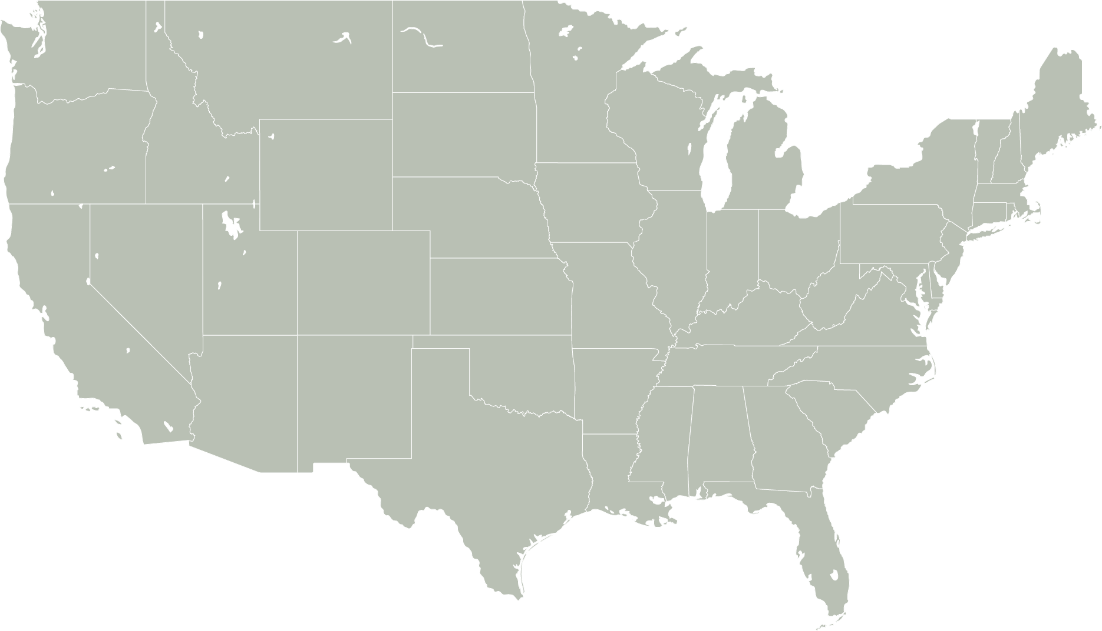
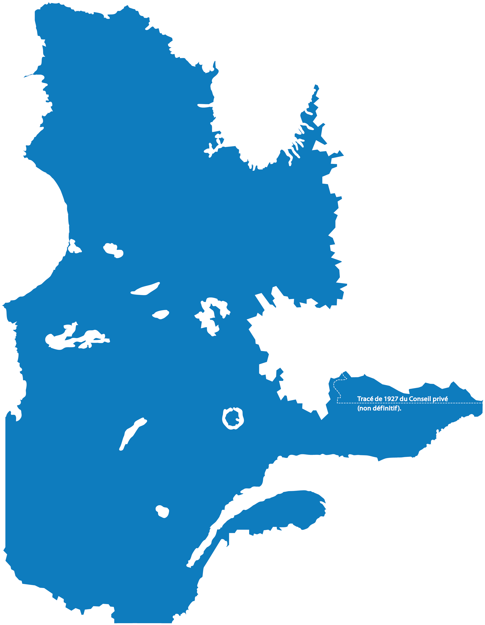
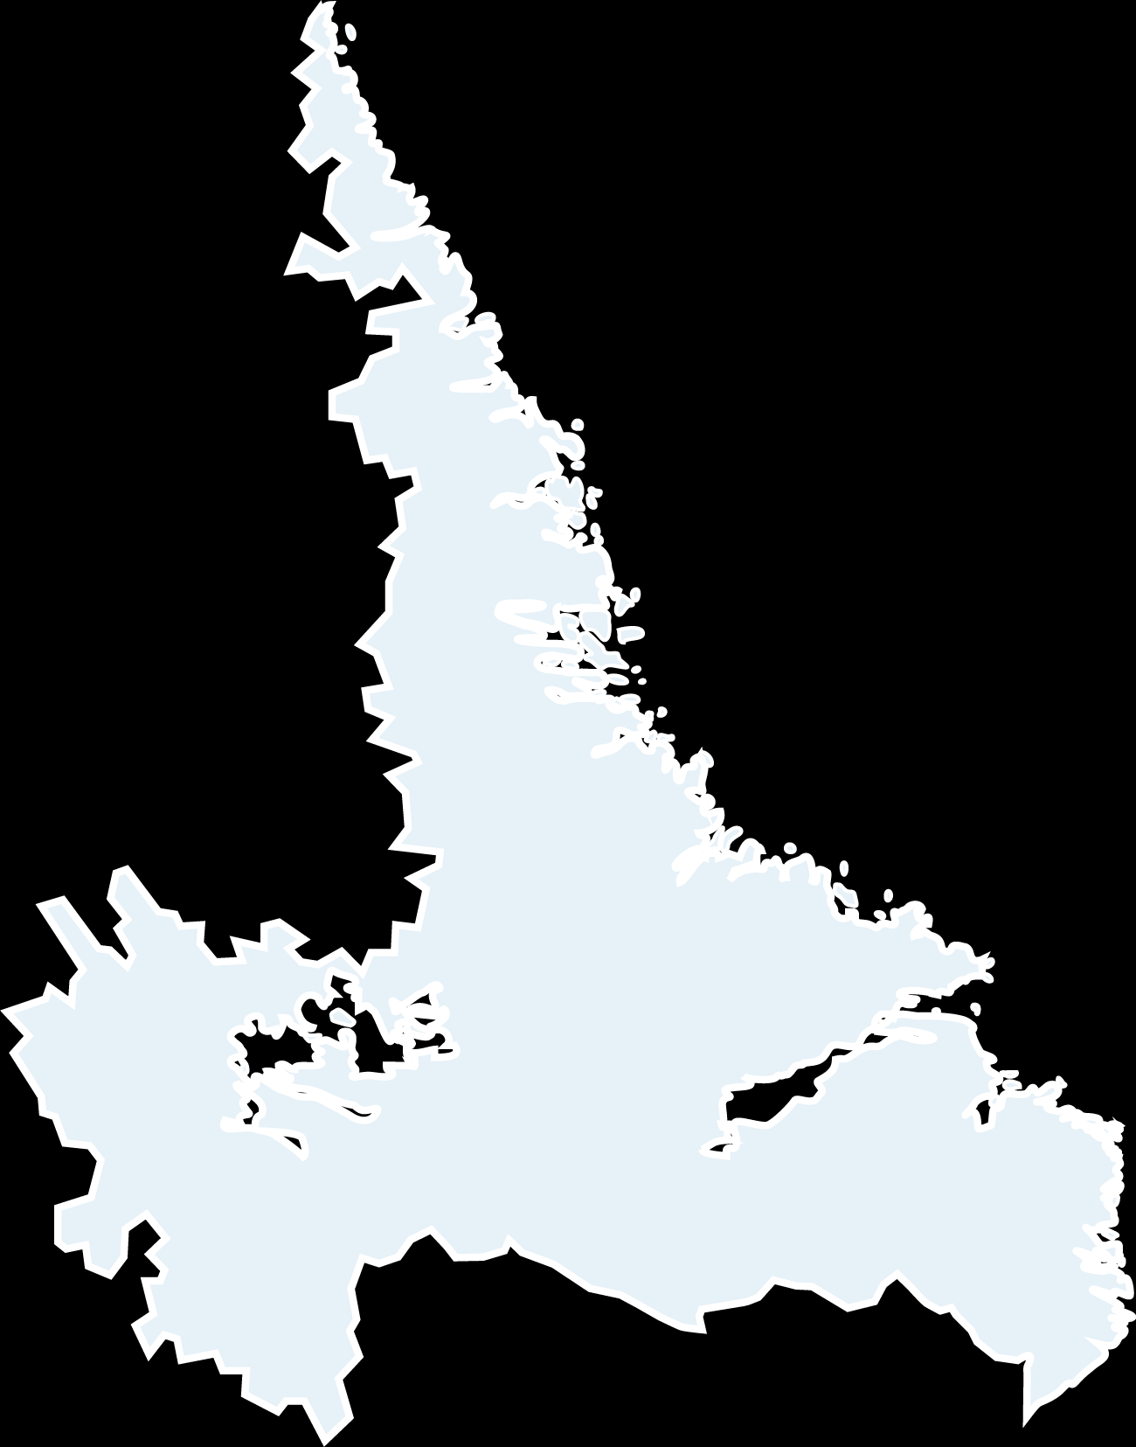
Québec: vast land area and water resources

Slide 4
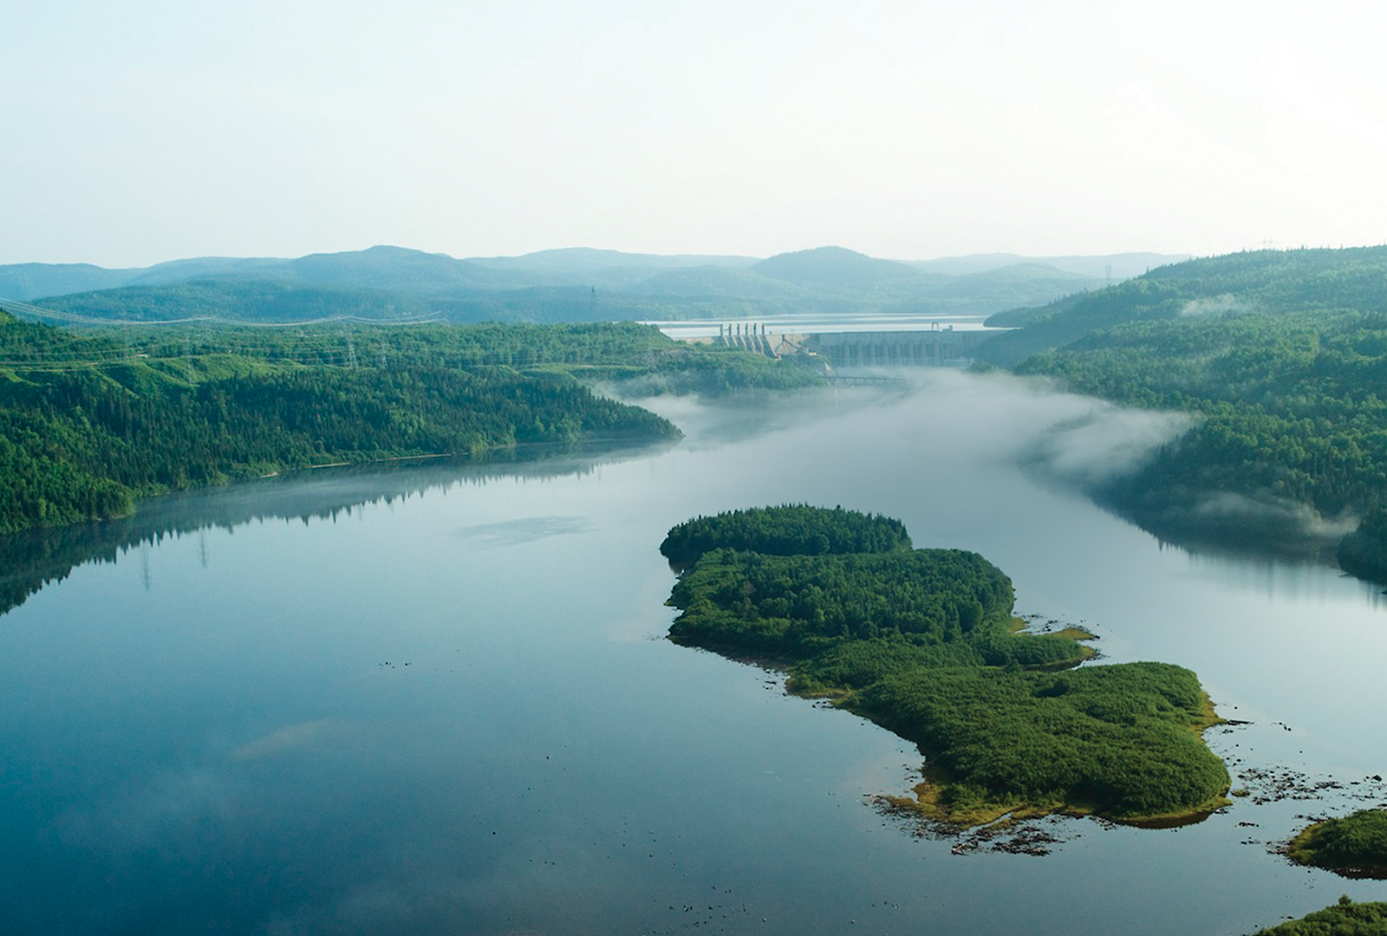
Our energy, an asset to Québec
99%
OF ELECTRICAL POWER
GENERATED USING WATER
clean,
renewable
and reliable

Slide 5
Greenhouse gas emissions from different power generation options
Hydroelectric - HQ: run-of-river
Boreal
Reservoirs
=
Low GHG
Emitters
Nuclear
Continuous generation
Wind
Intermittent generation
Hydroelectric - HQ: with reservoir
Photovoltaic solar
Thermal: natural gas
Thermal: coal

Slide 6
Evolution of inflation and energy prices in Québec
1963-2015
Index (1963 = 100)
Electricity
Natural gas
Oil
CPI

Slide 7
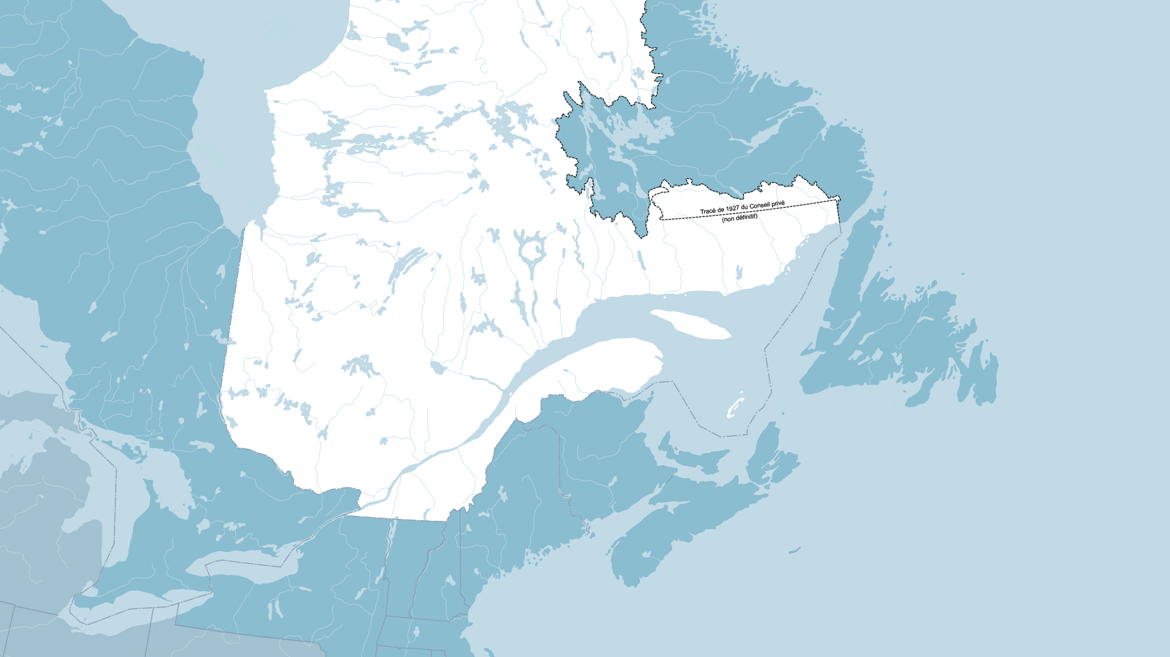

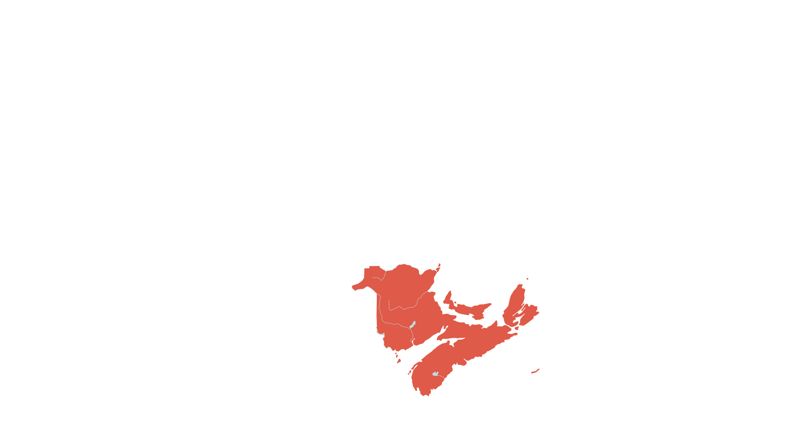
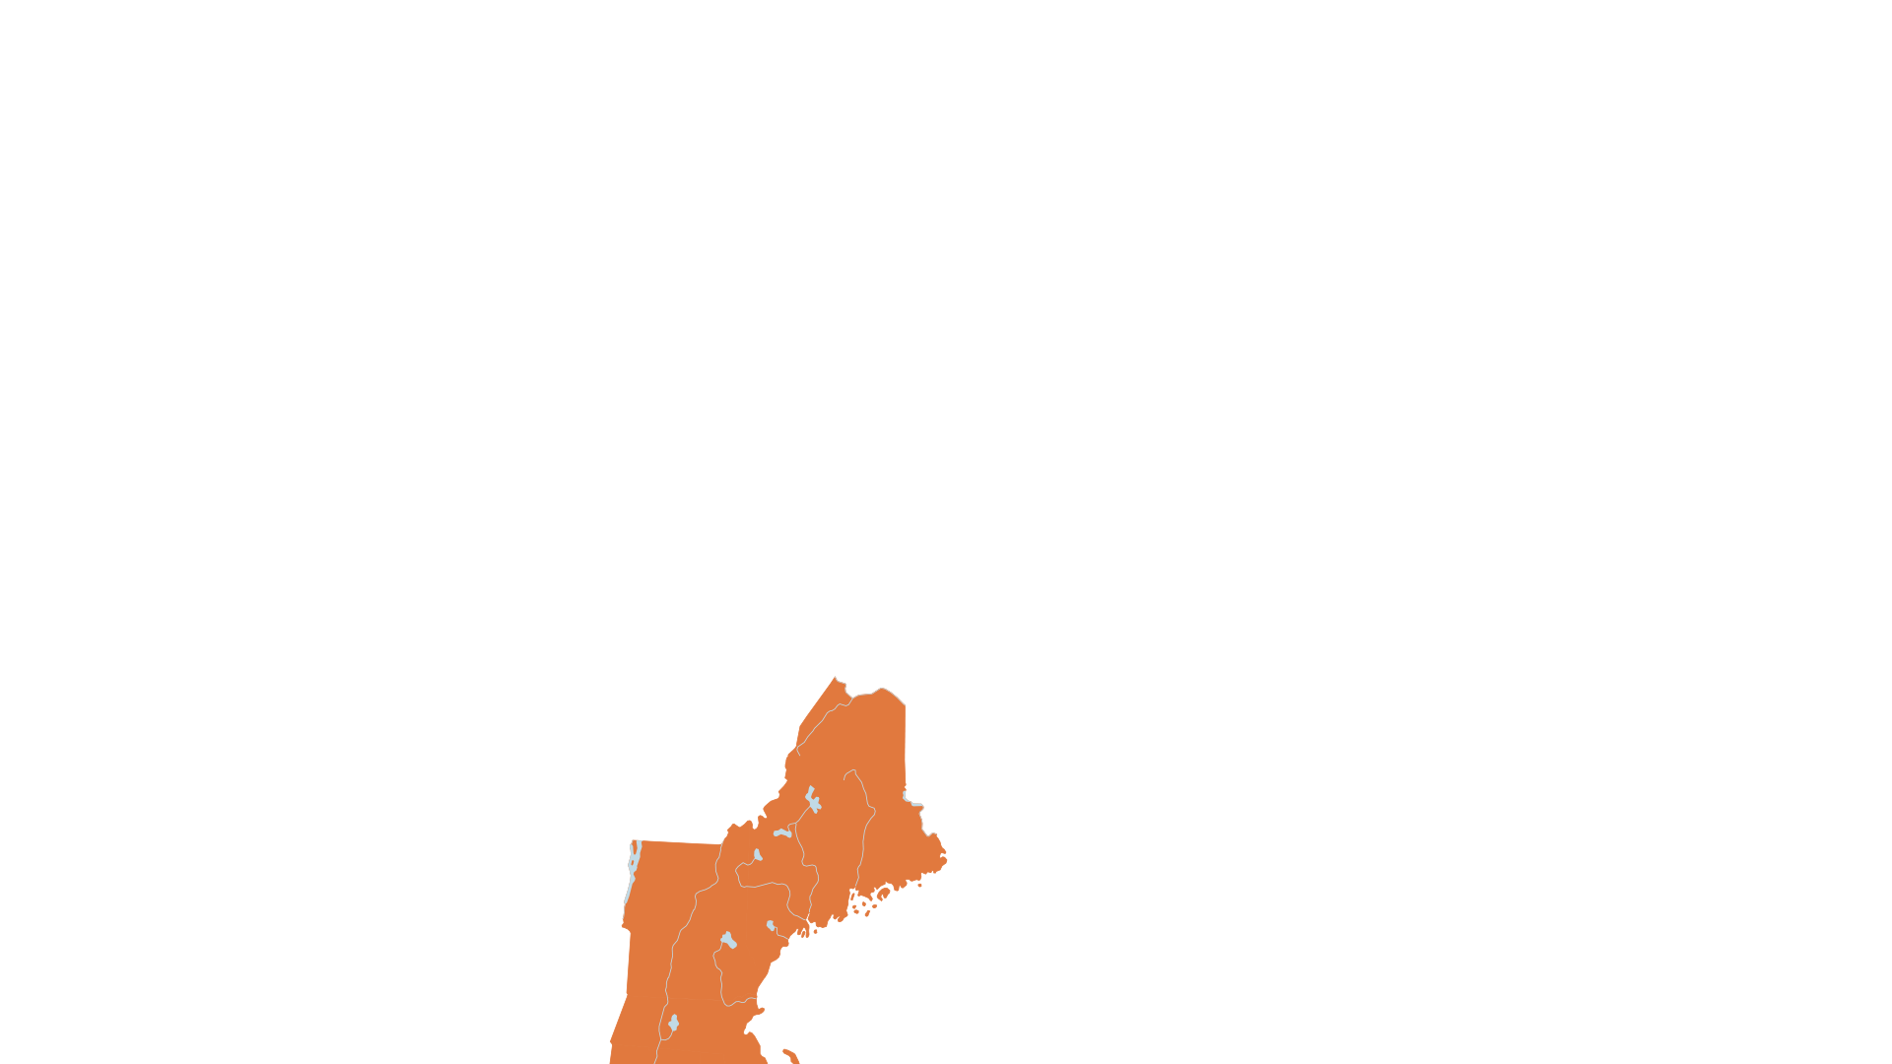

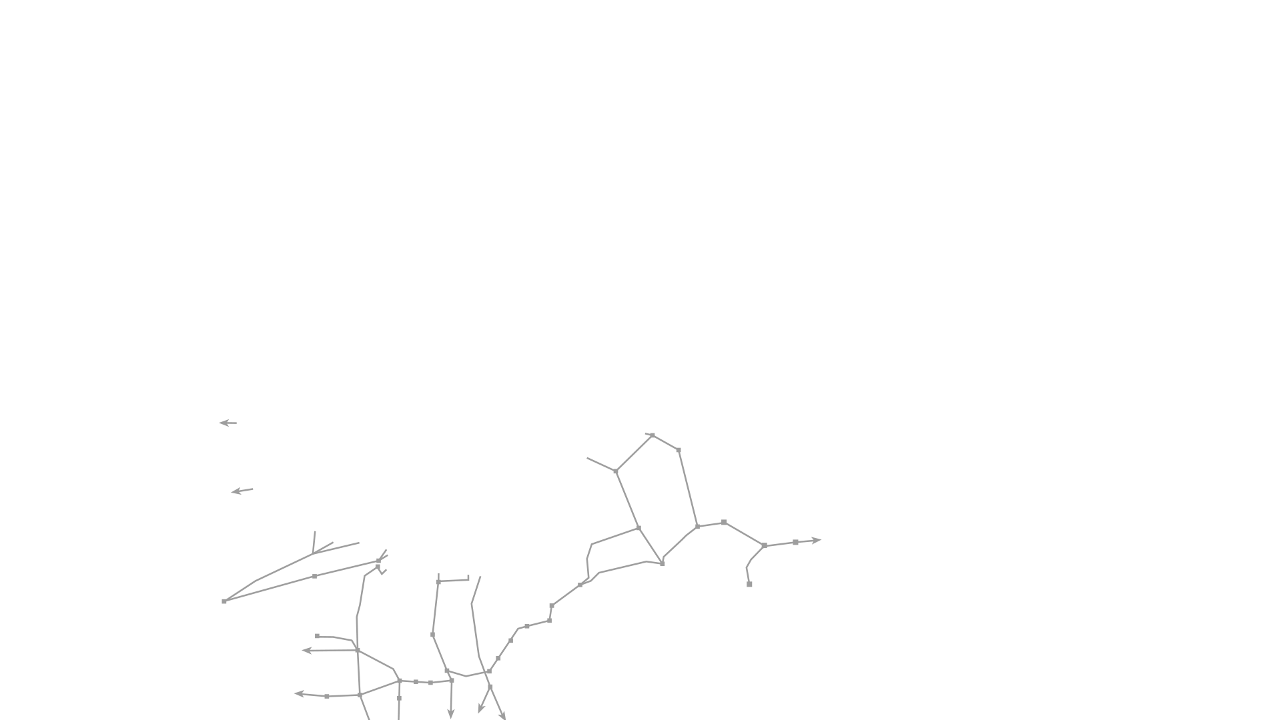




TODAY’S ENERGY
TRADING RELATIONSHIP
Today’s energy trading relationship
RADISSON
Ontario
3.6 TWh
QUÉBEC
New Brunswick
2.4 TWh
NOUVEAU-
BRUNSWICK
ONTARIO
DES CANTONS
ME
NY
VT
NH
New England
15.2 TWh
New York
7.2 TWh
THE NORTHERN PASS
MA
SANDY POND

Slide 8


Avoiding greenhouse gases through electricity exports
HYDRO-QUÉBEC EXPORTS AVOIDED 7.4 MILLION METRIC TONS OF CO₂ EQUIVALENT EMISSIONS, EQUAL TO:
EMISSIONS FROM 1.85 MILLION CARS
25% OF EMISSIONS FROM NEW ENGLAND’S THERMAL GENERATING STATIONS

Slide 9


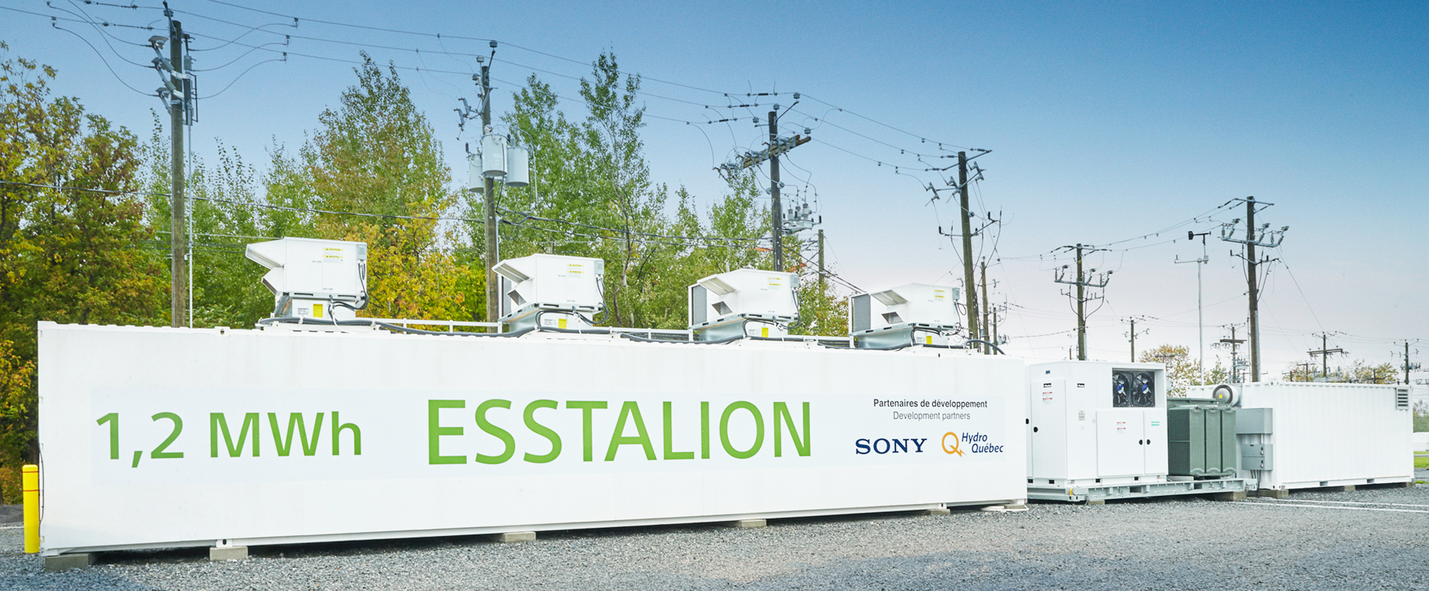
Our context
600
Annual investment of
More than
$130 M
CHARGING STATIONS
IN R&D

Slide 10
Our Strategies for the Future

Slide 11
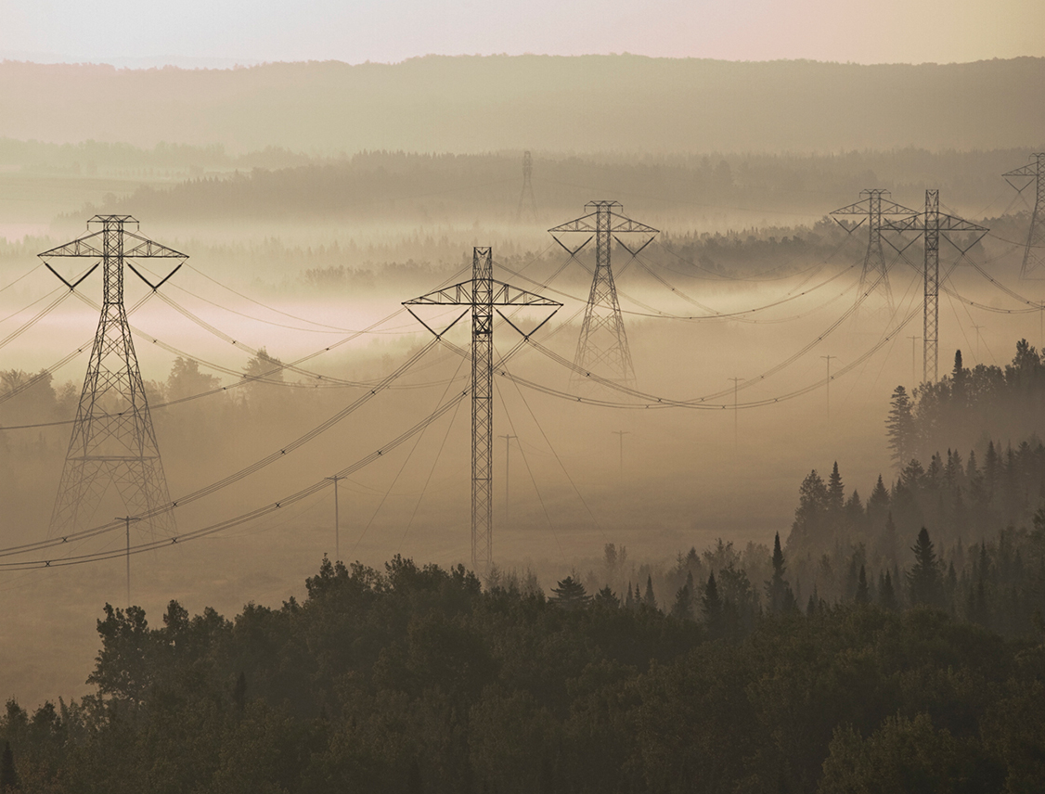
Develop new growth avenues
Increase exports
Acquire assets or stakes
Commercialize our innovations
Increase the capacity of our generating fleet

Slide 12
Enhancing the clean
energy trading
relationship
RADISSON
Nuclear refurbishment
QUÉBEC
Ambitious GHG reduction goals
NOUVEAU-
BRUNSWICK
ONTARIO
40% GHG reduction and 50% renewable goal by 2030
DES CANTONS
ME
Integration of renewable energy
NY
VT
100%
renewable
energy
NH
THE NORTHERN PASS
MA
SANDY POND

Slide 13
Optimizing grid integration to reduce GHG emissions
RADISSON
QUÉBEC
A significant agreement: 2017-2023
Energy 2 TWh per year to Ontario
Capacity 500 MW of winter capacity for Québec
Energy cycling making the electricity market more efficient
NOUVEAU-
BRUNSWICK
ONTARIO
DES CANTONS
ME
NY
VT
NH
THE NORTHERN PASS
MA
SANDY POND

Slide 14


Massachusetts: new business opportunities
RADISSON
QUÉBEC
Hydro: 9.45 TWh
Long-term contracts
NOUVEAU-
BRUNSWICK
ONTARIO
DES CANTONS
ME
NY
VT
NH
THE NORTHERN PASS
MA
SANDY POND

Slide 15
Gary Sutherland
Hydro-Québec
Setting new sights with our clean energy
Business Development, Acquisitions and Strategies
JPAC Session, Ottawa
November 7, 2016

